Slide 1
International Business Communications
(Week 1 - Lecture)
Marie Pitson

Slide 2
This week, we will:
Explore why international business communication (IBC) is important
Introduce communication theory
Explore the concept of culture and its impact on communication
Explore and discuss the role of stereotypes

Slide 3
Introduction
Module Aims
To develop a greater intercultural awareness in international business contexts
To develop more effectiveness in business communication in international scenarios in English

Slide 4
Introduction
Lecturer details
Marie Pitson – AS212 marie.pitson@uwtsd.ac.uk
Assessment
Assessment Component 1 – 50% Supporting Paper (1500 words & presentation)
Assessment Component 2 – 50% Written report (2500 words)

Slide 5
International Business Communications
The process of communication is what allows us to interact with other people; without it, we would be unable to share knowledge or experiences with anything outside of ourselves. Common forms of communication include speaking, writing, gestures, touch and broadcasting
International business consists of transactions that are devised and carried out across national borders to satisfy the objectives of individuals, companies, and organizations.
=
International Business Communication (IBC) are the interactive processes which allow communication across international boarders. This is sometimes also referred to as ‘global’ or ‘transcultural’ communication.

Slide 6
International Business communication
Communication a key element of international business, whether it is manufacturing or tourism. It is important to recognise potential barriers to communication and how cultural differences can impact this.
We need to consider different stereotypes associated with a variety of well known countries.
A barrier to communication can come from elements associated with stereotypes and cultures for different countries.

Slide 7
Communication: Verbal vs Non Verbal
Can we communicate without words?
Voice attributes
What are they and how do they affect communication?
Physical attributes
What could be considered here and how do they affect communication?
The power of touch
What and when is OK?
Which is better, verbal or non verbal?

Slide 8


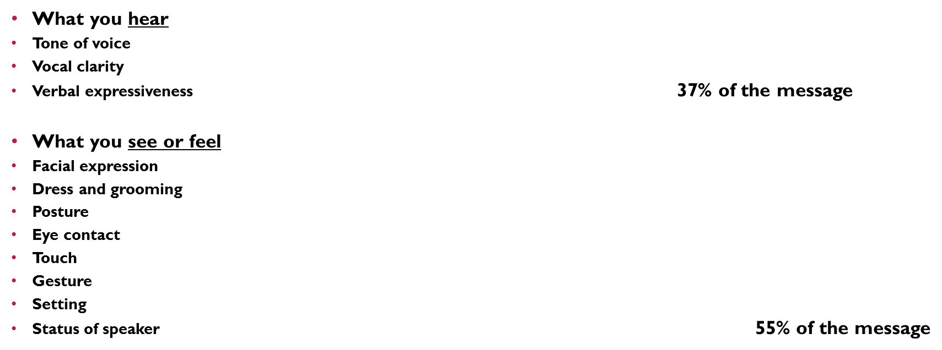
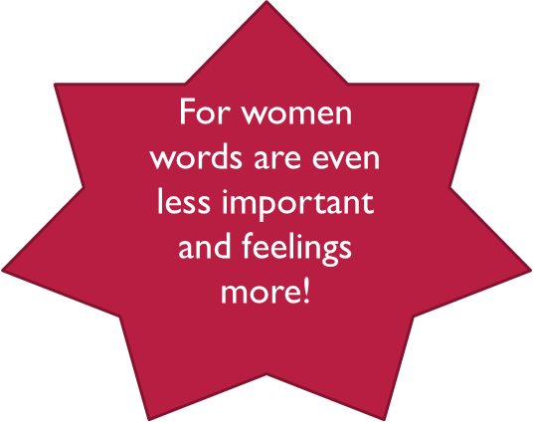



Slide 9
Communication is a 2-way process
Communication skills involve:
Listening to others (Receiving) message
Asserting/ Expressing (Sending)
Barriers to communication can lead to misunderstanding and confusion

Slide 10
Communication is a 2-way process
sender
receiver
values and attitudes
“generation gap”
sender
language
Cultural differences
noise
hearing
receiver

Slide 11
Eye contact & visible mouth
Some questions
Body language
Effective
Communication skills
Encouragement
to continue
Silence
Smiling face
Summarising
what has been said
Checking
for understanding
Notes:
Encourage participants to think about a situation where they must communicate with someone who is hard of hearing; anxious; has been put down in the past; doesn’t know who you are – what are some of the things you can do to help communication?

Slide 12
Discussion
In pairs, discuss possible barriers to effective communication
Feedback to the group

Slide 13
Potential barriers include: Colloquialism
Colloquialism is the use of informal words, phrases, or even slang in a piece of writing.
Colloquialisms are generally geographic in nature, as they are words and phrases that belong to a region or local dialect.
Native speakers of a language understand and use colloquialisms without realizing it.
Colloquialisms often get confused with slang and jargon. The difference is that slang words are used in specific social groups, where colloquialisms can generally be understood across all ages as long as the speakers are from the same geographic area.

Slide 14
Activity
Here is a list of 4 Cockney slang (London) words and 4 popular teenage slang words. Your task (working in your groups) is to try and to identify what the slang words mean.
“Dog and Bone” Peng ting
“Loaf of Bread” Squad
“Whistle and Flute” GOAT
”Adam and Eve” It’s lit

Slide 15
Answers
“Dog and Bone” Phone – “Is that your dog barking?”
“Loaf of Bread” = Head - “Use your loaf”
“Whistle and Flute” = Suit – “Nice whistle mate”
“Adam and Eve” = Believe – “I don’t Adam and Eve it”
Peng ting – A good looking person
Squad – A term for a friendship group
GOAT – Greatest Of All Time
It’s lit – Short for “it’s cool or awesome” (these words themselves are also slang for saying that something is good.

Slide 16
How slang words can have another meaning in another country
Fart is a natural gas that comes from the body. However, fart in Danish, Norwegian and Swedish means speed.
In English, a gift is something that you give to someone. In Germany, a gift means poison.
Kiss has a more juvenile meaning in Swedish – pee.
The common British name Gary means diarreah in Japanese.
Smoking means tuxedo in French.

Slide 17
Barriers to Effective Communication
Language
Time
Noise
Other people
Barriers to
effective
communication
Distractions
Too many questions
Cultural differences
Physical distance
Lack of interest
Discomfort with the topic
Disability
Notes:
Show the title of this slide and ask people to see if they can suggest some of the barriers-Then reveal the diagram when there has been 2 to 3 mins of ideas from the group

Slide 18
Culture defined
Culture is defined as: The sum total of learned beliefs, values and customs that serve to direct customer behaviour in a particular country market
Many people confuse culture with stereotypes.
A stereotype is “…a fixed, over generalised belief about a particular group or class of people.” (Caldwell, 1996).
The Oxford English Dictionary defines a stereotype as a “widely held but fixed and oversimplified image or idea of a particular type of person or thing.”

Slide 19
Stereotype definition
The definition of a stereotype is any commonly known public belief about a certain social group or a type of individual. Stereotypes are often confused with prejudices, because, like prejudices, a stereotype is based on a prior assumption. Stereotypes are often created about people of specific cultures or races.
https://www.youtube.com/watch?v=UDTVasxLNho

Slide 20
Stereotypes
Stereotypes cover racial groups, political groups, genders, demographic groups and activities.
Asians are good at maths
Republicans are rich
Women are bad drivers
Florida is full of elderly people
The British love tea

Slide 21
How do stereotypes happen?
Stereotypes don’t just appear out of nowhere – they are based on ideas and experiences with certain groups and then extended to apply to an entire group.
We look at the individual; spot something that we recognize and categorize them according to how this characteristic corresponds to something familiar to us: short or tall, man or woman, loud or quiet, hair colour, build, language spoken.
If we meet someone and discover what they do for a living, and scan through information to get a an idea of what this person may be like. i.e. Accountants are boring!
If you meet someone with red hair, you may think that they are “Irish”. Or it can lead to assumptions about their personality (red haired people have tempers).
A lack of exposure to other groups and cultures.
Television and movies.

Slide 22
Stereotypes - pros
Stereotypes can be useful if you are in a new surrounding and need to make a quick judgement. For example, if you’ve never met Royal Family, you already have a fixed idea on how they act. So if you suddenly meet the royalty, you already know how to react because of their stereotype.
Stereotypes enable you to categorize people into groups, which allows you to form expectations about people and situations.
Some people may like to be stereotypes as they want their looks and the way they dress to come across clearly to other people.

Slide 23
Stereotypes - cons
Make a judgement about someone that might be completely misguided and incorrect.
The media have a big impact on the way they perceive places and particular people.
Assuming that the same group of people share the same ideals and personality traits just because they have something in common.
Stereotypes can create problems in the workplace.
Affects the way we remember people.
Can lead to bullying and make offensive jokes.

Slide 24
Activity
In my box of goodies are strips of paper with the name of various countries.
Your task (working in groups) is to pick out two strips of paper, and with the countries that you are given, you are to write as many stereotypes as possible for that country.
Now, compare and contrast the stereotypes you have applied to each country.
Finally, look at any similarities with China

Slide 25

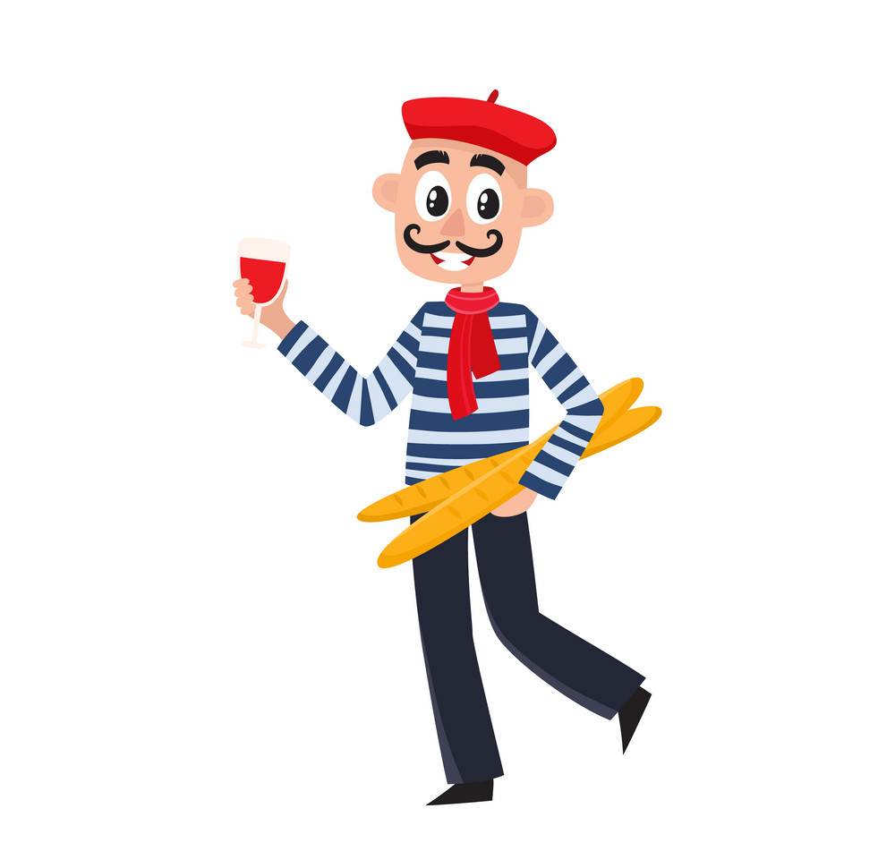

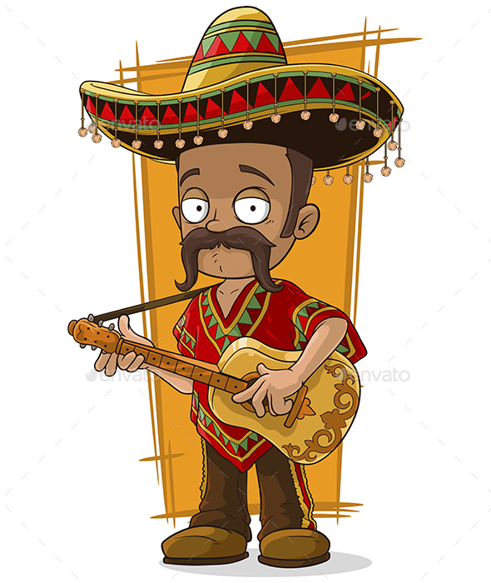
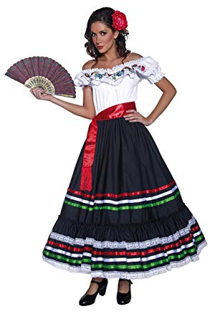
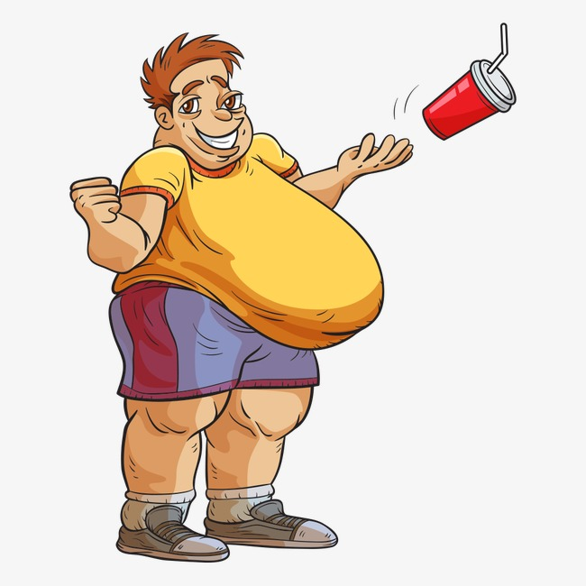



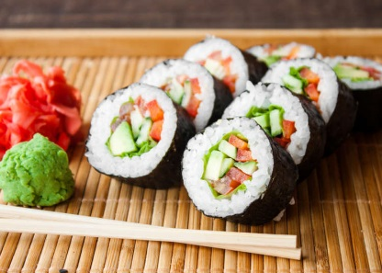

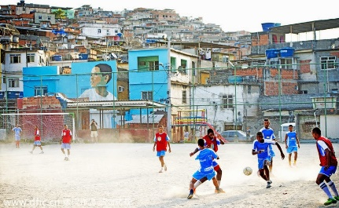
Flags/Pictures examples
https://www.youtube.com/watch?v=4MRZbWuUmkk

Slide 26
Not all stereotypes are accurate
“... overgeneralized sets of beliefs about members of a particular social group” (definition of “stereotype),” Schultz & Oskamp, 2002, p. 63).
"A stereotype is any generalization about a group ... By definition, a generalization about a group is bound to be "unjustified" for some portion of the group members" (Nelson, 2002, p. 5).
One stereotype that is popular particularly within the UK is that women can’t drive, particularly in comparison to their male counterparts. However recent statistics have proved otherwise.

Slide 27
Male vs female driving statistics
Men account for 73% of all worldwide road traffic deaths, three times the rate of women;
In Britain men account for 74% road traffic deaths, 70% of serious injuries and 59% slight injuries on the roads;
In Britain men make up 82% of cycling deaths and serious injuries, young male cyclists are the most over-represented age group, accounting for 30% of all cycling casualties;
In Britain 95% of convictions for deaths caused by dangerous driving are against men.

Slide 28
How different are we?
Which three behaviours did you strike as most odd when you came to the UK? Or, if you are British, which three behaviours did you find most odd travelling abroad?
Discuss in a small group how these behaviours make you feel.
Discuss how people would behave at home in the same situation

Slide 29


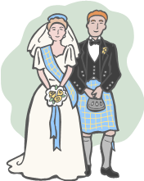

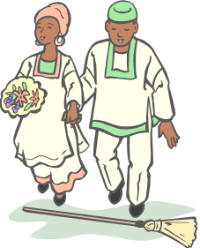

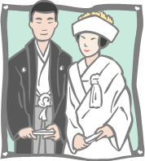
A large number of mental and verbal processes which reflect our knowledge and assessment of products and services.
The indicators consumers use to serve as guides for what is appropriate behaviour, enduring and relatively stable over time; widely accepted by members of a particular market.
Overt modes of behaviour that constitute culturally approved or acceptable ways of behaving in specific situations

Slide 30
Layers of Culture
A national level
  according to one’s country which determines our basic cultural assumptions.
A regional/ethnic/religious/linguistic affiliation level
  determining basic cultural beliefs.
A gender level
  according to whether a person was born as a girl or as a boy.
A generation level
  which separates grandparents, parents and children.
A social class level
  associated with educational opportunities, a person’s occupation or profession.
A peer group (social tribe) level
  reflects personality related choice of friendship group and self representation

Slide 31
Summary
Communication is the which allows us to interact with other people; it can be interrupted by a number of factors.
A key factor interrupting communications are cultural differences.
Several authors have developed models trying to capture different aspects of culture, which will be discussed in the tutorials next week.
Key models are Hall’s high context versus low context frameworks and Geert Hofstede’s six cultural dimensions, which, despite some weaknesses, provides a useful and widely used starting point for assessing cultural differences.

