Slide 1
Intro To UX Design

Slide 2
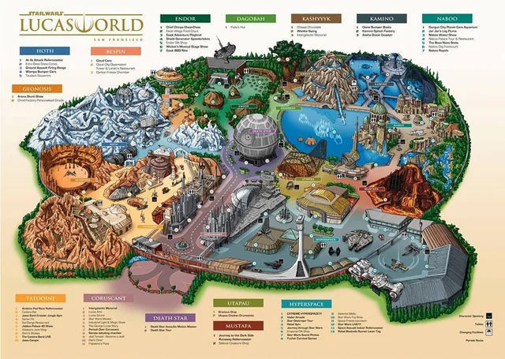
What Is UX?
UX= User Experience
UI= User Interface
Human Computer Interface
Consider the physical and digital world

Slide 3
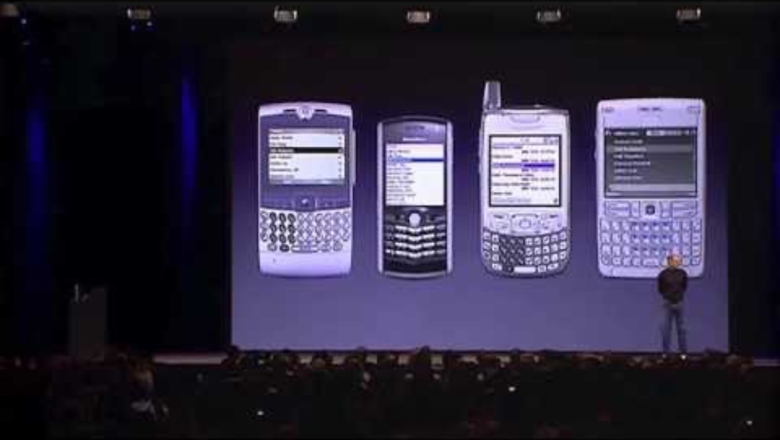
Human Computer Interface Design

Slide 4
Activity...
List the key information required to drive a car.

Slide 5
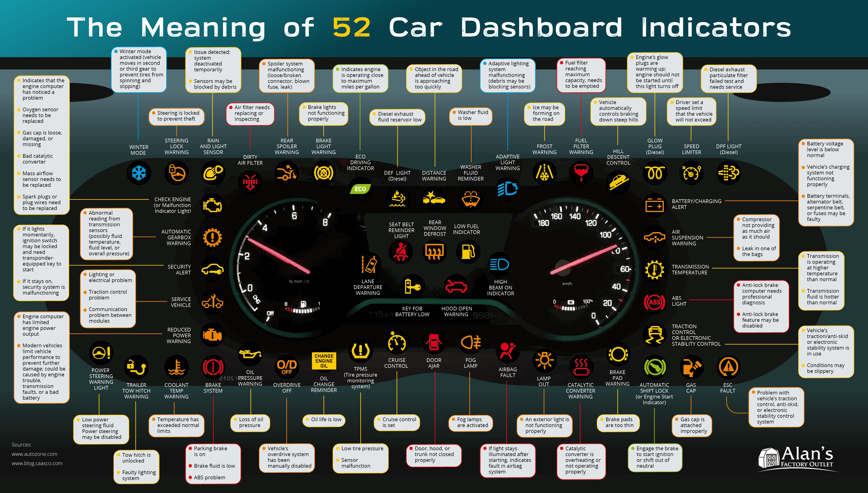
Activity...

Slide 6
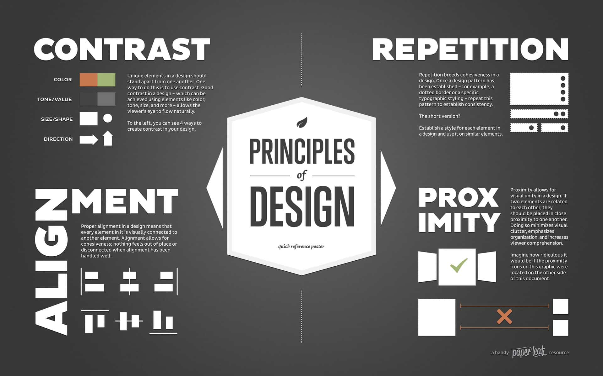
Design Language / Visual Communication

Slide 7
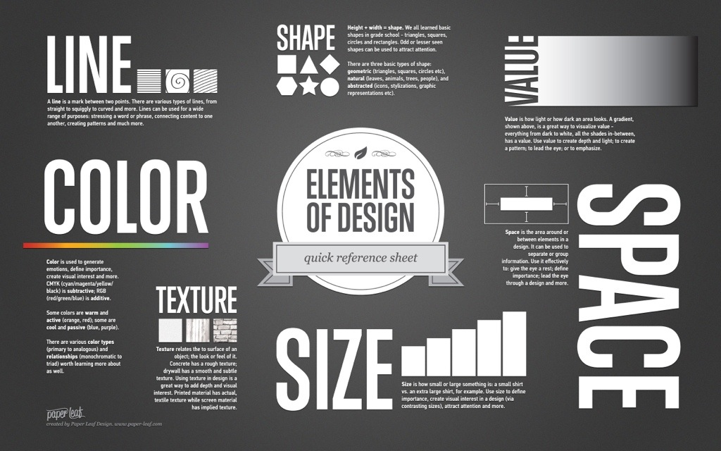
Design Language / Visual Communication

Slide 8
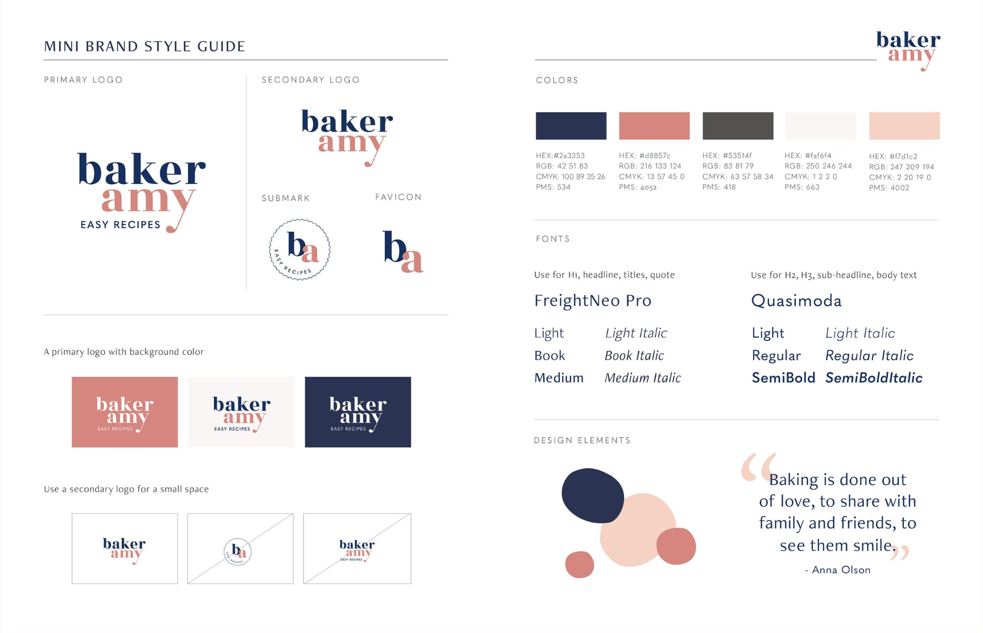
Design Guide

Slide 9
Activity...
Consider ways in which UI and UX can be designed to consider the end user.
1. On your own design an icon to represent the following:
  The Teaching and Learning building
  The corridor
  The vending machine
  The Mac Lab.
Then compare the designs with the group.
2. Design the journey to bring someone into our Mac Lab. Include information that will help the user.
3. Set up a Figma.com account
4. Develop the design as a flowchart prototype of the journey and experience.

