Slide 1
CertHE Skills for the Workplace
Module: BMSK4002
Effective Team Working and Communication
Evening Session 4

Slide 2
Overview of Session 4
Reflection on Last Session
Reflection on Research
Communication Models

Slide 3
Reflection On Last Session
What is communication?
Elements of Communication
Barriers to communication
  Unreliable transmission, defensiveness, distorted perception, stereotyping, cultural, guilt, distortions from the past
Communication styles
  Passive, Passive aggressive, aggressive, assertive
Difficult communications
  , Aggression Face to face Via the phone Giving bad news
Notes:
Facilitator to reveal the topics covered last time, only after the students have identified the key themes covered, and the activities they performed. Draw out, and capture on flipchart, the key learning points they identify before summarising yourself using the slide.

Slide 4
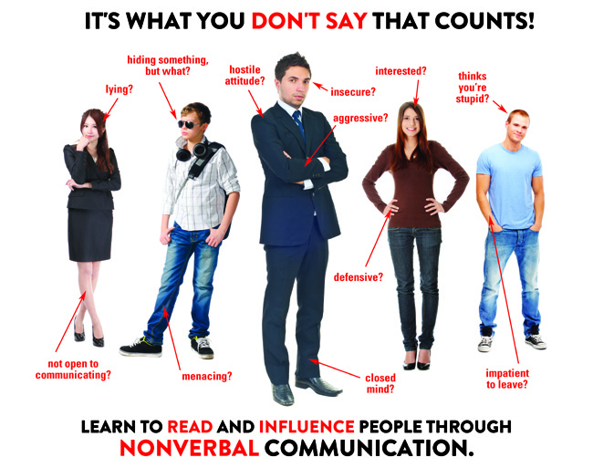
Reflection On Last Session
Non-verbal communication – intro
Body language
Facial expression
Posture
Eye Contact
Gestures
Touch
Notes:
Nonverbal communication is the transmission of information in addition to words in a communication to an audience or receiver of the communication content.
How Do People Communicate Nonverbally?

Slide 5
Reflection On Last Session
Listening
Level 5
Empathetic
Level 4
Active
Level 3
Selective
Level 2
Pretend
Level 1
Ignore
Notes:
Discuss the various levels and draw out the fact that most of us operate at Level 1 to 3. Illustrate this by asking how many times students have to ask what was just said?! Or can you repeat that please? Or worse, just forget about it!
Explain what each level means, and how only 4 & 5 are acceptable! Ask the group ‘why’ is this the case? Discuss their comments. Main point is that anything less than active listening is likely to lead to mis-communication!

Slide 6
Reflection On Research
How did you get on with the free on-line survey sites?
Did you manage to get some ideas for a communication skills survey?
Has anyone set something up?
What’s your next steps?
Notes:
This is a chance to see if anyone has done some basic research into on-line surveys, or even set a survey up…..or tried one out on their family or friends? The aim here is to share ideas and experiences, and try and generate some momentum, and help the students start preparing material for their assignment.

Slide 7
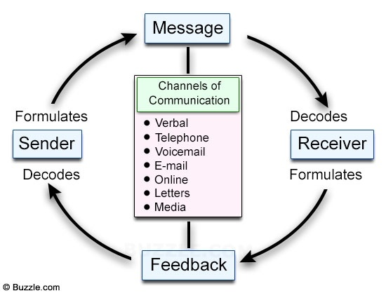
A Communication Cycle
Notes:
Discuss this model with the students – what are the implications? Ask for their thoughts – what is the model explaining? Is there anything missing from the diagram? They should identify that effective communication can be an iterative process – I send a message, then the recipient checks their understanding, and then I confirm their understanding or refine my message….and so on.
The students might identify that there do not appear to be any ‘barriers’ to communication in this model. It also suggests that all channels can be equally effective? Do we believe this to be the case? What about the impact of non-verbal communications – where will this be most obvious? Challenge their thinking and get them critically analysing the model, not just accepting it at face value.

Slide 8
A Communication Cycle
Communication Cycle video
Handout on cycle

Slide 9
The Shannon-Weaver Mathematical Model, 1949
Information Source
Transmitter (Encoder)
Channel
Receiver (Decoder)
Destination
Signal
Received
Signal
Message
Message
Noise Source
Notes:
What is this model telling us? This time there is noise……but is this ‘atmospheric interference’….it is 1949, or is it more than this? Students can look this up in their own time and answer these questions! This also seems ‘one-directional’…..is it?

Slide 10
The Shannon-Weaver Mathematical Model, 1949
Video link of The Shannon-Weaver Mathematical Model

Slide 11
Berlo’s Model of Communication
Source
Communication Skills
Attitudes
Knowledge
Social System
Culture
Message
Content
Elements
Treatment
Structure
Code
Channel
Hearing
Seeing
Touching
Smelling
Tasting
Receiver
Communication Skills
Attitudes
Knowledge
Social System
Culture
Encodes
Decodes
A Source encodes a Message for a Channel, then to a Receiver, who decodes it: S-M-C-R Model
Notes:
Discuss this with the students – another approach to the tricky subject of communications. Take them quickly through this model and the Schramm’s model on the next slide.

Slide 12
Berlo’s Model of Communication
Video of Berlo’s Model of Communication

Slide 13
Schramm’s Model of Communication, 1954
Message
Encoder
Interpreter
Decoder
Decoder
Interpreter
Encoder
Message
Notes:
Schramm's Model of Communication was postulated by Wilbur Schramm in 1954, where he suggested that communication is a two way process where both sender and receiver take turns to send and receive a message.

Slide 14
Comparative Study
Explain the similarities and the differences between the four models shown: Communication Cycle, Shannon & Weaver, et al.
Explain the relevance of the models for effective communication in management.
Write-up and present results
Exercise: 30 mins to prepare
Notes:
Lead a plenary session and take feedback from each group – asking for different thoughts on the models, similarities and differences, alternating for single responses between syndicates to ensure everyone has a chance to contribute. Students can also ask questions and the tutor can facilitate a discussion. A key observation is that communication makes up a huge part of our work and private lives, we are not that good at it, and, despite its apparent complexity, there are skills we can learn and practice, knowledge we can build up, behaviours we can adopt and attitudes we can change….which can make us expert communicators.

Slide 15
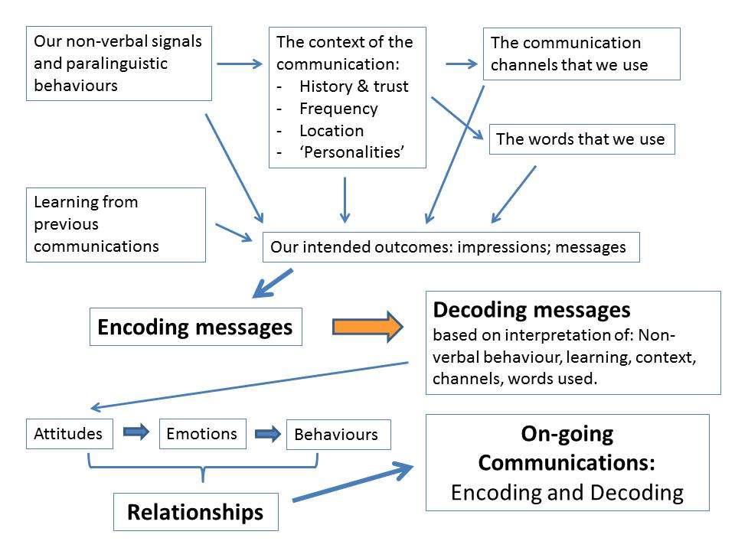
A Final Activity: The Context Of Communication
Notes:
The source of this is the Peter Morgan required Text. What are the students’ thoughts on this model? Discuss the key elements with them. Advise them to do some research – starting with the Morgan text.
Morgan, P. The Business Student’s Guide To Study And Employability.

Slide 16
The Context Of Communication
Examine the diagram and…
Key Learning Points?
Any terms you don’t understand?
Which of these could have the biggest impact on the quality of your communications?
Record your findings for feedback to the group and discussion. Exercise – 30 minutes to prepare
Notes:
The students should identify ‘complexity’, and that very little communication takes place in isolation…there are existing relationships and, often, baggage! A key consideration here is that “where communication is not interpreted correctly (i.e. ‘as intended’), it will have consequences for the beliefs and attitudes of the recipients, their emotions and then their broader behaviour, which is why many relationship issues in team, at work and elsewhere, tend to arise from poor communication. Morgan, P. (2017). P.245-246.

Slide 17

Summary
Take 5 minutes to reflect on the day and summarise your learning from today

Slide 18
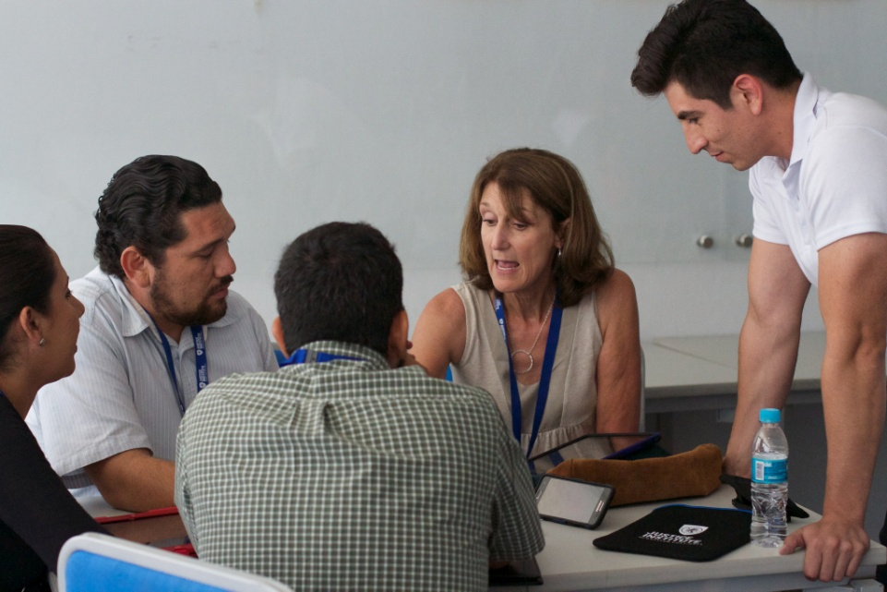
Further Research
By the next session, have a look at Peter Morgan’s Text, and research the following:-
The Context Of Communication Model
Paralinguistic Behaviours
Be prepared to join in
the discussion

