Slide 1
BMHP6030
Health, wellbeing & sustainable development
Student name: Shammah begum
Student ID: 2323587
Lecturer: Parese Ahmed

Slide 2
Introduction
The topic of the assignment is to discuss about the concepts of health and well-being and sustainable development
The chosen case study will be discussed through the NHS Diabetes prevention policy
The relevance in incorporating the concepts of health, wellbeing and sustainable development lies in protecting individuals for long-term through suitable prevention method that ensures their holistic well-being.
Sustainable development helps in ensuring that the care meets current medical and social needs of individuals without compromising the environment, economy, or the well-being of future generations.
Notes:
In this assignment, the concept of health, well-being and sustainable development will be discussed in detail. NHS diabetes prevention policy "Healthier You" one such prevention initiative which helps individuals to manage their diabetes by considering all other aspects of health such as physical, emotional, social and environmental factors that influence health outcome. In addition to this, sustainable development is essential to be integrated within health and social care as it helps in ensuring that the care meets current medical and social needs of individuals without compromising the environment, economy, or the well-being of future generations.

Slide 3

Definitions and key concepts (Health and well-being)
According to WHO's definition health is a state of complete well-being and does not only include physical well-being but also mental and social well-being instead of absence of disease (Schramme 2023).
According to WHO health is also considered as human rights (Schramme 2023).
Subjective well-being refers to an individual's personal evaluation of their own health and happiness in life.
Objective well-being refers to external, observable conditions which required for human survival and fulfilment using various social indicators.
ThePhoto by PhotoAuthor is licensed under CCYYSA.
Notes:
WHO does not consider health as the absence of disease but also considers the well-being of physical, mental and social well-being and one of the significant human rights. In addition to this, subjective well-being is related to individuals' own evaluation of their health and well-being which actually does not indicate good health whereas, objective well-being uses external observations, demographic data, clinical results and other social indicators to evaluate human health and well-being. Objective well-being provides the actual status of health and well-being. However, WHO's definition was criticised as it used the word "complete" to define the state of well-being which may become problematic for individuals with chronic disease, disabilties, genetic disease as according to the utopianism of the definition these people can actually never have good health. Here the definition by UN makes more sence which is discussed in next slide.

Slide 4
UN definition of health and Well-being and SDG
UN defines health and well-being from a holistic lenses that through adopting 17 sustainable development (SDG) goals it aims at ensuring healthy lives.
UN also acknowledges the influences of social and economic parameters while defining health and well-being.
UN considers health and well-being is not always influenced by individual factors but equity, equality, access to healthcare, income level shapes (UN 2026)
It also follows WHO's approach of considering health as human rights.
Notes:
UN considers health from the lense of sustainable development (SD) but also consider health as significant human right aligning with WHO's definition. UN believes in achieving good health and well-being is not only depended on individual factors but also environmental, social, and economic factors that influences equality, equity, accessibility to receive optimum health outcomes. Moreover, sustainable development indicates meeting today's health and well-being needs without compromising the future. The WHO recognises that sustainable policies can improve health while reducing environmental harms and generating long-term savings.

Slide 5
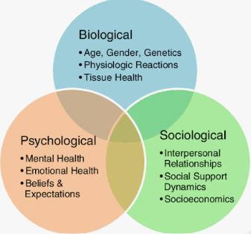
Theory 1: Biopsychosocial model
The Biopsychosocial Model of Engel highlights the interaction between biological, psychological and social factors in determining health outcomes.
Some of the biological factors that affect diabetes are genetic makeup of the family, age, glucose levels in the body and susceptibility to type 2 diabetes.
The psychological factors associated with diabetes include motivation, perception of control, stress, self-confidence and perceptions of lifestyle risk.
Some social factors include financial resources, availability of food, work schedule, safety of neighborhood and family support in behavior modification.
(Bookbush Institute 2024)
Notes:
Engel's Model contradicts models that explain disease solely based on biological reasons or choice such as the medical model of the health. In the case of prevention of diabetes, biological risk factors could be coupled with stress, self-confidence, and accessibility to nutritious food at affordable prices. Healthier You can tackle some of the psychological risk factors using counselling and setting targets, while group therapy sessions would provide the social motivation aspect. However, counselling alone is not enough to eliminate issues such as poverty, unsafe environment, or lack of stable employment.

Slide 6
Theory 2: Ecological Model
The Ecological Model explains health behaviour through interacting individual, interpersonal, organisational, community and policy influences.
Individual interventions develop knowledge and skills, while family support can reinforce healthier daily routines.
Community partnerships can improve access through culturally appropriate groups, accessible venues and local health promotion.
Policy interventions address structural influences, including food environments, transport, income inequality and access to preventive healthcare.
Notes:
The Ecological Model extends the concept of prevention beyond the individual and takes into account the social and environmental context in which behaviour occurs. Healthier You offers coaching at an individual level, yet participation is dependent on the referral process, the location of services, family obligations, and opportunities for exercise in the locality. Thus, its potential could be enhanced through collaboration with primary care, local government, community organizations, and the workplace. The Ecological Model is less focused than the Biopsychosocial Model on organizational and policy factors, however.

Slide 7
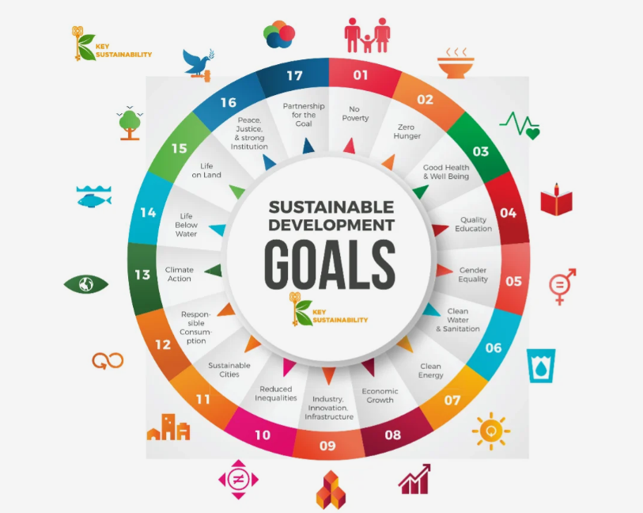
Sustainable Development GOals (SDG)
UN's SDGs were taken to eradicate poverty by 2030, to protect the planet so that all individuals can live with peace and enjoy life.
Among 17 goals, goal 3 focuses on health and well-being with the incorporation of Universal Health Coverage (UHC) to narrow down social and economic inequalities leading to poorer health outcome (UNDP 2026).
The UK's NHS's Healthier You: Diabetes Prevention program is also sustainable and cost-effective but faces challenges due to inequalities.
Aligning with UN's SDG goal 3.4 which addresses premature mortality from non-communicable diseases, it also prevented 7-20% risk from T2D in UK (Barron et al. 2025).
Source: (UNDP 2026)
Notes:
UN's sustainable development goals were taken in 2015 to eradicate poverty, to protect the planet environmentally so that individuals' can live with peace and joy and to achieve these goals UN has taken 17 goals to improve those areas by 2030. Among 17 goals, goal 3 focuses on health and well-being with the incorporation of Universal Health Coverage (UHC) to narrow down social and economic inequalities leading to poorer health outcome. Within the context of UK, the NHS driven diabetes prevention programe is sustainable and cost-effective but UK's socio-economic disparities make it less effective to achieve the desired outcome. However, its alignment with SDG goal 3.4 which focuses on addressing premature mortality from non-communicable diseases, it also prevented 7-20% risk from T2D in UK.

Slide 8
Policy and Governance
WHO’s Health in All Policies framework aims at getting the government to think about health and equality issues outside the health sector.
The NHS Long Term Plan focused on prevention and increased funding for diabetes prevention, along with digital access to these services.
The Equality Act 2010 protects from discrimination and helps make reasonable adjustments for disabled service users.
Commissioning standards, provider training, informed consent, confidentiality, and outcome measurement are the key aspects of proper governance.
Notes:
There is also an external policy framework for Healthier You that emphasizes the importance of prevention and better health of populations. The NHS Long Term Plan had recognized diabetes prevention as an important issue in terms of enhanced provision and digital services. The Equality Act 2010 can also be mentioned here as related to the delivery of non-discriminating and accessible services. There is WHO's Health in All Policies approach, which emphasizes the role of housing, education, labor market, and transportation. Yet, the effectiveness of policies depends on their funding and implementation.

Slide 9
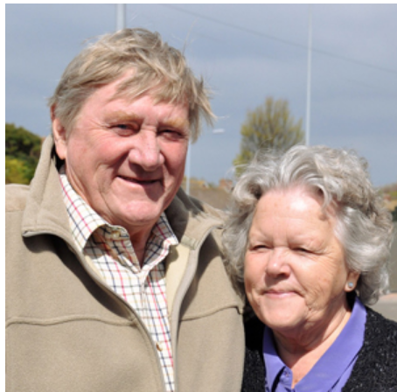
Case Study Example:
Peter, a 79-year-old man retired police officer was struggling with shortness of breath and numbness before diagnosis with diabetes (NHS England 2026).
In the first week of the programe Peter lost weights and lowered his cholesterol level also.
His wife was also refered to the programe who is also noticing improvement in his diabetes management.
The policy guides them to achieve a healthy weight, be physically active and eat a balanced diet and group activities with other patients motivate them.
(Source: NHS England 2026)
Notes:
Peter Stevens, aged 79, was referred to the NHS Diabetes Prevention Programme after high blood sugar was identified during a GP visit for breathlessness and numbness. His story illustrates how routine healthcare consultations can identify individuals at increased risk of type 2 diabetes and connect them with preventive support. The case highlights the importance of early identification, personalised lifestyle guidance and patient engagement in improving health and reducing the likelihood of developing diabetes.

Slide 10
Health Belief mOdel
Perceived susceptibility: Recognizing individuals who are at risk by means of blood test, NHS Health Check and referrals from clinical practitioners.
Perceived severity: Highlighting the possible consequences of type 2 diabetes to foster preventative behaviors among individuals.
Perceived benefits and barriers: Advocating healthy diet, exercise and weight loss while overcoming any perceived barriers to participation.
Cues to action and self-efficacy: Offering advice, coaching and setting of goals.
Notes:
The Health Belief Model helps explain how the NHS Diabetes Prevention Programme encourages preventive behaviour. Risk assessments increase perceived susceptibility, while information about diabetes complications communicates severity. Personalised lifestyle advice highlights the benefits of prevention, although barriers such as time, food affordability and motivation may reduce engagement. GP referrals provide cues to action, while health coaching and achievable goals strengthen self-efficacy. Peter’s story illustrates these principles: following referral, small dietary changes, walking and support from his wife helped him improve his health.

Slide 11
Success and Challenges
According to NHS England, the risk of type 2 diabetes can be reduced to 37% for individuals who have completed the program.
A review found that on average, participants lost 3.3 kg after completing the program (NHS England 2025).
Convenience, health coaching, and monitoring were some of the factors identified from qualitative interviews that helped in digital participation (Ross et al. 2023).
Some of the difficulties faced included referral problems, language barriers, lack of culture adaptation, and unequal completion.
Notes:
In terms of success the Healthier You program is capable of bringing about significant gains in terms of diabetes risk and weight loss among those participants completing the program. According to the report from NHS England, there was a 37% decrease in the risk of developing type 2 diabetes after completing the program, along with a weight loss of 3.3 kilograms on average. Qualitative study conducted among 32 adults revealed that factors such as convenience, comprehension, motivation and support from health coaches were responsible for digital engagement.

Slide 12
Equity and access (Inequalities)
The prevalence of type 2 diabetes is about 60% greater in the most deprived compared to the least deprived areas of England (Watkinson et al. 2024).
Certain ethnic minority groups are at an increased risk of developing diabetes and need culturally appropriate prevention messages.
It was observed that deprived groups were underrepresented in those taking part in eight programme visits (Bidulika et al. 2023)
Digital inequality, English as second language, disability and rigid visiting arrangements may be limiting factors (Bidulika et al. 2023).
Notes:
Health inequalities arise from differences in resources, living conditions and opportunities to maintain health. Government evidence reports that type 2 diabetes prevalence is 60% higher in the most deprived quintile than in the least deprived quintile. Research on Healthier You found that people living in deprived areas were under-represented among those completing eight sessions. Ethnic minority groups were represented strongly at referral stages, but representation decreased by completion. This demonstrates why equitable referral does not necessarily produce equitable engagement or outcomes.

Slide 13
Equity and access (Recommendations)
Providing interpretive services, translated materials and cultural examples developed in collaboration with the community and participants.
1
Ensuring that suitable community facilities, flexible appointment times, transport services and childcare facilities are provided where possible.
2
Providing telephone and face-to-face options to those who are excluded from digital participation or access problems.
3
Track referral, attendance and outcomes by ethnicity, deprivation, disability, age and method of delivery (NHS England, 2025b).
4
Notes:
Equity improvements need interventions that take into account the needs of various communities instead of the same intervention for all individuals. The providers need to work together with the communities in designing the material, offer translation services as well as address any disability issues. Flexibility in scheduling, use of community venues and offering appropriate support can help reduce participation barriers. Digital distribution of material needs to enhance choices but not eliminate available face-to-face options. Commissioning of the whole process from identification to outcomes can help assess disparities.

Slide 14
Conclusion
Health, wellbeing and sustainability require prevention strategies addressing biological, psychological, social and environmental influences.
Healthier You supports SDG 3 through structured lifestyle interventions designed to prevent or delay type 2 diabetes.
Evidence indicates promising outcomes, but participation and completion inequalities limit the programme’s equitable reach.
Future services should combine person-centred support, structural interventions, inclusive delivery and transparent evaluation of long-term outcomes.
Notes:
The National Health Service Diabetes Prevention Programme provides a good illustration of how beneficial it can be for health and social care when prevention, wellbeing and sustainability are considered. The programme's size and its outcomes indicate possible effectiveness in lowering the risk of developing diabetes and associated healthcare needs. Nonetheless, its success depends on easy access to referrals, ongoing commitment to the programme and environmental conditions impacting individuals' readiness to modify their lifestyle. The use of the Biopsychosocial Model, Ecological Model and Health Belief Model will help make more thorough planning.

Slide 15
References
Barron, E., Chappell, P., Hatfield, I., Hope, D. C., Ge, X., Bakhai, C., .and Valabhji, J. (2025). Association between the English National Health Service Diabetes Prevention Programme and incident multiple long-term conditions. Nature Medicine, 31(11), pp. 3825-3831. https://www.nature.com/articles/s41591-025-03922-1
Bidulka, P., Mathur, R., Lugo‐Palacios, D.G., O'Neill, S., Basu, A., Silverwood, R.J., Charlton, P., Briggs, A., Smeeth, L., Adler, A.I. and Douglas, I.J. (2023) Ethnic and socioeconomic disparities in initiation of second‐line antidiabetic treatment for people with type 2 diabetes in England: A cross‐sectional study. Diabetes, Obesity and Metabolism, 25(1), pp.282-292. https://dom-pubs.onlinelibrary.wiley.com/doi/abs/10.1111/dom.14874
NHS England (2025a) ‘NHS diabetes prevention scheme helps one million people’ [Online]. Available at: https://www.england.nhs.uk/2025/12/nhs-diabetes-prevention-scheme-helps-one-million-people/ (Accessed on: 8 October 2026].
NHS England (2025a) ‘NHS initiative helps thousands more tackle their diabetes risk’ [Online]. Available at: https://www.england.nhs.uk/2025/05/nhs-initiative-helps-thousands-more-tackle-their-diabetes-risk/ [Accessed on 08th Oct 2026].
NHS England. (2026) Peter's Story [Online]. Available at: https://www.england.nhs.uk/diabetes/case-studies/peters-story/ [Accessed on 08th Oct 2026].
Ross, J., Cotterill, S., Bower, P. and Murray, E. (2023) Influences on patient uptake of and engagement with the National Health Service Digital Diabetes Prevention Programme: qualitative interview study. Journal of Medical Internet Research, 25, p.e40961. https://www.jmir.org/2023/1/e40961/
Schramme T. (2023) Health as Complete Well-Being: The WHO Definition and Beyond. Public health ethics, 16(3), pp. 210–218. https://doi.org/10.1093/phe/phad017
UN. (2026) Sustainable Development Goals [Online]. Available at: https://www.un.org/sustainabledevelopment/health/ [Accessed on 08th Oct 2026].
UNDP. (2025) Goal 3: Good Health and Well-Being [Online]. Available at: https://www.undp.org/sustainable-development-goals/good-health [Accessed on 08th Oct 2026].
Watkinson, R., McManus, E., Meacock, R., and Sutton, M. (2024) Age-and deprivation-related inequalities in identification of people at high risk of type 2 diabetes in England. BMC Public Health, 24(1), pp. 2166. https://link.springer.com/article/10.1186/s12889-024-19571-x

