Slide 2
Projects Planning
And Scheduling
Module Name: Group Project
Module Code: ACBA4014
Applied Computing - WISA

Slide 3
Project Characteristics
Objectives:
  A project is a set of related tasks that are coordinated to achieve a specific objective in a given time limit.
  Each objective has a specific goal to reach.
Schedule:
  A point in time when a task must be accomplished.
Resource Constraints:
  Time limits.
  Facilities and equipment
  Materials
  Labour and personnel – Projects typically involve many people, a team.

Slide 4
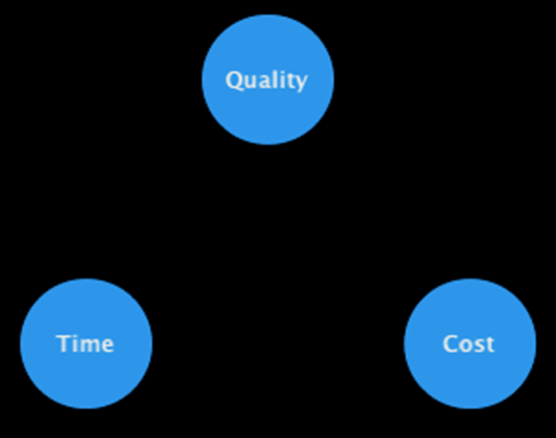
The Project Triangle
If time, money, or what your project accomplished were unlimited, you wouldn't need to do project management.
Most projects have a specific time limit, budget (budget: The estimated cost of a project that you establish in Project with your baseline plan.), and scope.

Slide 5
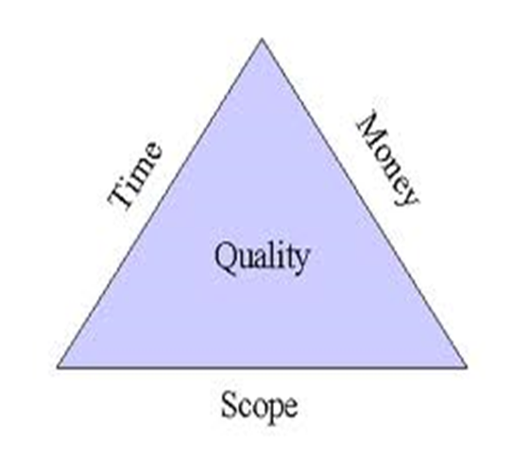
The Project Triangle
It is this combination of elements (time, money, and scope) that we refer to as the project triangle.
These competing elements are sometimes referred to as the triple constraints of a project.
Understanding the project triangle will allow you to make better choices when you need to make tradeoffs.
Notes:
Not everyone agrees that quality should be the third criterion. We could argue that if we meet and adhere to the scope of a project then quality should be reflected in all other aspects of the triangle.

Slide 6
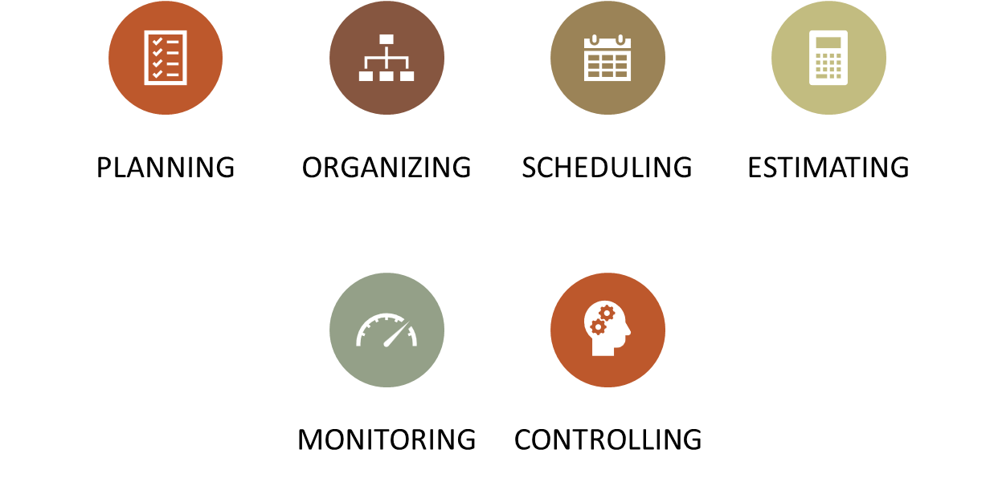
Project Management
What does it involve:
Notes:
This talk provides an overview of the basic steps needed to produce a project plan. The framework provided should allow you to identify where some of the particular issues discussed are applied to the planning process. As the focus is on project planning, techniques to do with project control are not explicitly described. However, in practice, one element of project planning will be to decide what project control procedures need to be in place.

Slide 7
The Four Key Phases to a Project
Initiating the project
Planning the project
Executing the project
Closing down the project
Notes:
The project management process typically includes four key phases: initiating the project, planning the project, executing the project, and closing the project. Each one of these will be looked at in turn.

Slide 8

Development Process of Software Systems
  Project Initiation
  Feasibility study
  Systems analysis
  Systems design
  Implementation
  Testing
  Conversion
  Operation and evaluation
  This is the traditional Waterfall Model of Software Development – We will discuss alternative models.
Notes:
A key point here is that developers may in fact be very competent, but incorrect estimates leading to unachievable targets will lead to extreme customer dissatisfaction. We will look at this further as a SDLC

Slide 9
Project Initiation
Applied Computing - WISA

Slide 10
Project Initiation
  Management may realise that existing systems fail to meet corporate needs
    Technological changes
    Increased competition
    Changes in legislation
    Customer preferences
  Users may become dissatisfied with the current system
    Frequent errors
    Productivity problems
    Want to benefit from IT innovations

Slide 11
Project Initiation
  Establishing the project initiation team. This involves organizing team members to assist in carrying out the project initiation activities.
  Establishing a relationship with the customer. The understanding of your customer's organization will foster a stronger relationship between the two of you.
  Establishing the project initiation plan. Defines the activities required to organize the team while working to define the goals and scope of the project.

Slide 12
Project Initiation
  Establishing management procedures. Concerned with developing team communication and reporting procedures, job assignments and roles, project change procedure, and how project funding and billing will be handled.
  Establishing the project management environment and workbook. Focuses on the collection and organization of the tools that you will use while managing the project.

Slide 13
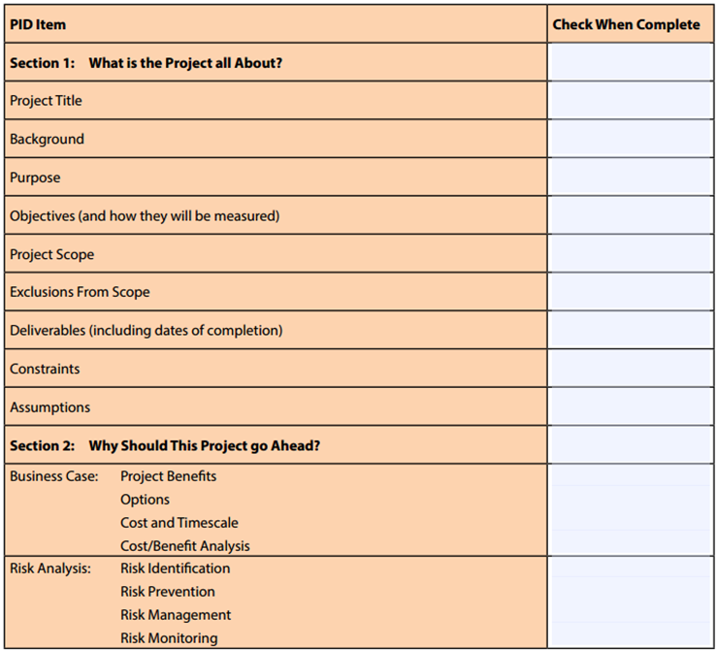
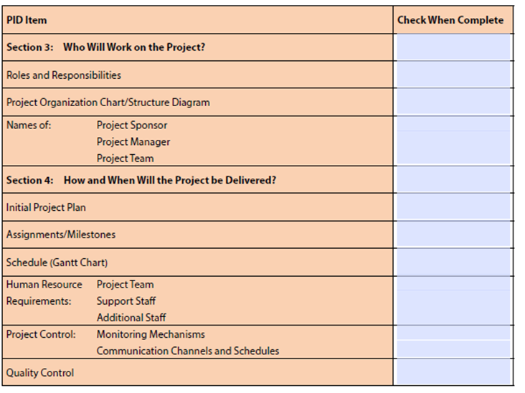
PID Example
PID templates may be specific to the organisation or customised for a specific project

Slide 14
Introduction / Puropose
  Why are you doing this work? Describe the desired end result of this project.
  Exercise:
    In a group write a brief introduction to your chosen Project

Slide 15
Objectives
  What specific outcomes will be achieved, and how will you measure these outcomes?
  Remember to limit the number of objectives for your project – four or five goals are typically enough.

Slide 16
Scope
  What are the boundaries for this project (for example, type of work, type of client, type of problem, geographic area covered)?
  List any areas excluded that you believe stakeholders might assume are included, but are not.
  The more specific you are, the less opportunity there is for misunderstanding at a later stage in the project.

Slide 17
Constraints
  What things must you take into consideration that will influence your deliverables and schedule?
  These are external variables that you cannot control but need to manage.

Slide 18
Authority
  Project Sponsor:
    Who has the ultimate authority and control over the project and its implementation?
  Project Manager:
    Who is the Project Manager, and what are his or her responsibilities?
  Project Organization Chart/Structure:
    Create a diagram that shows the lines of authority and reporting for each project team member.

Slide 19
Resources
  People:
    Project Stakeholders
    Who are the key members of the project team? What are their roles and job descriptions? What is their department or organization?
  Equipment such as Hardware and Software
  Finances

Slide 20
Feasibility Study
  Can the project be implemented?
    Is it possible given the economic, financial, organisational & technological constraints?
  Should the project be implemented?
    Does the cost of the system compare favourably with the benefits?

Slide 21
Feasibility Study
  Phases of the feasibility study:
  Organise the study
  Search for solutions
  Feasibility analysis
  Choice of solution

Slide 22
Feasibility Study
  Phases of the feasibility study:
  Organise the study
    A study team is appointed
    Management state the goals of the proposed system
    Limits may be set to organisational change

Slide 23
Feasibility Study
  Phases of the feasibility study:
  Search for solutions
  Information is collected:
    Information on present system
    Economic information
    Financial information
    Technical information
    Organisational information
  The study team then formulates possible solutions.
  What happens if:
    No feasible solution is found?
    A feasible solution is found, but costs twice as much as management has allocated?

Slide 24
Feasibility Study
  Phases of the feasibility study:
  Feasibility analysis
    Economic Feasibility
      A cost-benefit analysis is carried out.
      Accurate costs and benefits may be difficult to obtain at this stage, so estimates are used.
      What problems are there with using the number of lines of code needed to help estimate project costs?

Slide 25
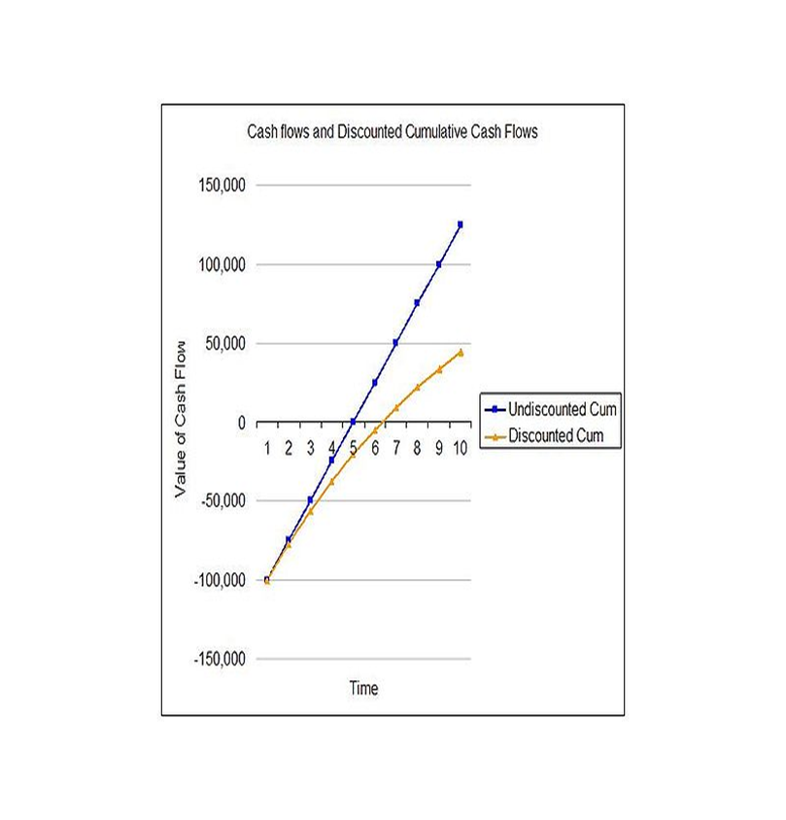
Feasibility Study
  Phases of the feasibility study:
  Feasibility analysis
    Financial Feasibility
      Check the costs against available funding.
      The value of money changes over time.
      Would an organisation invert £100,000 in a new computer system for a saving of £100,000 over the next 5 years?

Slide 26

Feasibility Study
  Phases of the feasibility study:
  Feasibility analysis
    Organisational Feasibility
      Organisational factors may make a project difficult.
        Staff resistance to change
        Lack of qualified staff
      How could such difficulties be dealt with?

Slide 27
Technological Constraints
  Equipment needed may be unavailable, unreliable or expensive.
    Example – The University of Huddersfield has a canal running through its campus and had to wait for wireless network techniques to become available to run certain networked applications.
  Statistical or mathematical techniques may be lacking.
    Examples - The NASA telemetry monitoring project, timetabling!

Slide 28
Project Planning
Applied Computing - WISA

Slide 29
Project Planning
  Describing project scope, alternatives, and feasibility. The understanding of the content and complexity of the project. Some relevant questions that should be answered include:
    What problem/opportunity does the project address?
    What results are to be achieved?
    What needs to be done?
    How will success be measured?
    How will we know when we are finished?
  Divide the project into tasks. This technique is also known as the work breakdown structure. This step is done to ensure an easy progression between tasks.

Slide 30
Project Planning
  Estimating resources and creating a resource plan. This helps to gather and arrange resources in the most effective manner.
  Developing a preliminary schedule. In this step, you are to assign time estimates to each activity in the work breakdown structure. From here, you will be able to create the target start and end dates for the project.
  Developing a communication plan. The idea here is to outline the communication procedures between management, team members, and the customer.
  Determining project standards and procedures. The specification of how various deliverables are produced and tested by the project team.

Slide 31
Project Planning
  Identifying and assessing risk. The goal here is to identify potential sources of risk and the consequences of those risks.
  Creating a preliminary budget. The budget should summarize the planned expenses and revenues related to the project.
  Developing a statement of work. This document will list the work to be done and the expected outcome of the project.
  Setting a baseline project plan. This should provide an estimate of the project's tasks and resource requirements

Slide 32
Software Project Planning
  What Software Project Planning Involves:
    Risk Analysis
    Risk Management
    Risk Monitoring - Project Tracking
    Software Project Scheduling
    Typical Task Network
    Approaches to Project Tracking

Slide 33
Software Project Planning
  Risk Management
  Create risk management and monitoring plan
  For each risk triplet, define the risk management steps
    What can go wrong?
    What are the chances of this particular event happening?
    What are the consequences?
  Risk management incurs additional project cost
  For larger projects, there may be 30-40 risks identified

Slide 34

Software Project Planning
  Risk Management – Simple Example
  Assume:
  Risk = High staff turnover
  Likelihood of occurrence = 70%
  Impact = Increase project time by 15%, project cost by 12%
  Risk Management steps may be:
    Identify high turnover causes
    Reduce causes before project starts
    Develop techniques to assure work continuity in light of turnover

Slide 35

Software Project Planning
  Scheduling
  The allocation of effort to specific sub-tasks
  The arrangement of the sub-tasks in time
    hopefully, no task will have to wait very long for completion of any dependent task
    at least, no resources should be wasted in this waiting
  Conversion of effort to people and time

Slide 36

Software Project Planning
  People – Work Relationships
  Adding people to a project when behind schedule is counterproductive (adding people to a late project makes it later)
  Using fewer people over a longer period of time is more beneficial than lots of people for a shorter period of time
  Use of small, tightly-knit teams is productive
  Inspire creativity and self-motivation within the structure of the project

Slide 37
Software Project Planning
  Scheduling Methods
  Project Evaluation & Review Technique and Critical Path Method (PERT and CPM) are:
    Usually presented pictorially
    Quantitative tools for the planner to determine:
      Critical path
      Most likely time estimates
      Boundary times (earliest task start time, latest task start time, earliest task finish time, latest task finish time, total float time)

Slide 38

Software Project Planning
  PERT Charts
  A graphical depiction of project task activities and their inter-relationships).
  PERT is one of the most widely used and best known techniques and requires that a project has:
    Well-defined activities that have a clear beginning and end point
    Activities that can be worked on independently of other activities
    Activities that are ordered
    Activities that when completed serve the purpose of the project

Slide 39
Software Project Planning
  Identifying Tasks
  Identify each activity to be completed in the project proportional to its time for completion:
    Requirements collection
    Screen design
    Report design
    Database construction
    Software programming
    System testing
    User documentation creation
    System installation

Slide 40
Software Project Planning
  Estimating Time of Tasks
  ET = o + 4r + p
  6
  Where:
    ET = estimated time for the completion for an activity
    o = optimistic completion time for an activity
    r = realistic completion lime for an activity
    p = pessimistic completion lime for an activity

Slide 41
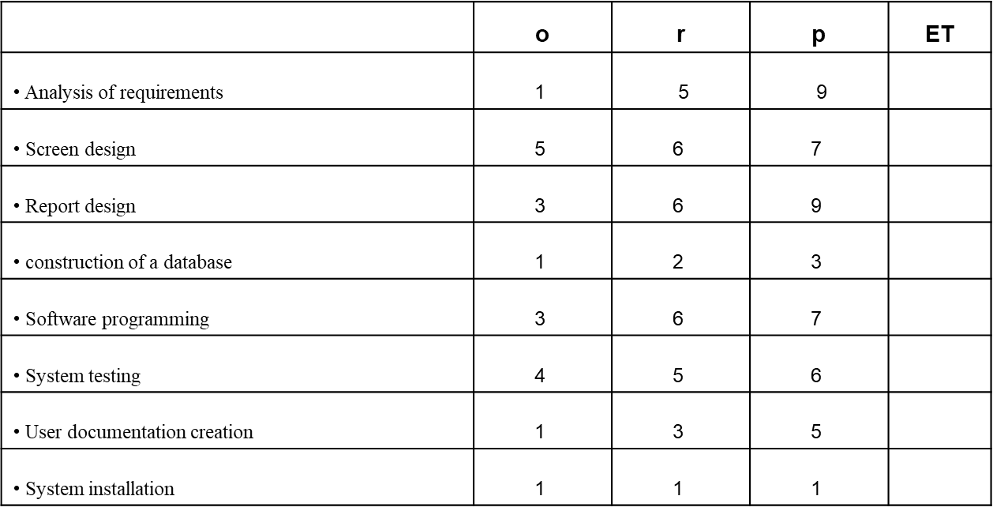
Software Project Planning
  Calculate Estimated Time of Tasks

Slide 42
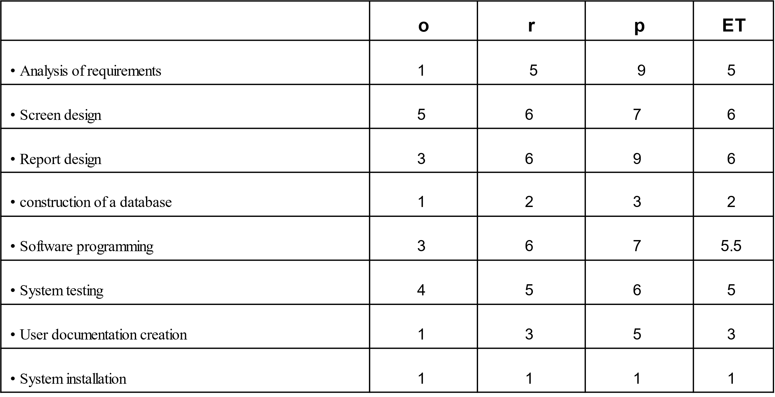
Software Project Planning
  Calculate Estimated Time of Tasks

Slide 43
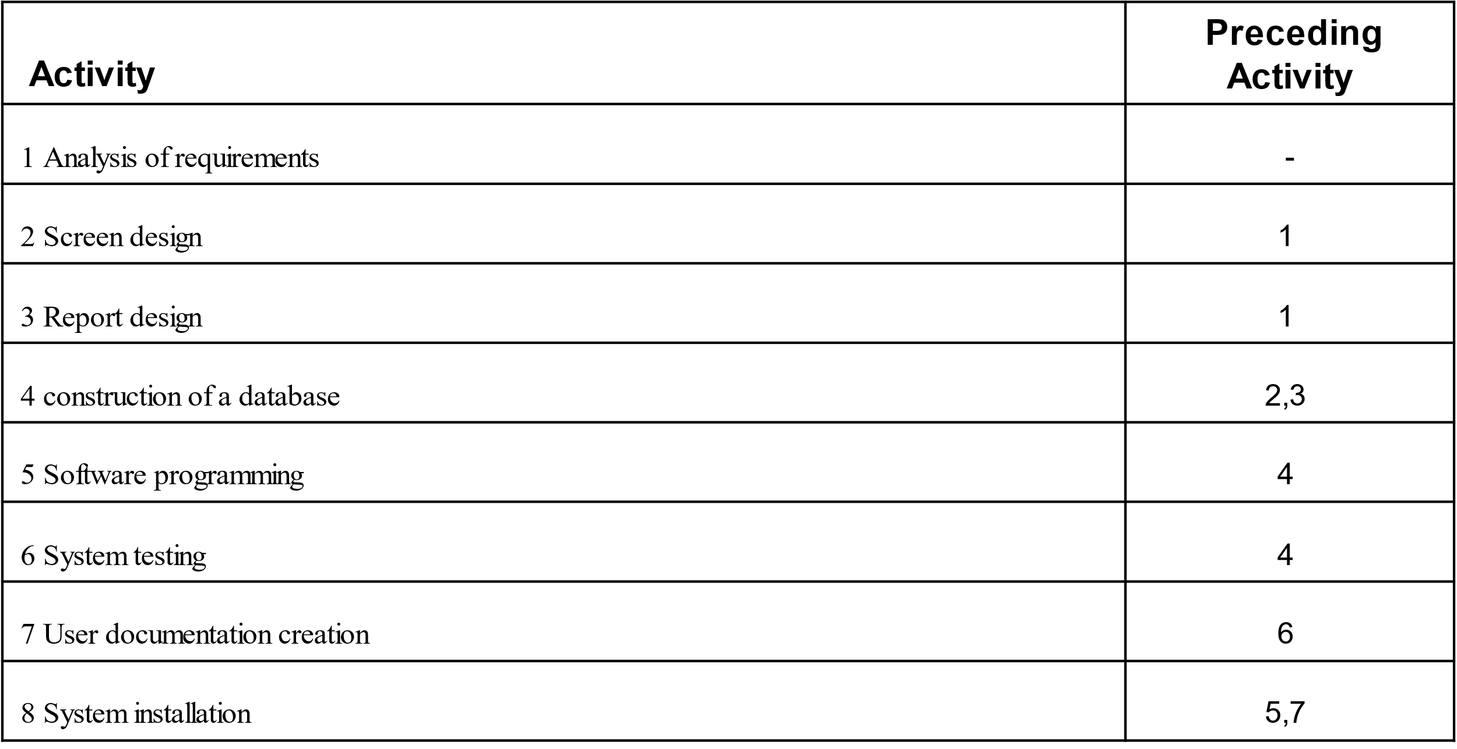
Software Project Planning
  Determine the Sequence of the Activities including Precedent Relationships among all the activities

Slide 44
Software Project Planning
  Construct a chart and determine the critical path
    Calculate each activities earliest and latest expected completion time.
    TE = the sum of the estimated time (ET) for each activity from left to right.
    If two or more activities precede an activity, the largest expected completion time of these activities is used

Slide 45
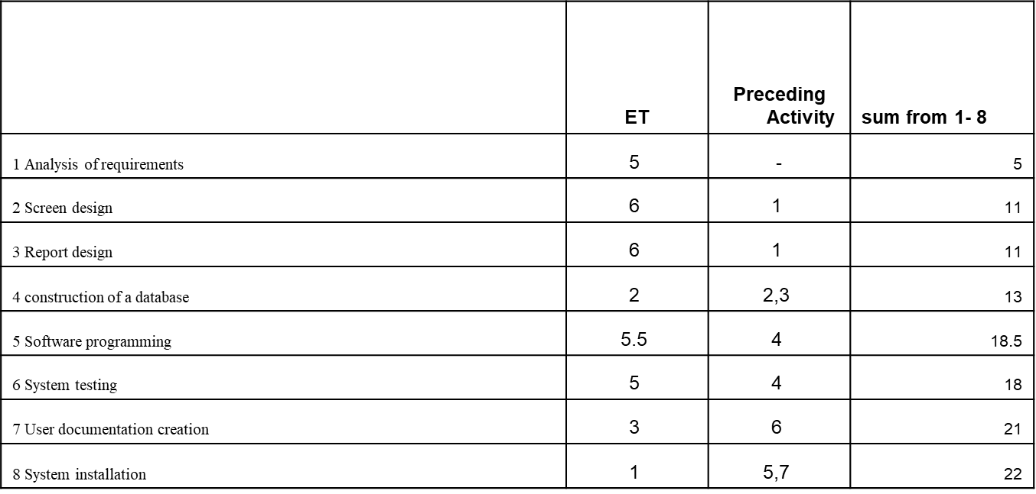
Software Project Planning
  Determine the T_{E}

Slide 46
Software Project Planning
  Determine the Earliest / Latest - T_{L}
    (TL) refers to the time in which an activity can be completed without delaying the project.
    To find the values for each activity’s latest expected completion time (TL), start at activity 8 and set TL equal to the final TE

Slide 47
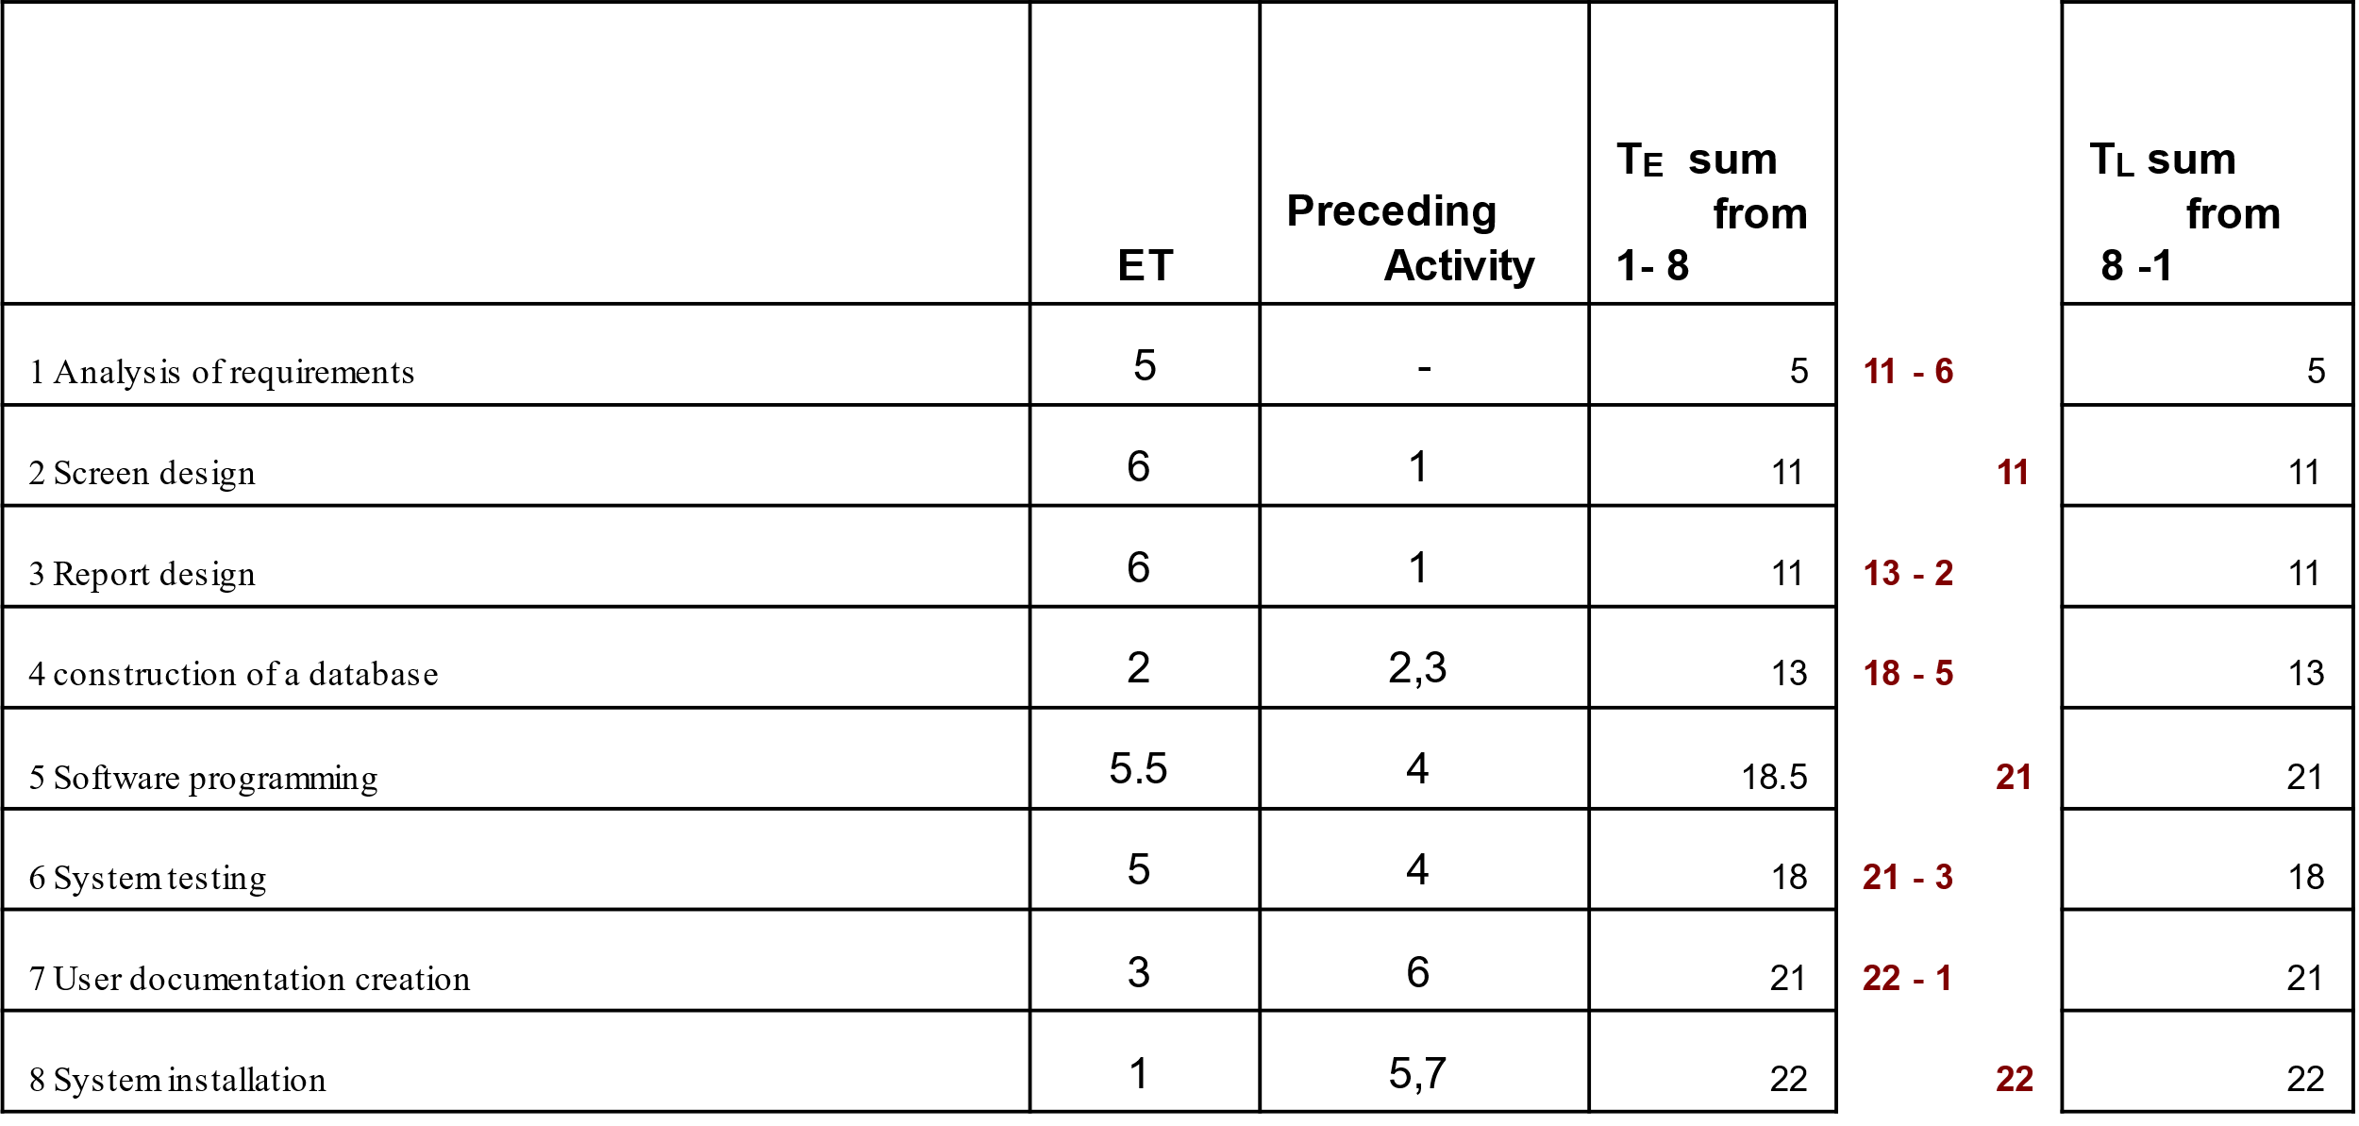
Software Project Planning
  Determine the T_{L}

Slide 48
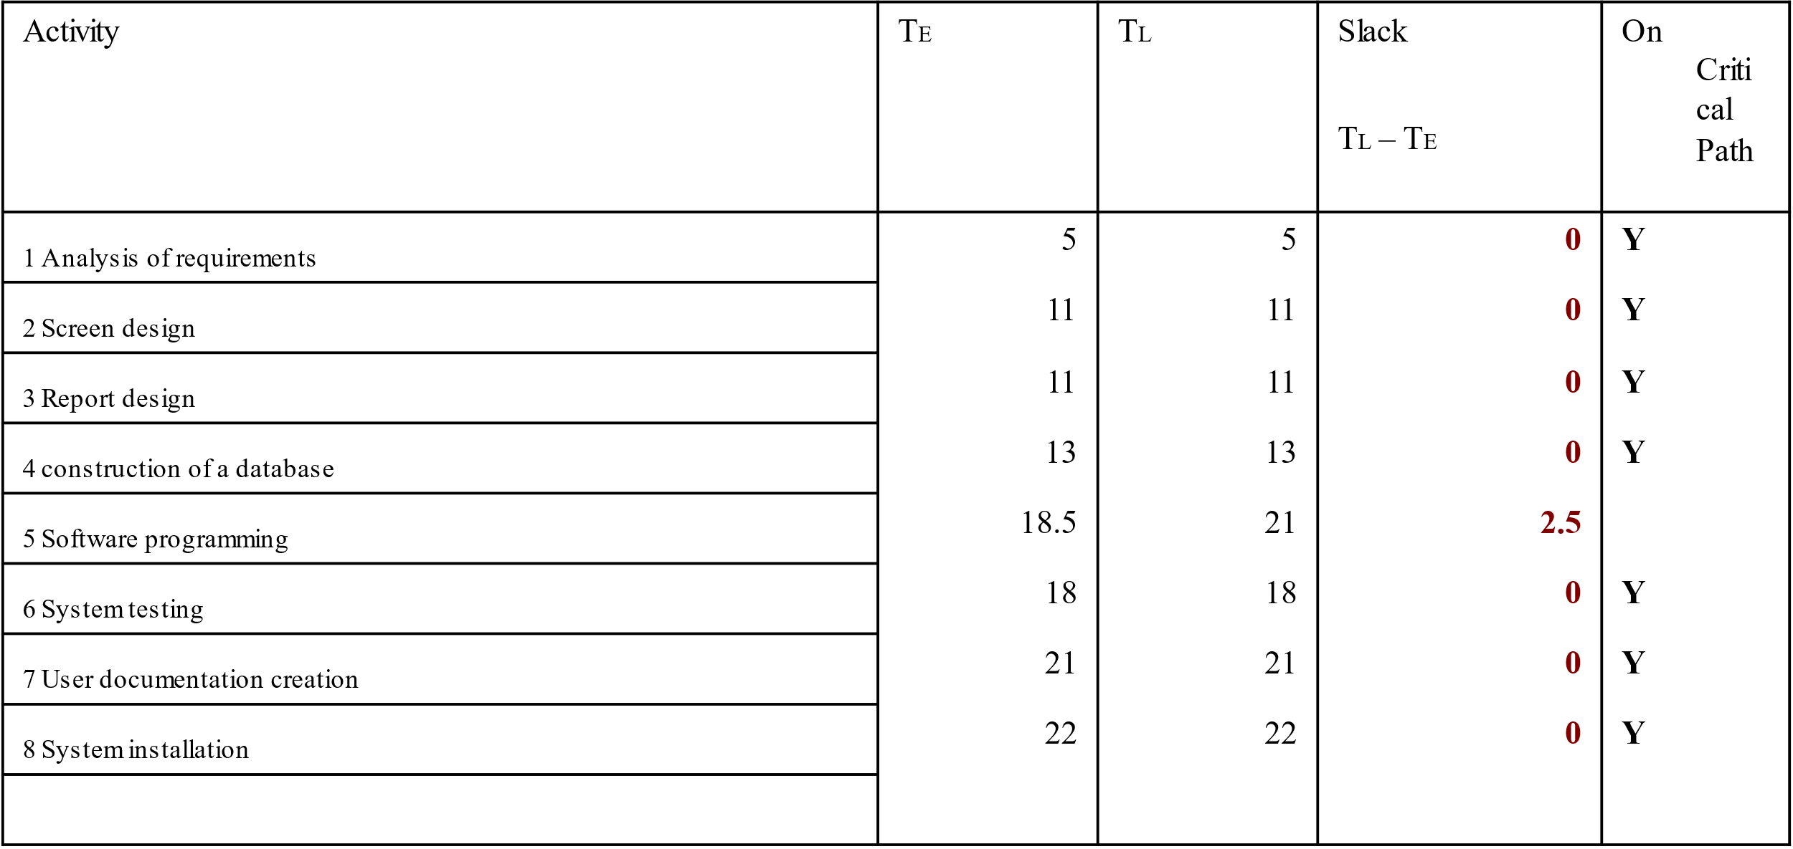
Software Project Planning
  Determine the Critical Path

Slide 49
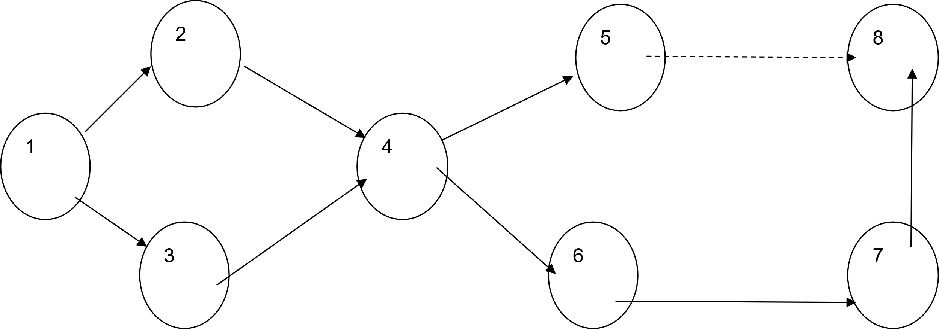
Software Project Planning
  Pert / Critical Path Chart

Slide 50
Software Project Planning
  Gantt Charts
  A graphical representation of a project that shows each task activity as a horizontal bar whose length is proportional to its time for completion
  In the form of a bar chart
  Indicates calendared chart of activities
  Can reflect resource requirements
  Computerised versions provide more details than original charts

Slide 51
Software Project Planning
  Constraints
  Constraints affect the relationship between activities:
    Technical
      One activity requires the output of another as input
    Management
      Decisions on what needs to be done, not dependent on technical needs
    Interproject
      Deliverables from one project are needed by another.
    Time (Date)
      Dates by which activities must be completed
Notes:
Technical – one activity requires the output of another as input.
management – management decisions on what needs to be done not dependent upon technical needs
Interproject – deliverables from one project are needed by another. (e.g. when a very large project is broken down into smaller projects)
Date – dates by which activities must be completed

Slide 52
Project Execution
Applied Computing - WISA

Slide 53
Project Execution
  Executing the baseline project plan. The job of the project manager is to initiate the execution of project activities, acquire and assign resources, orient and train new team members, keep the project on schedule, and assure the quality of project deliverables.
  Monitoring project progress against the baseline project plan. Using Gantt and PERT charts, which will be discussed in detail further on in this paper, can assist the project manager in doing this.
  Managing changes to the baseline project plan.

Slide 54
Project Execution
  Maintaining the project workbook. Maintaining complete records of all project events is necessary. The project workbook is the primary source of information for producing all project reports.
  Communicating the project status. This means that the entire project plan should be shard with the entire project team and any revisions to the plan should be communicated to all interested parties so that everyone understands how the plan is evolving.

Slide 55
Project Execution
  Project Tracking
  Conducting periodic project status meetings in which each team member reports progress and problems.
  Evaluating the results of all reviews conducted throughout the engineering process.
  Determining whether formal project milestones have been accomplished by the scheduled date.

Slide 56
Project Execution
  Project Tracking
  Comparing the actual start date to the planned start date for each task.
  Meeting informally with software engineers to obtain their subjective assessments of the progress to date and problems on the horizon.

Slide 57
Project Close-Down
Applied Computing - WISA

Slide 58
Project Close-Down
  Closing down the project. In this stage, it is important to notify all interested parties of the completion of the project. Also, all project documentation and records should be finalized so that the final review of the project can be conducted.
  Conducting post project reviews. This is done to determine the strengths and weaknesses of project deliverables, the processes used to create them, and the project management process.
  Closing the customer contract. The final activity is to ensure that all contractual terms of the project have been met.

Slide 59
Project Management Process
  The techniques listed above in the four key phases of project management enable a project team to:[3]
  Link project goals and objectives to stakeholder needs.
  Focus on customer needs.
  Build high-performance project teams.
  Work across functional boundaries.
  Develop work breakdown structures.
  Estimate project costs and schedules.
  Meet time constraints.
  Calculate risks.
  Establish a dependable project control and monitoring system.

