Slide 1
Lithium-ion battery in Tesla, Inc.​
Irina Burciu | 2018576 | Introduction Insights of technology Conclusions and references Lesson withdrawn from case study
Janos Zoltan Kelemen | 1920353 | Impacts of Modern Technology
Desmond Anthony Wilson | 2026623 | Background of the Organisation
Jalal Ahmed Hashim Nessa | 2027372 | Challenges before introducing modern technology
Koushik Modak
University of Wales Trinity Saint David
Presentation Date 20.08.2021

Slide 2
TABLE OF CONTENTS
Introduction.
Background of the organization.
Challenges before introducing Modern Technology.
Insights of Modern Technology Introduced.
Impacts of Modern Technology.
Lesson withdrawn from the case study.
Conclusion & References.
Q&A.

Slide 3
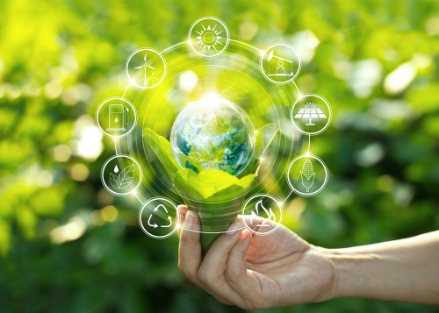
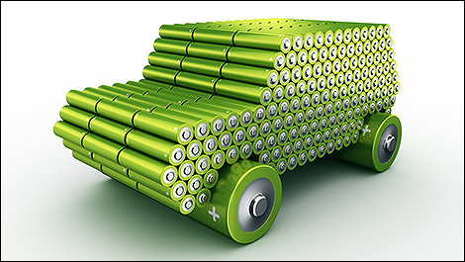
Introduction
Lithium-ion battery is a type of rechargeable battery, which are used by companies that has as aims to accelerate world's transition to sustainable energy.
Rechargeable batteries initially cost more than disposable batteries but have a much lower total cost of ownership and environmental impact, as they can be recharged inexpensively many times before they need replacing. (Microbattery.com, 2021)
(csoonline, 2021)
Sustainable energy meets the needs of the present without compromising the needs of future generations.
Transition to the green energy is one of the greatest challenges facing humanity in the 21st century.
(Conserve-energy-future.com, 2021)
(AceOnGroup, 2021)

Slide 4
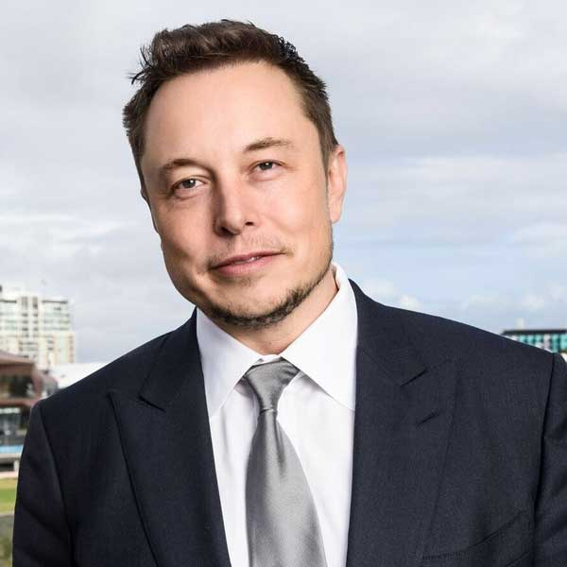
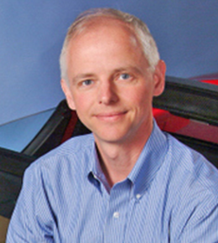
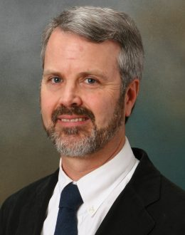
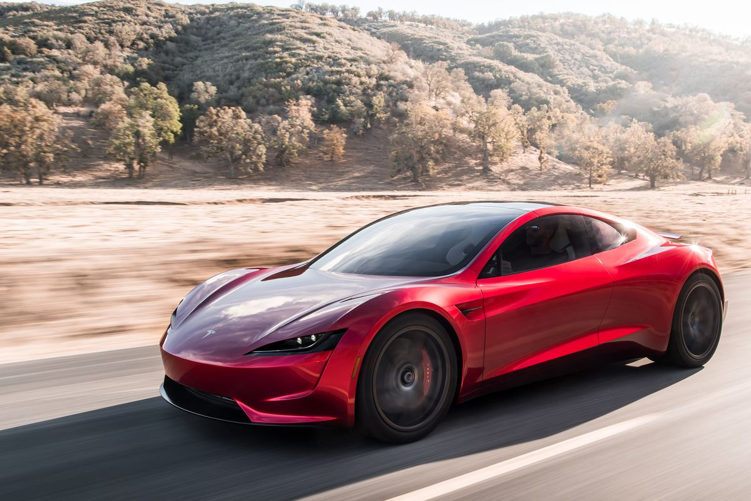
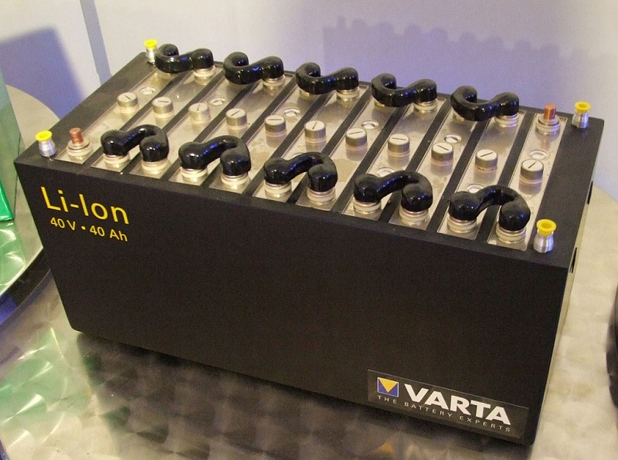
Background of the organization
• 2003 – Tesla was founded by engineer's Martin Eberhard and Marc Tarpenning. (Richard Gallary, 2009)
• 2003 – Martin Eberhard and Marc Tarpenning sold their eBook business for 187 million dollars. (Richard Gallardy, 2009)
• Elon Musk was an early investor.(Richard J. 2009)
• 2008 - Tesla released their first electric roadster using 992 lb lithium cobalt oxide battery. (Erik Gregersen, 2013)
• Electric motor was powered by lithium-ion cells which are commonly use in laptop computer batteries. (Erik G. 2013)
• Tesla factories based at Fremont, California, Gigafactory Shanghai. (Erik G. 2013)
Elon Musk CEO
Marc Tarpening
Martin Eberhard
(Wikipedia.org, 2021)
(Tesla.com, 2021)
(Power-technology.com, 2021)

Slide 5
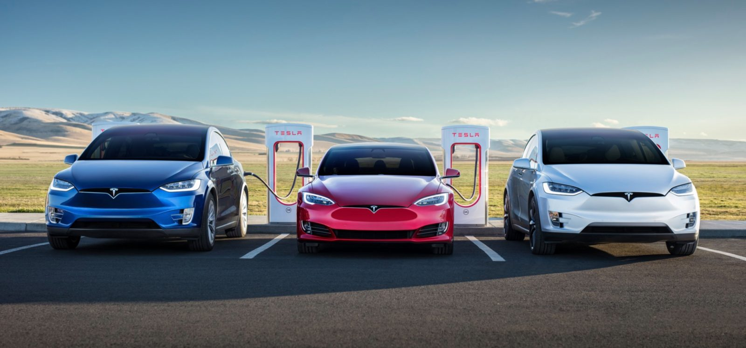
Aims and objectives
Tesla aim is to get a wider marker
Focus on two new model cars model S and model X
More enjoyable to drive.
Be better to use than gasoline vehicle.
(Tesla.com, 2021)
(Panmore.com, 2021)

Slide 6
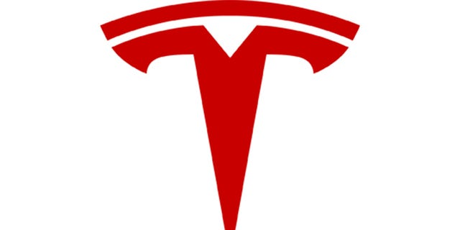
Mission and vision of company
To accelerate
The world’s transition
To sustainable energy
Most compelling
Car company
21st Century
The world’s transition to electric vehicles
(Tesla.com, 2021)
Current status and service of tesla
Status Updates
During the service appointment, you can check your car’s status on the Tesla app.
Apps
(Panmore.com, 2021)

Slide 7
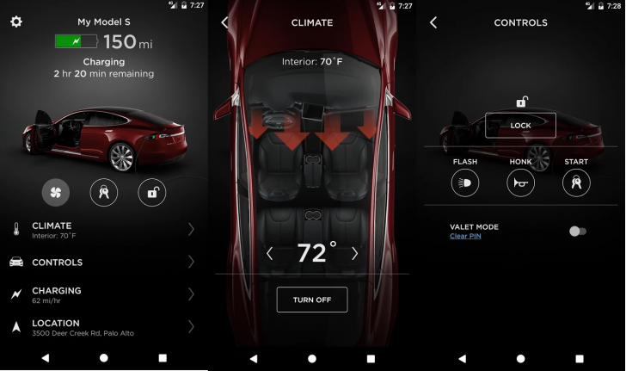
(Insideevs.com, 2021)

Slide 8
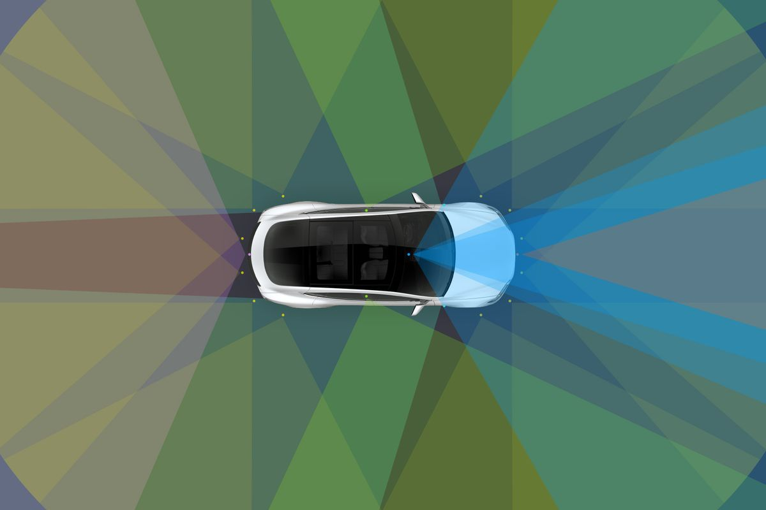
Challenges before introducing technology
Unable to provide autopilot feature.
Inability to store enough energy for being able to drive long distances without recharging.
(Tesla.com,2021)
(Tesla.com, 2021)

Slide 9
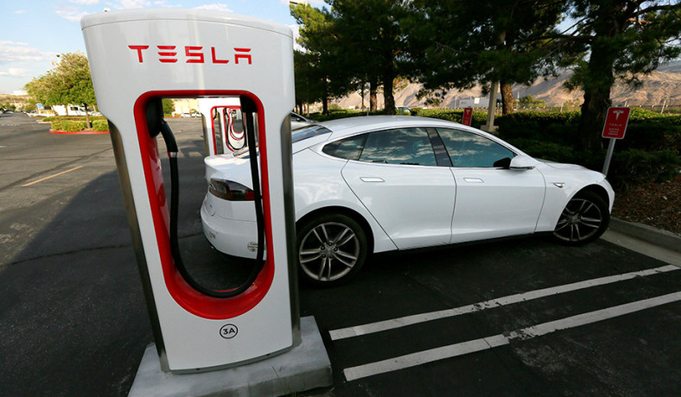
Inability to provide such fast acceleration power.​
Inability to provide an absolutely harmless car to the environment​
(nationalreview.com, 2021)
(B.Lombard, 2017)

Slide 10
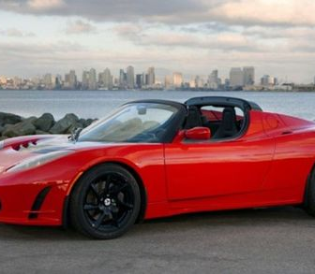
Insights of Modern Technology Introduced
One of most representative cars for this company is tesla Roaster as it was first highway legal serial production all-electric car, to use lithium-ion battery cells and the first production all-electric car to travel more than 320 kilometres per charge.(Wikipedia.org, 2021)
Li-ion battery is an advanced battery technology that uses lithium ions as a key component of its electrochemistry(Energy.com, 2021)
(Hearst Autos, 2021)

Slide 11
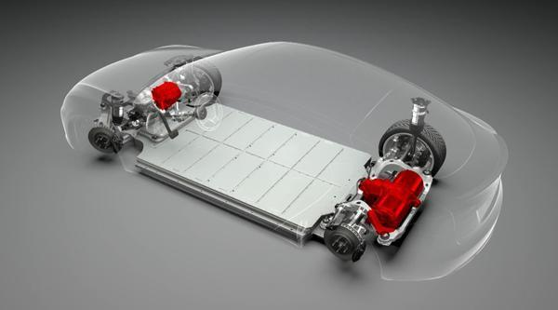
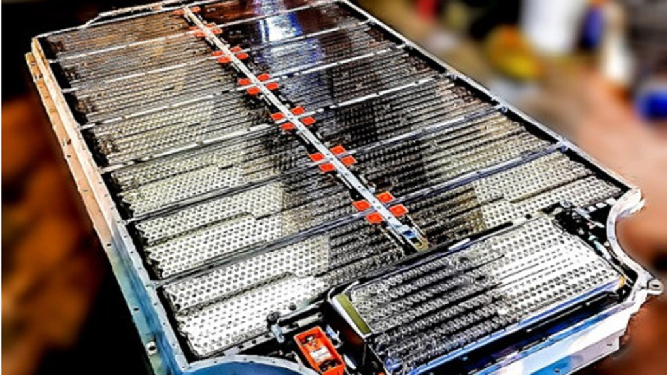
Battery system
System is composed of more than 7 000 cells.
A large current rate is necessary to charge such a big battery pack in an acceptable time.
A Tesla car can drive up to 480 km over one full charge.
The battery pack of the Roadster is one of the largest and technically most advanced lithium-ion battery packs in the world.
It is capable to deliver enough power to accelerate the Tesla Roadster from 0 to 60 miles per hour in 3,9 seconds.
(redgreenandblue.com, 2020)
(Tesla.com, 2021)
(Insideevs.com 2021)

Slide 12
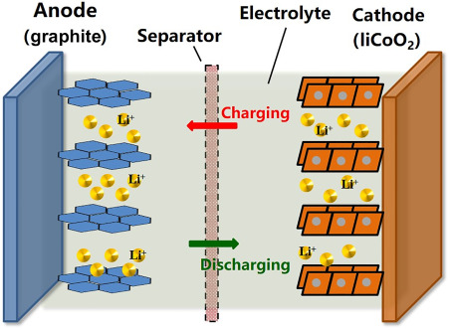
How does it work ?
Lithium ions create an electrical potential between the positive and negative sides. A thin layer of insulating material sits between the two sides of the battery and allows the lithium ions to pass through while blocking the electrons.
While the battery charges, lithium ions move through the separator from the positive side to the negative.
The movement of the lithium ions causes an electrical potential difference. Electrons (not lithium-ions) flow through your device and power it.
(Sciencedirect.com, 2021)
(Abdul Ghani Olabi, 2021)

Slide 13
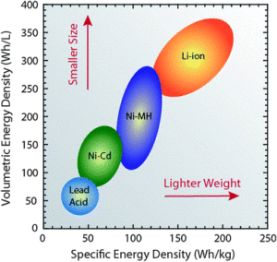
One of the highest energy densities of any battery technology today (100-265 Wh/kg or 250-670 Wh/L).
Can deliver large amounts of current for high-power applications.
Li-ion batteries also have low self-discharge rate of around 1.5-2% per month.
Do not contain toxic cadmium, which makes them easier to dispose of than Ni-Cd batteries.
(cei.washington.edu, 2020)
(cei.washington.edu, 2020)

Slide 14

Impacts of modern technology
Positive Impacts
Recycling
Positive climate impact
Fast charging
Rechargeability
Maximized energy output
Longevity
(I.Deviatkin, 2020)
(energizer.com, 2021)

Slide 15

(dw.com, 2021)
Negative Impacts
Side effects of mining lithium
Water pollution and depletion
High cost
(I.Deviatkin, 2020)

Slide 16
Lesson withdrawn from case study
We are absolutely convinced that Tesla and other companies that are using sustainable energy are the future of this planet, as technology have made a huge jump in last 60-70 years and planet is dying slowly due to too many harmful emissions.
As population of the world is almost 8 billions, recyclable energy is one of the direction that needs to be developed more and more by the humanity.
Technologies like lithium-ion batteries gives the opportunity to create a smarter and much comfortable in use cars.

Slide 17
Conclusion
In conclusion about our team-work we can say that because all the process is taking place online it was very difficult for us to get the presentation done. As easy as the term 'teamwork' sounds, it is equally difficult to bind a team together. The most challenging part is to understand the needs and expectations of each individual and bring us at the team level so that all can move forward together.

Slide 18
References
Panmore.com (2021) Tesla, Inc.’s Mission Statement & Vision Statement.
Available at: http://panmore.com/tesla-motors-inc-vision-statement-mission-statement-analysis
(Accessed: 4 August 2021)
Tesla.com (2021) Available at: https://www.tesla.com/about
(Accessed 4 August 2021)
Edward Niedermeyer.(2019) Ludicrous, The Unvarnished Story of Tesla Motors, BenBella books
Energy.com (2021) How does a Lithium-ion battery work.
Available at: https://www.energy.gov/eere/articles/how-does-lithium-ion-battery-work
(Accessed: 7 August 2021)
TheSteet.com (2021) History of Tesla: Timeline and Facts.
Available at: https://www.thestreet.com/technology/history-of-tesla-15088992
(Accessed at: 29 July 2021)
PNNL.gov (2021) Sustainable energy.
Available at:https://www.pnnl.gov/sustainable-energy
(Accessed at: 29 July 2021)

