Slide 1
Thinking about the essay(s): planning & focusing
Modernism & Modernisms

Slide 2
stArting
After reading the books, reading additional material, listening to podcasts, looking at the powerpoints, watching the videos and hopefully not only posting regular blogs but also responding to other people’s blogs, you should have chosen an area you are interested in exploring further.
One of the reasons for giving you so much choice is because the essay shouldn't be a test of your knowledge but a way of exploring writing and ideas. There has to be some way of relating to the tremendous range of material of the module in an inclusive way. For creative writers this must be a way of enabling you to draw on your skill as a writer and see what other writers in another time and space did in their writing. This should be enormously valuable for you. Having an open choice means that you are able to work to your strengths.

Slide 3
Possibilities
You may be interested in form (the short story, other short form fiction and its difference to the realist novel, the imagist poem); or in technique (free indirect discourse, stream of consciousness, collage, and the movement away from direct causality, vers libre,) or if you are interested in ideas (different senses of time, interior space, ideas of the self) or the impact of new technology (photography, gramophones, film, radio, telephone, pulp fiction, advertising) or events (loss of belief in and collapse of empire; the Great War – and the legacy of that war in the revelation of censorship, the loss of life, the enormous death toll of Spanish flu – hugely increased by troop movement across Europe and red cross trains crowded with the sick and injured). The sense that the authorities can’t be trusted, that only art can last and its role is to tell the truth about the human in a different way to the ways used by the authorities (Pound’s Cathay, Joyce’s Ulysses), to make the reader think freely.
I am sure that you can think of others …

Slide 4
procedure
the point is to discuss it in close relation to the text, backed up with additional reading and to keep in mind the learning outcomes. They should determine how you respond.
As they make clear you are not expected to write an essay on say The Waste Land – or Dubliners – or ‘Metamorphosis’. You are writing about Modernism and its complexity (Modernisms) and your texts are detailed case studies of this hugely significant movement.

Slide 5
LEARNING OUTCOMES
the ability to exhibit a detailed knowledge and understanding of the key concepts and philosophical assumptions underpinning literary Modernism and Post-Modernism, and the interconnection between these concepts;
a sophisticated and theoretically informed knowledge of a wide range of Modernist and post-Modernist texts;
a detailed knowledge and understanding of the characteristic formal and thematic features associated with modernism and Post-Modernism;
a critically informed familiarity with the historical and socio-cultural contexts of modernism and Post-Modernism generally and in individual texts in particular;
a sophisticated awareness of the ongoing critical and theoretical understandings of ‘Modernism’ and ‘Post-Modernism: their precise definition(s) and historical importance.

Slide 6
plAnning
As always I start with the number of words you have available for the essay. You have 3000 This means you need a plan to workout how many words are available per topic and text .
If you look at my own session by session timetable you will see I start by thinking about issues and the texts that illustrate them . I give a primary text and then an additional text on which you can also draw in your essay. Obviously these texts relate to each other as well not nearly to the topic I have chosen.
If you look at my powerpoints I have tried to make it clear which are drawn from secondary commentary and which are quotations from the primary texts. This makes evident - I hope - that you are expected to quote a fair amount. Only that way can you prove what you are arguing.
An essay is not an assertion of what you feel but of what you can understand by forensic examination of the text and its contexts.

Slide 7
balancing different parts & references
I often show images of good essays to demonstrate what you are expected to do.
The introduction should have a lot of reference is proving every statement that you make. Its role is to convince the reader you know what you were talking about and just putting vague comments or generalizations here will not convince. This enables you a little more freedom in examining the actual texts . As long as you know what you're talking about the reader will take this on board. So I do not expect so many references in these sections - although of course I do expect some.
Poor essays often start with generalizations and few references and then go on to produce a collage of other people’s opinions about the texts without your comments, so the reader is uncertain as to what you yourself think.
I show you a brief example to prove the point. I have put the full essay in the assessment section for you to see. Not a modernism essay of course but the focus is more on how you structure it

Slide 8
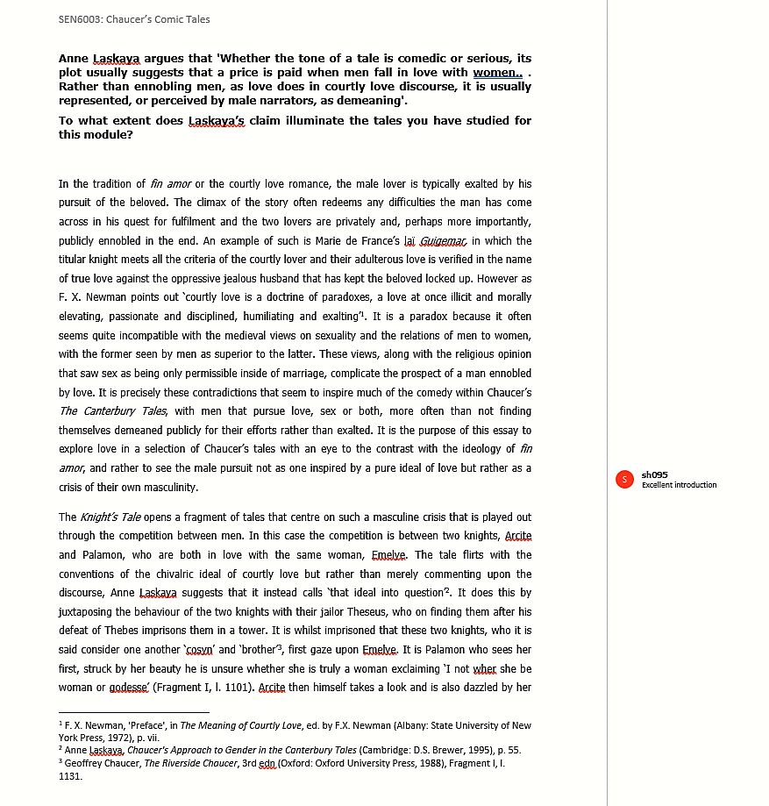
Example essay introduction
1 & 2 Assessment of the ideology of enoblement by love
3. Example to prove
4. secondary source (and quotation) to support point
5. Introduce complexity through paradox
6. Examples of alternatives views of men and sex (esp religious)
7. Use made of these contradictions By Chaucer
8. Statement of purpose of essay
9. Reference to what s/he will discuss and relates back to question
10. Start of essay. Choice of one tale as one of a group of tales that examines this issue
11. Footnotes
------
------
------
------
------
------
------
------
------
--------------------------------------
------
-----------------------
------

Slide 9
planning 2
Section | Topic | Words
Introd | introduce topic, why important which texts what you are going to discuss (keep chronological order. (no point discussing Waste Land before Heart of Darkness because Eliot is responding to Conrad) Possibly select aspects of your topic and link to a particular tex in order to enable you to focus on a different issue with the second text Refer to other material in less detail/passing | 3-500
Body 1 | Introd text why and discuss with quotation from primary and secondary | 1,000
Body 2 | Develop argument - discuss with quotation from primary and secondary | 1,000
Conclus | Summary and suggestion of possible development * | 3-500
* Should you wish to develop the issue in your second essay.
Word count- Some leeway for body if you keep introduction and conclusion short .
(Footnotes, appendices and bibliography don’t count as word)

Slide 10
Contact me to discuss
Most important thing is – as I keep saying – the blog.
I intend giving feedback on the blogs, many of which are brilliant, but have been so busy
I can help you formulate the topic if you want to discuss.
I am also hoping that we can have a brief Teams meeting (
Hope useful.

