Slide 1
Indexing
Indexing: Database Systems (DBS)
Dr Stephen Hole & Mr Nathan Morgan

Slide 2
Customer Lookup
Assuming that you need to look up for all customers with the last name ‘Noweak’ their phone numbers on a phone book.
With the understanding that names on the phone book are in alphabetically order, you first look for the page where the last name is ‘Noweak’, then look for first name ‘Gus’, and finally get his phone number.

Slide 3
Customer Lookup
Suppose the names on the phone book were not ordered alphabetically, you would have to go through all pages, check every name until you find Gus Noweak’s phone number.
This is called sequential scan which you go over all entries until you find the one that you are looking for.

Slide 4
Speed Improvement
Similar to a phonebook, the data stored in the table should be organised in a particular order to speed up various searches.
This is why indexes come into play.
An index is a separated data structure e.g., B-Tree that speeds up the data retrieval on a table at the cost of additional writes and storage to maintain it.

Slide 5
Index Definition
An index is a list of all the names, subjects and ideas in a piece of written work, designed to help readers quickly find where they are discussed in the text.
Usually found at the end of the text, an index doesn’t just list the content (that’s what a table of contents is for), it analyses it.

Slide 6
Index Features
A good index will:
  be arranged in alphabetical order
  include accurate page references that lead to useful information on a topic
  avoid listing every use of a word or phrase
  be consistent across similar topics
  cross-reference information to point to other headings of interest or preferred terms.

Slide 7
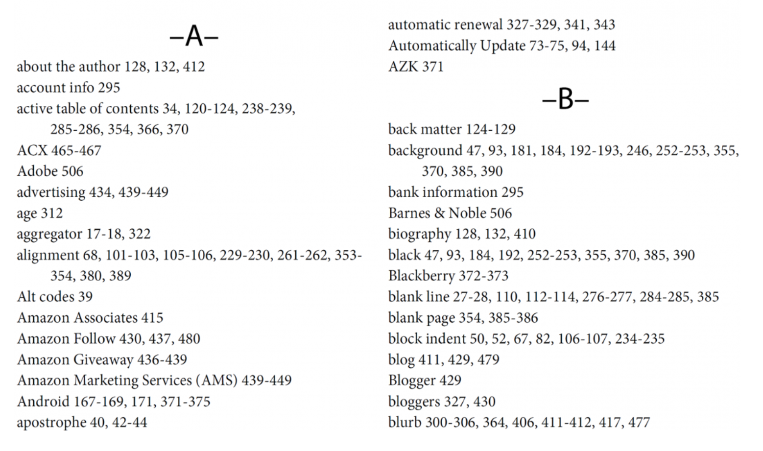
Sample of a Book Index

Slide 8
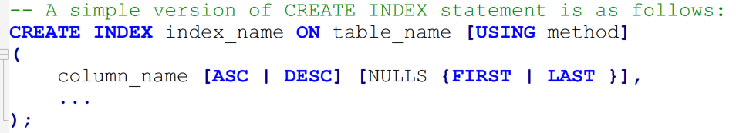
Simple Create Index Statement
First, specify the index name after the CREATE INDEX clause.
The index name should be meaningful and easy to remember.

Slide 9
Simple Create Index Statement
Second, specify the name of the table to which the index belongs.
Third, specify the index method such as btree, hash, gist, spgist, gin, and brin.
PostgreSQL uses btree by default.

Slide 10
Simple Create Index Statement
Fourth, list one or more columns that to be stored in the index.
The ASC and DESC specify the sort order.
ASC is the default.
NULLS FIRST or NULLS LAST specifies nulls sort before or after non-nulls.
The NULLS FIRST is the default when DESC is specified and NULLS LAST is the default when DESC is not specified.

Slide 11
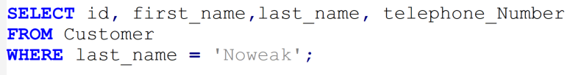
Table Scan Query
The following query finds all Customers where the last name is Noweak and displays id, first name, last name and telephone number(s) attributes.
It is obvious that the database engine had to scan the whole Customer table to look for the last name because there is no index available for the last name column.

Slide 12
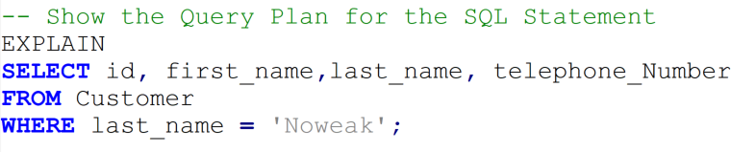
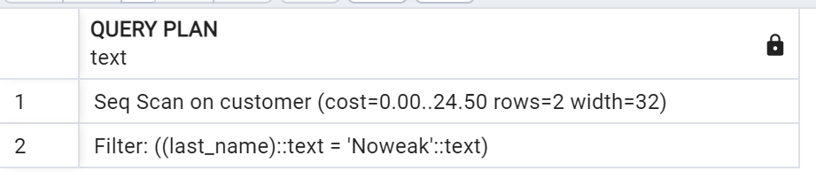
Table Scan Query - Sequential
To check if a query uses an index or not, you use the EXPLAIN statement.

Slide 13
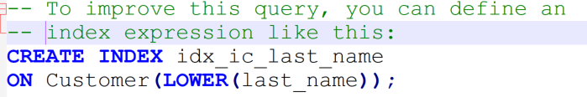
Create Index to Increase Lookup Speed
To create an index for the values in the last name column of the customer table, you use the following statement:

Slide 14
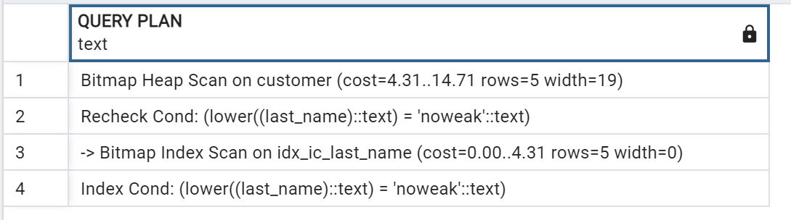
Index Scan Query Plan
Now, if you execute the query again, you will find that the database engine uses the index for lookup:

Slide 15
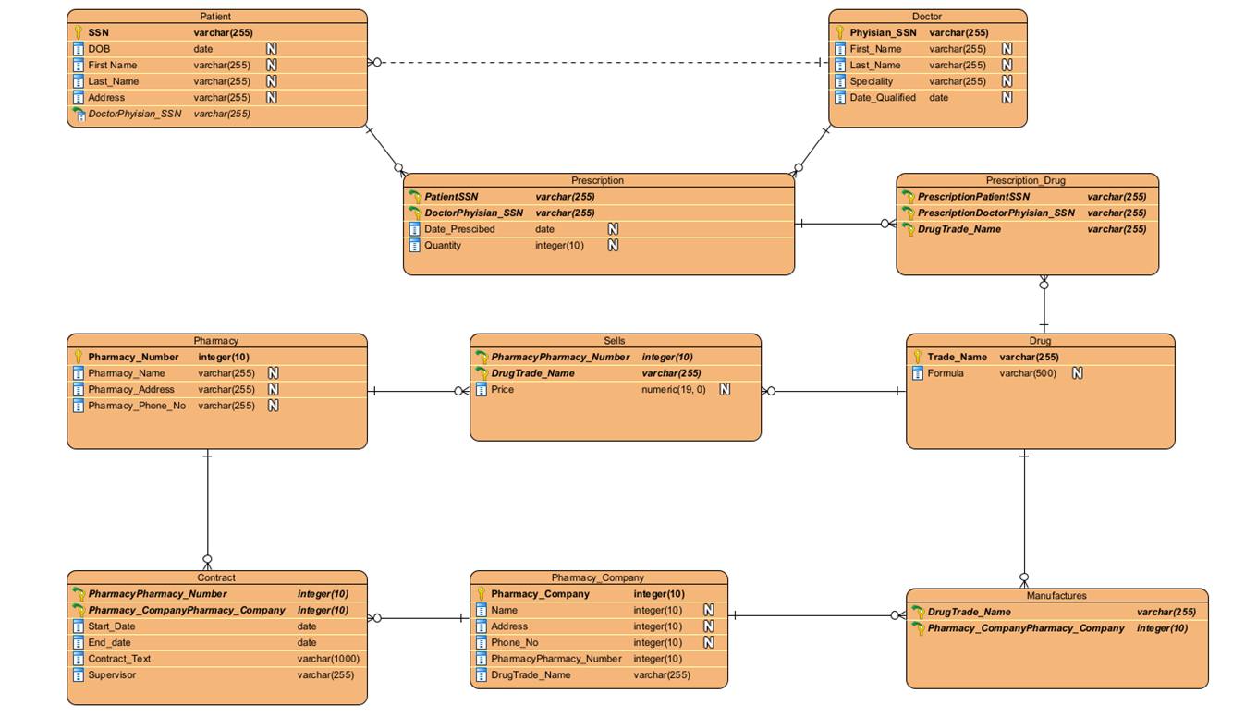
Possible ER Pharmacy Solution

Slide 16
Possible ER Pharmacy Solution
Consider creating indexes on the Foreign Keys to speed up table joins.

Slide 17
Too Many Indexes
The saying “Too much of a good thing is not always good” holds true when discussing indexes.
Too many indexes create additional overhead associated with the extra amount of data pages that the Query Optimizer needs to go through.
Also, too many indexes require too much space and add to the time it takes to accomplish maintenance tasks.
Indexes are awesome and make queries much faster. Read queries. Not write queries. In fact they slow down write queries. Not significantly, but it is enough to make a difference.

