Slide 1


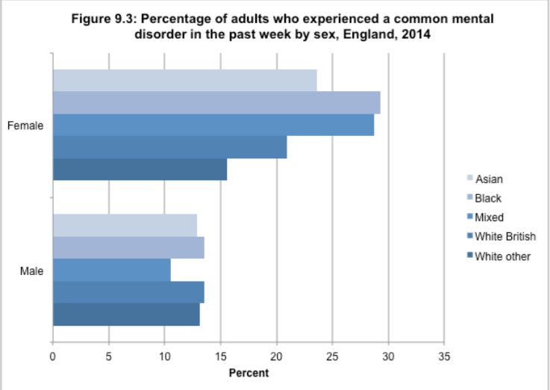


The prevalence of Mental Health Issues amongst Black, Asian and Minority Ethnic (BAME) culture within the UK
This poster will examine the prevalence, incidence and treatment of Mental health issues amongst people from BAME culture within the UK. It will explore the factors affecting accessing treatment and identify successful treatment methods including community based approach. Finally, it will evaluate the role of community based approaches for BAME people and will make suggestions for future improvement.
Introduction
What is culture?
‘Culture is a fuzzy set of basic assumptions and values, orientations to life, beliefs, policies, procedures and behavioral conventions that are shared by a group of people, and that influence(but do not determine) each member’s behavior and his/her interpretations of the ‘meaning’ of other people’s behavior.’ (Spencer-0atey, 2008)
‘... the set of attitudes, values, beliefs, and behaviors shared by a group of people, but different for each individual, communicated from one generation to the next.’ (Matsumoto, 1996)
What is BAME?
Black, Asian and Minority Ethnic (BAME) is an inclusive term used in the UK to describe anyone who is not from a white background. The term BAME includes people from a wide variety of backgrounds including
Black African and Black Caribbean people
Asian people
People who are mixed race
(Rethink, n.d)
Statistics
BAME backgrounds make up 14% of our population (Rethink, 2021)
Anxiety and depression are more common in black women (Cabinet Office, 2017)
There is an increased risk of suicide among older Southern Asian women(Mental Health Foundation, n.d)
Psychotic disorders are ten times more prevalent among black men in comparison to white men. In 2014, it was estimated that within the past year 3% of black men had suffered a psychotic disorder. (Cabinet Office, 2017)
The rate of black people who are detained under the mental health act is four times higher than the rate for white people(Gov.uk, 2021)
(NHS, 2014)
In comparison to any other group, black adults are least likely to report receiving any treatment (medication, counselling or therapy) for a mental health disorder. Around 14% of White British adults received treatment for a mental health disorder compared to around 7% of BAME people. The outcome is also notably better for white people. (Cabinet Office, 2017)
#
“In these Streets”
Delivering Race Equality in Mental Health Care (DRE).
What factors affect access to and engagement with NHS Mental Health Services?
A study by Simkhada et al (2021) identified the following six themes
• Stigma and fear
• Gender
• Language
• Tradition and culture
• Family involvement
• Lack of cultural awareness in health workers
A study by Memon et al (2016) identified the following six barriers to accessing MH services
• Inability to recognize and accept MH problems
• Positive impact of social networks
• The reluctance of men to discuss and seek help for psychological problems
• Identity as a culture
Negative perceptions and stigmas associated with mental health
• Factors related to money
As part of the study, factors affecting the relationship between service users and providers were also identified.
DRE
A 5 year action plan for tackling race inequalities in mental health care in England and Wales
Designed to improve Mental Health Services for people from BAME communities
A comprehensive framework of action built around 3 building blocks for change.
1. More appropriate and responsive services
2. Community Engagement
3. Better information
(Department for Health, 2005)
The Sheffield EPIC project
The Sheffield EPIC project was identified as a successful community based approach during a review of DRE in 2009.
An NHS employed Community Development Worker was employed one day a week in a Pakistani voluntary sector organization
Community treatment options were extended, resulting in a 12.5% fall in Pakistani inpatients
Patients reported increased satisfaction with service
Knowledge of mental health conditions increased
Further EPIC projects have been set up to support other BAME groups (African Caribbean and Somali communities)
                (Wilson, 2009)
What community based support is available..???
Mary Seacole House in Liverpool
Attendance at mental health resource centers by survivors of the mental health system
Alternative, self-organized BAME mental health facilities with evidence of service users value and appreciation
As BAME survivors of the mental health system, the centre provided a sanctuary from the combination of discrimination and exclusion.
Place-based support played an important role in daily life, according to participants
Despite this appreciation, BAME service users continue to experience negative experiences in the mainstream system, which confirms anomalies in service delivery.
(Wainwright et al 2019)
                The Cares of Life Project (CoLP)
                Through the Cares of Life Project, statutory agencies and local black community organizations were to improve their interface and communication
                Tailor made and acceptable community based interventions were delivered by Community Development Workers.
                The CoLP team worked with the local community, identifying individuals from key nonprofits and institutions that could advocate for the CoLP service and encourage people with depression to contact it.
                Psychosocial interventions can be provided in the community for free to BAME individuals with anxiety and depression that are culturally acceptable and effective.
                (Afuwape et al 2010)
But why is this….???
NHS (2014))
Conclusion
Developing Cross cultural persepcitves in health care should be a priority. Successful community based treatment projects such as EPIC and CoLp both evidence the benefit of community based approach for BAME people, with more community centres like Mary Seacole House being needed. More projects like this need to be funded and established in order to improve the mental health of BAME people.

Slide 2
Reference list
Afuwape, S. A., Craig, T. K., Harris, T., Clarke, M., Flood, A., Olajide, D., ... & Thornicroft, G. (2010). The Cares of Life Project (CoLP): an exploratory randomised controlled trial of a community-based intervention for black people with common mental disorder. Journal of affective disorders, 127(1-3), 370-374. https://doi.org/10.1016/j.jad.2010.05.017
Cabinet Office (2018). Race Disparity Audit Summary Findings from the Ethnicity Facts. https://assets.publishing.service.gov.uk/government/uploads/system/uploads/attachment_data/file/686071/Revised_RDA_report_March_2018.pdf
Department of Health (2005) Delivering Race Equality in Mental Health Care: An Action Plan for Reform Inside and Outside Services and the Government's Response to the Independent Inquiry into the Death of David Bennett. TSO (The Stationery Office)
Gov.uk. (2021) Detentions under the Mental Health Act/ Main facts and figures https://www.ethnicity-facts-figures.service.gov.uk/health/mental-health/detentions-under-the-mental-health-act/latest
Matsumoto, D. (1996) Culture and Psychology. Pacific Grove, CA: Brooks/Cole.
Memon, A., Taylor, K., Mohebati, L. M., Sundin, J., Cooper, M., Scanlon, T., & de Visser, R. (2016). Perceived barriers to accessing mental health services among black and minority
ethnic (BME) communities: a qualitative study in Southeast England. BMJ open, 6(11), e01233
Mental Health Foundation (n.d). Black, Asian and Minority Ethnic (BAME) communities. www.mentalhealth.org.uk/a-to-z/b/black-asian-and-minority-ethnicbame-communities
NHS (2014) Adult Psychiatric Morbidity Survey; Survey of Mental Health and Wellbeing, England, 2014 https://digital.nhs.uk/data-and-information/publications/statistical/adult-psychiatric-morbidity-survey/adult-psychiatric-morbidity-survey-survey-of-mental-health-and-wellbeing-england-2014
Rethink (2021) Black Asian and Minority Ethnic (BAME) mental health https://www.rethink.org/advice-and-information/living-with-mental-illness/wellbeing-physical-health/black-asian-and-minority-ethnic-mental-health/
Simkhada, B., Vahdaninia, M., van Teijlingen, E., & Blunt, H. (2021). Cultural issues on accessing mental health services in Nepali and Iranian migrants communities in the UK. International Journal of Mental Health Nursing. 30(6) 1610-1619 https://doi.org/10.1111/inm.12913
Spencer-Oatey, H. (2008) Culturally Speaking. Culture, Communication and Politeness Theory. 2nd edition. London: Continuum.
Wainwright, J., McKeown, M., & Kinney, M. (2019). “In these streets”: the saliency of place in an alternative black mental health resource centre. International Journal of Human Rights in Healthcare. https://doi.org/10.1108/IJHRH-08-2019-0062
Wilson, M. (2009) Delivering Race Equality in Mental Health Care: a review. Delivering Race Equality (DRE) in mental health care https://lemosandcrane.co.uk/resources/DoH%20-%20Delivering%20Race%20Equality%20in%20Mental%20Health%20Care%20-%20A%20Review.pdf

