Slide 1

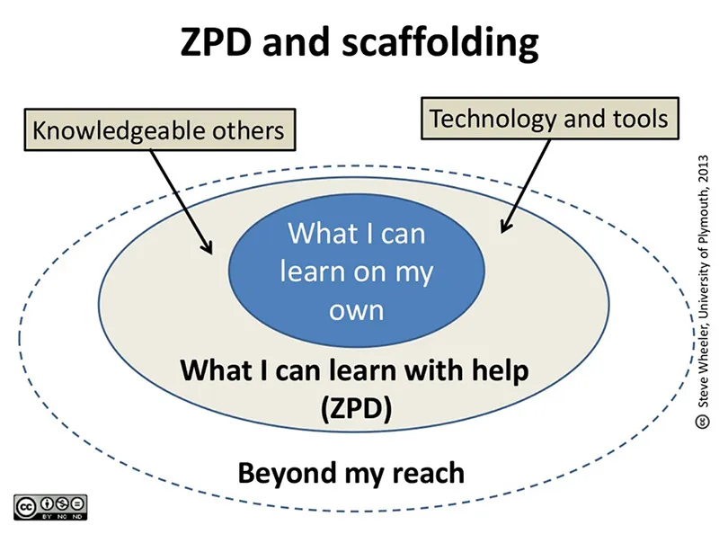
What is the Hidden Curriculum?
Within the Hidden Curriculum there are learning experiences that are not included within the explicit curriculum.
“This is all the things that you are taught that are not found on the academic curriculum(like maths, P.E or English). It’s all the ‘other’ things that you learn – like being punctual, following rules, meeting deadlines” (ExpertVish, pg.1, 2020).
Within the Hidden Curriculum there are learning experiences that are not included within the explicit curriculum. The skills pupils that are taught through everyday experience such as respect, values, developing a work ethic and the aspiration to achieve.
The Hidden Curriculum
How does the Hidden Curriculum compare to the National Curriculum
The National Curriculum must be followed by all schools. It teaches pupils the core subjects including Maths, Literacy and Science.
According to the National Curriculum children should achieve certain skills based on their age.
The National Curriculum does not help pupils learn everyday skills that they need to fit in to society. All these skills are taught within the Hidden Curriculum.
.
“The Hidden Curriculum refers to the unwritten rules, values and normative patterns of behaviour which students are expected to conform to and learn while in school” (Thompson, pg.1, 2017).
“The hidden-curriculum concept is based on the recognition that students absorb lessons in school that may or may not be part of the formal course of study” (Great Schools Partnerships, pg.1, 2014).
How does the New Curriculum compare to the Hidden Curriculum?
The New Curriculum is due to be completely implemented in schools throughout Wales by September 2022.
The New Curriculum will focus on preparing pupils for life and more emphasis will be put on digital skills.
The New Curriculum links to the Hidden Curriculum as it looks at other aspects of skills pupils require not only to prepare for work life but also being a part of society.
v
Functionalists Views on the Hidden Curriculum
“The Functionalist perspective of education looks at education as a training system for students, so they are given their appropriate place in society” (IPL, pg.1, 2020).
Functionalists view schools as a scaled down adaptation of the wider community in which people live and work.
Marxists views on the Hidden Curriculum
“Marxists believe that education teaches us the norms and values” (IPL, pg.1, 2020).
Marxists believe that norms of society are influenced by economic factors” (Jacqueline, pg.1, 2013).
The Marxist theory states that by going to school daily can teach the working-class values needed within education.
Example of the Hidden Curriculum
“One of the most prominent ‘subjects’ in the hidden curriculum is attitude towards gender” (Madhavan pg.1, , 2016).
Certain subjects and areas of the classroom can be perceived as being
gender specific.
Policies linked to the Hidden Curriculum
Every setting is required to have various policies, policies are there to ensure the safety and protection of the staff , children and the families.
Policies linked to the Hidden Curriculum include:
Behavior Policy
Equality Policy
Attendance Policy
Theories
Skinner’s Theory
Skinners theory is based on ‘Operant Conditioning’ he believed that by rewarding good behaviour will encourage that behaviour to be repeated. He also believed that punishing unwanted behaviour can stop this behaviour from being repeated.
Vygotsky’s Zone of
Vygotsky’s Theory
“Vygotsky's theories stress the fundamental role of social interaction in the development of cognition (Vygotsky, 1978), as he believed strongly that community plays a central role in the process of "making meaning” (McLeod, pg.1, 2020).
How is the Hidden Curriculum implemented in the setting?
There are various lessons pupils learn within the setting, lessons that are linked to the Hidden Curriculum.
These include:
Value of the month (Honesty, friendship, respect, trust, kindness and perseverance}.
The Golden Rules which discuss what behavior is expected from pupils.
Reward/punishment Systems to help pupils make the right choices.
Proximal Development

Slide 2
Reference List
Eggel98 (2015) ‘The Hidden Curriculum is Predominantly a Marxist Concept’, People are Great, 7 October. Available at: The Hidden Curriculum is predominantly a Marxist concept – People Are Great (wordpress.com) (Accessed: 3rd January 2021)
ExpertVish (2021) ‘Education and Functionalism’, Sociology Articles. Available at: Education and Functionalism – Sociology Articles (Accessed: 3rd January 2021)
ExpertVish (2020) ‘The Hidden Curriculum’, Sociology Articles. Available at: The HIDDEN CURRICULUM – Sociology Articles (Accessed: 22nd December 2020)
Freepik (2020) Businessman Research, Free Vector [Online] Available at: Free Vector | Businessman research cartoon (freepik.com) (Accessed: 21st December 2020)
Great Schools Partnership (2014) ‘Hidden Curriculum’, The Glossary of Education Reform, for Journalists, Parents and Community Members, 13 July. Available at: Hidden Curriculum Definition (edglossary.org) (Accessed: 21st December 2020)
IPL (2020) ‘Compare and Contrast Marxism and Functionalism on Education’, IPL. Available at: Compare And Contrast Marxism And Functionalism On Education | ipl.org (Accessed: 22nd December 2020)
Jacqueline (2013) ‘Comparison of Marxism and Functionalism’, Get Revising, 2 March. Available at: Comparison of Marxism and Functionalism - Compare and contrast table in A Level and IB Sociology (getrevising.co.uk) (Accessed: 23rd December 2020)

Slide 3
Jacqueline (2013) ‘Comparison of Marxism and Functionalism’, Get Revising, 2 March. Available at: Comparison of Marxism and Functionalism - Compare and contrast table in A Level and IB Sociology (getrevising.co.uk) (Accessed: 23rd December 2020)
Madhavan, D. (2016) ‘Critical Pedagogy’, EFL Magazine, 21 October. Available at: Critical Pedagogy: The Hidden Curriculum | EFL Magazine (Accessed: 22nd December 2020)
McLeod, S. (2020) ‘Lev Vygotsky’s Sociocultural Theory’, Simple Psychology. Available at: Lev Vygotsky's Sociocultural Theory | Simply Psychology (Accessed: 2nd January 2020)
Thompson, K. (2017) ‘The Hidden Curriculum and School Ethos’, ReviseSociology, 9 November. Available at: The Hidden Curriculum and School Ethos – ReviseSociology (Accessed: 21st December 2020)
Wales. Welsh Government (2020) Curriculum for Wales. [Online]. Available at: Curriculum for Wales: overview | GOV.WALES (Accessed: 2nd January 2021)

