Slide 1

MSC CYBER SECURITY AND DIGITAL FORENSICS
Module: Digital Forensics Analysis
Student Name: Ashthaben Babariya
Student Id: 2507706

Slide 2
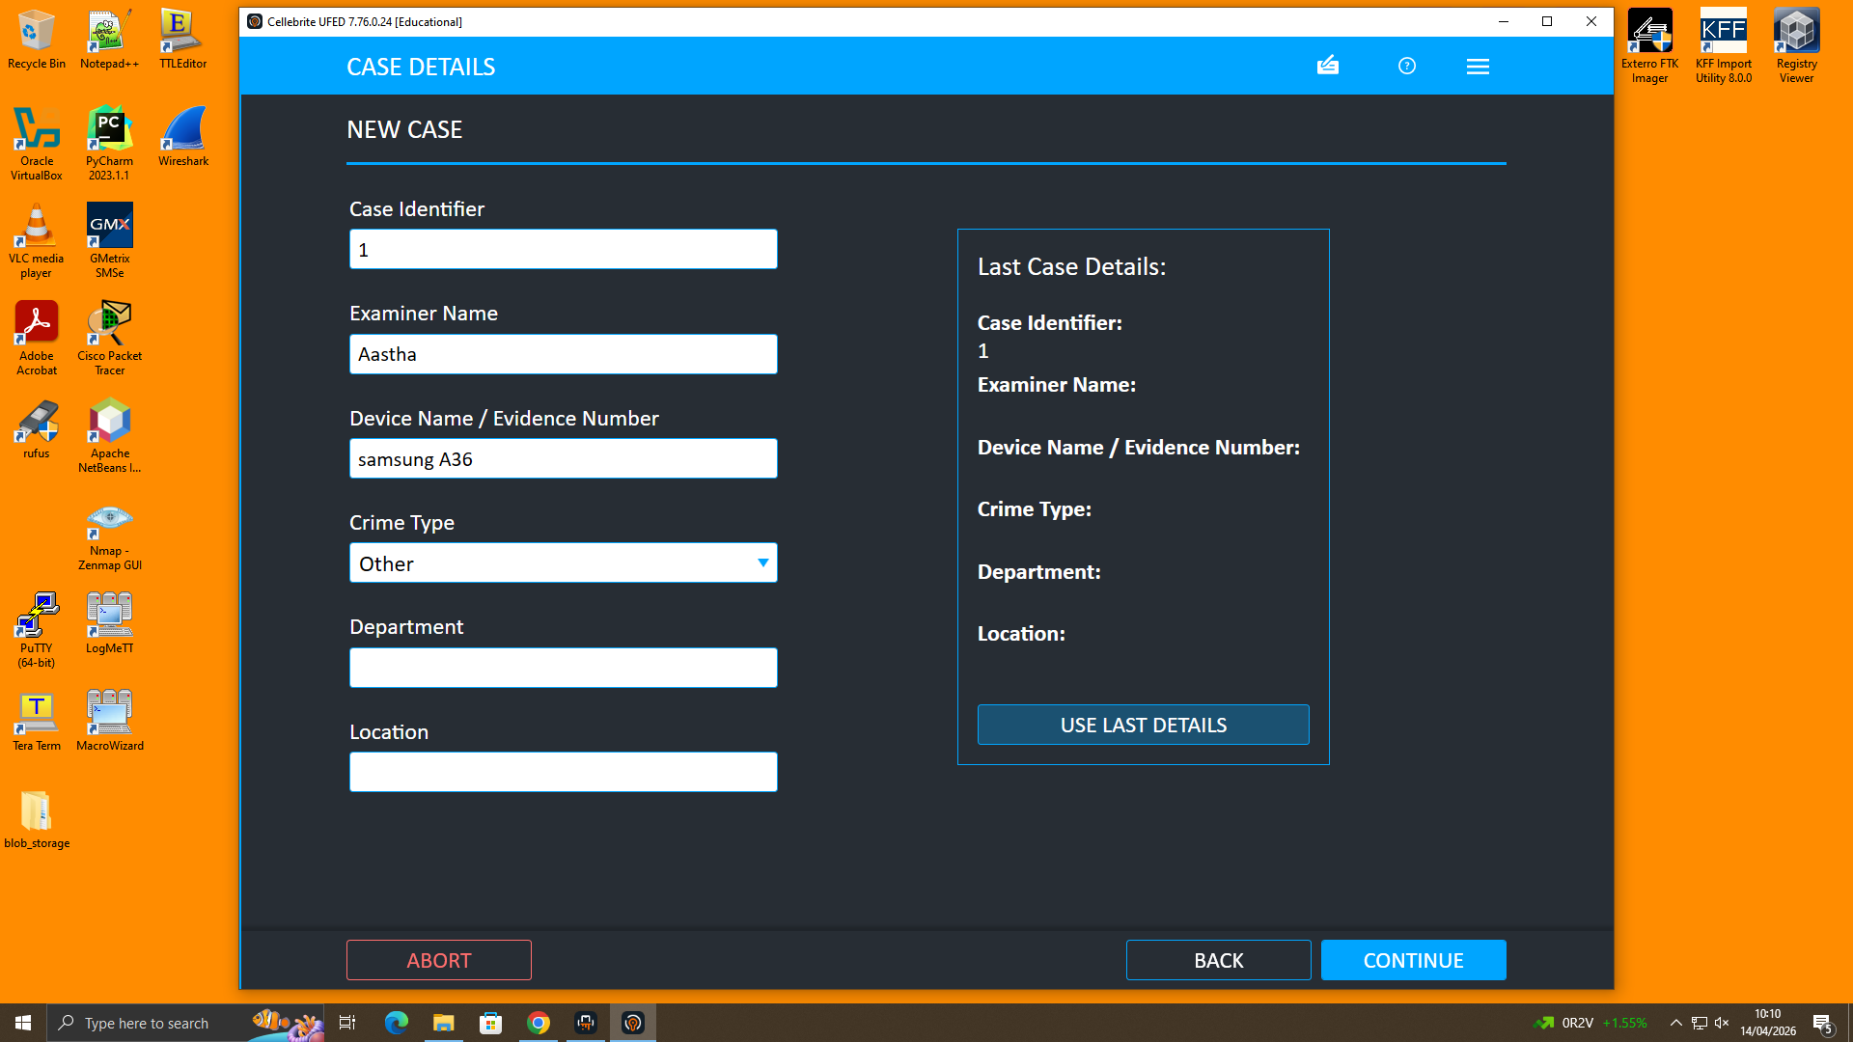
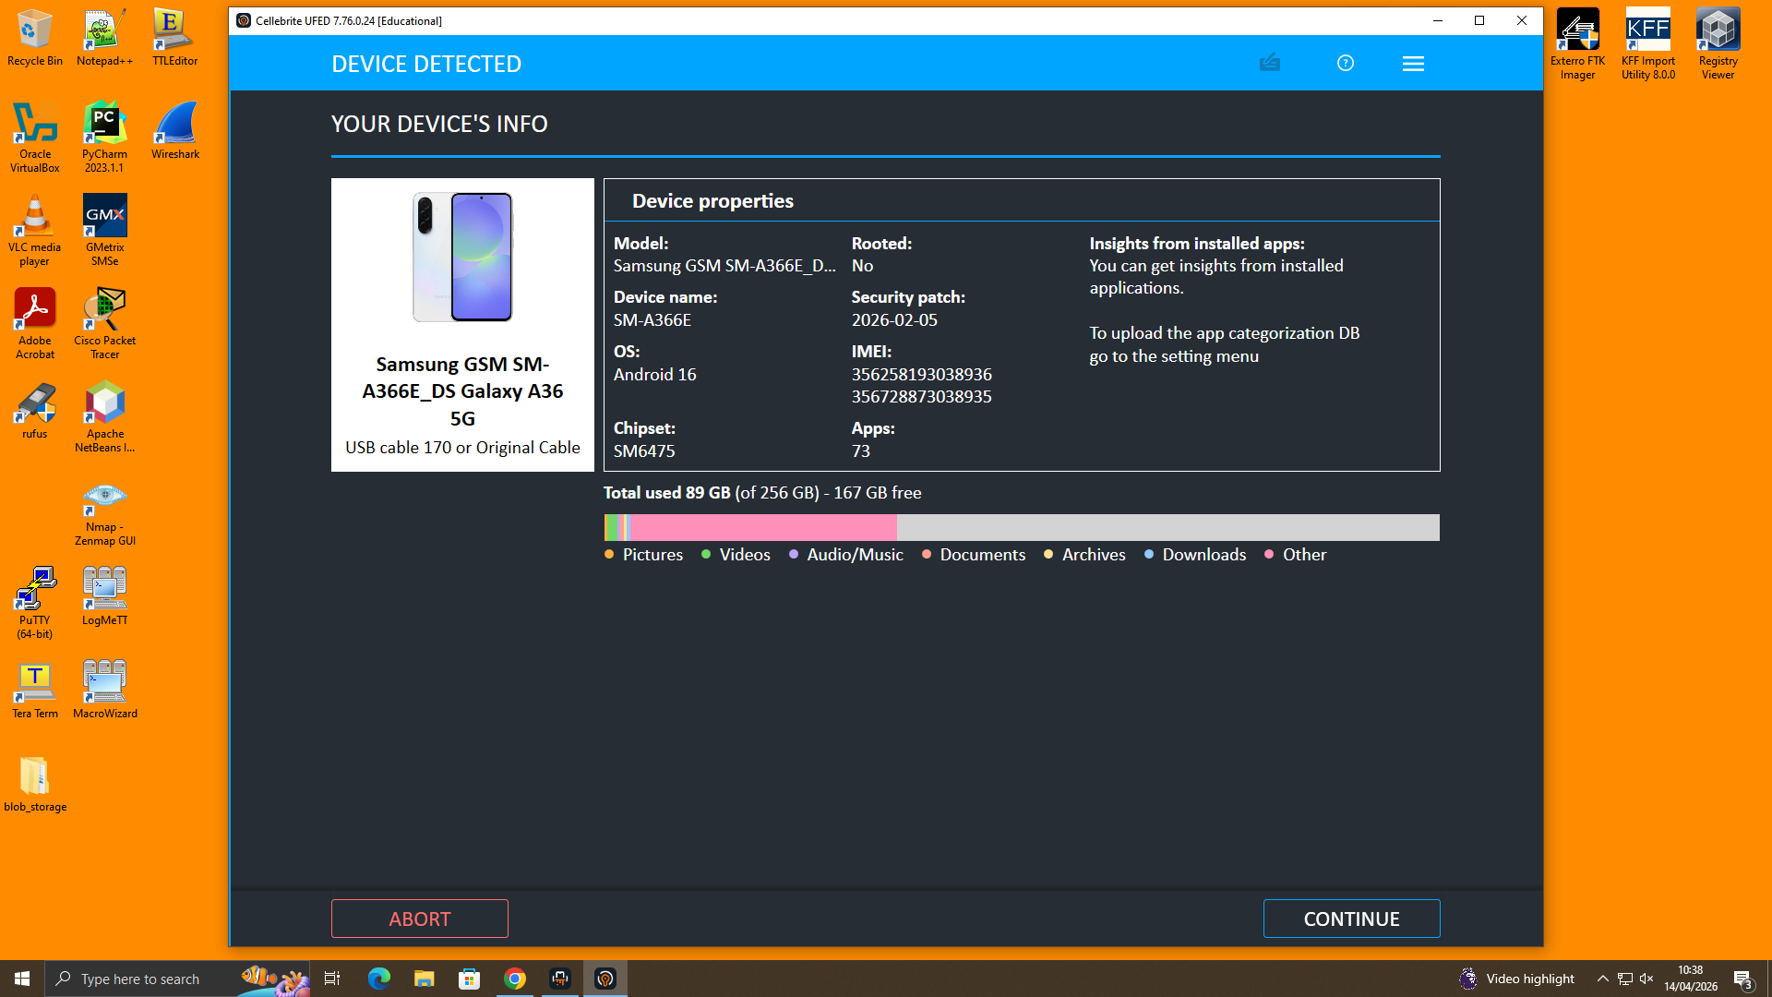
TASK-1 Personal Device Acquisition – Samsung Galaxy A36 (Cellebrite UFED)
UFED Extraction — Device Connection

Slide 3
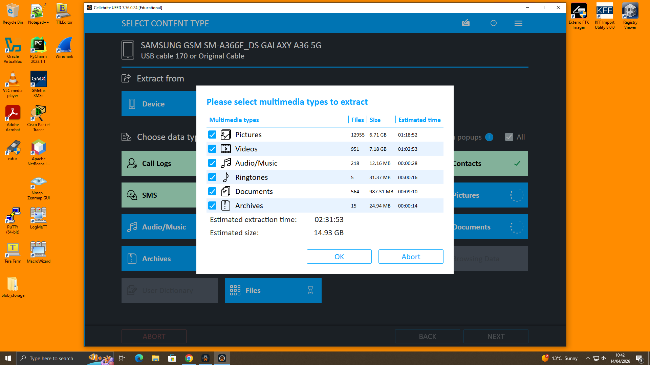
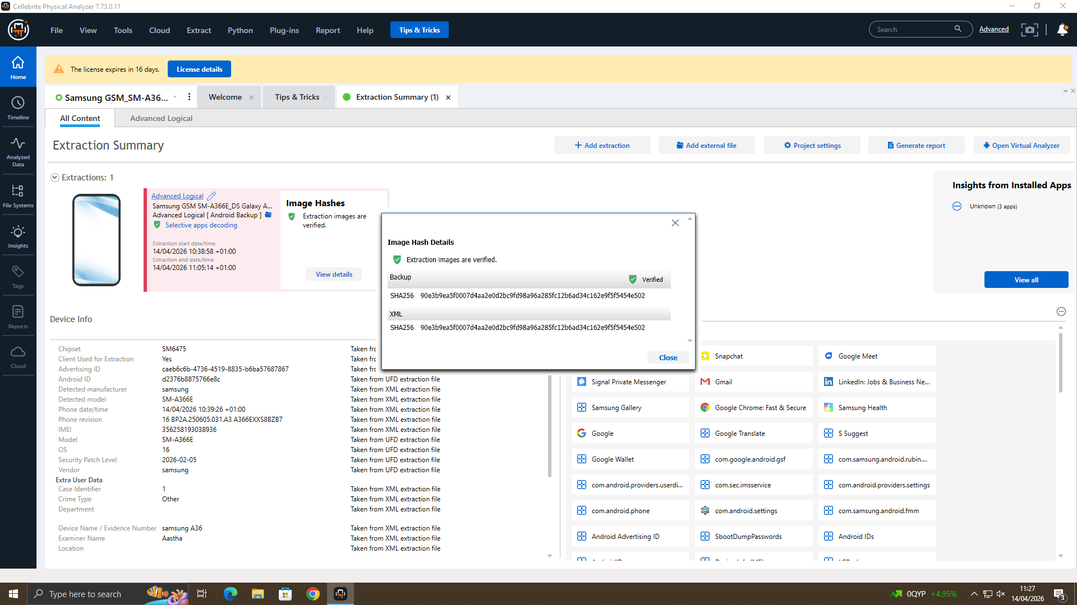
TASK-1 Personal Device Acquisition – Samsung Galaxy A36 (Cellebrite UFED)
Extraction Results and Hash Generation

Slide 4
Case Overview
Device 1
Model: Huawei
User: Emma
Device 2
Model: Samsung Galaxy A13
User: Joe
Device 3
Model: Nokia C2
User: Norman
Device 4
Model: Ulefone Note 14
User: Unknown

Slide 5
Aim and Objectives
Primary Aim:
To carry out a systematic forensic investigation of mobile device data using advanced tools, with the goal of uncovering meaningful digital evidence.
🔹 Evidence Acquisition:
To extract valuable data such as call logs, messages, contacts, and transaction-related information from various data sources.
🔹 Correlation of Data:
To analyse and link information from different platforms in order to identify patterns and relationships between user activities.
🔹 Timeline Reconstruction:
To arrange the collected data in chronological order, helping to clearly understand the sequence of events.

Slide 6
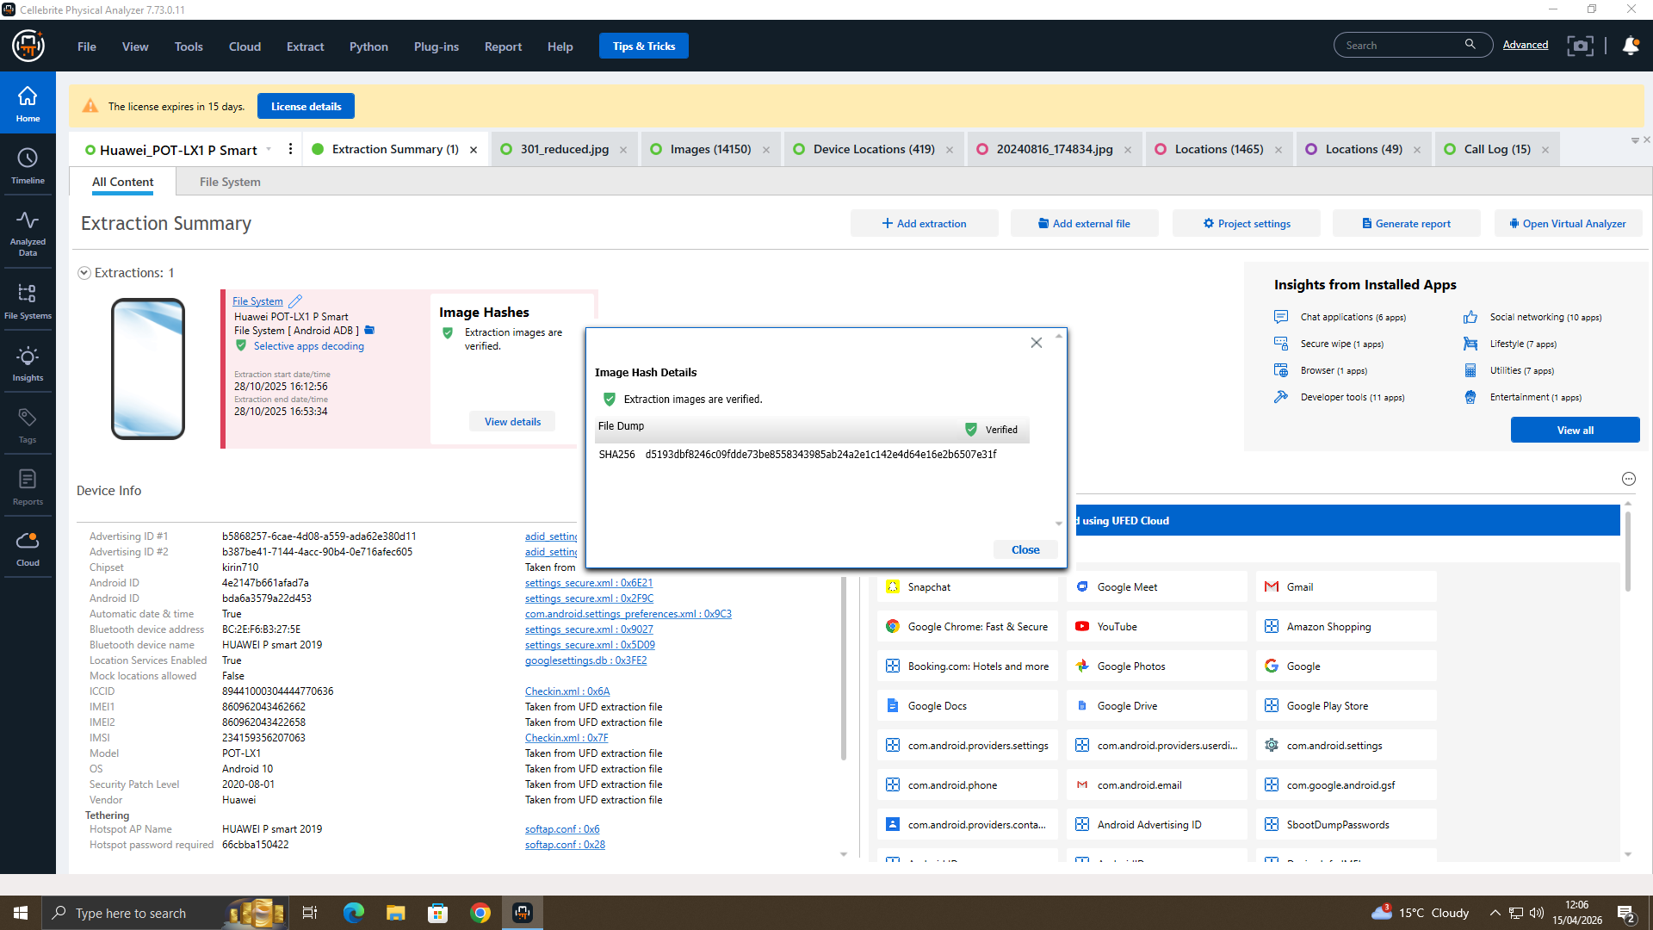
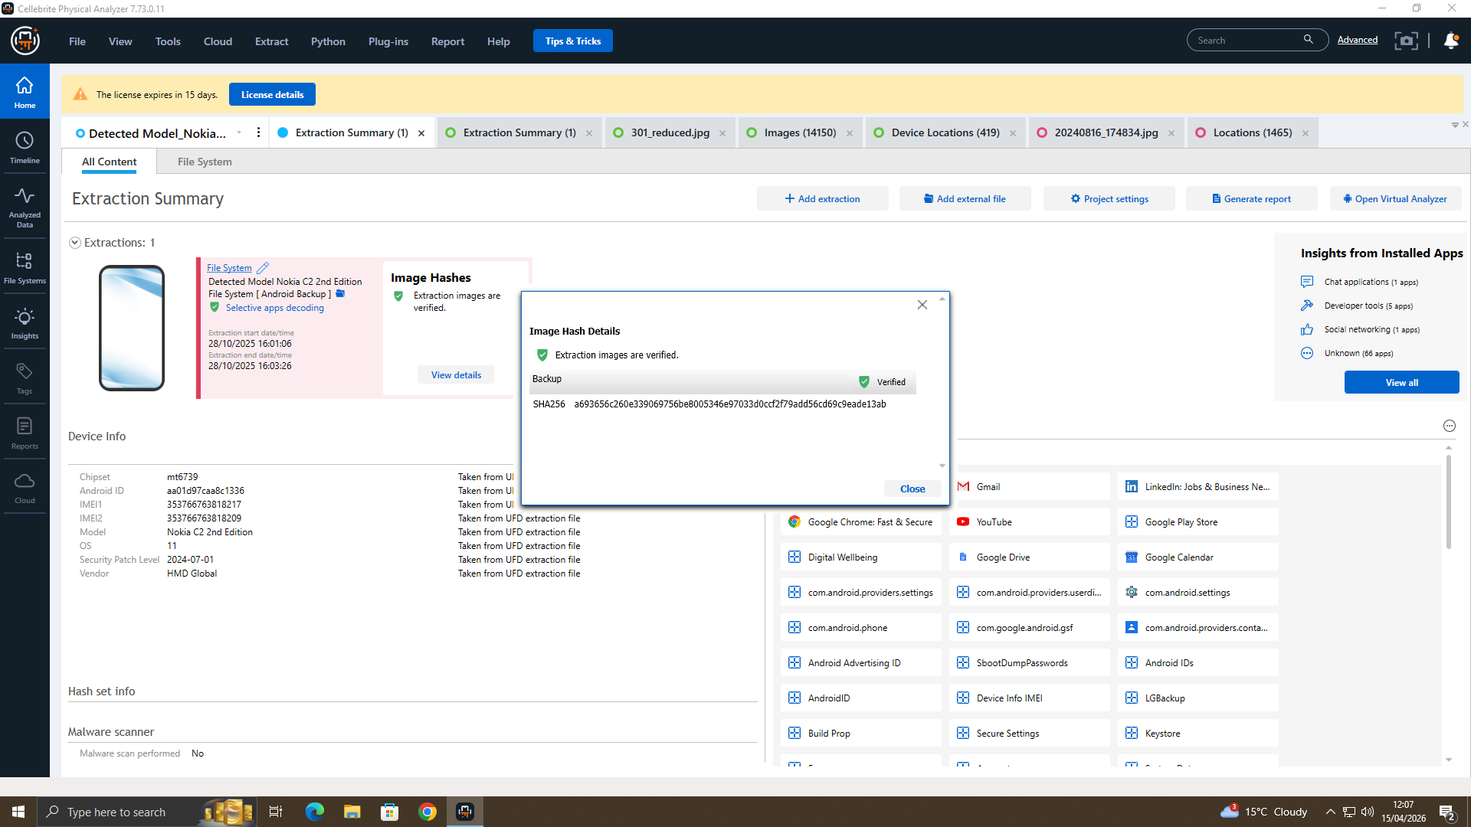


Hash Verification – Images(4)
Ulefone Note 14
Samsung Galaxy A13

Slide 7
CASE STUDY
Unauthorised access has been detected involving the AI chip patent QT-AI-2025
Emma has been identified as the main internal person of interest
The activity appears to be linked to an attempt to steal and sell confidential information
There are signs of outside involvement, with Joe acting as a middle contact
Norman is believed to be the intended buyer of the sensitive data

Slide 8
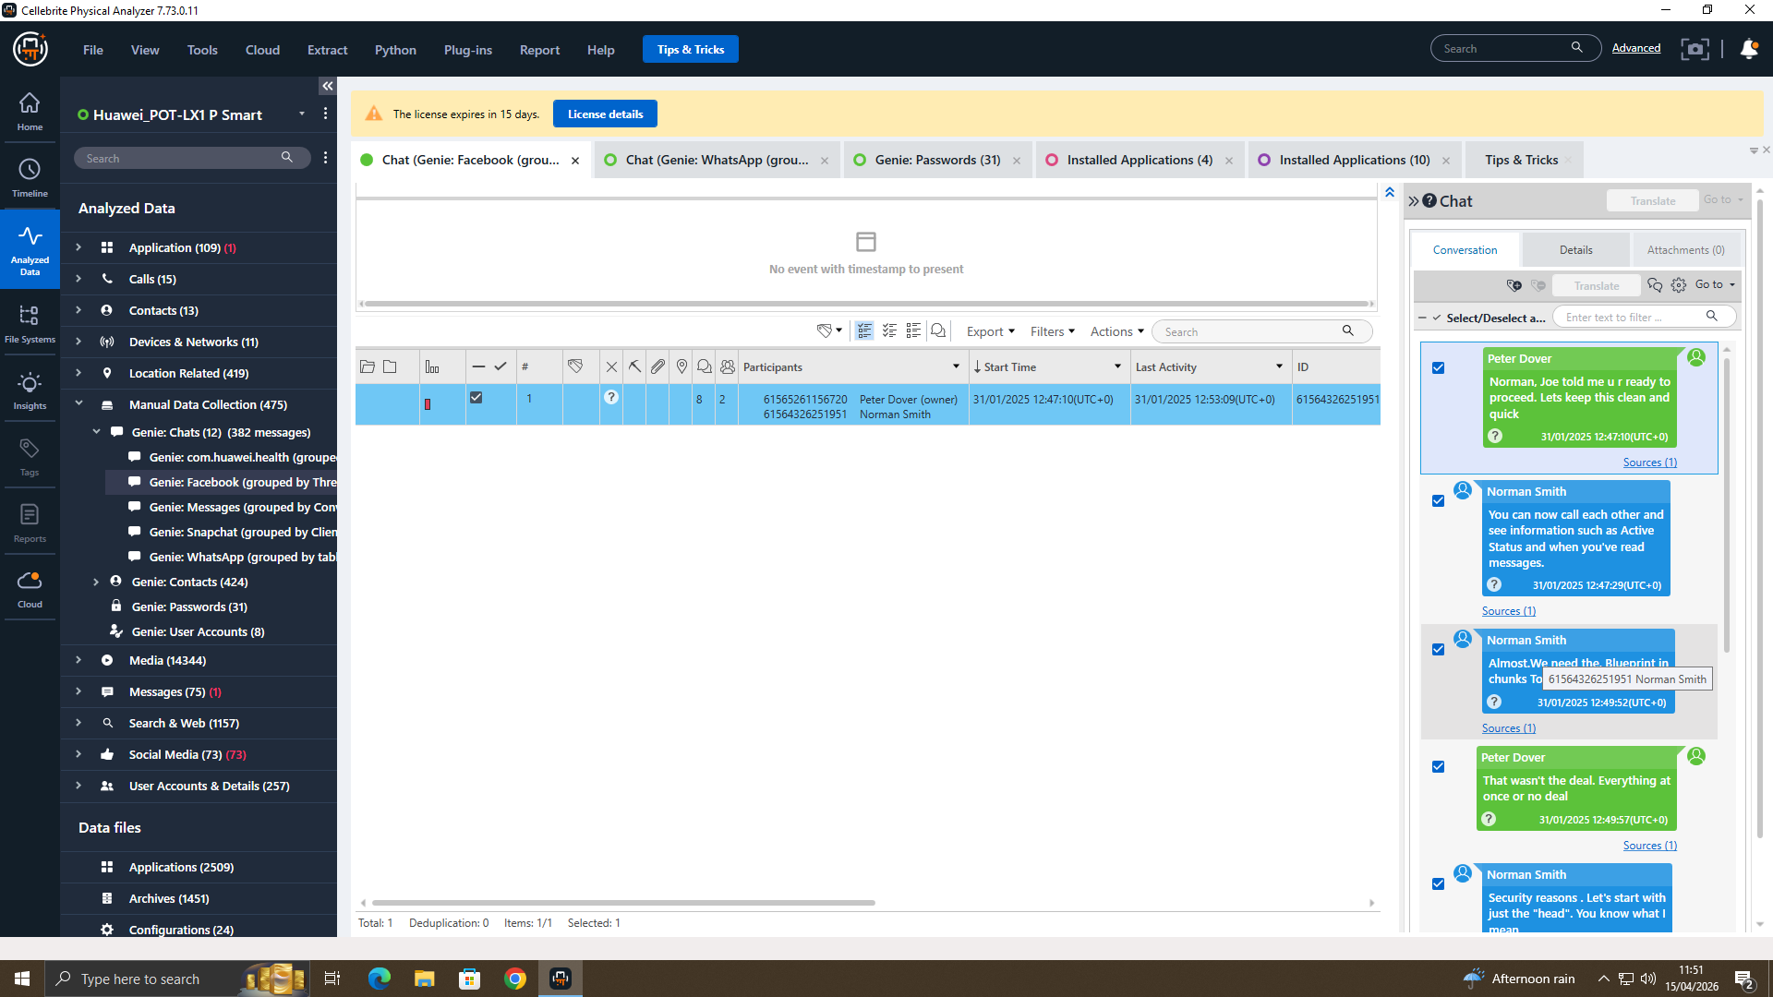
COLLECTION OF EVIDENCE IN CASE STUDY
Emma’s Android phone, which holds records of her conversations and activity
A USB drive belonging to Emma, believed to contain files related to the patent
Joe’s iPhone (running iOS 17), with a large amount of message history
Norman’s Android phone, connected to the wider communication chain

Slide 9
DATA EXTRACTION
Cellebrite UFED was used to safely extract data from the devices
Cellebrite Physical Analyzer helped break down the data and organise it into clear categories
The USB drive was examined using Autopsy and Forensic Toolkit (FTK) to identify relevant files
For Android devices, a full file system extraction was carried out to capture all data
For iOS devices, an advanced logical extraction method was used to retrieve important information

Slide 10
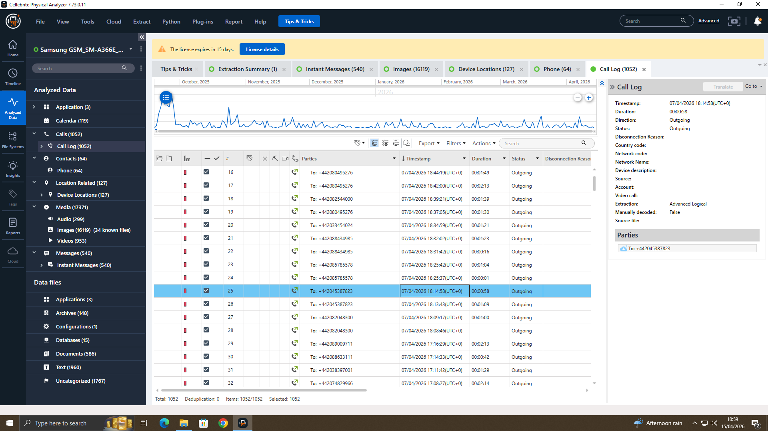
DATA INTEGRITY & EVIDENCE MANAGEMENT
All devices were carefully logged and tracked at every stage of the investigation
Each piece of evidence was given a unique ID to keep everything organised
Details of the examiner, along with dates and times, were recorded for accuracy
Data integrity was verified using SHA-256 hashing to ensure nothing was altered

Slide 11
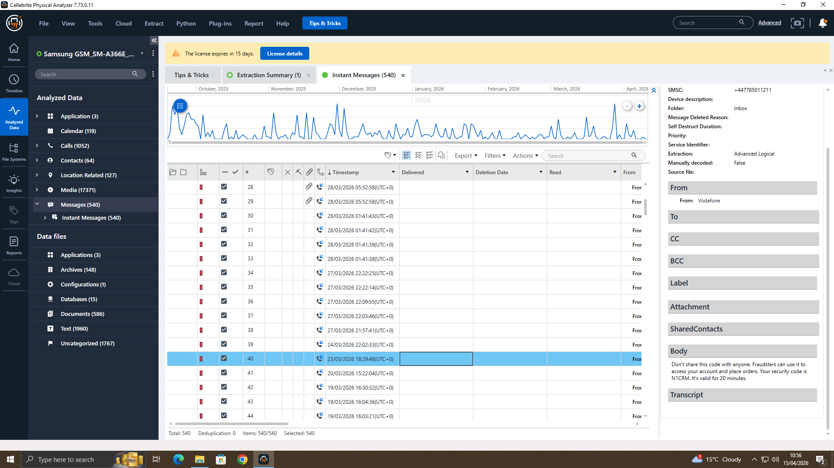
INTERACTION OVERVIEW
Nearly 2,000 messages were recovered from the iOS device
Conversations involved several contacts, including some that could not be identified
Communication took place across different platforms like WhatsApp, SMS, and email
The message patterns suggest ongoing and well-coordinated interaction

Slide 12
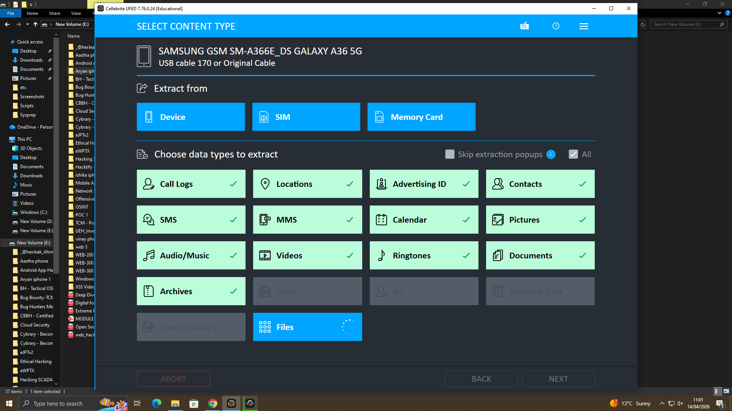
DIGITAL FILE REVIEW
A very large number of images were found on the iOS device (over 28,000 in total)
The collection includes screenshots along with images of documents
Several audio files were also recovered, indicating recorded conversations
Overall, the media content appears to support the handling of sensitive or context-related information

Slide 13
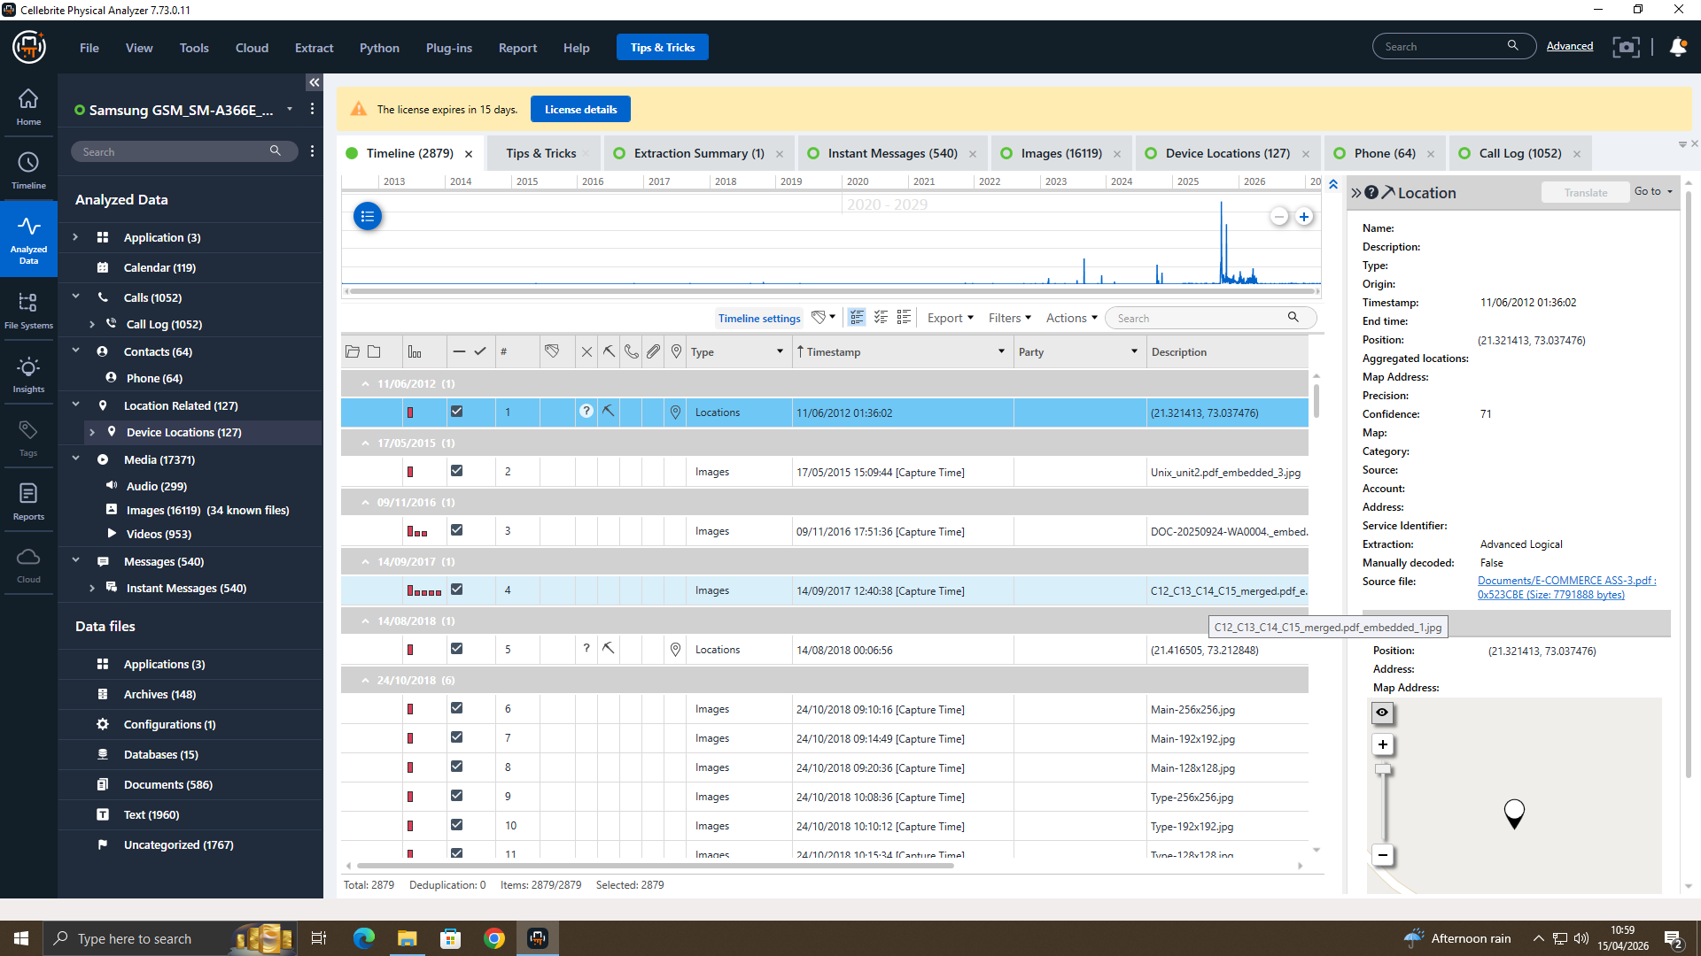
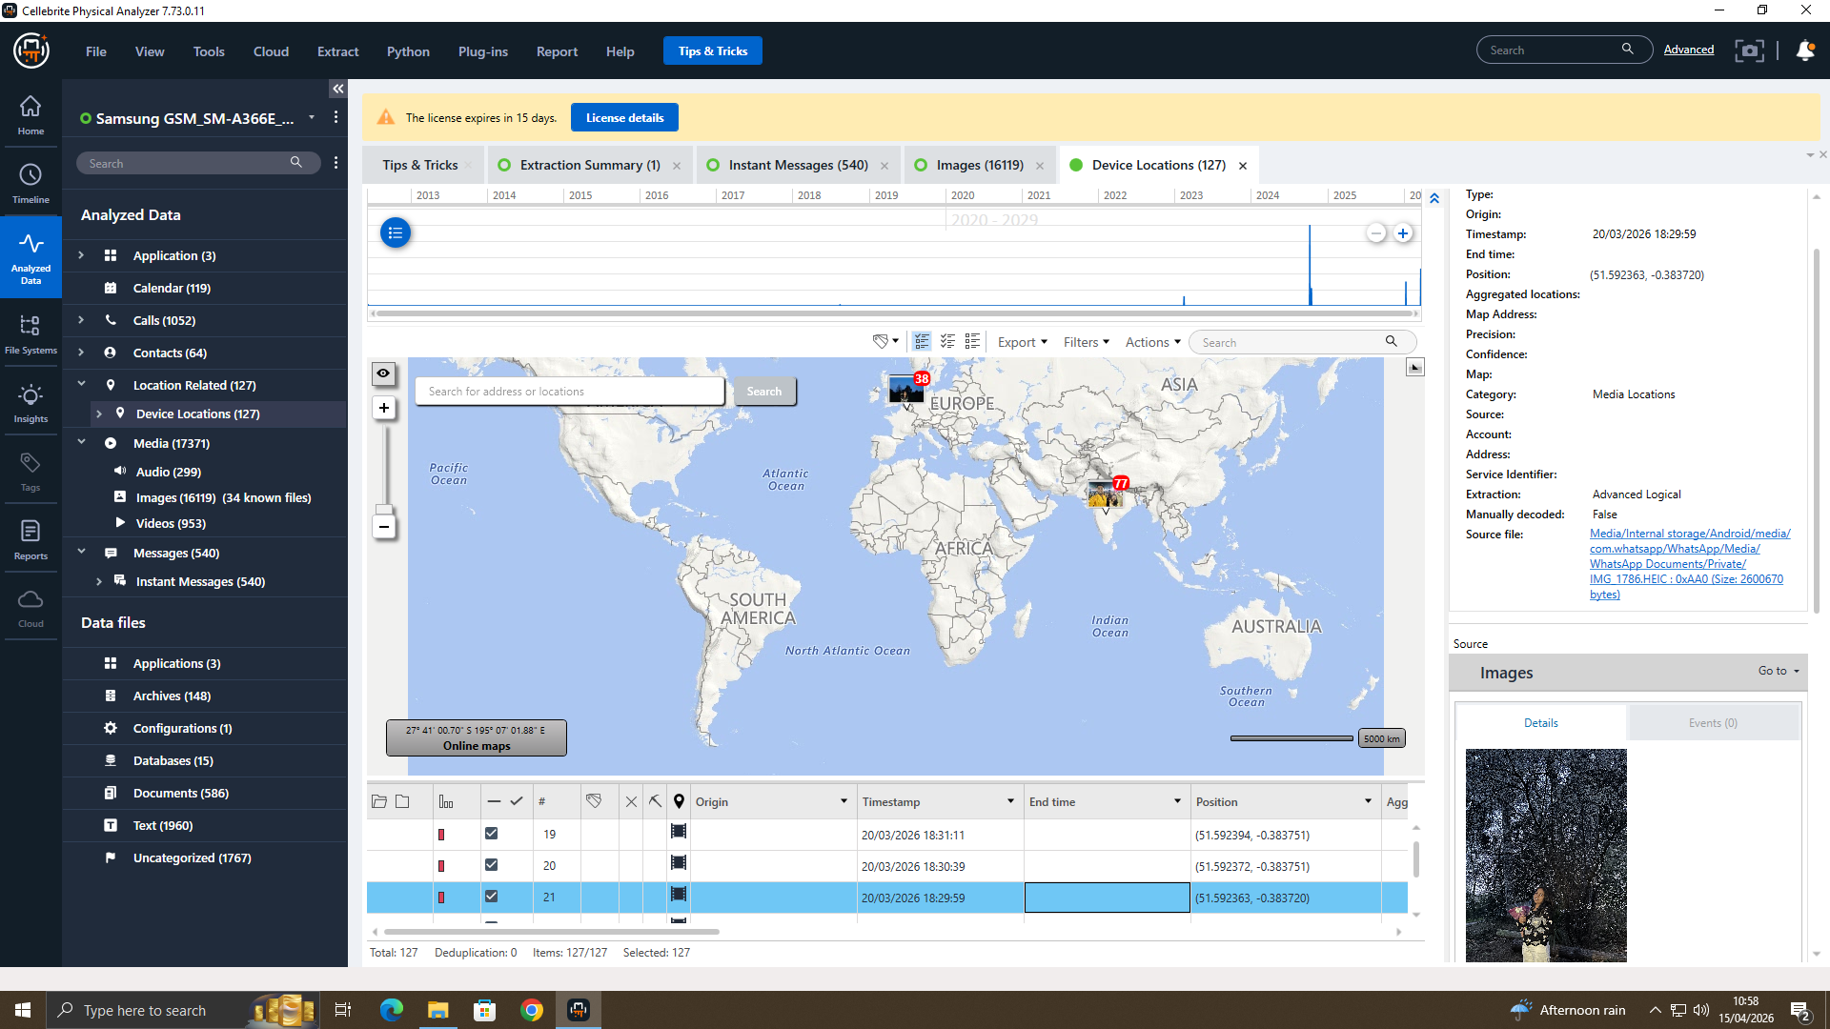
LOCATION EVIDENCE REVIEW
More than 173,000 location data points were collected from the devices
Movements were mapped across various areas within the UK
Location data was compared with messages and time records to find links
The findings suggest that the suspects likely met in person on several occasions

Slide 14
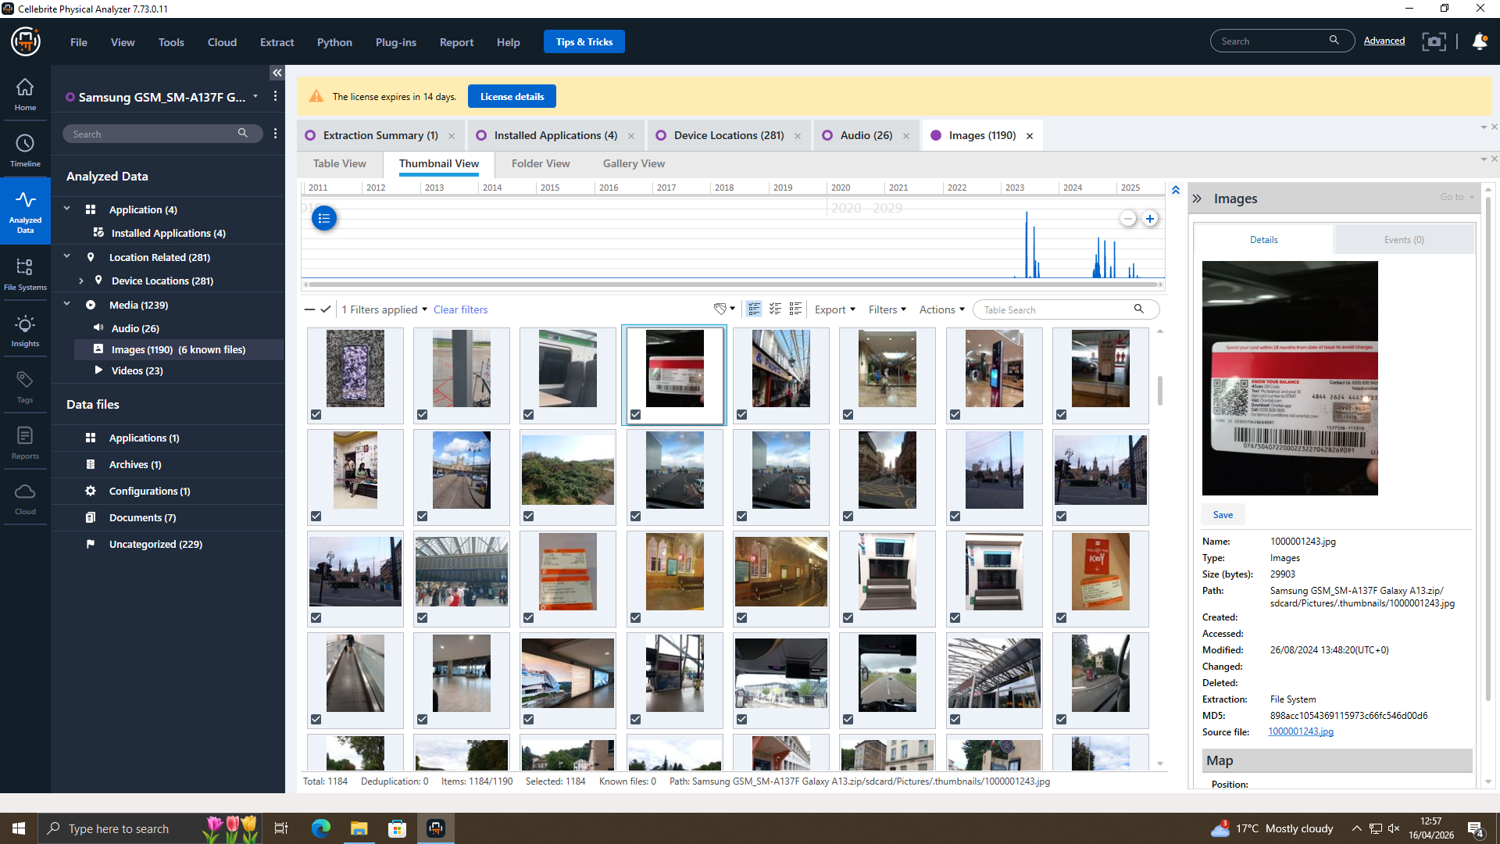
INVOLVEMENT OF SUSPECTS OVER TIME
Emma is believed to be the main individual involved, responsible for accessing and moving the data
Joe appears to have supported the process by acting as a communication link between parties
Norman is thought to be the intended receiver or potential buyer of the shared information
The sequence of events suggests a shift from initial communication to possible data transfer activity

Slide 15
CONCLUSION
The findings suggest a possible case of organised corporate espionage
Multiple pieces of evidence point towards coordinated actions across different sources
It is recommended that legal steps are considered against those involved
Strengthening access controls and improving monitoring systems is advised to prevent future incidents

