Slide 2
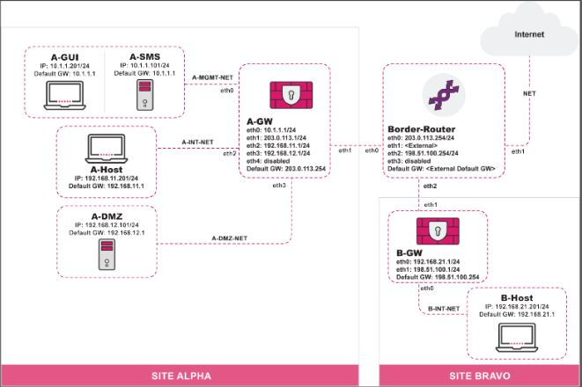
Initial Toplogy

Slide 3
Initial Toplogy
There are two networks, including Alpha and Bravo. Alpha comprises three subnets: A-MGMT-NET, A-INT-NET, and A-DMZ-NET. Devices in both Alpha and Bravo networks are connected to their respective security gateways, while these two security gateways are connected to the border router which connects the internet.

Slide 4
Security Posture
Irregular Security Audits:
Lack of a clear security audit policy: Regular security audits, security level assessments, and related measures.
Lack of detailed security audit procedures: Frequency of security audits, assignment of responsibilities, and tools used.
Lack of professional security audit personnel
Lack of continuous improvement: Regularly updating security settings based on security audit results.

Slide 5
Security Posture
Irregular Security Updates:
Need to Set Update Frequency: Set the update frequency so that critical devices are checked for updates monthly.
Maintain an Update Log: This helps in troubleshooting and security audits.
Automate Updates: Reduces errors due to manual operations.

Slide 6
Security Posture
Single Point of Failure:
Lack of Redundant Design: All management information is stored in SMS; A-GW, B-GW, and the Border-Router are the only ports connecting Site Alpha and Site Bravo to the internet. If compromised, the network will be paralyzed.
Urgent Need for Topology Optimization: Increase the number of security gateways and routers.
Need for a Disaster Recovery Plan: There is a need for rapid recovery after a security incident.

Slide 7
Security Posture
Inconsistencies and Errors:
Possible Causes of Security Policy Errors:
    Security Policy Updates are Not Timely
    Poor Team Communication
    Improper Access Management
    Lack of Testing for the Security Policy: The effectiveness of the Security Policy cannot be guaranteed.
    Lack of Responsibility Assignment

Slide 8
Security Posture
Licensing Structure:
Over-Subscription of Services:The company may have purchased services that exceed actual needs.
Mismatched Licensing Levels: There may be a mismatch between the licensing levels and the company's needs.
Need of Assessment: Conduct a comprehensive security needs assessment to determine the actual functionalities and protection levels required by the company.
Optimization of Existing Solutions: Review the current security architecture to identify systems and features that can be optimized or phased out.
Regular Review of License Utilization: Establish a mechanism for regular reviews of the security solutions and license utilization to ensure that security investments are aligned with the company's actual needs and business growth.

Slide 9
Security Posture
User Roles and Permissions:
Lack of role and permission definitions: Unauthorized access, data breaches, and vulnerabilities in network security.
Using Check Point Identity Awareness: Check Point Identity Awareness features fine-grained control, ease of deployment, and visualization capabilities, which can help establish a clear framework for roles and permissions.

Slide 10
Security Posture
Overlapping and Conflicting Policies:
Policy Setting Conflicts: Different departments or teams may independently set security policies, leading to inconsistencies between them.
Lack of Centralized Management: There is no unified platform to coordinate and control all security policies centrally.
Insufficient Policy Review: The formulation and review of security policies may lack systematic and periodic assessment.
Unified Policy Management: Implement a centralized security policy management system to ensure that all policies are managed and approved from a single control point.
Regular Review and Update of Policies: Regularly review existing security policies to ensure they are aligned with current business needs and network environments.
Cross-Departmental Collaboration: Establish a cross-departmental security policy coordination team.

Slide 11
Security Posture
Application Control:
Merely locking a few malicious software programs without establishing a comprehensive application control policy.
Lack of understanding of the application usage patterns within the network.
Using Check Point Application Control:
  Understand the application usage patterns within the network and develop informed policies.
  Build fine-grained policies: Establish policies based on applications and users.

Slide 12
Security Posture
Outdated IPS rules:
IPS not enabled
Using Check Point IPS:
  Detect and Prevent: Known exploits, vulnerabilities, protocol misuse, tunneling attempts
  Efficient and Flexible Deployment: Predefined recommended profile, signature activation rules

Slide 13
Security Posture
Challenges Posed by IoT Devices:
Unmanaged IoT devices pose security risks
Potential of sensitive data leakage.
Using of Check Point IoT Security Solution:
  Device Discovery & Risk Analysis
  Zero Trust Network Access
  Firewall-based Intrusion Prevention

Slide 14
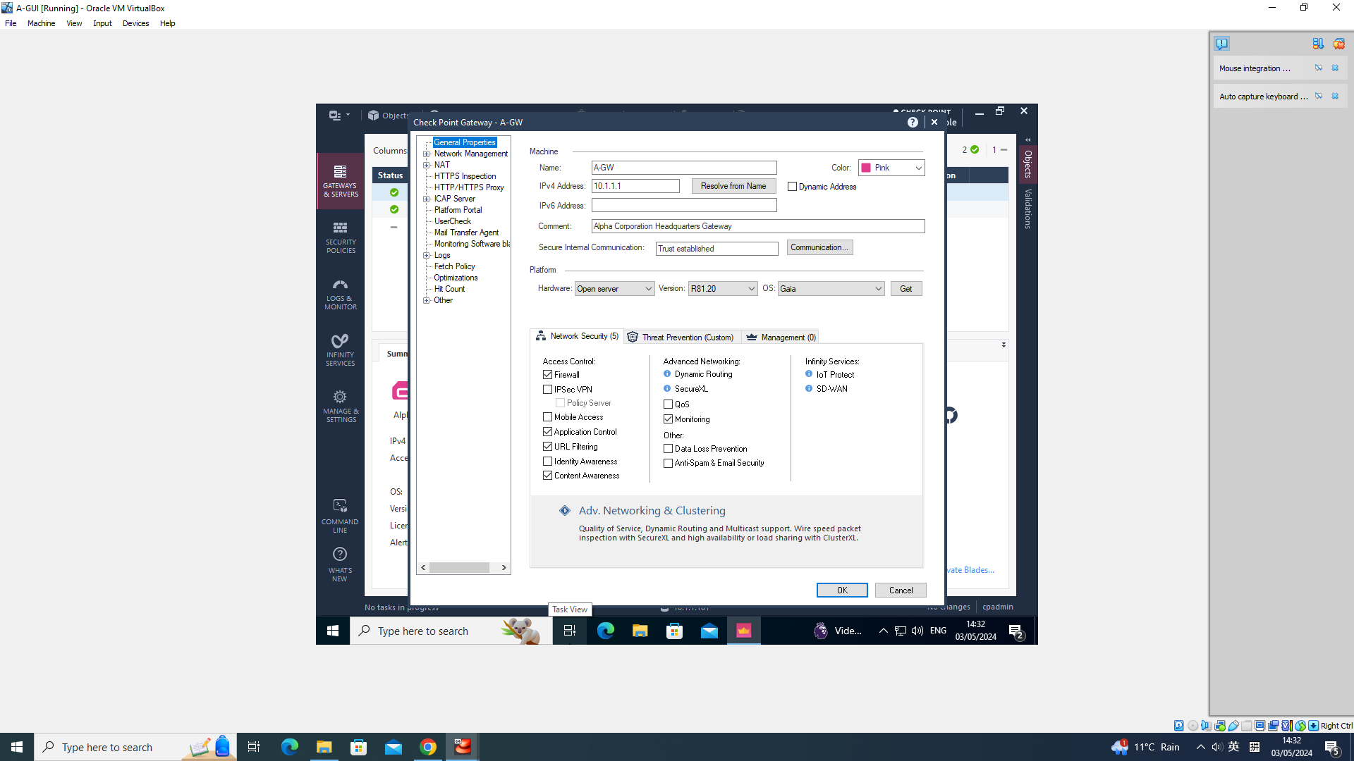
Establishing SIC and Managing Administrator Access
Creat an A-GW Object:

Slide 15
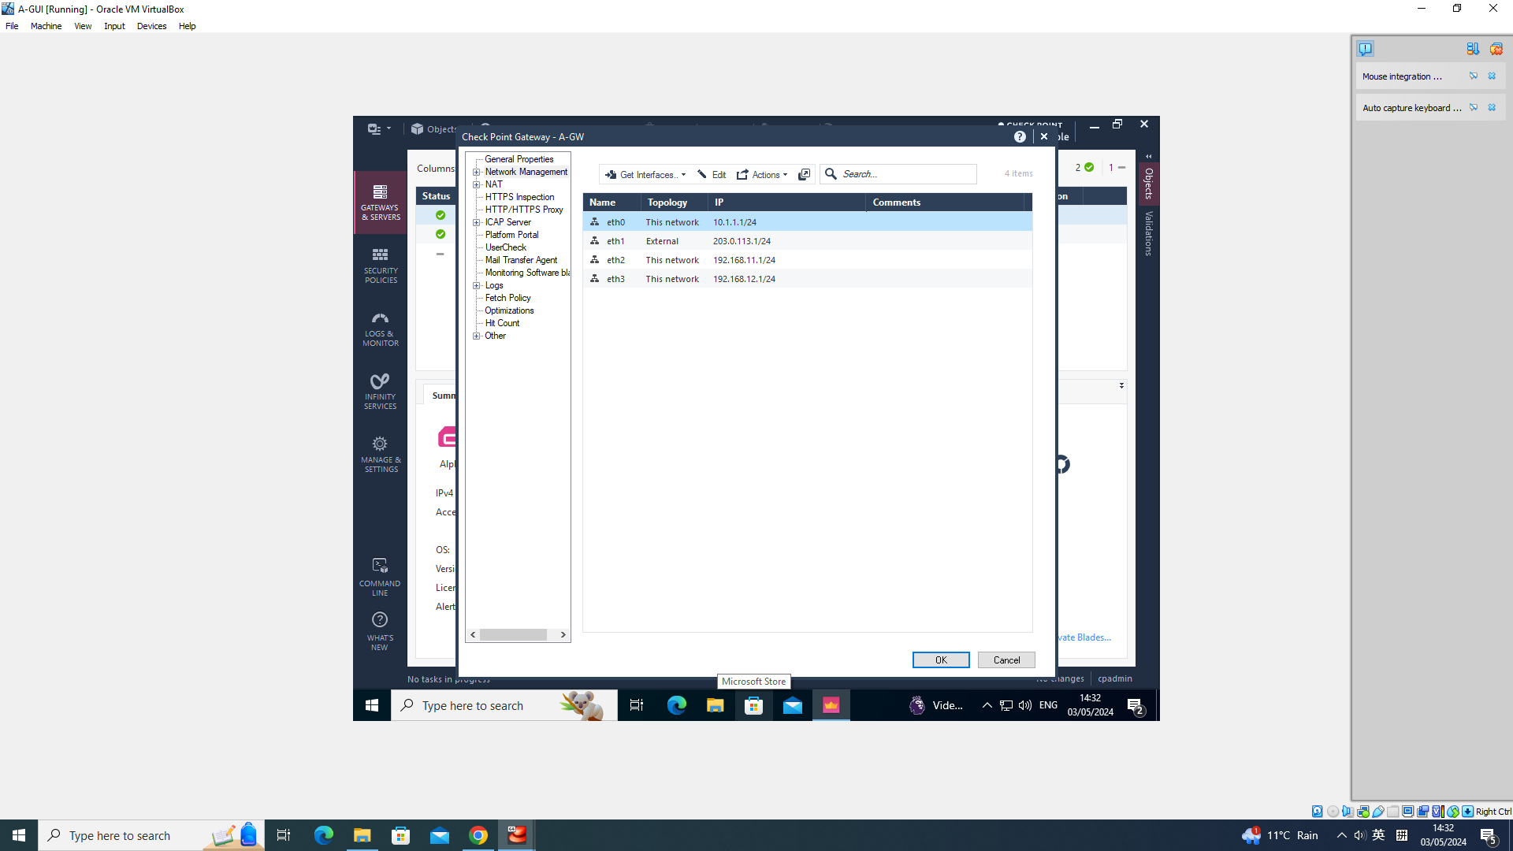
Establishing SIC and Managing Administrator Access
Creat an A-GW Object:

Slide 16
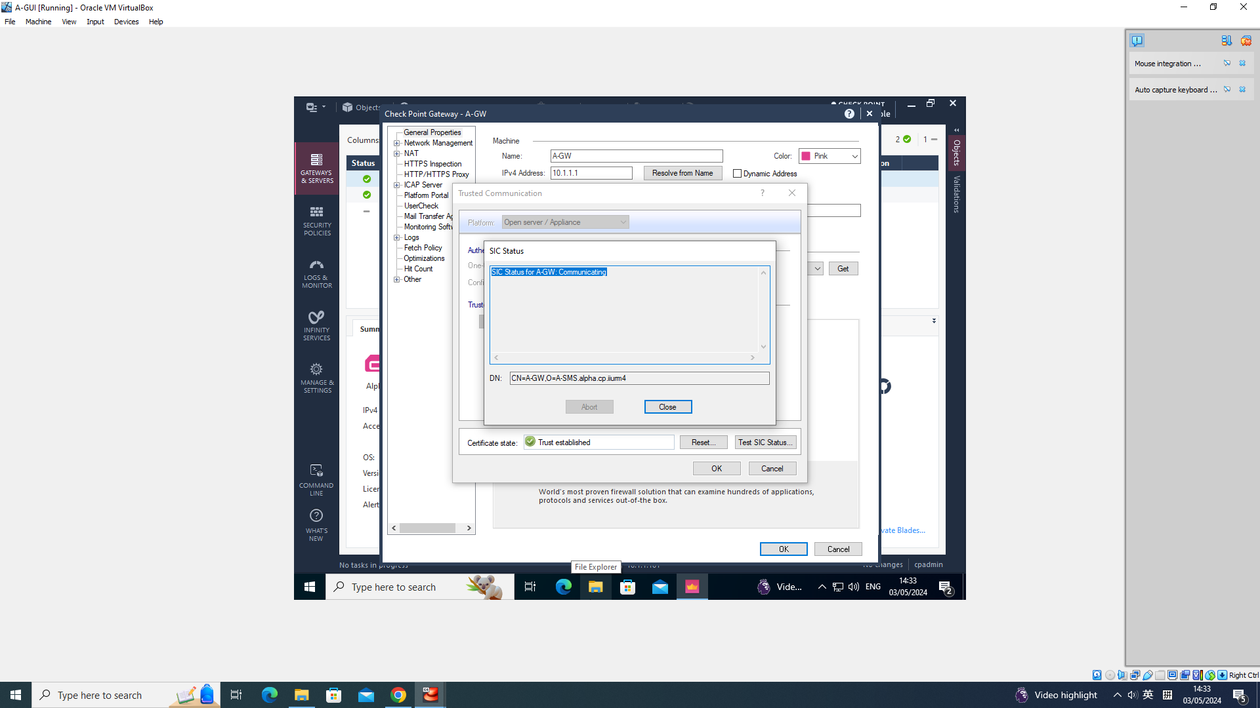
Establishing SIC and Managing Administrator Access
Establishing SIC:

Slide 17
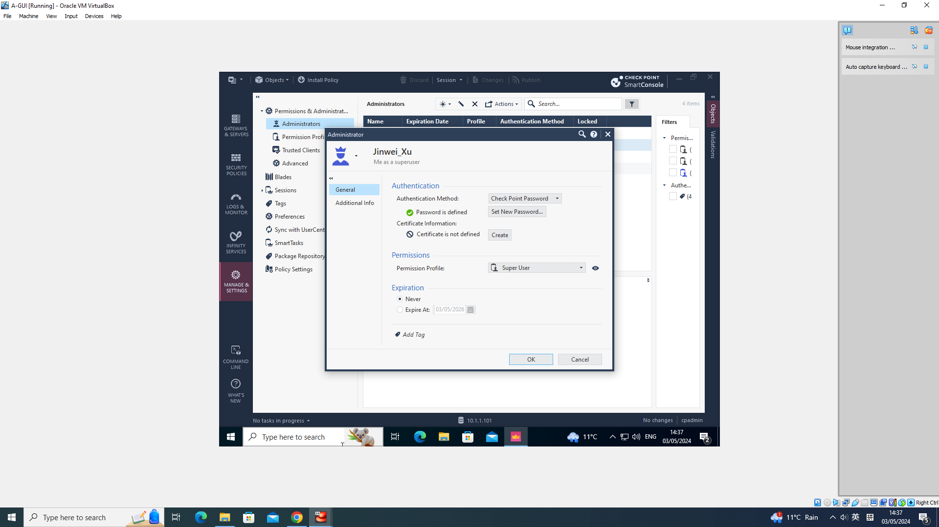
Establishing SIC and Managing Administrator Access
Creating Administrator and Assigning Profiles:

Slide 18

Establishing SIC and Managing Administrator Access
Creating Administrator and Assigning Profiles:

Slide 19
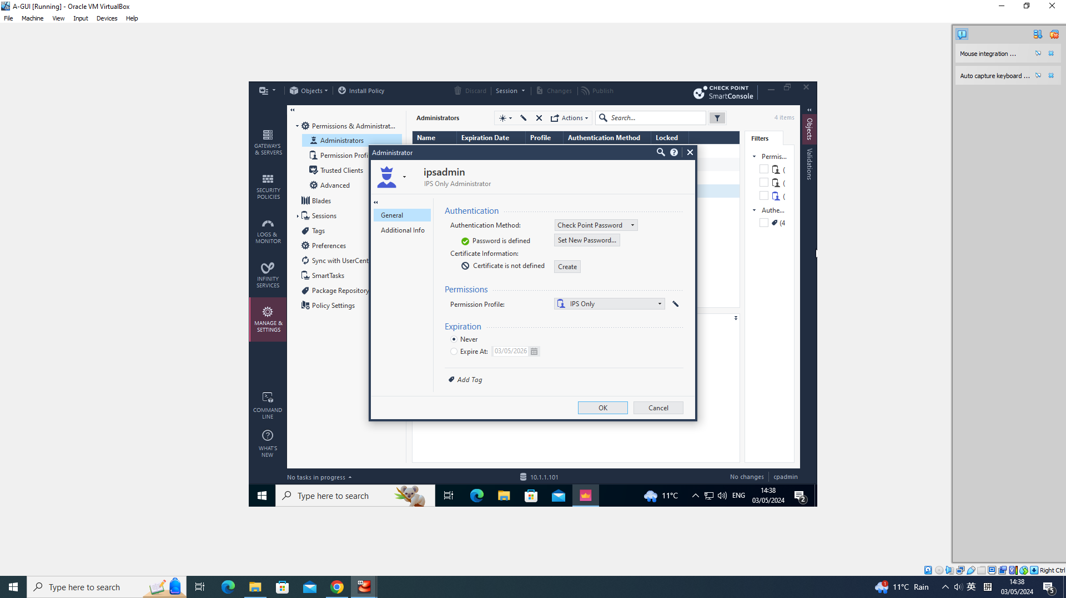
Establishing SIC and Managing Administrator Access
Creating Administrator and Assigning Profiles:

Slide 20
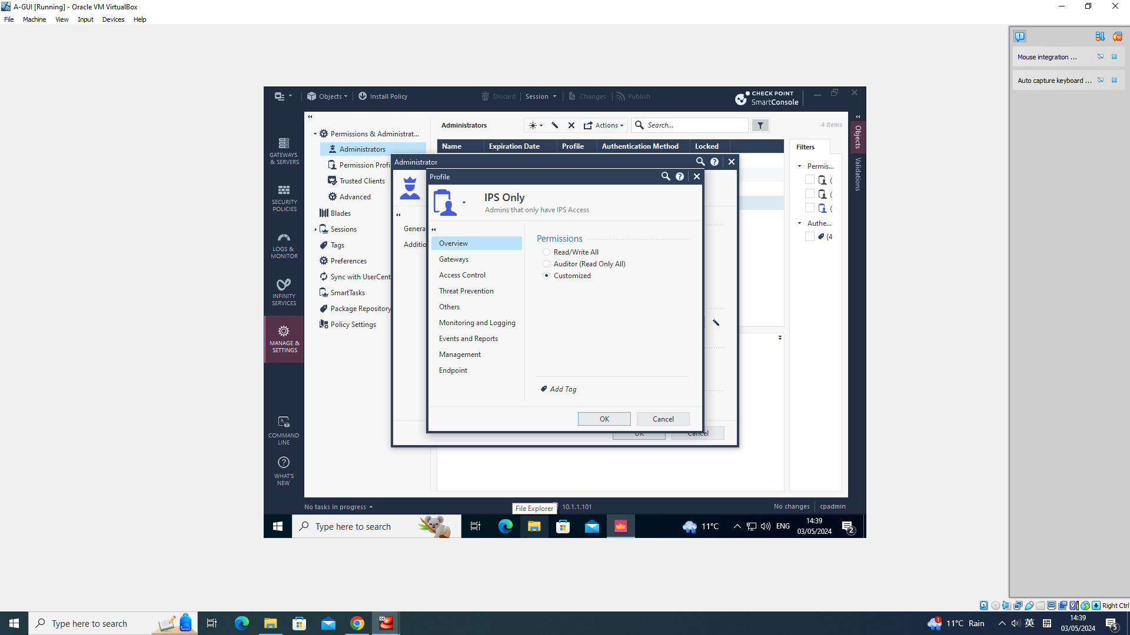
Establishing SIC and Managing Administrator Access
Creating Administrator and Assigning Profiles:

Slide 21
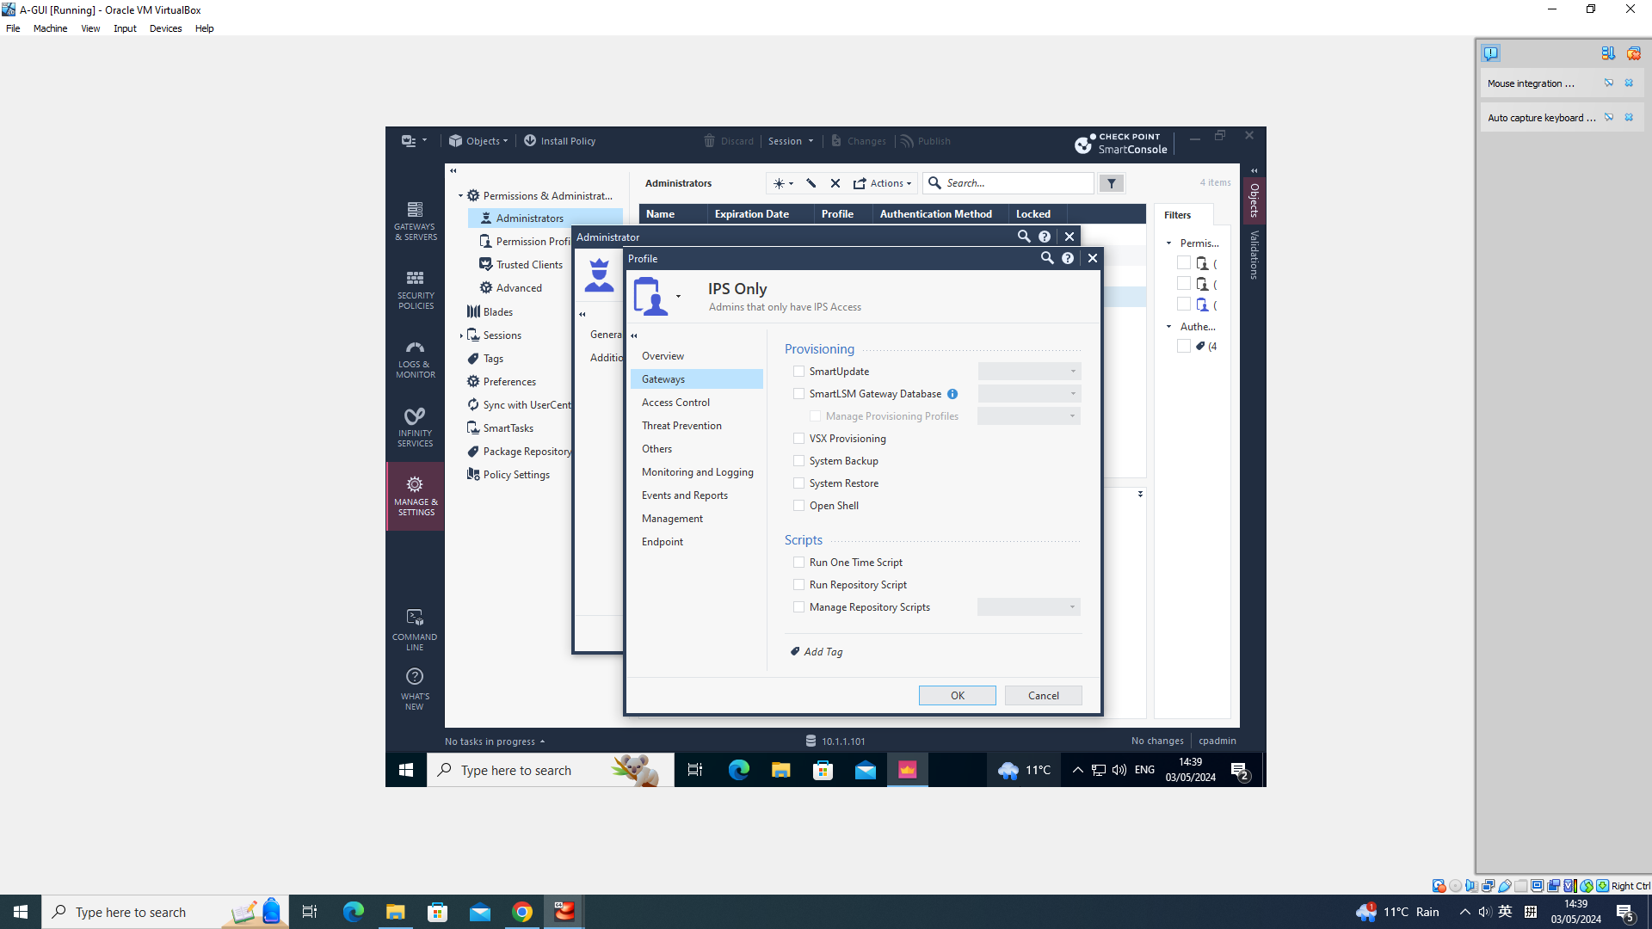
Establishing SIC and Managing Administrator Access
Creating Administrator and Assigning Profiles:

Slide 22
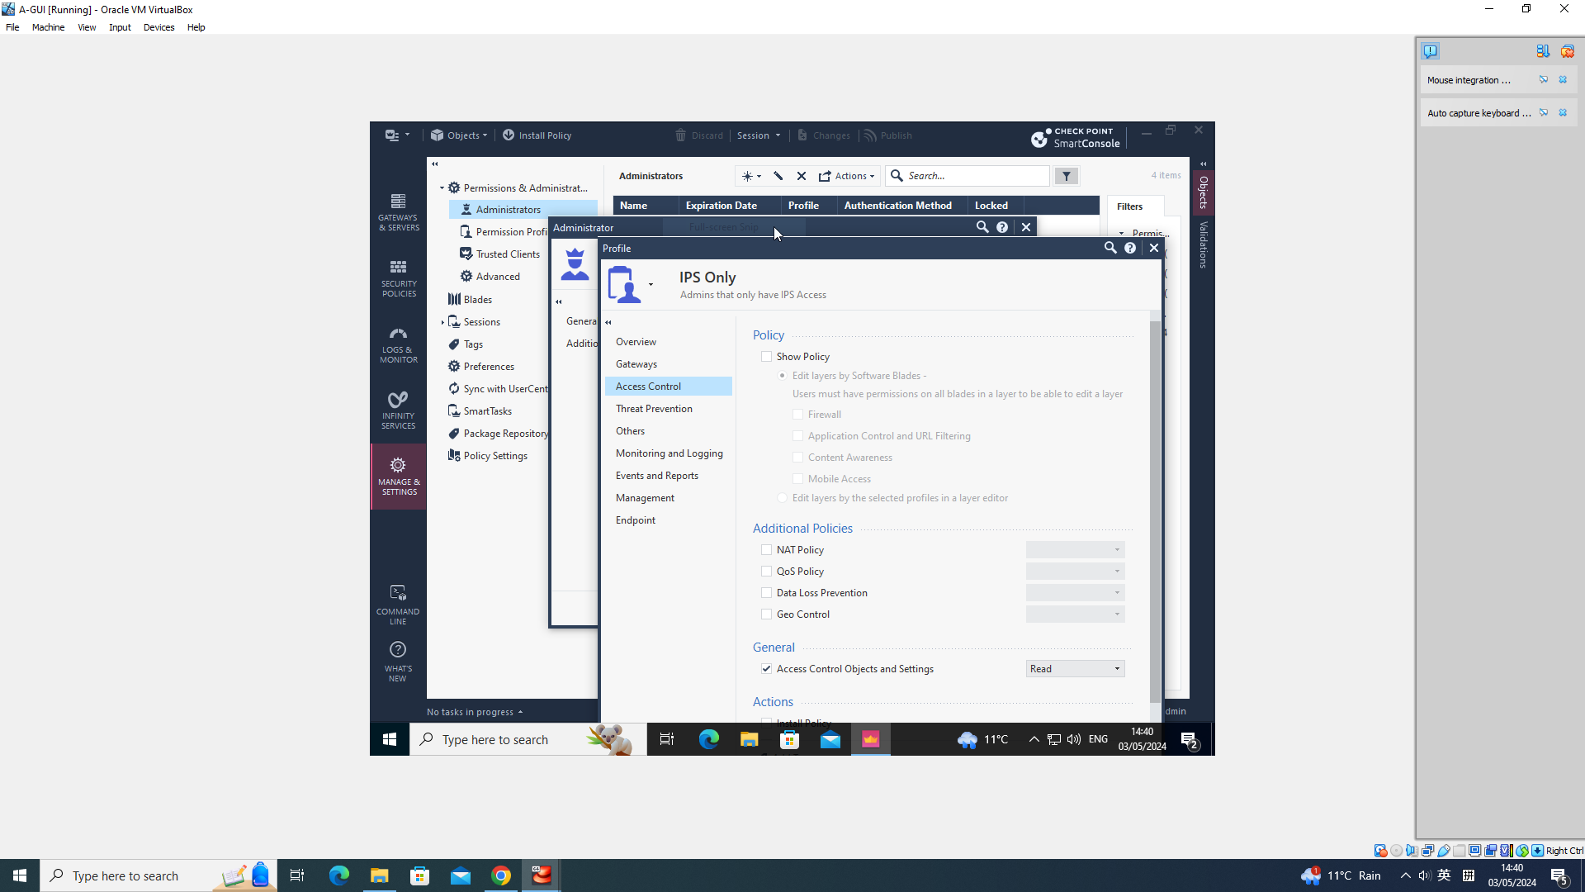
Establishing SIC and Managing Administrator Access
Creating Administrator and Assigning Profiles:

Slide 23
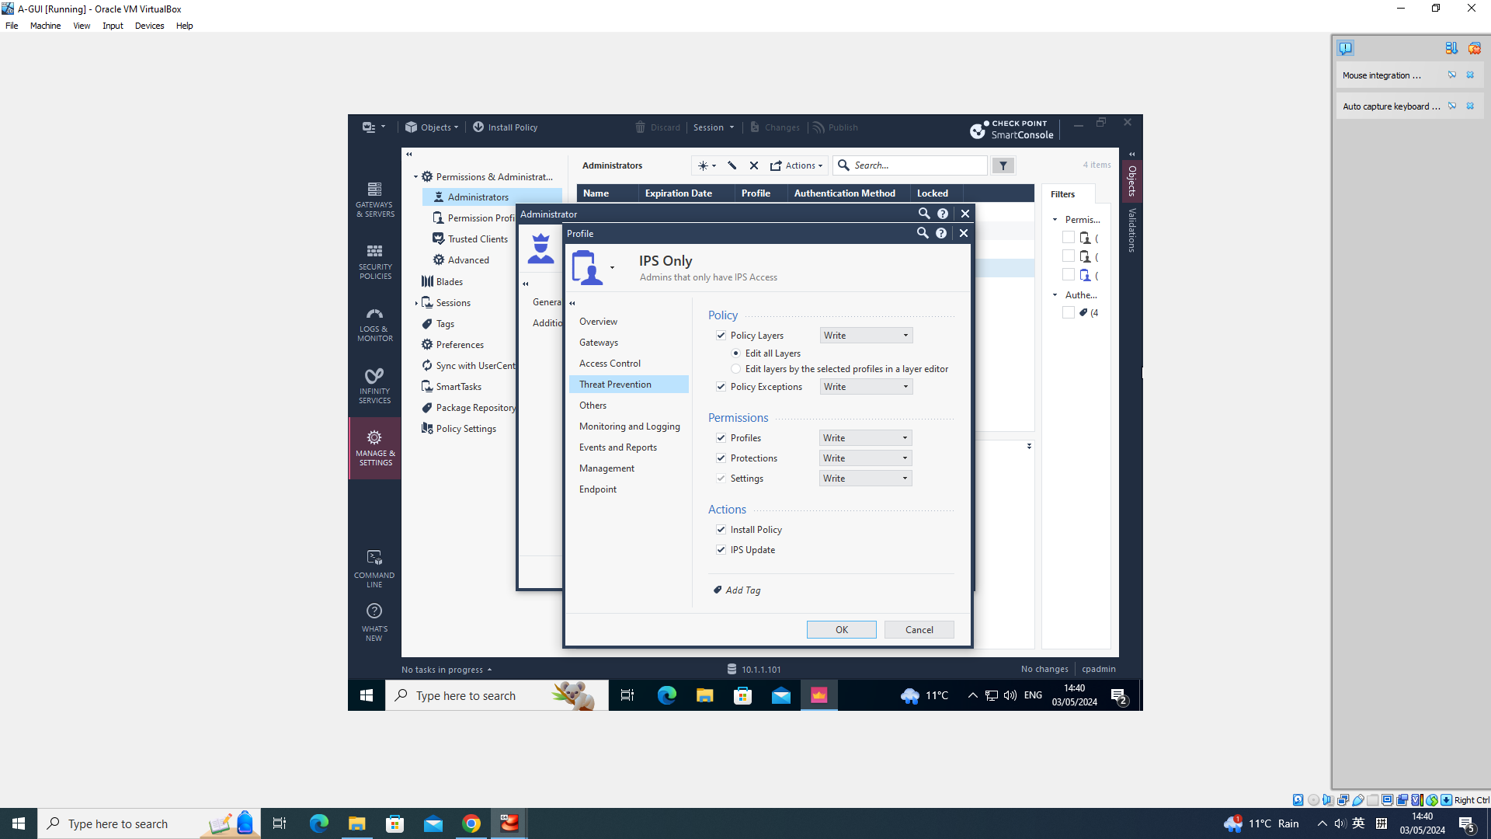
Establishing SIC and Managing Administrator Access
Creating Administrator and Assigning Profiles:

Slide 24
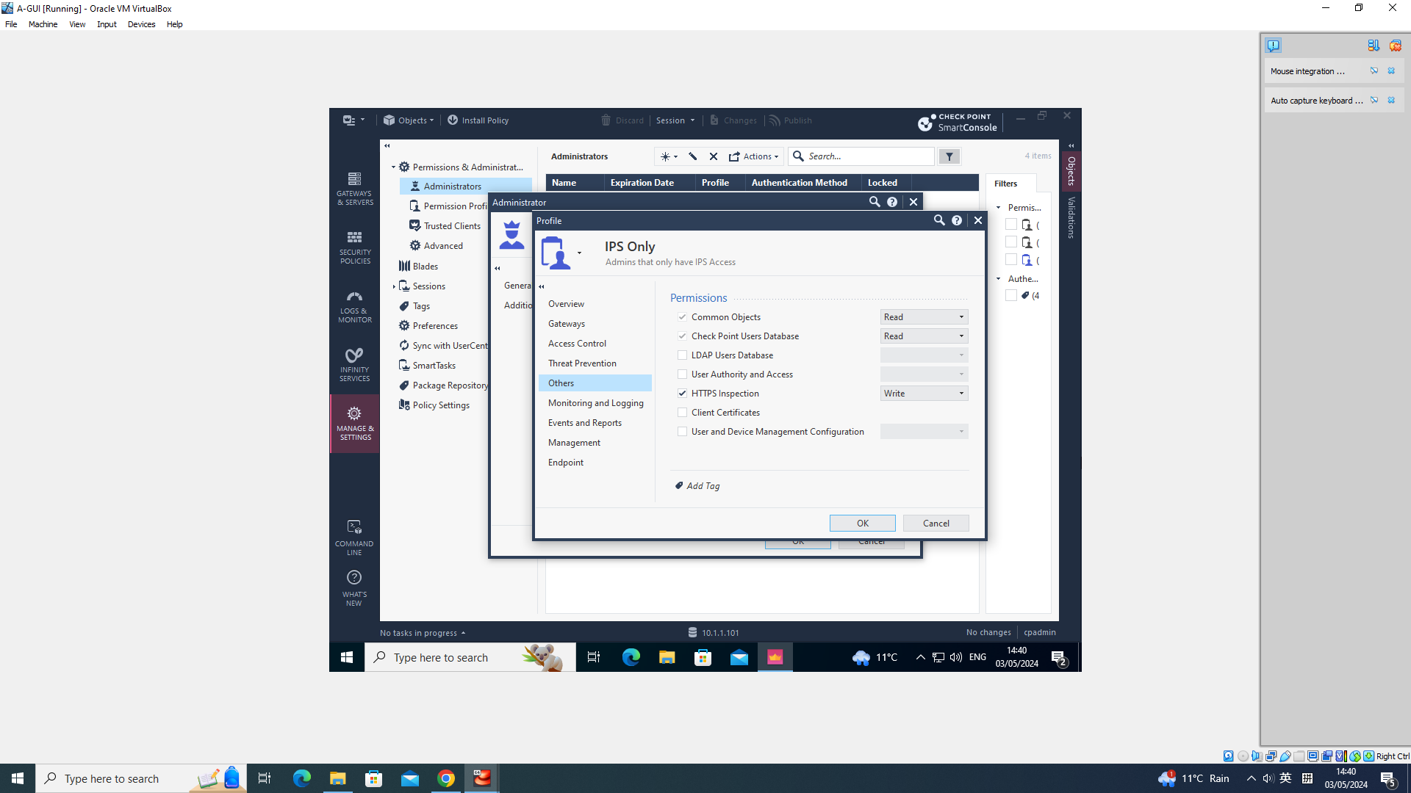
Establishing SIC and Managing Administrator Access
Creating Administrator and Assigning Profiles:

Slide 25
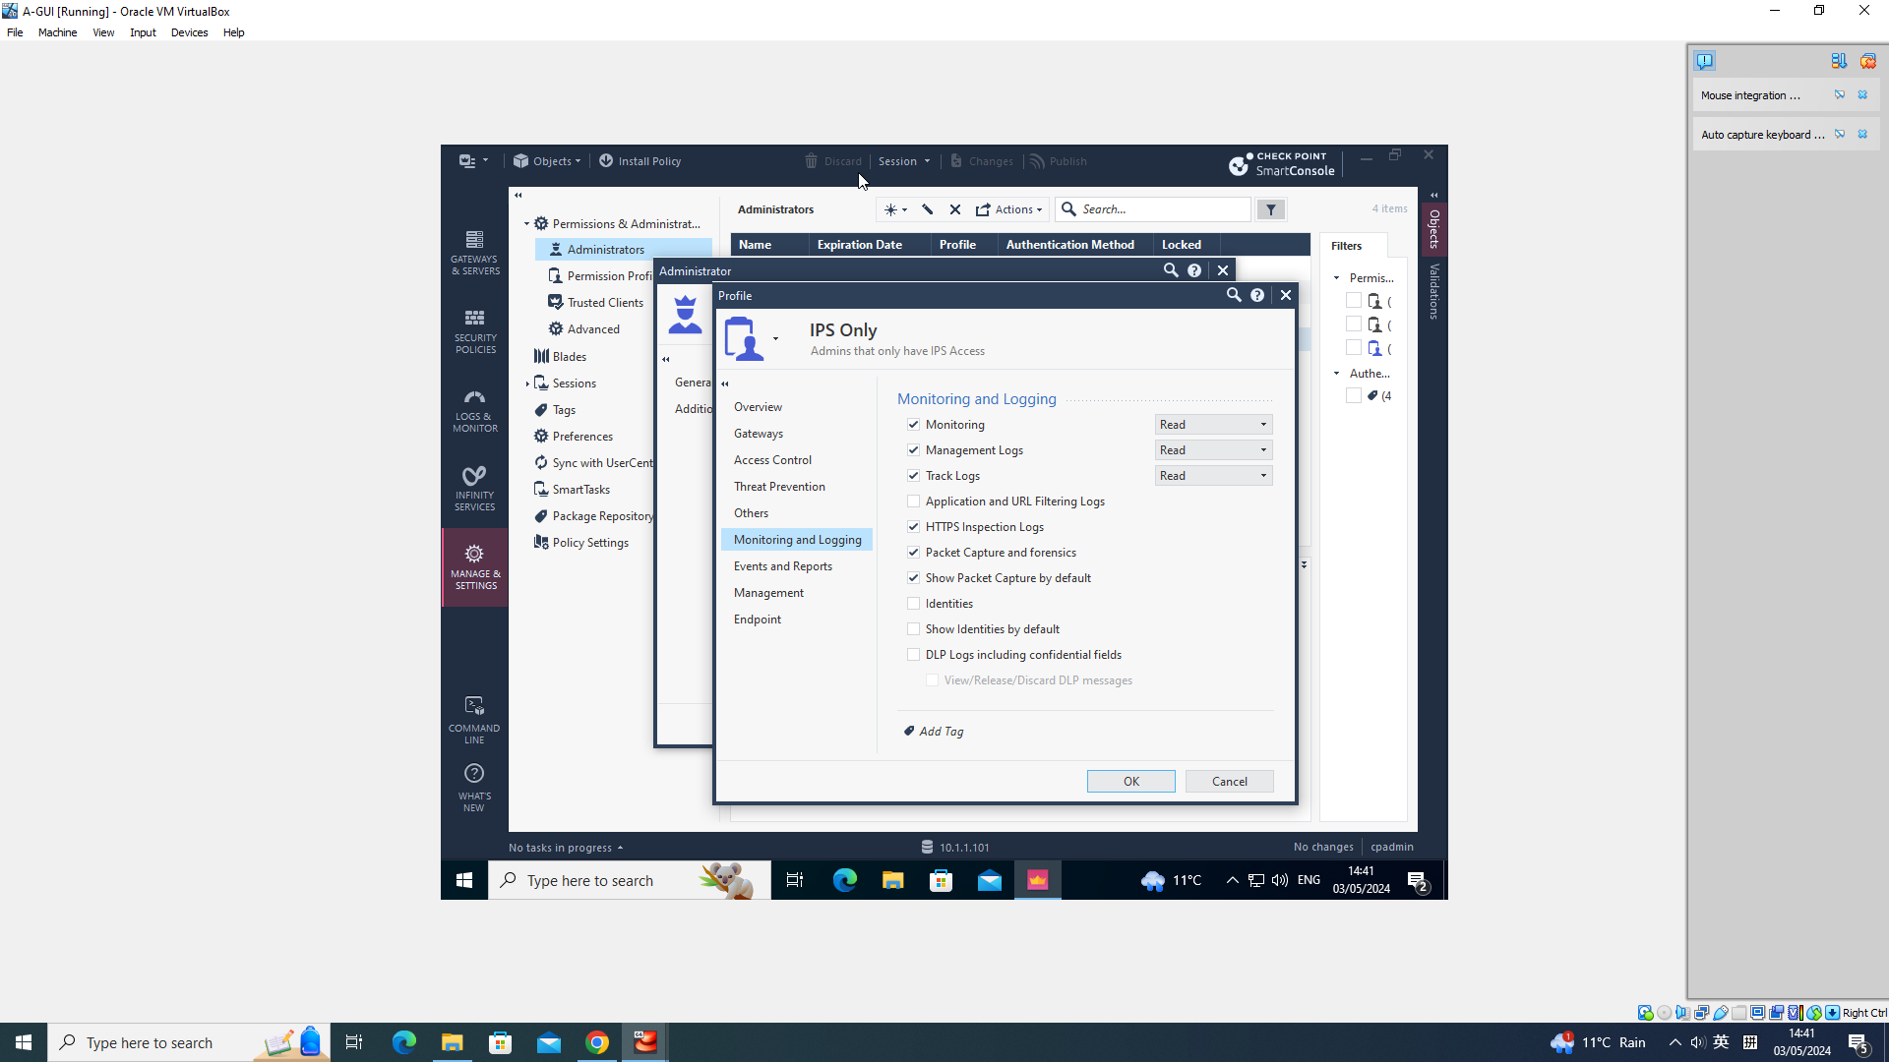
Establishing SIC and Managing Administrator Access
Creating Administrator and Assigning Profiles:

Slide 26
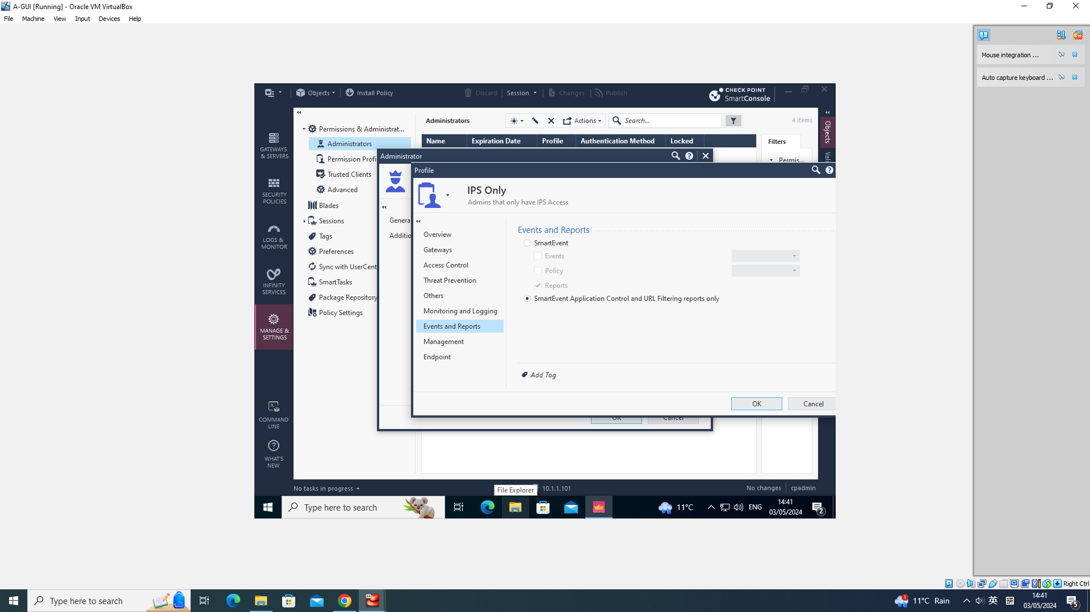
Establishing SIC and Managing Administrator Access
Creating Administrator and Assigning Profiles:

Slide 27

Establishing SIC and Managing Administrator Access
Creating Administrator and Assigning Profiles:

Slide 28
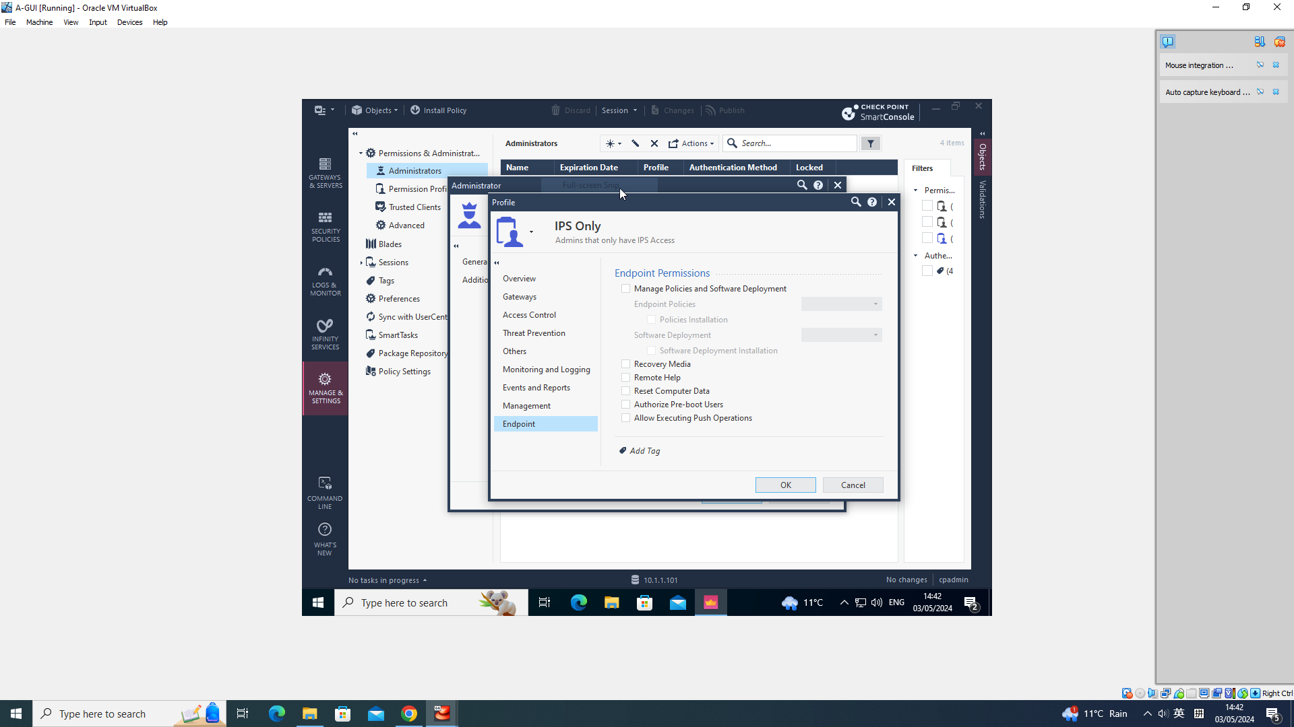
Establishing SIC and Managing Administrator Access
Creating Administrator and Assigning Profiles:

Slide 29
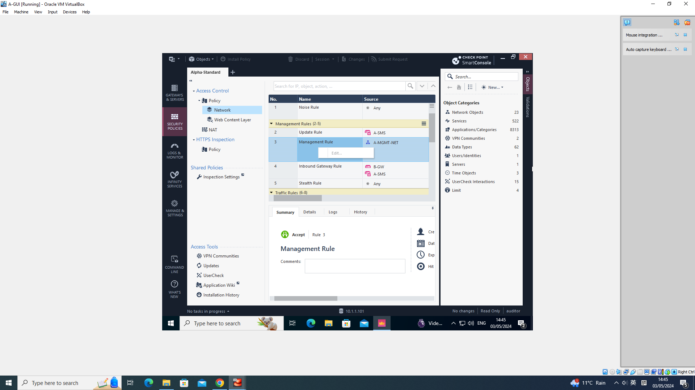
Establishing SIC and Managing Administrator Access
Testing Administrator Profiles Assigning :

Slide 30
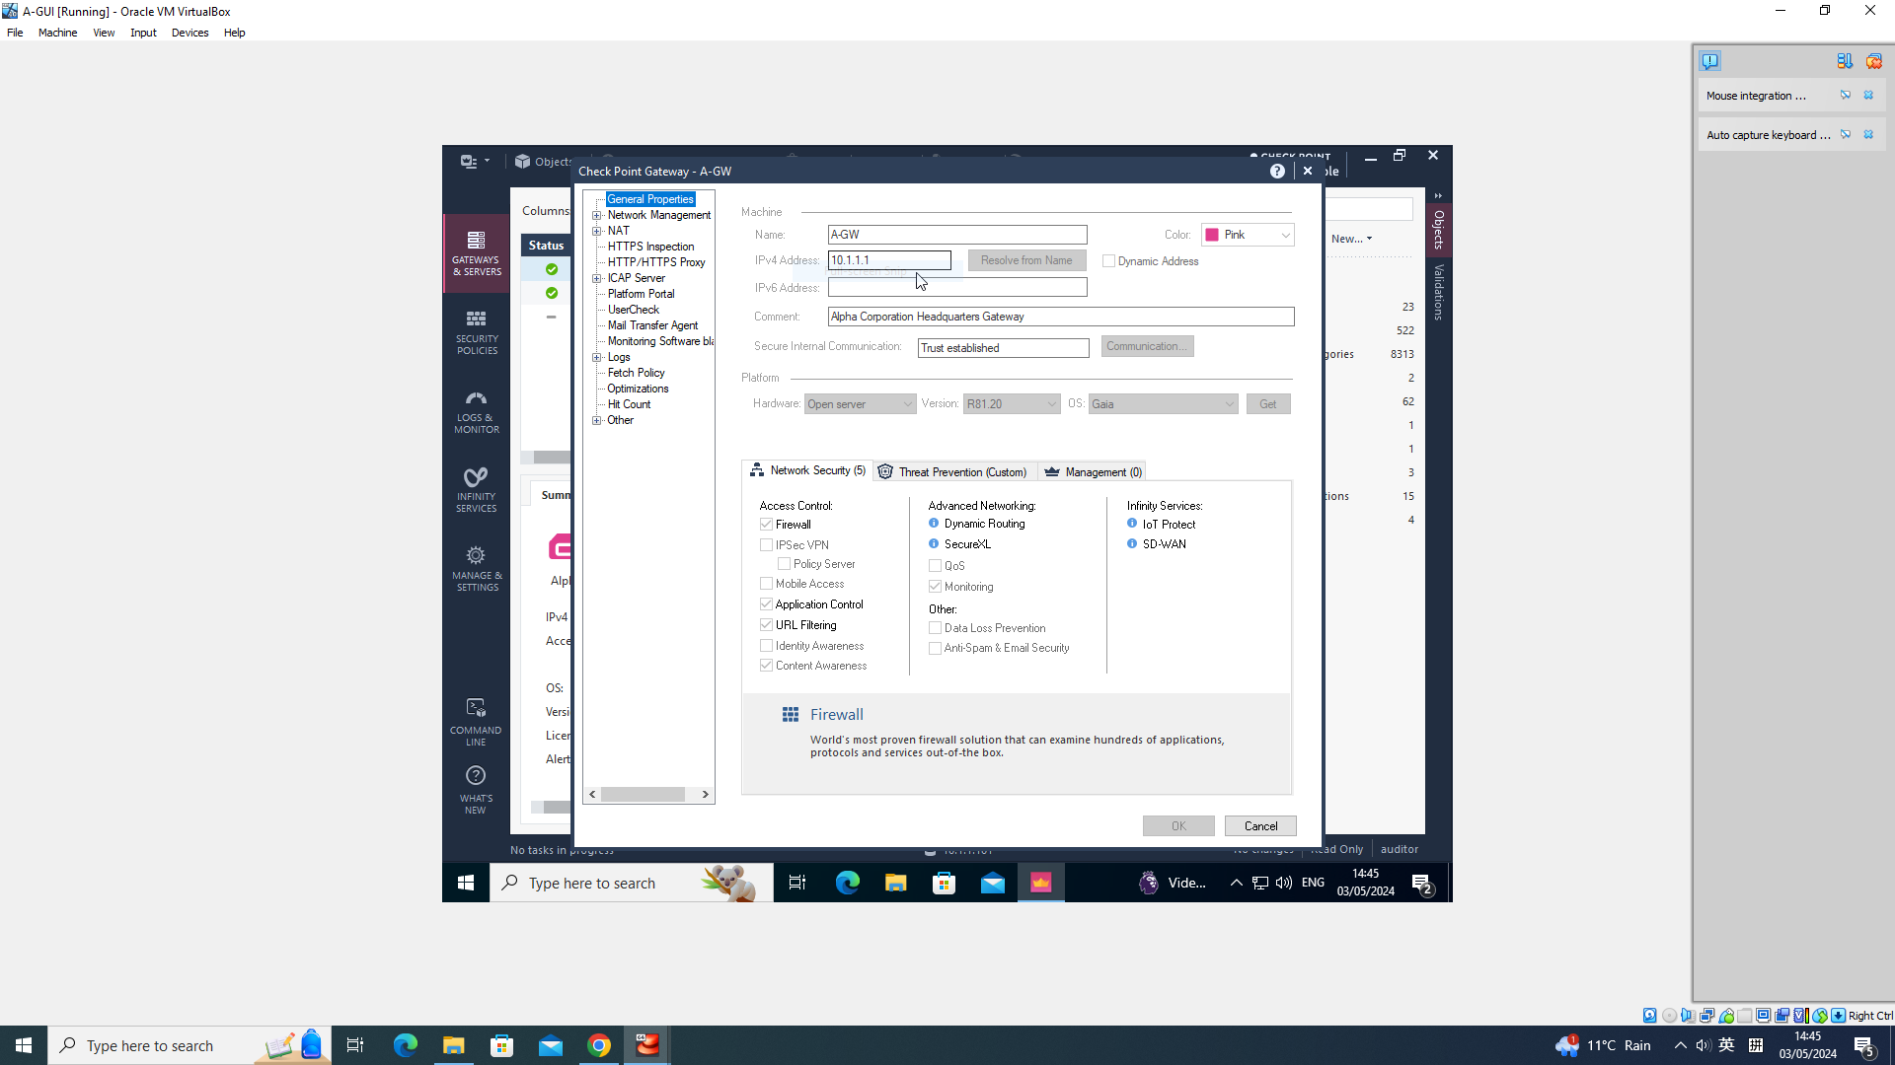
Establishing SIC and Managing Administrator Access
Testing Administrator Profiles Assigning :

Slide 31
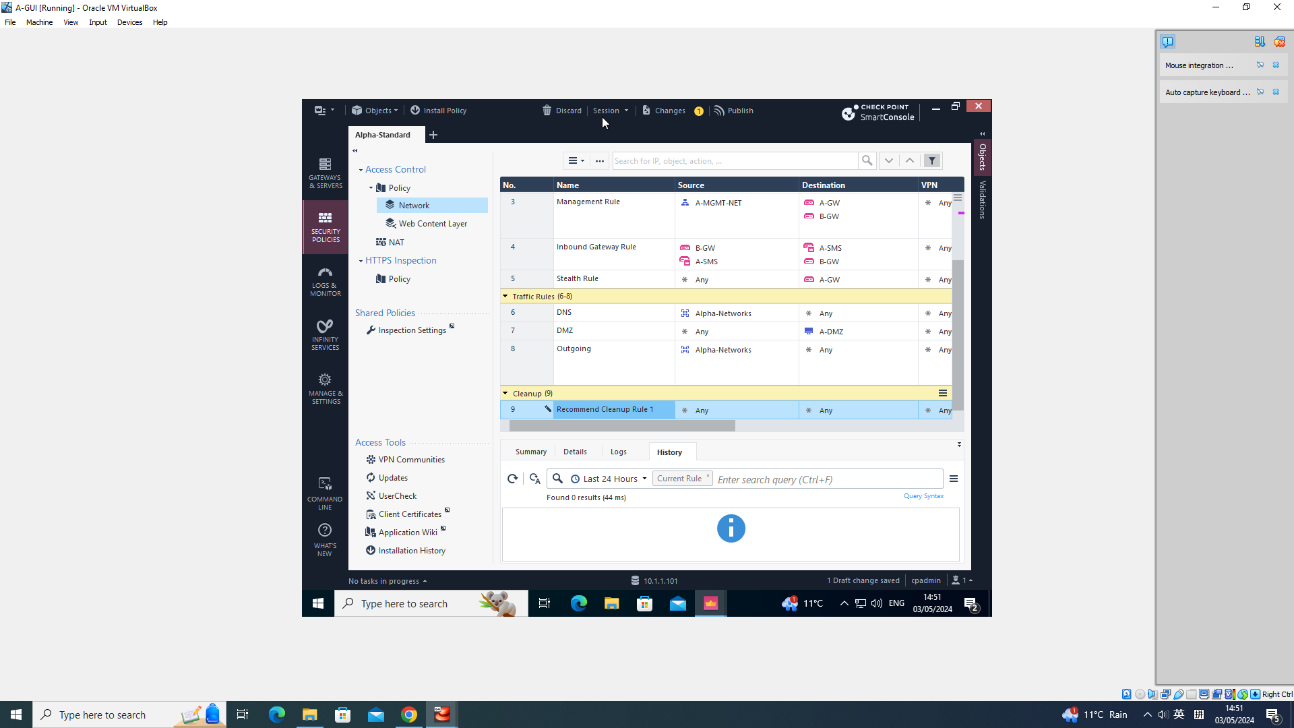
Establishing SIC and Managing Administrator Access
Concurrent Administrator Session:

Slide 32
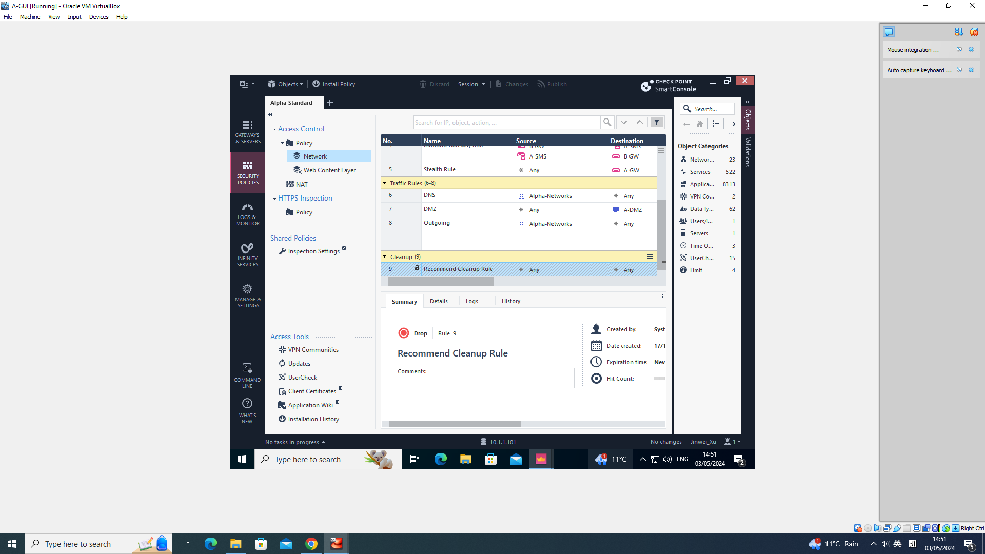
Establishing SIC and Managing Administrator Access
Concurrent Administrator Session:

Slide 33
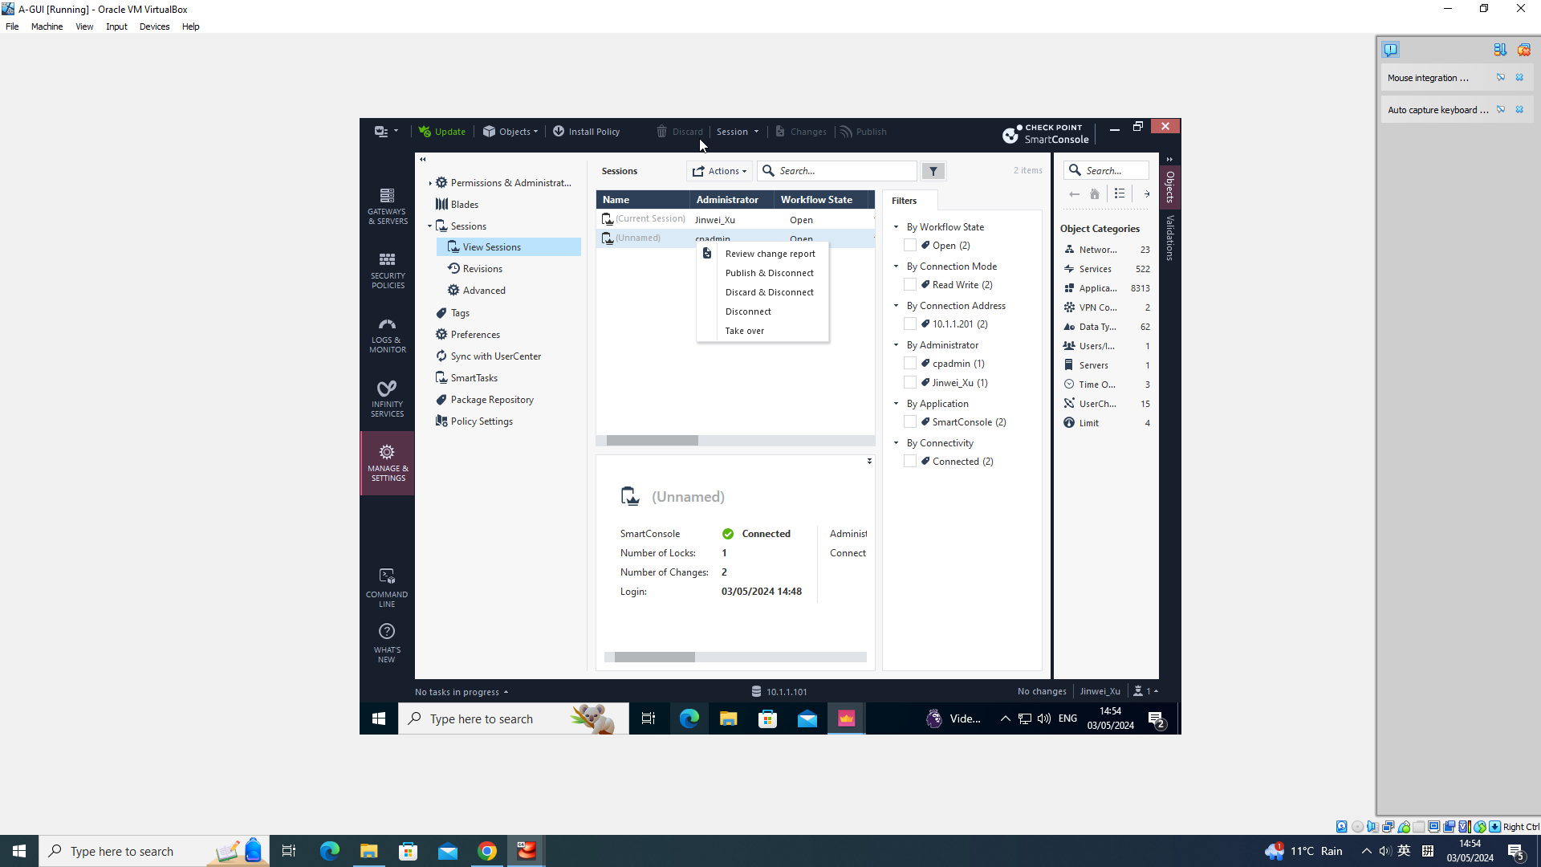
Establishing SIC and Managing Administrator Access
Taking over a Session:

Slide 34
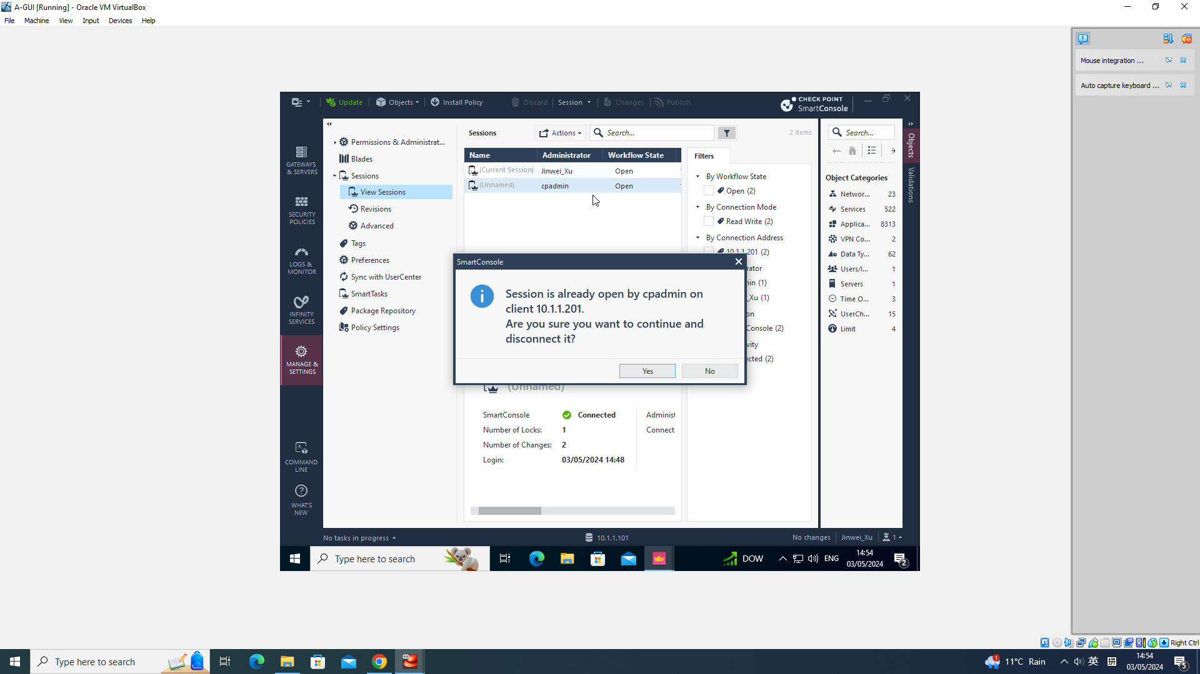
Establishing SIC and Managing Administrator Access
Taking over a Session:

Slide 35

Establishing SIC and Managing Administrator Access
Taking over a Session:

Slide 36
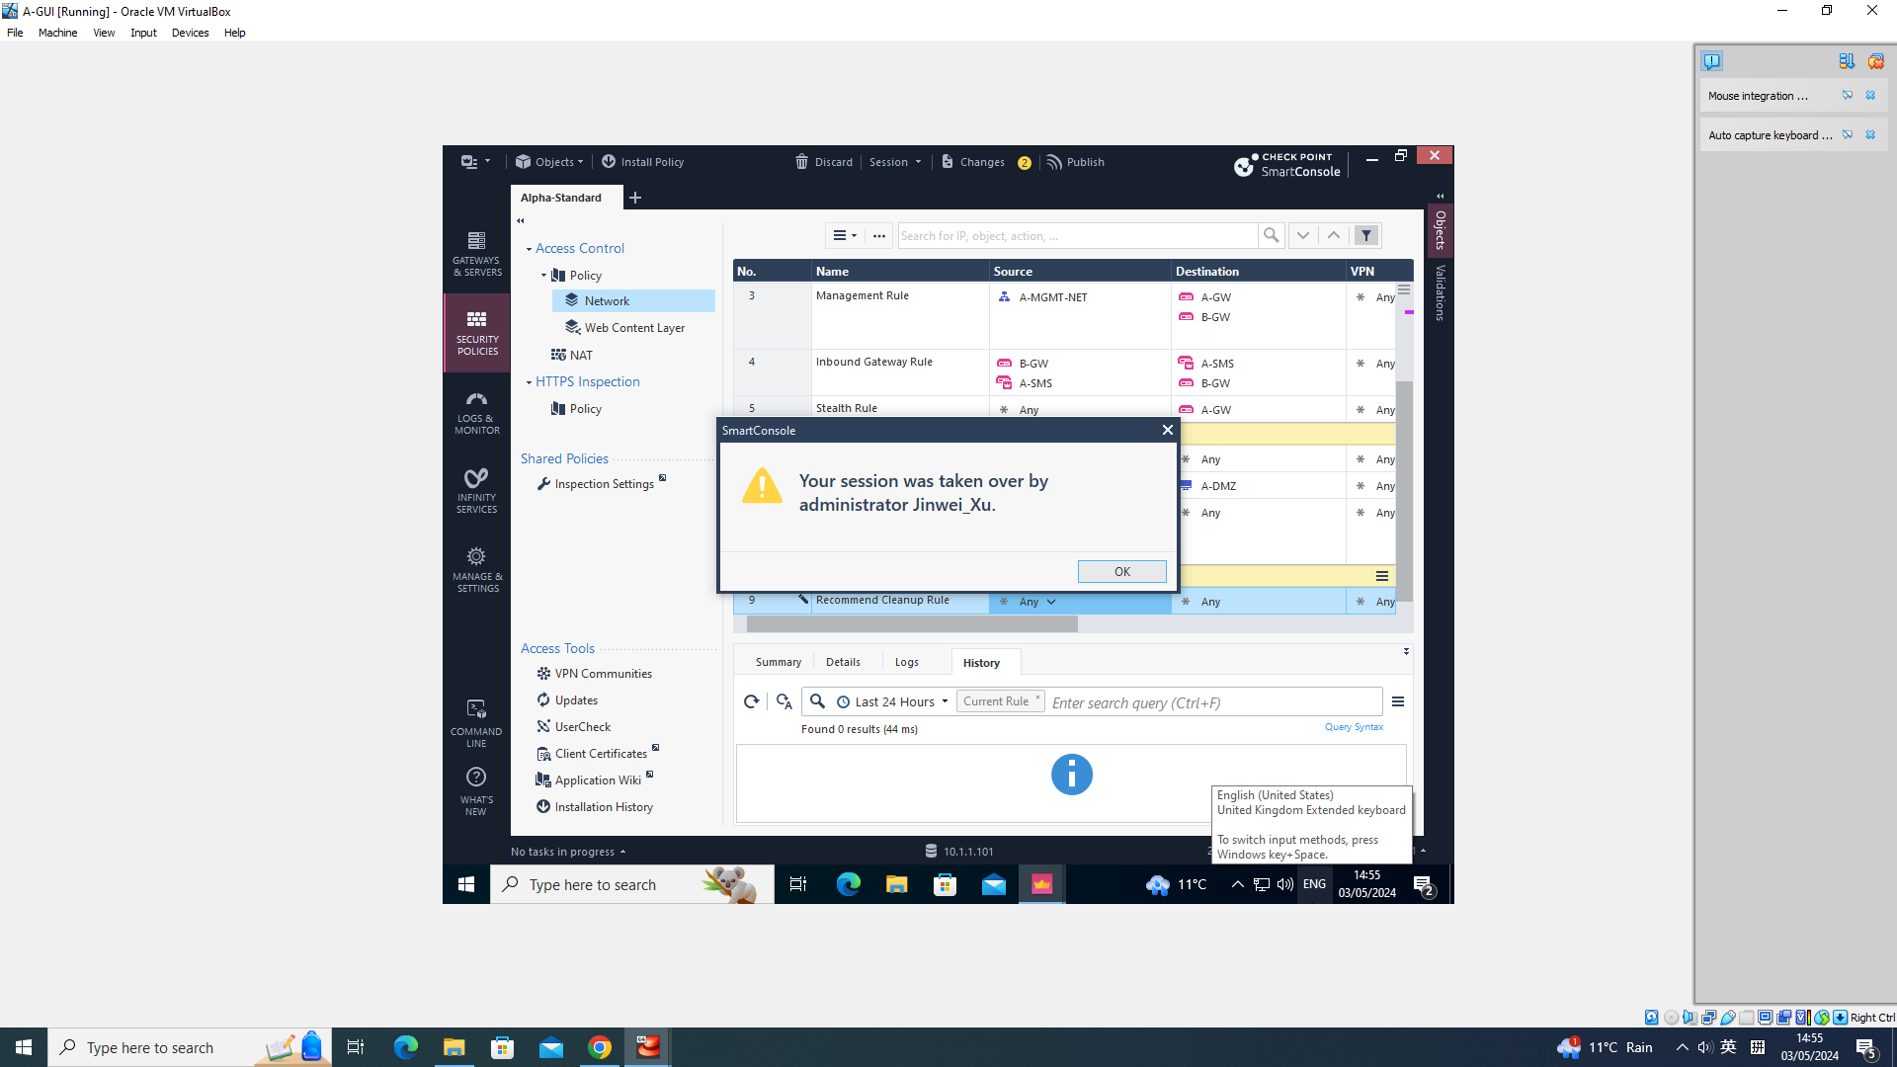
Establishing SIC and Managing Administrator Access
Taking over a Session:

Slide 37
Check Point Licensing and Contracts
Objectives and Outcomes:
Learn the purpose and use of Check Point licenses and contracts.
Manage licenses and contracts using Smart Update.
Review licenses and contracts status.

Slide 38
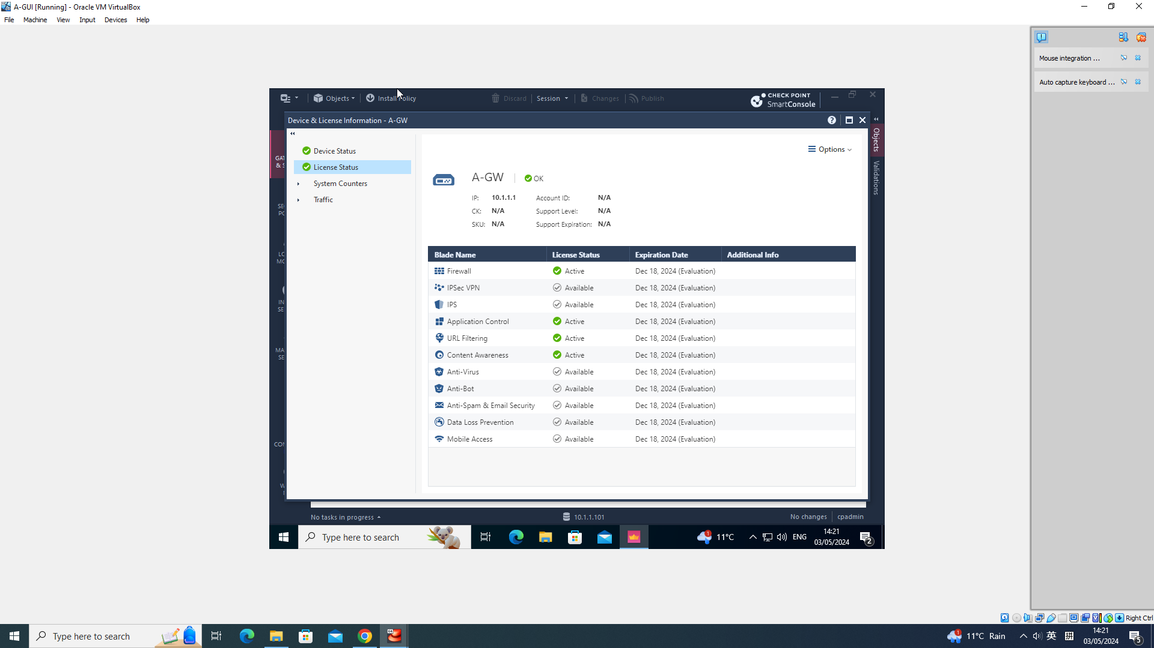
Check Point Licensing and Contracts
License Status in SmartConsole:

Slide 39
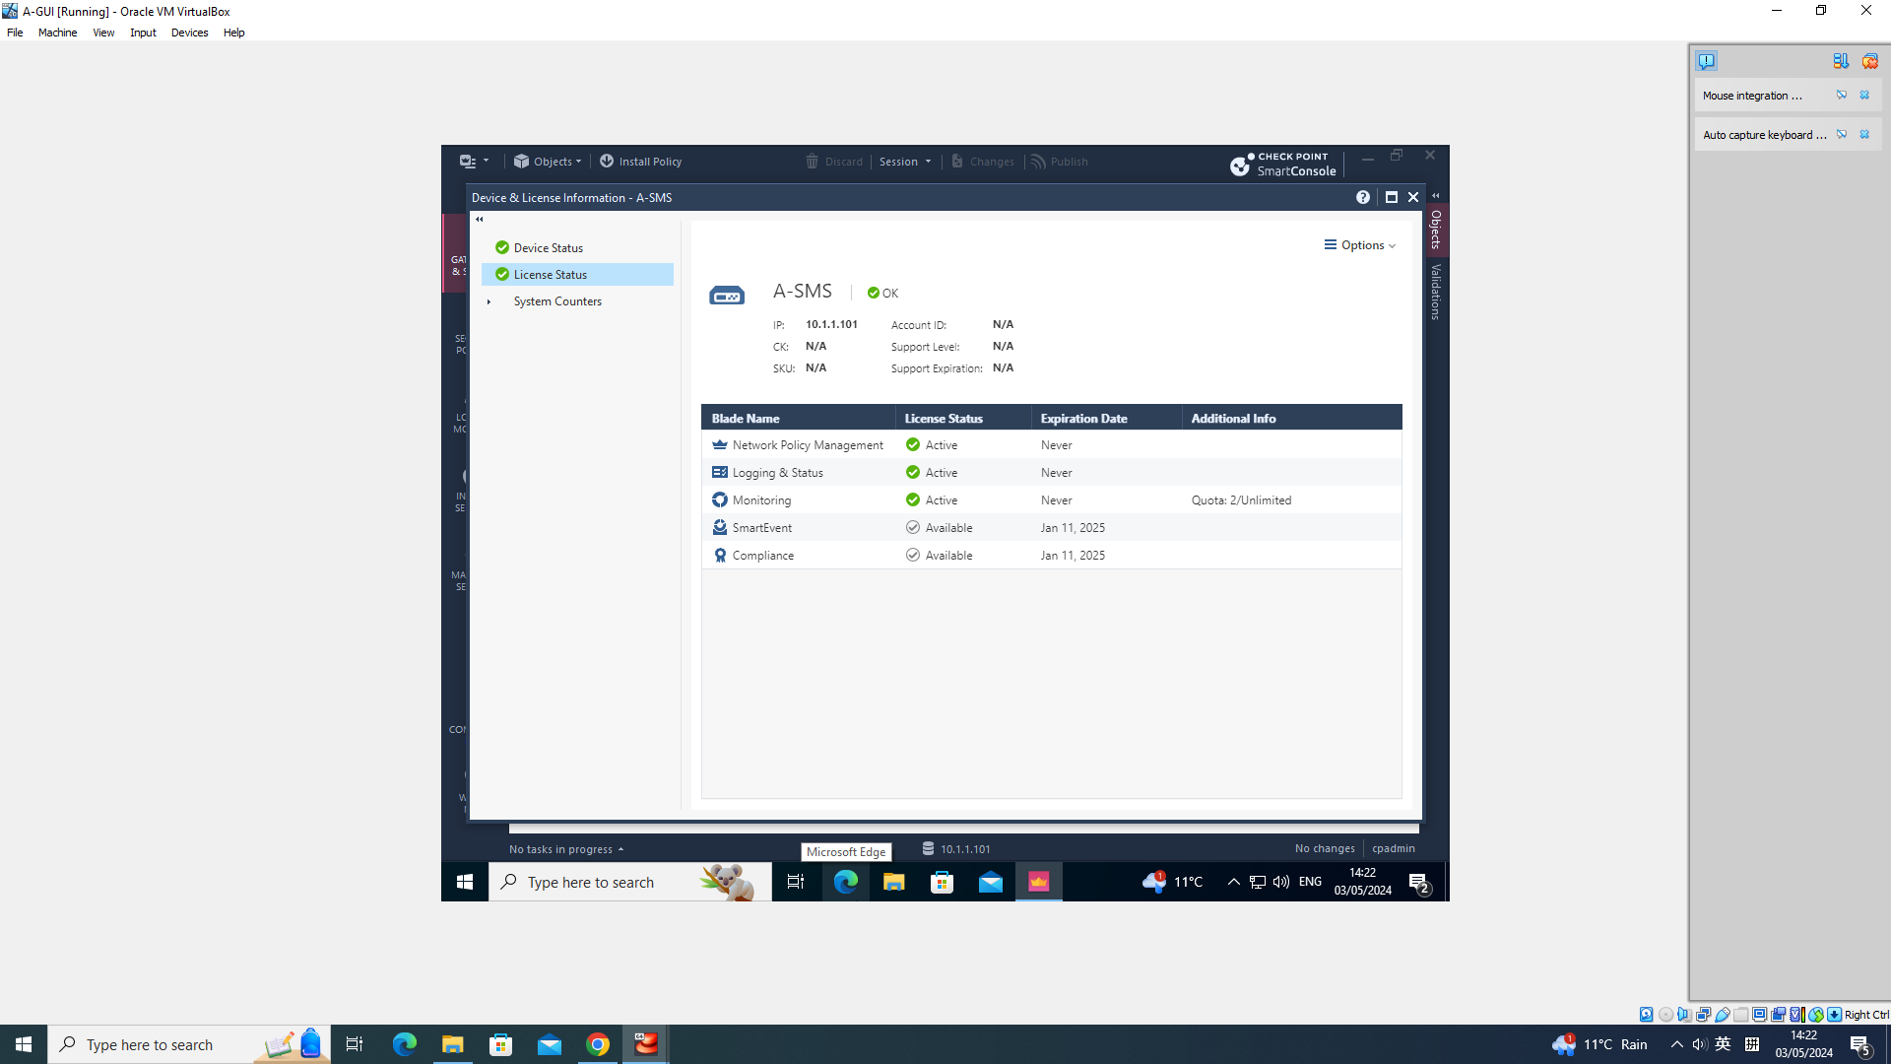
Check Point Licensing and Contracts
License Status in SmartConsole :

Slide 40
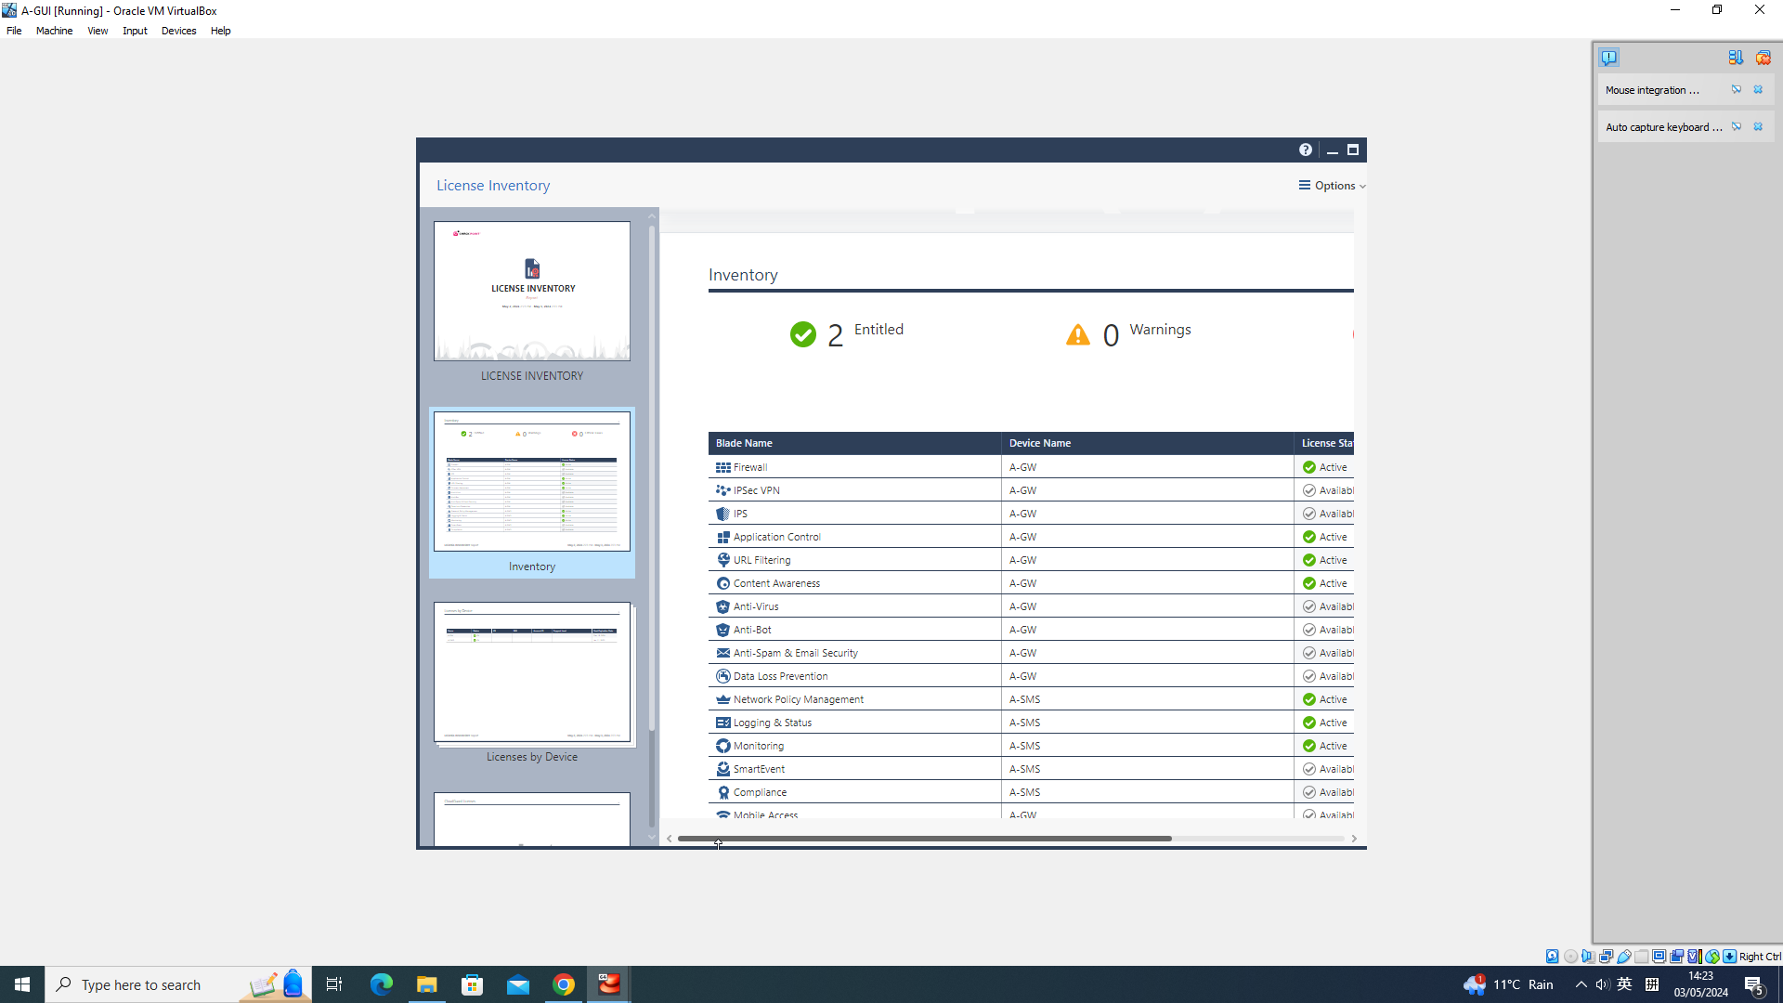
Check Point Licensing and Contracts
License Report:

Slide 41
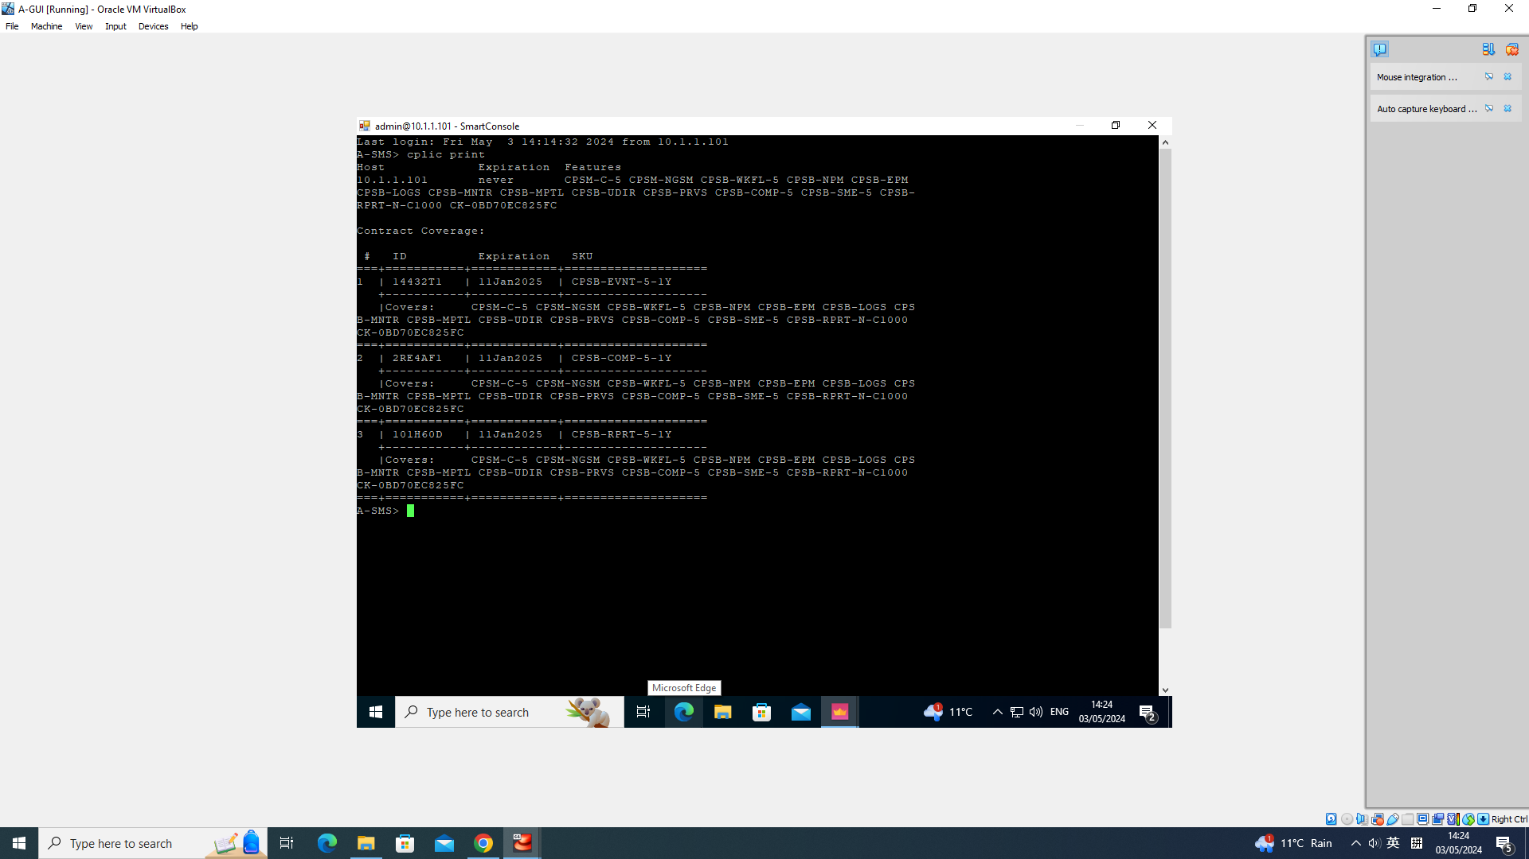
Check Point Licensing and Contracts
Viewing License in Command Line:

Slide 42
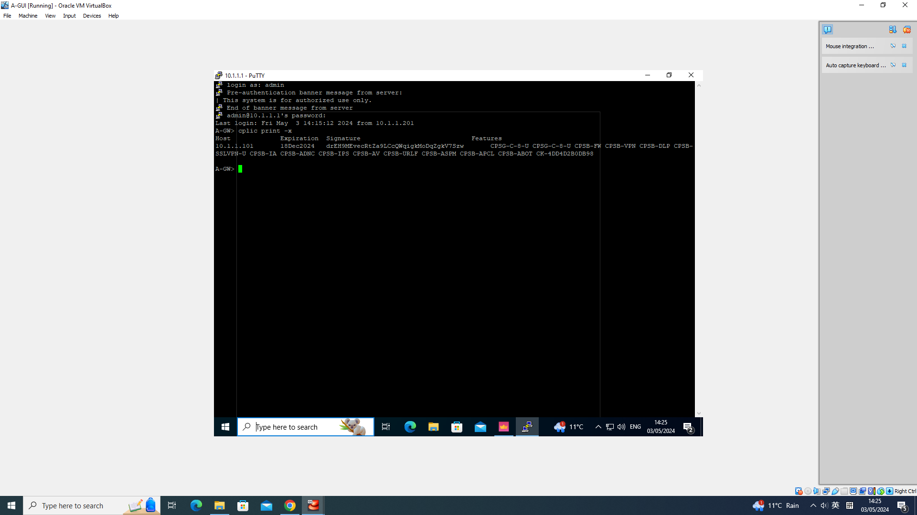
Check Point Licensing and Contracts
Viewing License in Command Line :

Slide 43
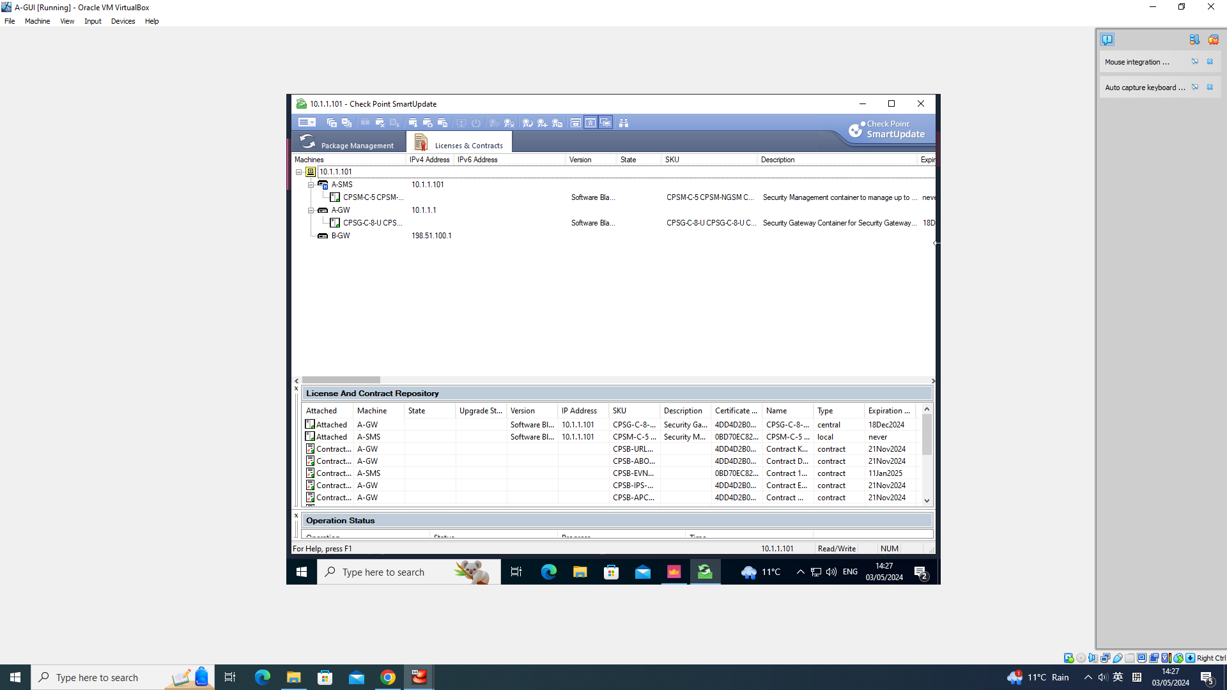
Check Point Licensing and Contracts
Using SmartUpdate to Manage Licenses and Contracts:

Slide 44
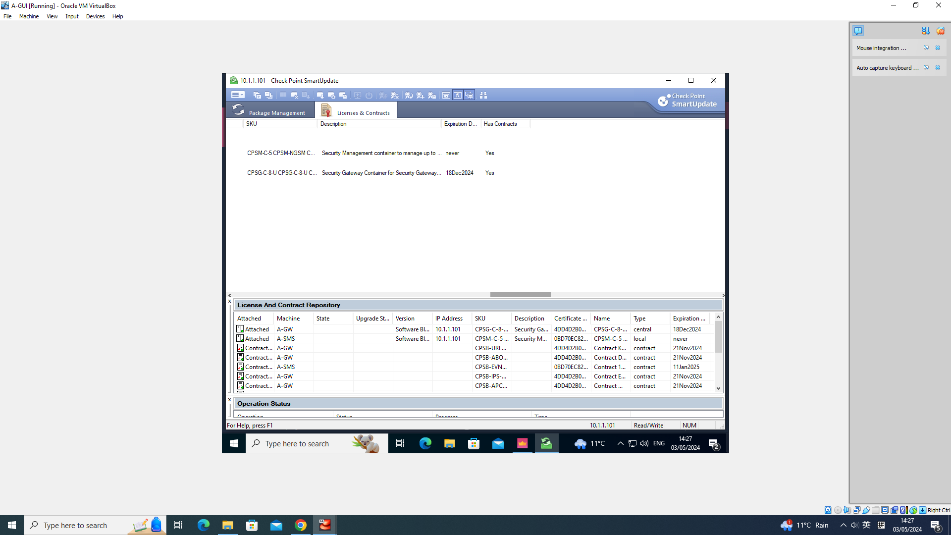
Check Point Licensing and Contracts
Using SmartUpdate to Manage Licenses and Contracts :

Slide 45
Check Point Licensing and Contracts
Video:
https://uowtsd-my.sharepoint.com/:v:/r/personal/2304705_student_uwtsd_ac_uk/Documents/Documents/Enterprise%20Network%20Security/Assignment/License%20Recording.mp4?csf=1&web=1&nav=eyJyZWZlcnJhbEluZm8iOnsicmVmZXJyYWxBcHAiOiJPbmVEcml2ZUZvckJ1c2luZXNzIiwicmVmZXJyYWxBcHBQbGF0Zm9ybSI6IldlYiIsInJlZmVycmFsTW9kZSI6InZpZXciLCJyZWZlcnJhbFZpZXciOiJNeUZpbGVzTGlua0NvcHkifX0&e=2DBhsv

Slide 46
Check Point Licensing and Contracts
Challenges:
Due to the initial settings, the virtual machine cannot connect to the Internet, preventing the copying of the License and contract into the virtual machine.
After installing licenses and contracts, the licenses for the gateway and SMS remain unlicensed for a long period of time.

Slide 47
Check Point Security Policy
Objectives and Outcomes:
Learn Check Point security policy
Create policy packet, policy layer
Create security policy rule
Publish and install policy
Test policy

Slide 48
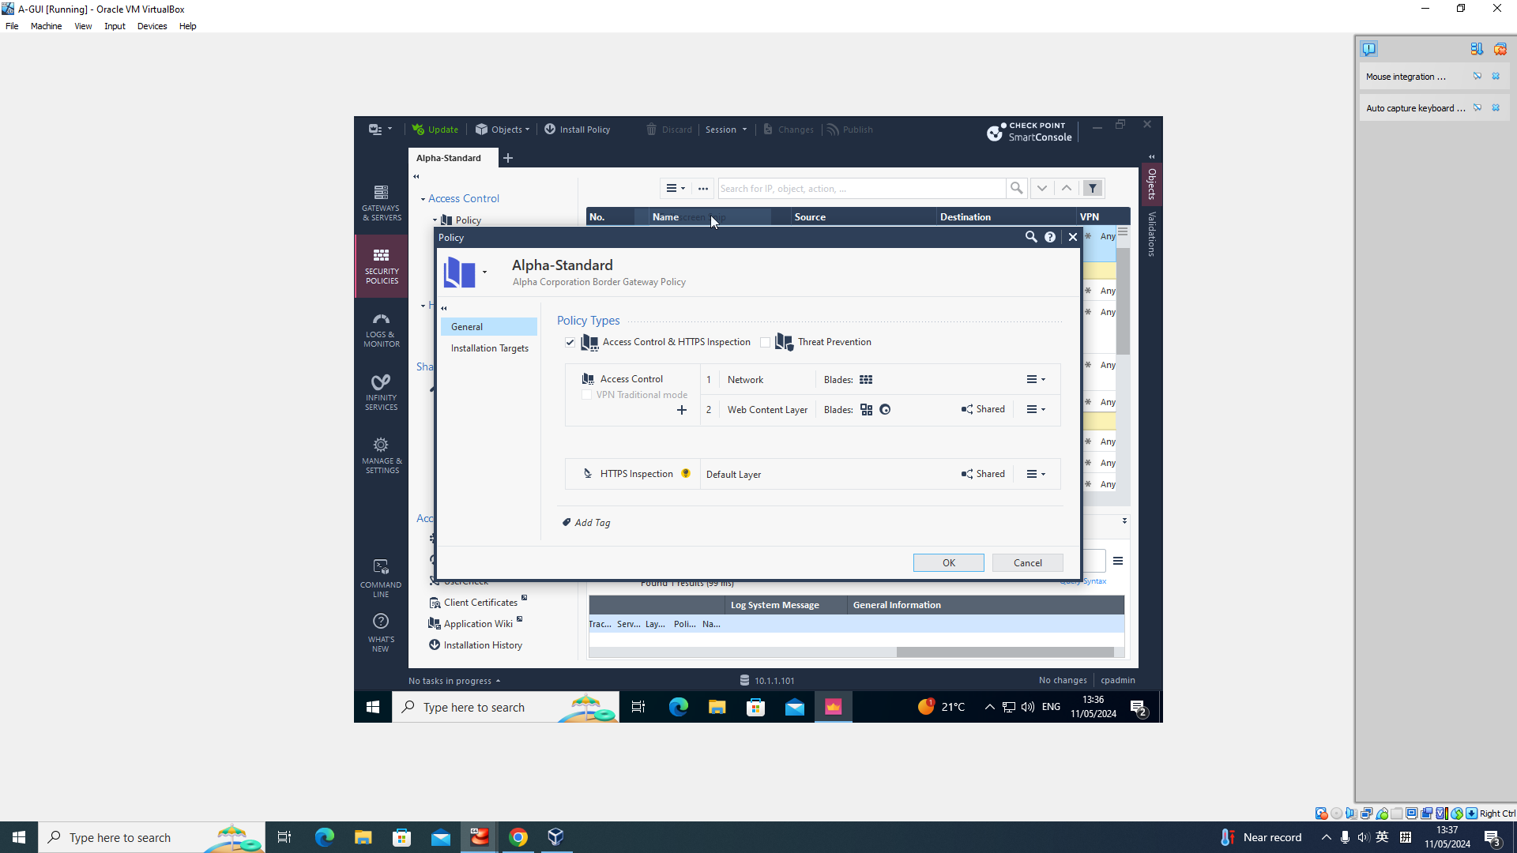
Check Point Security Policy
Policy Packet:

Slide 49
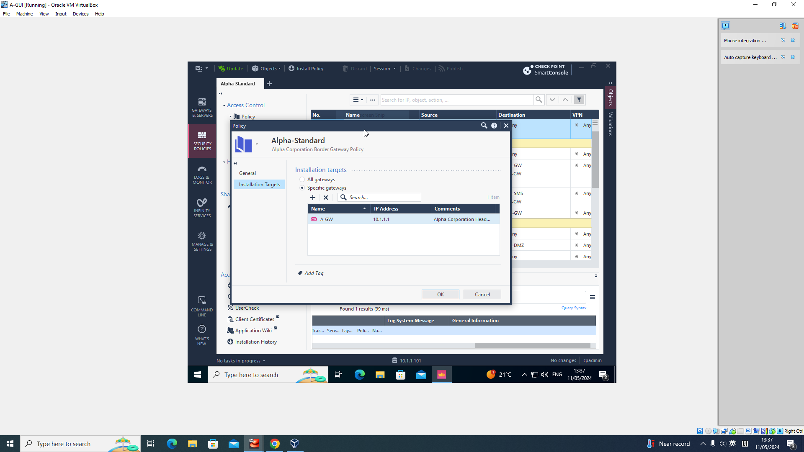
Check Point Security Policy
Policy Packet:

Slide 50
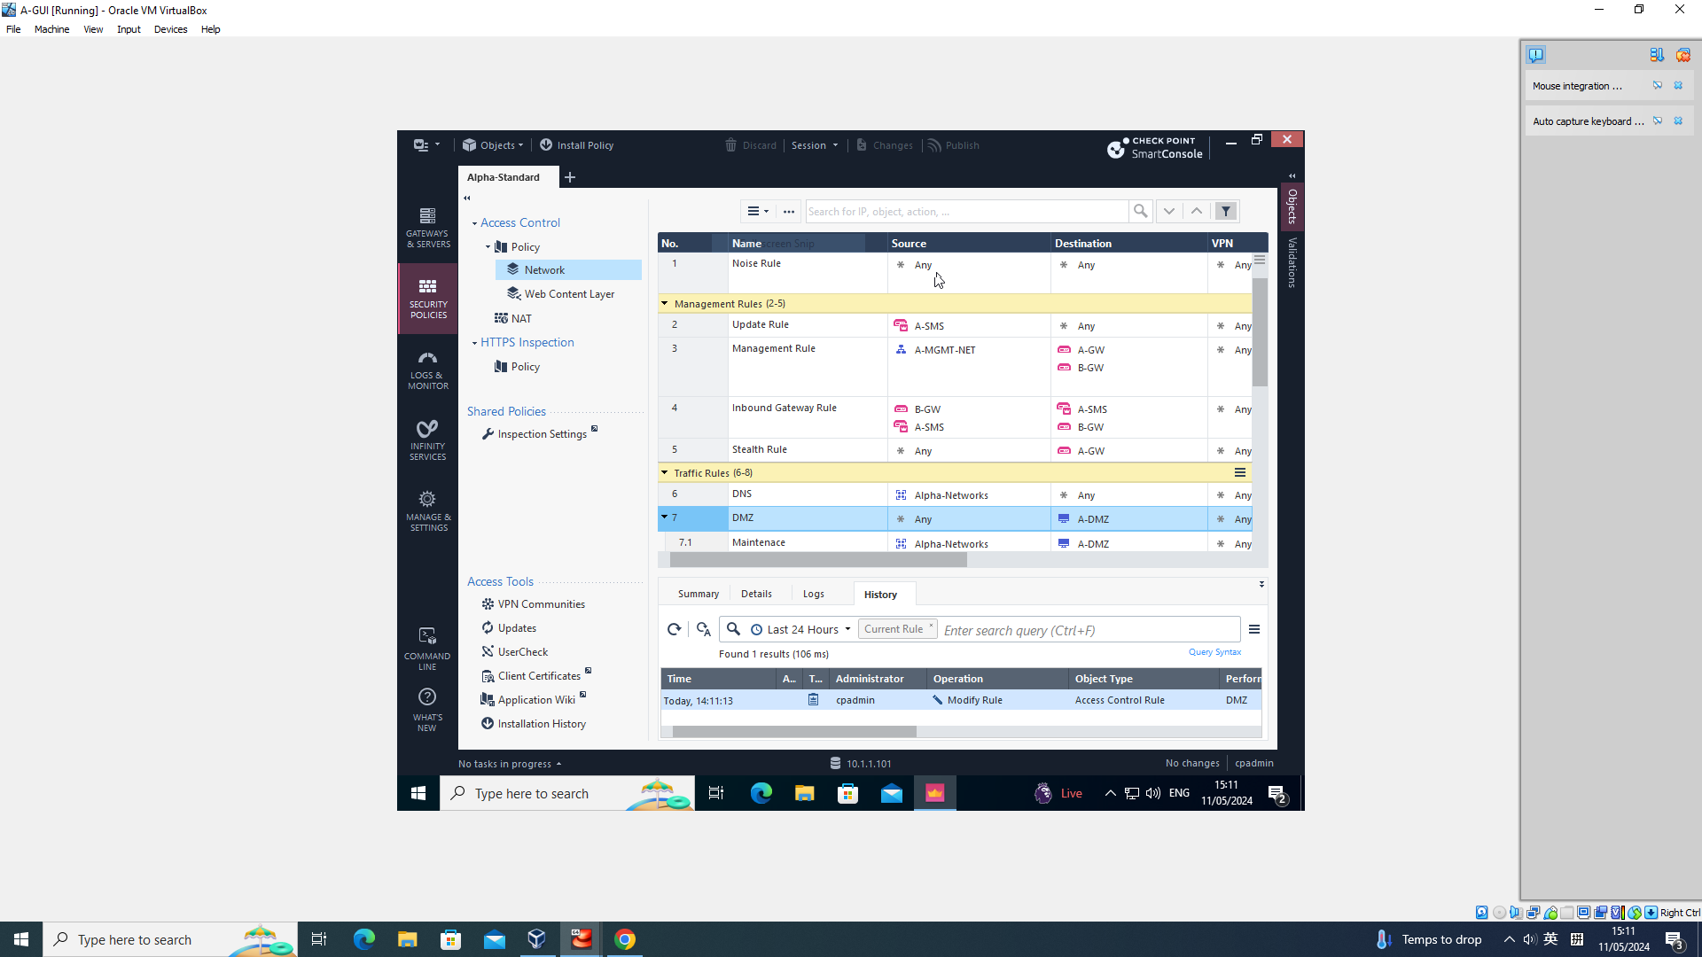
Check Point Security Policy
Policy Layer:

Slide 51
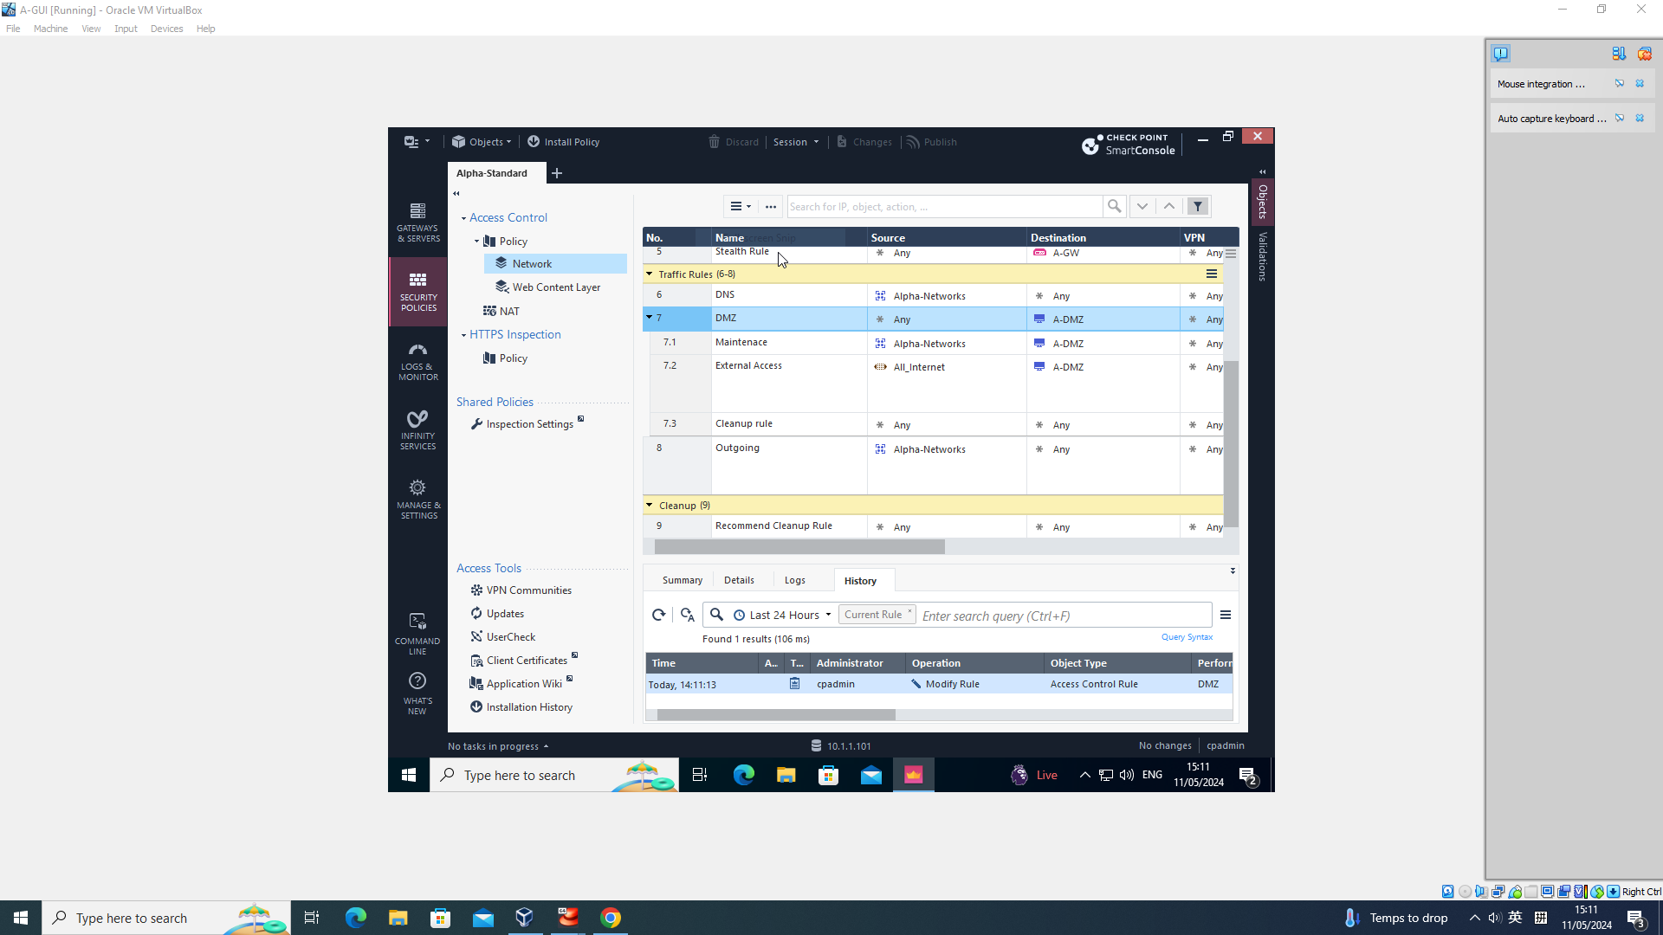
Check Point Security Policy
Inline layer:

Slide 52
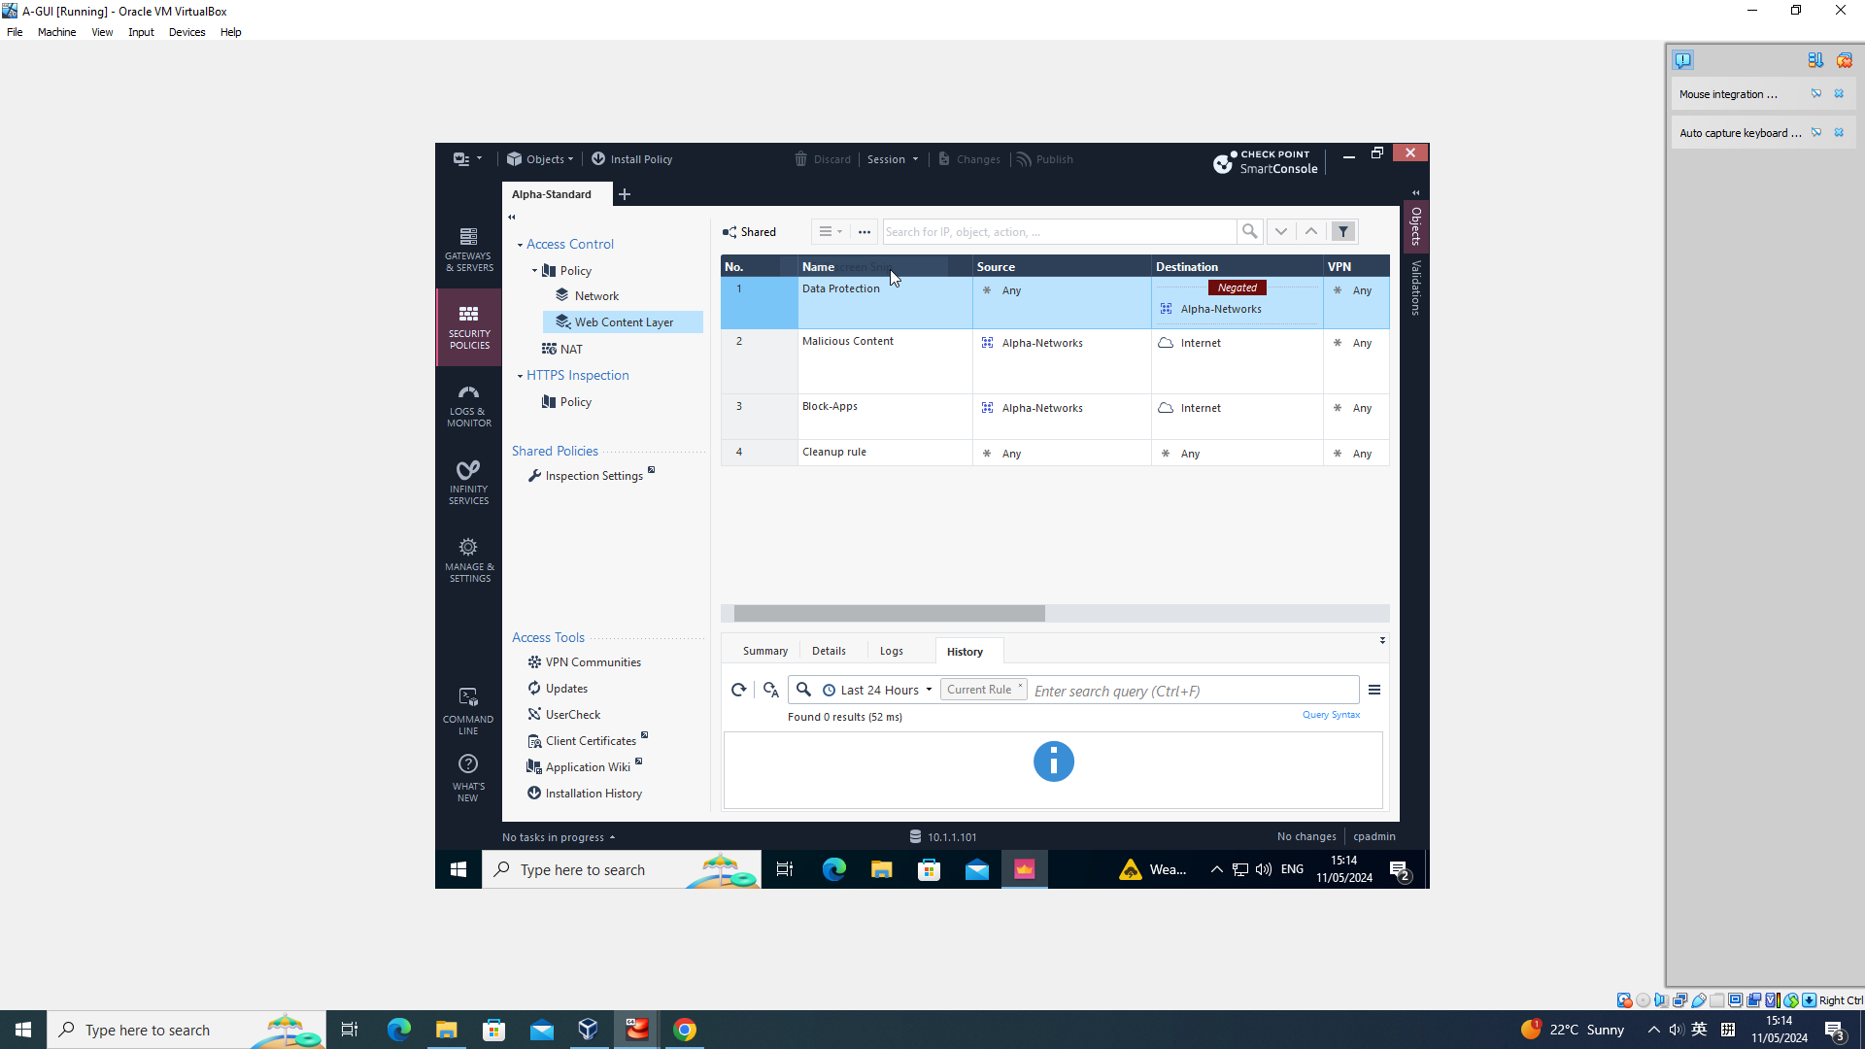
Check Point Security Policy
Ordered layer:

Slide 53
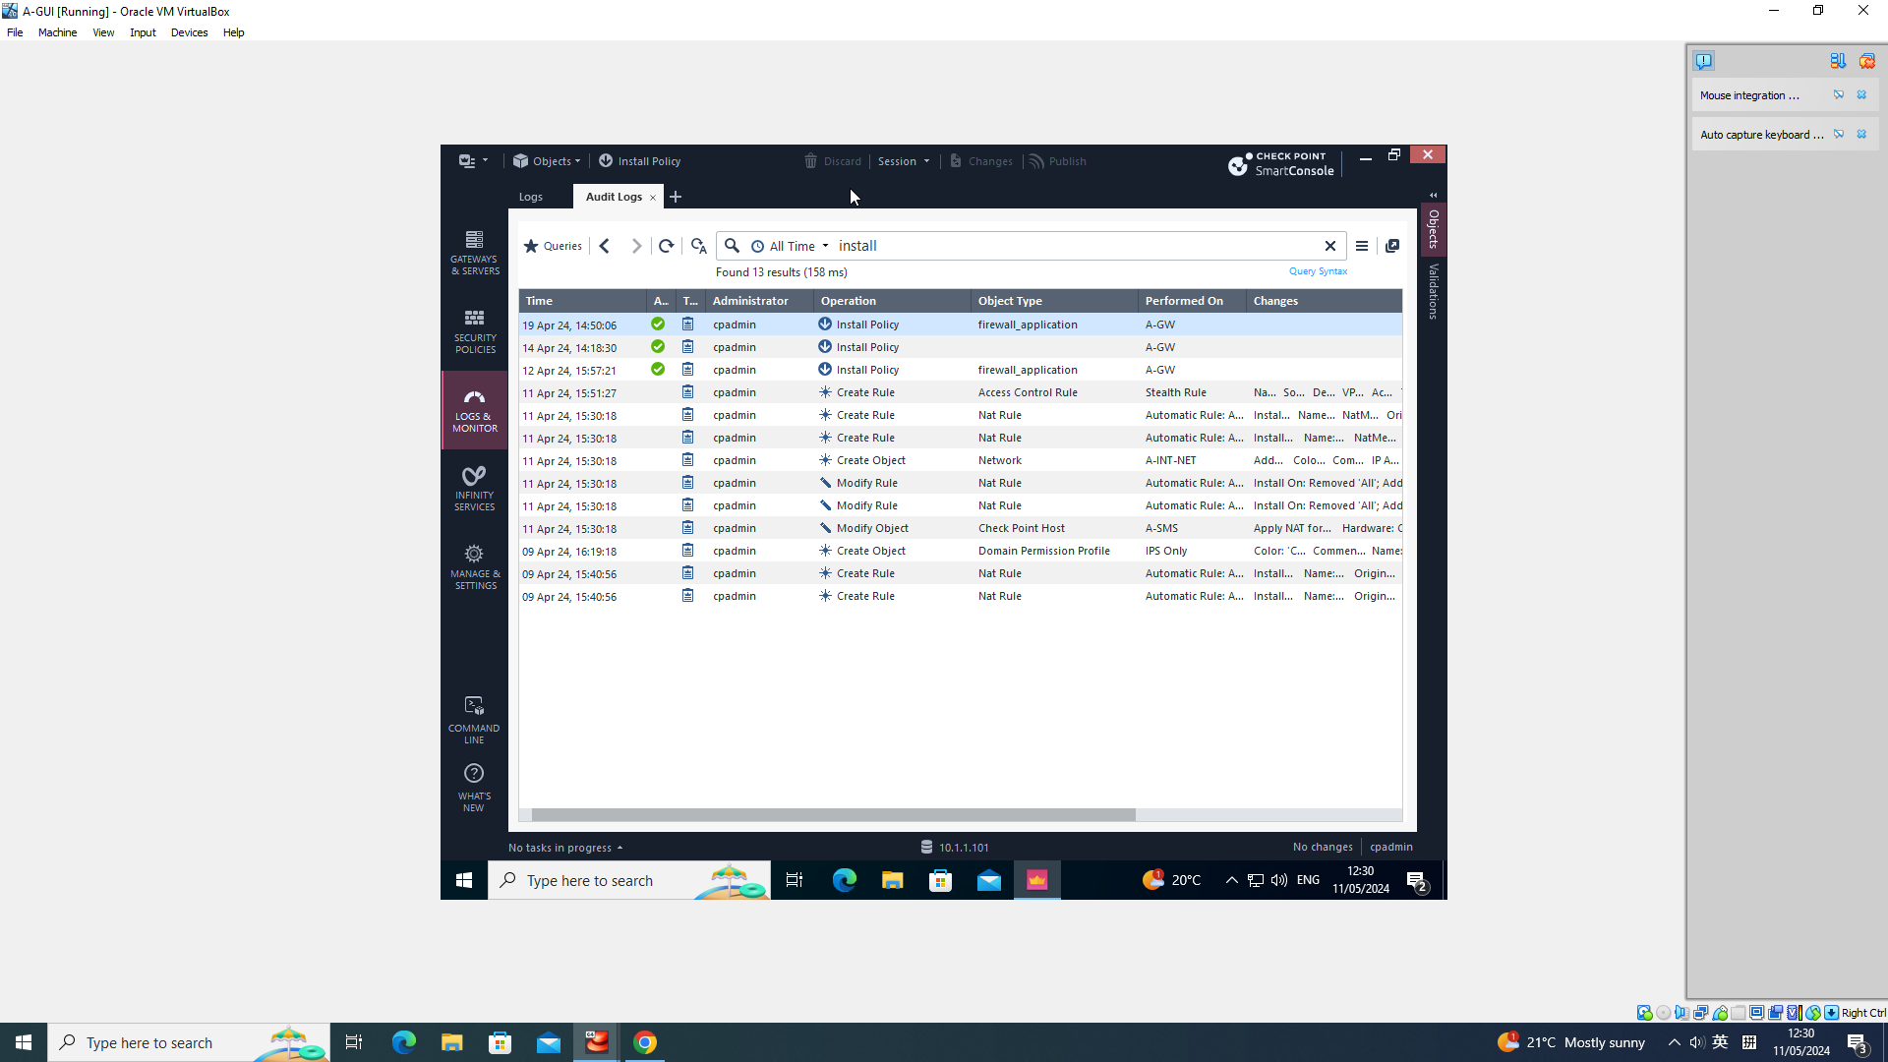
Check Point Security Policy
Policy Installation Log:

Slide 54
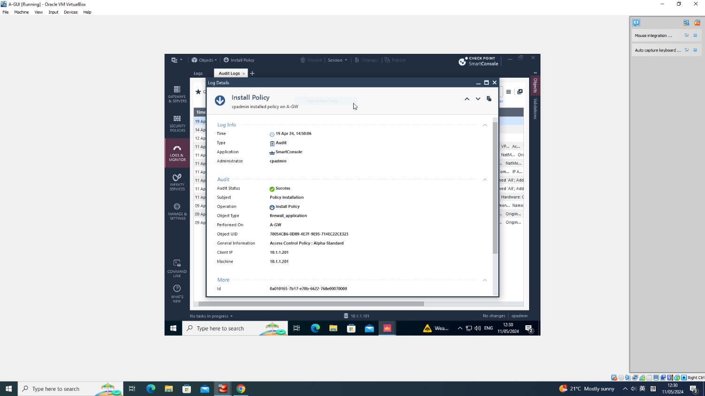
Check Point Security Policy
Policy Installation Log:

Slide 55
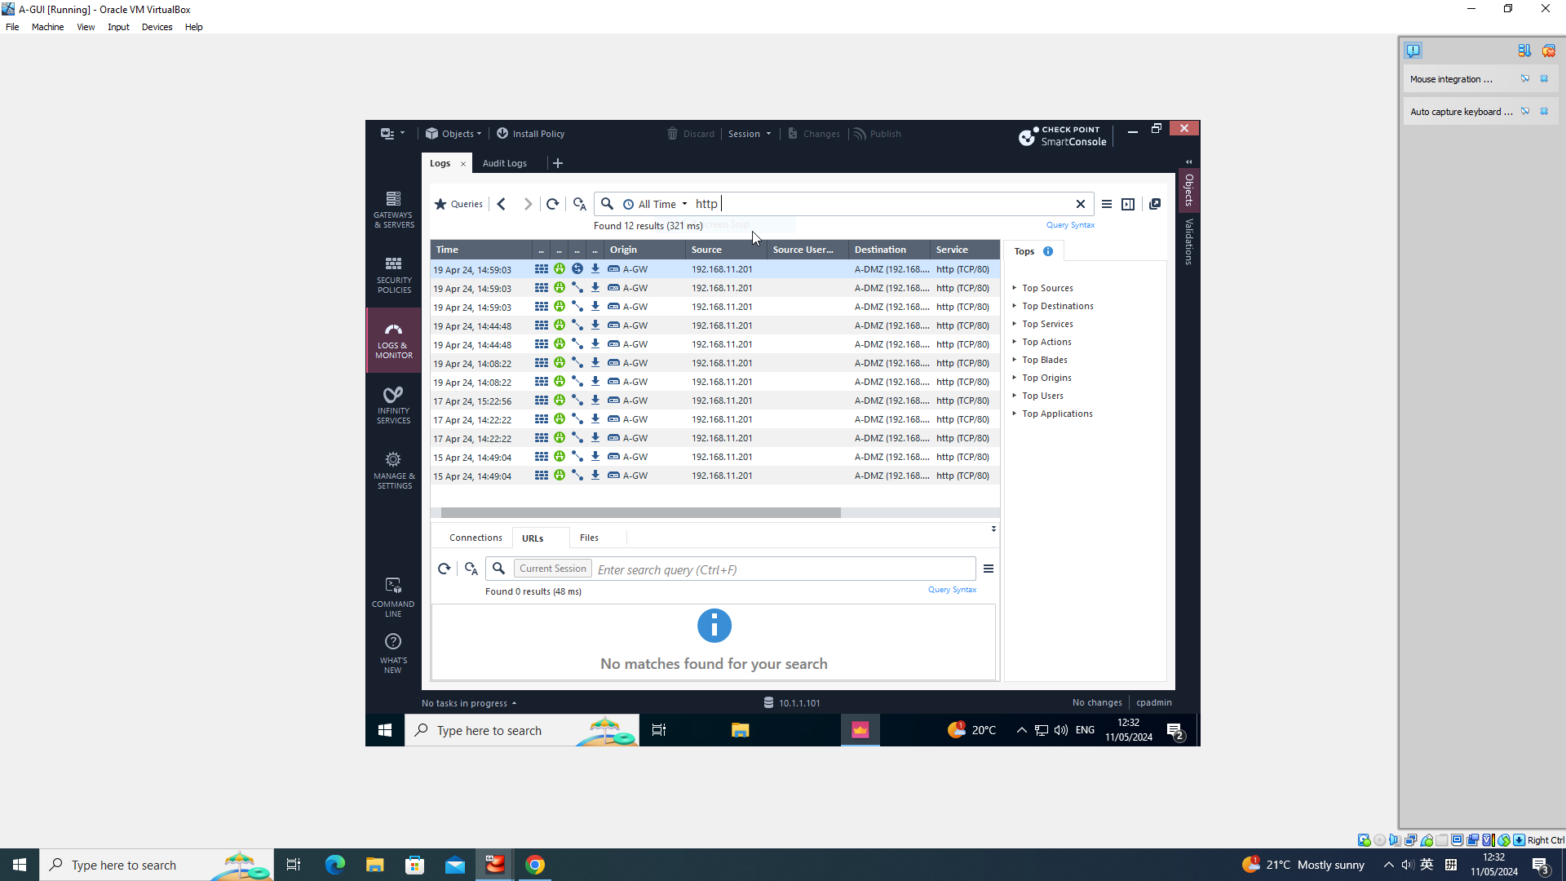
Check Point Security Policy
Test of Policy:

Slide 56
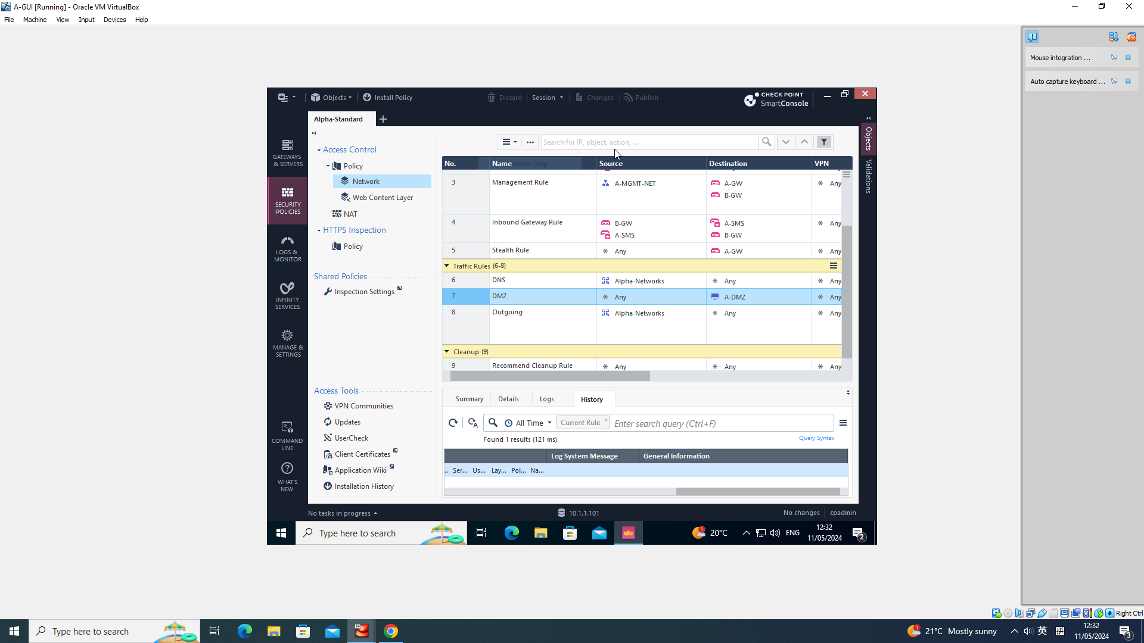
Check Point Security Policy
Test of Policy:

Slide 57
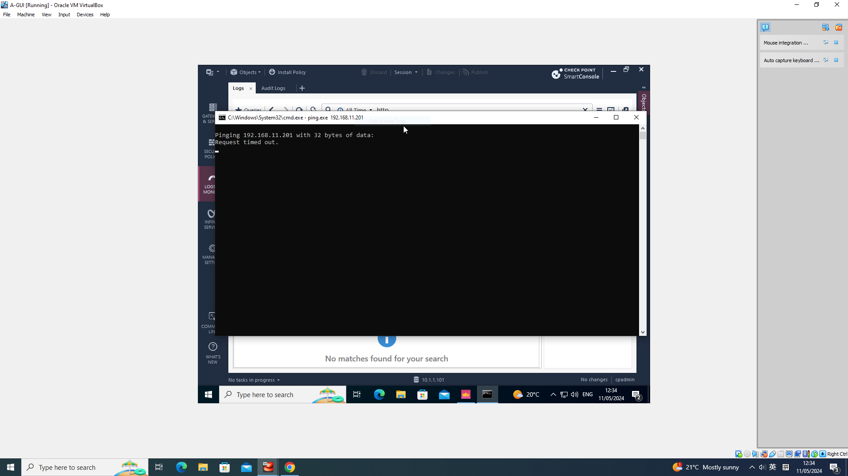
Check Point Security Policy
Test of Policy:

Slide 58
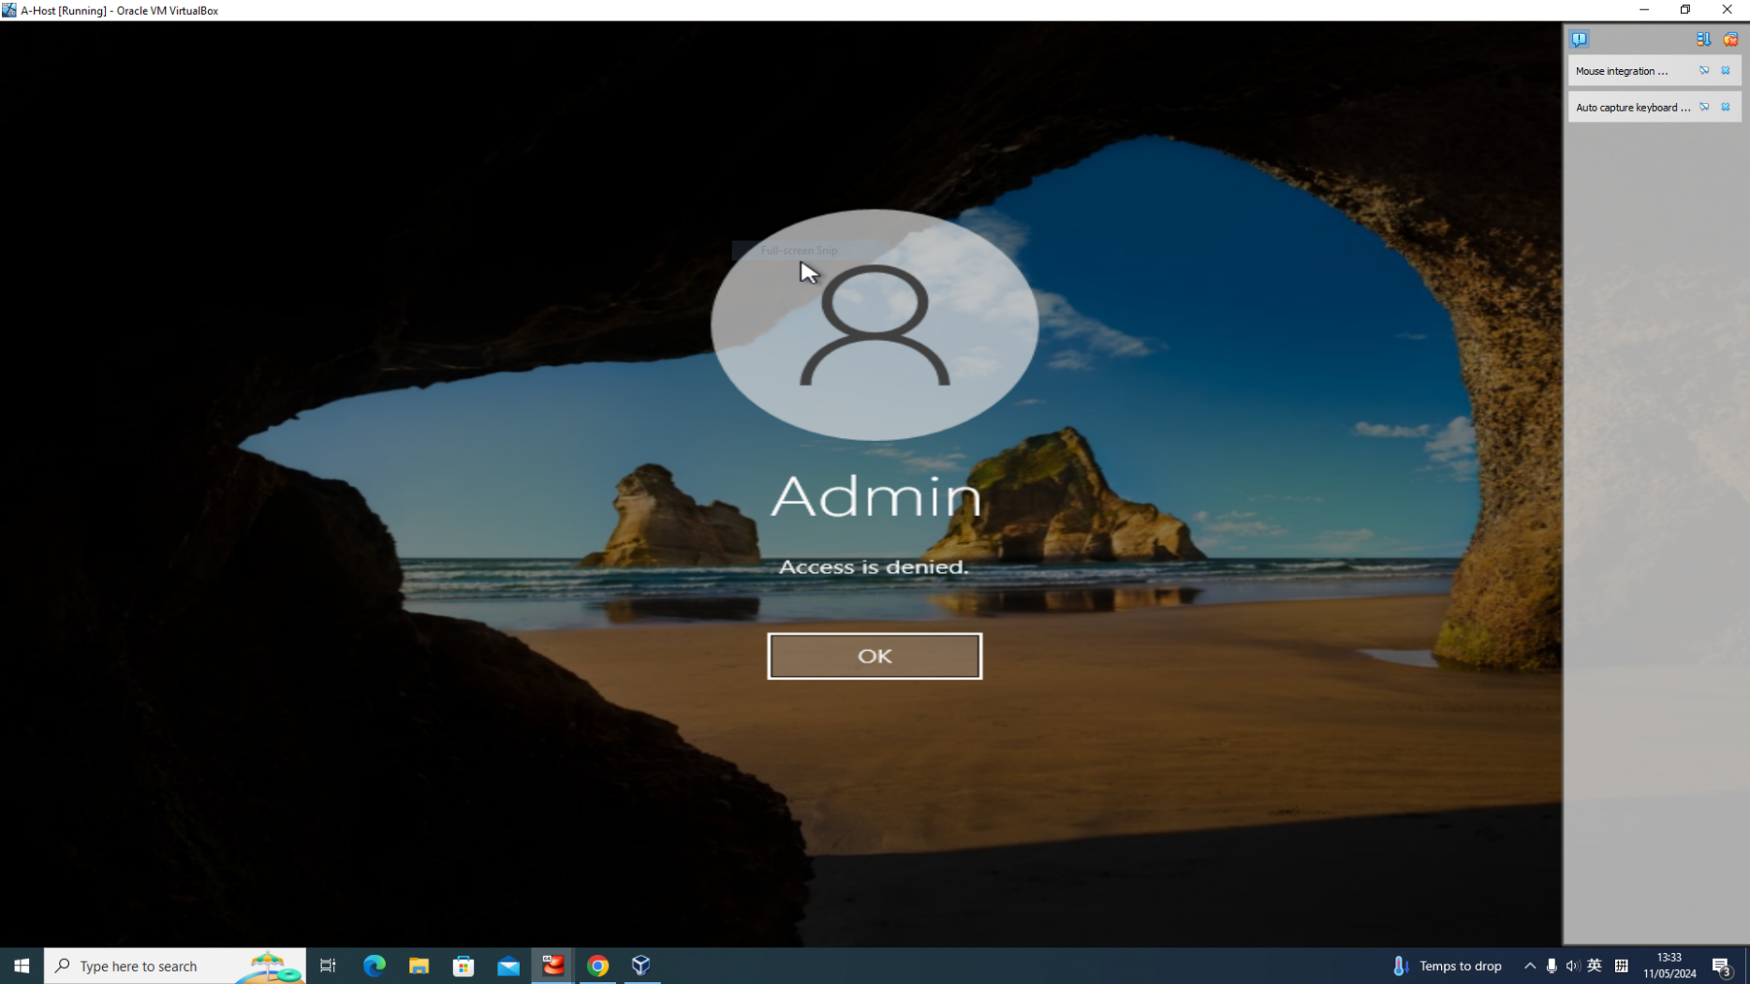
Check Point Security Policy
Test of Policy:

Slide 59
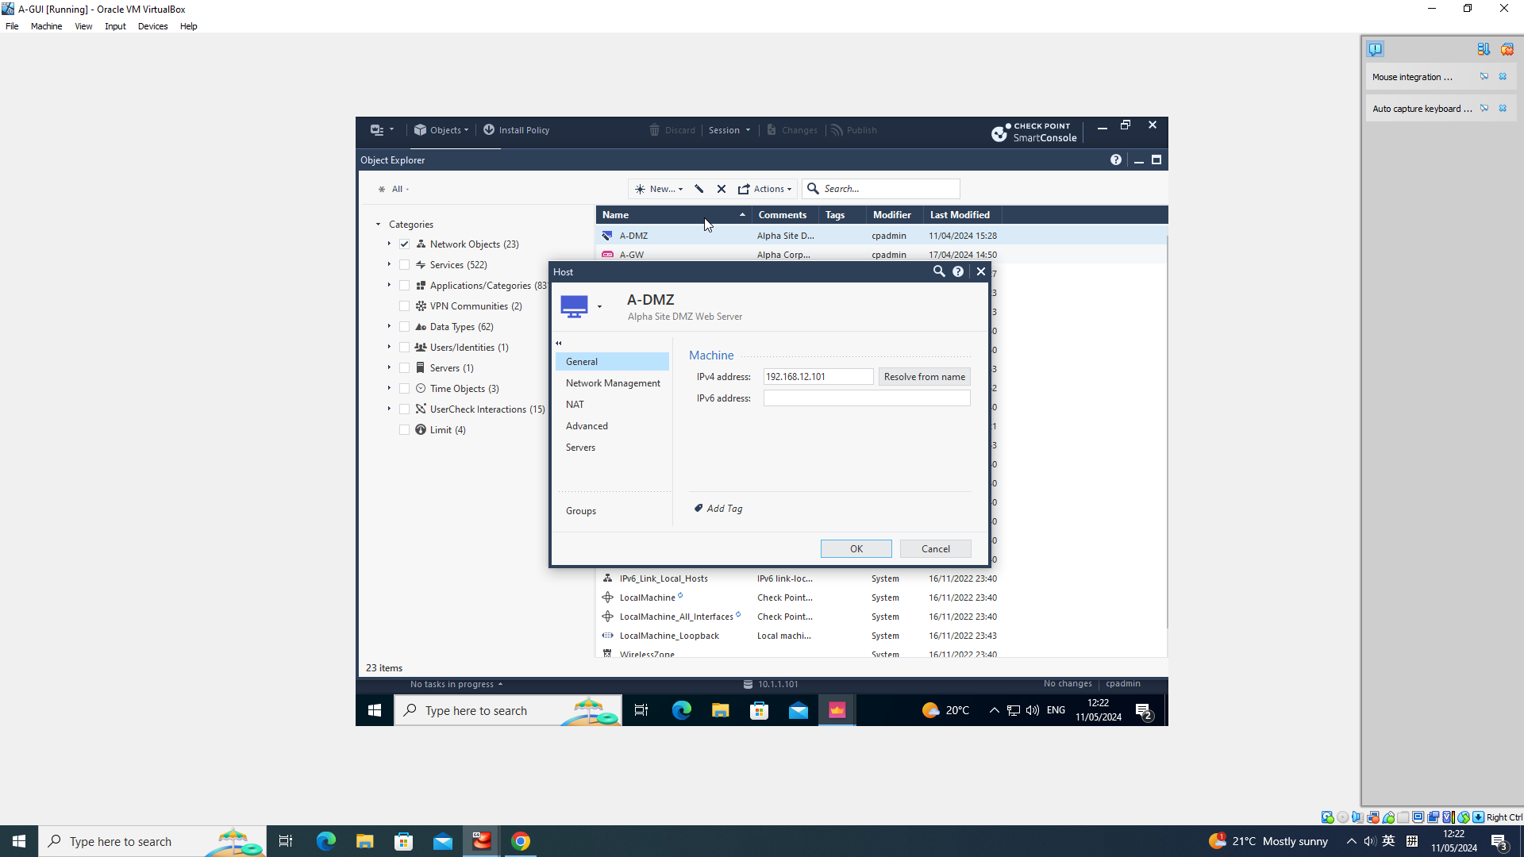
Check Point Security Policy
Policy Objects:

Slide 60
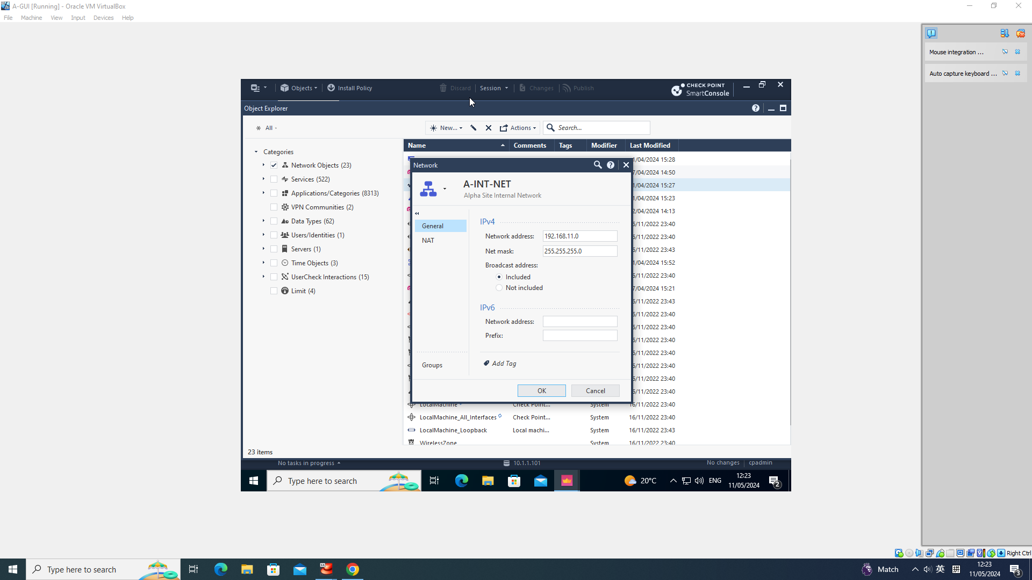
Check Point Security Policy
Policy Objects:

Slide 61
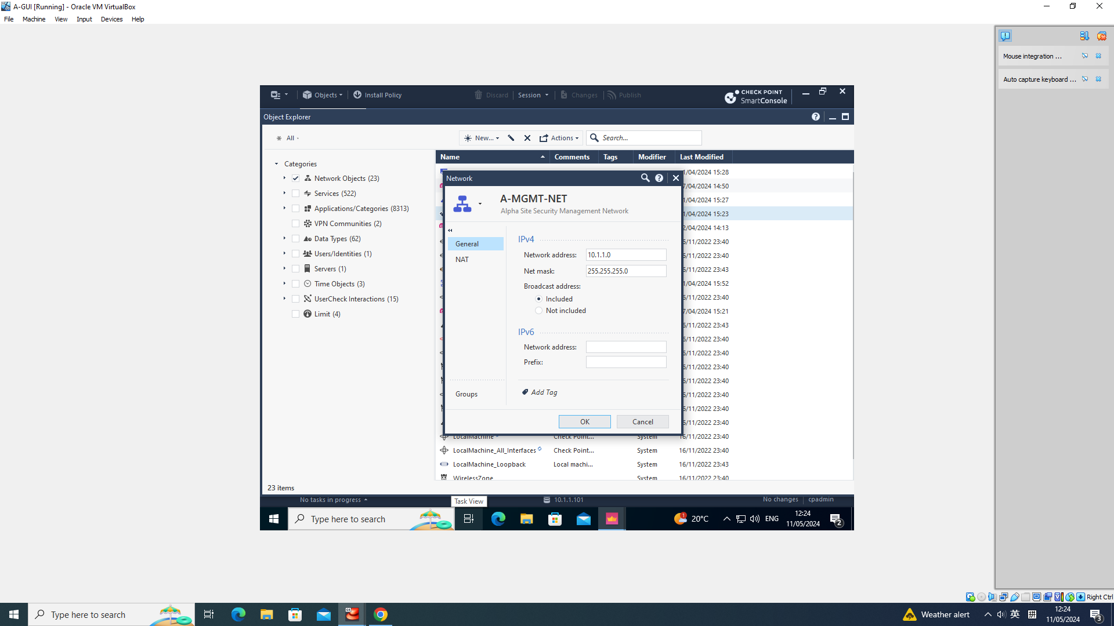
Check Point Security Policy
Policy Objects:

Slide 62

Check Point Security Policy
Policy Objects:

Slide 63
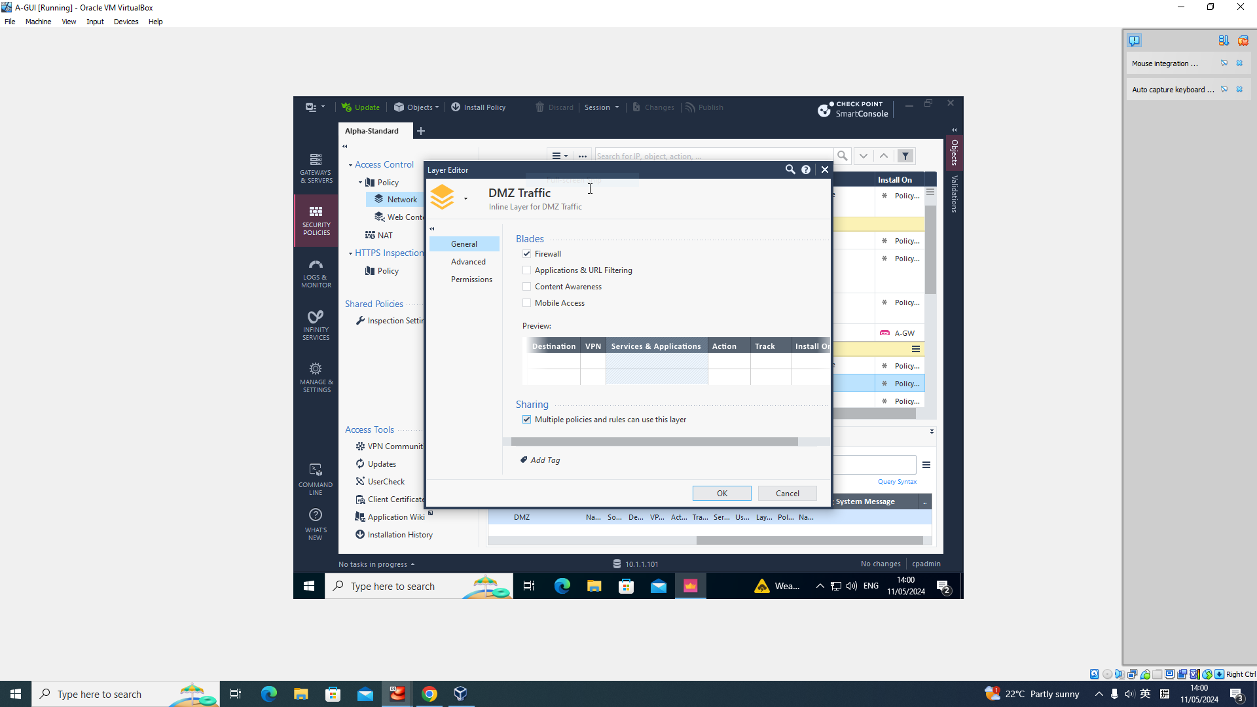
Check Point Security Policy
Inline Layer Details:

Slide 64
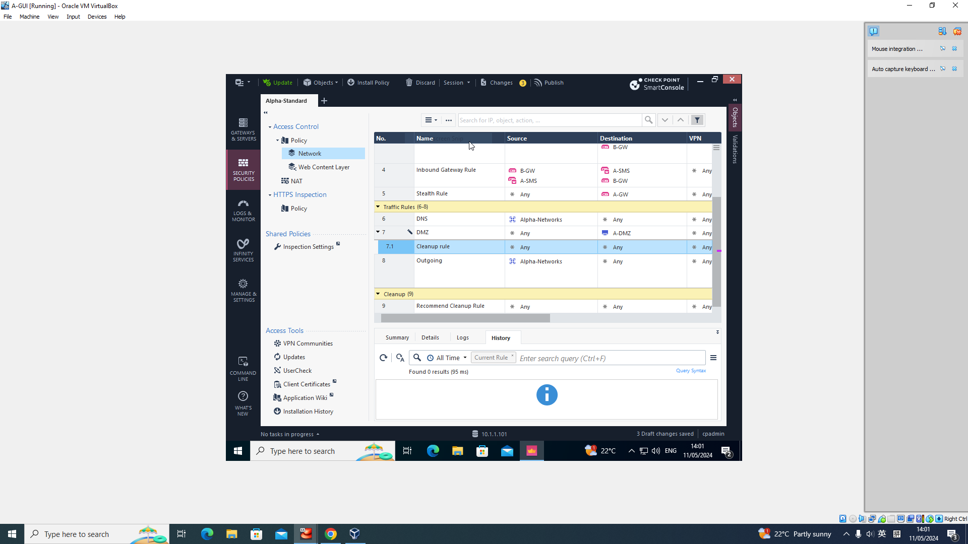
Check Point Security Policy
Inline Layer Details:

Slide 65
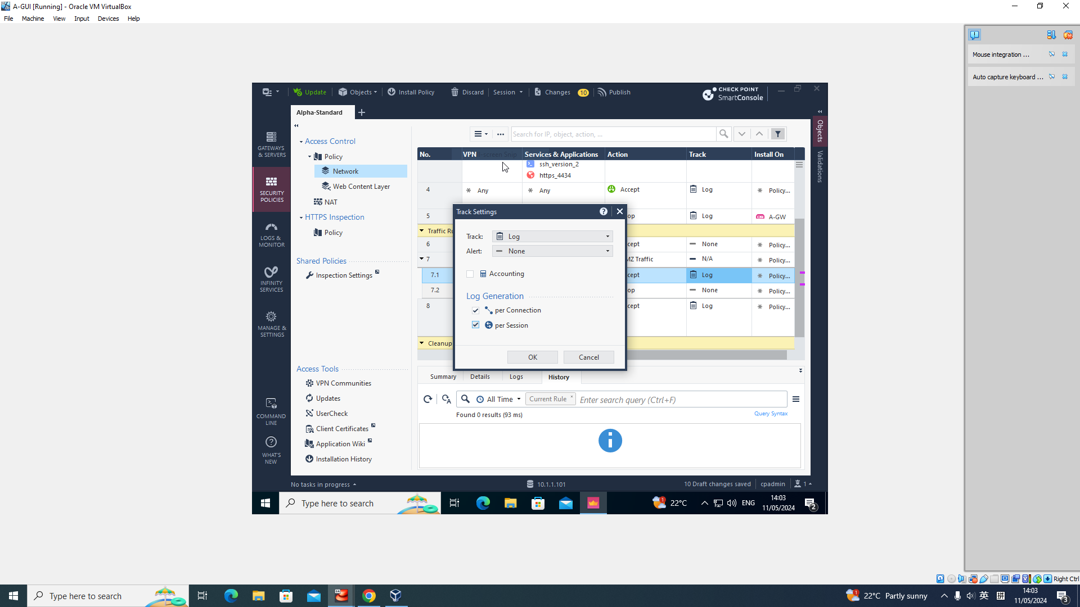
Check Point Security Policy
Inline Layer Details:

Slide 66
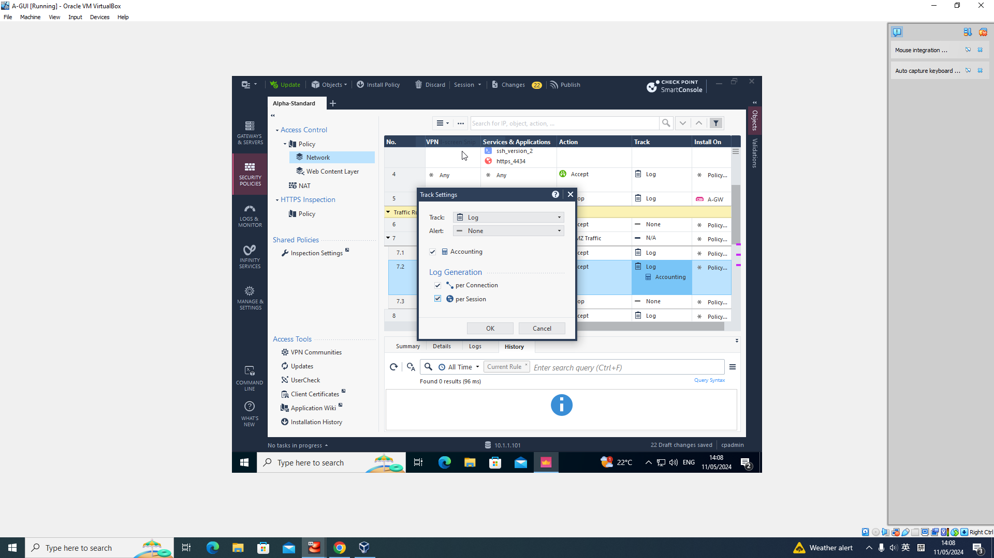
Check Point Security Policy
Inline Layer Details:

Slide 67
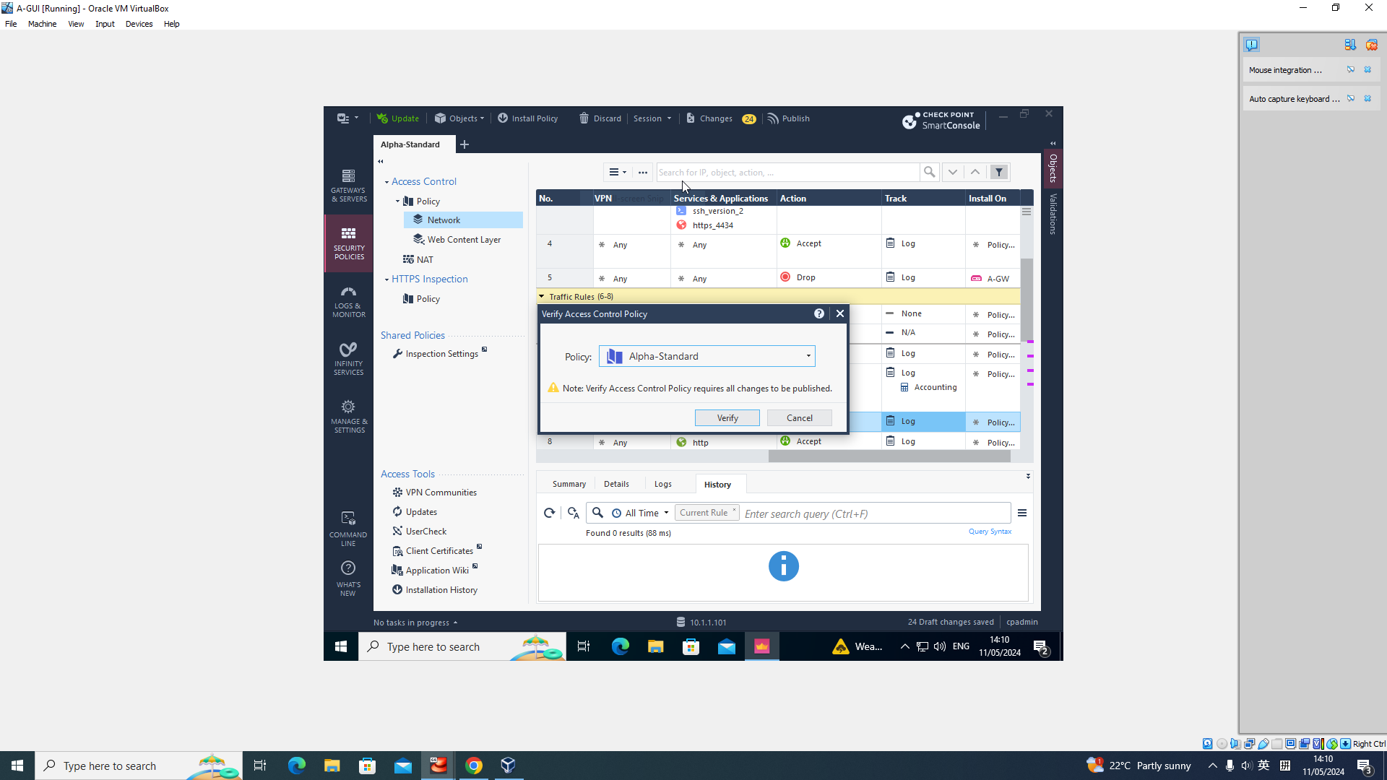
Check Point Security Policy
Inline Layer Details:

Slide 68
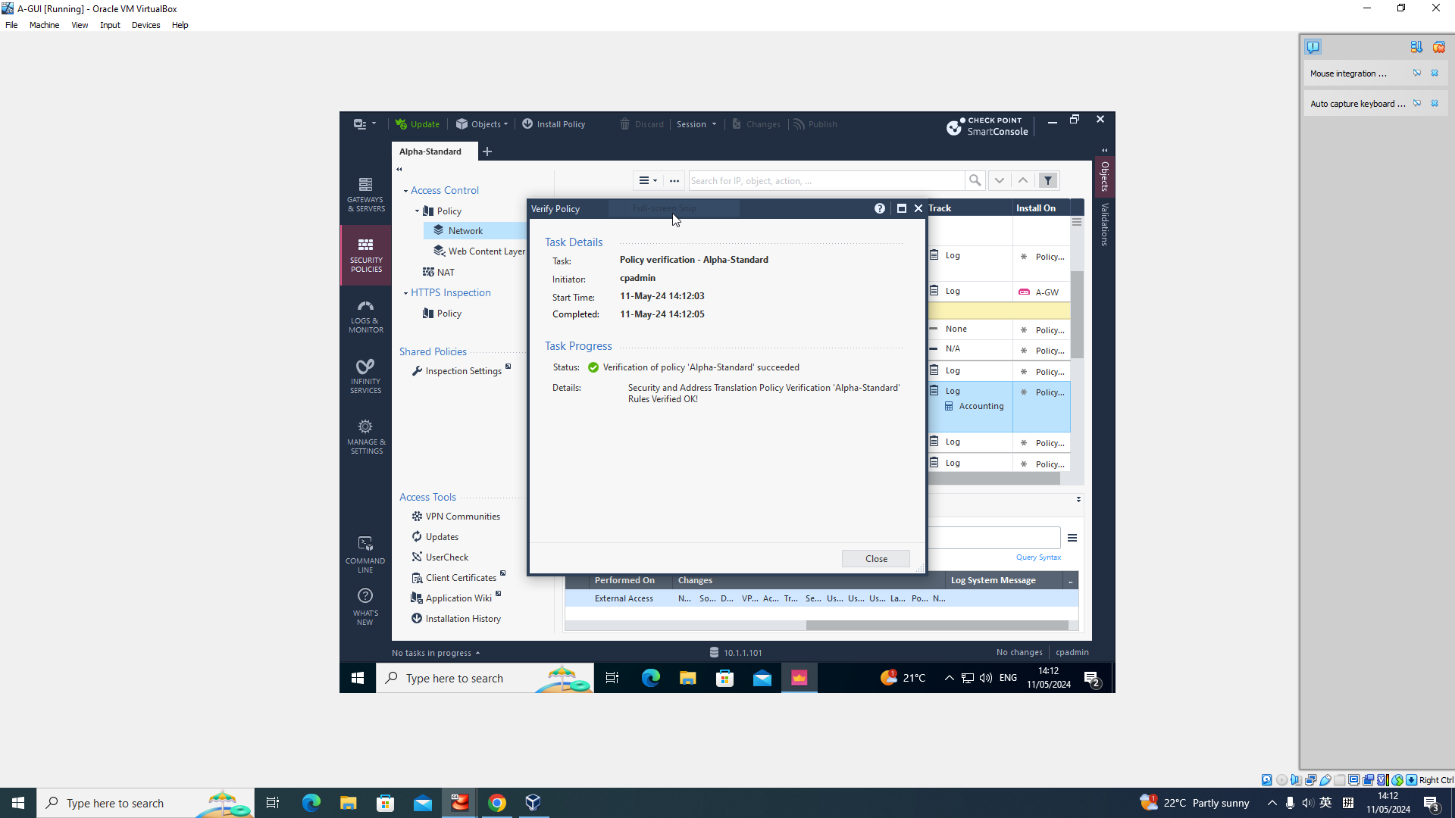
Check Point Security Policy
Inline Layer Details:

Slide 69
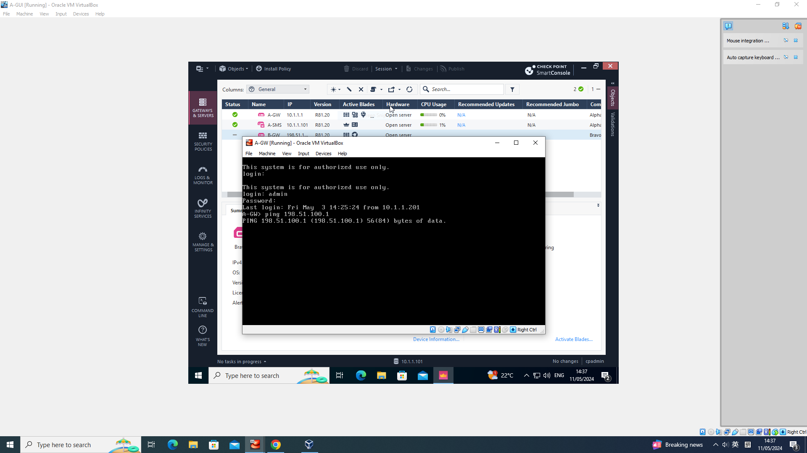
Check Point Security Policy
B-GW is not accessible:

Slide 70
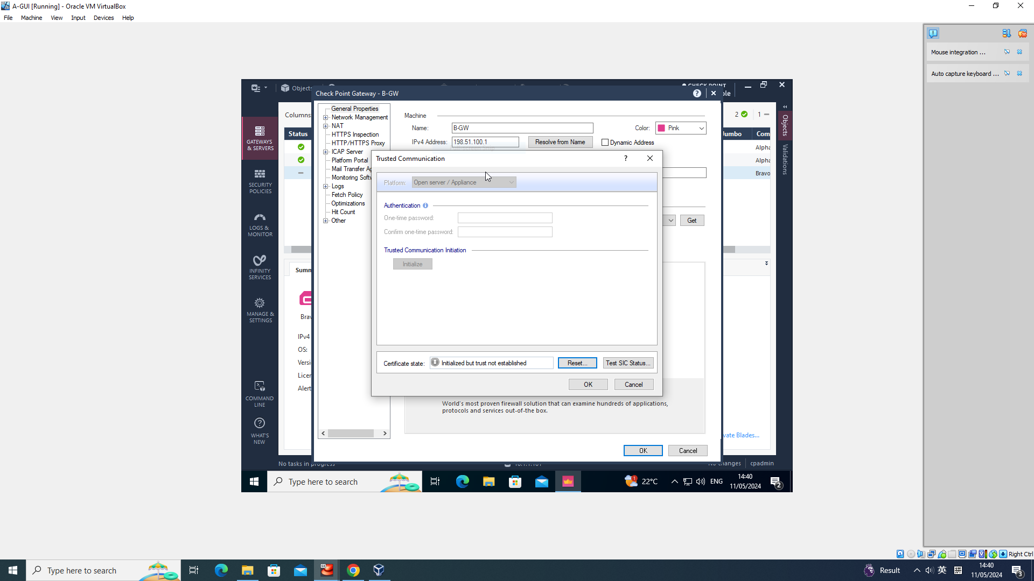
Check Point Security Policy
B-GW is not accessible:

Slide 71

Check Point Security Policy
B-GW is not accessible:

Slide 72
Check Point Security Policy
Video:
https://uowtsd-my.sharepoint.com/:v:/r/personal/2304705_student_uwtsd_ac_uk/Documents/Documents/Enterprise%20Network%20Security/Assignment/Policy%20Recording.mp4?csf=1&web=1&nav=eyJyZWZlcnJhbEluZm8iOnsicmVmZXJyYWxBcHAiOiJPbmVEcml2ZUZvckJ1c2luZXNzIiwicmVmZXJyYWxBcHBQbGF0Zm9ybSI6IldlYiIsInJlZmVycmFsTW9kZSI6InZpZXciLCJyZWZlcnJhbFZpZXciOiJNeUZpbGVzTGlua0NvcHkifX0&e=UsM9hp

Slide 73
Check Point Security Policy
Challenge:
Due to an issue with the router, the B-GW cannot connect. Therefore, policies and rules related to B-GW cannot be set up, published, installed, or tested.
A-HOST cannot be logged into for some reason.

Slide 74
Recommendations for Future Improvements
There are still many Check Point functionalities to be implemented:
Check Point NAT Functionality：Ensures network privacy protection and boundary enforcement.
Application Control and URL filtering：Granular security policies
Site-to-Site VPN：Ensures secure communication between networks, enabling internal resource sharing.
Monitoring: Records various logs, monitors network status using various tracking tools.
Security Maintenance: Establishes a regular maintenance strategy, performs periodic backups.
IoT Security: Incorporates IoT devices into the protection system.

Slide 75
Personal Reflection
During the experiments, besides independently solving issues, my classmates and teachers also provided significant assistance. They would remind me of details I hadn't considered.

Slide 76
Technical Reflection
I've learned how to deploy, configure, and manage Check Point security solutions, as well as gaining insight into the basics of enterprise networks. Additionally, I've acquired skills in creating and debugging networks using VirtualBox.

Slide 77
Conclusion
I learned how to deploy, configure, and manage a Check Point security solution, and conducted experiments to implement most aspects of a company network. I presented my findings, analyzing the security posture based on current network vulnerabilities. I summarized the work done and provided insights into future prospects.

Slide 78
Any Questions?

