Slide 1
DIGITAL FORENSICS ANALYSIS
Case Investigation Report
Quantum Tech | Corporate Espionage | Patent QT-AI-2025
ACCA7031 MSc Cybersecurity & Digital Forensics
Habibullah Shaikh | 2503799 | April 2026

Slide 2
Case Background
Quantum Tech: AI chip patent QT-AI-2025 accessed without authorisation
Suspect Emma: Senior engineer with privileged database access
Plan: Sell patent to competitor NexGen Circuits via intermediary Joe
Buyer: Norman Smith, coordinated by Vanessa (NexGen R&D Director)
3 devices seized all procedures followed NIST SP 800-86 & ISO/IEC 27037:2012
E-001
Emma
Huawei POT-LX1
Primary Suspect
E-002
Joe
Samsung Android
Intermediary
E-003
Norman Smith
Nokia Android
Buyer

Slide 3
Evidence Inventory & Methodology
Evidence Devices
Ref | Device / Suspect | Platforms | Status
E-001 | Emma Huawei POT-LX1 | WhatsApp, Instagram, Gmail | ✓ Verified
E-002 | Joe Samsung | WhatsApp, Instagram DMs | ✓ Verified
E-003 | Norman Nokia | Facebook, WhatsApp, Email | ✓ Verified
Methodology NIST SP 800-86 Four Phases
1
2
3
4
Collect
Examine
Analyse
Report

Slide 4
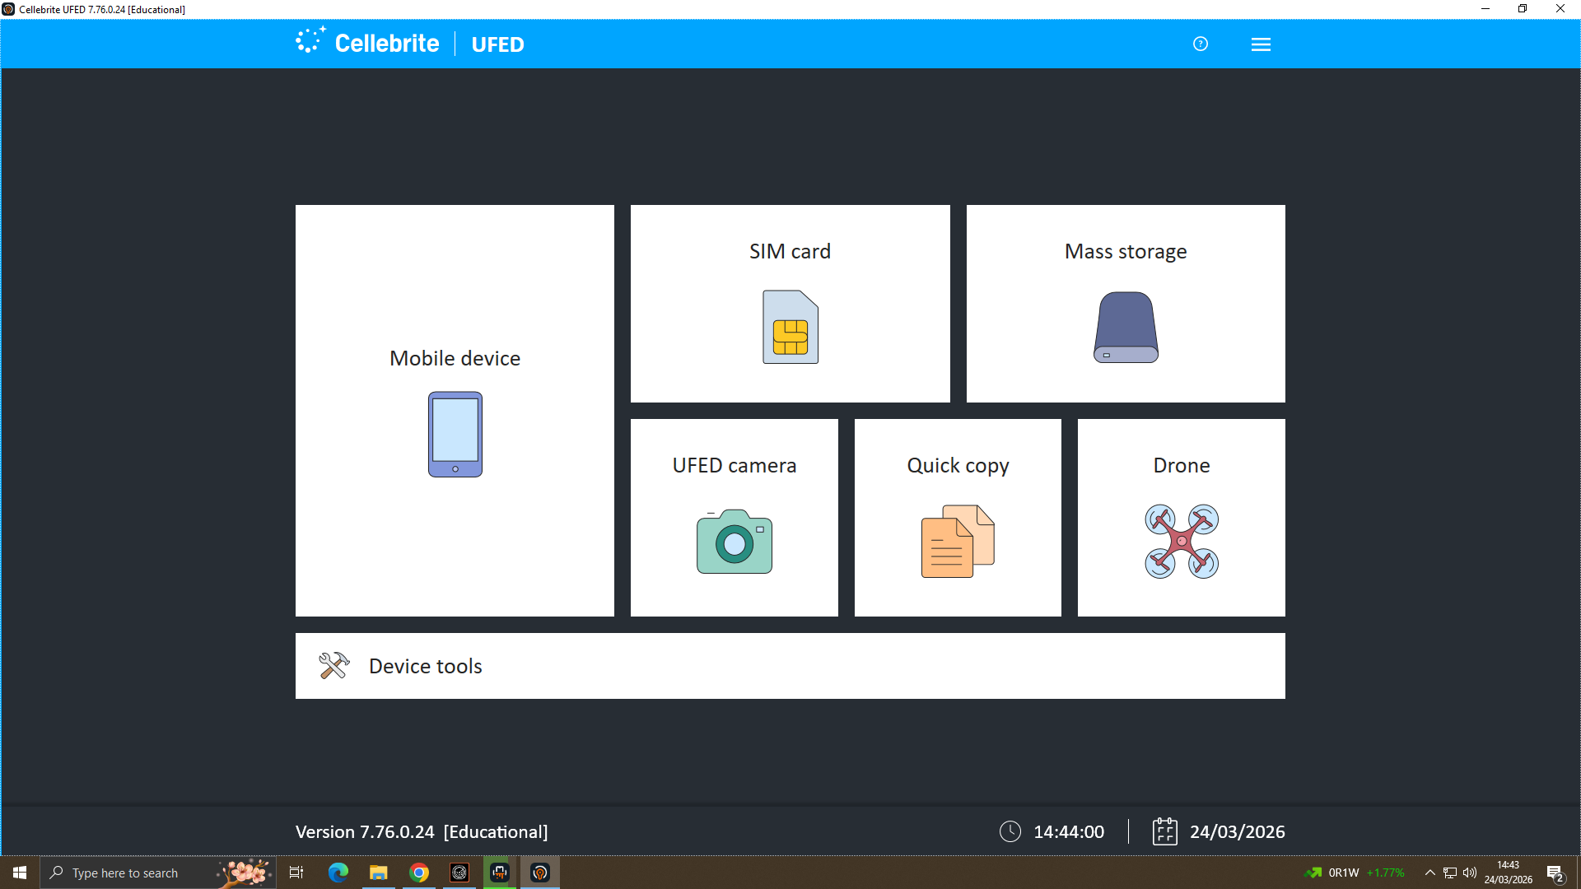
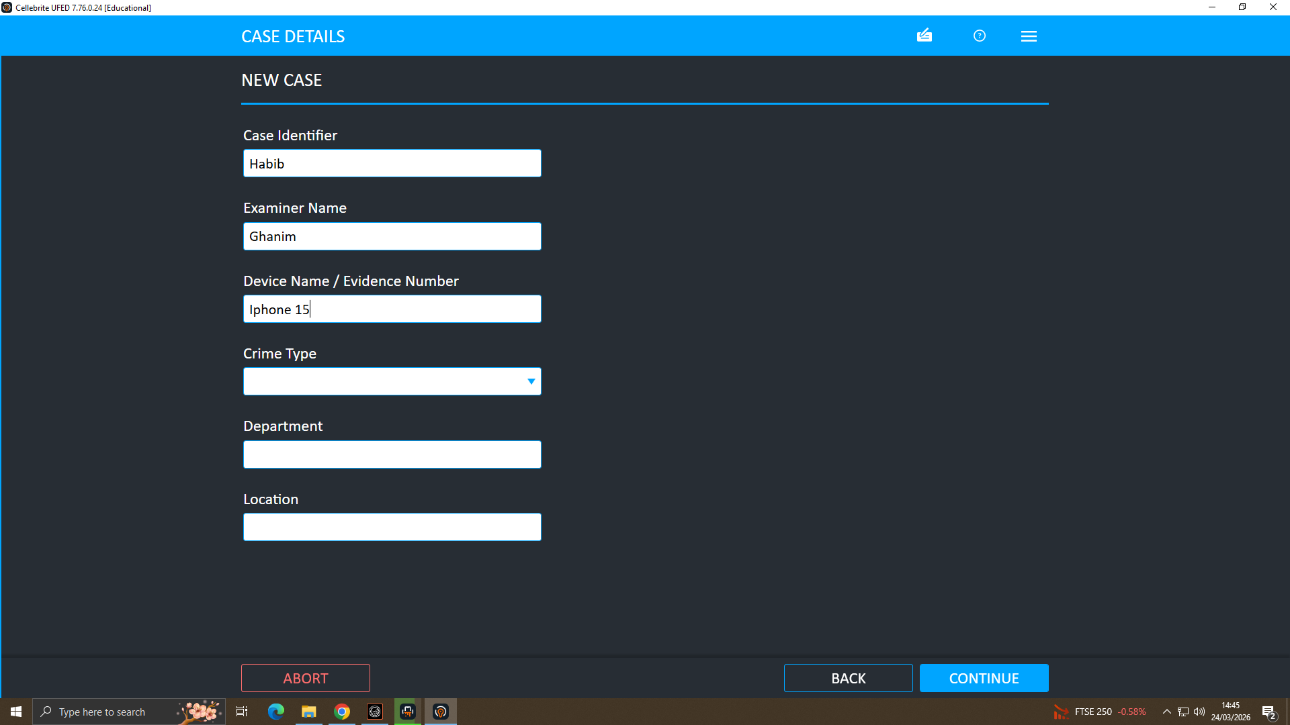
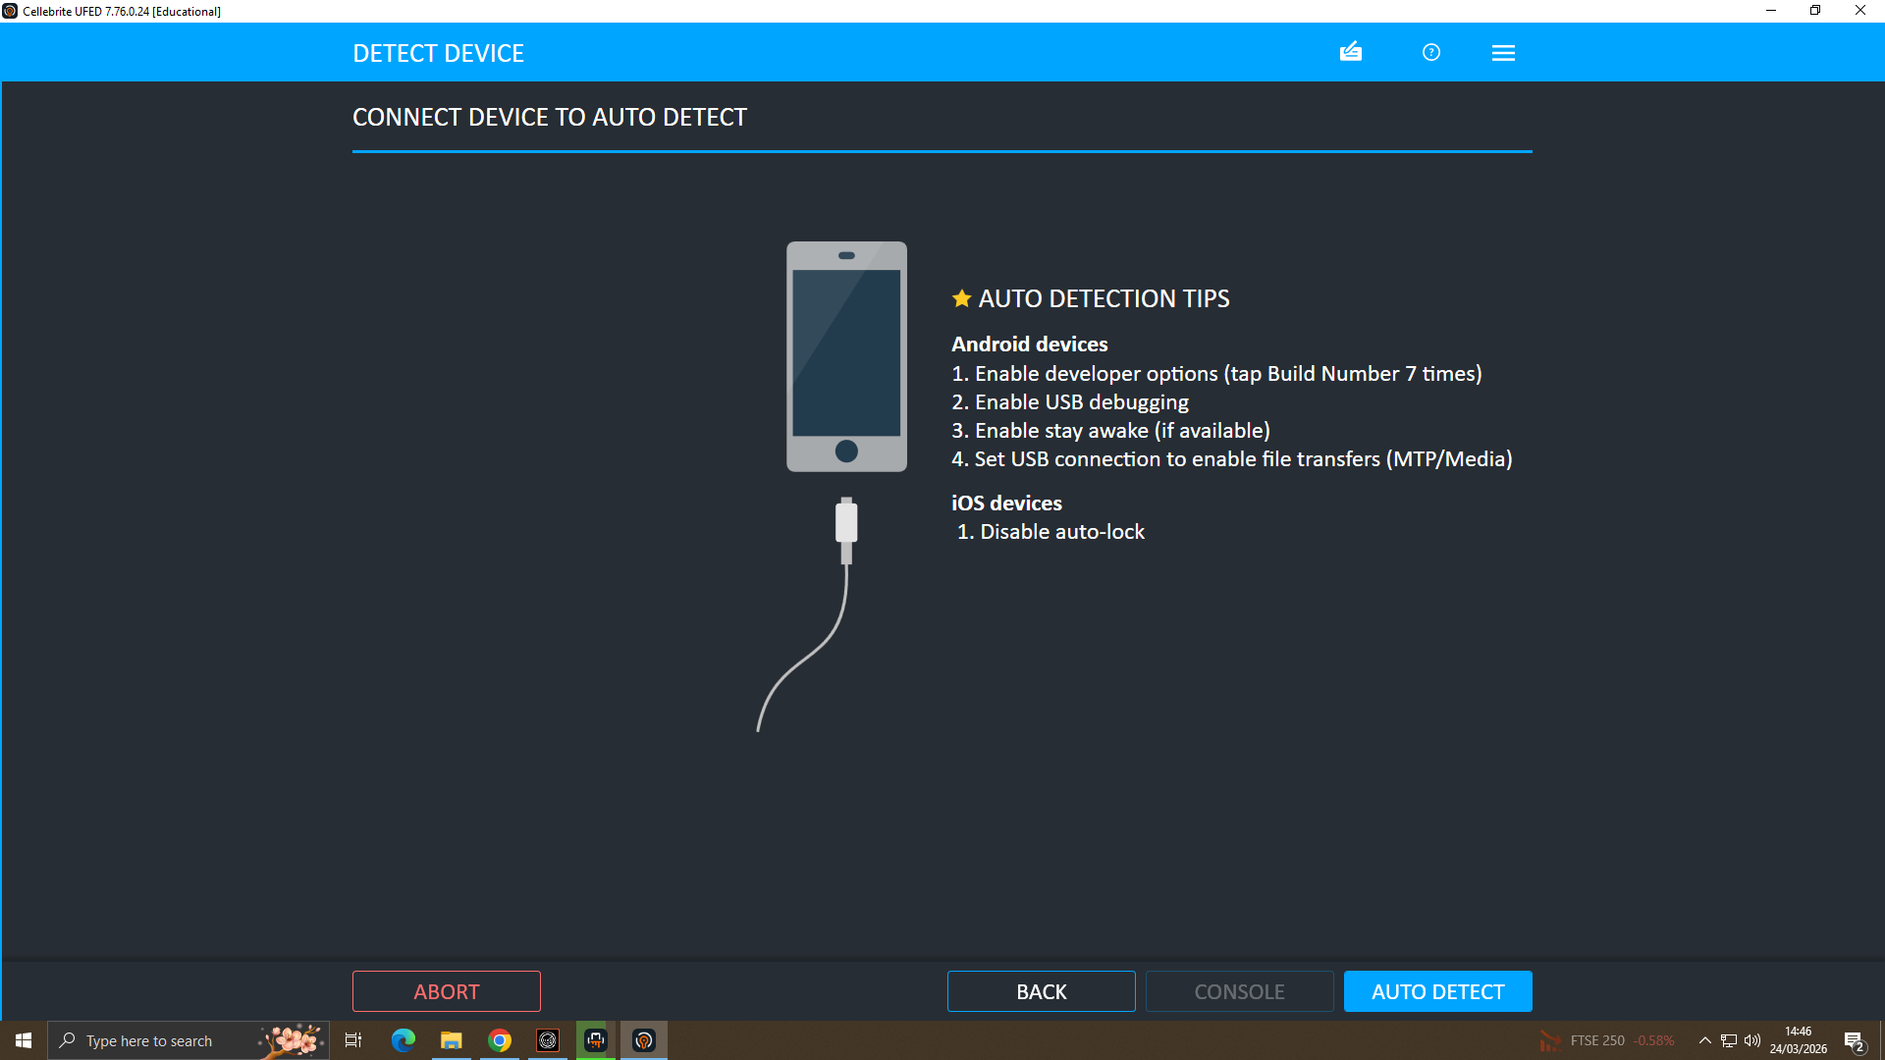
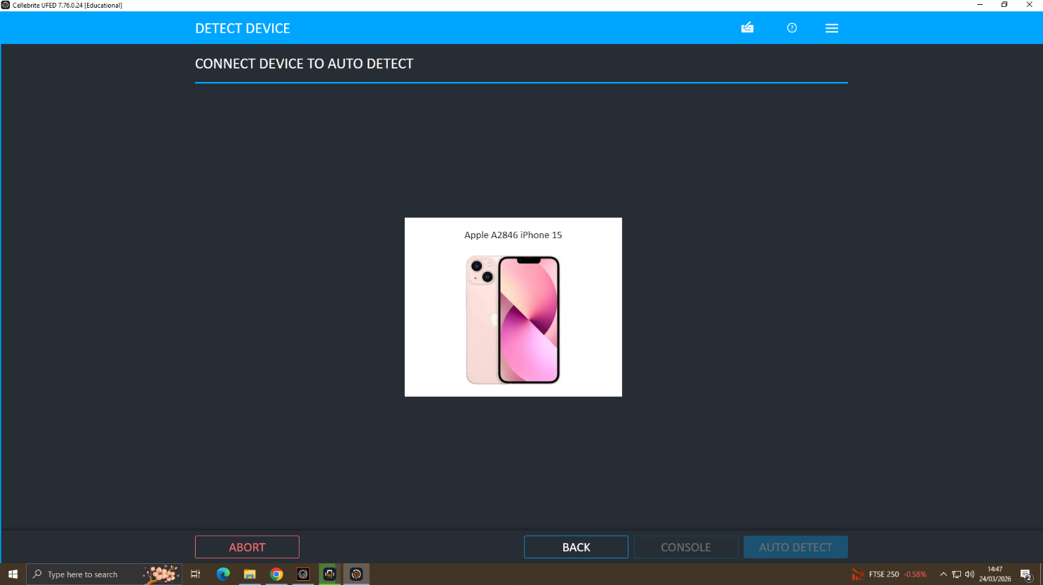
Evidence Acquisition Cellebrite UFED
UFED Home Screen
Case Details
Auto Detect Device
Device Auto-Detected

Slide 5
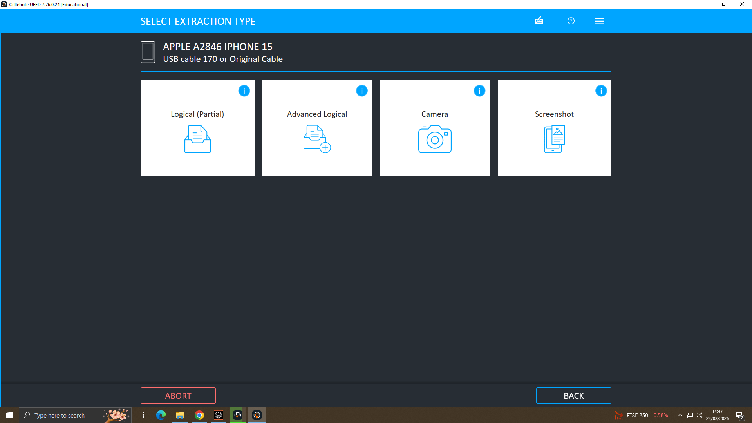
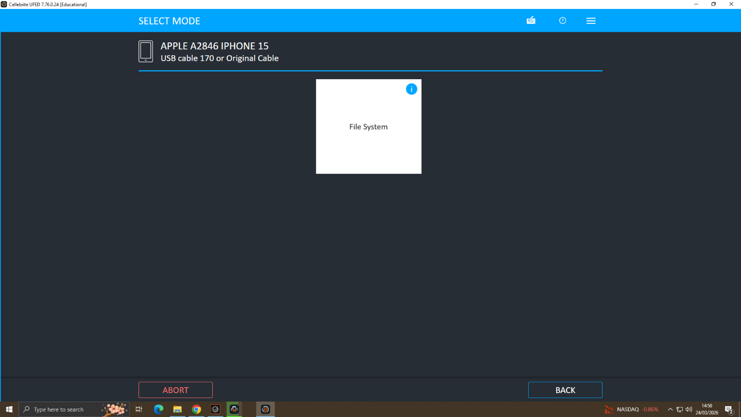
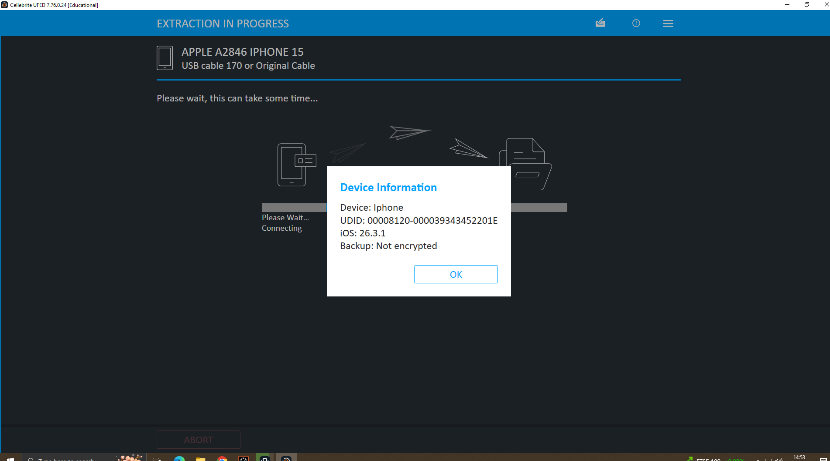
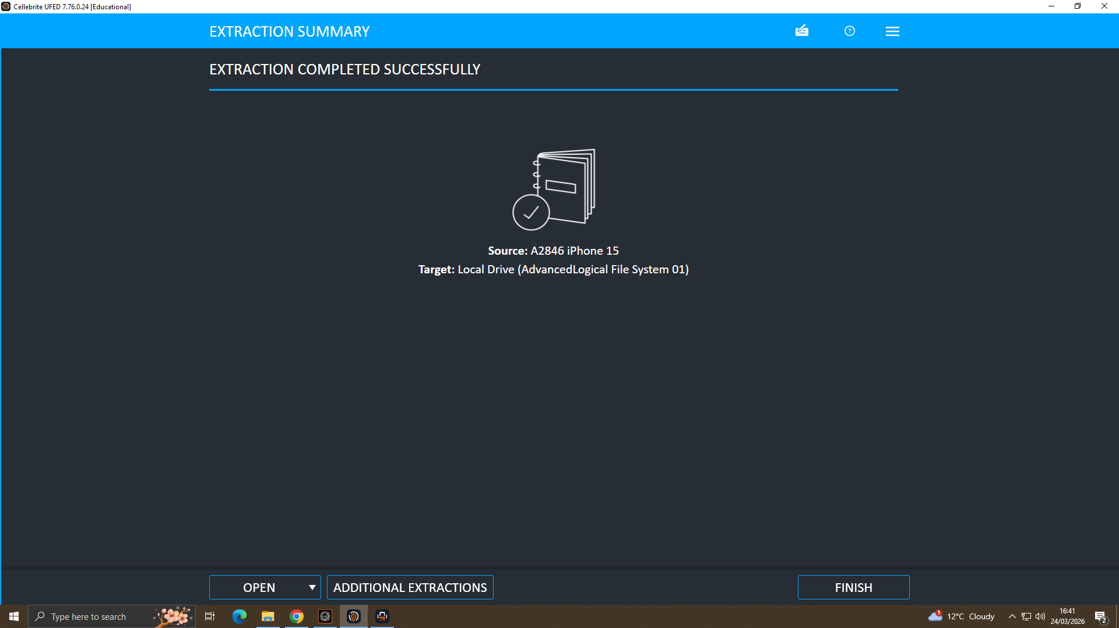
Evidence Acquisition Cellebrite UFED
Advanced Logical Extraction
File System & Save Location
Device Info & Encryption Status
Extraction Completed ✓

Slide 6
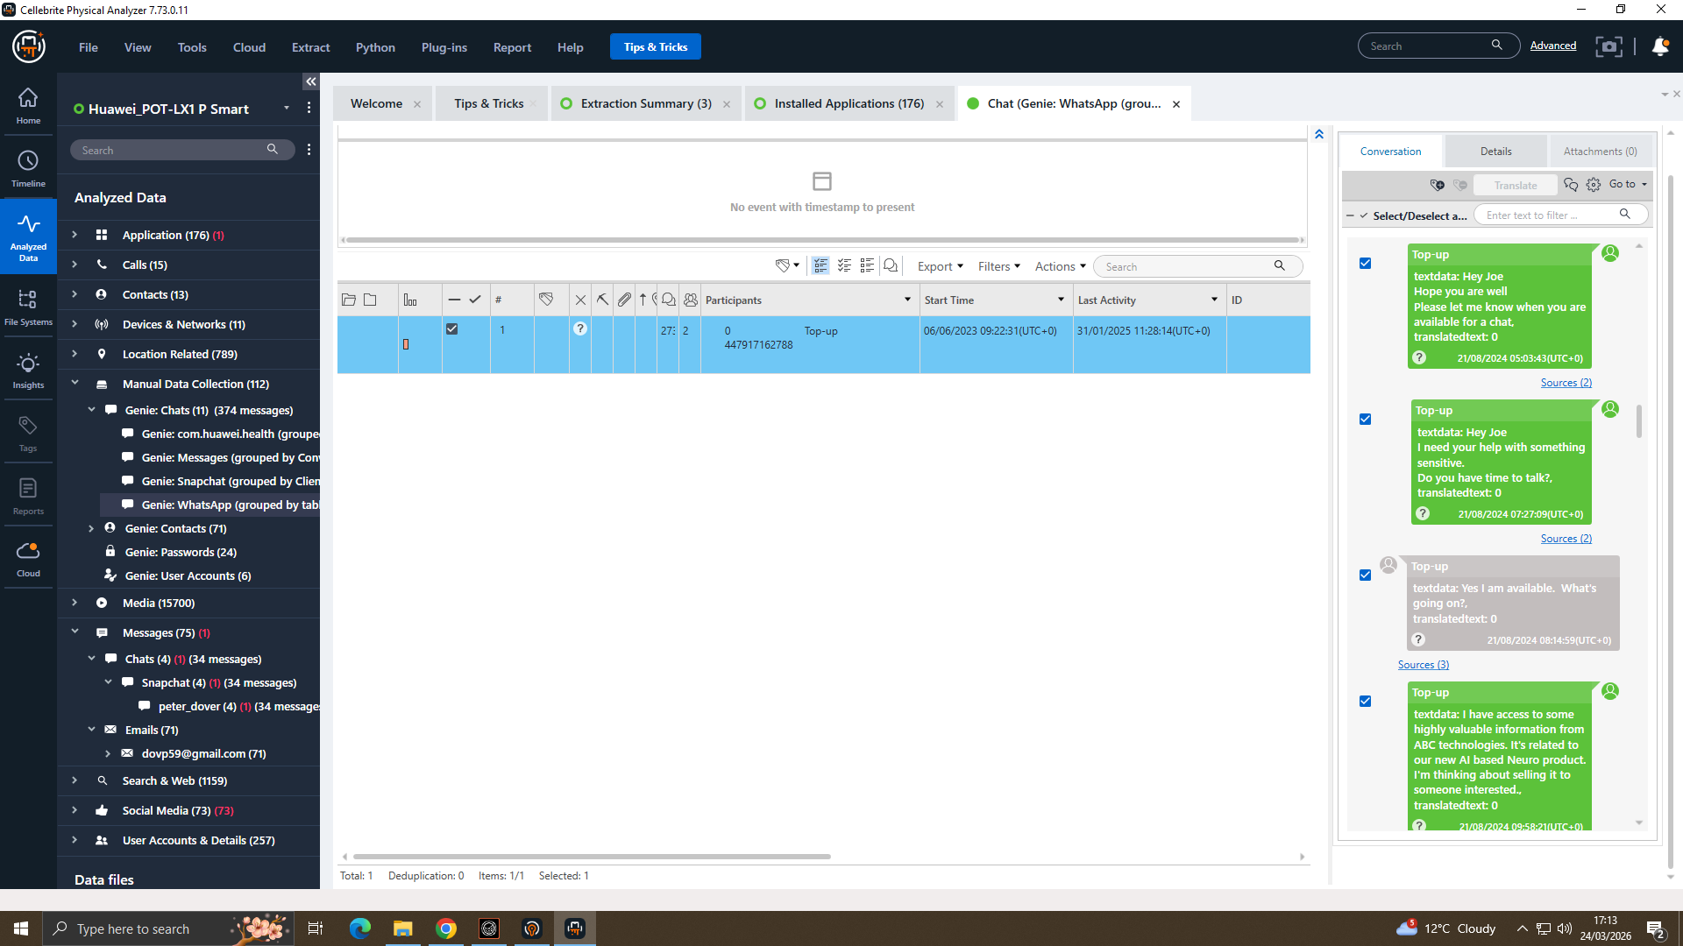
WhatsApp Evidence E-001: Emma's Huawei
Intent to Sell

Slide 7
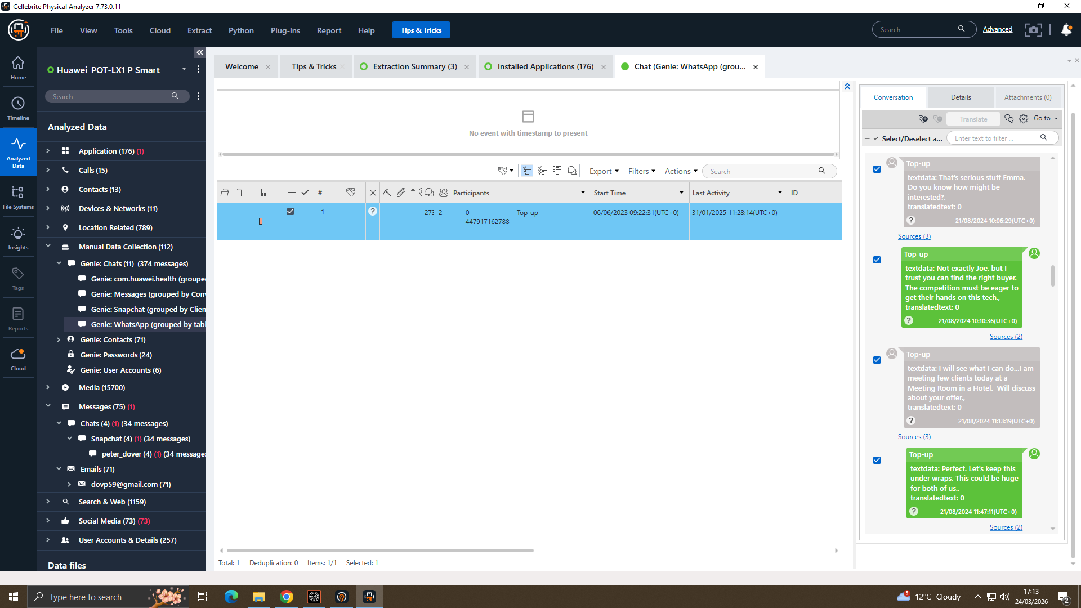
Deliberate Concealment

Slide 8
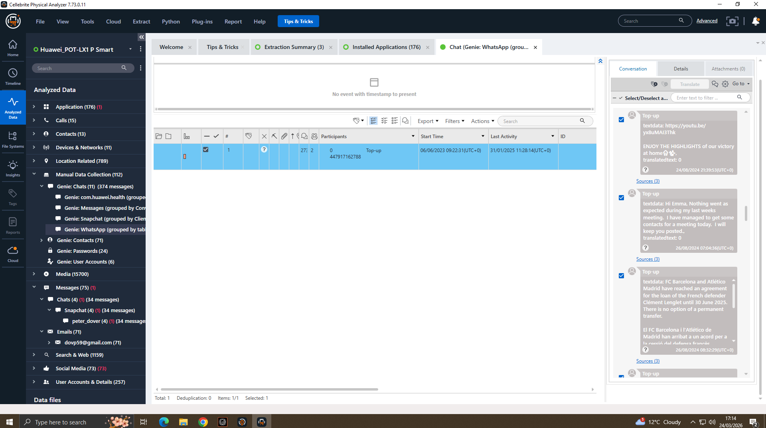
Manchester Meeting
Thinking of selling AI product info → criminal intent established
Keep this under wraps' → deliberate concealment, consciousness of guilt
Physical meeting arranged in Manchester → conspiracy moves offline
374 total WhatsApp messages recovered from E-001 via Cellebrite Genie Chats

Slide 9
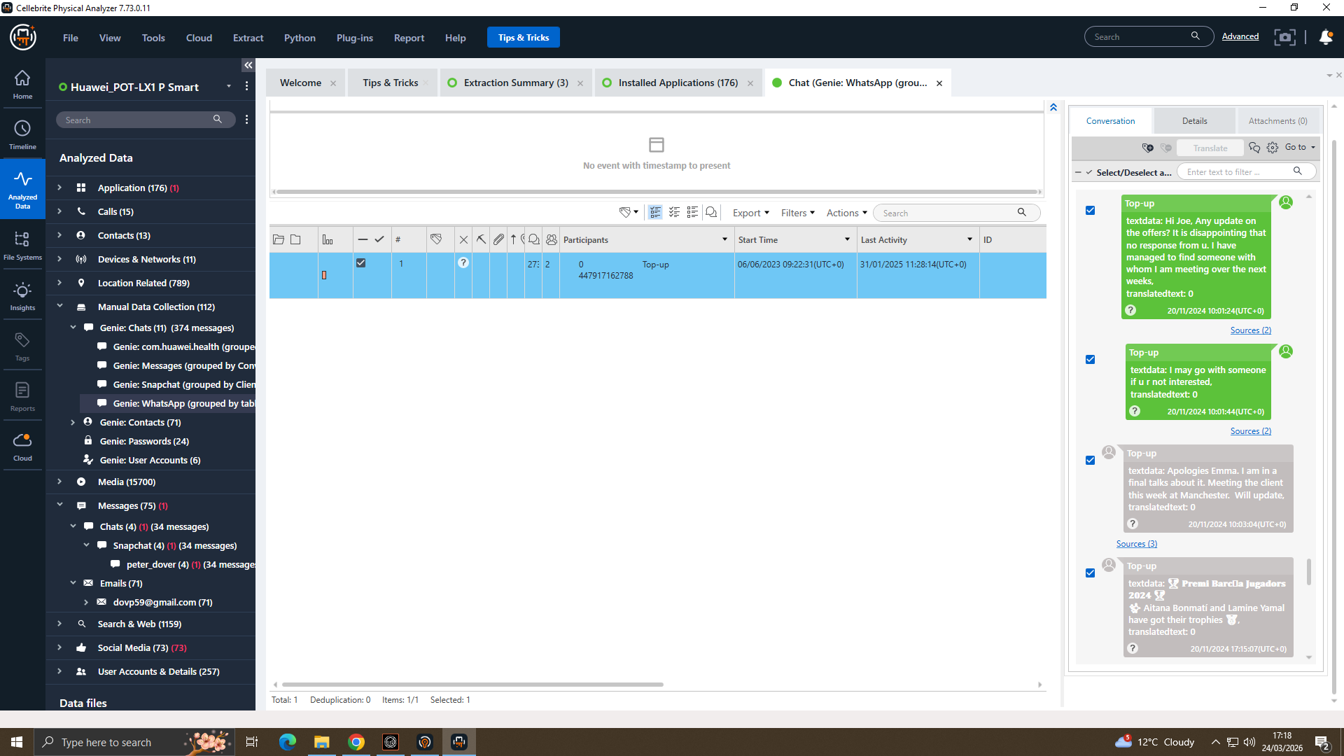
WhatsApp Evidence
Pressure & Urgency

Slide 10
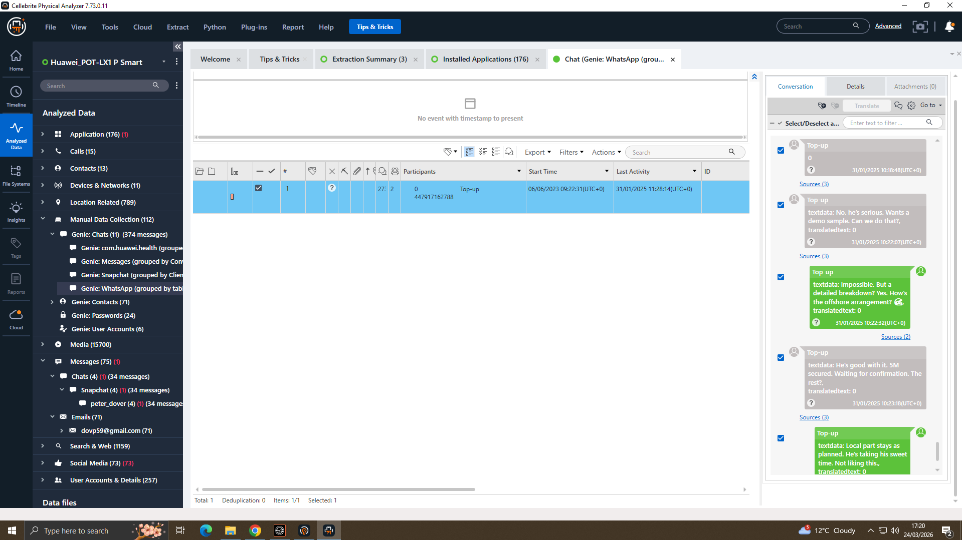
Offshore Discussion
Need to move fast / reach others' → pressure tactics, escalation confirmed
Offshore payment discussed → financial concealment, international transfer

Slide 11
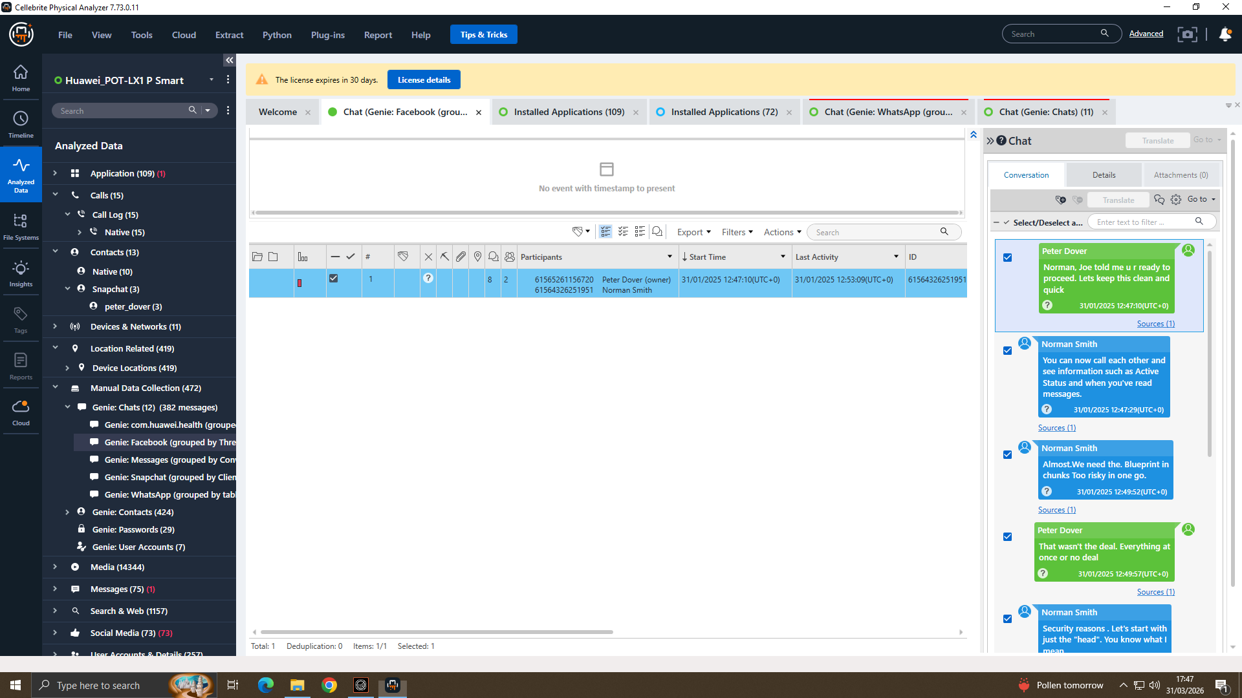
Facebook Messenger E-003: Norman's Nokia
Blueprint Requested

Slide 12
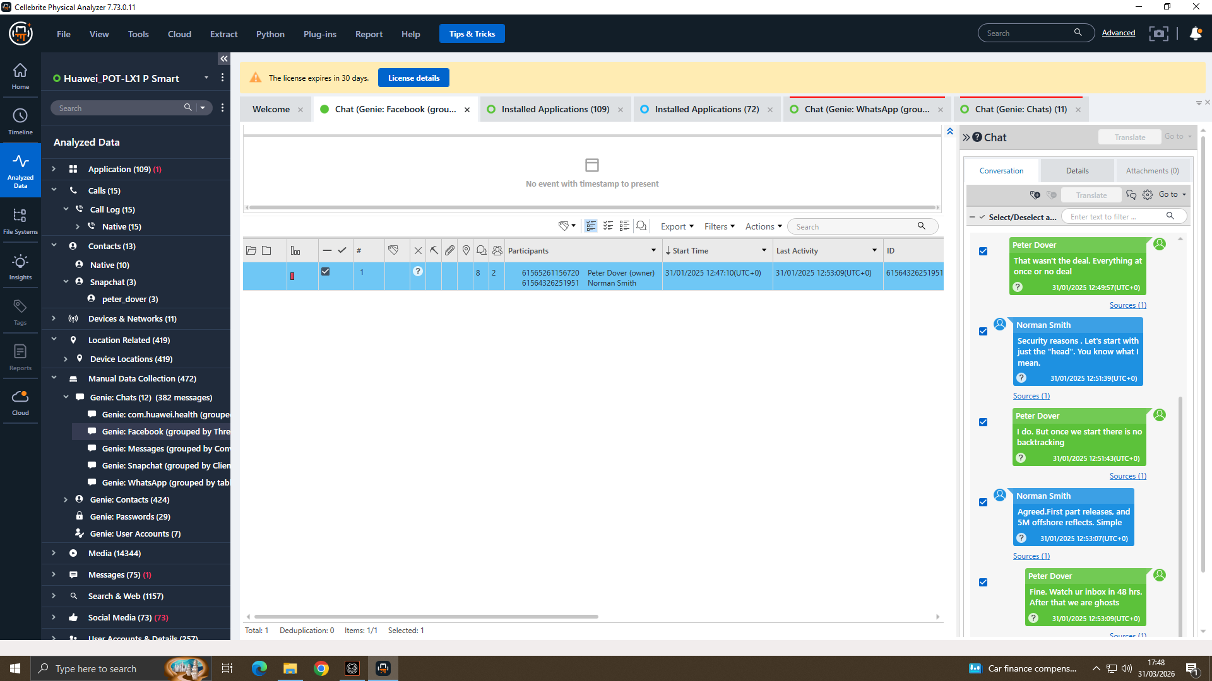
£5M Offshore Payment
Blueprint in chunks → direct request for QT-AI-2025 patent
£5M offshore → money laundering (Proceeds of Crime Act 2002)
After that we are ghosting → planned evidence destruction (Criminal Justice Act 2003)

Slide 13
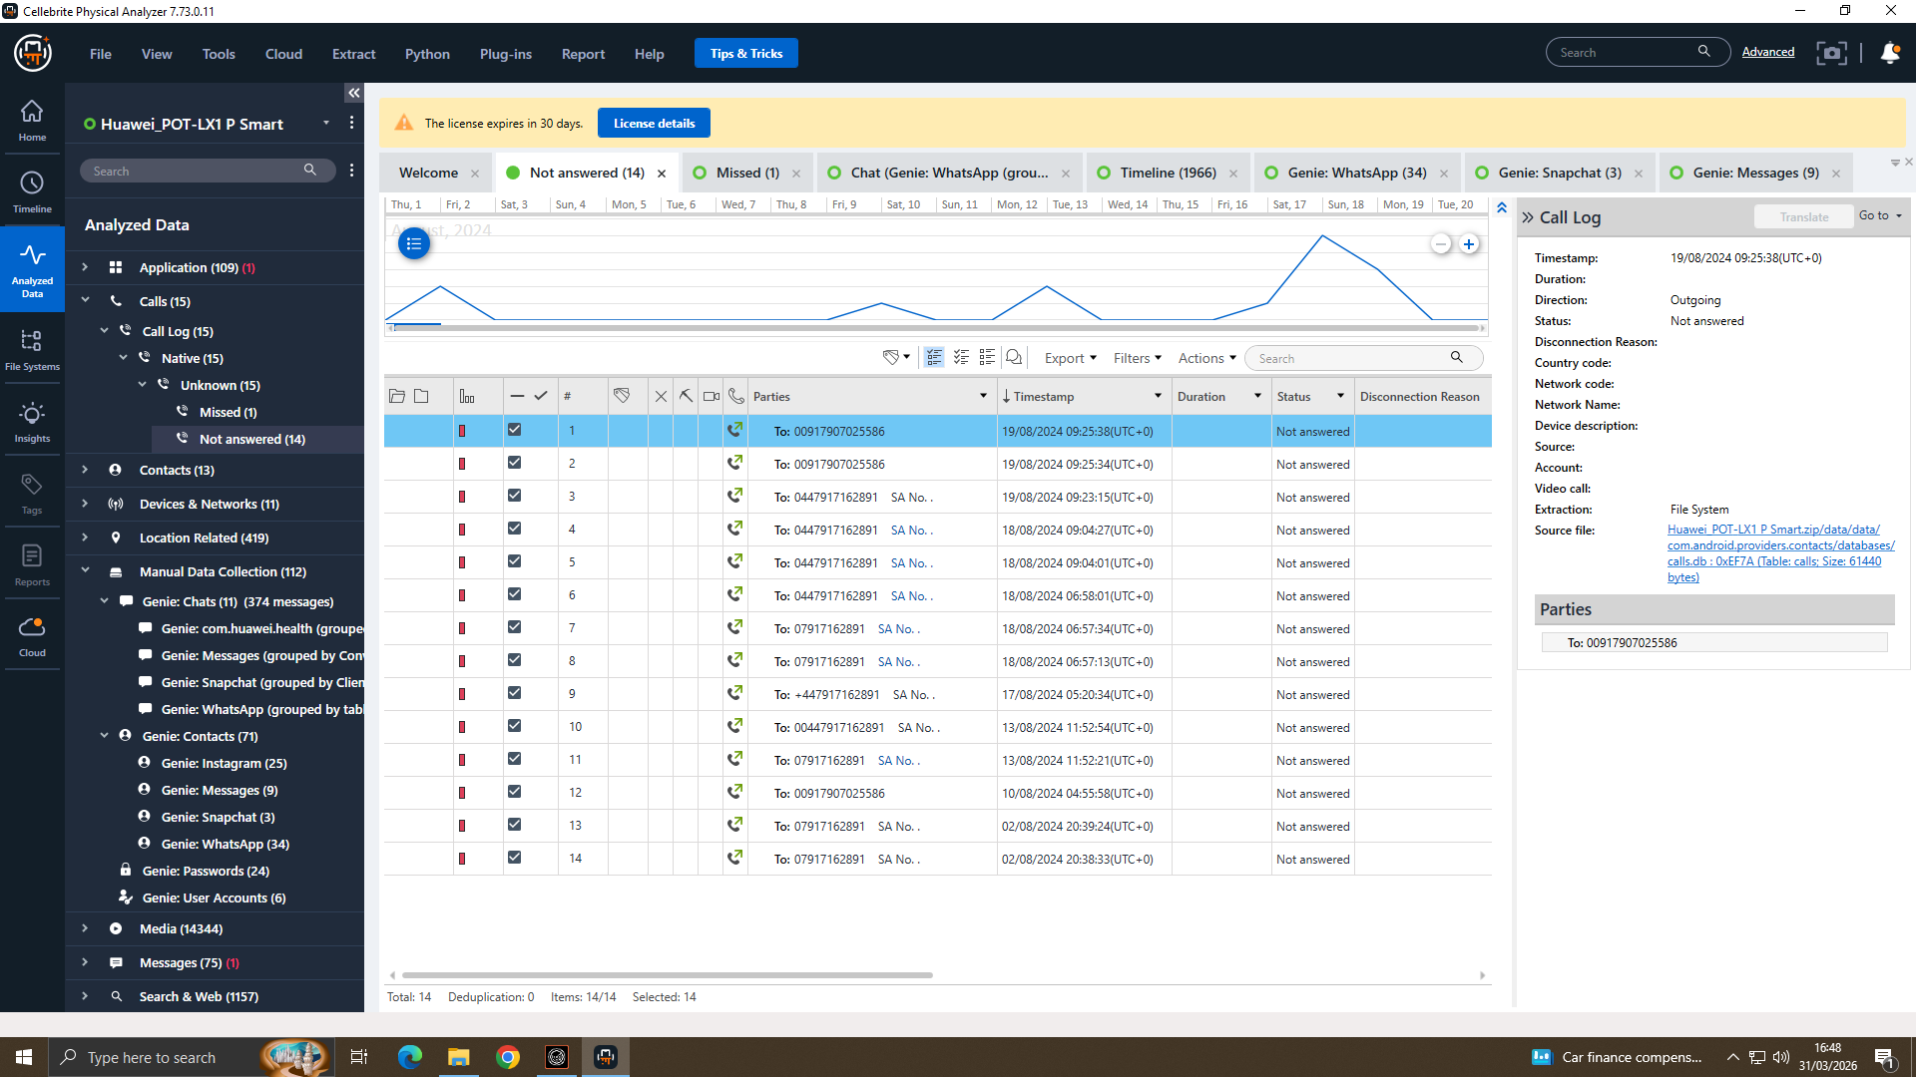
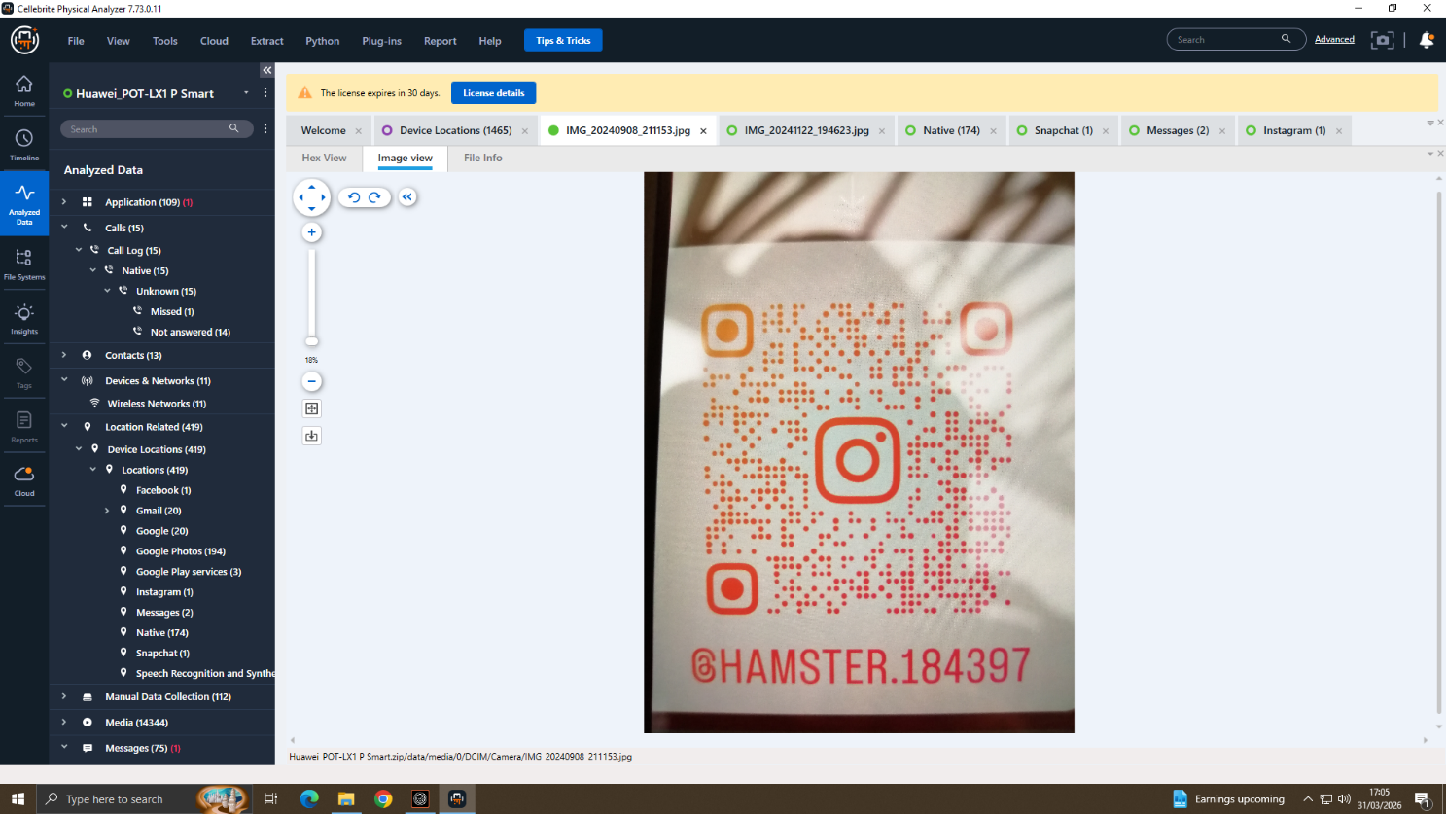
Call Logs & Instagram QR Code
Call Logs E-001 Emma's Huawei
Instagram QR @HAMSTER.184397 E-001
15 call records 2 distinct numbers
Int'l number +00917907025586 called twice (Aug 2024)
07917162891 called multiple times unanswered
Calls align with WhatsApp conspiracy messages
5,708 media files recovered from E-001
@HAMSTER.184397 = secondary covert channel
Multi-platform evasion strategy confirmed
Court order recommended to preserve account

Slide 14
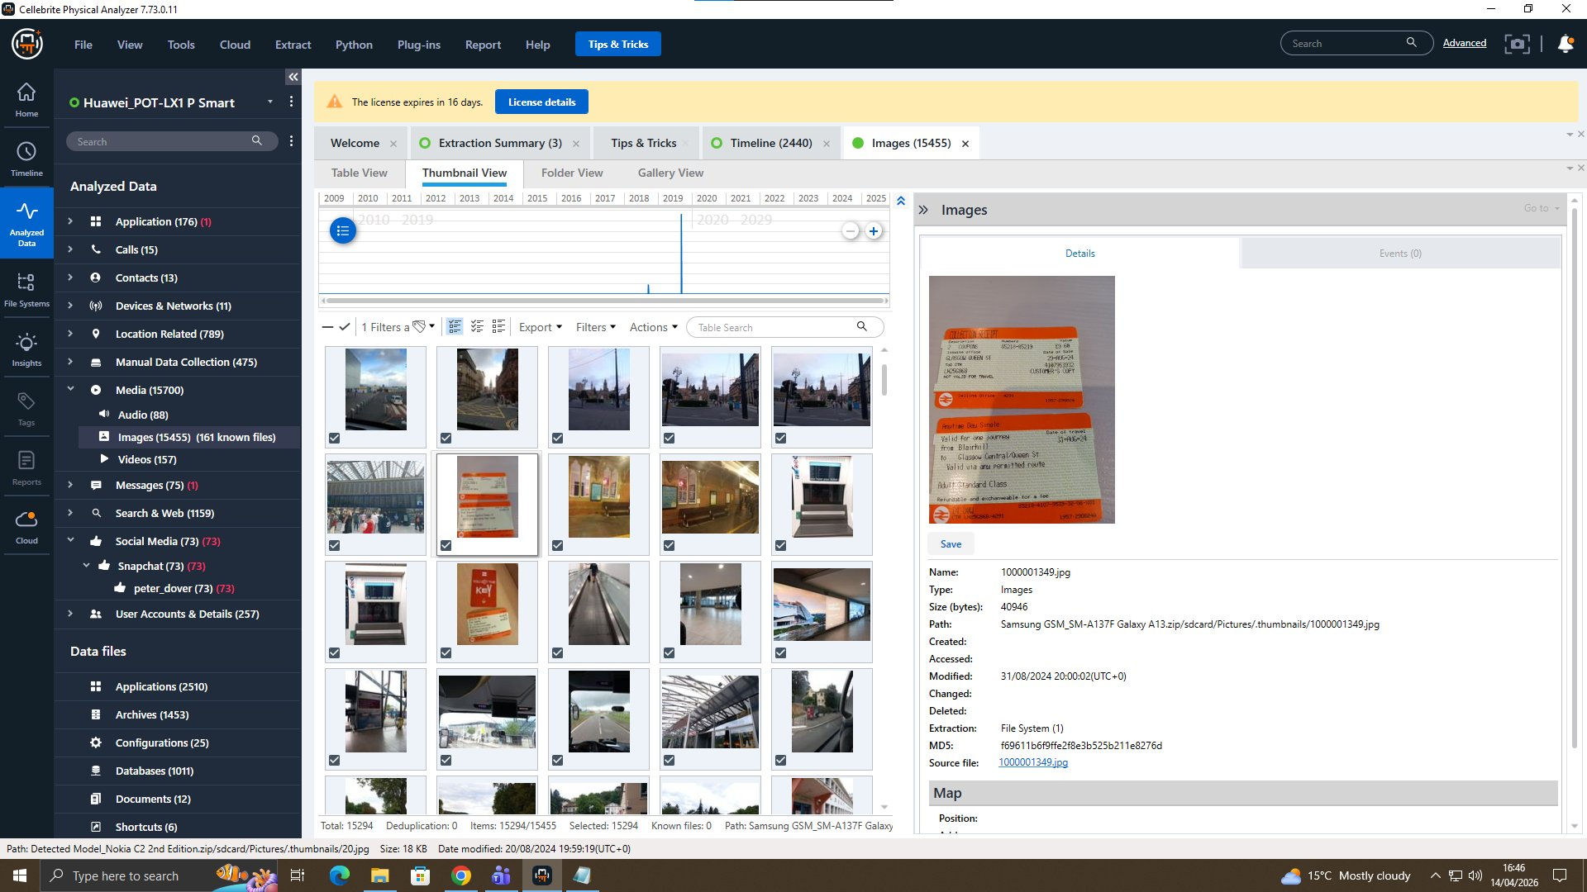
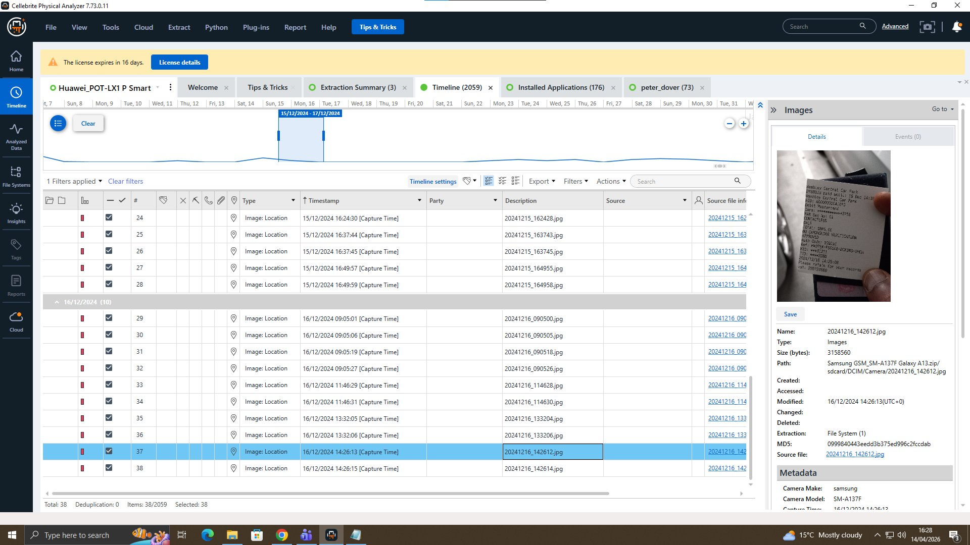
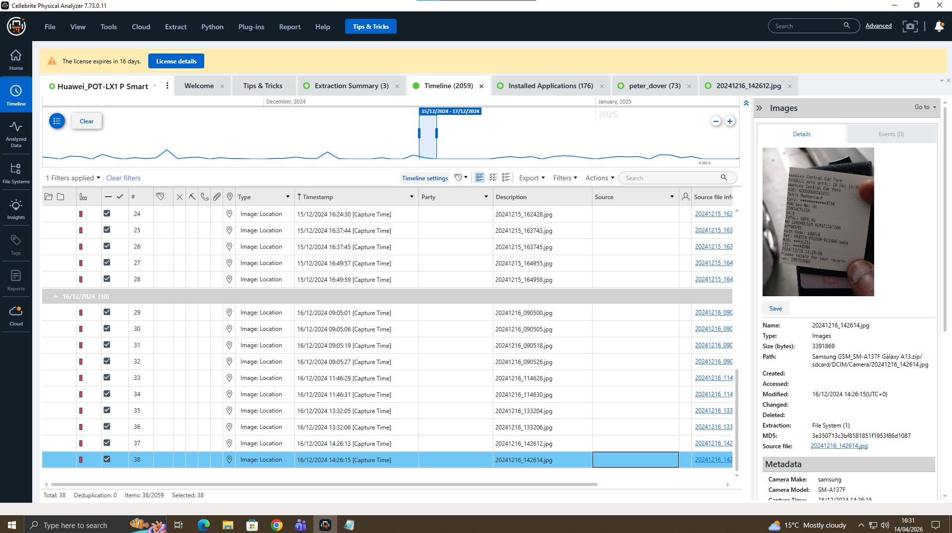
Media & Location Analysis E-002: Joe's Samsung
Media Overview 15,455 images
GPS Location Tagged (14:26:13)
GPS Location Tagged (14:26:15)
15,455 images recovered includes train ticket (physical travel evidence)
2 geotagged photos taken within 2 seconds on 16/12/2024 likely photographing a document
GPS coordinates in EXIF metadata → ExifTool extraction will pinpoint exact location
Dated ~6 weeks before the 31/01/2025 patent transfer deadline evidentially significant

Slide 15
Consolidated Evidence Timeline
Aug 2024
Emma: 'Thinking of selling' AI info (WhatsApp, E-001) CRIMINAL INTENT
Aug 2024
Emma calls 2 numbers repeatedly coordination with co-conspirators (E-001)
Nov 2024
Emma locates buyer, pressure tactics: 'may go with someone else' (E-001)
Dec 2024
Joe photographed at GPS location two sequential geotagged images (E-002)
Jan 2025
Norman: 'We need the Blueprint in chunks' patent transfer negotiated (E-003)
Dec 2025
£5M offshore agreed; 'Watch ur Inbox in 48 hrs then we are ghosting' (E-003)
Mar 2026
Forensic acquisition of all 3 devices hash-verified, legally admissible

Slide 16
Suspect Profiling
EMMA
JOE (Peter Dover)
NORMAN SMITH
Huawei E-001
Samsung E-002
Nokia E-003
Primary Perpetrator
Intermediary
Buyer & Receiver
Senior engineer privileged patent DB access
Initiated and drove the conspiracy
WhatsApp: admitted intent to sell
Used @HAMSTER.184397 as covert channel
Computer Misuse Act 1990 | Trade Secrets Regs 2018
Brokered deal between Emma & Norman
Confirmed doc delivery: 'Watch ur Inbox 48 hrs'
Planned evidence wipe: 'We are ghosting'
GPS & travel evidence corroborates movement
Computer Misuse Act 1990 | Criminal Justice Act 2003
Buyer for NexGen Circuits
Requested 'Blueprint in chunks'
Arranged £5M offshore payment
Facebook Messenger on E-003 key evidence
Proceeds of Crime Act 2002 | Fraud Act 2006

Slide 17
Conclusion & Recommendations
Conclusion
Recommendations
3-suspect conspiracy proven Emma (insider), Joe (broker), Norman (buyer)
WhatsApp: intent, concealment & buyer coordination
Facebook: patent request, £5M offshore, evidence destruction plan
Multi-platform evasion: WhatsApp + Facebook + Instagram confirmed
All evidence: NIST SP 800-86 & ISO/IEC 27037:2012 compliant legally admissible
Law Enforcement: Charge all 3 under Trade Secrets Regs 2018 & Computer Misuse Act 1990
Investigate £5M offshore payment money laundering (Proceeds of Crime Act 2002)
Court order: preserve Instagram @HAMSTER.184397
Cross-ref call numbers across all 3 devices
Quantum Tech: Revoke Emma's access, deploy DLP & UBA, enforce least-privilege
Civil action against NexGen Circuits under Trade Secrets Regs 2018
Relevant Legislation:
Computer Misuse Act 1990
Trade Secrets Regs 2018
Proceeds of Crime Act 2002
Criminal Justice Act 2003
Fraud Act 2006

