Slide 1
Electrical & Electronic Principles
ACDB4002 & ACDA4006
Steve Mosey

Slide 2
Useful Information
Lecturer
  Steve Mosey
  Stephen.mosey@uwtsd.ac.uk

Slide 3
Useful Information
Assessment –
  50% Practical (perform a practical exercise and produce a formal report)
  50% Exam at end of summer term (May)

Slide 4
Useful Information
Lecture notes and slides on Moodle
Assignments on Moodle via Turn it in

Slide 5
Module Aim
To understand the fundamental operation of common analogue and digital components and circuits.

Slide 6
Topics
Definitions of current, voltage, resistance, power, ohm’s law
Passive devices, resistors, capacitors, inductors.
Semiconductor devices e.g. diodes, transistors etc.
Basic DC and AC theory, simple power supplies.
Series and parallel circuits
Commonly used ICs as building blocks, 555, 741, 7805 etc.
Timing and clock circuits, RC, crystal oscillator modules etc.
Passive filters
Amplifier principles, frequency response curves , input and output impedance
Op-amps, basic configurations
Thevenin equivalent circuits
Electromagnetism
Basic logic gates and configurations, Boolean algebra
Combinational logic applications

Slide 7
Module Outcomes
Upon the successful completion of this module, the student should be able to:
Investigate and analyse basic analogue and digital electronic circuits encountered during the course.
Apply appropriate software techniques (e.g. Multisim / Proteus) to simulate basic circuits.
Perform practical exercises to deploy test equipment, perform measurements and present results.

Slide 8
Learning & Teaching Strategy
Activity type | Hours | Percentage
Scheduled learning | 60 | 30%
Independent learning | 140 | 70%
Placement learning | 0 | 0%
TOTAL | 200 | 100%

Slide 9
Reading List
Electrical and Electronic Principles and Technology, John Bird, Routledge; 6 edition (6 Mar. 2017)
Electronic and Electrical Engineering: Principles and Practice, Electronic, Lionel Warnes, Palgrave Macmillan; 3rd Edition (13 Dec. 2002)
The Art of Electronics, Paul Horowitz and Winfield Hill, Cambridge University Press; 3rd Edition (9 Apr. 2015)

Slide 10
Any Questions so far..?

Slide 11
What Is Electricity?
Various definitions…
Reader’s Digest Universal Dictionary:
  “A class of phenomena arising from the existence and interaction of positively and negatively charged particles.”
Cambridge University Press On-line Dictionary.
  “A form of energy, produced in various ways, which provides power to devices that create light, heat, etc.”
Compact Oxford English Dictionary
  “A form of energy resulting from the existence of charged particles (such as electrons or protons), either statically as an accumulation of charge or dynamically as a current.”

Slide 12
What Is Electricity?
Wikipedia:
  “'Electricity' is the term the early scientists used when they were actually referring to 'charge'. “
  “Present usage of the term 'electricity' has become confused. In addition to the electric charge definition, the word electricity has several popular definitions which are contradictory.”

Slide 13
What Is Electricity?
Many sources say that "electricity" is the quantity of electrical energy measured in joules or kilowatt-hours.
Other sources call it the motion of charges within a conductor, and they measure the quantity of electricity in terms of amperes.
It is advisable to be cautious when interpreting the term "electricity" in place of the more precise terms electric charge, electric current, electrical energy, etc.

Slide 14
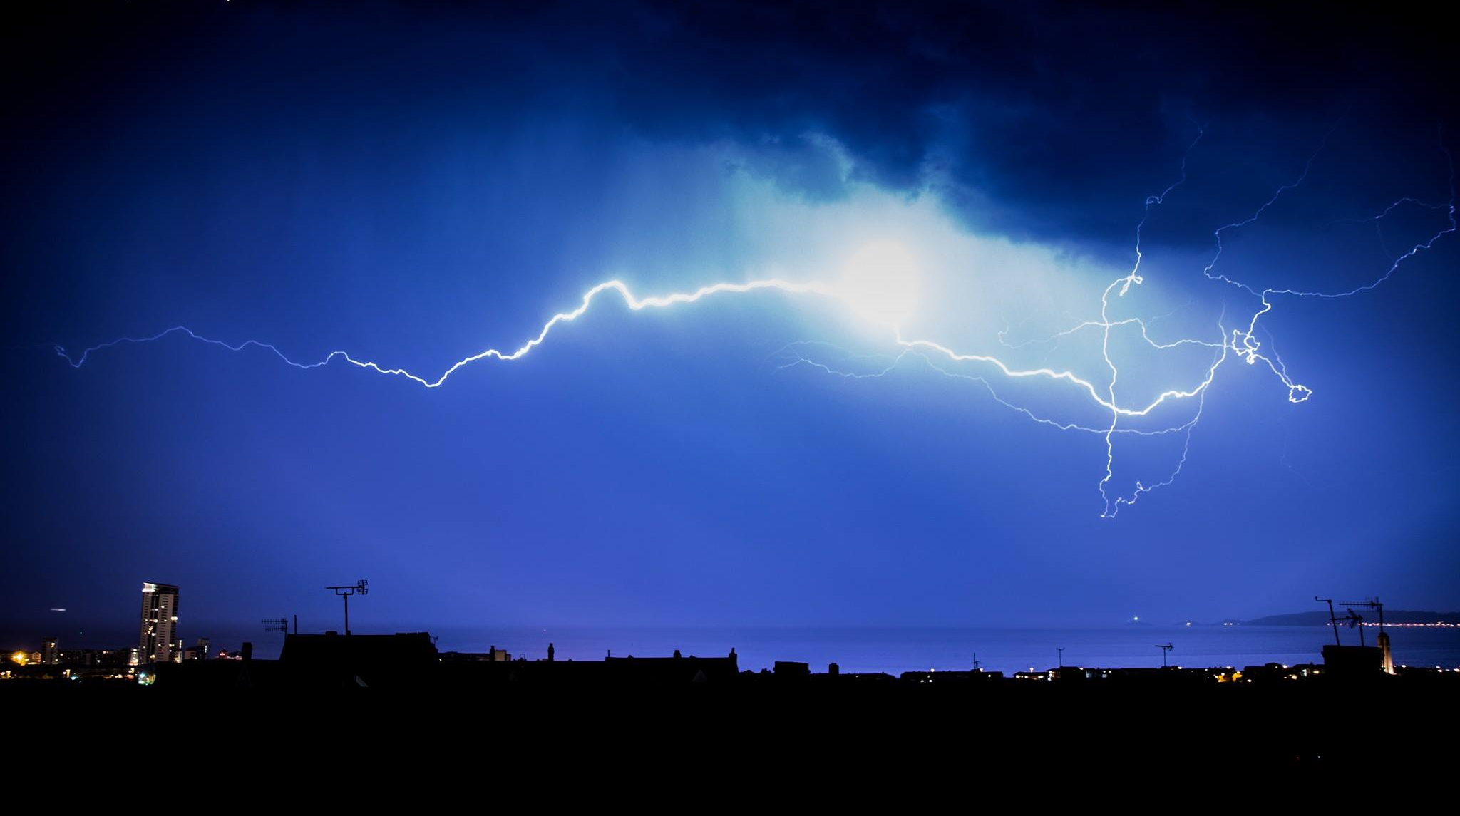
Lightning over Swansea bay. This discharge is probably about 100 MV and 30 kA

Slide 15
What Is Energy?
Reader’s Digest Universal Dictionary:
  “The work that a physical system is capable of doing in changing from its actual state to a specific reference state….”
Dictionary.reference.com:
  “The capacity of a physical system to do work.”
Thefreedictionary.com:
  “A source of usable power, such as petroleum or coal.
  Principle of conservation of energy.”

Slide 16
Conservation of Energy
The PRINCIPLE OF CONSERVATION OF ENERGY states that:
  “Energy can neither be created or destroyed, it can only be converted from one form into another.”
Example of different types of energy are electrical, sound, light , mechanical and heat.
Energy is measured in units of the joule ( J ).

Slide 17
What is Power?
Power is defined as “the rate of doing work” i.e. it is the rate of usage of joules. The unit is joules/sec (J/s) and is more commonly called the “watt” (W). Where 1 W = 1 J/s.
Imagine a joule as a packet of energy, the quicker we use up these packets of energy then the greater the power consumed.
Alternatively the more joules per second we use the greater the power dissipated ( used up ).

Slide 18
Some Definitions
Current – flow of electric charge in a circuit. Measured in Amps (A)
Voltage – electric potential or “electric pressure”. Measured in Volts (V)
Resistance – how difficult it is to pass electric current. Measured in Ohms (Ω)
Power – rate at which electrical energy is transferred by a circuit. Measured in Watts (W)

Slide 19
Powers of 10
Number | Power | SI prefix | SI Symbol
0.000000000000000000001 | -21 | zepto | z
0.000000000000000001 | -18 | atto | a
0.000000000000001 | -15 | femto | f
0.000000000001 | -12 | pico | p
0.000000001 | -9 | nano | n
0.000001 | -6 | micro | µ
0.001 | -3 | milli | m
1 | 0
1000 | 3 | kilo | k
1000000 | 6 | Mega | M
1000000000 | 9 | Giga | G
1000000000000 | 12 | Tera | T
1000000000000000 | 15 | Peta | P
1000000000000000000 | 18 | Exa | E
1000000000000000000000 | 21 | Zetta | Z

Slide 20
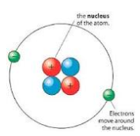
Atomic Structure
An atom is a particle of matter that uniquely defines a chemical element.
It is the building block of all matter, everything is made up from atoms.
It consists of a central nucleus that is usually surrounded by one or more electrons.
Each electron is negatively charged.
The nucleus is positively charged and contains one or more relatively heavy particles known as protons and neutrons.

Slide 21
Atomic Structure
Protons and neutrons have a similar weight and are much , much heavier than the electron.
The majority of the weight of an atom is in the nucleus.
There is a lot of space between the nucleus and the surrounding electrons, hence most of an atom is space and so most of matter is space.
The inter-atomic forces within the atom hold it together.
Inner shell electrons are more firmly bound to the nucleus .
The further an electron shell is from the nucleus the weaker the bonding force.

Slide 22
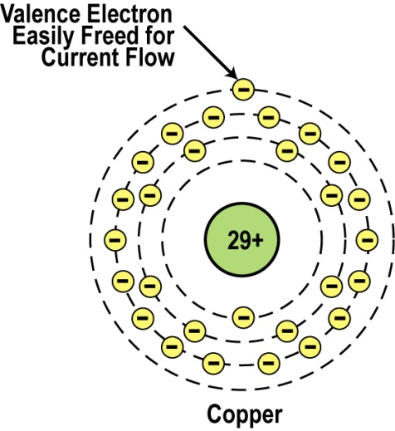
Atomic Structure
2,8,18,1 = 29 electrons in the energy shells or bands
Above is an example of a copper atom.
It has 29 protons, 29 electrons and 35 neutrons.
Note the single electron in the outer shell, or band, known as the Valence Band.
Atoms that have equal numbers of electrons and protons are said to be electrically neutral.

Slide 23
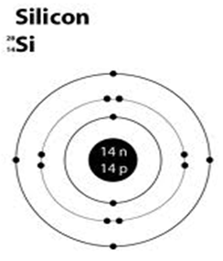
Insulators
Have complete shells and all the electrons are tightly bound to their central nucleus.
Pure Silicon is an insulator.
It has 14 electrons, an all of its energy shells are full.
And their electrons are tightly bound to the central nucleus.
It has no free electrons and is therefore an example of an insulator.
Atomic Mass: Total number of Protons and Neutrons within the nucleus.
Atomic Number : This is simply the number of Protons in the Nucleus, but note also there will be an equal number of Electrons as Protons but they reside in the shells surrounding the Nucleus.

Slide 24
Conductors
Good conductors have low resistance so electrons flow through them with ease.
Best element conductors include:
Copper, silver, gold, aluminum, & nickel
Alloys are also good conductors e.g. Brass & steel
Good conductors can also be liquid e.g. Salt water
An example of a copper atom is shown.
Copper has 29 Electrons in its atomic structure.
28 tightly bound the central nucleus and 1 lightly bound.
The outer shell electron is known as a free electron and is easily dislodged from the atom to become a FREE ELECTRON which may roam freely within the copper material.

Slide 25
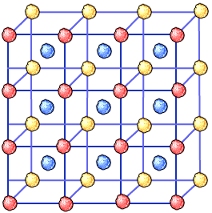
Metals as Conductors
The vast majority of conductors are metallic
Metals are made of a lattice of atoms surrounded by a sea of free valence electrons
Large numbers of valence electrons in the lattice increase conductivity in the material

Slide 26
Electrical Conductivity
A metal consists of a lattice of atoms, each with an outer shell of electrons that freely dissociate from their parent atoms and travel through the lattice. This is also known as a positive ionic lattice.
This 'sea' of dissociable electrons allows the metal to conduct electric current.
When an electrical potential difference (a voltage) is applied across the metal, the resulting electric field causes electrons to drift towards the positive terminal.
The actual drift velocity of electrons is very small, in the order of magnitude of a meter per hour.
However, as the electrons are densely packed in the material, the electromagnetic field is propagated through the metal at nearly the speed of light.

Slide 27
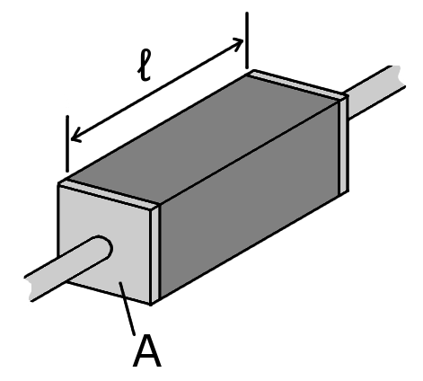
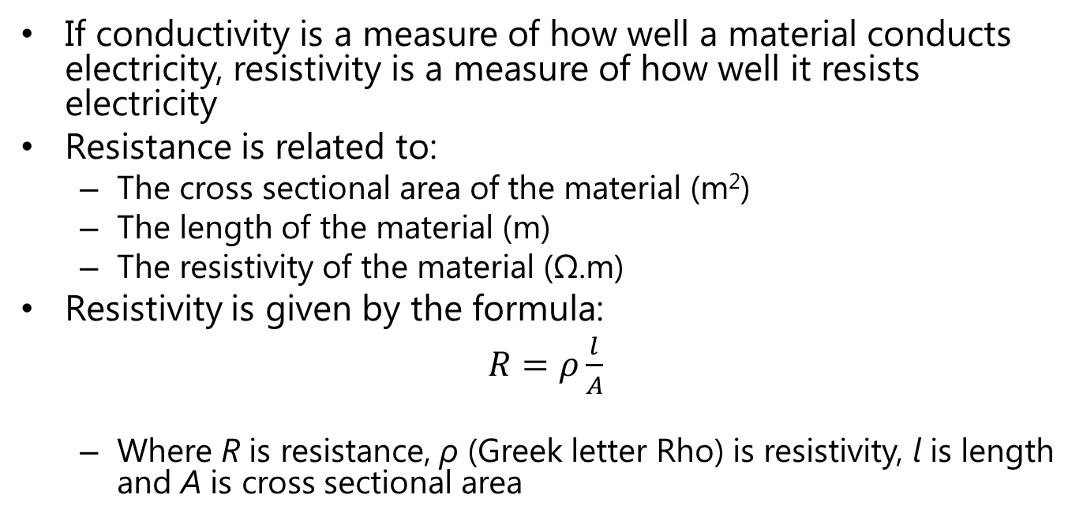
Resistance and Resistivity
If conductivity is a measure of how well a material conducts electricity, resistivity is a measure of how well it resists electricity
Resistance is related to:
  The cross sectional area of the material (m²)
  The length of the material (m)
  The resistivity of the material (Ω.m)
Resistivity is given by the formula:
$R=ρ\frac{l}{A}$
  Where R is resistance, ρ (Greek letter Rho) is resistivity, l is length and A is cross sectional area

Slide 28
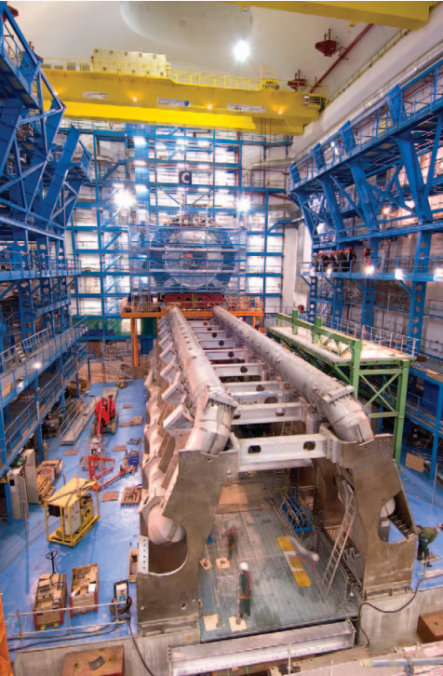
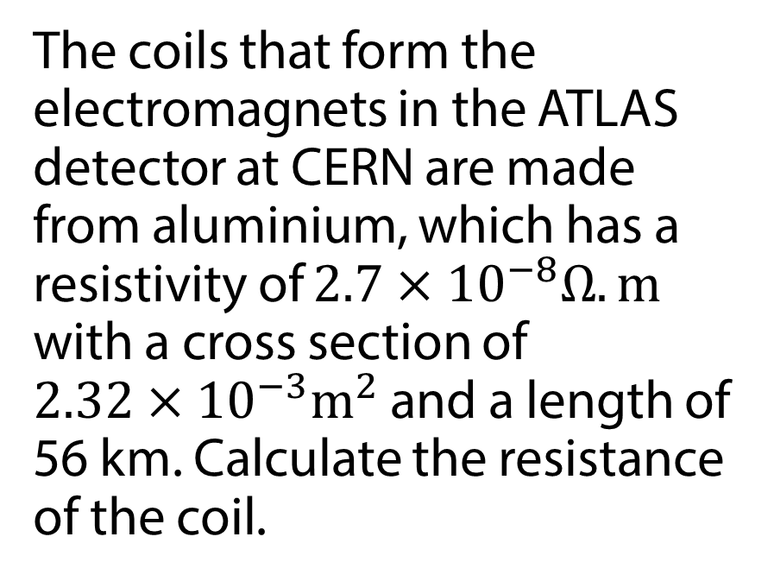
Resistivity - Example
The coils that form the electromagnets in the ATLAS detector at CERN are made from aluminium, which has a resistivity of $2.7×{10}^{−8}Ω.m$ with a cross section of $2.32×{10}^{−3}m^{2}$ and a length of 56 km. Calculate the resistance of the coil.

Slide 29
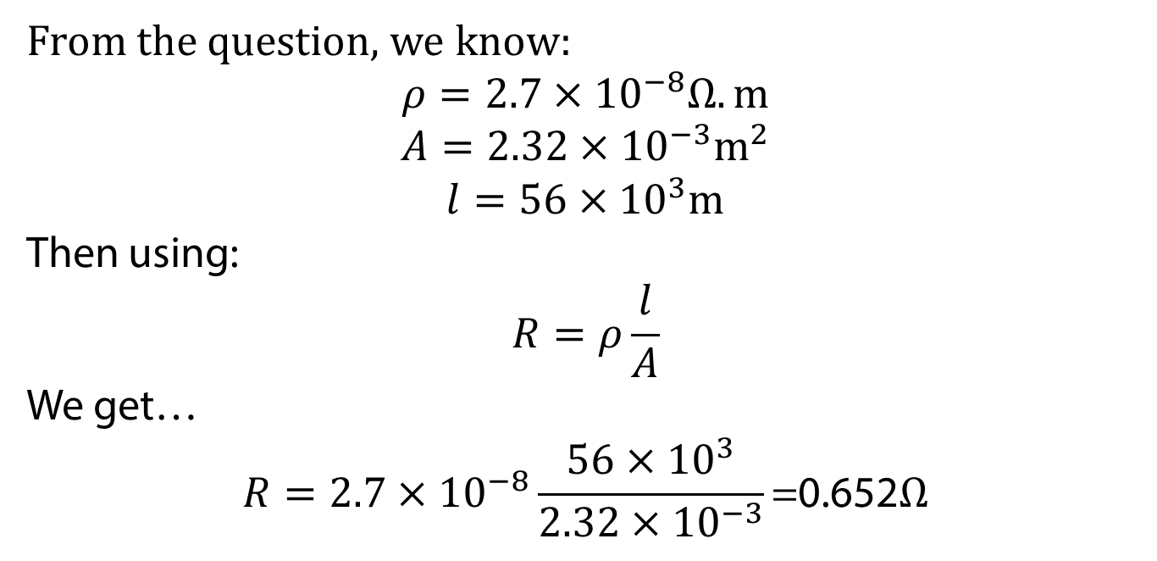
Resistivity – Example Solution
From the question, we know:
$$ρ=2.7×{10}^{−8}Ω.m$$
$$A=2.32×{10}^{−3}m^{2}$$
$$l=56×{10}^{3}m$$
Then using:
$$R=ρ\frac{l}{A}$$
We get…
$$R=2.7×{10}^{−8}\frac{56×{10}^{3}}{2.32×{10}^{−3}}\text{=0.652}Ω$$

Slide 30
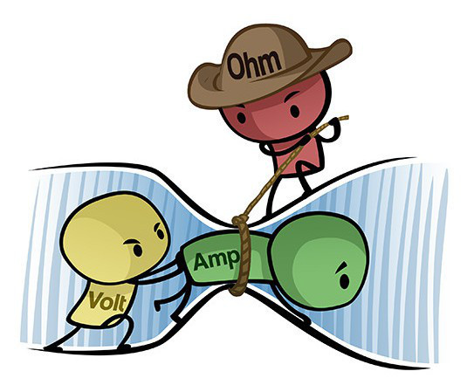
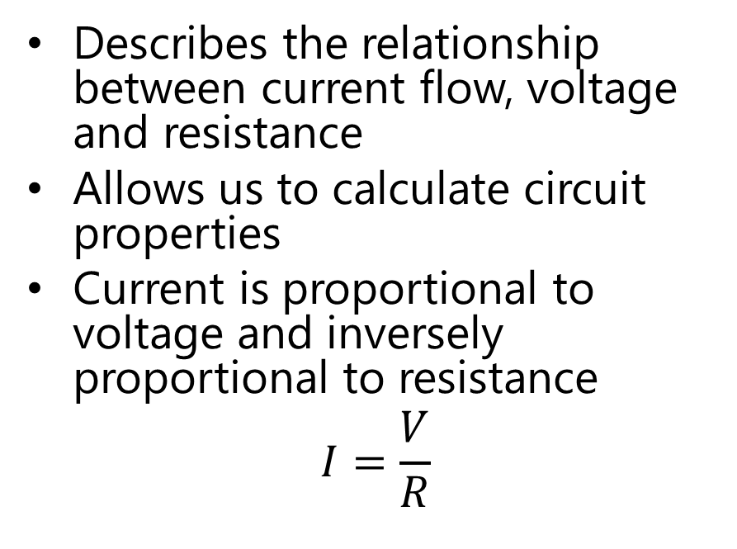
Ohm’s Law
Describes the relationship between current flow, voltage and resistance
Allows us to calculate circuit properties
Current is proportional to voltage and inversely proportional to resistance
$$I=\frac{V}{R}$$

Slide 31
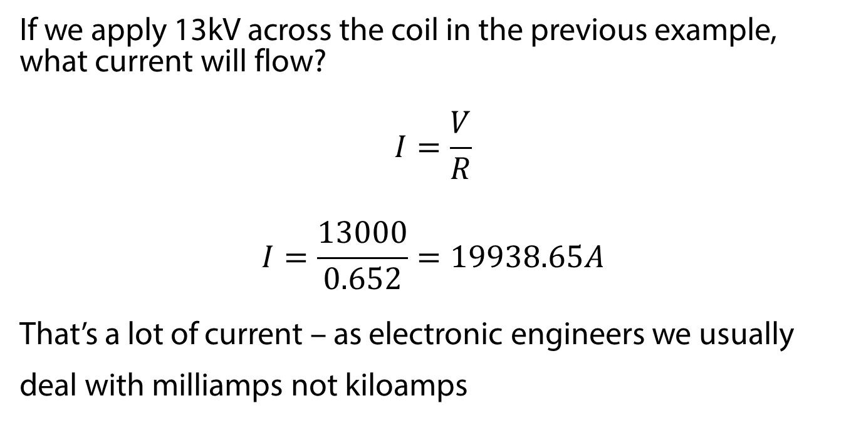
Ohm’s Law - Example
If we apply 13kV across the coil in the previous example, what current will flow?
$$I=\frac{V}{R}$$
$$I=\frac{13000}{0.652}=19938.65A$$
That’s a lot of current – as electronic engineers we usually deal with milliamps not kiloamps

Slide 32

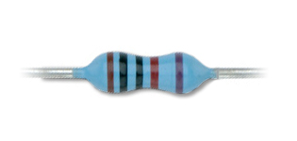
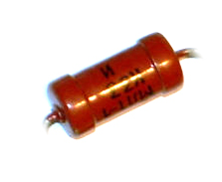
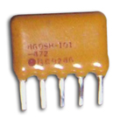
Resistors
Resistors are commonly used in electronic circuits to control voltage and current
There are several different types of resistors that can be used

Slide 33
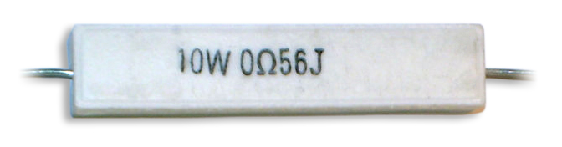
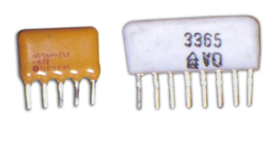
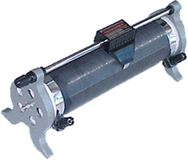

Resistors
The type of resistor used has to be appropriate for the application.
A high power resistor.
Several resistors in one package (resistor arrays).
A low power resistor.
A rheostat (variable resistor) for experimentation.

Slide 34
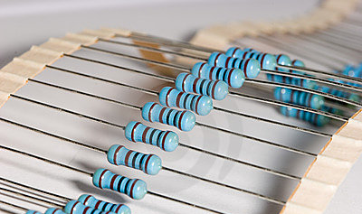
Resistors
The value of a resistor, its resistance, is measured in ohms (Ω).
This indicates how much it reduces the current flow.
A higher value of resistance reduces the current flow more than a lower value resistance.
It is common to use Ω, kΩ, and MΩ values for resistors.

Slide 35
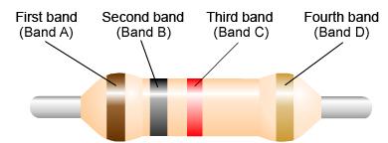
Resistor Colour Code
The value is displayed by a series of coloured bands.
The simplest color code is one that has four bands.
In order to read the code, it is necessary to get the resistor the right way round.
Arrange the resistor so that the band on its own is on the right.

Slide 36
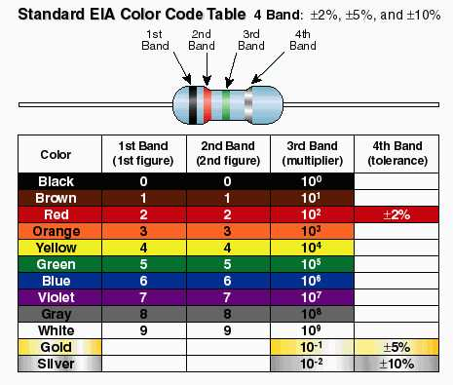
Resistor Colour Code

Slide 37
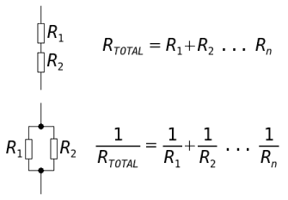
Resistors
The values of resistors in series are added to find the total resistance
The values of resistors in parallel

Slide 38
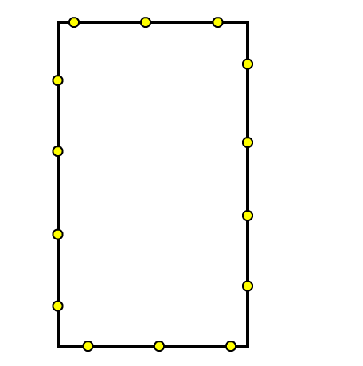
Resistors in Series
In a series circuit, the same current from the battery flows through each resistor.
Resistors are often connected together in series. It is possible to predict these things:
  voltage across resistors
  total current flowing
  total resistance of the circuit
I
R₁
V₁
V
R₂
V₂
R₃
V₃

Slide 39
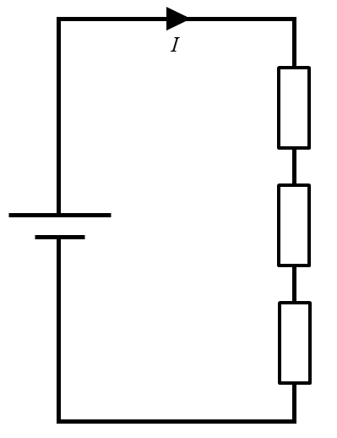
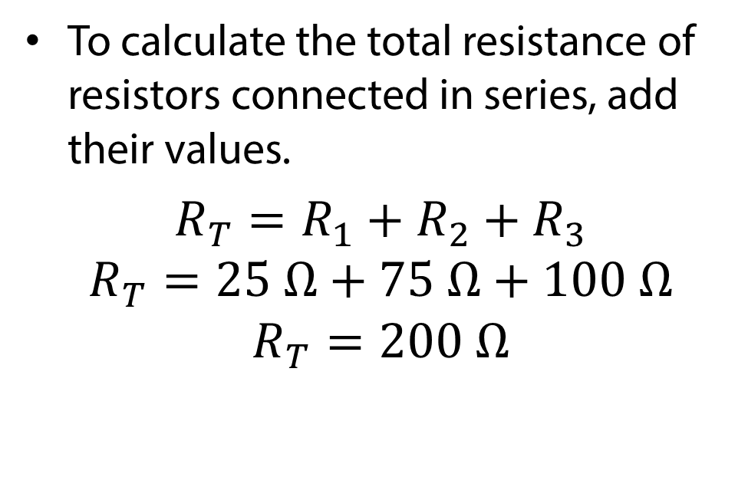
Resistors in Series
To calculate the total resistance of resistors connected in series, add their values.
$R_{T}=R_{1}+R_{2}+R_{3}$
$$R_{T}=25 Ω+75 Ω+100 Ω$$
$$R_{T}=200 Ω$$
R₁
25 Ω
R₂
75 Ω
R₃
100 Ω

Slide 40
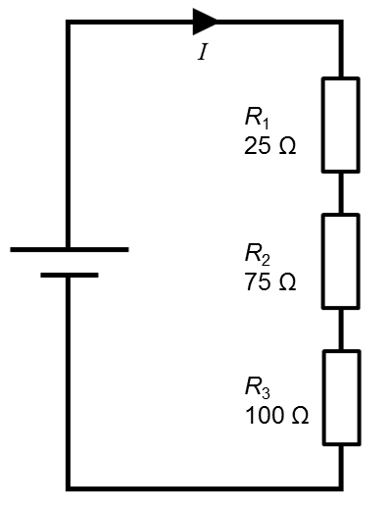
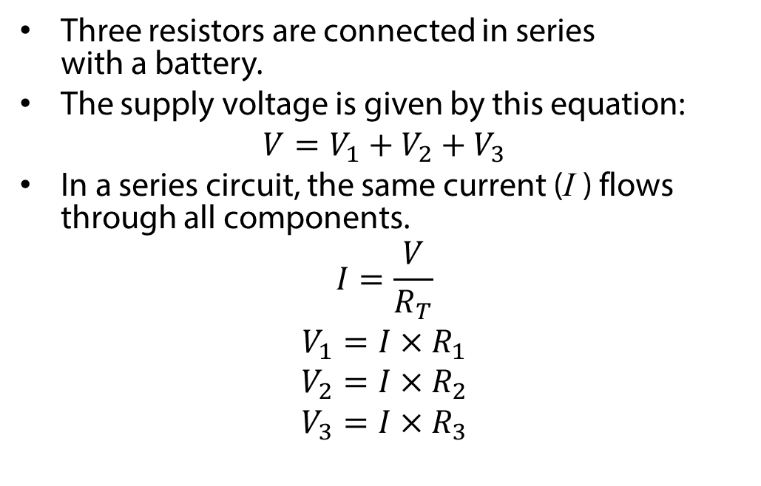
Voltage in a Series Circuit
Three resistors are connected in series
with a battery.
The supply voltage is given by this equation:
$$V=V_{1}+V_{2}+V_{3}$$
In a series circuit, the same current (I ) flows through all components.
$$I=\frac{V}{R_{T}}$$
$$V_{1}=I×R_{1}$$
$$V_{2}=I×R_{2}$$
$$V_{3}=I×R_{3}$$

Slide 41
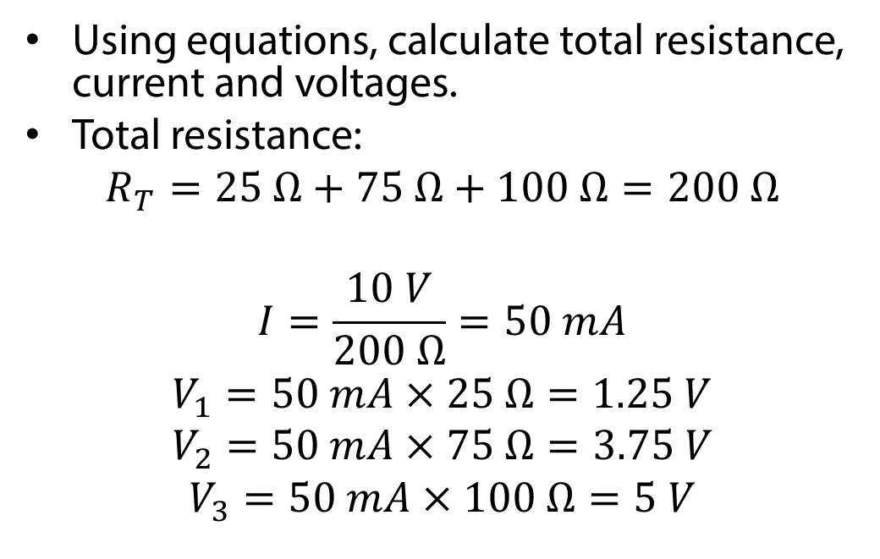
Voltage in a Series Circuit
Using equations, calculate total resistance, current and voltages.
Total resistance:
$$R_{T}=25 Ω+75 Ω+100 Ω=200 Ω$$
$$I=\frac{10 V}{200 Ω}=50 mA$$
$$V_{1}=50 mA×25 Ω=1.25 V$$
$$V_{2}=50 mA×75 Ω=3.75 V$$
$$V_{3}=50 mA×100 Ω=5 V$$
10 V

Slide 42
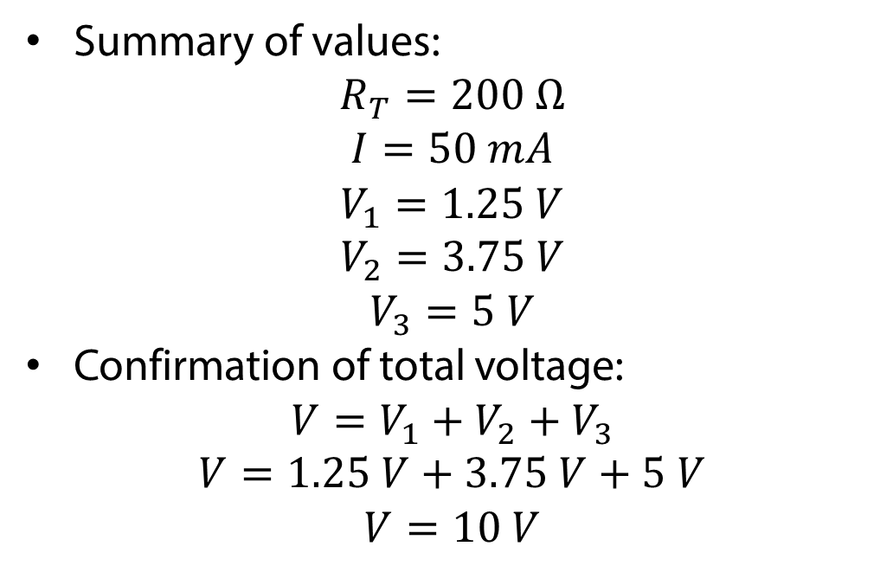
Voltage in a Series Circuit
Summary of values:
$$R_{T}=200 Ω$$
$$I=50 mA$$
$$V_{1}=1.25 V$$
$$V_{2}=3.75 V$$
$$V_{3}=5 V$$
Confirmation of total voltage:
$$V=V_{1}+V_{2}+V_{3}$$
$$V=1.25 V+3.75 V+5 V$$
$$V=10 V$$
10 V

Slide 43
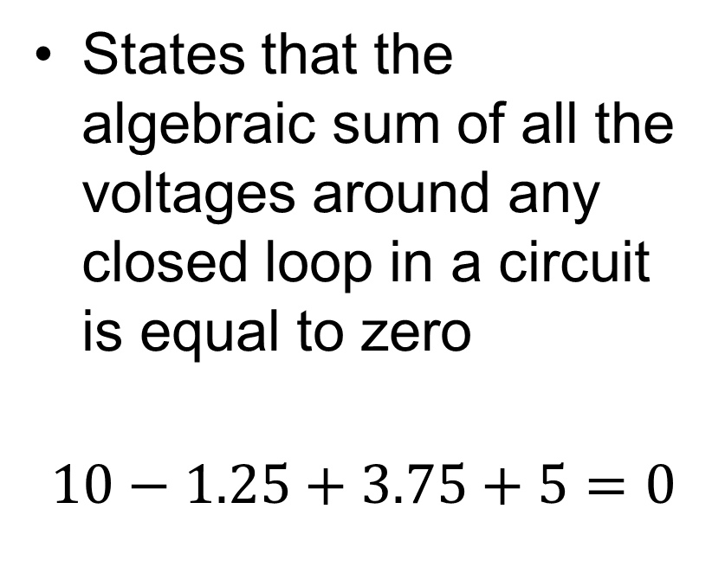
Kirchoff’s Voltage Law
States that the algebraic sum of all the voltages around any closed loop in a circuit is equal to zero
$$10−1.25+3.75+5=0$$
1.25V
10V
3.75V
5V

Slide 44
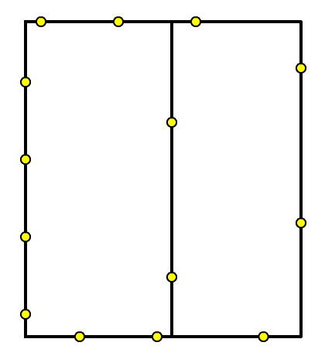
Resistors in Parallel
In a parallel circuit, the current from the battery splits and flows through each resistor.
Components are often connected together in parallel. It is possible to predict these things:
  current flowing through each resistor
  total current flowing
  total resistance of the circuit
R₁
R₂
Conventional current flow

Slide 45
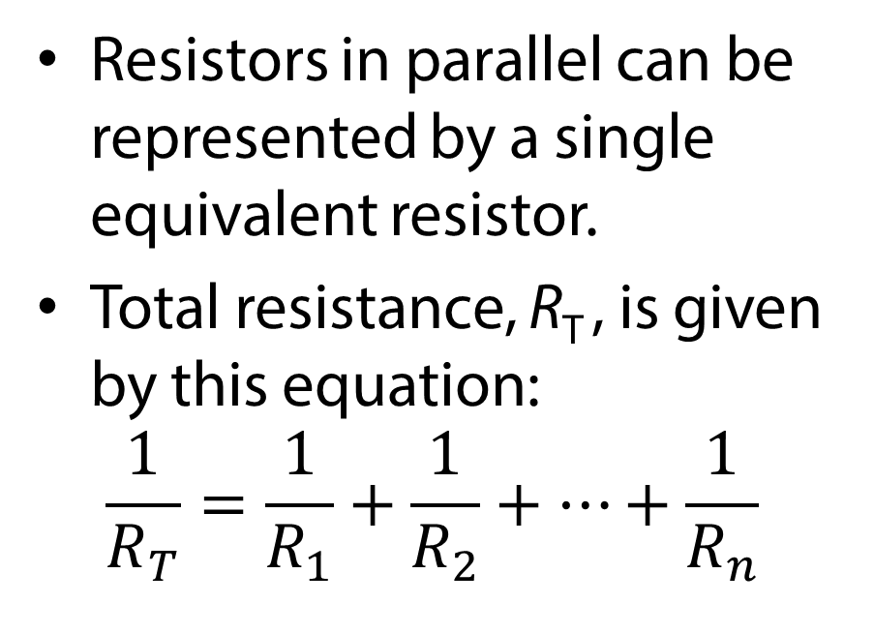
Resistors in Parallel
Resistors in parallel can be represented by a single equivalent resistor.
Total resistance, R_{T} , is given by this equation:
$$\frac{1}{R_{T}}=\frac{1}{R_{1}}+\frac{1}{R_{2}}+…+\frac{1}{R_{n}}$$
R₁
R₂
R_{n}

Slide 46
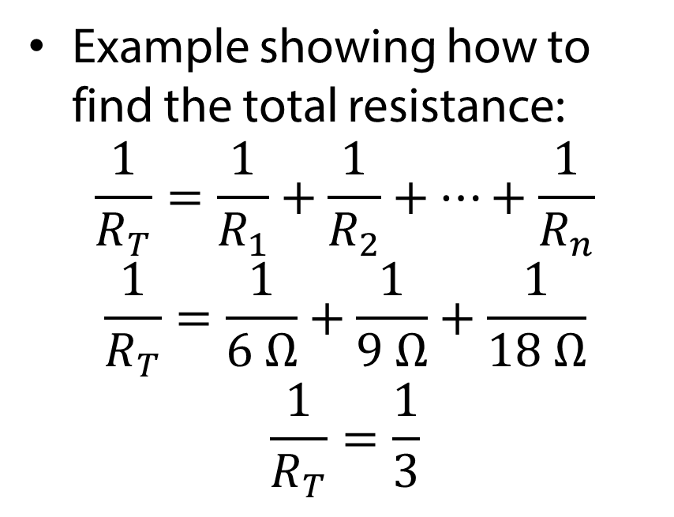
Resistors in Parallel
Example showing how to find the total resistance:
$$\frac{1}{R_{T}}=\frac{1}{R_{1}}+\frac{1}{R_{2}}+…+\frac{1}{R_{n}}$$
$$\frac{1}{R_{T}}=\frac{1}{6 Ω}+\frac{1}{9 Ω}+\frac{1}{18 Ω}$$
$$\frac{1}{R_{T}}=\frac{1}{3}$$
R₁
6 Ω
R₂
9 Ω
R₃
18 Ω

Slide 47
Points to note.
NOTE: If we have only two resistors are in parallel we can also say:
R_{T} = PRODUCT = R1 x R2
SUM R1 + R2
Also, if we have N identical resistors of value “R” in parallel then net effective resistance R_{T} = R
N

Slide 48
For parallel connected resistors the following criteria must be true:
  There must be two common points of contact between the resistors,
  The same voltage must be across all resistors that are in parallel.
Points to note:
For series connected resistors: the current is common to all the resistors connected in series.
For parallel connected resistors: the voltage is common to all of the resistors connected in parallel.

Slide 49
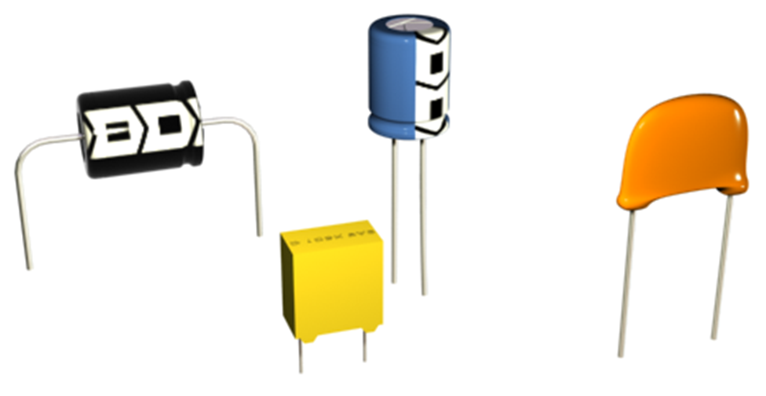

Capacitors
A capacitor is a two terminal electronic device that has the property of CAPACITANCE and is capable of storing electrical energy, a little like a battery. However a battery stores its energy in the form of chemicals.
A capacitor consists of two conductive plates separated by an insulating material called a DIELECTRIC. The type of dielectric defines the properties of the capacitor.
Axial electrolytic
Radial electrolytic
Conductive plate
Ceramic
Dielectric
Polyester

Slide 50
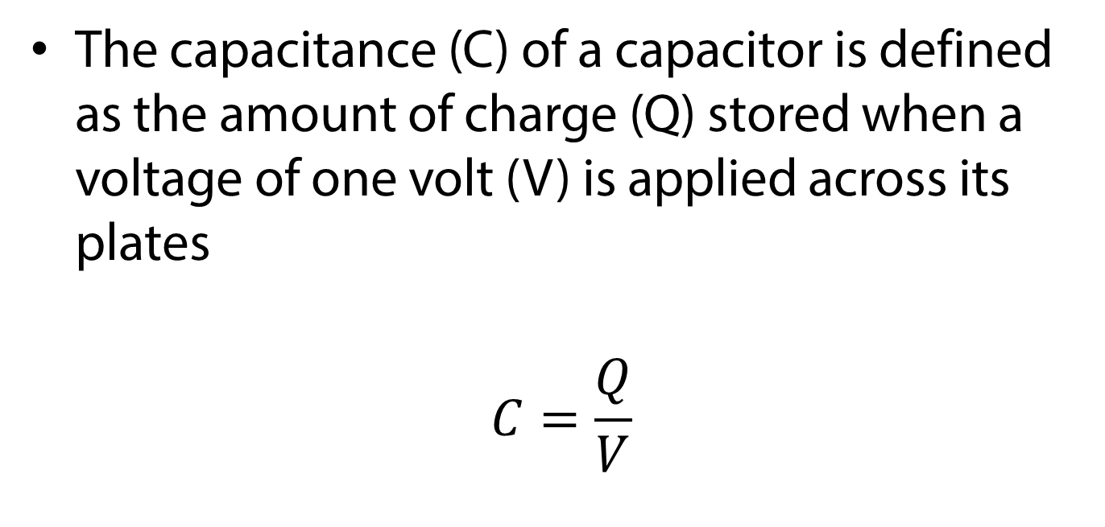
Capacitors
The capacitance (C) of a capacitor is defined as the amount of charge (Q) stored when a voltage of one volt (V) is applied across its plates
$$C=\frac{Q}{V}$$

Slide 51
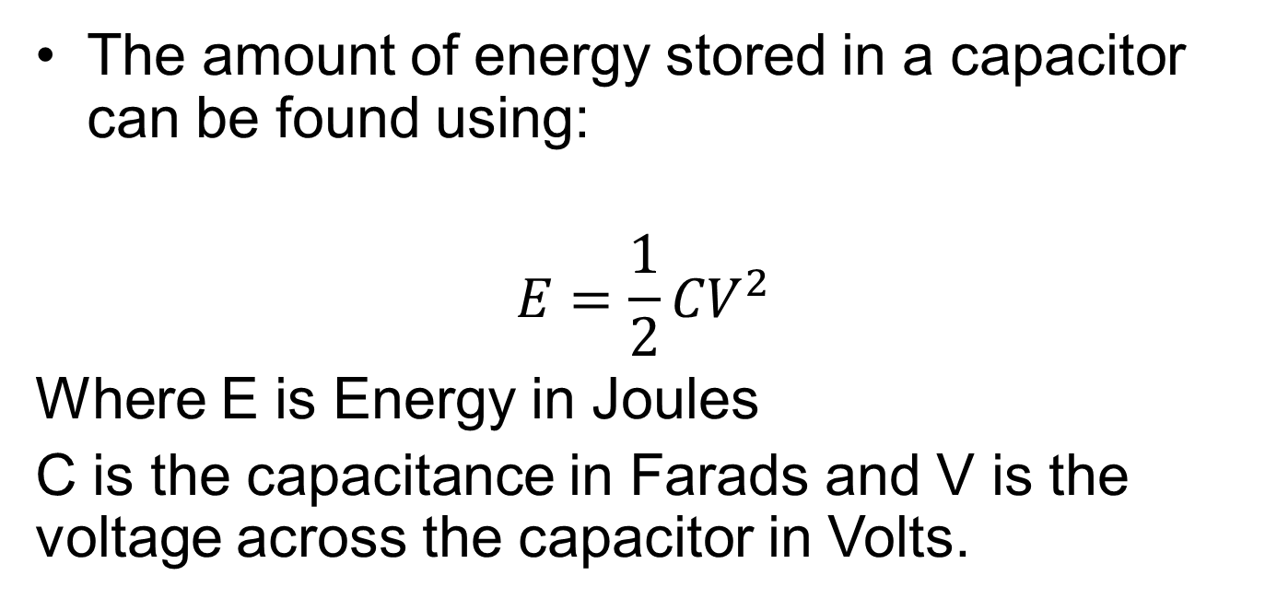
Capacitors
The amount of energy stored in a capacitor can be found using:
$$E=\frac{1}{2}{CV}^{2}$$
Where E is Energy in Joules
C is the capacitance in Farads and V is the voltage across the capacitor in Volts.

Slide 52
Capacitors
Capacitance is measured in farad (F), but it is more usual to see it measured in sub-multiples:
  millifarad (mF): 1,000 mF = 1 F
  microfarad (µF): 1,000,000 µF = 1 F
  nanofarad (nF): 1,000,000,000 nF = 1 F
  picofarad (pF) : 1,000,000,000,000 pF = 1 F

Slide 53
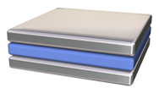
Capacitors
Two conducting surfaces that face each other across a small distance will store an electric charge.
The amount of charge stored depends upon:
  The distance between the plates
  The area of the plates
  The material between the plates (called the dielectric)
Plate 1
Distance
Plate 2
Dielectric

Slide 54
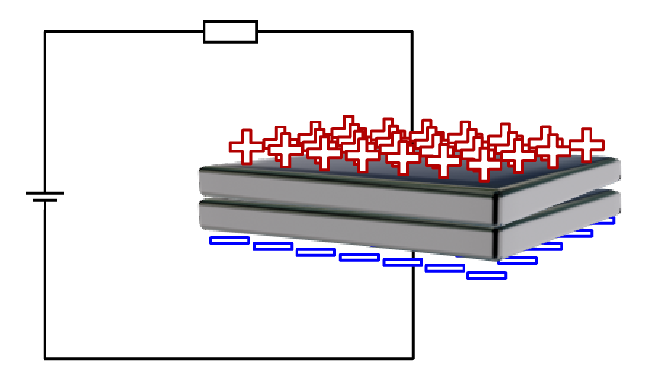
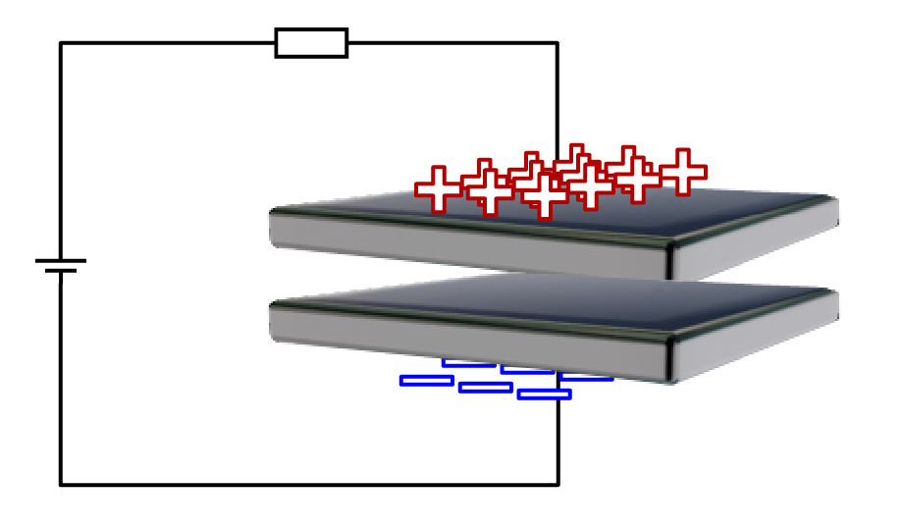
Capacitors
The larger the area of the plates, the greater the amount of charge that can be stored on them.
This makes the capacitance directly proportional to the area of the plates.
The closer the plates are, the stronger the force between the charges. This also means more charge can be stored on the plates.
This makes the capacitance inversely proportional to the distance (d ) between the plates.
V
C ∝ A
V
d
1
C ∝
d

Slide 55
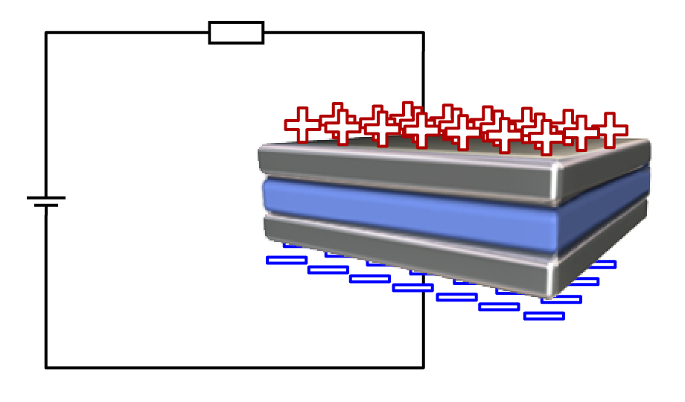
Capacitors
The dielectric is an electrical insulator placed between the plates.
There has to be a factor that measures the effect the dielectric has on the charge on the plates.
It is called the permittivity and given the symbol ε (epsilon).
By definition, capacitance is directly proportional to the permittivity of the dielectric.
V
Dielectric
C ∝ ε

Slide 56
Permittivity
Noun – PHYSICS
The ability of a substance to store electrical energy in an electric field.

Slide 57
Capacitors
If we bring these factors together into one formula, we have:
ε A
C =
d
where:
C = capacitance in F
ε = permittivity of dielectric in F/m
A = area of plates in m²
d = distance between plates in m

Slide 58
Capacitors
ε is known as the absolute permittivity
It is easier to use the relative permittivity of a material, ε_{r} .
This compares the permittivity of a material with the permittivity of free space (a vacuum), ε_{o} .
These are related by this formula:
ε = ε_{r} ε_{o}
V
Dielectric
ε_{r} ε_{o} A
C =
d

Slide 59
Absolute and Relative Permittivity
ε_{o} is a constant. It has the value 8.854 × 10⁻¹² F/m.
ε_{r} has no unit, as it is a ratio. It is said to be dimensionless.
The table shows the relative permittivity of common materials.
Material | Relative Permittivity
Vacuum | 1 (by definition)
Air | 1.000576
Polythene | 2.3
Ebonite | 3
Oiled paper | ~4
Glass | ~5
Mica | 7

Slide 60
Pop Quiz
How is the charge on a capacitor related to the distance between the plates?
There is no relationship
It is inversely proportional
It is directly proportional
It is exponentially proportional

Slide 61
Pop Quiz
What is the absolute permittivity of Teflon if it has a relative permittivity of 2.1 and the permittivity of free space is 8.854 × 10⁻¹² F/m?
ε = ε_{r} ε_{o}
ε = 2.1 × 8.854 × 10⁻¹² F/m
ε = 18.59 × 10⁻¹² F/m
18.59 × 10⁻¹² F/m

Slide 62
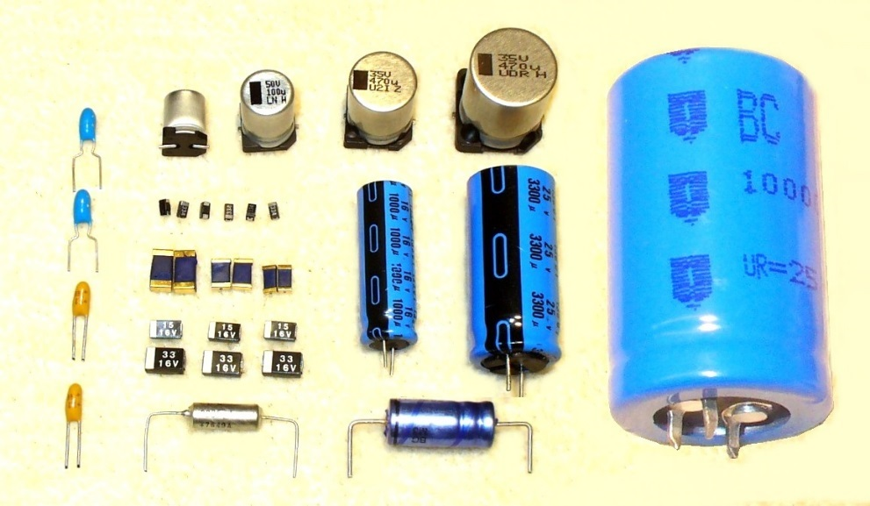
Capacitors
The type of dielectric used in a capacitor gives its type, such as polyester, ceramic and electrolytic.
The dielectric also determines the range of capacitor values.
Ceramic and polyester capacitors will have small values in nanofarads and picofarads.
Electrolytic capacitors have larger values in microfarads.

Slide 63
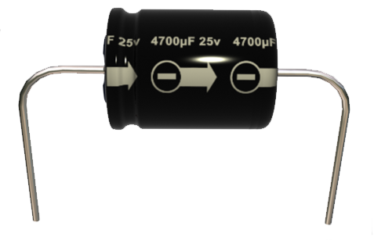
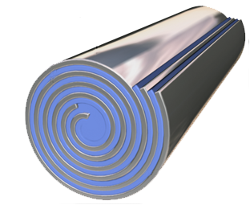
Capacitors – Working voltage
Plate 1
Plate 2
Dielectric
Working voltage
The dielectric is very thin and can easily be damaged if the voltage across the capacitor is too high.
A capacitor’s working voltage must not be exceeded.

Slide 64
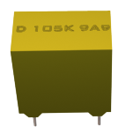
Labelling Capacitors
Value
Code
Capacitors are labelled in several different ways.
Electrolytic capacitors have the value written in full.
Some types of capacitor use a code to indicate the value.

Slide 65
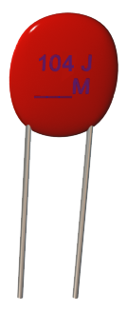
Labelling Capacitors
One code system uses a 3 digit number to indicate the capacitor value in picofarads.
The code 104 is one, zero, and 4 extra zeros, which is 100,000 pF.

Slide 66
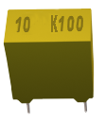
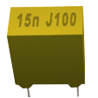
Labelling Capacitors
In another system, a number on its own indicates a value in microfarads.
10 = 10 µF
A number followed by an n indicates nanofarads
15n = 15 nF

Slide 67
Labelling Capacitors
The label also shows
the tolerance and working voltage.
The table shows
the tolerance code
for capacitors.
It is not uncommon for capacitors to have a tolerance of 20%.
Some ceramic capacitors have a tolerance of +80% and -20%.
Letter Code | Tolerance (%)
F | 1
G | 2
H | 3
J | 5
K | 10
M | 20
Z | +80,-20
P | +100,-0

Slide 68
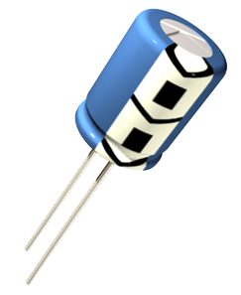
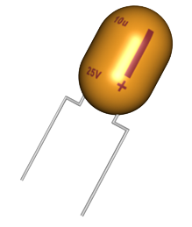
Polarised Capacitors
Most capacitors can
be connected either way around.
Electrolytic and tantalum capacitors are polarised and must only be inserted in a circuit one way.
Electrolytic
Tantulum

Slide 69
Polarised Capacitors
Polarised capacitors must be inserted with their negative terminals connected to the negative side of the circuit.
The labelling on the capacitor indicates the polarity of the terminals.
Negative
terminal
Electrolytic
Positive
terminal
Tantulum

Slide 70


Capacitor Symbols
Here is the circuit symbol for a non-polarised capacitor.
The symbol for a polarised capacitor is almost the same, except for the addition of a
+ sign on one terminal.
Non-polarised
Polarised

Slide 71


Capacitors in Series
Capacitors can be connected in series
This has the effect of increasing the spacing between the plates
The total capacitance will decrease
$$C=\frac{εA}{d}$$

Slide 72

Capacitors in Series
Capacitors in series can be represented by a single equivalent capacitor.
Total capacitance, C_{T} , is given by this equation:
$\frac{1}{C_{T}}=\frac{1}{C_{1}}+\frac{1}{C_{2}}+…+\frac{1}{C_{n}}$

Slide 73


Capacitors in Series
Example showing how to find the total capacitance:
$$\frac{1}{C_{T}}=\frac{1}{C_{1}}+\frac{1}{C_{2}}+…+\frac{1}{C_{n}}$$
$$\frac{1}{C_{T}}=\frac{1}{1×{10}^{−6}}+\frac{1}{5×{10}^{−6}}+\frac{1}{10×{10}^{−6}}$$
$$\frac{1}{C_{T}}=1300000$$
$$C_{T}=\frac{1}{1300000}=769.23×{10}^{−9} F$$
$$C_{T}=769.23 nF$$

Slide 74


Capacitors in Parallel
Capacitors can be connected in parallel
This has the effect of increasing the area of the plates
The total capacitance will increase
$$C=\frac{εA}{d}$$

Slide 75

Capacitors in Parallel
Capacitors in parallel can be represented by a single equivalent capacitor.
Total capacitance, C_{T} , is given by this equation:
$$C_{T}=C_{1}+C_{2}+…+C_{n}$$

Slide 76


Capacitors in Parallel
Example showing how to find the total capacitance:
$$C_{T}=C_{1}+C_{2}+…+C_{n}$$
$$C_{T}=1×{10}^{−6}+5×{10}^{−6}+10×{10}^{−6}$$
$$C_{T}=16×{10}^{−6} F$$
$$C_{T}=16 μF$$

Slide 77
Pop Quiz
When capacitors are connected in series, the total capacitance _________.
  Increases
  Decreases
  Stays the same

Slide 78
Pop Quiz
When capacitors are connected in parallel, the total capacitance _________.
  Increases
  Decreases
  Stays the same

Slide 79

Inductors
An Inductor, also called a coil, reactor or choke is a coil of wire wound around a core
Core may be made from iron, ferrite, air

Slide 80

Inductors
Inductors store electrical energy in a magnetic field when current flows through it

Slide 81
Inductors
When the current is removed, the collapsing magnetic field induces a voltage into the coil, opposing the original voltage.
This is called ‘Back EMF’

Slide 82

Inductors
$\text{Inductors} \text{are} \text{used} \text{in} \text{many} \text{electronic} \text{circuits}\text{.}$
The inductance of an inductor is difficult to calculate but for a solenoid is can be estimated using:
$$L=\frac{μ_{0}μ_{r}N^{2}A}{d}$$
Where L is the inductance in Henrys, $μ_{0}$ is the permeability of free space, $μ_{r}$ is the relative permeability of the core material, N is the number of turns in the coil, A is the cross sectional area of the coil and d is the length of the coil.

Slide 83
Permeability
Noun - PHYSICS
A quantity measuring the influence of a substance on the magnetic flux in the region it occupies.

Slide 84

Absolute and Relative Permeability
$μ_{0}$ is a constant. It has the value $4π×{10}^{−7} H/m$
$μ_{r}$ has no unit, as it is a ratio. It is said to be dimensionless
The table shows the relative permeability of common materials
Material | Relative Permeability
Vacuum | 1 (by definition)
Iron | 200,000
Electrical steel | 4000
Carbon Steel | 100
Nickel | 100 – 600
Aluminium | 1.000 022
Wood | 1.000 000 43

Slide 85



Inductors
d=100 mm
dia = 4 mm
$$L=\frac{μ_{0}μ_{r}N^{2}A}{d}$$
Find the inductance of the air-core coil:
$A=\frac{π{dia}^{2}}{4}=\frac{(π){(4×{10}^{−3}m)}^{2}}{4}=12.57×{10}^{−6}m^{2}$
$L=\frac{μ_{0}μ_{r}N^{2}A}{d}=\frac{4π×{10}^{−7}×1×{100}^{2}×12.57×{10}^{−6}}{0.1}$
$L=1.58×{10}^{−6} H$

Slide 86




Inductors in Series
$$L=\frac{μ_{0}μ_{r}N^{2}A}{d}$$
Inductors in series are simply added together because the number of coil turns is effectively increased, with the total circuit inductance $L_{T}$ being equal to the sum of all the individual inductances added together.
$$L_{T}=L_{1}+L_{2}+…+L_{n}$$

Slide 87


Inductors in Series
Example:
$$L_{T}=L_{1}+L_{2}+…+L_{n}$$
$$L_{T}=1×{10}^{−3}+5×{10}^{−3}+10×{10}^{−3}$$
$$L_{T}=16×{10}^{−3}H$$

Slide 88


Inductors in Parallel
When inductors are connected in parallel, the total inductance is less than any one of the parallel inductors’ inductances.
Total inductance, L_{T} , is given by this equation:
$$\frac{1}{L_{T}}=\frac{1}{L_{1}}+\frac{1}{L_{2}}+…+\frac{1}{L_{n}}$$

Slide 89


Inductors in Parallel
Example:
$$\frac{1}{L_{T}}=\frac{1}{L_{1}}+\frac{1}{L_{2}}+…+\frac{1}{L_{n}}$$
$$\frac{1}{L_{T}}=\frac{1}{1×{10}^{−3}}+\frac{1}{5×{10}^{−3}}+\frac{1}{10×{10}^{−3}}$$
$$\frac{1}{L_{T}}=1300$$
$$L_{T}=\frac{1}{1300}=769.23×{10}^{−6}H$$

Slide 90
Pop Quiz
When inductors are connected in series, the total inductance _________.
  Increases
  Decreases
  Stays the same

Slide 91
Pop Quiz
When inductors are connected in parallel, the total inductance _________.
  Increases
  Decreases
  Stays the same

Slide 92

Relationship Between Volts, Amps, Ohms & Watts
Ohm's law basically states that the amount of current in a circuit varies directly with the voltage and varies inversely with the resistance.
Example: if you wish to find the power (P) of a circuit and you know the voltage (V) is 12 volts and the current (I) is 4 amps substitute the numbers into the equation:
Power = V×I
P = 12 × 4 =48 watts

Slide 93
Ohms Law Questions

Slide 94

Voltage Sources
Voltage sources may be d.c. (direct current) like a battery or a.c.(alternating current) like the mains.
A d.c.voltage source, such as a battery, may be considered to consist of an ideal source of voltage in series with a certain amount of resistance typically called R_{int} or R_{s}. Where R_{int} stands for “internal resistance” and R_{s} stands for “source resistance”.
+
+
R_{int}
R_{int}
Alternatively
V_{s}
V_{s}
-
-

Slide 95
Voltage Sources
So, a practical battery is more accurately described as a source of voltage with some internal resistance in series with it.
The output of a power amplifier may be considered as an a.c. voltage source with its own internal resistance.
Note: from now on we will always consider voltage sources as having an internal resistance.
In addition all signal sources will also be considered to have their own internal resistance as well. See later note on signal sources.

Slide 96
Voltage Sources
What is the significance of the internal resistance?
Answer:
The internal resistance acts like a resistance internally to the battery/power supply but in-line with any load connected to the supply.
This means that it adds to the total circuit resistance and also causes an internal voltage drop within the battery/supply.
This means that the actual “terminal voltage” of the supply will always be less than the nominal internal voltage V_{s}.

Slide 97
Voltage Sources
So whenever we connect a load onto a power supply the terminal voltage of the supply will drop.
The drop in voltage will be due to the voltage drop across R_{int} which results from the load current flowing through R_{int}.
V_{int}
V_{load} = V_{s} - V_{int}
+
R_{int}
V_{load}
V_{s}
Load resistance

Slide 98
Voltage Sources
Because there is always a voltage drop internally to the voltage source when current flows into the load it means that there is always some power loss within the power supply when it is connected to a load and is supplying current to the load.
This means that when a power amplifier supplies power to a speaker, some of the power destined for the speaker will actually be lost (as heat) within the power amplifier.
In some power amplifiers up to 75% or more power may be lost within the amplifier.
A power amplifier is not a power supply in the strictest sense but the principle still applies.

Slide 99
Voltage Sources
From now on YOU must always consider the effect of the internal resistance of all supplies because it has an effect on circuit performance. The effect may be minimal or very significant.

Slide 100
Maximum Power Transfer
Maximum Power Transfer occurs when the resistive value of the load is equal in value to that of the voltage sources internal resistance allowing maximum power to be supplied.

Slide 101


Maximum Power Transfer
We are going to plot a graph of power dissipated by the load resistor as a function of load resistance.
Three steps to calculate load power:
  $R_{T}=R_{Src}+R_{Load}$
  $I=\frac{V}{R}$
  $P=I^{2}R_{Load}$

Slide 102

Maximum Power Transfer
Plotting the graph we can see that maximum load power occurs when the load resistance is equal to the source resistance
$$R_{Load}=R_{src}$$

Slide 103
SEMICONDUCTOR BASICS : Qualitative description
CONDUCTORS: Mainly metals: Lots of free electrons, e.g. copper may release one free electron per atom.
INSULATORS: Wood, glass, plastics, ceramics etc. Little or no free electrons.
SEMICONDUCTORS: Silicon, Germanium, Gallium etc.
Pure silicon, Germanium etc. are effectively insulating but if we heat them they will become poor conductors.
An increase in temperature of only 10ºC will increase silicon’s conductivity by a factor of between 2 and 3.
This means that for a given applied voltage a 10 degree rise in temperature may result in an almost tripling of current.

Slide 104



Effects of doubling the temperature and doubling the voltage on a block of Silicon.

Slide 105
PROBLEMS WITH PURE SILICON
Increasing the TEMPERATURE increases the current (without changing the voltage) at an exponential rate. However, if we increase the VOLTAGE the current will increase at a LINEAR rate.
This gives us a problem, because temperature (over which we have little control) exerts far more influence over current than the voltage (which we would normally want to use to control current).

Slide 106
Solutions to the Problems With Pure Silicone
There are two ways around this problem:
We can make more free electrons available in large quantities by adding impurities in controlled amounts to the pure (INTRINSIC) semiconductor material. This process is known as DOPING. These impurity-produced free electrons are not temperature dependent BUT they are voltage dependent, and therefore their conductivity is under our control by means of externally applied voltages.
The impurity produced electrons simply overwhelm the thermally generated electrons due to their significantly greater numbers. The device manufacturers are responsible for the doping process, not the device user.

Slide 107
Solutions to the Problems With Pure Silicone
We can take care in designing circuits to enhance the linear relationship between applied voltage and resulting current flow. Correct use of NEGATIVE FEEDBACK can play a significant part in overcoming temperature dependent semiconductor behaviour.

Slide 108
Structure of Semiconductor Crystals
Silicon is one of many common semiconductors used today and is usually used as the primary semiconductor material for discussion of basic semiconductor theory.
Silicon is known as a TETRAVALENT material, which simply means that it has 4 VALENCE ELECTRONS i.e. it has 4 electrons in its outermost energy shell surrounding the nucleus of its atoms. The outermost shell is also known as the VALENCE SHELL (BAND).
The VALENCE ELECTRONS are the only ones that are capable of leaving or being remove from the atom to take place in conduction, however, it is not easy to get these electrons to leave the atom by means of voltage.

Slide 109
Structure of Semiconductor Crystals
In metals the valence electrons are free to move under the influence of an externally applied electric field ( voltage). So metals are good conductors because they readily give up their valence electrons and pure, intrinsic, semiconductors are poor conductors because their valence electrons are quite strongly bound to the nucleus of the atom and are not readily removed to take part as free electrons for conduction.
Insulators have their valence electrons very tightly bound to the nucleus and are therefore poor conductors as they do not readily give up their electrons. Semiconductors, however, although they do not tend to give up their valence electrons to voltage application they do readily give up valence electrons due to temperature and at all temperatures above ABSOLUTE ZERO .

Slide 110
Structure of Semiconductor Crystals
It is possible for valence electrons to escape from the valence band and take part in conduction at ever increasing amounts as applied temperature increases. Hence the significant temperature dependence of intrinsic silicon. These free electrons generated as a result of thermal energy gain from its surroundings are known as THERMALLY GENERATED ELECTRONS.
In practice silicon has a crystal lattice structure where adjacent atoms form bonds (COVALENT BONDS) between their valence electrons .These covalent bonds tend to help hold the valence electrons to the lattice. When these bonds arc formed the holding forces are about 0.7 eV (ELECTRON VOLTS), whereas the normal bonding force to a single atom is about 0.05 eV.

Slide 111
Structure of Semiconductor Crystals
Covalent bonds in semiconductors are so weak that many are broken at any temperature above absolute zero. The higher the temperature, the more covalent bonds are broken. Whenever a covalent bond is ruptured by thermal energy, an electron becomes free to wander and to be moved by an electric field (if one is present). In a pure silicon crystal, electrons freed by thermal energy are the only ones available for current flow; it would take impractically high voltages to rip electrons from their covalent moorings. When the electron leaves its home in the crystal, it leaves a DANGLING BOND behind.

Slide 112
Structure of Semiconductor Crystals
This dangling bond has a definite attraction for any electron passing close by and may capture it if it strays too near. The dangling bond is called a HOLE in semiconductor jargon; and because of its attraction for electrons, it is conveniently treated as though it were a positively charged body. It is not really a body, of course. It is just a force fie1d. Pretending that it is an object allows us to visualise complex semiconductor actions.
Once we agree to treat the hole as a positively charged particle, we must accord it all the rights and privileges of a duly authorised, charged body. Strange as it may seem, one of these privileges is mobility: the hole must have the freedom to move through the structure, just as the electron does.

Slide 113

Structure of Semiconductor Crystals
This concept of hole mobility is, of course, a fiction, but it is a very convenient bit of fiction. Although we cannot really visualise holes moving under the influence of an electric field, we can easily visualise changing concentrations of holes.
For a simple sketch demonstrating this concept, in which B is an electron whose covalent bond has been broken and has gained its freedom. The dangling bond A is the hole.
Note: remove the electron next to the star.

Slide 114
Electron and Hole Distribution
When no electric field is involved, free electrons are pretty evenly distributed throughout the semiconductor block. Electrons are also being captured by dangling bonds (holes), and each capture annihilates an electron-hole pair. This is because, when an electron is captured by a hole, the hole is filled and no longer exists, and the captured electron is no longer a free electron.
Thermally generated Electron-hole pairs are constantly being created and destroyed in about equal numbers. Consequently, a kind of equilibrium is established. Therefore under no-field conditions there is no current flow through the crystal. However if we apply a field then current will flow.

Slide 115
Electron and Hole Distribution
The size of this current flow, however, is comparatively small but if we add (DOPE) the silicon with a small quantity of DONOR atoms which have 5 valence electrons then we can introduce one free electron for each atom into the crystal structure. Such atoms are known as PENTAVALENT ATOMS. This has the effect of swamping the thermally generated free electrons and we now have a situation where the current flow is due mainly to the added free electrons controlled by the field rather due to thermally excited electrons. The donated electrons are around 1 million times more numerous than the thermally generated ones.

Slide 116
Electron and Hole Distribution
The purpose of doping is to make the semiconductor current flow less temperature sensitive. Since we have added many electrons to the crystal we have added negative charges and so this type of silicon is known as n-type silicon.
By similar reasoning if we add atoms which have only three valence electrons (TRIVALENT) then we have a deficit of one electron per impurity atom. In this case the impurity is called an ACCEPTOR since it leaves the structure with a deficit of one electron per atom (a HOLE) which may accept another electron in its near vicinity. Since holes are positive in nature then we may make p-type silicon.
The doping materials are different in each case for n and p type and they are known as IMPURITIES. Two examples of such impurities are Boron and Arsenic.
Combinations of p and n type silicon gave rise to the spread of semiconductor technology as we know it today since they form the basic materials in most semiconductor devices.

Slide 117
Semiconductors
Silicon on its own does not readily conduct
  It is doped with either Antimony or Boron to make it N-type or P-type
N-type has additional electrons available to conduct
P-type has an absence of an electron between the atoms
N-type
Donor impurity
contributes free
electrons
P-type
Si
Si
Acceptor impurity
creates a hole
Si
Sb
Si
Si
B
Si
Si
Si
Sb – Antimony atom
Si – Silicon atom
B – Boron atom

Slide 118

Diodes
When the p and n type semiconductors are joined a pn junction is formed.
Free electrons and holes near the junction diffuse across the junction in attempt to redistribute themselves uniformly within both materials.
These recombine and cancel each other out near the junction.
This leaves a region either side of the junction that is devoid of free carriers.
This area is known as the depletion region.
p - type n type

Slide 119



Formation of the Depletion Region or Space Charge Region
The depletion region is now left with fixed ions which form a potential barrier.
The potential barrier acts to prevent any further diffusion of free charges across the junction.
In order to get free charges across the junction we will need to drive them across by means of an applied electric field i.e. voltage.
Depletion
Region

Slide 120
Application of an external field (Voltage)
We may apply an external field in one of two ways:
Forward voltage ( Forward Bias )
Reverse Voltage ( Reverse Bias )

Slide 121


Forward Biased Diode
A Forward Current (Conventional current) will flow across the junction as shown below
It takes a forward voltage of approximately 500 – 700 mV to cause the current to flow against the in-built Potential Barrier.
This causes the depletion region to narrow

Slide 122

Reverse Bias
In the reverse bias condition the free charges are drawn away from the junction and so no current flows EXCEPT for a small reverse leakage or (saturation current)
The reverse current exists because of a small amount of thermally generated electron hole pairs generated within the junction due to thermal effects acting on the atoms.
The depletion region widens as free charges are attracted away from the junction.

Slide 123
Points to note
The reverse saturation current is relatively small compared to the forward current.
Both currents exist simultaneously.
A natural internal battery is generated within the space charge region and an external field is required to drive conventional current through the diode from the p side (Anode) to the n side ( Cathode ).
The applied external voltage must exceed the internal diode voltage if forward current is to flow.
When conducting in the forward direction the pn junction current is limited by the external circuit an can therefore become very large unless restricted.
In the reverse bias mode, however, the reverse current is virtually zero.

Slide 124
Diodes
From the above we can see that the DIODE may act as a low resistance path when forward biased and a high resistance path when reverse biased.
This means that we may consider it to be a little bit like a switch i.e. it can act as an almost short circuit in the forward direction and an almost open circuit in the reverse direction. Similar to a NON RETURN VALVE in the mechanical world.
Anode Cathode

Slide 125
Current – Voltage Characteristics
The current – voltage characteristic curve shows how the current is dependent upon the applied voltage
When a diode is forward biased it allows current to pass
When reversed biased it prevents current from flowing
I
V
Reverse biased
Forward biased

Slide 126
Forward Voltage Drop
The diode will be forward biased when the anode voltage is more positive than the cathode
As previously discussed, the diode does not fully conduct straight away.
For a silicon diode, approximately 0.6 V must be applied before it will conduct.
This is called the forward voltage drop (VF).
I
0.6 V
V
V_{F}

Slide 127
Forward Current
Once the diode starts to conduct, the current flow increases rapidly in the forward direction
If the forward current (IF) exceeds a maximum value specified by the diode manufacturer, the diode may be damaged.
The maximum value (IF max) is quoted in the diode manufacturer’s datasheet.
I
I_{F max}
V

Slide 128
Reverse Current
In practise, a reverse biased diode will not block current completely.
It will allow a small current to pass.
This current is called the reverse current (IR).
It is often only a few micro amps.
I
I_{R}
V

Slide 129
Reverse Breakdown Voltage
If the reverse bias voltage is very large, (typically 50-100 V)
the current will suddenly increase rapidly in the reverse direction.
This point is called the reverse breakdown voltage (VR max).
If the reverse bias voltage exceeds
VR max the diode will
no longer operate as
a one-way valve and may be damaged.
I
V_{R max}
V
Reverse breakdown

Slide 130

Simulating current-voltage characteristics of a diode
Build the circuit shown in Proteus

Slide 131
Current – Voltage characteristics
To measure this, we need Proteus to control the voltage of the source
The we measure the current so we can create a graph with supply voltage as an X-axis and circuit current as Y-axis

Slide 132

Set up the voltage source
Select “Manual Edits”
Enter “X” as the value
This X will be changed by Proteus as the simulation runs

Slide 133

Create the I-V Graph
Select the “Graph Mode” Icon
Select “DC Sweep” from the “Graphs” section and draw a box on your schematic where you want your graph

Slide 134

Setup the graph
Drag the current probe onto the graph
Right click the graph and select “Edit Properties” and setup the following:
  Sweep variable = X (This is the voltage source)
  Start value = -100m (Lowest value for source voltage)
  Stop value = 1.75 (Highest value for source voltage)
  Nominal value = 700m
  No. steps = 1500 (Number of measurements between max & min values)

Slide 135

Run the simulation
For small forward voltages the diode will conduct LARGE currents
Current (A)
Diode starts to conduct here
~0.6 to 0.7V
Current increases linearly with voltage
Forward Voltage (V)

Slide 136

Reverse I-V Characteristics
We can add another graph to show reverse current – voltage characteristics (Reverse breakdown voltage)
Setup the following:
  Sweep variable = X
  Start value = -1.1k
  Stop value = 0
  Nominal value = 500m
  No Steps = 5100

Slide 137

Run the simulation
Further increases in reverse voltages cause the diode to conduct VERY LARGE currents – Will cause irreparable damage to diode
Diode starts to breakdown here
~-1kV for 1N4007
Diode BLOCKS reverse voltages (up to a point) – No current flows
Current (A)
Reverse Voltage (V)

Slide 138


Bipolar Junction Transistor (BJT)
BJTs are made from three layers of semiconductor
An NPN transistor
is made from a thin
p-type layer between two n-type layers.
A PNP transistor has the opposite configuration.
The current flowing
into or out of the base controls a larger current flowing between the collector and emitter.

Slide 139

Bipolar Junction Transistor – Practical Behaviour
A transistor can be considered to act like a variable resistor between its Collector and Emitter terminals.
12 V
RT
IC
Hi
C
Lamp
IBmax
IB
B
RT
Lo
IB
E
IE
Lamp off
Lamp dim
Lamp fully on
If IB switches from 0 to IBmax then RT will switch between Hi to Lo and the lamp will switch from off to on as if controlled by a mechanical switch.

Slide 140
Bipolar Junction Transistor – Practical Behaviour
We may therefore consider the transistor as having two modes of operation:
1) switch mode
2) linear, amplification mode
The Bipolar transistor may be considered to be a current controlled device, not all transistors are, some may be considered to be voltage controlled devices, such as the Field Effect transistor ( FET ).
Transistors operating in switched mode are suitable for digital electronic circuits whilst when operating in linear mode they may be used in analogue circuits.

Slide 141
Bipolar Junction Transistor – Practical Behaviour
The base current IB controls the collector current IC. In what’s called the “linear region” the following relationship holds true:
IC = hFE . IB where hFE is a multiplication factor.
Suppose we want to control the illumination of a lamp by means of a transistor. Assuming we have a 9V lamp, a 12 V supply and a transistor with a hfe of 100. Assume also that the lamp is rated at 6W.
In order for the lamp to be fully illuminated ( 9V across it ) then Vce, the collector/emitter voltage, must = 12-9 = 3V.
IC = P/V = 6W/9V = 2/3 A
But IC = hFE . IB therefore, re-arranging the expression we get;
IB = IC / hFE = (2/3) / 100 = 6.66 mA
12V
IC
c
Lamp
IB
b
e
IE

Slide 142
Bipolar Junction Transistor – Practical Behaviour
This means that the transistor will now have a resistance of
RT = Vc/IC
Therefore RT = 3 / (2/3) = 4.5Ω
RT forms a potential divider with the resistance of the lamp and thus controls the voltage and current available to illuminate the lamp.
By adjusting IB between 0 and 6.66 mA we can control the full range of lamp illumination.
In practice IB flows into the base and out of the emitter and therefore adds to IC which enters the collector and exits via the emitter as well.
Therefore IE = IB + IC
However, since IC >> IB (usually) we may say:
IE = IC approximately.

Slide 143

Bipolar Transistor Characteristics
Transistors have three main characteristics:
Input characteristic (I_{B} against V_{BE})
Transfer characteristic (I_{C} against I_{B})
Output characteristic (I_{C} against V_{CE})
R_{L}
I_{C}
R_{B}
I_{B}
C
B
V_{CE}
V_{BE}
E
An alternative common-emitter circuit using a separate voltage supply for the base

Slide 144



Input Characteristic
I_{B}
Active
When V_{BE} is below about 0.5 V, I_{B} is zero and the transistor is cut off.
In the active region, an increase in V_{BE} produces an increase in I_{B}.
Depending on the type of transistor, saturation will occur when V_{BE} is, typically, between 0.6-0.8 V.
I_{B} can still increase, but V_{BE} remains at this value.
Saturated
0.5 V
0.7 V
V_{BE}
Cut-off voltage
I_{B}
V_{BE}

Slide 145

Transfer Characteristic
I_{C}
Saturated
When I_{B} is zero, I_{C} is also zero and the transistor is cut off.
In the active region, I_{B} is proportional to I_{C} , so the graph is a straight line.
As I_{B} increases further, I_{C} stops increasing.
The graph becomes flat when the transistor is saturated.
Active
I_{B}
Cut-off
I_{C}
I_{B}

Slide 146

Transfer Characteristic
I_{C}
Saturated
The gradient of the straight part of the graph is the current gain (hFE).
An equation can be used to calculate hFE:
$$h_{FE}=\frac{I_{C}}{I_{B}}$$
On some transistor datasheets, current gain may be represented by β (Beta) .
I_{C}
Active
I_{B}
I_{B}
I_{C}
I_{B}

Slide 147






Output Characteristic
I_{B} = 40 µA
An output characteristic graph is produced for a fixed value of I_{B}.
When the transistor is active, I_{C} equals the current gain multiplied by I_{B}. This is independent of V_{CE}.
There is a family of curves for different values of I_{B}.
The combination of all these curves form the active region of the output graph.
I_{C}
I_{B} = 30 µA
Active
I_{B} = 20 µA
I_{B} = 10 µA
I_{B} = 0
V_{CE}
I_{C}
V_{CE}

Slide 148
Output Characteristic
Saturated
I_{B} = 40 µA
The lowest curve is where I_{B} equals zero and I_{C} is also close to zero. This is where the transistor is in cut-off mode.
The sloped section of the graph follows the same line for any value of I_{B}.
At any point on the slope, an increase in I_{B} will not produce an increase in I_{C}. This is where the transistor is saturated.
I_{C}
I_{B} = 30 µA
Active
I_{B} = 20 µA
I_{B} = 10 µA
I_{B} = 0
V_{CE}
Cut-off
I_{C}
V_{CE}

Slide 149
The DC Load Line
V_{s}
I_{C}
Load voltage
V_{L}
R_{B}
R_{L}
= 0
When the transistor is not activated, it has the supply voltage across it.
When the transistor is conducting freely, the current is limited only by the load resistor.
Joining these two points on the output characteristic graph gives the DC load line.
I_{B}
V_{CE}
= V_{s}
0
I_{C}
V_{CE}
V_{s}

Slide 150
Range of Operation
When used as a switch, the transistor goes between the cut-off state and saturation.
In amplifier (linear) mode, the transistor operates in the active region between saturation and cut-off.
Saturation
I_{C}
Active Region
I_{B} = 0
Cut-off
V_{CE}

Slide 151

Power Dissipation
15 V
Transistors generate heat when they have currents flowing through them.
The electrical power dissipated in a transistor can be calculated using the equation:
$$P=V_{BE}I_{B}+V_{CE}I_{C}$$
where:
P = power in watts
The first term (V_{BE}I_{B}) is very small, so is often ignored in calculations:
$$P=V_{CE}I_{C}$$
I_{C} = 20 mA
V_{CE} = 9 V
P = V_{CE}I_{C}
P = 9 V × 20 mA
P = 180 mW

Slide 152



Maximum Power
The maximum power (P_{tot}) a transistor can handle can be plotted on the output characteristic graph
The area below the curve is where the transistor can operate without risk of damage.
When switching, the transistor usually goes to point A by a larger than necessary base current.
200
V_{s}
180
A
I_{C} =
R_{L}
160
P_{tot} = 300 mW
140
120
R_{L} = 75 Ω
I_{C} in mA
100
Saturation
80
60
40
20
I_{B} = 0 mA
Cut-off
0
0
1
2
3
4
5
6
7
8
9
10
11
12
V_{CE} in V

Slide 153
Power Limitations
200
V_{s}
180
I_{C} =
R_{L}
160
P_{tot} = 300 mW
140
120
R_{L} = 75 Ω
When used as a switch, it is possible for the power to exceed P_{tot}.
This is acceptable if the switching happens quickly and is not too frequent.
Switching on inductive components, such as relays, can damage the transistor.
Placing a protection diode in parallel with the relay protects the transistor from damage.
I_{C}
100
80
60
40
20
I_{B} = 0 mA
0
0
1
2
3
4
5
6
7
8
9
10
11
12
V_{CE}
Relay
0 V

Slide 154

Base Resistance
To calculate the base resistance, three values are needed: V_{s}, R_{L} and hFE.
The calculation involves finding I_{C}, then I_{B} and finally R_{B}.
Step 1: Finding I_{C}
At saturation, all of the supply voltage will be across the load.
This equation can be used
$$I_{C}=\frac{V_{S}}{R_{L}}$$
V_{s}
I_{C}
R_{L}
V_{L} = V_{s}
0

Slide 155

Base Resistance
Step 2: Finding I_{B}
Rearrange the transfer characteristic equation to find the base current:
$$I_{B}=\frac{I_{C}}{h_{FE}}$$
To ensure the transistor switches quickly, calculate the base current as 5 times this value:
$$I_{BT}=\frac{5×I_{C}}{h_{FE}}$$
Where I_{BT} = total base current in A
V_{s}
I_{C}
R_{L}
V_{L} = V_{s}
I_{BT}
0

Slide 156

Base Resistance
Step 3: Finding R_{B}
$$R_{B}=\frac{V_{S}}{I_{BT}}$$
For a silicon transistor, 0.6 V of the supply voltage will be across the transistor, not the base resistor:
$$R_{B}=\frac{V_{S}−0.6V}{I_{BT}}$$
This difference is not always significant enough to be included.
V_{s}
I_{C}
R_{B}
R_{L}
V_{L} = V_{s}
I_{BT}
0.6 V
0

Slide 157

Example
What value base resistor should be used for this circuit?
Find$I_{C}$
$$I_{C}=\frac{V_{S}}{R_{L}}$$
$$I_{C}=\frac{15 V}{100 Ω}=0.15 A$$
Find $I_{BT}$
$$I_{BT}=\frac{5×0.15}{200}=3.75 mA$$
V_{s} = 15 V
V_{s}
I_{C} = 0.15 A
I_{C}
R_{B}
V_{L} = V_{s}
R_{L} = 100 Ω
R_{L}
I_{BT}
I_{BT} = 3.75 mA
hFE = 200
0.6 V
0

Slide 158

Example
Step 3: Find $R_{B}$
$$R_{B}=\frac{15 V −0.6 V}{3.75×{10}^{−3} A}$$
$$R_{B}=3840 Ω$$
The nearest standard resistor value to this is 3.9 kΩ.
V_{s} = 15 V
I_{C} = 0.15 A
R_{B}
V_{L} = V_{s}
R_{B} = 3,840 Ω
R_{L} = 100 Ω
I_{BT} = 3.75 mA
β = 200
0.6 V
0

Slide 159

Field Effect Transistors

Slide 160




Junction Gate Field Effect Transistor (JFET)
Like the BJT, the JFET is made from two types of semiconductor
A path is provided between the drain and source for current to flow
The gate is a ring surrounding a narrower part of this path
When a voltage is applied between the gate and source, the current from the the drain to source is restricted

Slide 161

Junction Gate Field Effect Transistor
Unlike BJTs JFETs are exclusively voltage controlled in that they do not need a biasing current
By applying a reverse bias voltage to the gate terminal the depletion layer surrounding the channel between the drain and source expands reducing the channel area available for current flow
JFETs are usually on when there is no voltage difference between the gate and source terminals.
JFETs are depletion mode devices
The gate resistance is often in the region of ${10}^{10}Ω$ meaning the device has negligible effect on external circuits connected to its gate

Slide 162
Commonly used ICs as Building blocks
Many electronic systems can be built using a building block approach.
Common building blocks include:
  Oscillators
  Monostable multivibtrators
  Amplifiers
    Inverting, Non inverting, Summing, Difference
    Integrators, Differentiators
  Regulators / power supply circuits

Slide 163
555 Timer

Slide 164
741 Operational Amplifier

Slide 165
7805 Voltage Regulator

Slide 166
Timing and Clock Circuits

Slide 167
RC and Crystal oscillators

Slide 168
Passive Filters

Slide 169
Amplifier principles

Slide 170
frequency response curves

Slide 171
Input and Output Impedance

Slide 172
Op-amps, basic configurations

Slide 173
Thevenin equivalent circuits

Slide 174
Electromagnetism

Slide 175
Basic logic gates and configurations, Boolean algebra

Slide 176
Combinational logic applications

