Slide 1
Module Name : Electronics I
Module Code : ACDB5002
Lecture : 7
Topic : SMPS
Lecture By,
Mrs. Jenifer Prince Devaraj,
Lecturer - Embedded Electronics,
Faculty of Applied Computing,
UWTSD
Email:j.prince-devaraj@uwtsd.ac.uk

Slide 2
SWITCH MODE POWER SUPPLY
Switch Mode Power Supply (SMPS)
SMPS is a type of regulated power supply that uses a high frequency switching regulator to convert the power supply and to regulate the output in a highly efficient way.
The switching regulator is again a transistor (like a power MOSFET) just like in Linear Regulator, but the difference is that the transistor in SMPS doesn’t continuously stay in saturation or fully ON state but rather switches between fully ON and fully OFF states at a very high frequency. Hence the name Switching Mode Power Supply.
UWTSD Lectures / ACDB5002 – Electronics 1

Slide 3
SWITCH MODE POWER SUPPLY
Switch Mode Power Supply (SMPS)
Switch Mode or Switching Mode Power Supply or simply SMPS is a type of Power Supply Unit (PSU) that uses switching devices to transfer electrical energy from source to load.
The source is either AC or DC and the load is DC.
The most common application of an SMPS is the power supply unit of a computer.
Some of the advantages of SMPS includes high efficiency, low cost and high power density.
UWTSD Lectures / ACDB5002 – Electronics 1

Slide 4
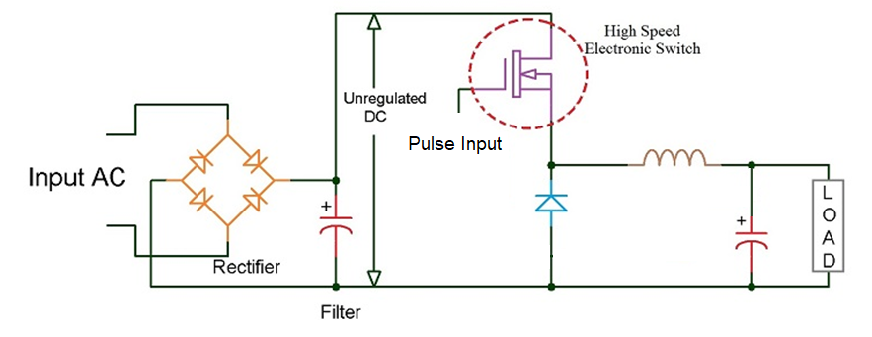
SWITCH MODE POWER SUPPLY
Switch Mode Power Supply (SMPS)
SMPS switches between fully ON and fully OFF states at a very high frequency. Hence the name Switching Mode Power Supply.
UWTSD Lectures / ACDB5002 – Electronics 1

Slide 5
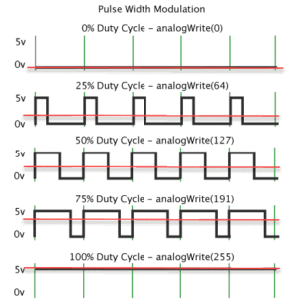

SWITCH MODE POWER SUPPLY
Duty Cycle
Duty Cycle is defined as the ratio of a time a load / circuit is ON compared to the time the load / circuit is OFF
UWTSD Lectures / ACDB5002 – Electronics 1

Slide 6
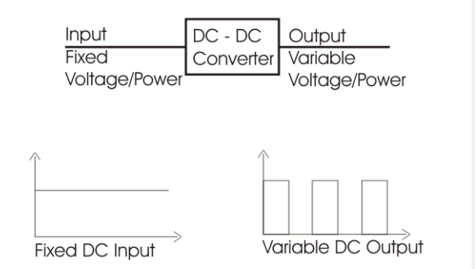
SWITCH MODE POWER SUPPLY
DC Chopper
Chopper is a basically static power electronics device which converts fixed DC voltage/power to variable DC voltage or power.
It is nothing but a high-speed switch which connects and disconnects the load from source at a higher rate.
UWTSD Lectures / ACDB5002 – Electronics 1

Slide 7
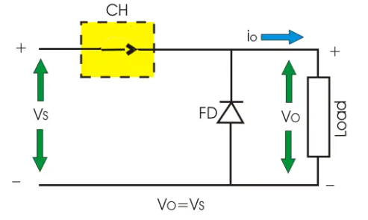
SWITCH MODE POWER SUPPLY
DC Chopper- ON State
When CH is turned ON, Vs directly appears across the load as shown in figure. So, Vo = VS.
UWTSD Lectures / ACDB5002 – Electronics 1

Slide 8
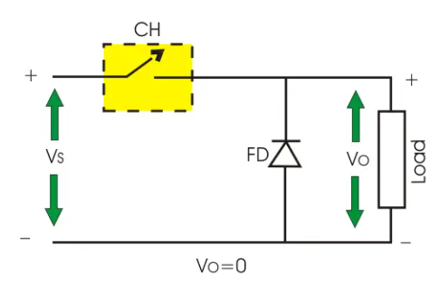
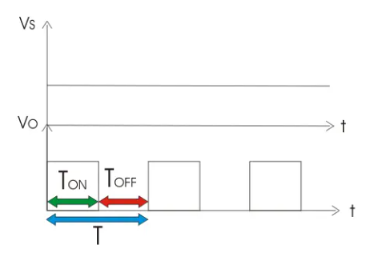
SWITCH MODE POWER SUPPLY
DC Chopper- OFF State
When CH is turned off, Vs is disconnected from the load. So, output voltage Vo = 0.
UWTSD Lectures / ACDB5002 – Electronics 1

Slide 9
SWITCH MODE POWER SUPPLY
Types of (SMPS)
The three basic and important types in SMPS are:
Buck Converter or Step – down Converter
Boost Converter or Step – up Converter
Buck – Boost Converter
UWTSD Lectures / ACDB5002 – Electronics 1

Slide 10
SWITCH MODE POWER SUPPLY
Buck Converter
Buck Converter is a type of SMPS circuit and DC to DC Converter, where the output voltage is less than input voltage. Hence, a Buck Converter is also known as a Step – down Converter.
It is one of the simplest SMPS power converter techniques and is often used in RAM, USB etc.
UWTSD Lectures / ACDB5002 – Electronics 1

Slide 11
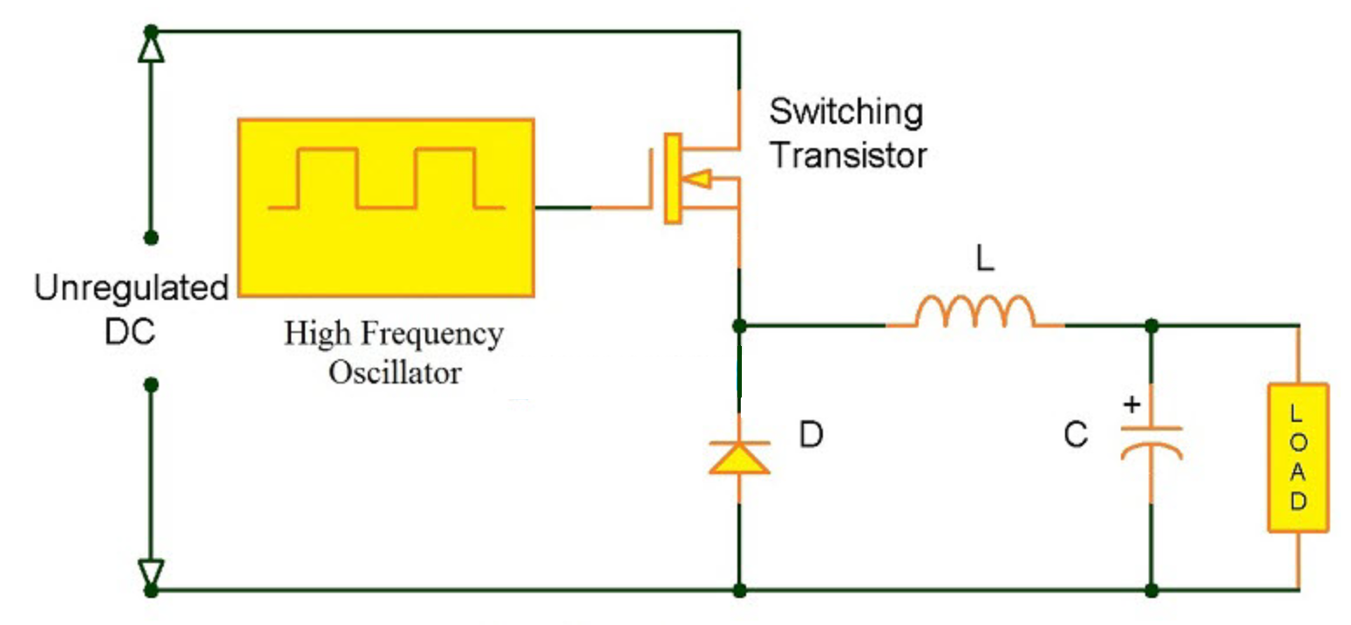
SWITCH MODE POWER SUPPLY
Buck Converter
The input DC in buck converter can be a rectified AC or a battery.
A simple buck converter using two switches (one transistor and one diode) and an energy storing element (inductor)
UWTSD Lectures / ACDB5002 – Electronics 1

Slide 12
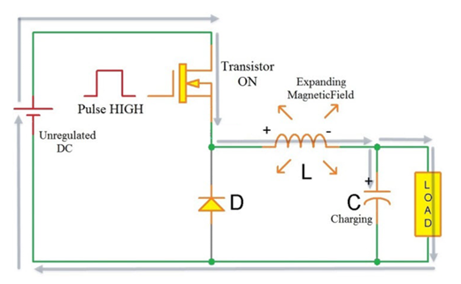
SWITCH MODE POWER SUPPLY
Buck Converter Operation – Pulse High
When the pulse input to the Gate terminal of the MOSFET is HIGH, the Transistor is turned ON.
Therefore, the transistor will supply current to the load.
During this time, the Diode D is reverse biased and will not be a part of the circuit during this period.
UWTSD Lectures / ACDB5002 – Electronics 1

Slide 13
SWITCH MODE POWER SUPPLY
Buck Converter Operation – Pulse High
Initially, the inductor resists the change in current
Hence, the current to the load will increase gradually with expanding magnetic field.
Also, the charge on the capacitor is built up gradually up to the supply voltage.
UWTSD Lectures / ACDB5002 – Electronics 1

Slide 14
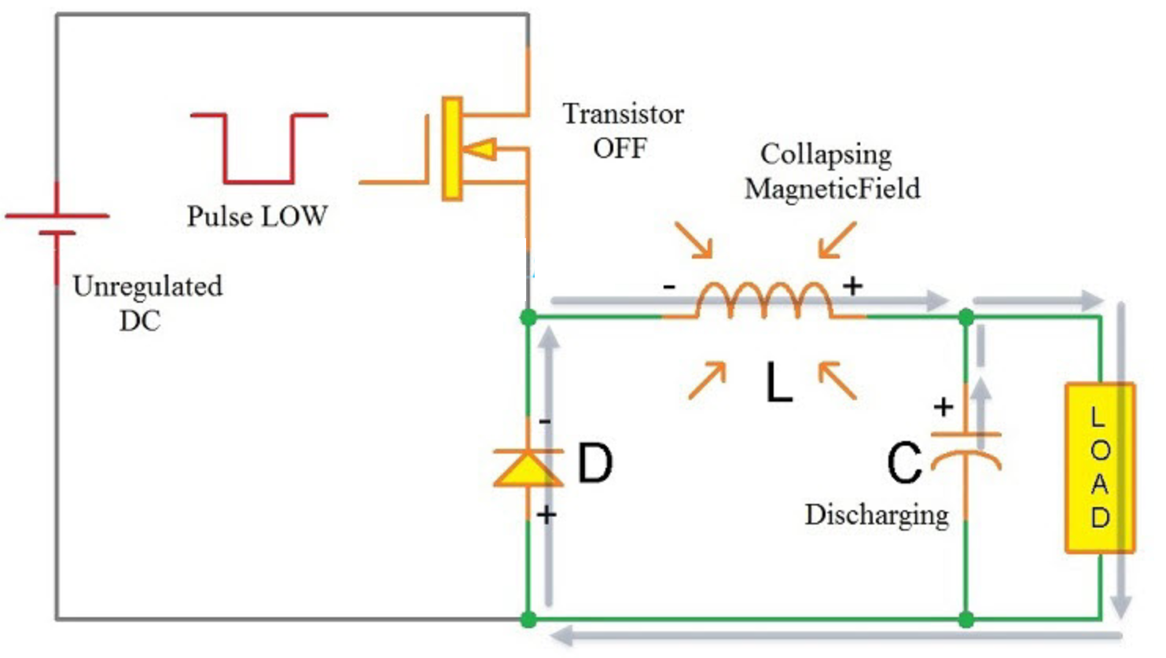
SWITCH MODE POWER SUPPLY
Buck Converter Operation – Pulse Low
When the pulse becomes LOW, the switching Transistor is turned OFF.
The magnetic field that is built up during the Transistor ON state, starts collapsing now and releases the energy back into the circuit.
UWTSD Lectures / ACDB5002 – Electronics 1

Slide 15
SWITCH MODE POWER SUPPLY
Buck Converter Operation – Pulse Low
The polarity of the voltage across the inductor i.e. its back e.m.f is now reversed.
The energy from the inductor starts collapsing and keeps the current flowing in the circuit through load and the diode, as the diode D is forward biased.
Once the energy from the inductor is completely utilized, the capacitor starts discharging and acts as the main source of supply until the transistor is turned ON.
When the transistor is turned ON, it will once again supply current to inductor, capacitor and load and the process continues.
UWTSD Lectures / ACDB5002 – Electronics 1

Slide 16
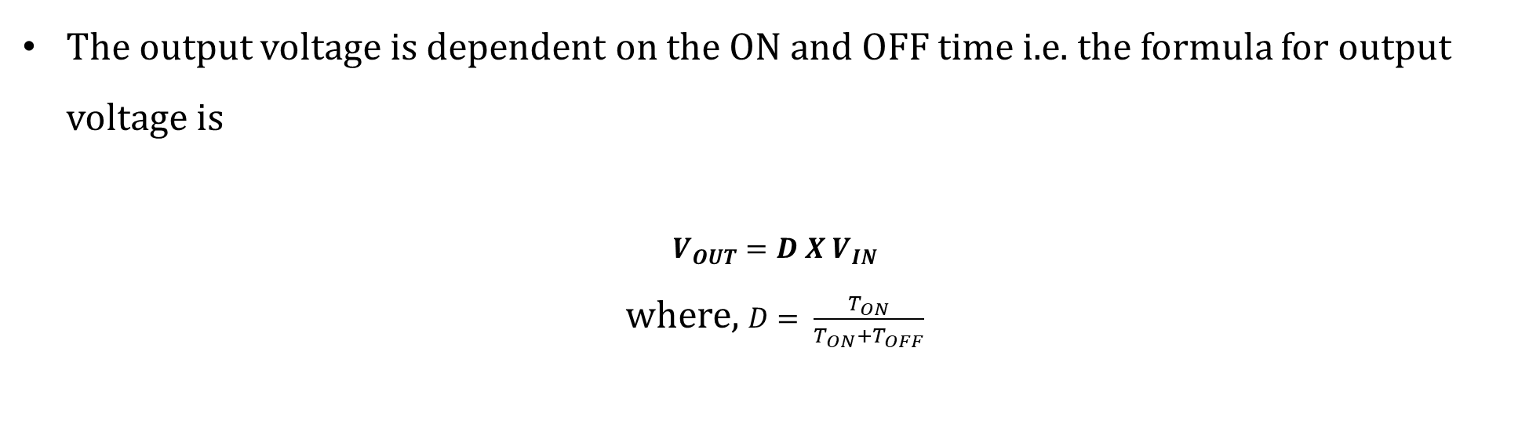
SWITCH MODE POWER SUPPLY
Buck Converter
The output voltage is dependent on the ON and OFF time i.e. the formula for output voltage is
$$V_{OUT}=D X V_{IN}$$
where, $D= \frac{T_{ON}}{T_{ON}+T_{OFF}}$
UWTSD Lectures / ACDB5002 – Electronics 1

Slide 17
SWITCH MODE POWER SUPPLY
Boost Converter
A Boost Converter, as the name suggests, is type of switched mode power supply, which boosts or increases the output voltage with respect to the input voltage.
Boost Converters are also known as Step – up Converters as the output voltage is higher than the input voltage.
Eg: Laptop Chargers in Cars ; Typical Car batteries provide 12V and Laptops require anywhere between 18 to 22V.
UWTSD Lectures / ACDB5002 – Electronics 1

Slide 18
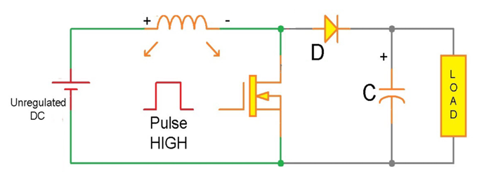
SWITCH MODE POWER SUPPLY
Boost Converter
The input to this Boost converter is unregulated DC, which can be given from rectified AC, batteries, Solar, DC Generators, etc.
UWTSD Lectures / ACDB5002 – Electronics 1

Slide 19
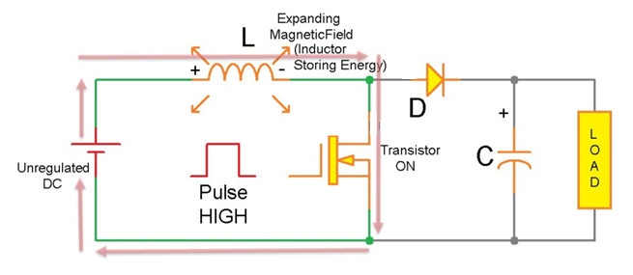
SWITCH MODE POWER SUPPLY
Boost Converter Operation- Pulse High
When the pulse is HIGH, the transistor is turned ON and it closes a part of the circuit consisting of Inductor, Transistor and input supply.
Current flows from the input through the inductor and transistor.
UWTSD Lectures / ACDB5002 – Electronics 1

Slide 20
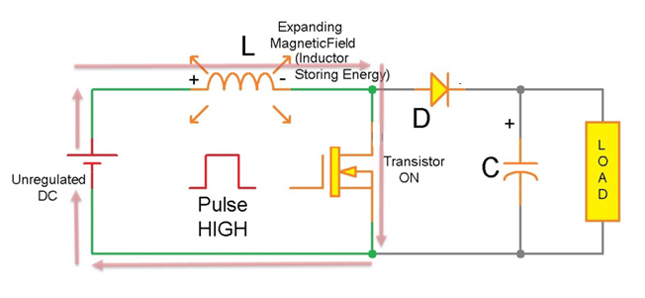
SWITCH MODE POWER SUPPLY
Boost Converter Operation- Pulse High
The inductor, initially resists the change in current but the magnetic field will increase gradually allowing inductor to store energy.
The impedance of the rest of the circuit i.e. Diode, Capacitor and Load is much higher and hence, there will be no flow of current in that part of the circuit.
UWTSD Lectures / ACDB5002 – Electronics 1

Slide 21
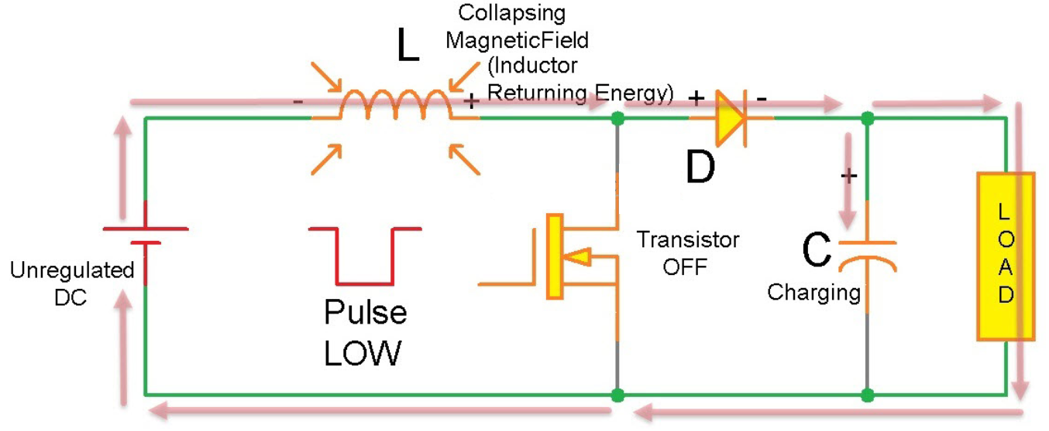
SWITCH MODE POWER SUPPLY
Boost Converter Operation- Pulse Low
When the square wave pulse goes LOW, the transistor is turned OFF.
This action will cause a drop in the current through the inductor, producing a back e.m.f in the circuit due to collapsing magnetic field.
Also, the polarity of the voltage across the inductor is now reversed and will be in series with the input voltage.
UWTSD Lectures / ACDB5002 – Electronics 1

Slide 22
SWITCH MODE POWER SUPPLY
Boost Converter Operation- Pulse Low
The combination of the input voltage and Inductor Back e.m.f cannot pass through the inductor as it is turned OFF.
Hence, the diode is forward biased and charges the Capacitor and supplies current to load.
An important point to note here is that the voltage supplied to the capacitor and load during the Transistor OFF state is a combination of input voltage and inductors back e.m.f, which is higher than the input voltage.
UWTSD Lectures / ACDB5002 – Electronics 1

Slide 23
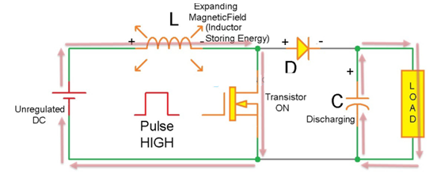
SWITCH MODE POWER SUPPLY
Boost Converter Operation- Pulse High
When the transistor is turned ON again, the current flows again through the inductor and transistor.
As the diode is reverse biased, the capacitor discharges it potential, which is sum of input voltage and inductor voltage, through the load acting as its source during this period.
UWTSD Lectures / ACDB5002 – Electronics 1

Slide 24
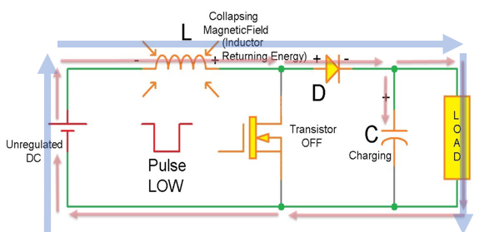
SWITCH MODE POWER SUPPLY
Boost Converter – When Transistor is ON
Boost Converter – When Transistor is OFF
UWTSD Lectures / ACDB5002 – Electronics 1

Slide 25
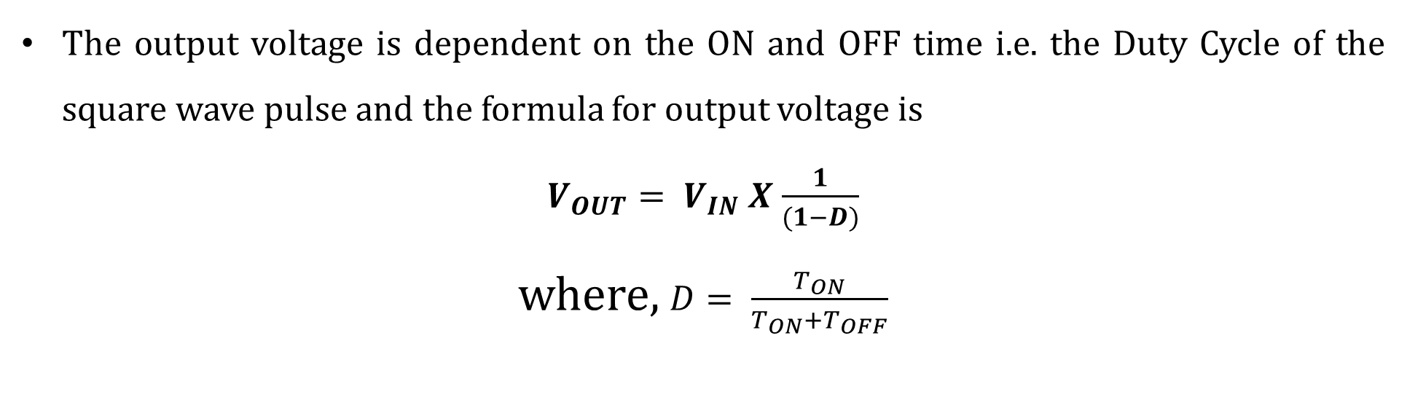
SWITCH MODE POWER SUPPLY
Boost Converter
The output voltage is dependent on the ON and OFF time i.e. the Duty Cycle of the square wave pulse and the formula for output voltage is
$V_{OUT}= V_{IN}$ $X$ $\frac{1}{(1−D)}$
where, $D= \frac{T_{ON}}{T_{ON}+T_{OFF}}$
UWTSD Lectures / ACDB5002 – Electronics 1

Slide 26
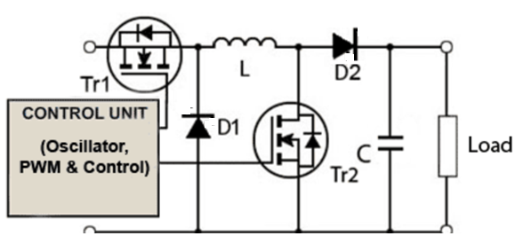
SWITCH MODE POWER SUPPLY
Buck – Boost Converter
A Buck-Boost converter is a type of switched mode power supply that combines the principles of the Buck Converter and the Boost converter in a single circuit.
The buck–boost converter is a type of DC-to-DC converter that has an output voltage magnitude that is either greater than or less than the input voltage magnitude.
UWTSD Lectures / ACDB5002 – Electronics 1

Slide 27
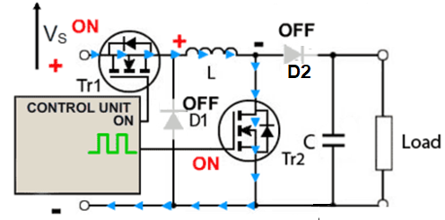
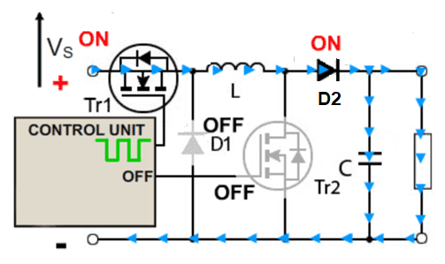
SWITCH MODE POWER SUPPLY
Operation as a Buck Converter
(Tr1-ON and Tr 2- OFF)
Initially, both Tr’s are ON and the L Charges during this time.
Then, Tr2 is turned off, and Tr1 is switched on and off by a high frequency square wave from the control unit.
When the gate of Tr1 is OFF, current flows though L, charging its magnetic field, charging C and supplying the load.
The diode D1 is turned off due to the positive voltage on its cathode.
UWTSD Lectures / ACDB5002 – Electronics 1

Slide 28
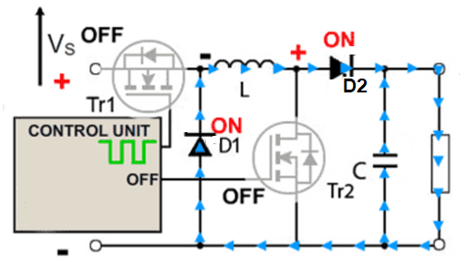
SWITCH MODE POWER SUPPLY
Operation as a Buck Converter
(Tr1-OFF and Tr 2- OFF)
The current flow during the buck operation of the circuit is when the control unit switches Tr1 off.
The initial source of current is now the inductor L. Its magnetic field is collapsing, the back e.m.f. generated by the collapsing field reverses the polarity of the voltage across L, which turns on D1 and current flows through D2 and the load.
UWTSD Lectures / ACDB5002 – Electronics 1

Slide 29
SWITCH MODE POWER SUPPLY
Operation as a Buck Converter
As the current due to the discharge of L decreases, the charge accumulated in C during the on period of Tr1 now also adds to the current flowing through the load, keeping VOUT reasonably constant during the off period.
This helps VOUT close to the value of VS.
UWTSD Lectures / ACDB5002 – Electronics 1

Slide 30
SWITCH MODE POWER SUPPLY
Operation as a Boost Converter
In Boost Converter mode, Tr1 is turned on continually and the high frequency square wave applied to Tr2 gate.
During the ON periods when Tr2 is conducting, the input current flows through the inductor L and via Tr2, directly back to the supply negative terminal charging up the magnetic field around L.
UWTSD Lectures / ACDB5002 – Electronics 1

Slide 31
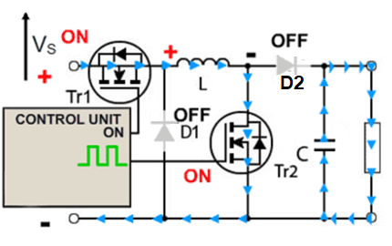
SWITCH MODE POWER SUPPLY
Operation as a Boost Converter
When this happens, D2 cannot conduct as its anode is being held at ground potential by the heavily conducting Tr2.
For the duration of the ON period, the load is being supplied entirely by the charge on the capacitor C, built up on previous oscillator cycles.
UWTSD Lectures / ACDB5002 – Electronics 1

Slide 32
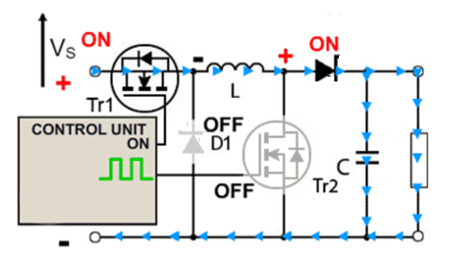
SWITCH MODE POWER SUPPLY
Operation as a Boost Converter –Off Period
At the start of the off period of Tr2, L is charged and C is partially discharged.
The inductor L now generates a back e.m.f. and its value that depends on the rate of change of current as Tr2 switches OFF and ON the amount of inductance the coil possesses;
UWTSD Lectures / ACDB5002 – Electronics 1

Slide 33
SWITCH MODE POWER SUPPLY
Operation as a Boost Converter –Off Period
Therefore, the back e.m.f can be any voltage over a wide range, depending on the design of the circuit.
The polarity of the voltage across L has now reversed, and so adds to the input voltage VS giving an output voltage that is at least equal to or greater than the input voltage.
D2 is now forward biased and so the circuit current supplies the load current, and at the same time re-charges the capacitor to VS + VL ready for the next on period of Tr2.
UWTSD Lectures / ACDB5002 – Electronics 1

Slide 34
SWITCH MODE POWER SUPPLY
Buck Converter Boost Converter
UWTSD Lectures / ACDB5002 – Electronics 1

Slide 35
SWITCH MODE POWER SUPPLY
Buck-Boost Converter
UWTSD Lectures / ACDB5002 – Electronics 1

Slide 36
Thank You

