Slide 1
OME Electromagnetic Radiation
Lecture 4
Simple Harmonic Motion

Slide 2
Maxwell’s equations
A full consideration of Maxwell’s equations, which would include the mathematical notation used, is beyond the scope of this module.
For now, we will explore two aspects:
A constant current flowing in a conductor will create a magnetic field. A coil connected to a DC source will create a steady magnetic field.
A changing magnetic field will cause a current to flow in a conductor. A coil in a steady magnetic field will not create DC.

Slide 3
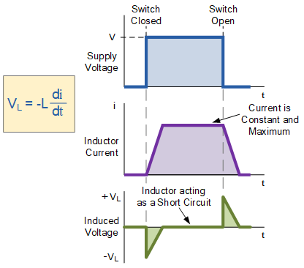
Inductance

Slide 4
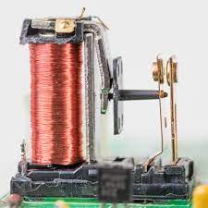
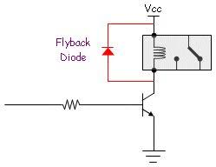
Electromagnetic relay
Noisy!

Slide 5
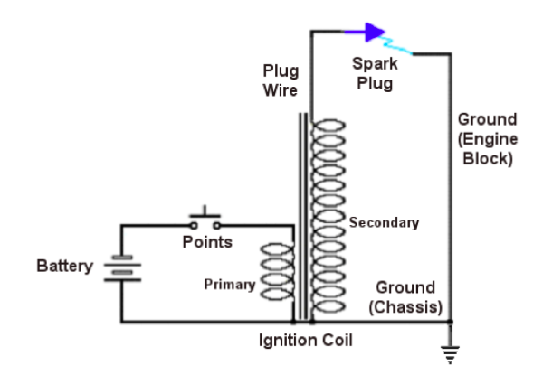
Spark ignition circuit
Noisy!

Slide 6
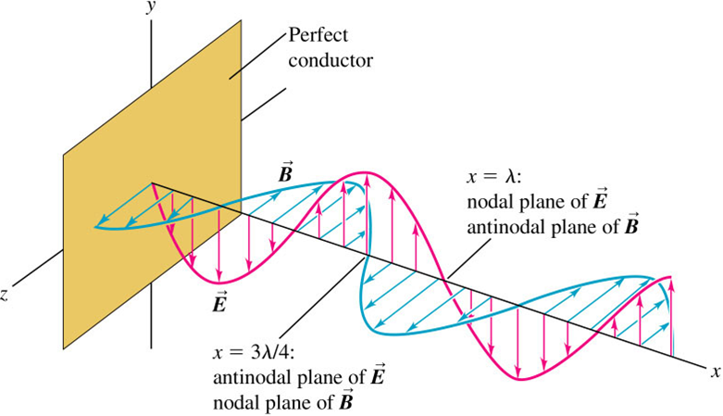
Anatomy of an electromagnetic wave

Slide 7
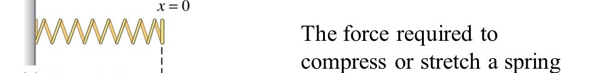
Revision of basic concepts – force on a spring
F_{s} = kx (k = spring constant)
U_{s} = ½ kx²
Elastic energy is stored, not lost

Slide 8
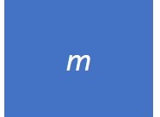
Revision of basic concepts – force on a mass
Force required to accelerate the mass
F_{m} = ma
U_{m} = ½ mv²
Energy is stored, not lost

Slide 9
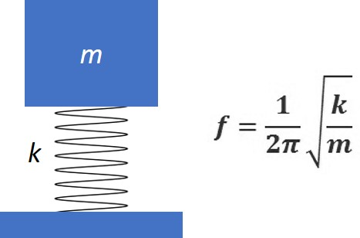
Mechanical oscillator
Energy stored in the mechanical oscillator U = ½ mv² + ½ kx²

Slide 10
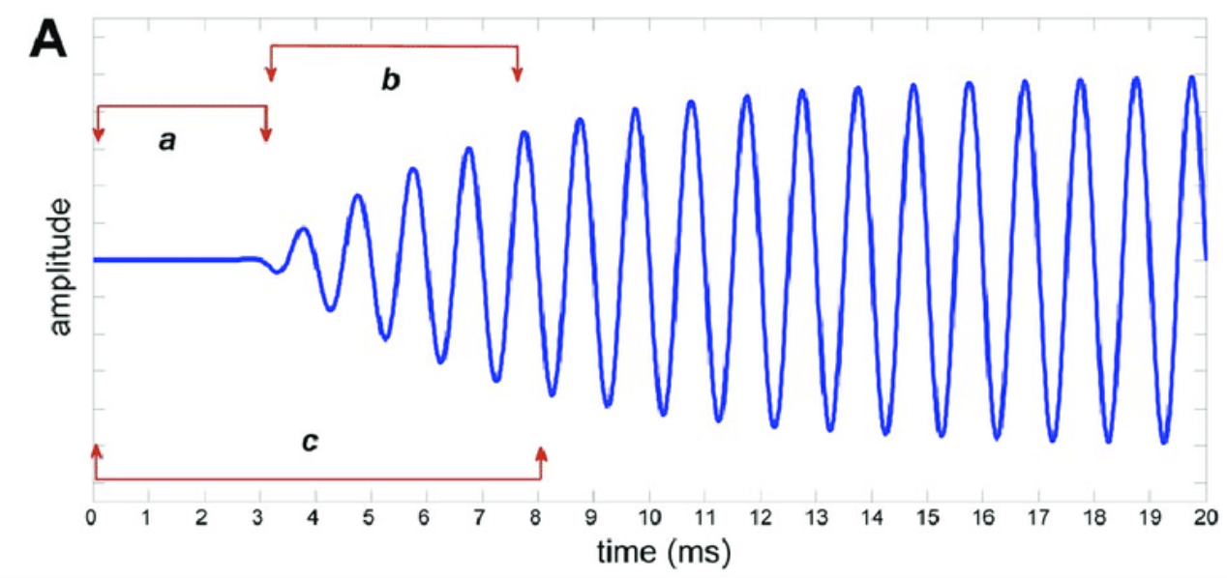
Natural frequency and resonance

Slide 11
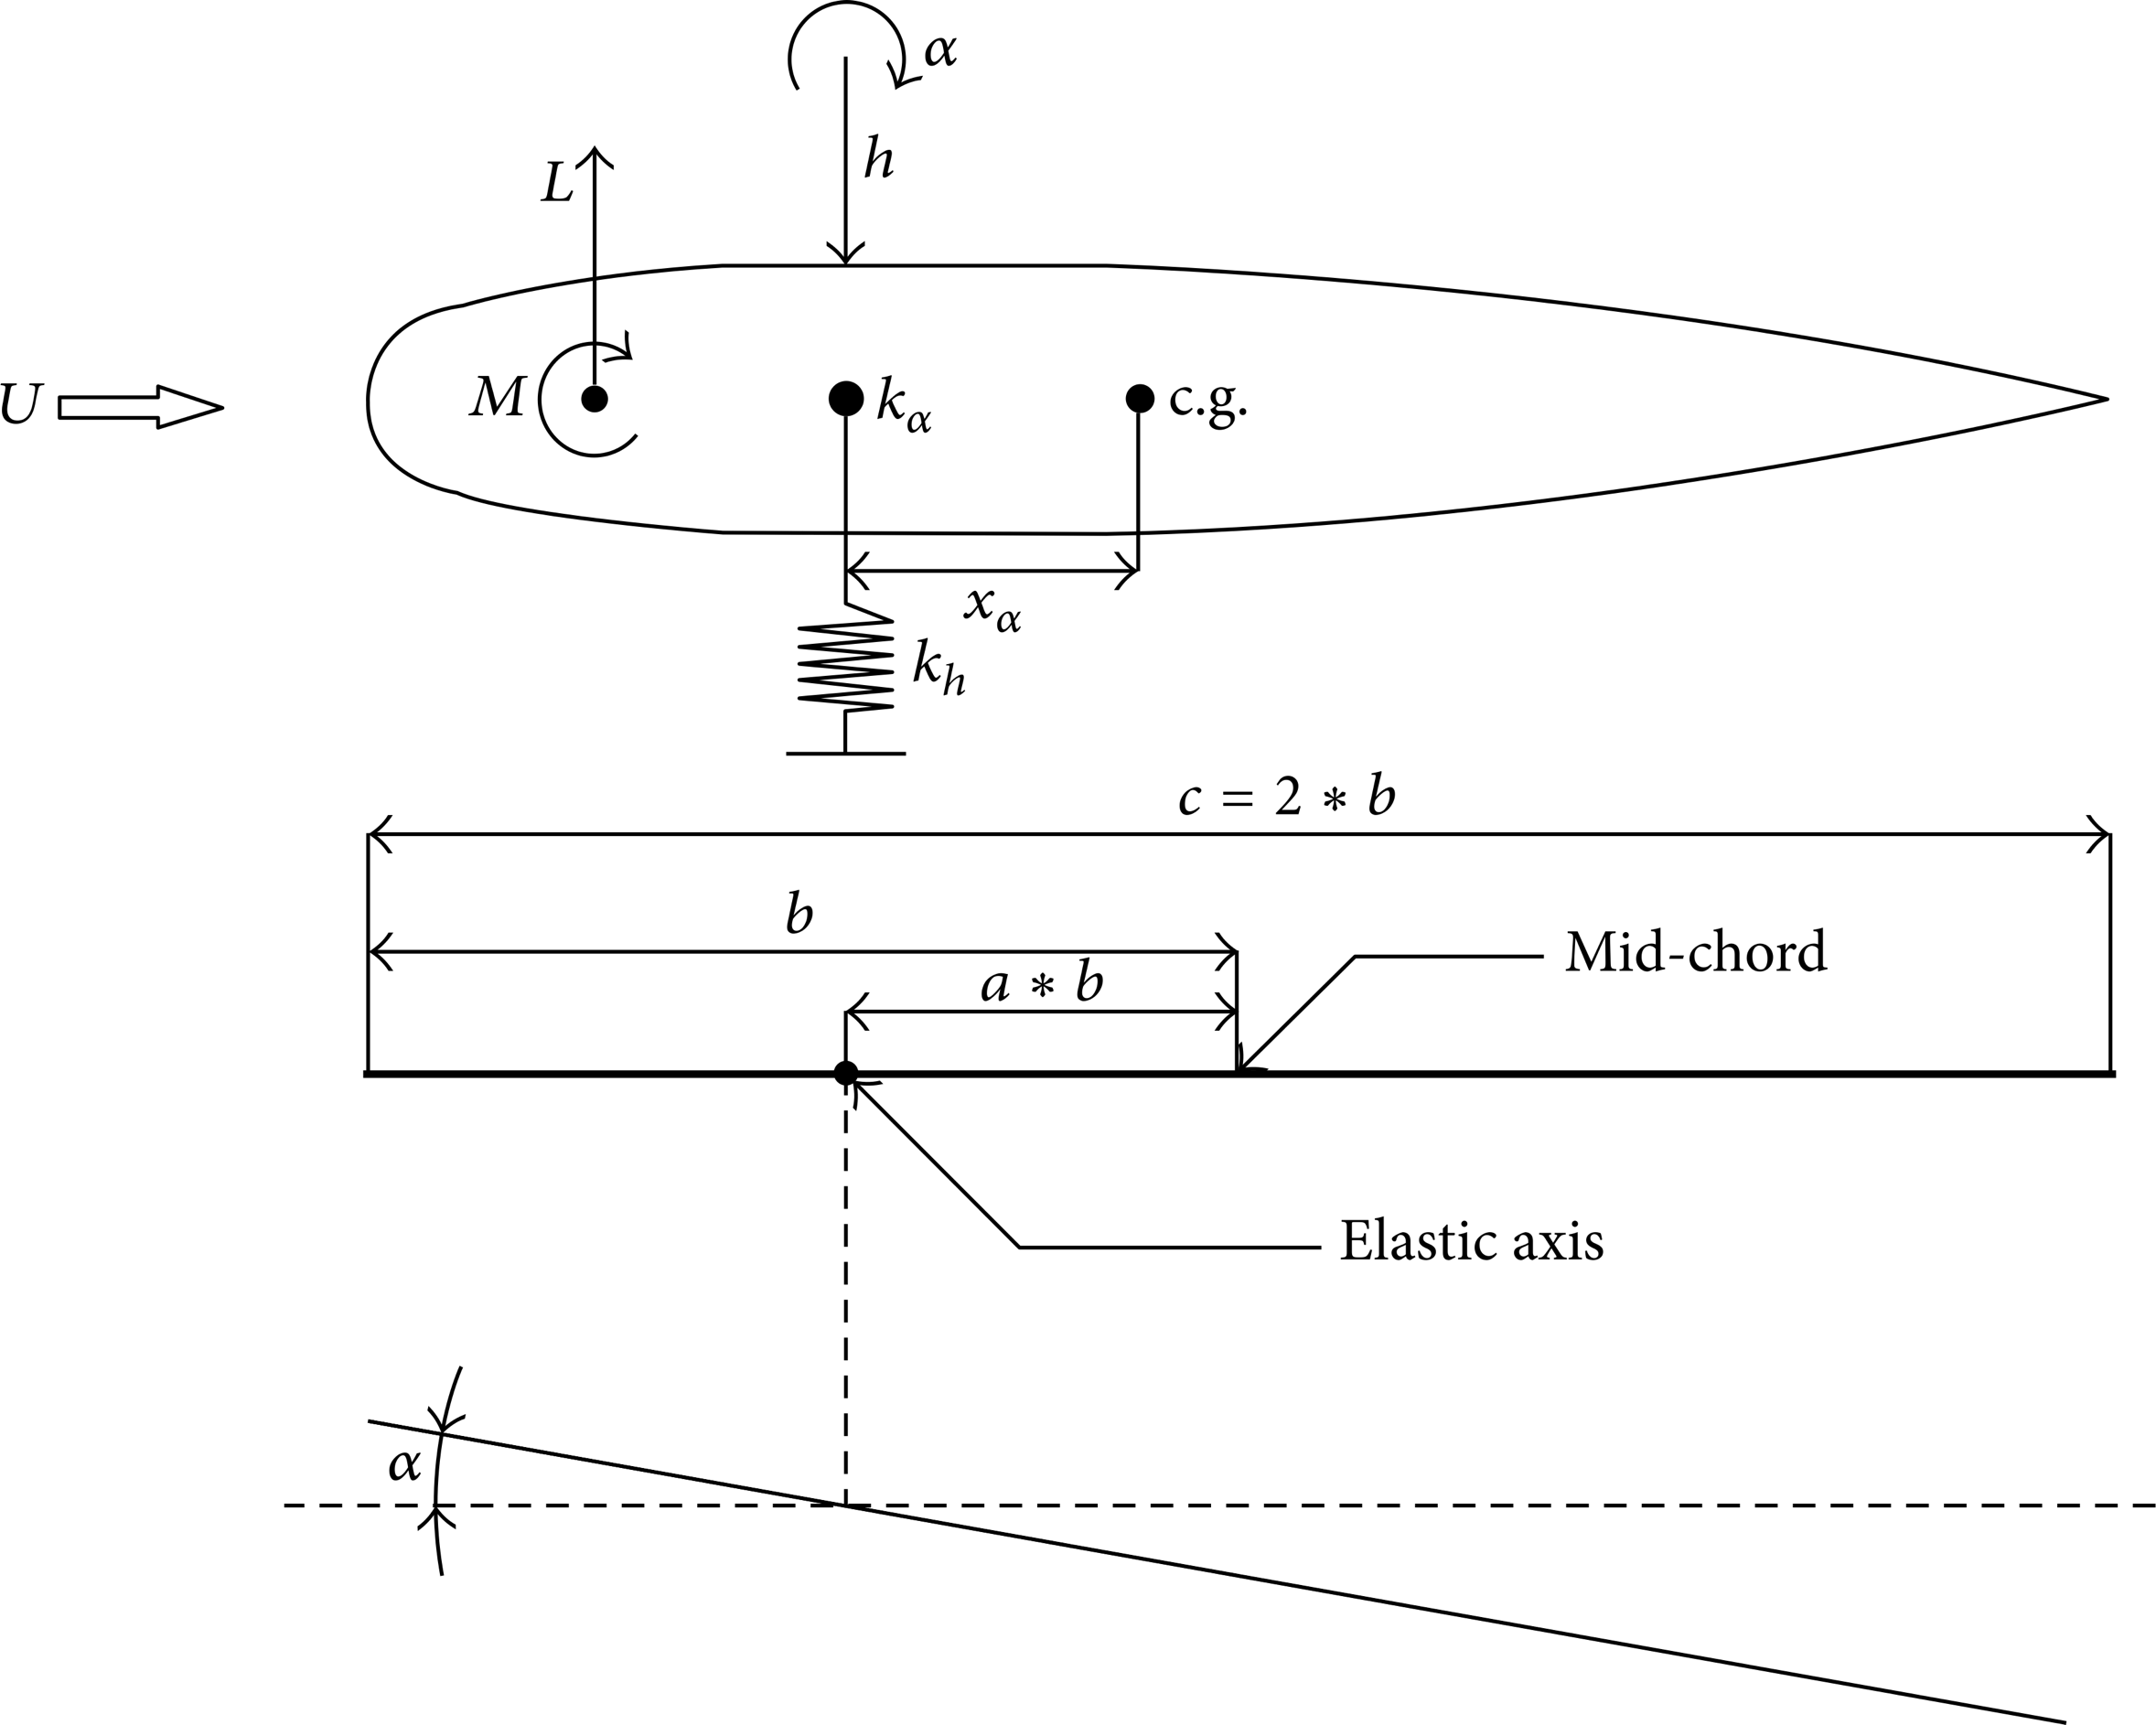

Natural frequency and resonance

Slide 12

Revision of basic concepts – force on a dashpot
Force required to move the piston
F_{d} = cv (c is damping coefficient)
U_{d} = ½ cv²
The dashpot simply dissipates energy

Slide 13
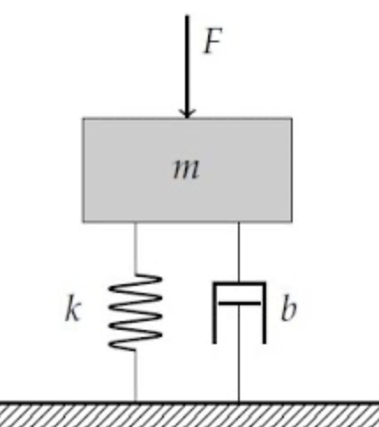
Mass-spring damper or visco-elastic model
Energy stored in the mechanical oscillator U = ½ mv² + ½ kx²

Slide 14
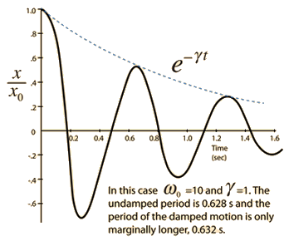
Damping

Slide 15
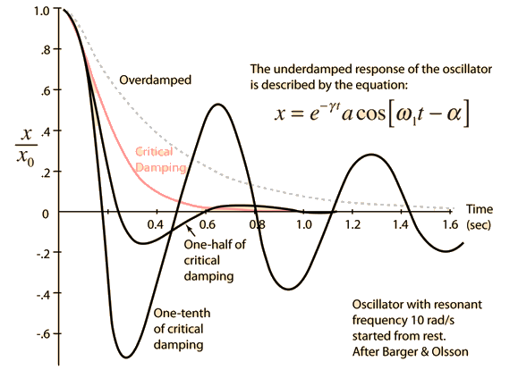
Damping

Slide 16

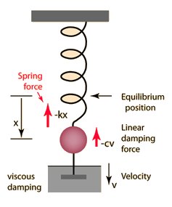


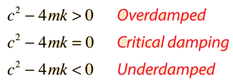
Damping
The Newton's 2nd Law motion equation is
This is in the form of a homogeneous second order differential equation and has a solution of the form

Slide 17
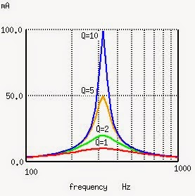
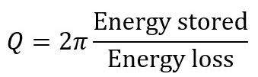
Q Factor

Slide 18
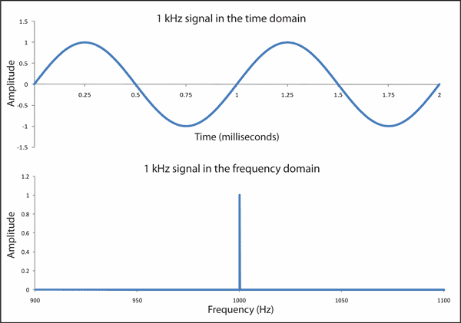
Time and frequency domain representation

Slide 19
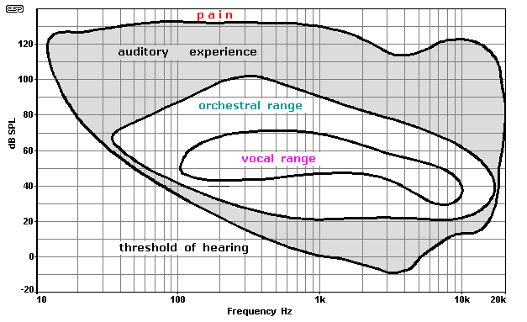
Frequency resolution – human ear

Slide 20
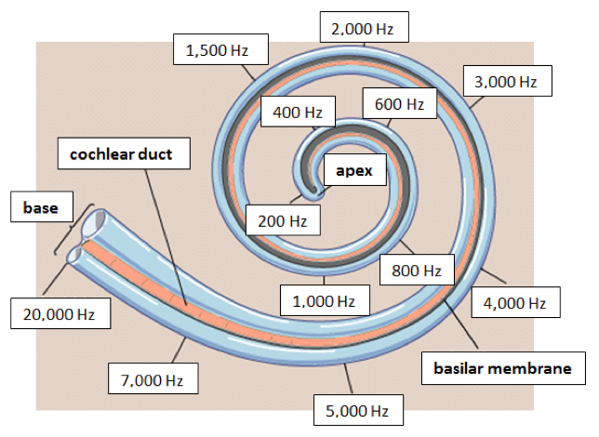
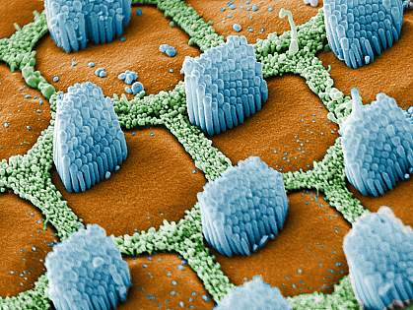
Frequency resolution – human ear
Auditory hair cells are specialized along the length of the cochlea to respond to specific sound frequencies.

Slide 21
Dynamic range and frequency range
dB - one decibel (0.1 bel) equals 10 times the common logarithm of the power ratio
10 log (P₂/P₁) dB
10 log (P₂/P₁) = 10 log 2 = 3 dB
power is proportional to voltage squared
20 log (V₂/V₁) = 10 log 2 = 6 dB
octave – increasing or decreasing frequency by an octave is to double or halve the frequency.
A multimeter has voltage range from 0.01 mV to 1000 V. What is this range expressed in octaves and dB?
What is Ariana Grande’s vocal range in Hz, and octaves?

Slide 22
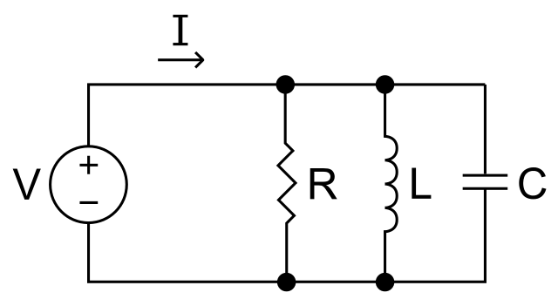
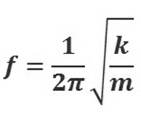

Mechanical-electrical comparisons
inductance ≡ mass
capacitance = spring
damper = resistor

Slide 23
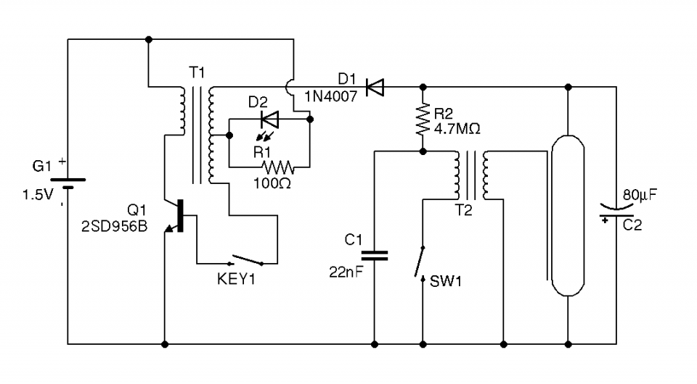
Camera flash

Slide 24
Sensitivity of human ear in comparison to energy of nitrogen molecule

Slide 25
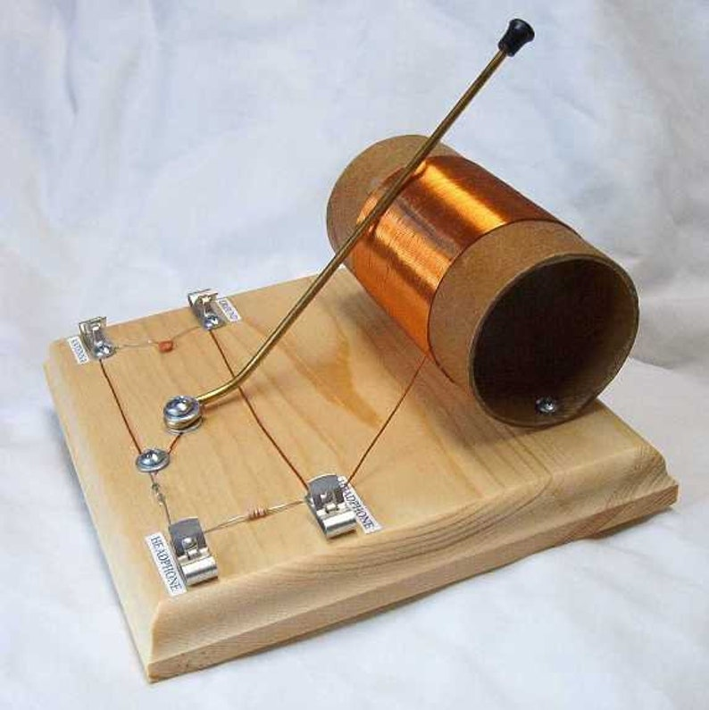
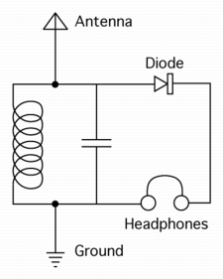
Crystal radio

Slide 26
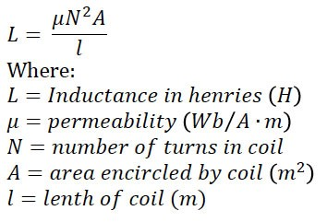
Crystal radio

Slide 27
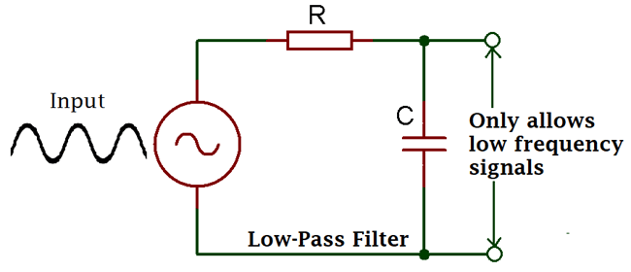
Low-pass filter
The relationship between frequency, inertia and force in an oscillating system

Slide 28
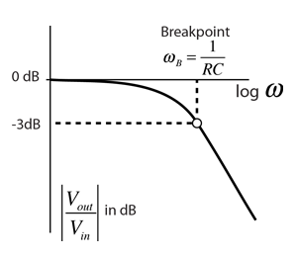
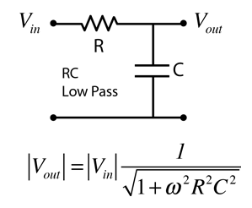
Low-pass filter

Slide 29
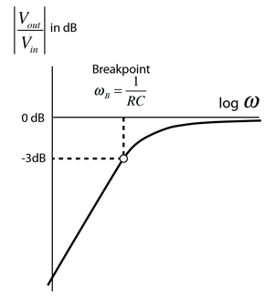
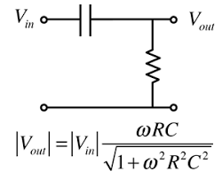
Hi-pass filter

Slide 30
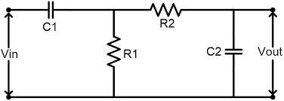
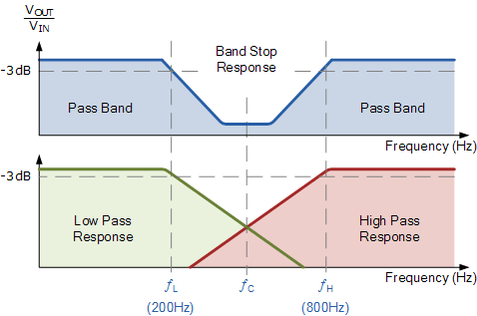
band-stop filter

Slide 31
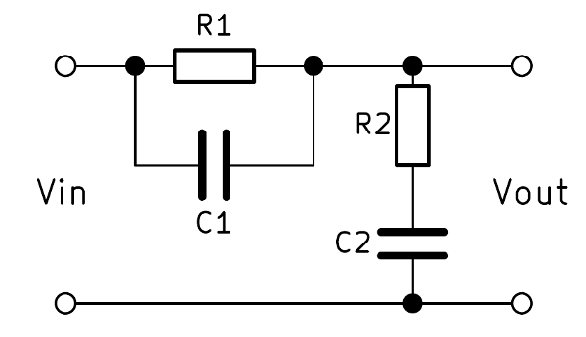
Band-stop (notch filters)
(Different circuit implementation but same effect)

Slide 32
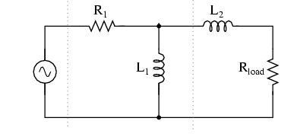
RC filters can also be implemented in LR versions
For example:
Why are RC circuits normally preferred to LR circuits?

Slide 33
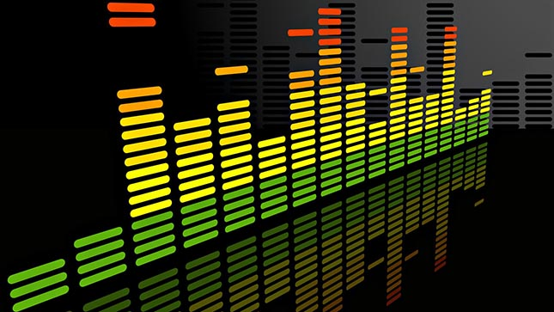
Compare band-pass filters with Fourier techniques

Slide 34
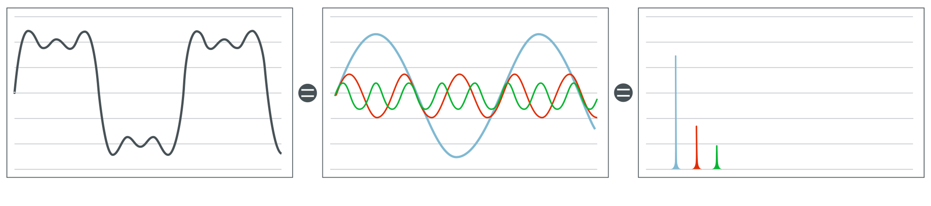
Time and frequency domain representation
Signal in time domain
Signal in frequency domain

Slide 35
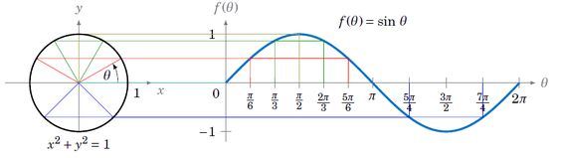
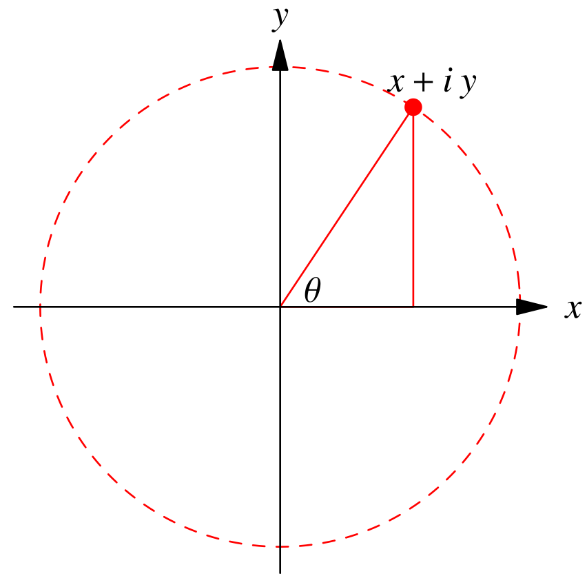
Joint time-frequency representation
Argand diagram
-x + iy
+x + iy
For a given frequency, the real and imaginary rectangular coordinates represent the amplitude and phase of components
-x - iy
+x - iy

Slide 36
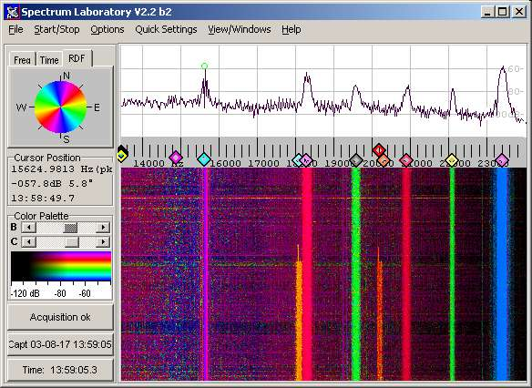
Joint time-frequency representation

Slide 37
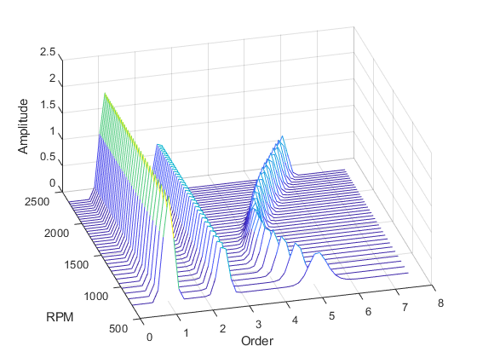
Joint time-frequency representation
-x + iy
+x + iy
-x - iy
+x - iy

Slide 38
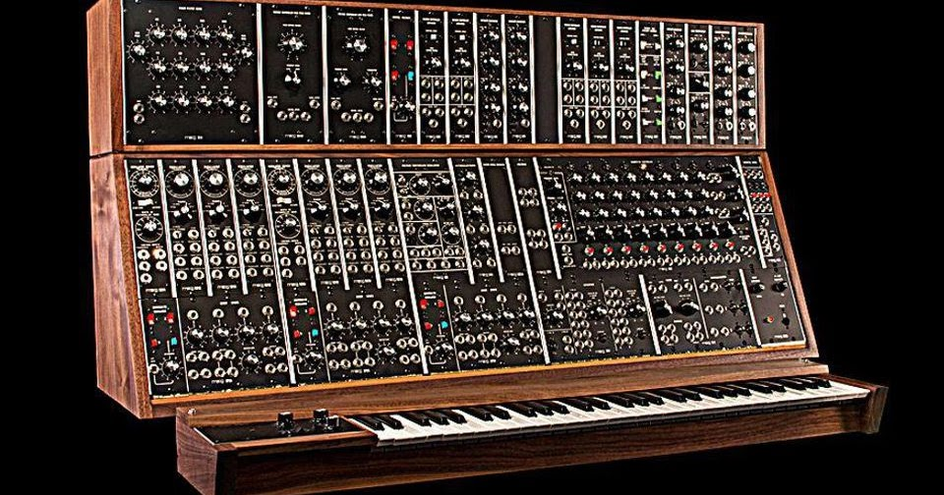
Moog synthesiser – 1964 analog

Slide 39
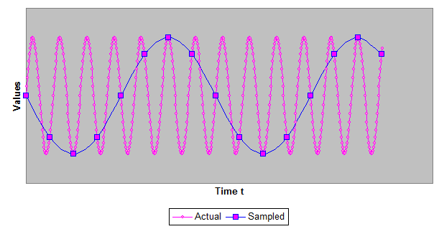
Aliasing
Nyquist's theorem states that a periodic signal must be sampled at more than twice the highest frequency component of the signal. In practice, because of the finite time available, a sample rate somewhat higher than this is necessary.

Slide 40
Harmonics
A harmonic is a frequency which is an integral (whole number) multiple of the fundamental frequency.
A subharmonic is a frequency which is a fraction of a fundamental frequency.

Slide 41
Wave speed
V = f λ
C = f λ
where:
V = wave velocity
f = frequency
λ = wavelength
c = speed of light

Slide 42
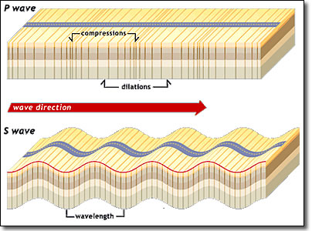
Transverse and longitudinal waves

Slide 43
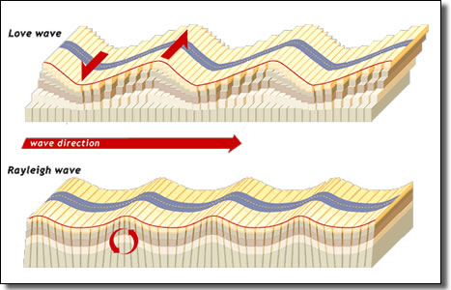
Surface waves

