Slide 1
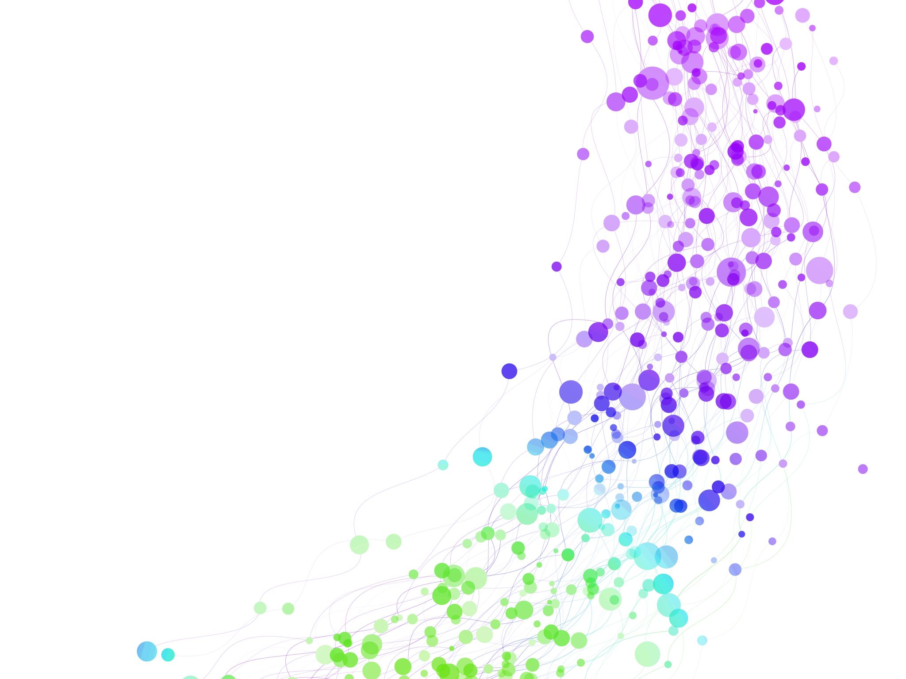
Developing relationships & workplace achievement~ BMSW5102
Haleema Qureshi
2112158
Individual presentation
Employee motivation

Slide 2

Introduction
In this presentation will cover:
1. motivation definition and its importance
2. the types of motivation ( intrinsic & extrinsic motivations)
3. discover the different theories of motivation and focus on Maslow’s and Hertzberg’s theories.

Slide 3

Employee Motivation Defined
Workplace motivation is currently a highly popular and significant area of research, drawing considerable attention from both researchers and Human Resource professionals.(Kian, Yussef, 2015).
According to Pinder (2014), Workplace motivation is about inspiring employees to be enthusiastic, dedicated, and excel in their roles.
It involves creating a supportive environment that encourages self-motivation, recognizes achievements, and aligns individual goals with the company's objectives, leading to a sense of purpose and satisfaction among employees.

Slide 4
Key elements of motivation
Motivation elements
Communication
Incentives and reward system
Trust and persistence
Commitment
Employee motivation elements are factors that influence employees' eagerness to perform and contribute to the organization.

Slide 5

Benefits of a motivated employee
Increased employee engagement
Improved work ethic and boosts performance in the organization
Creates a positive work culture and environment
Motivated employees can increase efficiency

Slide 6

Types of motivation
According to Hennessey and his colleagues (2015), they defined two types of motivations.
Intrinsic motivation is the desire to do something simply for the sake of doing it, to enjoy the task itself.
Extrinsic motivation is the desire to do something in order to achieve a goal or satisfy an externally imposed constraint.
(Garnand, 2018)

Slide 7
Extrinsic and intrinsic defined
Intrinsic motivation
Doing something because you enjoy it and want to.
You find it fulfilling to do.
Extrinsic motivation
External rewards like wage increase, bonus etc.
More of a personal reward- an emotional connection.
Competition and social status
Less enjoyable work.
Personal enjoyment- doing things you love to do.
For rewards and benefits.

Slide 8
My personal motivations
Wage increase
Praises
Words of affirmation
Personal growth
Fulfilment of goals (personal goals and company goals)

Slide 9
Motivation Theories
There are a variety of motivation theories and their importance. They provide a framework for understanding human behaviours and tailoring one's needs to help the organization work more efficiently and effectively.
Turabik and Baskan (2015) specified that the realization of organizational goals effectively will be ensured easier by highly motivated individuals.
In the following slide, we will focus on Maslow’s and Hertzberg’s theories regarding motivation.

Slide 10
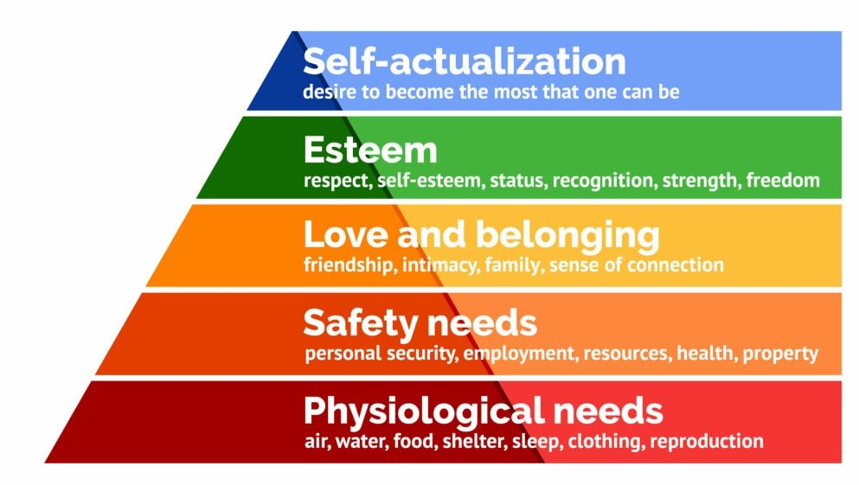
Maslow’s Theory of Hierarchical Needs
Maslow's hierarchy of needs is a motivational theory in psychology that consists of a five-tier model of human needs, often depicted as hierarchical levels within a pyramid (Mcleod, 2023).
(Mcleod, 2023)

Slide 11
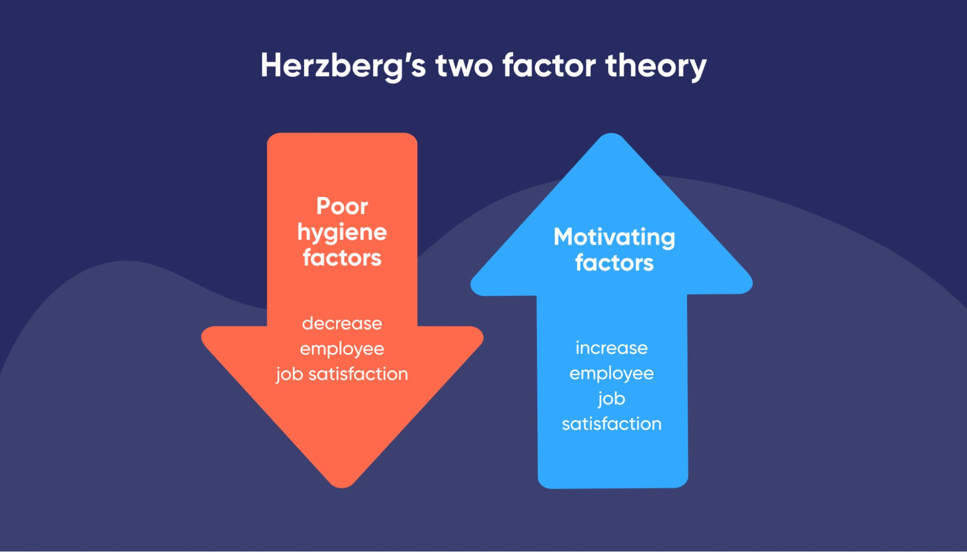
Hertzberg’s two-factor Theory
This theory's central concept is the distinction between motivational and hygienic factors. There are two types of job satisfaction factors.
Motivation factors contribute to job satisfaction because of the individual's need for self-growth and self-actualization (Alshmemri and others, 2017).
(Bluedonkey, nd)

Slide 12
Conclusions
Motivation is a crucial skill for individuals, enabling them to excel and contribute within an organization.
Balancing intrinsic and extrinsic motivation is vital for personal growth and character development.
Various motivation theories are important in achieving organizational goals through highly motivated individuals.
Theories like Maslow's hierarchy of needs and Herzberg's Two-Factor Theory are particularly significant in understanding and fostering workplace motivation.
Understanding and applying these theories can help create motivating environments, drive success, and foster personal and professional growth.

Slide 13
References
Alshmemri, M., Shahwan-Akl, L. and Maude, P. (2017). ‘Herzberg’s two-factor theory’, Life Science Journal, 14(5), (pp).12-16.
Garnand, I. (2018) Intrinsic motivation as a lifestyle, Vanguard. Available at: https://psuvanguard.com/intrinsic-motivation-as-a-lifestyle/ (Accessed: 05 July 2023).
Hennessey, B., Moran, S., Altringer, B. and Amabile, T.M. (2015). ‘Extrinsic and intrinsic motivation’, Wiley Encyclopaedia of Management, (pp).1-4.
Kian, T.S. and Yusoff, W.F.W. (2015). ‘Intrinsic-Extrinsic Motivation Revisited: Exploring their Definitions’, International Journal of Management Sciences, 6(3), (pp).136-140.
Mcleod, S. (2023) Maslow’s hierarchy of needs theory, Simply Psychology. Available at: https://www.simplypsychology.org/maslow.html (Accessed: 05 July 2023).
Pinder, C.C. (2014). Work motivation in organizational behaviour. psychology press.
Turabik, T. and Baskan, G.A. (2015). ‘The importance of motivation theories in terms of education systems’, Procedia-Social and Behavioral Sciences, 186, (pp).1055-1063.
McLeod, S. (2007). ‘Maslow's hierarchy of needs’, Simply psychology, 1(1-18).

Slide 14



