Slide 1



Slide 2
Introduction - Project Brief
Project title: Tetris — Python (Pygame) Implementation
Overview: A modern, single-player re-creation of the classic Tetris game featuring falling tetrominoes, line clearing, scoring, levels, and a simple menu/UI.
Motivation & rationale:
Practice object-oriented programming and state management in Python
Build a complete game loop with input handling, collision detection, and rendering
Explore 2D graphics and audio with Pygame for portfolio and employability
Scope
Core Tetris mechanics (spawn, move, rotate, soft/fast drop)
Line clear + scoring + level progression
Basic UI (title screen, game scene, game over), next-piece preview, simple sound
Target users: Casual players and classmates; instructors evaluating programming and game-dev skills
Platform & tech: Desktop application built with Python 3.x and Pygame; lightweight assets (fonts/sounds)
One-sentence aim:
Build a clean, reliable Tetris clone in Python/Pygame that demonstrates solid game architecture, polished core mechanics, and clear UI/UX.

Slide 3
Aim & Objectives
Aim
To design and develop a fully functional Tetris game using Python and Pygame, demonstrating practical understanding of game development concepts, event-driven programming, and object-oriented design.
Objectives
Research and Planning
  Study existing Tetris implementations and their mechanics.
  Analyse how game loops, rendering, and input handling work in Pygame.
Design and Development
  Implement all Tetris shapes (tetrominoes) with correct rotation and collision detection.
  Build a modular structure using classes for game states, shapes, and scenes.
  Create responsive controls (move, rotate, soft drop, hard drop).
User Interface and Experience
  Develop a clear UI with a main menu, score display, next-shape preview, and game-over screen.
  Add sound effects and background music for better engagement.
Testing and Evaluation
  Test gameplay functionality and performance across different screen sizes.
  Ensure smooth frame rate and responsive input without lag.
Reflection and Future Work
  Identify improvements such as leaderboard, pause/resume feature, and difficulty modes.
  Reflect on learning outcomes in Python game design and software architecture.

Slide 4
Literature Review / Background
Overview of Tetris
Game Development with Python
Relevance to This Project
Tetris was originally created by Alexey Pajitnov in 1984 and has since become one of the most iconic puzzle games in history.
The core gameplay involves arranging falling geometric shapes (tetrominoes) to complete horizontal lines, which are then cleared from the screen.
Its simplicity and addictive challenge have made Tetris an important case study in human–computer interaction, cognitive psychology, and game design balance
Python has gained popularity for educational and indie game projects due to its readability, simplicity, and active community.
The Pygame library provides essential tools for 2D graphics rendering, event handling, animation, and sound management.
Compared to engines like Unity (C#) or Godot (GDScript), Pygame offers more low-level control and is ideal for learning fundamental game mechanics.
This project draws inspiration from traditional Tetris gameplay while enhancing it with a modern interface, scoring system, and speed progression.
Existing tutorials and open-source clones often lack structure; therefore, this project focuses on modular object-oriented design and clear scene management, creating a clean and maintainable codebase.

Slide 5
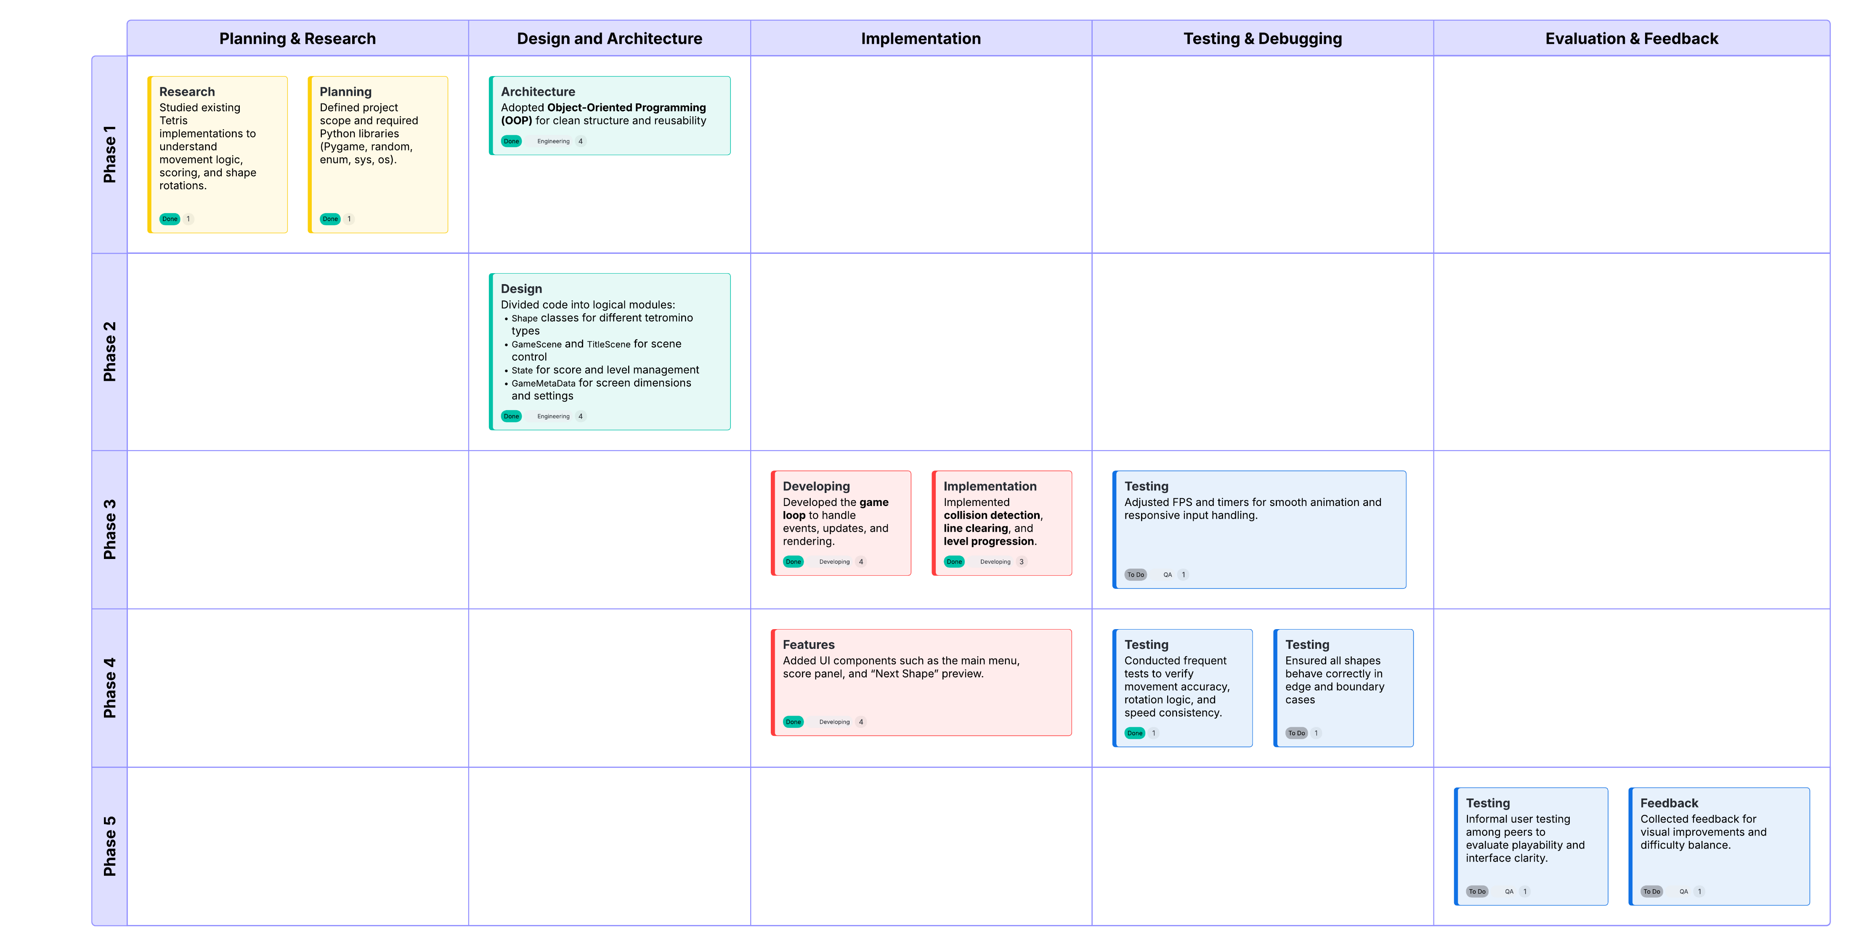
Methodology
Development Approach
1.The project follows an Agile-inspired iterative process, allowing gradual development, testing, and improvement.
2.Each iteration focused on adding core functionality, testing gameplay stability, and refining user experience.
Tools & Technologies
Language: Python 3.x
Library: Pygame
IDE: Visual Studio Code
Version Control: GitHub (for backup and iteration tracking)
Assets: Custom sounds, simple color palette, system font (fallback if Tetris font missing)

Slide 6
Design Overview
Game Concept
1.The project recreates the classic Tetris experience while applying modern programming principles for flexibility and maintainability.
2.The design focuses on simplicity, modularity, and user engagement through visual feedback, color contrast, and sound effects.
Shape Classes
GameScene
TitleScene
State
GameMetaData
SceneBase
Define the seven Tetris tetromino types with color, rotation, and movement logic.
Manages active gameplay, including piece movement, collision checks, score, and rendering.
Displays main menu, navigation between “New Game”, “Continue”, “Options”, and “Exit”.
Stores the current game state — level, score, and cleared lines.
Defines constants such as screen dimensions, grid size, and layout.
Provides common functions for UI rendering and scene transitions.
User Interface Design
Main Menu:
Simple text-based navigation with keyboard controls (↑, ↓, Enter), highlighting selected options in red.
Game Screen:
  10×20 grid playfield
  Side panel displaying Score, Lines, Level, and Next Shape
  Clear color scheme for visibility (blue grid, bright shapes)
Game Over Screen:
Red “GAME OVER” text with option to restart or exit.
Color & Visual Style
Each tetromino has a unique color for quick recognition.
Background: black for contrast
Grid lines: light blue for subtle visibility
Highlights and outlines used for 3D-like depth effect.
Sound Design
Background music plays continuously during gameplay.
Sound effects:
Rotation (rotate.wav)
Invalid rotation (tilt_rotate.wav)
Speed mode (speed_mode.wav)
Audio feedback enhances engagement and responsiveness.

Slide 7

System Architecture
Overview
The game is built on a modular and object-oriented architecture, ensuring each part of the system handles a specific responsibility.
The structure allows for easy debugging, updates, and feature expansion (e.g., adding new game modes or UI features).
Object-Oriented Shape System
Game State Management
Main Loop (main() function)
The State class tracks:
  score – increases with cleared lines and movements
  level – increases after every 10 cleared lines
  full_line_no – total number of completed rows
Difficulty and speed scale with the player’s level (reduced frame delay).
Each Tetris shape (tetromino) is represented as a class derived from a base class Shape.
Inheritance allows each piece to define its own rotation logic through the prepare_for_rotate() method.
Common methods:
  move_left(), move_right(), move_down()
  rotate() – changes block orientation if space is available
  is_finished_or_collided() – checks if the shape reached the bottom or hit another block
Scene Management
1.Initializes the Pygame engine, window, and audio mixer.
2.Loads sounds, fonts, and sets up display parameters.
3.Controls the game’s frame rate (FPS) for smooth animation.
4.Continuously executes:
  Process Input – checks player key events.
  Update State – moves pieces, updates score and level.
  Render Scene – redraws visuals on screen.
The project uses a scene-based structure, allowing smooth transitions between different screens:
TitleScene → Main menu (New Game, Options, Exit)
GameScene → Core gameplay
Game Over → Returns to TitleScene
Scenes are controlled by a shared variable Scenes.active_scene.
NEXT PAGE

Slide 8
System Architecture
Rendering & Collision Logic
System Diagram
The game area is stored as a 2D list (matrix) representing the 10×20 grid.
Each cell value corresponds to a color number for a placed block.
The system checks for complete lines, removes them, and shifts remaining rows down.
Rendering uses pygame.draw.rect() for every active block and grid line.
Main()
Initializes and runs main loo[
Scene Manager
(Title / GameScene)
Shape Objects
(Hero, TeeWee, etc)
Rendering & Events
GameState
(Score)
Previous

Slide 9
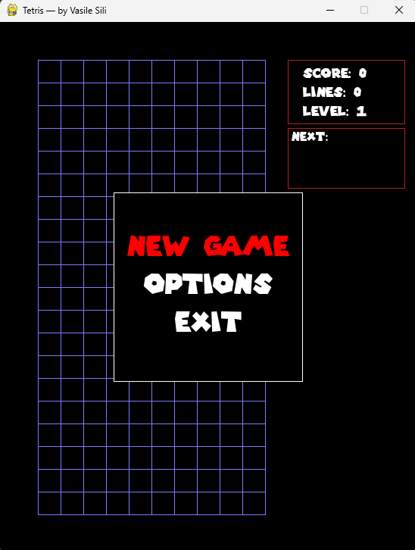
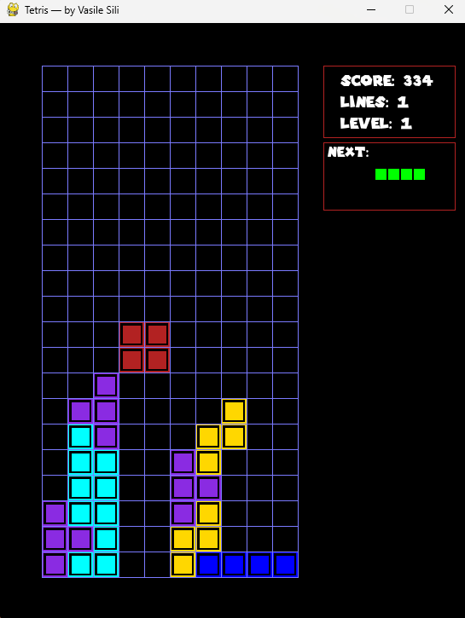
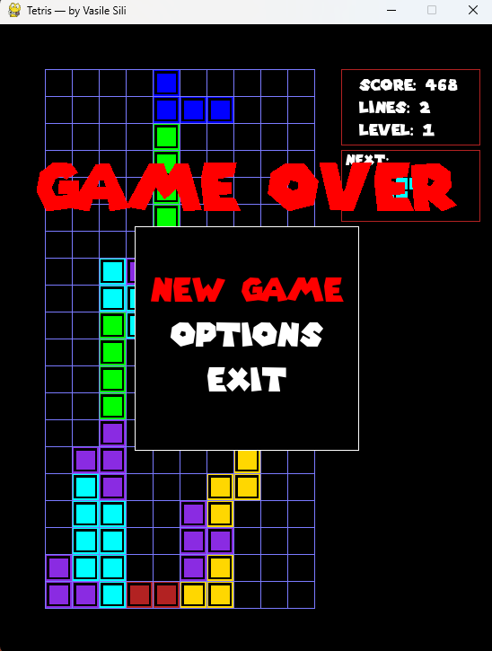
UI Design Mockups
Overview
The game interface is designed with a clean, functional layout that ensures visibility, simplicity, and player focus.
All elements are arranged logically to help the player track progress and make quick decisions during gameplay.
The game features a simple and functional interface designed for clarity and ease of use. The title screen allows players to start a new game or exit, with highlighted options in red for selection. The main game screen includes a 10×20 grid for gameplay, a side panel showing the score, lines, level, and a preview of the next shape. Bright, distinct colors are used for each tetromino against a dark background to enhance visibility. When the game ends, a clear “GAME OVER” message appears with options to restart or return to the menu. The overall layout, color scheme, and keyboard-only controls ensure smooth and accessible gameplay.

Slide 10
Conclusion
Summary of Achievements
Key Learning Outcomes
Future Improvements
Successfully developed a fully playable Tetris game using Python and Pygame.
Implemented core gameplay features:
  Piece generation, rotation, and collision detection
  Line clearing, scoring, and level progression
  Main menu, “Next Shape” preview, and Game Over screen
Created a structured and maintainable architecture using object-oriented programming principles.
Enhanced user experience through colorful visuals, sound effects, and smooth controls.
Strengthened understanding of event-driven programming and game loop logic.
Gained hands-on experience in 2D rendering, input handling, and state management.
Improved ability to design modular code for interactive applications.
Learned to debug, test, and balance gameplay using iterative methods.
Add pause/resume and settings menu.
Introduce a leaderboard to save top scores.
Implement difficulty scaling and enhanced visual effects.
Package the game as an executable for easier distribution.
Final Reflection
Key Learning Outcomes
This project demonstrates how a classic game concept can be rebuilt with modern programming practices, blending creativity, logic, and user experience.
It provided valuable insight into software design, problem-solving, and game development principles, serving as a strong foundation for future projects in interactive media.
Implementing precise collision detection and rotation logic for each shape.
Managing speed and frame rate consistency across systems.
Handling font and sound loading errors gracefully within Pygame.

Slide 11
References
1. A. Hufschmitt, S. Cardon and E. Jacopin, “Can Musical Tempo Makes Tetris Game Harder?,” in *Proc. IEEE CogFilm2020*, 2020.
2. S. Asif, M. Coulombe, E. D. Demaine, M. L. Demaine, A. Hesterberg, J. Lynch and M. Singhal, “Tetris is NP-hard even with O(1) rows or columns,” arXiv preprint arXiv:2009.14336, 2020.
3. “Game Development with Python Using Pygame,” EAI Endorsed Trans. Scalable Inf. Syst., vol. 17, no. 6, Oct. 2022, doi:10.4108/eai.17-6-2022.2322877.
4. “A Genetic Approach to the Formulation of Tetris Engine,” in *Proc. ACM GECCO 2023 Workshops*, 2023.
5. M. K. Jayanthi Kannan, *Introduction to Pygame and Game Development using Python Pygame*, 1st ed., Vellore Inst. of Technol., Jan. 2024.
6. V. E. M. Craig et al., “Potential for use of Tetris in the neonatal unit – a scoping review,” *BMC Digital Health*, vol. 3, Article 34, 2024.
7. L. Eleftheria, “Distilling Gaming Strategy through Explainability in Tetris,” *IMXW Journal*, 2025.
8. J. A. Bairaktaris, “Outsmarting algorithms: A comparative battle between reinforcement learning and heuristic methods in solving the classic Tetris game,” *Computers & Education: Artificial Intelligence*, vol. ?, 2025.

Slide 12


