Slide 1
Data Mining & Visualisation
Business Understanding
Dr Serif Salem

Slide 2
Recap - Data Mining Approaches
Two fundamental approaches to data mining:
  Hypothesis Testing Approach
  Discovery Approach.
Each approach follows a different methodology in analysing data and extracting insights.
DM Approaches
Hypothesis Testing Approach
Discovery Approach.
Directed (Supervised
Undirected (Unsupervised)

Slide 3
Recap - Data Mining Approaches
🔍 Hypothesis Testing Approach (Top-Down) - Example:
A retail company hypothesizes that customers who buy online are more likely to make repeat purchases than in-store buyers.
Data is collected and analysed to confirm or refute this claim.
🔍 Discovery Approach (Bottom-Up) - Example:
A marketing team analyses customer transactions without a predefined assumption and discovers that people buying baby products often purchase coffee, leading to new targeted promotions.
Data is collected and analysed to discover new patterns.

Slide 4
Recap - Common Techniques
Classification
Regression
Clustering
Association Rule Mining
Dimensionality Reduction

Slide 5
Recap - Common Techniques
Technique | Type | Example Algorithm | Use Case
Classification | Supervised | Decision Trees, SVM | Fraud detection
Regression | Supervised | Linear Regression | Sales forecasting
Clustering | Unsupervised | K-Means, DBSCAN | Customer segmentation
Association Rule Mining | Unsupervised | Apriori, FP-Growth | Market Basket Analysis
Dimensionality Reduction | Unsupervised | PCA, t-SNE | Feature Selection

Slide 6
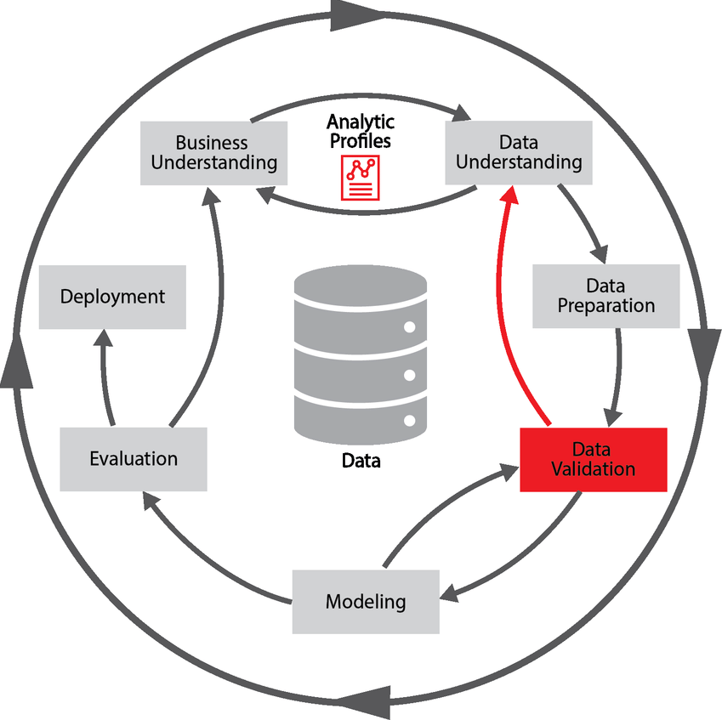
Recap – CRISP-DM
6-phase cycle
Multiple iteration through 5 of the stages
  Business understanding
  Data understanding
  Data preparation
  Modelling
  Evaluation
Final deployment stage

Slide 7
Recap – CRISP-DM
1. Business Understanding
  Define business objectives and requirements.
  Identify the problem to be solved.
  Translate business objectives into data science goals.
2. Data Understanding
  Collect initial data and assess its quality.
  Explore the data using visualisation and statistical summaries.
  Identify potential patterns and relationships.
3. Data Preparation
  Clean and preprocess the data (handling missing values, outliers, etc.).
  Transform variables, normalise, or encode categorical data.
  Select relevant features for model building.

Slide 8
Recap – CRISP-DM
4. Modelling
  Choose appropriate algorithms and techniques (e.g., regression, decision trees, neural networks).
  Train and validate models using the prepared data.
  Optimise parameters to improve performance.
5. Evaluation
  Assess model performance using appropriate metrics (e.g., accuracy, RMSE, F1-score).
  Compare models to determine the best fit for the business problem.
  Ensure the model meets business objectives before deployment.
6. Deployment
  Implement the model in a real-world application.
  Monitor its performance and update it as needed.
  Document findings and lessons learned for future projects.

Slide 9
CRISP Phase 1:
Business Understanding

Slide 10
Content
Why Business Understanding Matters in Data Analytics
Key Steps in Business Understanding
Defining Business Objectives – What problem are we solving?
Assessing the Current Situation – Available data, constraints, risks
Setting Data Mining Goals – What insights or models are needed?
Defining Success Metrics – Business & technical evaluation criteria.
Practical Activity on the Chosen Dataset.

Slide 11
Why Business Understanding Matters in Data Analytics
✅ Data Without Context is Useless
  Collecting and analysing data without clear business objectives leads to irrelevant insights.
  Example: A company analysing customer purchase trends without defining the goal (e.g., increasing sales, reducing churn) may extract misleading conclusions.
✅ Ensuring Data Science Solves the Right Problem
  Business objectives dictate what data is needed, how it is processed, and what success looks like.
  Example: A bank wants to predict loan default – understanding financial risk, regulations, and key indicators is essential before analysing data.
Poor business understanding can lead to wasted resources and incorrect solutions.

Slide 12
The Role of Stakeholders in Defining the Problem
Who are the Stakeholders?
  Business Leaders: Define strategic objectives (e.g., increasing customer retention).
  Domain Experts: Provide industry-specific insights (e.g., healthcare professionals in a medical analytics project).
  Data Analysts & Scientists: Translate business needs into data-driven approaches.
  IT/Data Engineers: Ensure data availability, quality, and security.
Example: A retailer wants to improve demand forecasting.
  Business leaders define success as reducing stockouts and excess inventory.
  Data scientists determine which sales and inventory data to analyse.
  IT teams provide reliable access to historical sales data.
With a clear business understanding, we can now proceed to data collection and exploration in CRISP-DM Phase 2: Data Understanding.

Slide 13
Key Steps in Business Understanding – A Retail Business Case
1️⃣ Defining Business Objectives – What problem are we solving?
2️⃣ Assessing the Current Situation – Available data, constraints, risks
3️⃣ Setting Data Mining Goals – What insights or models are needed?
4️⃣ Defining Success Metrics – Business & technical evaluation criteria
📌 Scenario: A large UK-based retail company has noticed an increase in customer churn. They want to use data analytics to understand why customers leave and how to retain them.

Slide 14
Step 1: Defining Business Objectives
✅ Key Question: What problem are we trying to solve?
🔹 Scenario Discussion:
  The retail company notices a 15% increase in customer churn in the past six months.
  Business leaders suspect pricing issues, competitor influence, or poor customer experience but lack data to confirm.
  Their objective: Reduce customer churn by identifying key reasons why customers leave and developing targeted retention strategies.
Notes:
✅ Importance of Clear Objectives:
Helps in focusing data collection efforts.
Ensures alignment between business and data science teams.
Prevents data-driven projects from going off track.

Slide 15
Step 2: Assessing the Current Situation
✅ Key Question: What resources, constraints, and risks must we consider?
🔹 Scenario Discussion:
The company has historical customer transaction data, loyalty programme data, and customer feedback surveys.
Data limitations:
  Missing purchase history for some customers.
  Lack of sentiment analysis from online reviews.
  Incomplete competitor pricing data.
Risks:
  GDPR and data privacy concerns when analysing customer behaviour.
  Limited budget for advanced AI solutions.
  Bias in collected feedback (only highly engaged customers respond).

Slide 16
Step 2: Assessing the Current Situation
✅ Key Question: How to deal with the limitations and risks?
✅ Action Plan:
  Identify gaps in existing data and possible external data sources.
  Work with IT and compliance teams to ensure ethical data usage.
  Establish data quality checks before analysis.

Slide 17
Step 3: Setting Data Mining Goals
✅ Key Question: Which DM Techniques can be suitable for this issue?
✅ Techniques Considered:
  Supervised machine learning (classification models like Decision Trees, Random Forests) for churn prediction.
  Unsupervised learning (Clustering techniques like K-Means) for customer segmentation.
  Sentiment analysis to understand customer complaints.

Slide 18
Step 3: Setting Data Mining Goals
✅ Key Question: How can data analytics help achieve our business objective?
🔹 Scenario Discussion:
The business wants to predict which customers are likely to churn and identify common churn patterns.
Possible data mining goals:
  Develop a predictive churn model using customer transaction history and feedback.
  Segment customers based on purchase behaviour and engagement levels.
  Identify the most effective retention strategies based on past interventions.

Slide 19
Step 4: Defining Success Metrics
✅ Key Question: How do we measure success?
🔹 Scenario Discussion:
Both business-focused and technical KPIs is needed for model effectiveness.
  Business Metrics:
    Reduce churn rate by at least 5% within six months.
    Increase customer retention rate by 10% through targeted offers.
    Boost customer engagement (measured through repeat purchases and loyalty sign-ups).
  Technical Metrics:
    Churn model accuracy of at least 85%.
    Low false positives (ensuring non-churning customers aren’t misclassified).
    Scalability and interpretability of the model for business users.

Slide 20
Step 4: Defining Success Metrics
✅ Key Question: How to ensure the accuracy of the measures?
✅ Ensuring Measurable Impact:
  Define a benchmark before implementation.
  Conduct A/B testing to compare results of targeted retention strategies.
  Regularly evaluate model performance and refine strategies.

Slide 21
From Business Understanding to Data Understanding
Key Questions:
What data do we need to analyse customer behaviour and churn patterns?
  ✔ Relevant Data Sources – ✔ Data Collection Approaches.
Why does selecting the right data sources matter?
  ✔ Relevance – ✔ Completeness – ✔ Consistency – ✔ Timeliness.
Why does data quality matter before analysis?
  ✔ Missing Values – ✔ Outliers & Errors – ✔ Duplicate & Inconsistent Records.

Slide 22
From Business Understanding to Data Understanding
We have defined the business objective: Reduce customer churn by identifying key reasons and implementing retention strategies.
The next step is to identify and collect relevant data that can help achieve this goal.

Slide 24
Activity - Phase 1: Business Understanding
Individually, prepare a 1–2 pages structured report detailing your chosen dataset and its relevance to a business problem. This report should include a clear explanation of:
✅ The business context and why this dataset is relevant.
✅ A description of dataset attributes and structure.
✅ An initial assessment of data challenges that may affect analysis.

Slide 25
Activity - Phase 1: Business Understanding
📌 Section 1: Business Context
Describe the industry or domain related to the dataset (e.g., Retail, Finance, Healthcare).
Define a specific business problem the dataset can help solve.
Identify the potential stakeholders who would use insights from this data (e.g., marketing managers, financial analysts).
💡 Example for a Retail Dataset:
"The dataset focuses on online retail transactions, which is crucial for understanding customer purchasing behaviour. The business problem being addressed is customer churn – identifying why certain customers stop purchasing and how to retain them. Key stakeholders include marketing and sales teams responsible for customer retention strategies."

Slide 26
Activity - Phase 1: Business Understanding
📌 Section 2: Dataset Overview
Dataset Name & Source (e.g., Kaggle, UCI, Government Data Portal).
Number of Records & Features (e.g., 50,000 transactions, 15 features).
Key Attributes – Provide a brief description of at least 5 important features in the dataset.
💡 Example Table:
Attribute | Description | Example Value
Customer ID | Unique identifier for each customer | 12345
Purchase Date | Date of transaction | 2023-01-15
Transaction Amount | Total purchase value in GBP | £75.30
Product Category | Type of item purchased | Electronics
Discount Applied | Percentage discount on purchase | 10%

Slide 27
Activity - Phase 1: Business Understanding
📌 Section 3: Potential Data Challenges
Identify at least three challenges that may arise in later stages (Data Understanding, Modelling).
Consider issues like missing values, data inconsistencies, outliers, or bias.
💡 Example Challenges:
  ✔ Missing values: Some customer records may not have transaction history, affecting churn prediction models.
  ✔ Duplicate entries: Repeated transactions for the same customer could skew total sales calculations.
  ✔ Unbalanced data: If most customers in the dataset are from a single region, it may not generalise well.

