Slide 1
The Benefits of Green Exercise

Slide 2
How do you feel when you go outside for a walk? If it is a green place, whether in the city or countryside, the chances are high that you will feel better. Even when it is bitterly cold, fiendishly hot, or lashing with rain, being close to nature and the elements seems to improve our sense of well-being. Thus, participating in physical activity in greenspaces – ‘green exercise’ – brings additional mental and physical health benefits, which could form part of a solution to a number of growing health and environmental problems.

Slide 3
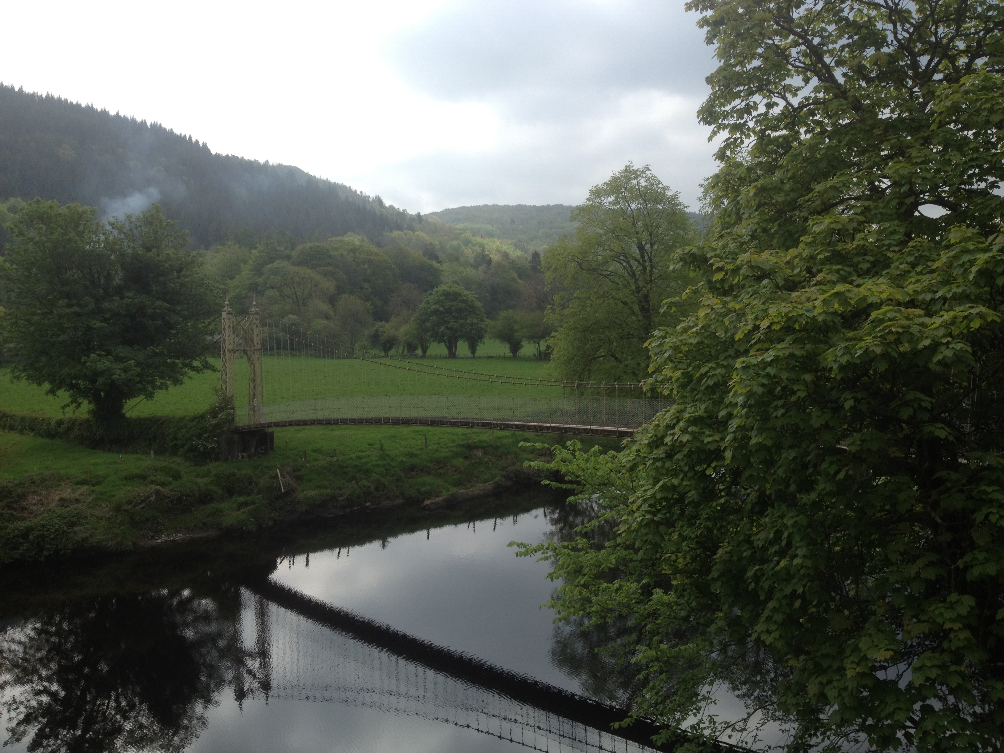

Slide 4
Evidence now shows that there is a positive relationship between exposure to nature and mental and physical health. At the same time, social interactions can be fostered and memories of places are created.

Slide 5
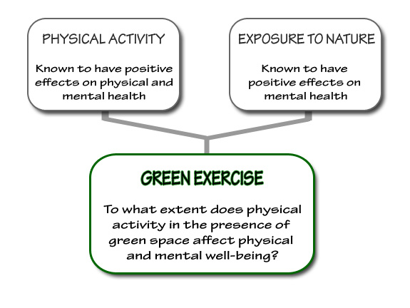

Slide 6
From recent research, three broad health outcomes are possible:
Improvement of psychological well-being (by enhancing mood and self-esteem, whilst reducing feelings of anger, confusion, depression and tension);
Generation of physical health benefits (by reducing blood pressure and burning calories);
Facilitation of social networking and connectivity (by enhancing social capital).

Slide 7
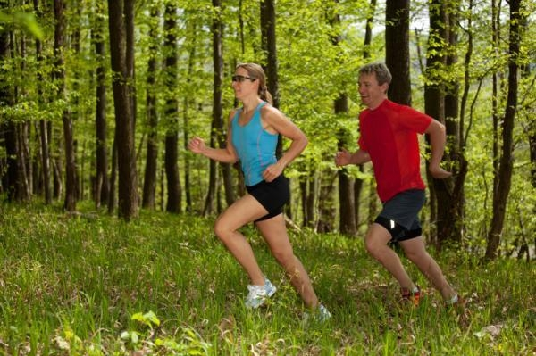

Slide 8
Key quantitative findings emerging from the large amount of data available show that:
3 out of 4 people feel less depressed, tense and angry after participating in a form of green exercise;
2 out of 3 people experience an overall improvement in their level of mood;
Almost two thirds of people report improved levels of self-esteem;
An improvement in mean self-esteem and mood levels is always reported after participation in different green exercise activities.

Slide 9
Green Excercise seems to be effective in generating a variety of health benefits and fostering social bonds, which leads to healthier communities and reduces public health costs.
Establishing this emotional connection with the environment also inspires people to think about, and become engaged with environmental issues such as conservation and climate change and encourages environmentally friendly behaviours.
Greenspaces are perfect surroundings for outdoor learning, where engaging with nature can lead to enhanced connectedness to nature and increased environmental knowledge.

Slide 10
What we Know and What we Suspect
Nature & Health Evidence
Know
Nature (including parks, gardens, countryside and wildernesses) is good for you, bringing mental health benefits.
Nature is a place where physical activity is likely and easy, bringing physical health benefits.
All types of people (age, gender, social groups, ethnic groups) benefit, but vulnerable, ill, disaffected and disadvantaged seem to benefit more (e.g. green exercise is more effective for people who start with poorer mental health).
All types of natures produce positive health and memory outcomes, from nearby nature to countrysides to wildlands.
Nature can act therapeutically, making many people better, but not the severely ill or depressed.

Slide 11
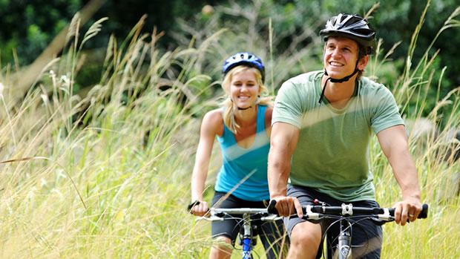
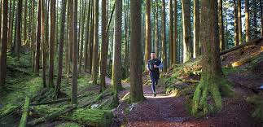

Slide 12
Suspect
Engagements with animals (pets, wild) results in the same kinds of mental health benefits as with nature and places.
There is a hard-wired, genetic component to human engagement with green places (biophilia), resulting in different outcomes depending on the view.
Physiological profiles can be produced to measure GE/GC interventions (eg endocrine indicators, blood pressure).
Danger could offset mental health benefits, as could extreme weather.
Nature or activities in nature could set the context for curing certain conditions or problems.

Slide 13
Living Space & Design
Urban unpleasant scenes (with no green nature) raise blood pressure and reduce self-esteem and mood indicators.
People living near to and with access to nature and green space are likely to be healthier (with green design implications).
Stockaded new-build in both green- and brown-field sites will result in diminished engagement by residents with local natural places.
Nearby nature and pocket parks in urban areas are vitally-important natural health resources, and could have greater benefits for society because of their ease of access.
Ecotown design could incorporate better planning for physical activity and direct engagements with green places.

Slide 14
Memory & Knowledge
There is a link between knowledge/memory and engagement – people who know more about nature go out more.
The creation of memory comes from personal experience in places or received experiences in stories. Places are created by people’s interactions in them; disconnections create anonymous space and foods.
Long-term meaningful engagements with nature change people, and can create enduring memories.
Brief exposure to green space provides similar therapeutic mental health outcomes as longer exposures, but longer ones may result in different emotions and memories.

Slide 15
Towards Sustainable Behaviours and Divergence
There are several different types of engagement with nature, with different outcomes for memory creation and behavioural change.
There are different patterns (types) of responses to nature engagements over nine month periods after intervention.
Events change people, especially scary ones when adrenalin flows, and where nature intrudes and threatens.
Engagements with nature that are tactile and physical, where the body is in the place, are more likely to result in awareness change and transformation. Engagements with specific places (defined by differing ecologies) will result in divergent lifeways rather than convergent ones.
Engagement with nature can be transformative.
Engagements with nature can lead to behavioural changes that will result in environmentally-sensitive behaviours across all parts of lifeways.
Greater engagement with nature changes food consumption behaviour resulting in health benefits.

Slide 16
Health Professionals
Very few doctors are as yet convinced that GE and GC public health interventions are effective treatments.
Green care could be used more widely as a treatment and should be used as therapeutic options by health care professionals.
The mainstream medical establishment will need quantified studies using standard methods of (dis)proof to accept that GE/GC are serious options.
Analysis of post-intervention pathways or routes will allow development of predictive methods pre-intervention, thus allowing severe (unresponsive) individuals to be given alternative treatments.

