Slide 1

Enterprise Networks Presentation (ACCA7032)
Connor Michael Anthony Wilson (2011592@student.uwtsd.ac.uk)
MSC Digital Forensics and Cybersecurity
University of Wales Trinity Saint David

Slide 2
What is Checkpoint?
Check Point Software Technologies Ltd. is a multinational company based in the United States and Israel that provides a range of IT security products and services. Their offerings include software and hardware solutions for network security, endpoint security, cloud security, mobile security, data security, and security management.
For this presentation. The presenter will be discussing the different features within the checkpoint software solution as well as the network topology and configuration of network with examples on how the network is setup.

Slide 3
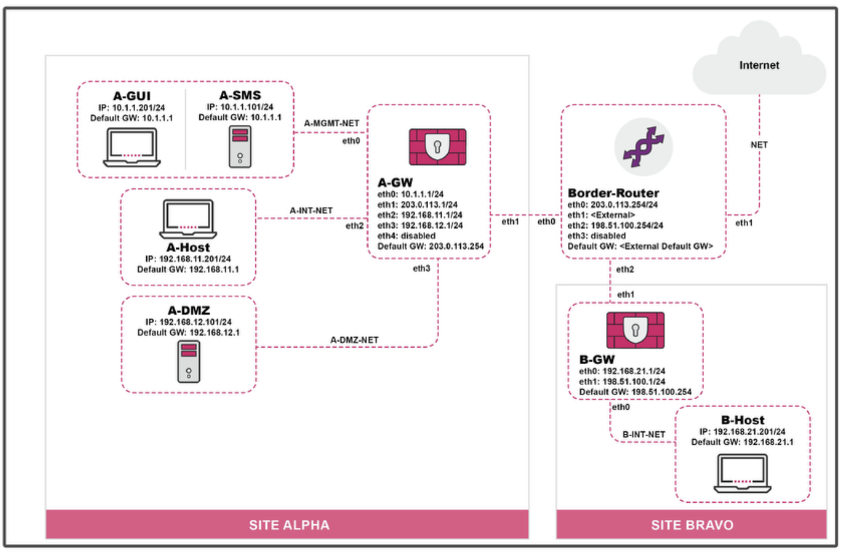
Initial Network Topology
I took advantage of the network topology provided by the lab booklet for this module.
Topology had windows server machine that was used to configuration of the network via the checkpoint SmartConsole.
A-host was a generic windows machine that was used for emulation of a user environment when testing protocol and logging features of the checkpoint portal.
GW machines were running the Gaia Operating system and were used as a gateway between the host and admin machines as it is responsible for Protocol Translation between different networks and architectures, Firewall capabilities as well as Network Address Translation (NAT): Gateways often perform NAT, which hides the internal IP addresses of devices on a private network by translating them to a single public IP address. This enhances security by masking the internal network structure from external entities.

Slide 4
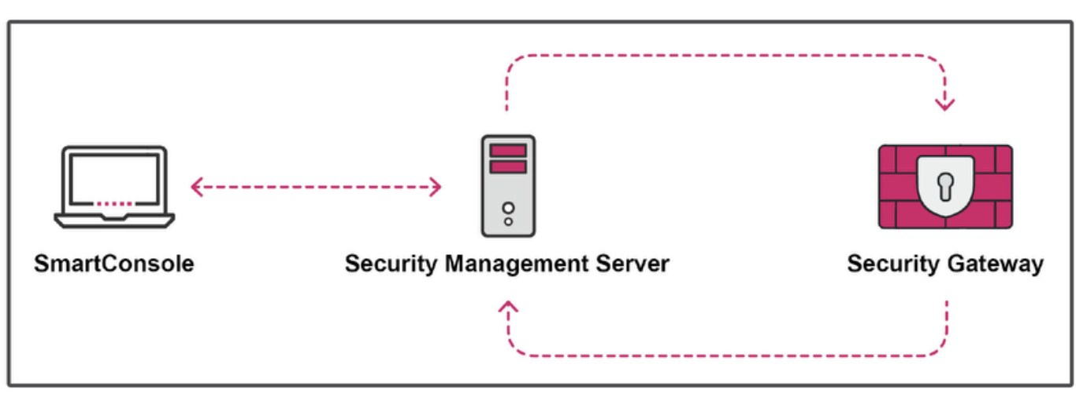
Three tier architecture
The first component of the Three-Tier Architecture is SmartConsole, which offers a graphical interface for centralized management of the Check Point environment. Common uses include:
Creating and managing security policies, user and administrator accounts, management servers, gateways, and other devices.
Monitoring logs, events, performance, and regulation compliance.
Maintaining licenses and updating products.
Important: SmartConsole is a tool that sends policy and configuration information to the Security Management Server for storage; it does not store this information itself.
There is also a clientless version which can be connected to via the web browser using a ip address similar to what would be used to configure a router or modem on a home network

Slide 5
Network Topology Overview:
Host Machine Running Windows:
Not interconnected with any other devices.
Windows Server Machine:
Used for configuration of the network checkpoint options.
Connected directly to a server management server.
DMZ Server:
Connected to a Gaia operating machine gateway server.
Gateway Server:
Connected to another site via a border router.
Border router connects to the internet.
Another gateway server and host machine running on Windows at the other site.

Slide 6
Security Analysis:
1. Host Machine Running Windows (Isolated)
Strengths:
  Isolation: This machine is not connected to any other devices, reducing the risk of network-based attacks.
  Attack Surface: Limited attack vectors as there are no network connections.
Weaknesses:
  Physical Security: Needs strong physical security controls to prevent unauthorized access.
  Local Threats: Still susceptible to threats from local media (e.g., USB drives).
2. Windows Server Machine (Configuring Network Checkpoint Options)
Strengths:
  Centralized Management: Allows centralized control and configuration of network security policies.
  Access Control: Should implement strict access controls to ensure only authorized personnel can configure settings.
Weaknesses:
  Direct Connection: Connected directly to the server management server, which could be a potential vulnerability if not properly secured.
  Patch Management: Needs regular updates and patches to mitigate vulnerabilities inherent to the Windows operating system.
3. DMZ Server
Strengths:
  Isolation: Placed in a demilitarized zone (DMZ), which helps isolate it from the internal network, reducing the risk of internal threats.
  Controlled Access: Provides a controlled access point for external services while limiting exposure to the internal network.
Weaknesses:
  Exposure: More exposed to external attacks since it interfaces with the internet.
  Configuration: Must ensure the DMZ server is correctly configured to minimize vulnerabilities.

Slide 7
Security Analysis continued
4. Gaia Operating Machine Gateway Server
Strengths:
  Secure OS: Gaia is a secure operating system designed for Check Point firewalls, providing robust security features.
  Firewall Capabilities: Acts as a firewall, protecting the internal network from external threats.
Weaknesses:
  Complexity: Requires skilled administration to ensure configurations are secure and optimized.
  Single Point of Failure: If compromised, it could provide an entry point to the internal network.
5. Gateway Server (Connected to Border Router and Another Site)
Strengths:
  Site-to-Site Security: Facilitates secure communication between sites, possibly using VPNs.
  Traffic Control: Manages traffic between the sites and the internet, providing an additional security layer.
Weaknesses:
  Exposure: Connected to the internet, making it susceptible to internet-based attacks.
  Configuration Management: Requires constant monitoring and updating to address new threats.
6. Border Router (Connecting to the Internet)
Strengths:
  Traffic Filtering: Can filter traffic entering and leaving the network, acting as the first line of defense.
  Routing Control: Manages the routing of data, ensuring it reaches the correct destination securely.
Weaknesses:
  Public Exposure: Directly exposed to the internet, making it a prime target for attackers.
  Security Configurations: Needs to be configured with strong security policies to prevent unauthorized access.
7. Other Host Machine Running Windows at the Other Site
Strengths:
  Site Separation: Provides redundancy and separation of resources, enhancing security.
  Endpoint Security: Should have robust endpoint security measures (antivirus, anti-malware, etc.).
Weaknesses:
  Endpoint Vulnerabilities: Susceptible to endpoint-specific attacks, such as malware and phishing.
  Inter-Site Security: Security relies on the integrity of the gateway servers and the connection between sites.

Slide 8
Overall Security Posture:
Strengths:
  Layered Security: The use of a DMZ, gateways, and border routers indicates a layered approach to security, which is effective in mitigating risks.
  Specialized Systems: Use of Gaia OS for gateway servers enhances security with specialized features.
  Separation of Concerns: Isolated host machines and separated network segments reduce the risk of widespread compromise.
Weaknesses:
  Complexity: The complexity of the network requires skilled administration and constant monitoring.
  Potential Single Points of Failure: Gateway servers and border routers are critical points that, if compromised, could impact the entire network.
  Exposure to External Threats: Components connected to the internet are inherently at higher risk of attack.
Recommendations:
Regular Updates and Patching: Ensure all systems, especially Windows machines and network devices, are regularly updated and patched.
Strong Access Controls: Implement strict access control measures, especially for systems involved in network management and configuration.
Network Monitoring: Employ comprehensive network monitoring tools to detect and respond to anomalies and potential threats promptly.
Security Policies and Training: Establish robust security policies and conduct regular training for staff to recognize and respond to security threats.
Incident Response Plan: Develop and regularly update an incident response plan to quickly address and mitigate any security breaches.
By addressing these areas, the overall security posture of the network can be significantly strengthened, reducing the risk of compromise.

Slide 9
Overall Security Posture Continued
Strong Access Controls:
Implement strict access control measures, especially for systems involved in network management and configuration. Define user roles and permissions clearly to prevent unauthorized access. The User permissions include a superuser account with unlimited access (read/write) an admin with the rights under the name: Connor_Wilson as well audit accounts for ISP with read only access to be able to verify information but not make any adjustments.

Slide 10
Overall Security Posture Continued
Network Monitoring:
  Employ comprehensive network monitoring tools to detect and respond to anomalies and potential threats promptly. This be checked via logs on the system by administrator or other valid network staff
Security Policies and Training:
  Establish robust security policies and conduct regular training for staff to recognize and respond to security threats. Ensure policies are consistent and do not conflict with each other. The employment of security frameworks could assist with guidance on the type of training that would be valid for a
Incident Response Plan:
  Develop and regularly update an incident response plan to quickly address and mitigate any security breaches.
Irregular Security Audits:
  Conduct irregular and unannounced security audits to identify and address vulnerabilities before they can be exploited.
Irregular Security Updates:
  Implement a strategy for irregular security updates, ensuring that all critical systems receive updates as soon as they are available, outside of regular update schedules.
Single Points of Failure:
  Identify and mitigate single points of failure by implementing redundancy and failover mechanisms, particularly for critical components like gateway servers and border routers.
Inconsistencies and Errors:
  Regularly review and rectify inconsistencies and configuration errors in the network setup to maintain a robust security posture.
Licensing Structure:
  Review and manage the licensing structure to ensure all security solutions are properly licensed and up to date, avoiding gaps in coverage. If licenses are not deployed correctly, it could affect functionality of the network structure as an element such as the gateway may become dysfunctional without a valid license file.
User Roles and Permissions:
  Clearly define and enforce user roles and permissions to prevent unauthorized access and ensure that users only have the access necessary for their roles.
Overlapping and Conflicting Policies:
  Ensure that security policies are not overlapping or conflicting. Conduct regular policy reviews to align and streamline them for maximum effectiveness.
Lack of Control Over Application Usage:
  Implement application control measures to monitor and restrict the usage of unauthorized applications within the network.
IPS Rules are Outdated:
  Regularly update Intrusion Prevention System (IPS) rules to ensure they are effective against the latest threats.
Challenges Posed by IoT Devices:
  Address the challenges posed by IoT devices by segmenting IoT networks, applying strong access controls, and regularly updating IoT firmware to mitigate vulnerabilities.

Slide 11
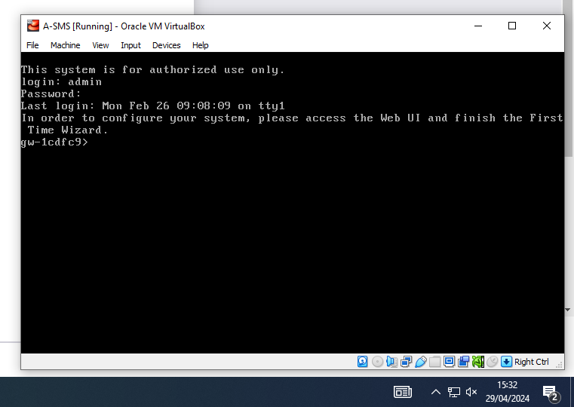
Gaia Operating System Initial Setup (A-GW)
When I started working on this initial lab at the start of the document atleast on my machine the initial setup of the operating system had been completed so I progressed onto the next lab.

Slide 12
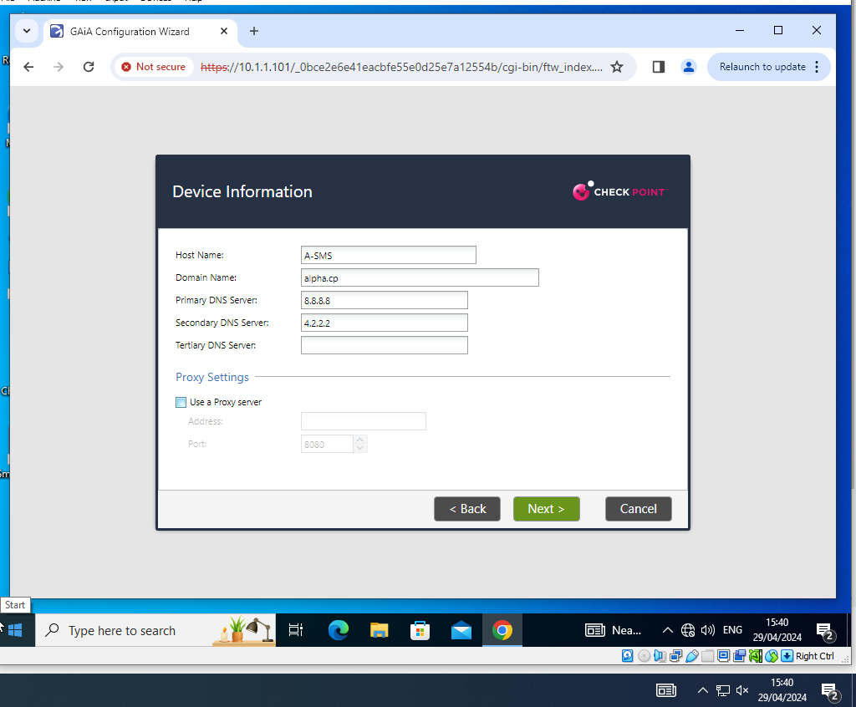
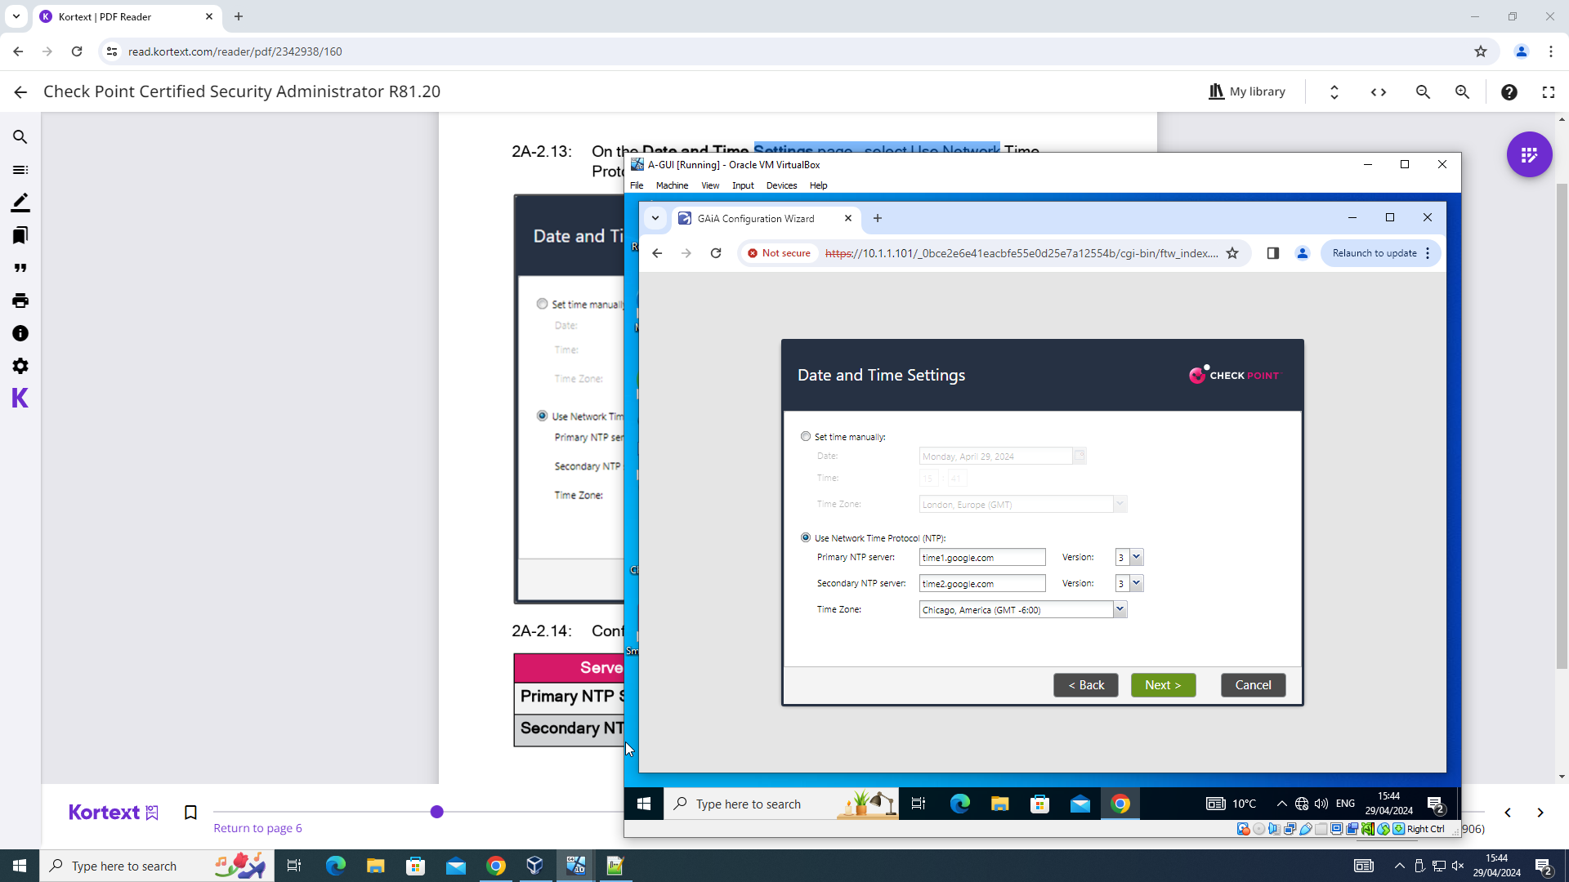
Running Initial Setup wizard via the Clientless Smart Console.
Notes:
Running through the initial setup wizard involved configuring the network devices via the A-GUI on the Clintless Smart Console. This consisted of inputting Network details (IP address, Subnet Masks) for each network device in the Topology which set a foundation before other features within Checkpoint could be adjusted.

Slide 13
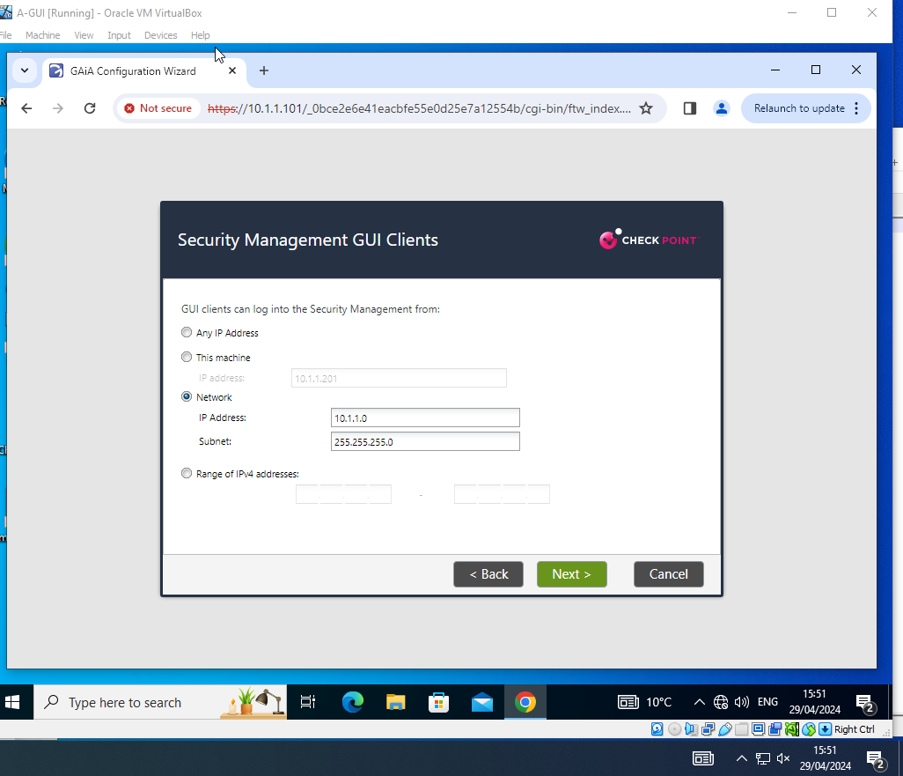
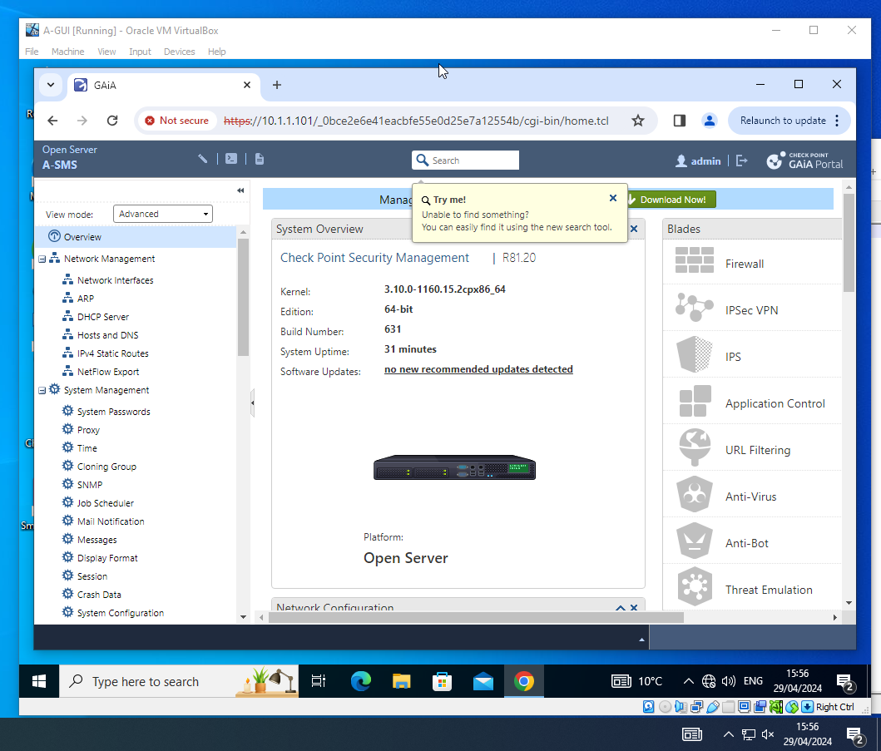
Running Initial Setup wizard via the Clientless Smart Console Continued

Slide 14
Running Initial Setup wizard via the Clientless Smart Console Continued
Notes:
Configuring the NTP server so that the time and date function can be setup on the server. If it is not configured correctly there could timeouts that occurring during connection or could be validation issues.

Slide 15
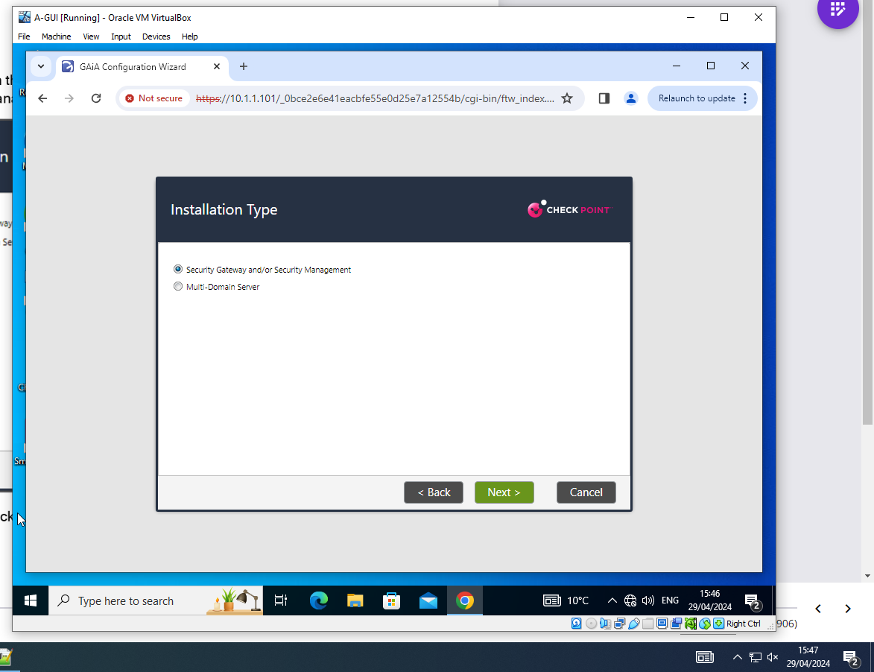
Running Initial Setup wizard via the Clientless Smart Console Continued

Slide 16
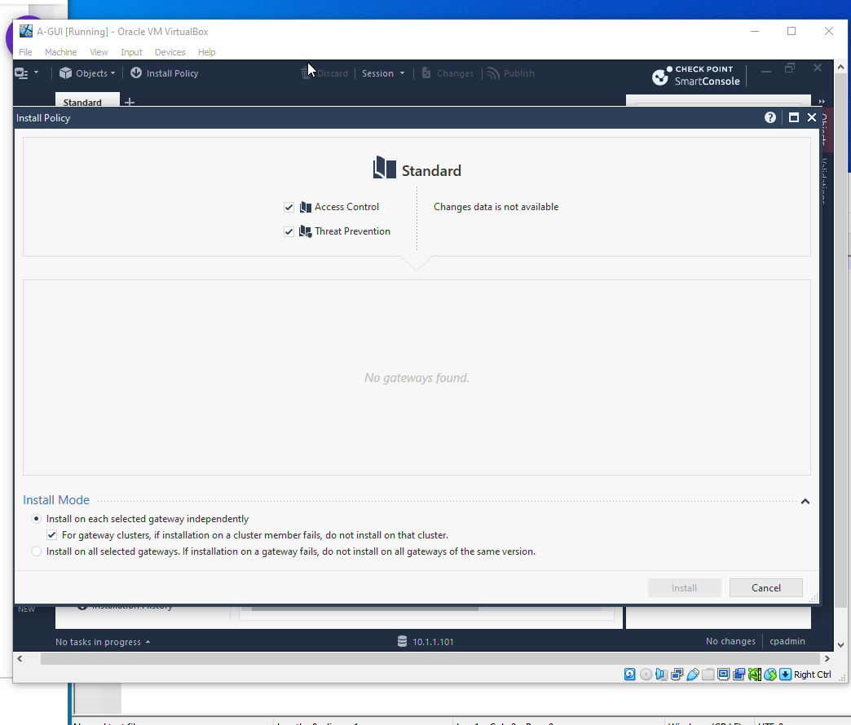
Installing Policy options within the Smartconsole

Slide 17
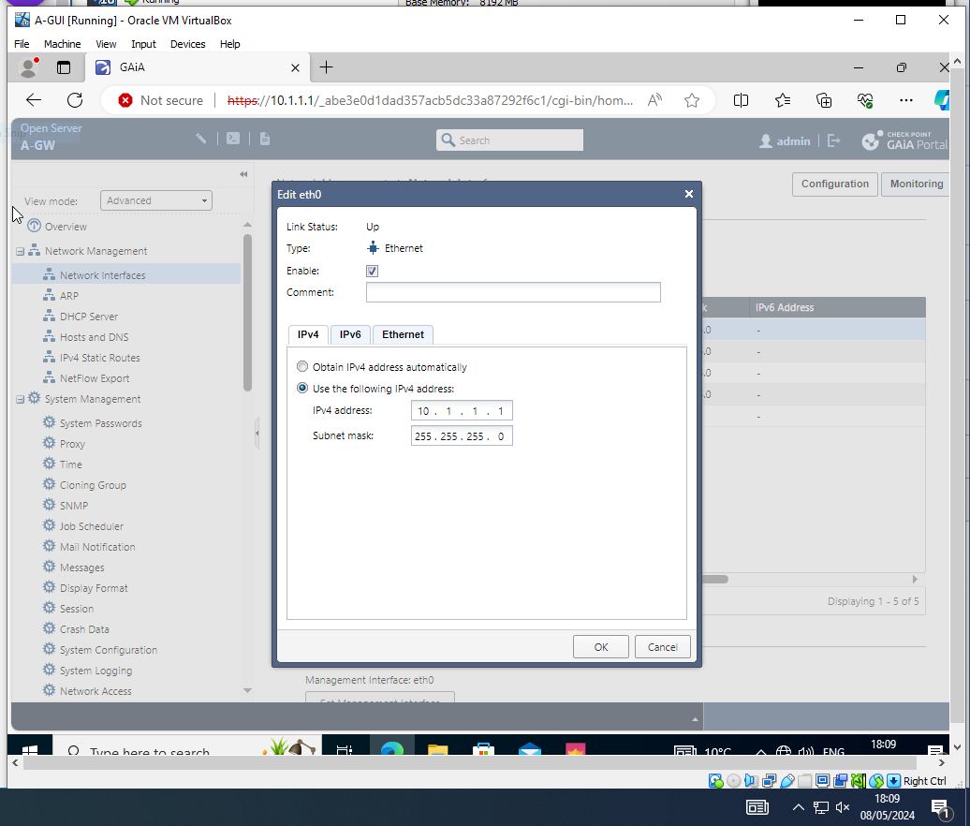
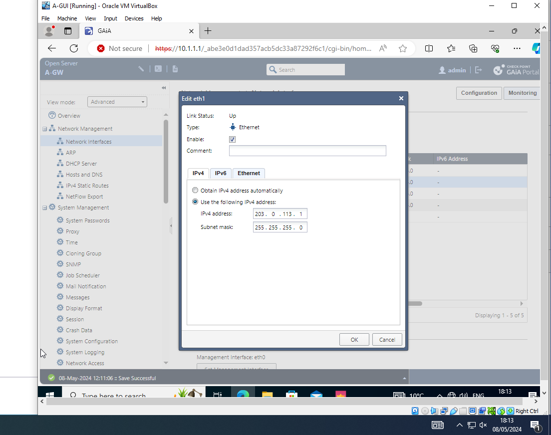
Further Network configuration for Ethernet Connections.

Slide 18
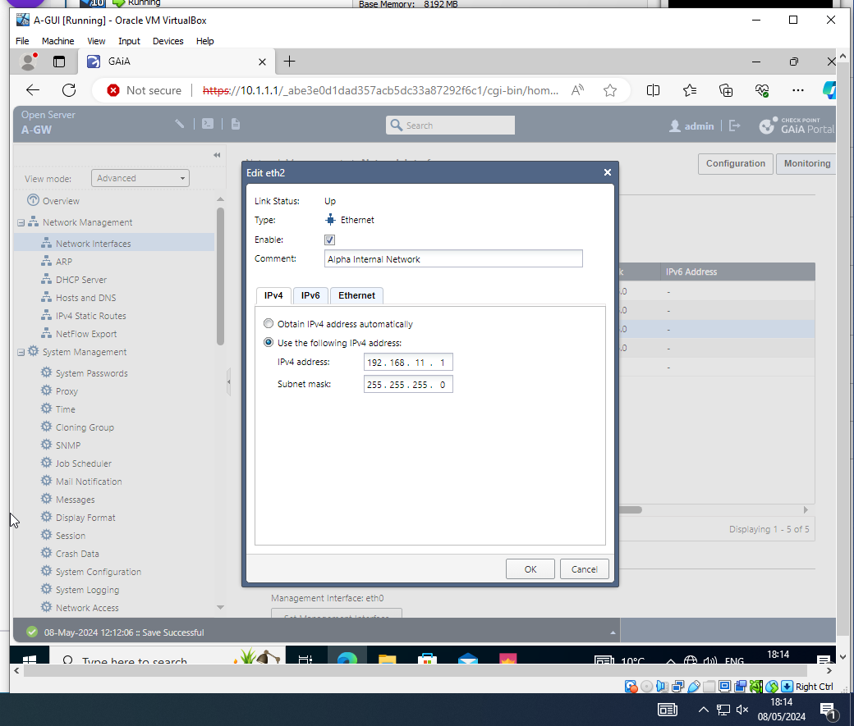
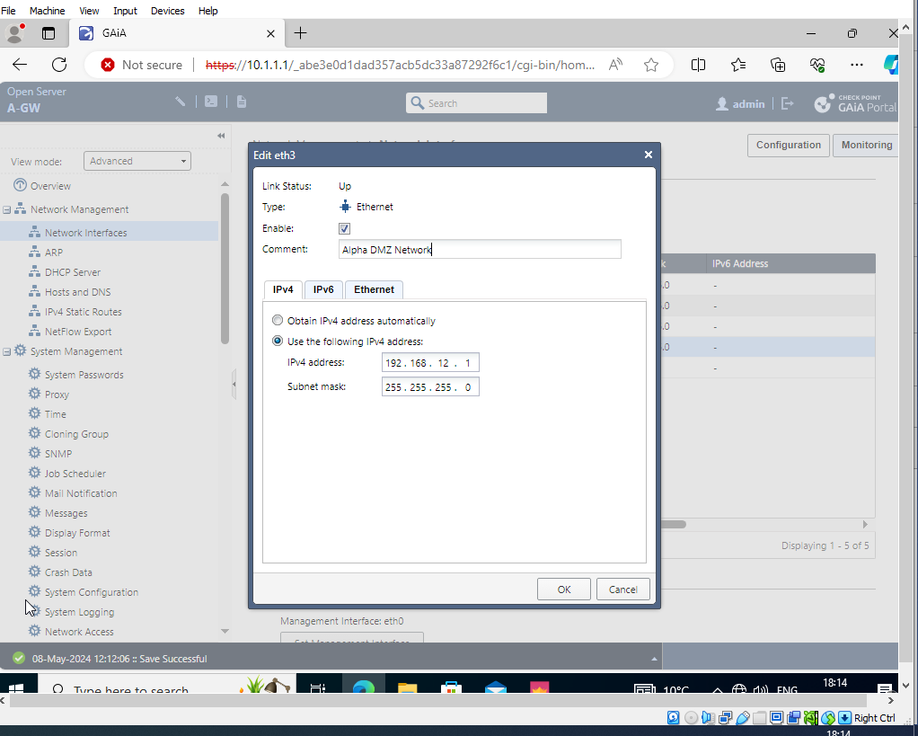
Further Network configuration for Ethernet Connections.

Slide 19
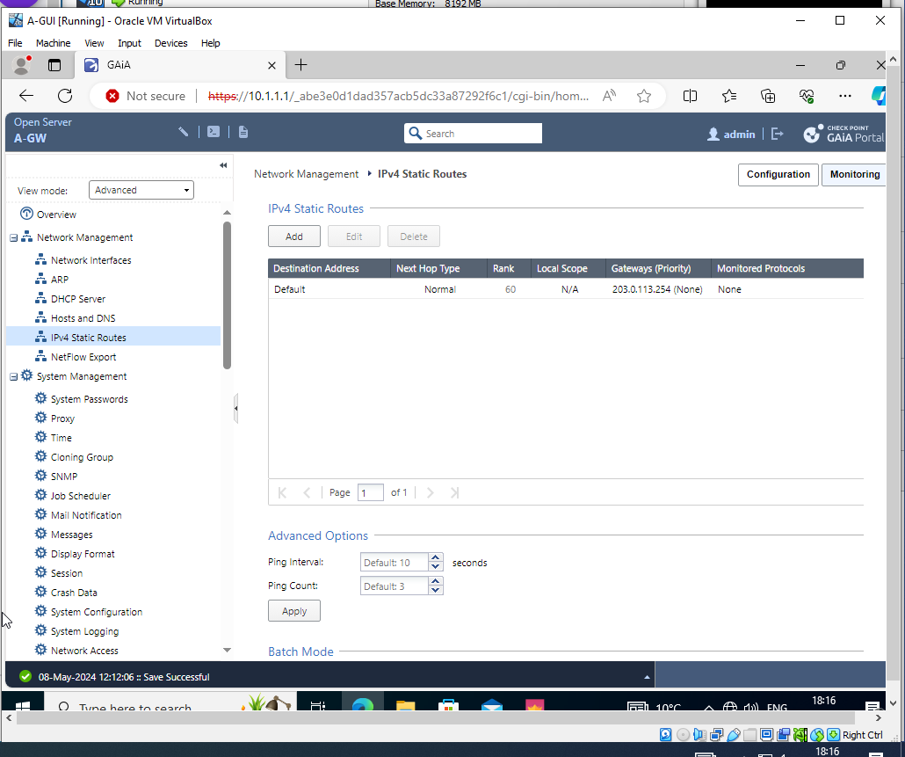
Further Network configuration for Ethernet Connections.

Slide 20
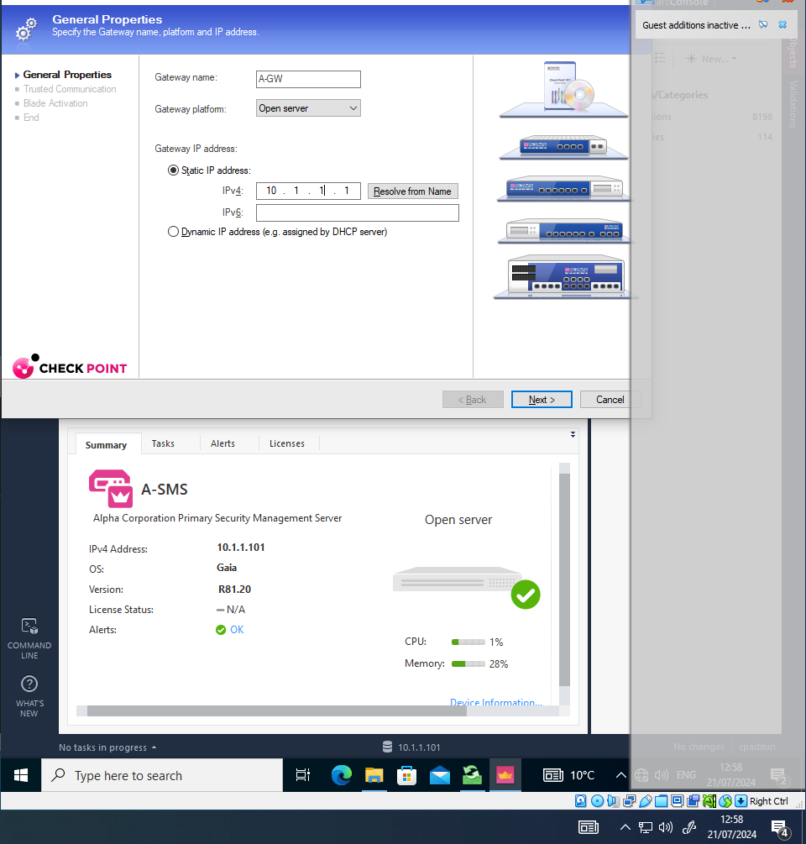
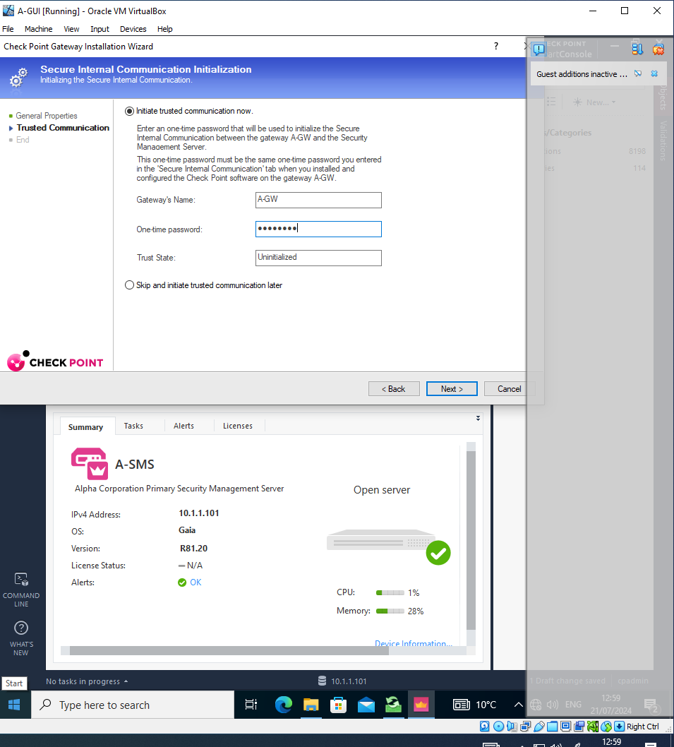
Checkpoint Installation wizard setup for Gateway Server information.
Notes:
Gateway Login information and login details configuration was completed during this step.

Slide 21
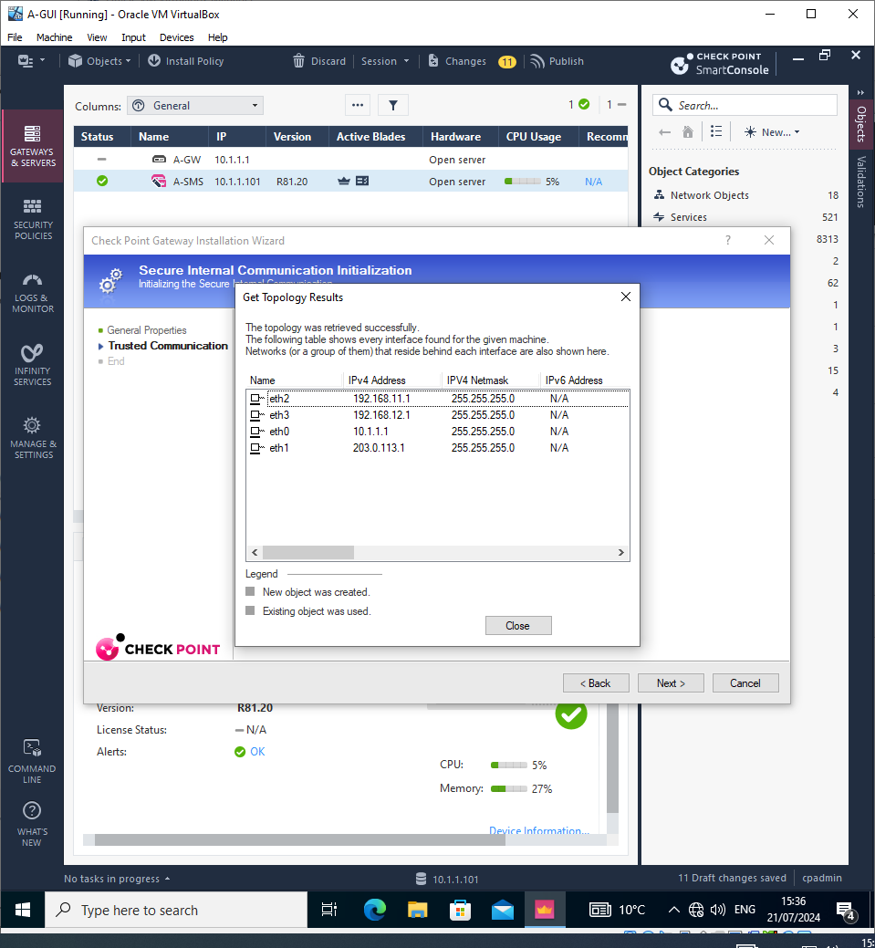
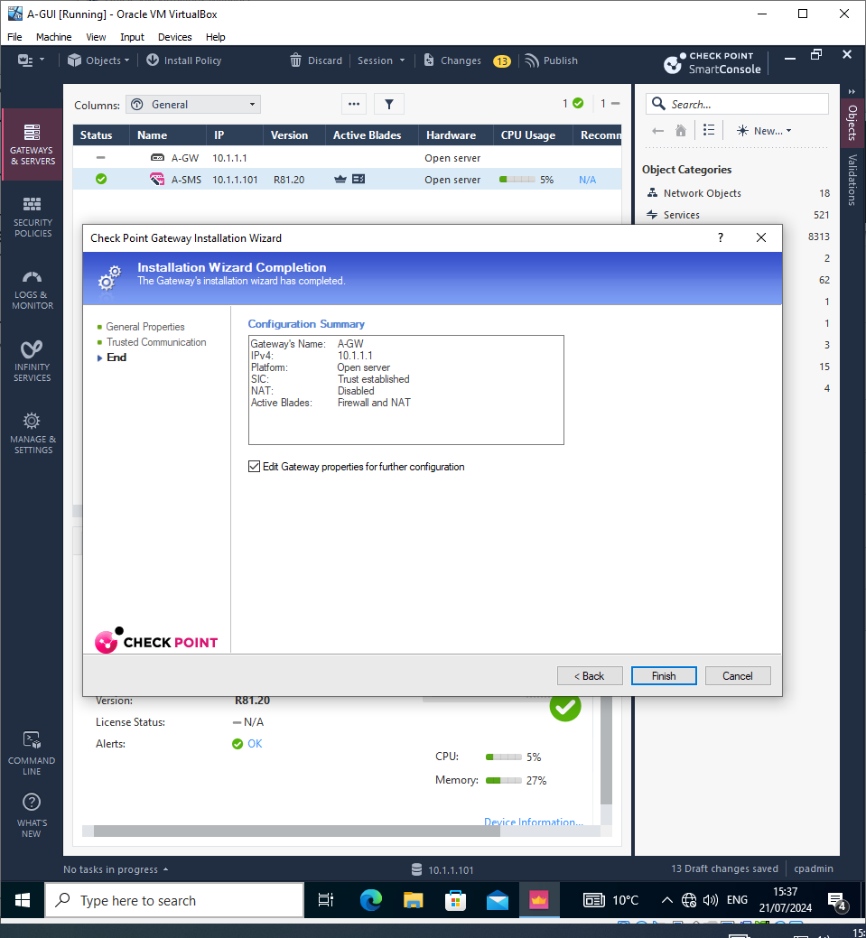
Configuration Summary and verifying Topology information
Notes:
Verifying Network Topology information was correct before continuing (Left hand image) and

Slide 22
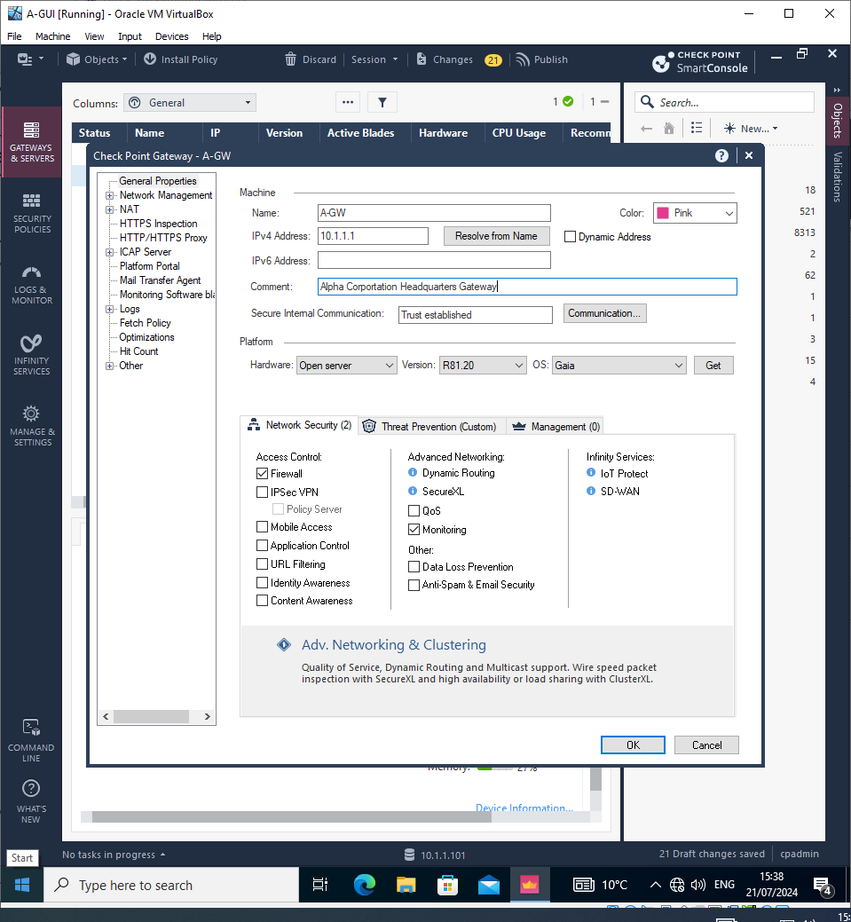
Configuring network features and Comment for identifiability

Slide 23
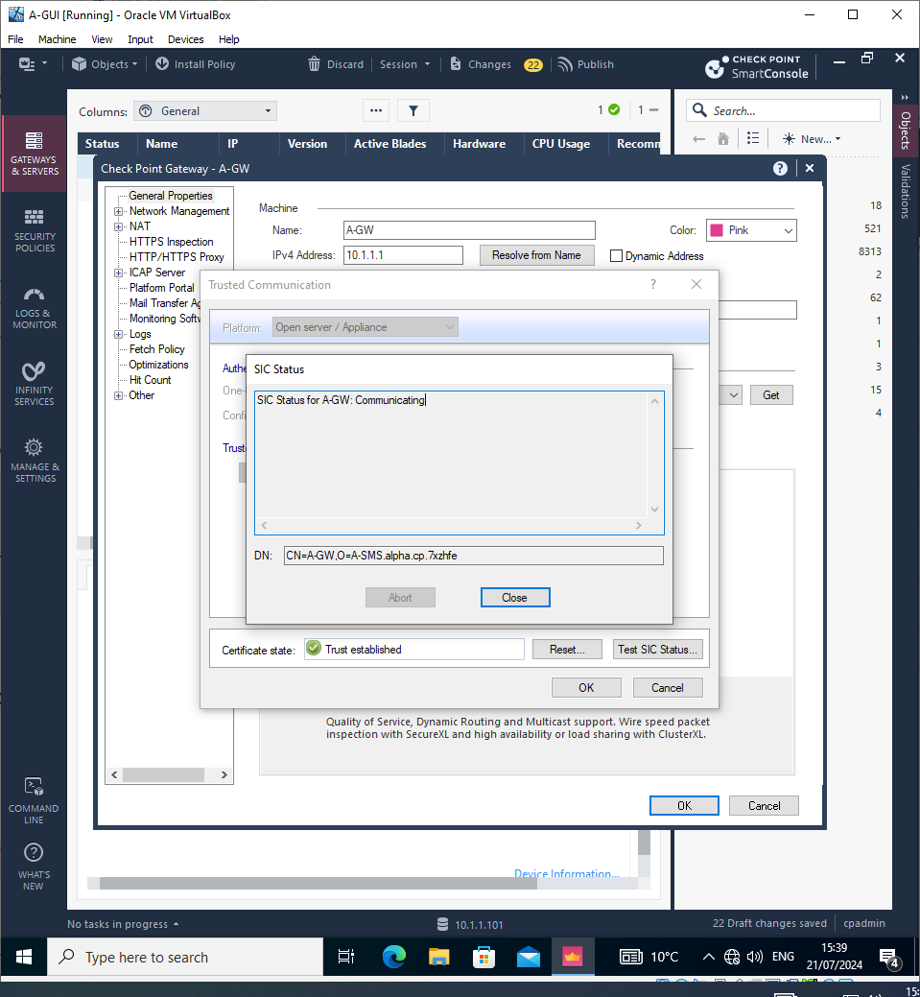
Verifying SIC Status.

Slide 24
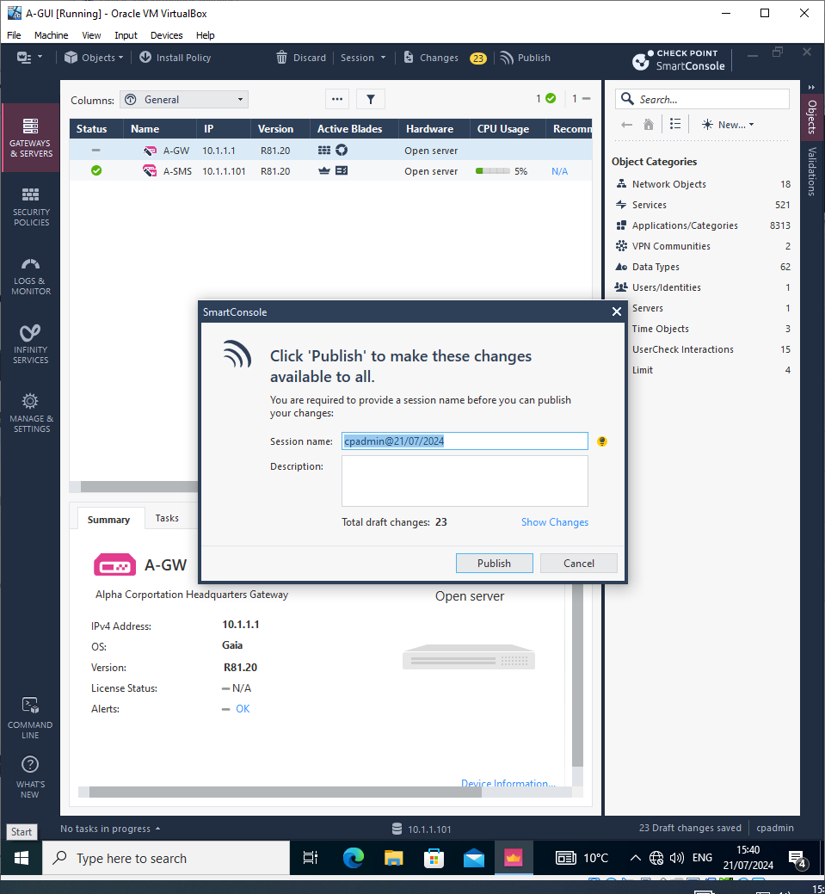
Finalise changes for Network Features after successful SIC test.

Slide 25
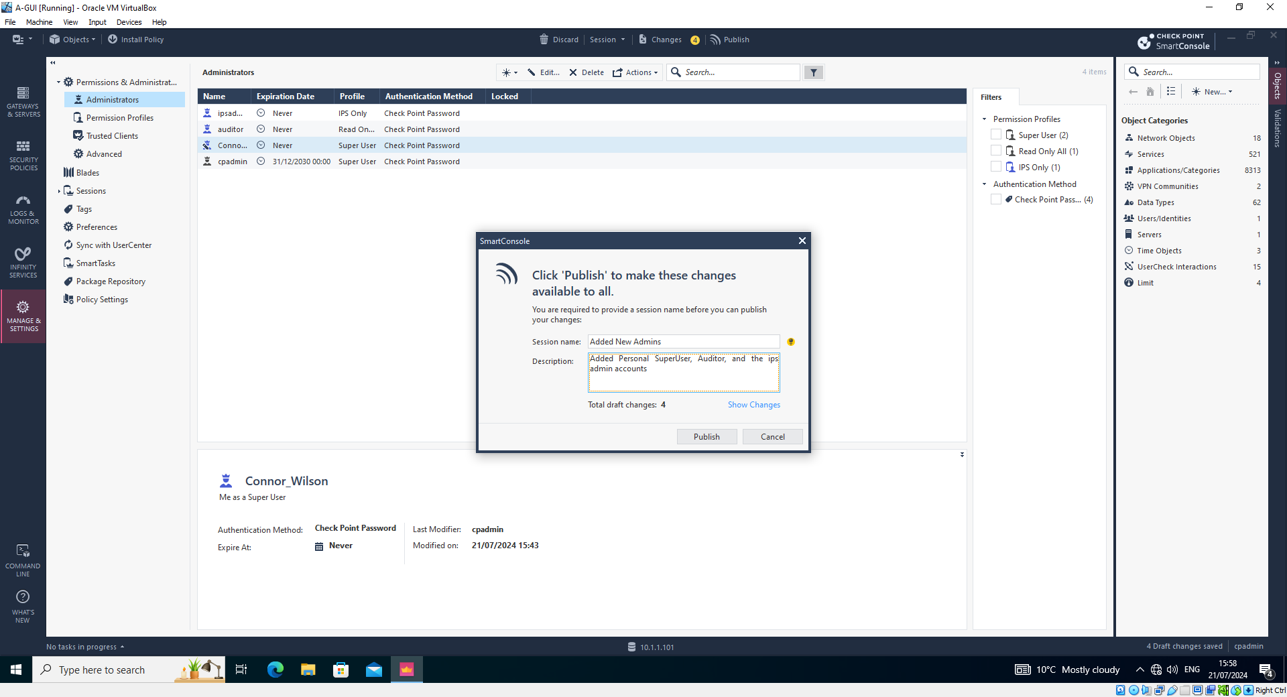
Setting up User accounts with permissions and publishing changes

Slide 26
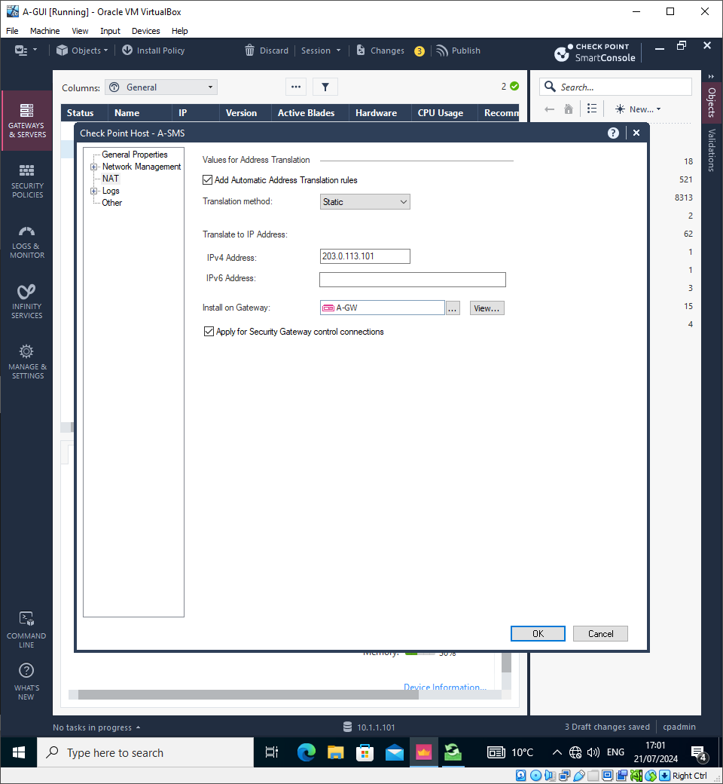
Configuring Policies

Slide 27
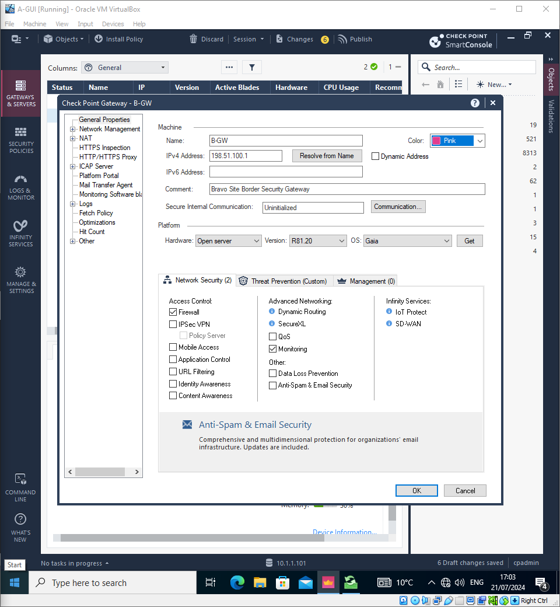
Enabling Network Features for GW-B

Slide 28
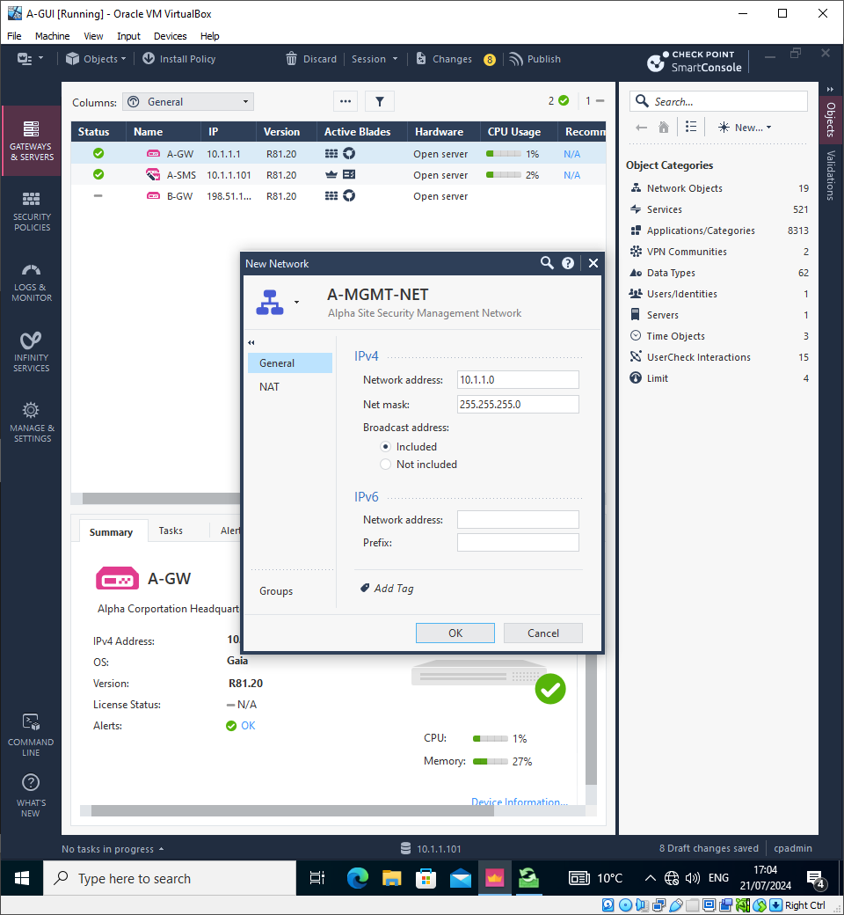
Creating A-MGMT Network

Slide 29
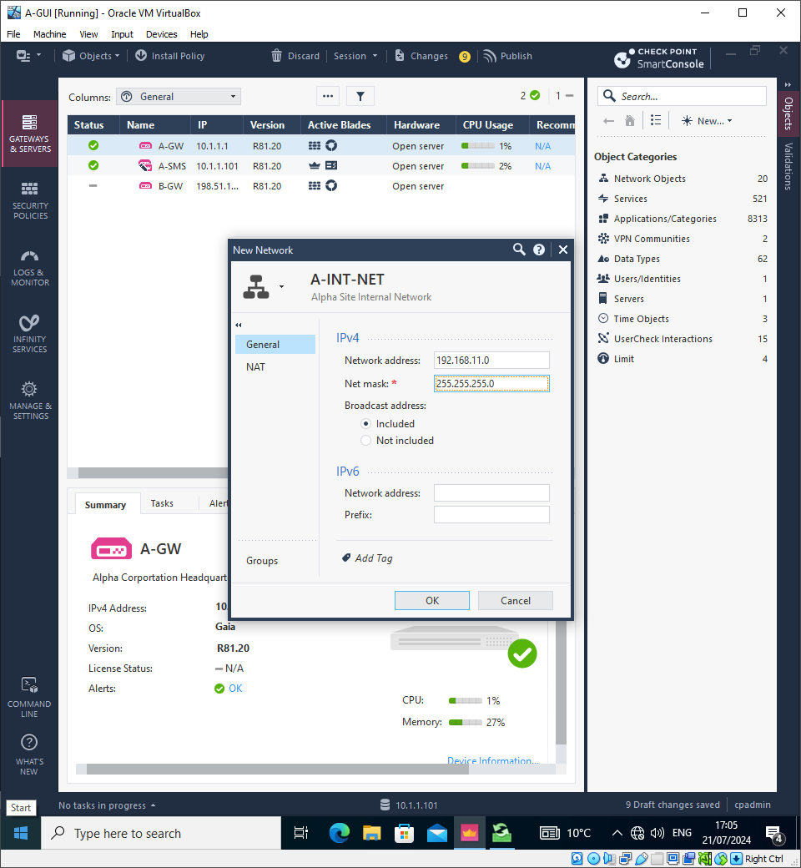
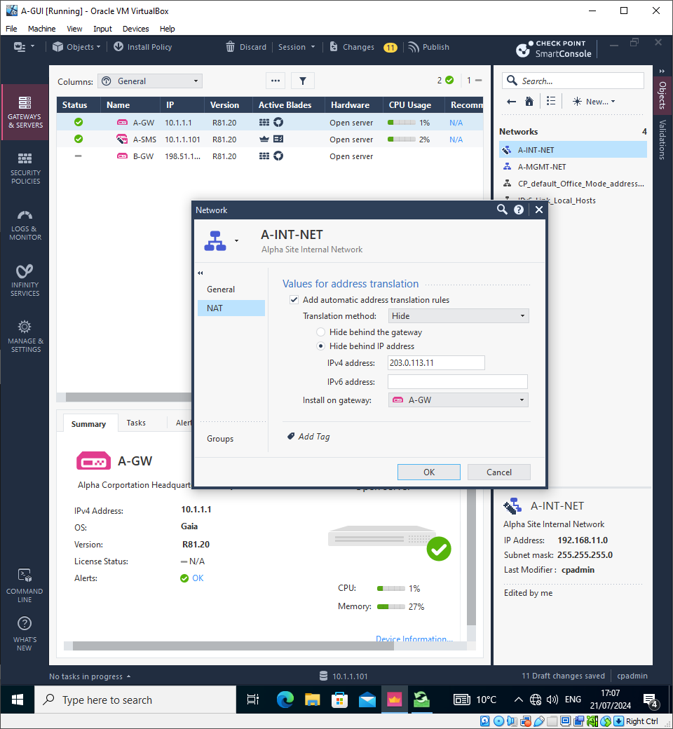
A-INT-NET Creation and configuration

Slide 30
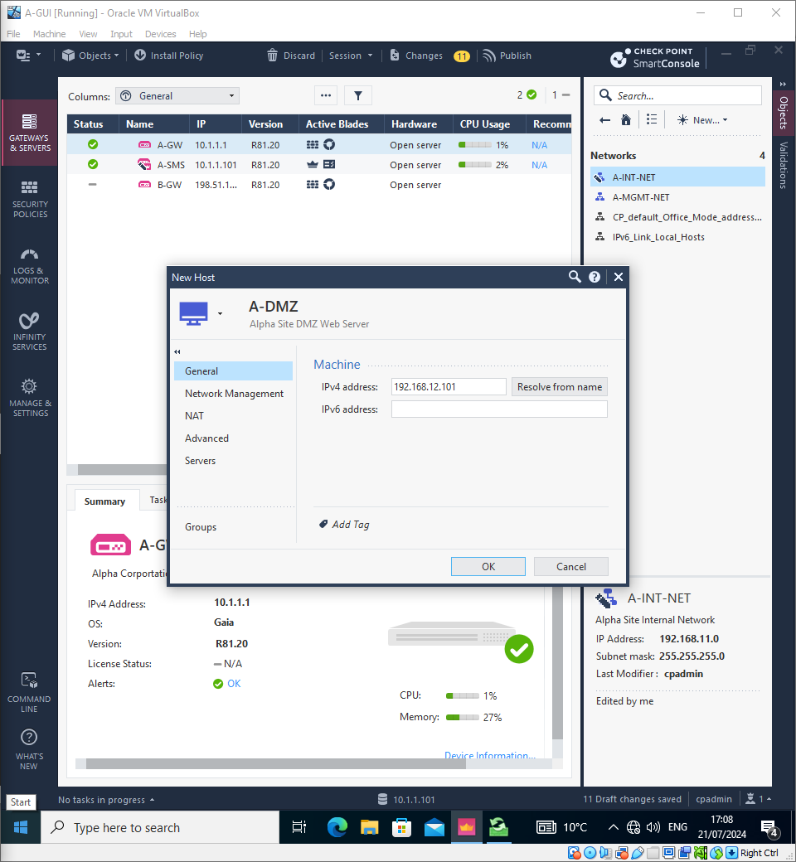
A-DMZ Web Server Creation

Slide 31
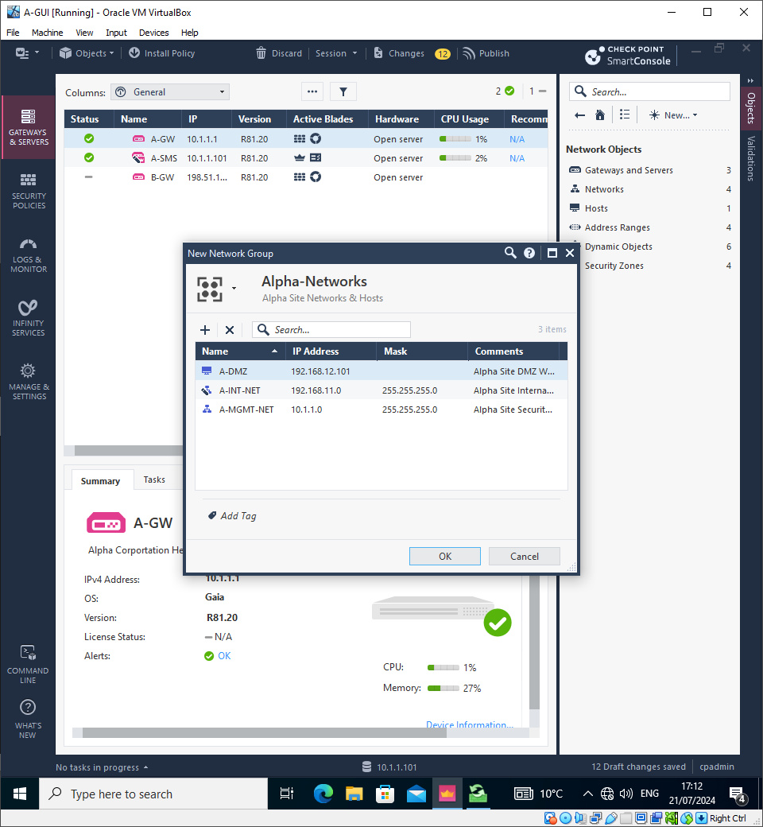
Alpha Networks site group creation

Slide 32
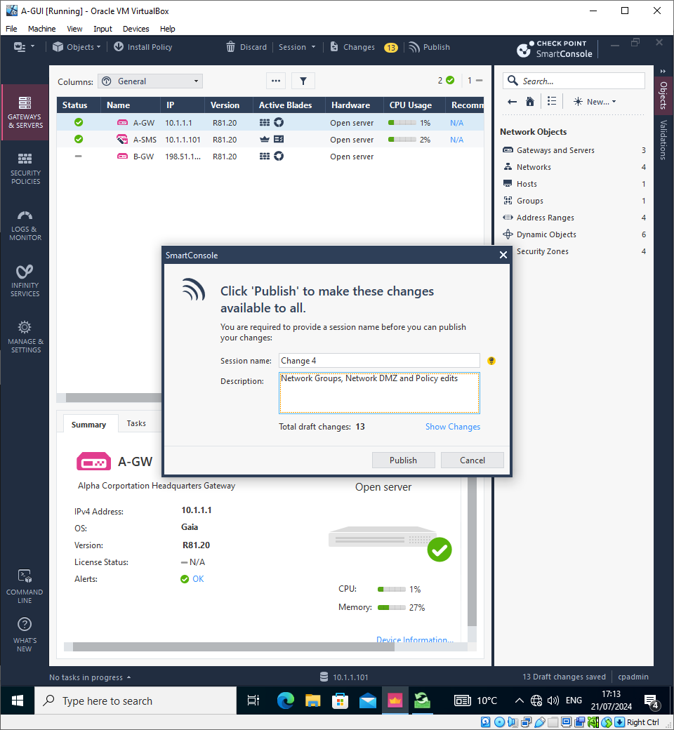
Publishing Network Groups, Gateway and network object configuration

Slide 33
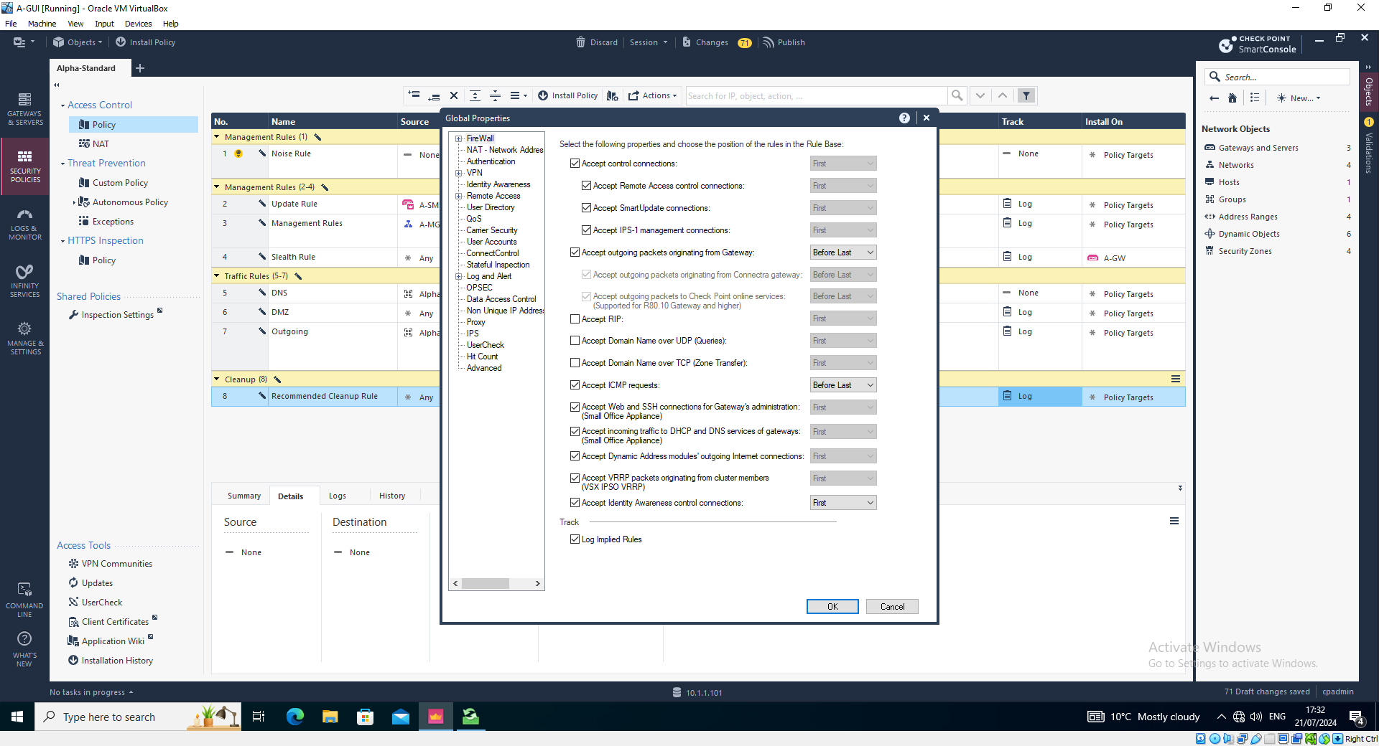
Policy Configuration

Slide 34
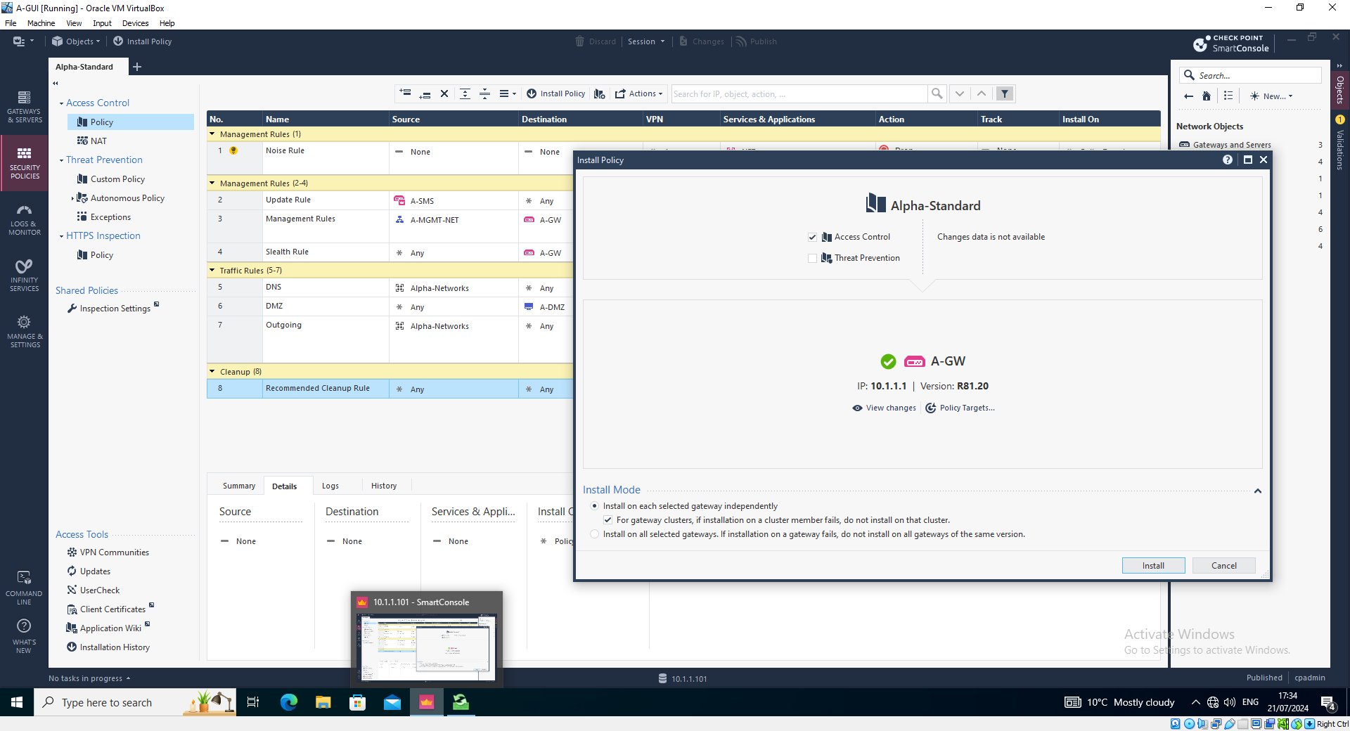
Installing Policy to GW-A Gateway

Slide 35
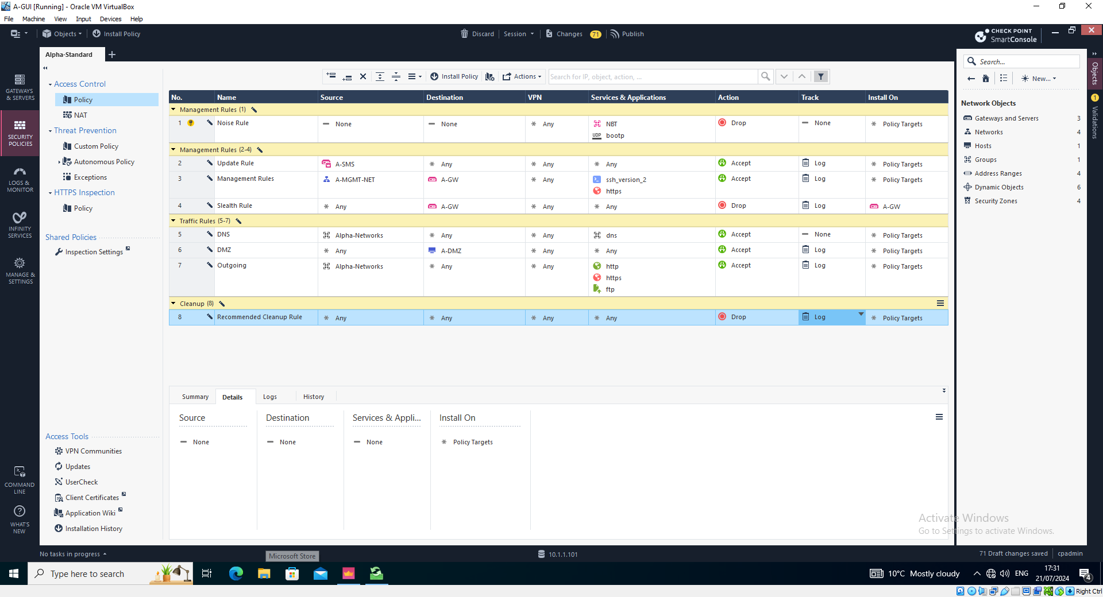
Finalized Policy Creation

Slide 36
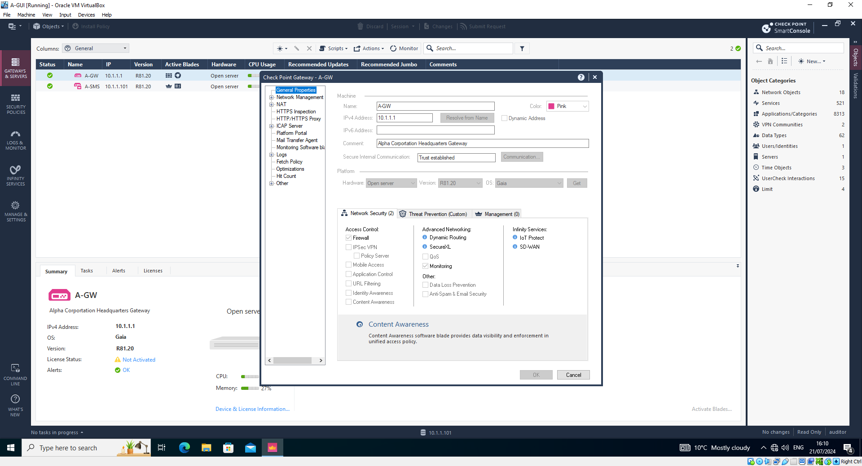
A-GW Configuration in Gateway and Servers
Notes:
Applying comments for easy identification in the network as well as the IP address and Color option

Slide 37
Personal and Technical Reflection.
I had some issues along the way while working on the assignment I was not able to progress once getting to Lab 5B due being unsuccessful in getting the machines to communicate with each.
This limited the potential of further learning and further enhancing my personal skills and understanding of creating a robust network configuration.
I also had some experience with my license expiring during the process of completing the labs but I ended up creating an evaluation account with Checkpoint which allowed me to continue with the labs. This stopped my progression as I was unable to get assist from Ray as others were consistently having issues in the class which demanded his attention and I had used my own resourcefulness to resolve the issue.
Other than this I found little to no issue with progressing through the labs until 5B and everything functioned correctly flowing the guidance provided via the Kortext documentation.

Slide 38
Conclusion
In conclusion, I have thoroughly examined our initial topology and analysed the existing security posture, identifying critical issues such as irregular security audits and updates, single points of failure, and outdated IPS rules. Our analysis also addressed inconsistencies and errors, licensing structure, user roles and permissions, overlapping policies, lack of control over application usage, and the challenges posed by IoT devices.
Through our implementation of the Checkpoint security solution, detailed with adequate screenshots and a live demo, I successfully tackled these vulnerabilities. We faced and overcame significant challenges, ensuring a robust and secure deployment.
My recommendations for future improvements focus on regular audits, timely updates, eliminating single points of failure, and continuously evolving our security policies to adapt to new threats. This comprehensive approach not only secures our current environment but also sets a foundation for future resilience.
If I had been more organised and prepared with this assignment I would of made additional implementations to the network in line with best pratices advised by mainstream security frameworks such as NIST Cybersecurity Framework or ISO 27001 for example as this would further improve my skills which could be applicable in an employment scenario working in cybersecurity and enhance my employment prospects.

