Slide 1
Mark Huntly
m.huntly@uwtsd.ac.uk
Cloud Principles
Three Main Concepts

Slide 2
Principles and Concepts
Load Balancing
Application Gateway
Scaling

Slide 3
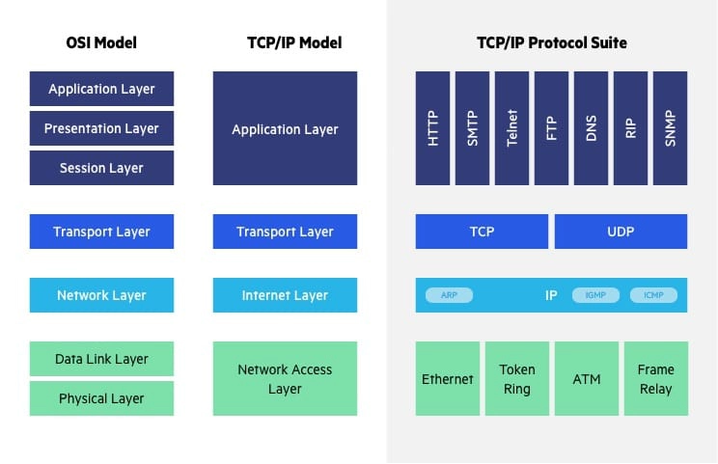
Layer 7
Layer 6
Layer 5
Layer 4
Layer 3
Layer 2
Layer 1

Slide 4
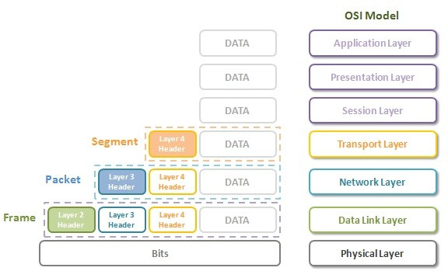

Slide 5
Layer 7
Layer 6
Layer 5
Layer 4
Layer 3
Layer 2
Layer 1

Slide 6
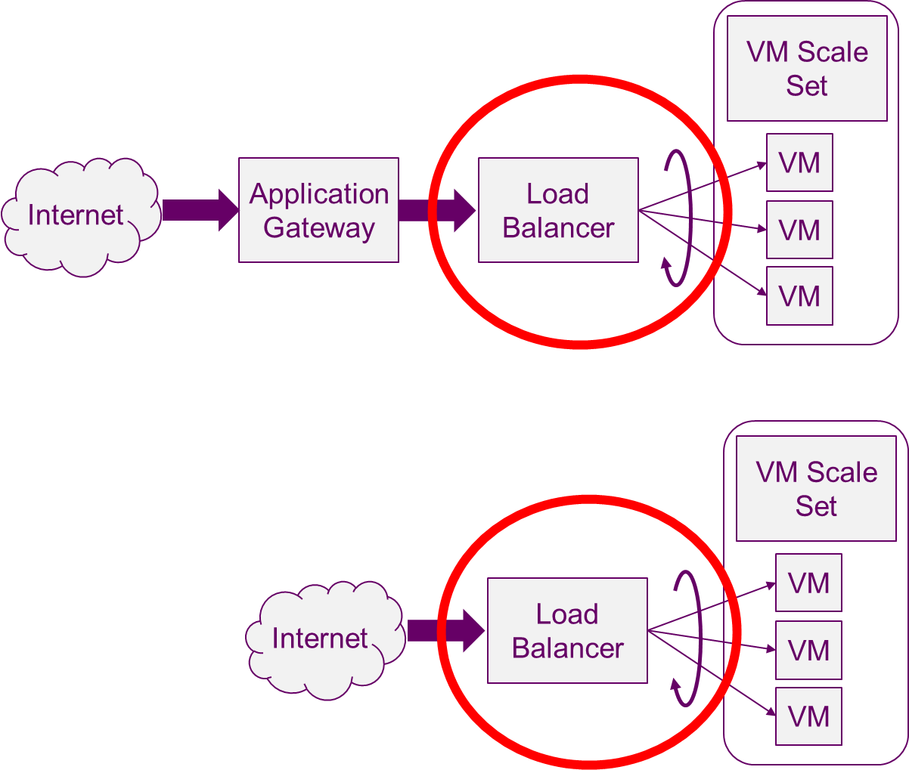
Load Balancer
Routes incoming client traffic.
  to a target (e.g. a VM)
Monitors the health of the targets so that it only routes to healthy targets
  High availability
Distributes traffic evenly across targets to give better performance by preventing one target becoming overloaded
A load balancer is a reverse proxy
  A type of proxy server that retrieves resources on behalf of a client from one or more servers.
  These resources are then returned to the client, appearing as if they originated from the proxy server itself.
Notes:
Note: internally the traffic does not have to be web traffic. Obviously, a public load balancer is connected to a public IP address on the Internet and receives web traffic.

Slide 7
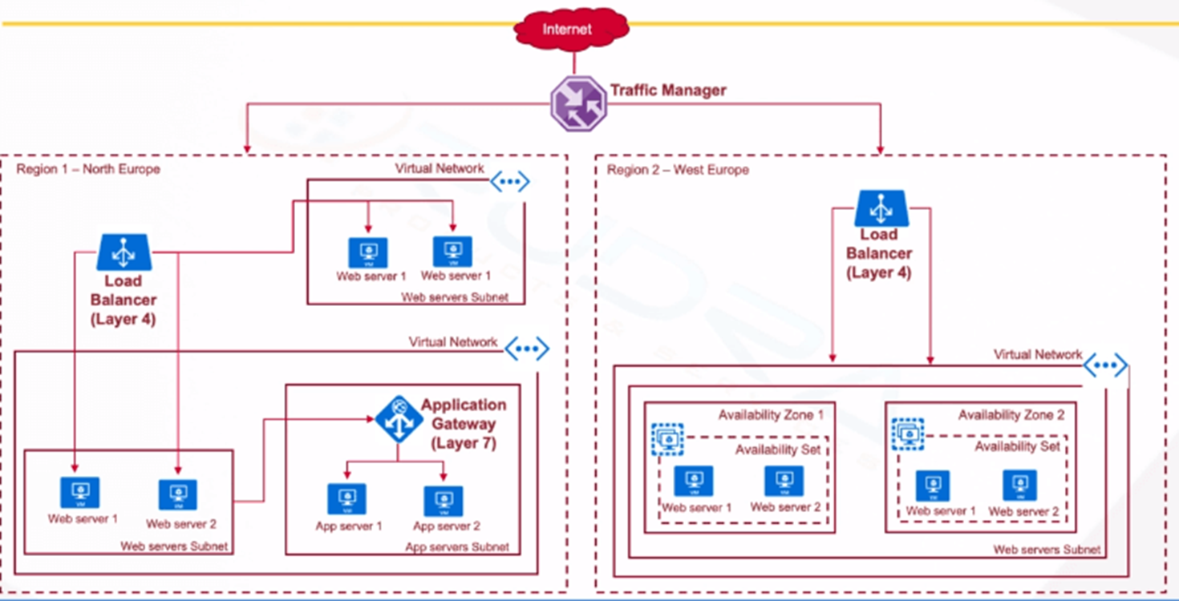
Load Balancer
A load balancer is a Layer 4 switch.
It works at the TCP/UDP packet level.

Slide 8
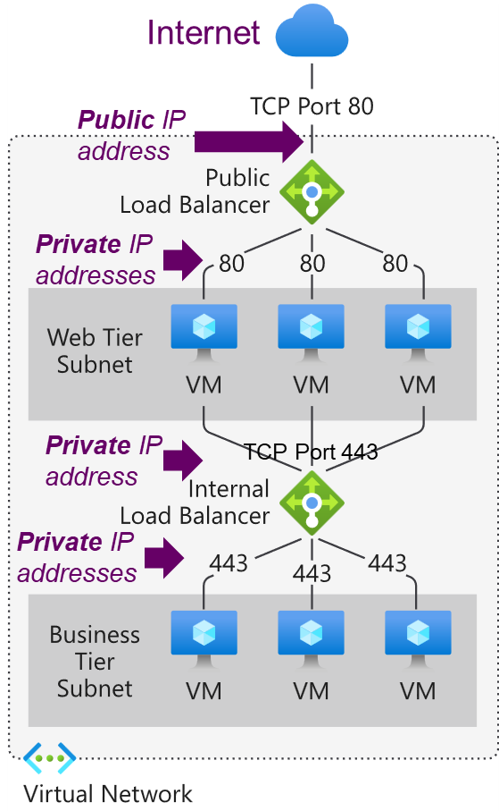
Load Balancing Techniques
Load balancing refers to evenly distributing load (incoming network traffic) across a group of backend resources or servers.
  Layer-4: uses <ip-address>:<port> combination for load balancing rules
A public load balancer is used to load balance inbound internet traffic to your VMs
An internal (or private) load balancer is used where private IPs are needed at the frontend only.
  Internal load balancers are used to load balance traffic inside a virtual network.
Notes:
Note: internally the traffic does not have to be web traffic. Obviously, a public load balancer is connected to a public IP address on the Internet and receives web traffic.

Slide 9
Load Balancing Techniques
Static vs Dynamic: fixed rules vs server selection based on current traffic & loading.
Round robin: a “taking it turns” approach, choosing each server in the pool in some sequence that distributes the load equally between them in rotation e.g. a circular list
IP hash: select servers based on a has on the incoming traffics source and destination IP addresses
Cooperative: distributed nodes work together to achieve a common LB decision. Provides a Pareto-optimal response time and also guarantee the fairness of the resource allocation to all the jobs, such that the jobs obtain the same response time independent of the allocated computer.
https://kemptechnologies.com/load-balancer/load-balancing-algorithms-techniques
https://www.researchgate.net/publication/229455409_Cooperative_load_balancing_in_distributed_systems
https://www.cloudflare.com/en-gb/learning/performance/types-of-load-balancing-algorithms/

Slide 10
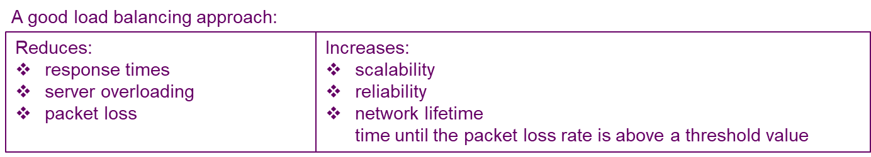
Load Balancing Techniques
Least connections: pass load to servers with the least number of current (aka active or outstanding) connections.
Least connections + response time: as least connections but also use the average response time of each server. By sending traffic to the servers with the quickest response time, the algorithm ensures the fastest service for user.
Response-based: requires “agent” software running on each VM to measure servers resource usage such as CPU and memory.
Weighted: LB algorithms can be combined with weighting, so that more powerful servers are given a higher weighting and process more of the load.

Slide 11
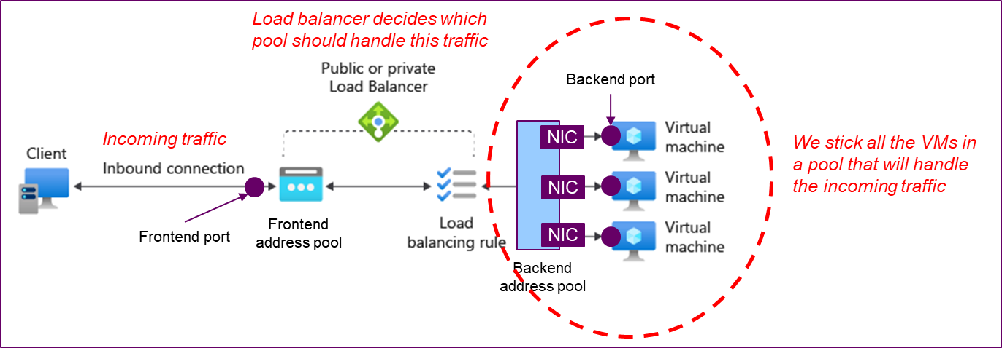
Load Balancing Components
Frontend IP Address Pool: you can specify a number of frontend IP addresses, either public or private.
Load Balancing Rule: a rule connecting a <frontend IP + frontend port> to a <backend pool + backend port>.
Backend Address Pool: a list of NICs for VMs which form a group able to handle traffic for the same service (backend port).

Slide 12
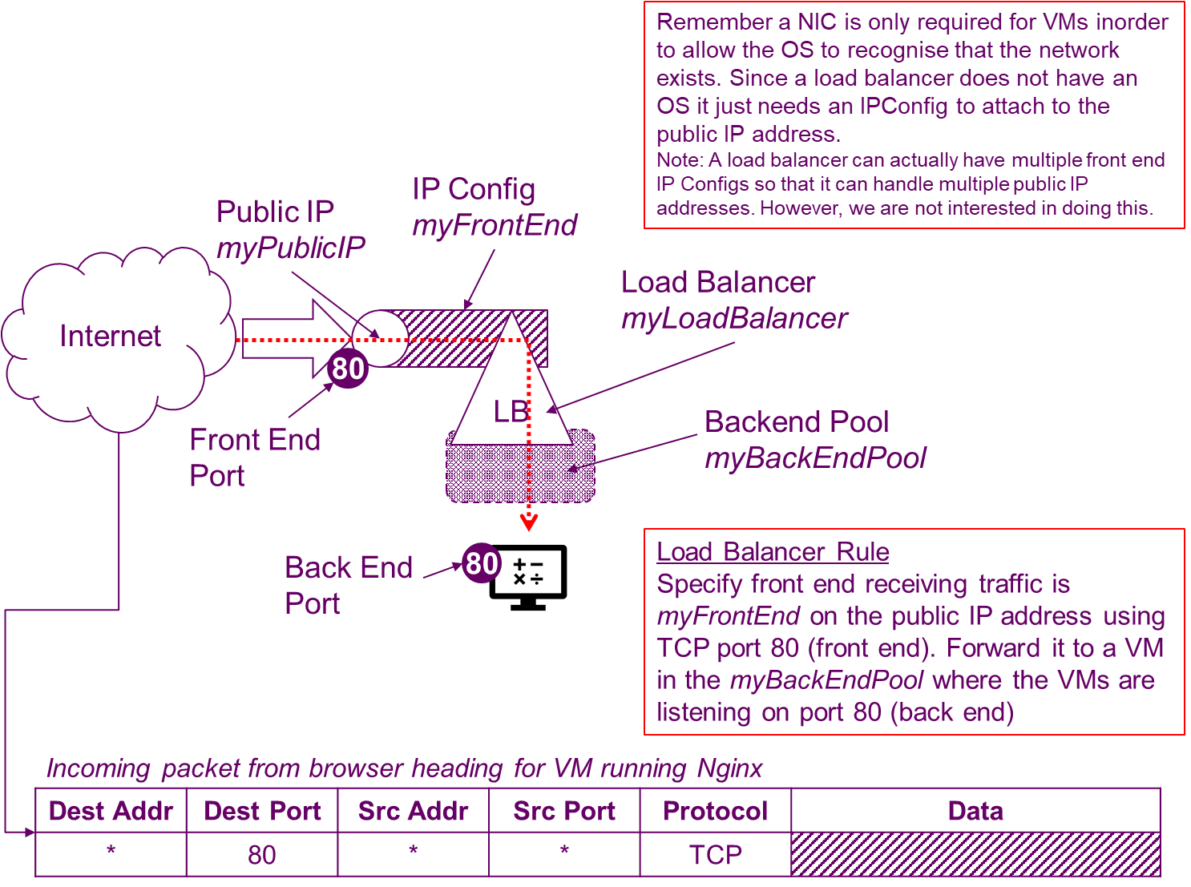
Load Balancing Components

Slide 13
Application Gateway
An Application Gateway works at the Application OSI Layer 7. Essentially it’s a Layer 7 switch for a web application.
Specifically, the “application” uses HTTP/HTTPS/WebSockets so it can inspect HTTP Request packets and route them based on HTML headers or URLs
For example, if /images is in the incoming URL, you can route traffic to a specific set of servers (known as a pool) configured for images. If /video is in the URL, that traffic is routed to another pool that's optimized for videos.

Slide 14
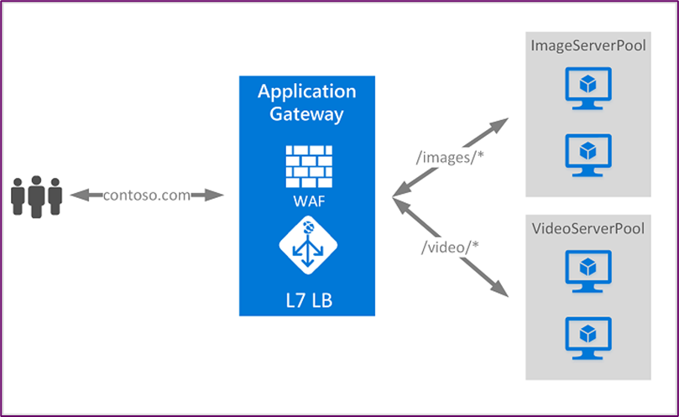
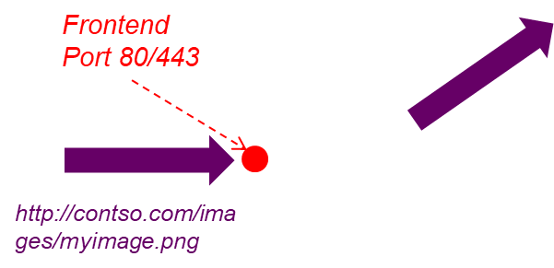
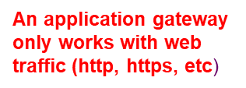
Application Gateway
For example, if /images is in the incoming URL, you can route traffic to a specific set of servers (known as a pool) configured for images. If /video is in the URL, that traffic is routed to another pool that's optimized for videos.
You can combine application gateways with load balancers# (aka network load balancers because they operate at the Network OSI Layer 4).
An AG automatically performs load balancing, so a separate load balancer is not required.
it also provides a firewall so we should pretty much always use an application gateway.

Slide 15
Application Gateway
Application Gateway operates as an application delivery controller (ADC).
It offers Transport Layer Security (TLS), previously known as Secure Sockets Layer (SSL), termination, cookie-based session affinity, round-robin load distribution, content-based routing, ability to host multiple websites, and security enhancements.
Application Gateway security enhancements include TLS policy management and end-to-end TLS support.
https://docs.microsoft.com/en-us/azure/application-gateway/overview
https://docs.microsoft.com/en-us/azure/application-gateway/application-gateway-components

Slide 16
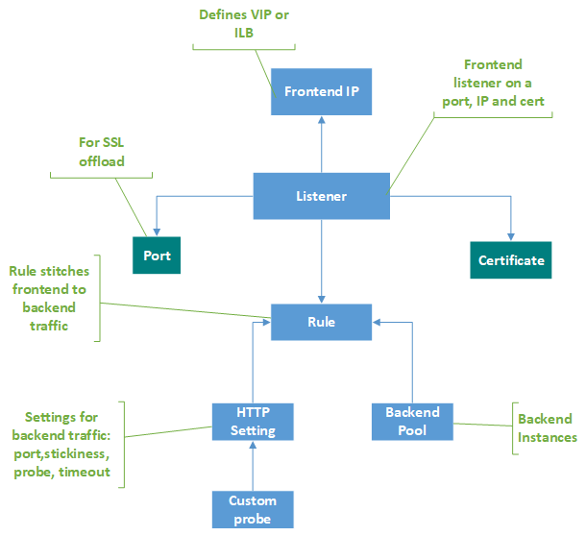
Application Gateway Components
Frontend IP: a list of one or more public and private IP addresses.
Your virtual network and public IP address must be in the same location as your application gateway.
Listener: A listener is a logical entity that checks for incoming connection requests. A listener accepts a request if the protocol, port, hostname, and IP address associated with the request match the same elements associated with the listener configuration. An application Gateway requires at least one listener.

Slide 17
Application Gateway Components
Request Routing Rule: determines how to route traffic on the listener. The rule binds the listener, the back-end server pool, and the backend HTTP settings. Forwards the request to the backend or redirects it elsewhere.
  Defines which backend server pool to forward it to.
  One listener can be attached to one rule
HTTP Settings: The port and protocol used in the HTTP settings determine whether the traffic between the application gateway and backend servers is encrypted (providing end-to-end TLS) or unencrypted. Also provides cookie-based session affinity.

Slide 18
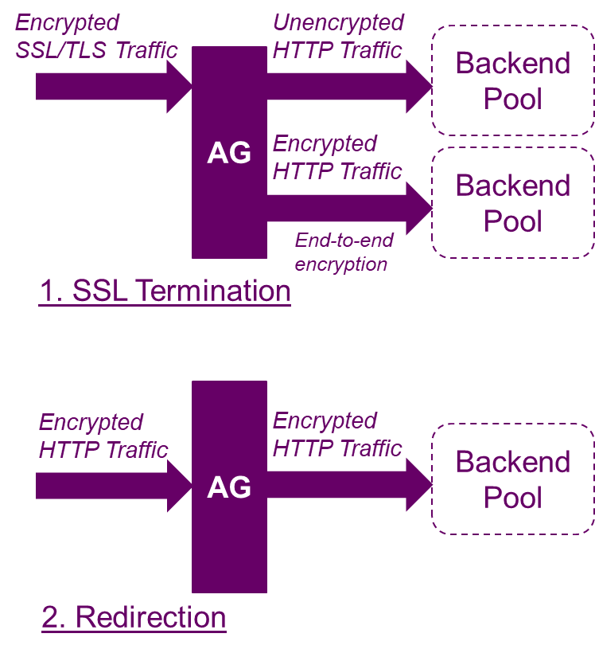
Application Gateway Features
AG terminates encrypted traffic and passes unencrypted traffic to the backend pool OR end-to-end encryption
Redirection: A common scenario for many web applications is to support automatic HTTP to HTTPS redirection to ensure all communication between an application and its users occurs over an encrypted path.
AG v2 supports:
  Autoscaling
  Zone redundancy
  Static virtual IP address (does not change over lifetime of AG)
  Use Application Gateway as the ingress for an Azure Kubernetes Service (AKS) cluster.

Slide 19
Application Gateway Features
Web Application Firewall (WAF) is a service that provides centralized protection of your web applications from common exploits and vulnerabilities
URL Path Based Routing allows you to route traffic to back-end server pools based on URL Paths of the request.
Multiple-site hosting for routing based on host name or domain name for more than one web application on the same application gateway

Slide 20
Application Gateway Features
Session affinity#: keep a user session on the same server. By using gateway-managed cookies, the Application Gateway can direct subsequent traffic from a user session to the same server for processing
Connection draining helps you achieve graceful removal of backend pool members during planned service updates. Ensures all deregistering instances of a backend pool don't receive any new request while allowing existing requests to complete within a configured time limit

Slide 21
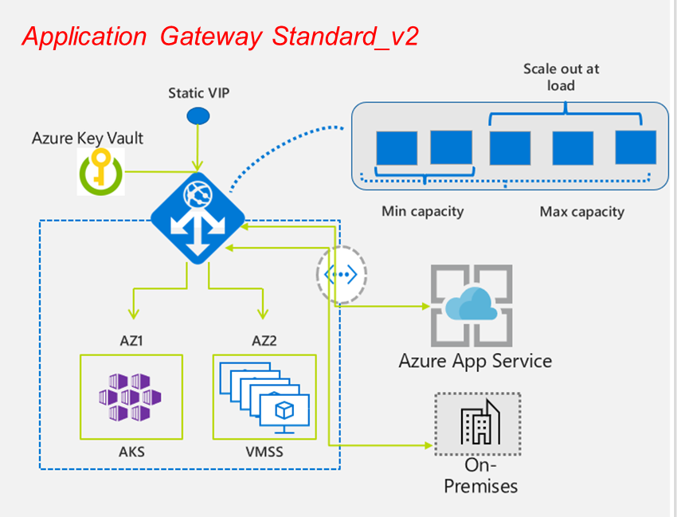
Application Gateway Features
Custom error pages.
HTTP header rewriting. HTTP headers allow the client and server to pass additional information with the request or the response.

Slide 22
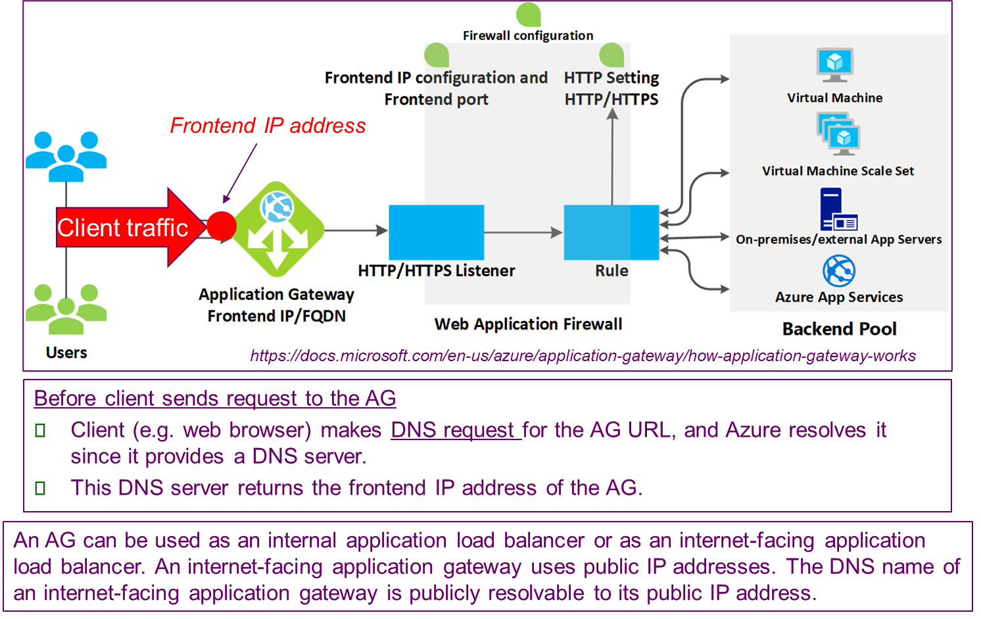
How AG Works

Slide 23
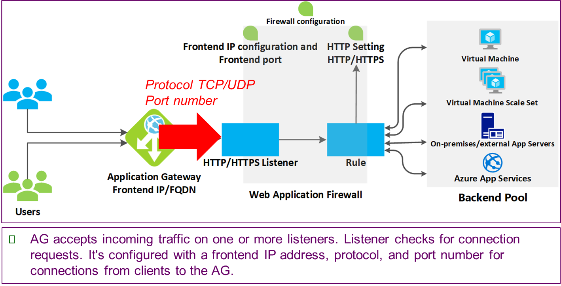
How AG Works

Slide 24
How AG Works

Slide 25
How AG Works

Slide 26
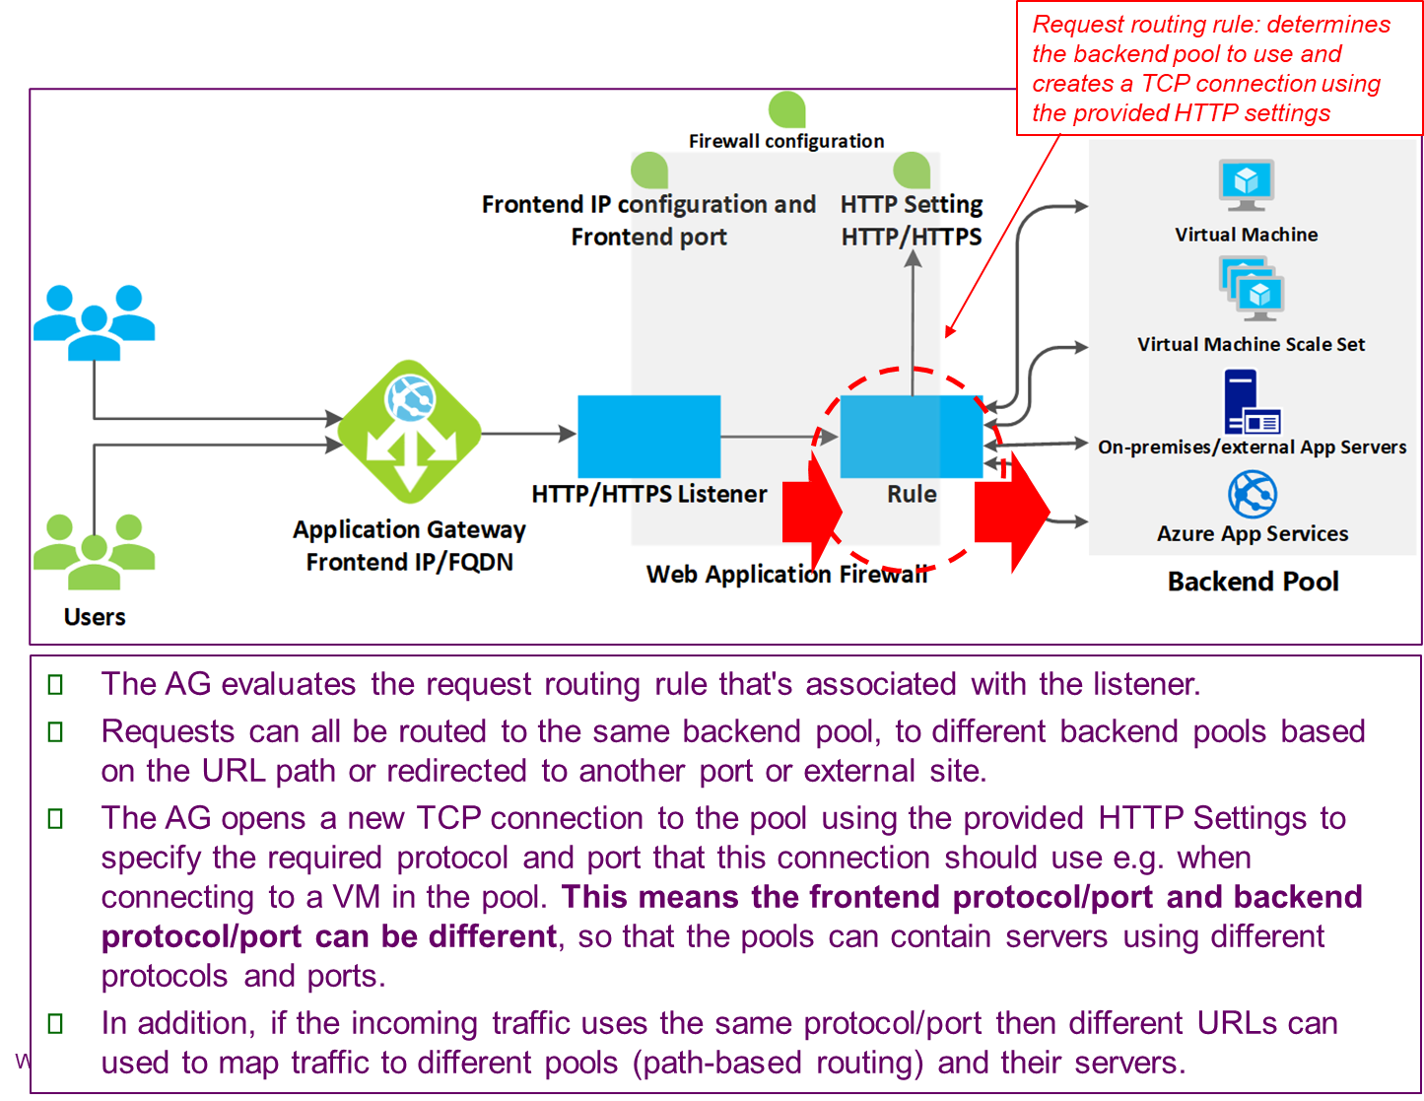
How AG Works

Slide 27
How AG Works

Slide 28
Default Load Balancer
When the application gateway selects the backend pool, it sends the request to one of the healthy backend servers in the pool.
The health of the server is determined by a health probe.
If the backend pool contains multiple servers, the application gateway uses a round-robin algorithm to route the requests between healthy servers.
This load balances the requests on the servers.

Slide 29
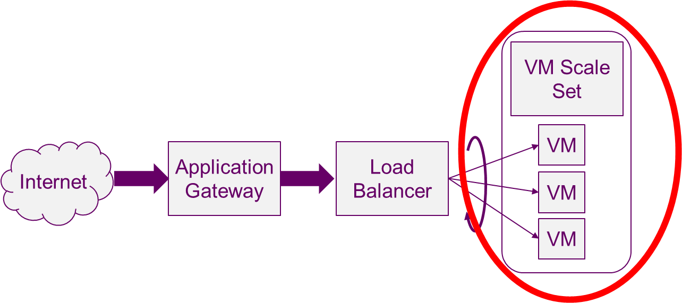
Scaling
Scalability in cloud computing refers to the ability to increase or decrease IT resources as needed to meet changing demand.
Scalability is one of the hallmarks of the cloud.

Slide 30
Virtual Machine Scale Set (VMSS)
Azure virtual machine scale sets let you create and manage a group of load balanced VMs.
  The number of VM instances can automatically increase or decrease in response to demand or a defined schedule.
The image is identical for each VM since the VMSS creates the VMs for us. The VMSS is used to spin up more VMs to handle the increase in traffic for the service we are providing.
Scale sets provide high availability to your applications, and allow you to centrally manage, configure, and update a large number of VMs.
You can build large-scale services for areas such as compute, big data, and container workloads.

Slide 31
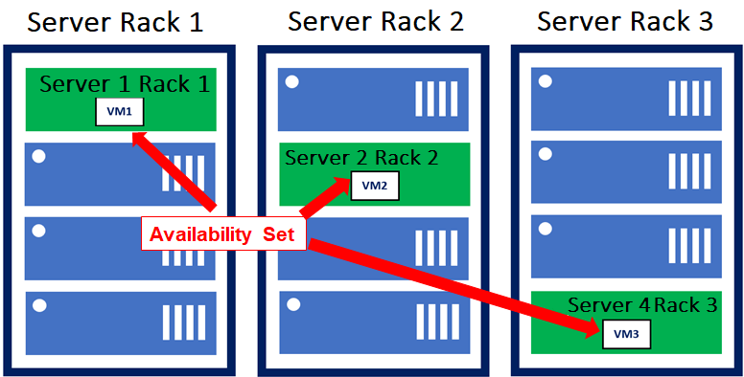
Virtual Machine Scale Set (VMSS)
Availability Sets allow us to group VMs so that Azure recognises they are offering redundancy, and to keep each VM copy isolated with separate physical servers, compute racks, storage units and network switches.
BUT within a single datacentre within an Azure Region.
AvailabilitySets are no longer recommended but they introduce some useful concepts we should know!!
https://adamtheautomator.com/azure-availability-sets/

Slide 32
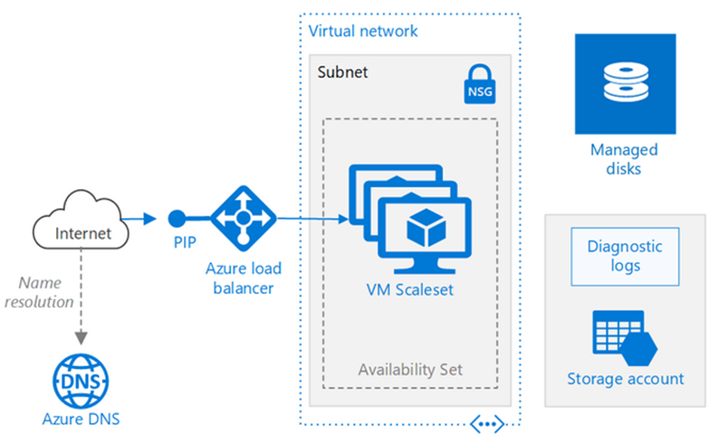
Virtual Machine Scale Set (VMSS)
A load balancer and scale set work hand-in-hand.
Traffic at the public IP is balanced over the VMs in the Scale Set by the Load Balancer.
Manually Scale
Automatically Scale

Slide 33
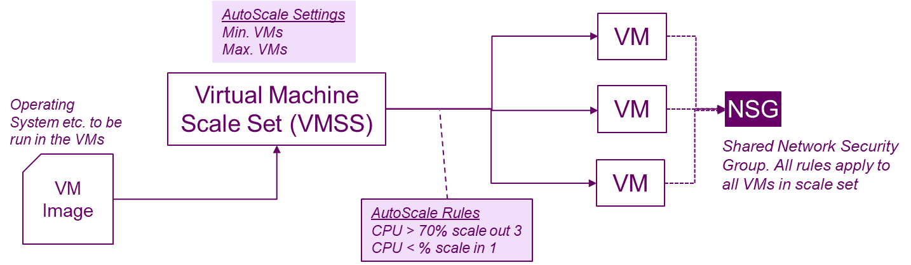
Virtual Machine Scale Set (VMSS)
Monitor VMs performance such as the average CPU load
Create and deallocate VMs as the load increases and decreases
Specify auto scaling rules to determine when to scale out and when to scale in
Example: Autoscale out by 3 instances if the average CPU load is greater than 70% over a 5-minute period

