Slide 1
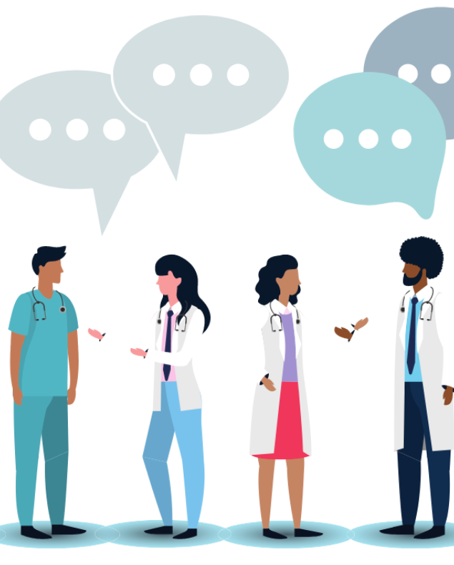
Communication
Professional Development within Health & Social Care
Nadeem Ashraf
Student ID: 2433627
Notes:
Good morning, my name is Nadeem Ashraf.
In this presentation I will talk about communication
I will explain what communication means
the main types of communication
why it is important in health and social care
I will describe the Shannon Weaver model
And finally I will give some practical examples of communication

Slide 2
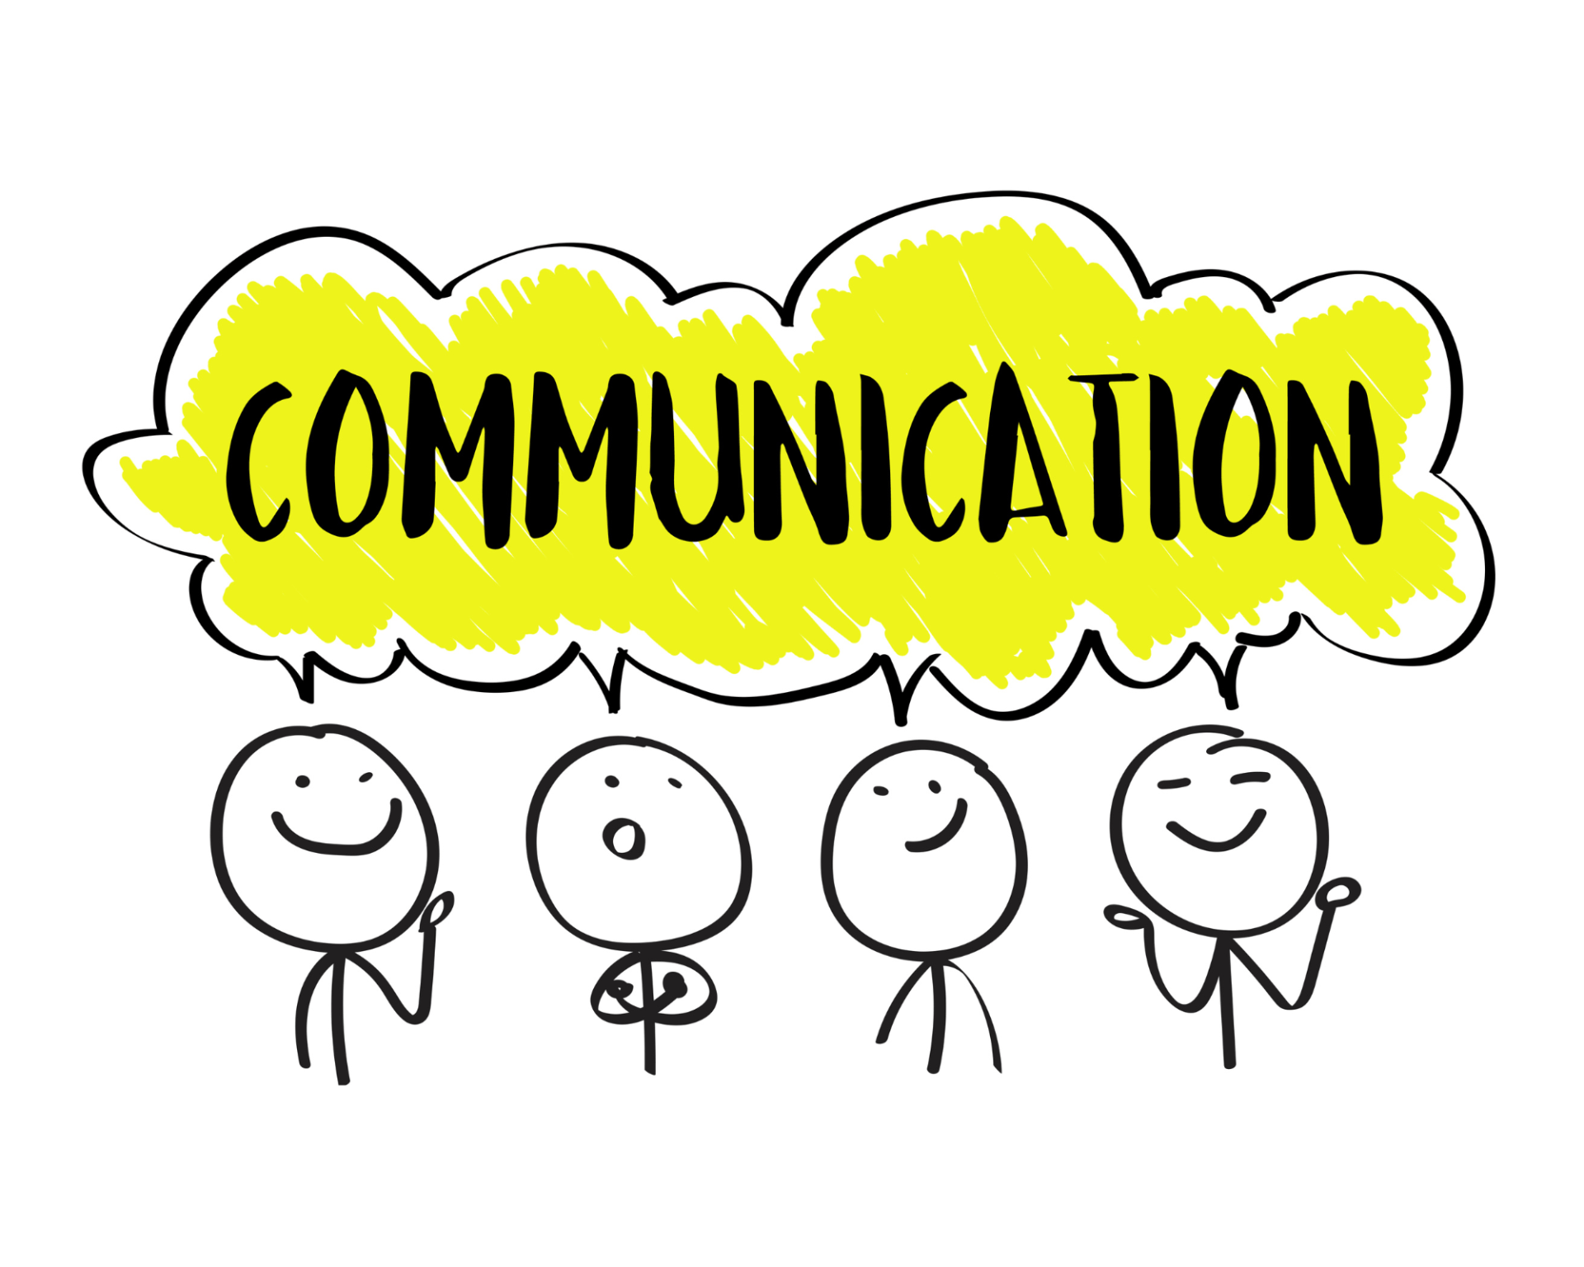
What does communication mean?
The act of sharing or exchanging information
By using various methods, such as:
• Speech
• Sounds
• Actions
• Writing
• Behaviour
(Webster, 2025)
Among many others…
(Cooper, 2023)
Notes:
Communication can be defined in many ways.
It is the process of sharing information from one person to another.
using speech, actions, body language and many other examples
In health and social care, communication should be strong and clear for the patient or colleague

Slide 3
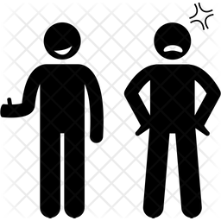

What are the two main Types of communication?
Non-verbal
eg: body language, eye contact, facial expressions, tone of voice
Verbal
eg: oral, written
(Masterclass, 2020)
Notes:
There are two main types of communication
Verbal includes speech and written communication – for example talking to a patient or writing medical documents
Non-verbal communication includes body language, eye contact, facial expressions, and tone of voice

Slide 4
Why is communication important in health & social care?
How you communicate makes a big difference in professional practice
Good communication is essential to build trust, share information and provide high quality care to patients
Communication is also necessary between all healthcare professionals to maintain a safe, organised and effective service for the public
Without clear communication, misunderstandings and errors can occur which can negatively impact patients and cause them harm or distress. It can also cause difficulties for colleagues
(Casper, 2025)
Notes:
Clear communication is very important in health and social care for many reasons.
Firstly, it improves patient safety and reduces risk of misunderstandings and errors
It also improves teamwork and builds trust between patients and colleagues.
Without clear communication, mistakes can happen which cause harm to others

Slide 5
Shannon-Weaver model of communication (1948)
Sender → Encoder → Channel → Decoder → Receiver
How the message is sent eg speech or text or body language
The person receiving the message
The person who wants to communicate a message
How the person receiving the message is interpreting the message
Turning thoughts into words
(Communication theory, 2024)
Notes:
The Shannon weaver model explains the process of communication with 5 main parts
First, the sender is the person who wants to communicate a message.
Second is the encoder where thoughts are turned into words or symbols.
Then the channel is how the message is sent, for example through speech
The decoder is interpretating of the message by the receiver.
Finally the receiver is the person who gets the message.

Slide 6
Example 1 – a patient with hearing difficulties
Scenario: An elderly patient is struggling to hear instructions during an appointment.
What I would do:
  Face the patient so they can see my lips and facial expressions
  Speak clearly and slowly (do not shout)
  Use simple language and short sentences
  Write important information down if needed
  Check their understanding by asking them to repeat key points
Why this helps:
It makes communication clear, respectful, and reduces misunderstanding.
Notes:
Example 1 - In this scenario, a patient is struggling to hear during an appointment
To improve communication, I would face the patient so they can see my lips and expressions.
I would speak clearly and slowly, but not shout, because that can be disrespectful
I would use simple language and write down information
Finally, I would check their understanding by asking them to repeat key points
This makes communication clear and respectful

Slide 7
Example 2 – a patient who is scared & anxious
Scenario: A patient looks anxious before a blood test and says they are scared.
What I would do:
  Speak in a calm, reassuring tone
  Acknowledge their feelings (e.g. “I understand this might seem scary”)
  Explain what will happen step by step using simple language
  Listen to their questions without interrupting
  Offer reassurance and support
  Use open body language and maintain appropriate eye contact
Why this helps:
It helps reduce fear, builds trust, and allows the patient to feel safe and supported.
Notes:
In example 2 - a patient is anxious before a blood test.
I would speak calmly, listen and offer support.
I would acknowledge their feelings and say: ‘I understand this might seem scary.’
I would explain the procedure using simple language.
I would use open body language and eye contact.
This builds trust, and makes the patient feel supported.

Slide 8
references
Communication Theory (2024). Shannon and Weaver Model of Communication. [online] Communication Theory. Available at: https://www.communicationtheory.org/shannon-and-weaver-model-of-communication/ [Accessed 7 February 2026].
Cooper, N. (2023). Different Communication Methods: How You Can Learn to Communicate Better. [online] NCC Blog. Available at: https://www.ncchomelearning.co.uk/blog/different-communication-methods/ [Accessed 7 February 2026].
Ebrary. (n.d.). The Shannon and Weaver Transmission Model. [online] Available at: https://ebrary.net/71372/education/shannon_weaver_transmission_model [Accessed 7 February 2026].
Health, M. and Casper, L. (2025). The Role of Communication in Health and Social Care: Why It Matters. [online] Institute of Mental Health. Available at: https://iomh.co.uk/the-role-of-communication-in-health-and-social-care-why-it-matters/ [Accessed 28 January 2026].
MasterClass. (2020). Verbal vs. Nonverbal Communication Explained - 2024 - MasterClass. [online] Available at: https://www.masterclass.com/articles/verbal-vs-nonverbal-communication [Accessed 28 January 2026].
Merriam Webster (2025). Definition of communication. [online] Merriam-Webster. Available at: https://www.merriam-webster.com/dictionary/communication [Accessed 28 January 2026].
Notes:
To conclude, communication is an important skill in health and social care.
Good communication increases trust, safety, and quality of care.
Thank you for listening.

