Slide 1

Oak Study Cafe Ltd
Program: Business Skills for Workplace
Module: LCLM4006 Enterprise & Entrepreneurship
Assignment: Business Plan Presentation
Lecturer: Dr Fouziya Farheen
Student: Foad Rabia Abdulaziz Fayyad
Student ID: 2432992

Slide 2

Overview of the Business Idea
Business Concept and Offering
The proposed venture is a multicultural student cafe located in Selly Oak, Birmingham, an area known for its large student population due to its proximity to the University of Birmingham. The primary objective of the cafe is to create an inclusive and comfortable environment where students can study, socialize, and enjoy culturally diverse food and beverages at affordable prices.
The cafe will operate seven days per week from 8:00 AM to 10:00 PM, providing a flexible space for students throughout the day. The product offering will prioritize quality and authenticity rather than offering an excessively large menu.

Slide 3

Products and Market Environment
The cafe will offer a variety of premium specialty coffee options, including espresso, cappuccino, latte, Arabic coffee, and Turkish coffee. In addition, the food menu will reflect Middle Eastern, Asian, and British culinary influences, including pastries, light meals, vegetarian options, and halal selections.
The UK hospitality sector remains an important contributor to small business growth (Department for Business and Trade, 2024). Furthermore, Birmingham is recognized as one of the most culturally diverse cities in the UK (ONS, 2023), which supports the demand for multicultural dining experiences and creates a favorable environment for this type of business.
In addition to food and beverages, the café will provide high-speed Wi-Fi, charging points, quiet study zones, and collaborative seating areas, allowing students to use the café as both a social and academic space.

Slide 4
Entrepreneurial Opportunity and Unique Selling Proposition
Entrepreneurial success depends on identifying unmet market needs and delivering differentiated value (Burns, 2020). Many cafés in Selly Oak focus mainly on standardized products and high customer turnover, while very few provide culturally diverse menus combined with structured study environments designed specifically for students.
The unique selling proposition (USP) of the proposed café integrates three key elements:
• Multicultural cuisine
• Premium specialty coffee
• Dedicated student study space
•This positioning creates a clear point of differentiation and reduces direct price competition with traditional coffee chains. In addition, consumer behavior research suggests that modern customers increasingly value experiential offerings alongside product quality (Kotler and Keller, 2020). By combining both social and academic value, the café encourages stronger customer engagement and repeat visits.

Slide 5
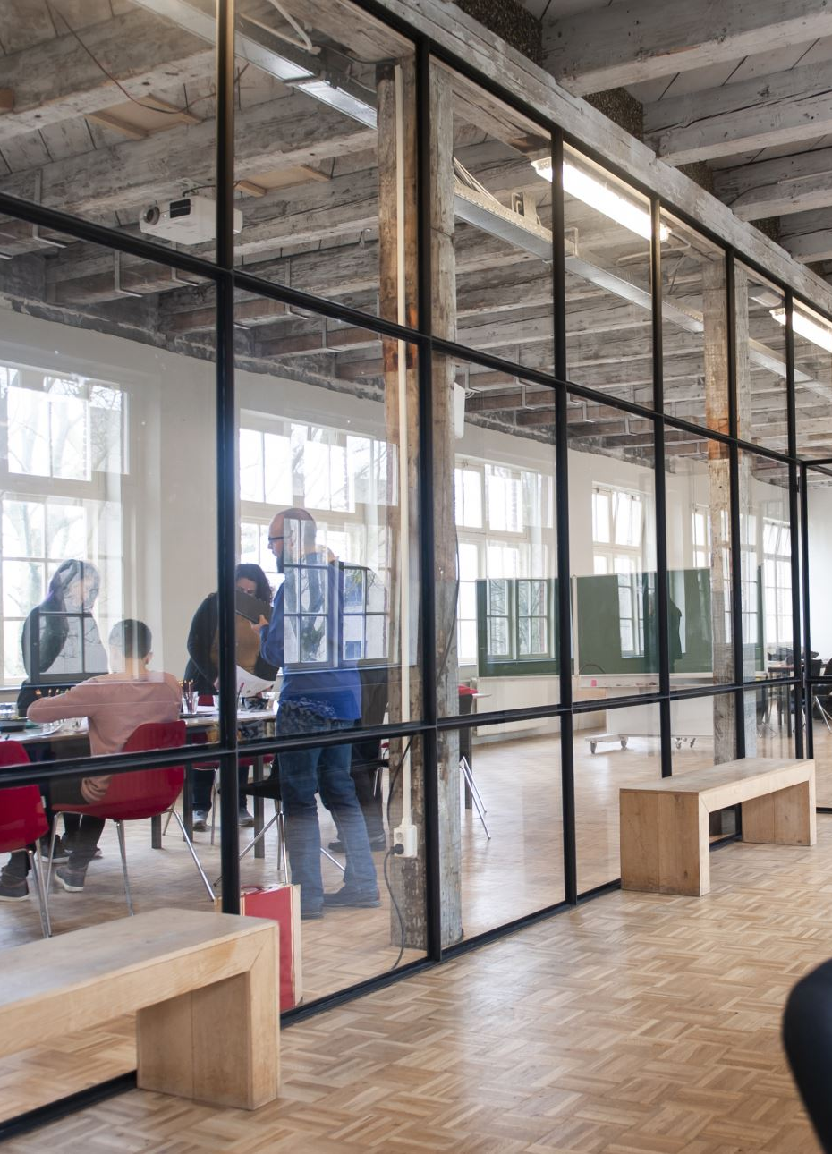
Legal Format and Management Structure
Legal Structure
Oak Study Cafe Ltd will operate as a Private Limited Company (Ltd). A Private Limited Company is a separate legal entity in which the liability of shareholders is limited to the amount they invest in the business (Scarborough, 2021). This legal structure is suitable for the café because it offers several important advantages.
Firstly, it protects the owner’s personal assets from business liabilities, reducing financial risk. Secondly, operating as a limited company enhances the credibility of the business with lenders, suppliers, and potential investors. In addition, the Ltd structure allows the business to expand more easily in the future while maintaining a clear separation between personal and business finances.
Management Structure
The cafe will adopt a relatively simple and flexible organizational structure to ensure effective communication and efficient operations during the early stages of the business.
The Owner or Founder will be responsible for strategic planning and financial management. A Cafe Manager will oversee the daily operations of the café and supervise staff. The team will also include Baristas, who will prepare beverages and coffee products, Kitchen Staff responsible for food preparation, and Service Staff who will ensure high levels of customer service and a positive customer experience.
A flexible management structure is particularly important for start-up businesses because it allows faster decision-making and operational efficiency (Burns, 2020).

Slide 6
Key External Factors – PESTEL
Factor | Impact
Political | The UK provides a stable political environment supportive of small business development. However, hospitality businesses must comply with Food Standards Agency regulations (FSA, 2023). Changes in National Minimum Wage legislation may increase labour costs (UK Government, 2024).
Economic | Inflation and rising living costs influence student disposable income (ONS, 2024). Nevertheless, the UK coffee shop market continues to demonstrate resilience, particularly in urban student locations (Statista, 2024).
Social | Birmingham’s multicultural demographic profile supports demand for diverse food concepts (ONS, 2023). Students increasingly prefer flexible social learning spaces outside traditional libraries.
Technological | Digital payments, online marketing, and social media engagement are essential for modern hospitality businesses (Kotler and Keller, 2020). Free Wi-Fi is considered a basic expectation among student customers.
Environmental | Sustainability awareness among young consumers continues to increase. The café will use recyclable packaging and implement waste-reduction practices in line with UK environmental guidance (UK Government, 2023).
Legal | Compliance with employment law, health and safety regulations, food hygiene standards, and data protection requirements is mandatory (FSA, 2023).

Slide 7
SWOT ANALYSIS
The SWOT framework evaluates internal capabilities and external risks (Johnson et al., 2020).
Strengths | Weaknesses | Opportunities | Threats
The cafe benefits from a differentiated multicultural concept and strategic student-focused location. The hybrid study-hospitality model increases customer dwell time and potential spending. | As a new entrant, the business lacks brand recognition. It is also highly dependent on student demand, which may fluctuate seasonally. Initial capital requirements create financial exposure. | Growing demand for multicultural dining presents expansion potential. Partnerships with university societies and delivery platforms could generate additional revenue streams. Sustainability initiatives may strengthen brand image. | Strong competition from established coffee chains remains the primary threat. Inflation and rising supplier costs may reduce profit margins (ONS, 2024). Wage increases may also raise operating costs (UK Government, 2024).

Slide 8

6. COMPETITION ANALYSIS
Key competitors include Starbucks, Costa Coffee, and independent cafés within Selly Oak. These businesses benefit from established brand recognition and economies of scale.
However, Porter (1985) argues that focused differentiation enables smaller firms to compete effectively. By targeting the student niche and emphasizing multicultural identity, the proposed café reduces direct competitive pressure and strengthens market positioning.

Slide 9
Marketing Strategies
Social Media Marketing
- Use Instagram and TikTok to promote products and student atmosphere
- Share short videos, offers, and cafe events
Student Loyalty & Discounts
- 10% student discount
- Digital loyalty card to encourage repeat visits

Slide 10

Funding Requirements
The total start-up capital required for Oak Study Cafe Ltd is estimated at £45,000. This funding will come from two main sources: £20,000 personal investment from the owner and a £25,000 bank loan. Combining personal investment with external financing allows the business to secure the necessary capital to launch the café successfully.
The funding will be used to cover the main start-up costs of the business. These include purchasing equipment such as coffee machines and furniture, paying the rent deposit for the café premises, funding marketing activities to promote the business, and purchasing the initial inventory of food and beverages. In addition, part of the funding will be used as working capital to support daily operations during the early stages.
Advantages
This funding structure demonstrates the owner’s commitment through personal investment and provides additional financial support through the bank loan, enabling the café to cover important start-up expenses.
Disadvantages
However, the bank loan must be repaid with interest, which may create financial pressure during the early stages if the business generates lower-than-expected revenue.

Slide 11
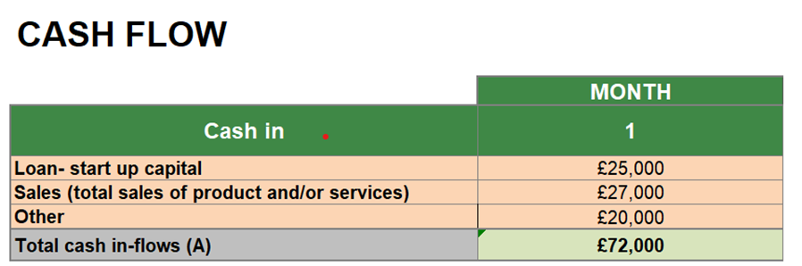
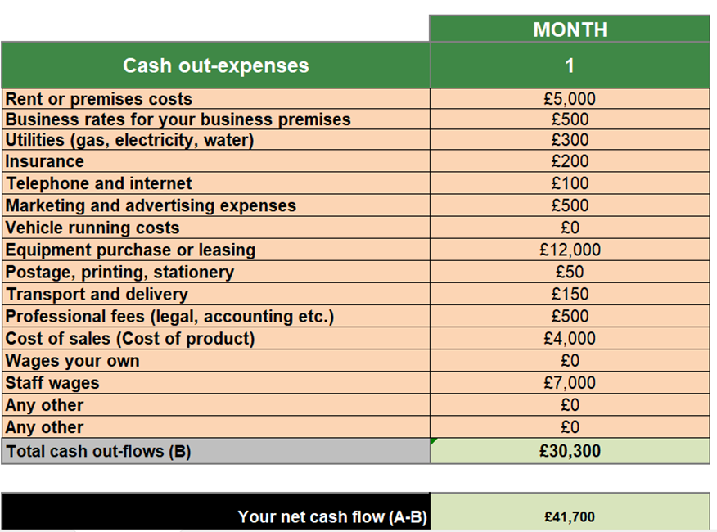
Startup Expenses and Cash Flow Forecast

Slide 12
Net Cash Flow Analysis
The net cash flow of the business is calculated by subtracting the total cash outflows from the total cash inflows.
Net Cash Flow = A – B
£72,000 – £30,300 = £41,700
The opening balance at the beginning of the period is £0, as the business is in the start-up phase. After accounting for all projected inflows and outflows, the closing balance is expected to be £41,700.
This positive closing balance indicates that the business is financially viable and demonstrates strong short-term liquidity. It also suggests that the cafe will have sufficient financial resources to support its initial operations and manage early-stage expenses.

Slide 13

Risk Management and Future Growth
The long-term sustainability of the Student Multicultural Cafe will depend on effective risk management and the ability to adapt to changing market conditions. One potential risk is the seasonal fluctuation in student demand, particularly during university holiday periods when footfall in Selly Oak may decline. This reduction in student presence could lead to lower customer traffic and reduced sales for the cafe.
To mitigate this risk, the business will implement flexible staffing schedules during quieter periods in order to control labor costs. In addition, promotional offers and marketing campaigns will be introduced to attract local residents and customers from the surrounding community. These strategies will help maintain a stable level of revenue even during periods when student demand is lower.
Another operational risk relates to rising supplier and utility costs, which could reduce profit margins over time. The business will address this challenge by establishing long-term relationships with reliable suppliers to ensure stable pricing and consistent product quality. The café will also regularly review its pricing strategies to protect profitability while remaining competitive in the local market. Maintaining strict control over inventory management and labour costs will also be essential during the early stages of operation.
From a growth perspective, the café has strong potential to expand its revenue streams through partnerships with university societies, themed cultural events, and possible collaboration with food delivery platforms. As brand recognition increases, there may also be opportunities to replicate the business model in other student-dense areas within Birmingham. By combining proactive risk management with gradual expansion strategies, the business can strengthen its resilience and support sustainable long-term growth.

Slide 14

Conclusion
In conclusion, Oak Study Cafe Ltd represents a unique and promising business opportunity within the Selly Oak area of Birmingham. The café aims to provide a multicultural dining experience combined with a comfortable study-friendly environment designed specifically for university students.
By offering premium specialty coffee, culturally diverse food options, and dedicated study facilities, the café differentiates itself from traditional coffee chains operating in the area. The strategic location in a student-dense area, together with effective marketing strategies and a clear financial plan, provides strong potential for attracting a stable customer base.
Furthermore, the financial projections indicate positive cash flow and operational feasibility during the early stages of the business. With appropriate risk management strategies and opportunities for future expansion, the café has the potential to grow and establish a strong presence within the local student community.
Overall, the Student Multicultural Cafe demonstrates strong potential for sustainable long term growth while also creating social and economic value by providing a supportive study environment for students, promoting multicultural food experiences, and contributing to local business development.

