Slide 1


THE YEAR OF MYTHS AND LEGENDS
TOURISM AND EVENTS IN WALES
JACQUI JONES
PROGRAMME DIRECTOR
TOURISM, HOSPITALITY AND EVENTS
UNIVERSITY OF WALES TRINITY ST DAVID
Notes:
Croeso – Welcome in Welsh

Slide 2
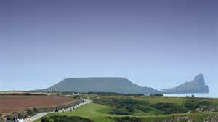
WALES
“There isn’t another country we know that offers such a range of attractions from Castles and Museums through to our world recognised beaches”
Lord Bourne (2015) Minister of State for Wales,
Former Dean of Faculty at University of Wales Trinity David

Slide 3
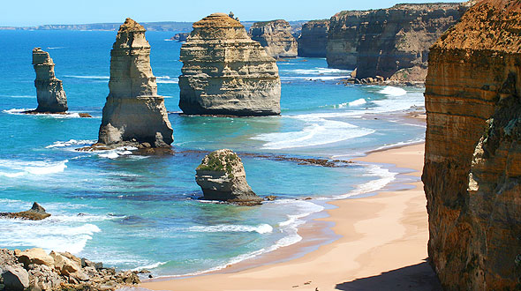
Tourism Strategy 2013-2020
Brand Wales
Increase Tourism Turnover by 20% by 2020
Increase Tourism Employment from 88,000 in 2011 to 106,000+ by 2020
Mood Marketing
Key Markets –Ireland, Germany and UK
International Developments
Cruise Industry
Future Issues
Limited connectivity, air capacity and impacts of Severn Bridge Toll
Notes:
In 2013 Wales launched a new strategy for growth for tourism and events. The strategy was based on mood marketing to address tourism issues.
Seaside tourism had thrived in Wales in 1930’s-1980’s but the seaside resorts were hard hit by British tourist chosing cheaper holidays abroad where they were guaranteed sunshine. The economic recession of 2007/8 promised an increase in visitors due to the higher costs of travelling overseas and the impacts of higher unemployment and wage cuts – this was known as Staycation where it was expected that tourist would stay at home and the UK tourism would thrive.
In reality this did not happen as UK was seen as the destination for 2nd holidays, short breaks and expensive compared to cheaper overseas destinations where the sun shines. The 1st cut backs tourists made were the 2nd holidays and short breaks and so tourism to Wales fell rather than increased.
As a result Visit Wales launched a new campaign to market brand Wales with a strategy for Growth to re launch tourism. They also identified issues effecting the nation with regard to travel connectivity, air capacity in to Wales and the bridge tolls. Numerous wet summers and poor weather conditions also encouraged tourists to go overseas on sun holidays rather than come to Wales.The growth strategy was designed to address these issues and use Wales’ strengths to market it as a tourism destination – notably culture, heritage,scenary, events and language although some would argue language could detract tourists.

Slide 4
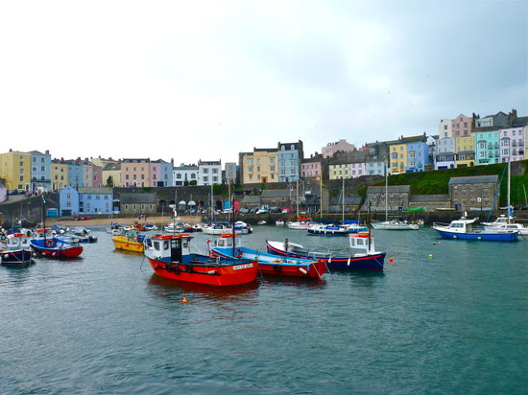
STAYCATION
IMPACTS OF TERRORISM AND RISK
CHANGING MARKETS – PARIS, TUNISIA, EGYPT, GREECE AND TURKEY
ECONOMIC CONDITIONS
SECOND HOLIDAYS
WEATHER CONDITIONS
GLAMPING AND WET WEATHER FACILITIES
BREXIT 2016
ABTA TRAVEL TRENDS
EVENTS STRATEGY – RYDER CUP 2010, OBAMA VISIT 2014,RUGBY WORLD CUP 2015
Notes:
Staycation was first considered at the start of the economic recession but became a fallacy as tourists chose to travel abroad to chase the sun and cheaper holidays. More recently as the country has come out of recession, terrorism has hit major overseas tourism destinations encouraging visitors to stay in UK to be safe. Spain which tourism trends show tourist favour has a shortage of capacity to cope with the increased visitor numbers, and in turn UK voting for Brexit (leaving the European Union) has seriously hit exchange rates. As a result in 2016 Staycation has become more of a tourism reality.

Slide 5

WALES TOURISM 2012
London 2012 Olympics – Football in Wales
854,000 overseas visitors compared to 1.1m in 2006
US visitors dropped from 168,000 in 2006 to 102,000 in 2012
European Visitors dropped from 823,000 in 2006 to 598,000 in 2012
Tourism Spend dropped from £361m in 2006 to £346m in 2012
7,000 visits made to Wales for the Olympics……….
“Events Stay Away Royal Wedding Effect”……………
Impact of Double Dip Economic Recession………….
Notes:
Olympics 2012 were expected to create a tourism boom in UK especially as Wales was hosting the football. In reality guests stayed away for fear of terrorism and overcrowding/travel problems. This created a what is known as a negative royal wedding effect with potential visitors staying away from London. Weymouth (home of sailing) and Cardiff (home of the football). This is noted in the visitor stats and was an instigator for the growth strategy to be launched to address the worrying downward trend in tourism in Wales.

Slide 6
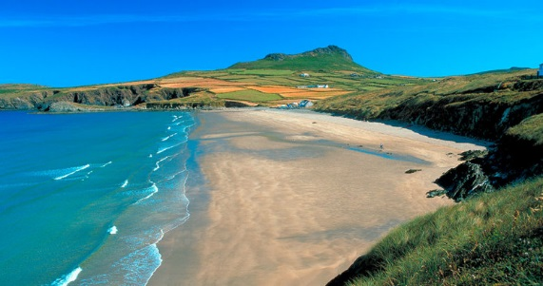
WALES TOURISM 2014
International Tourism Spend increased by 5% on 2013 to £368m
933,000 International Visitors -7% increase
Wales voted in Top 10 places to visit Rough Guides
Rhossili Beach near Swansea voted Top 10 beaches in the World
Llandudno Awarded as top UK Destination by Trip Advisor
Leaders Summit in Cardiff – Obama Visit to Celtic Manor and Cardiff Castle
Notes:
2013 recorded minor tourism increases after the Olympics however 2014 and the end of the recession accompanied by a good early summer recorded major increases in tourism to Wales. Films such as Harry Potter and Robin Hood previously being filmed in Wales increased interest in Wales. President Obama’s visit to Wales for the Summit created major international publicity for the nation and the venues of Celtic Manor and Cardiff Castle showing it’s rich heritage and reinforcing the impacts of the Ryder Cup 2010 which was hosted successfully at Celtic Manor.

Slide 7
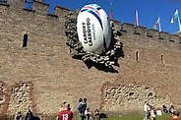
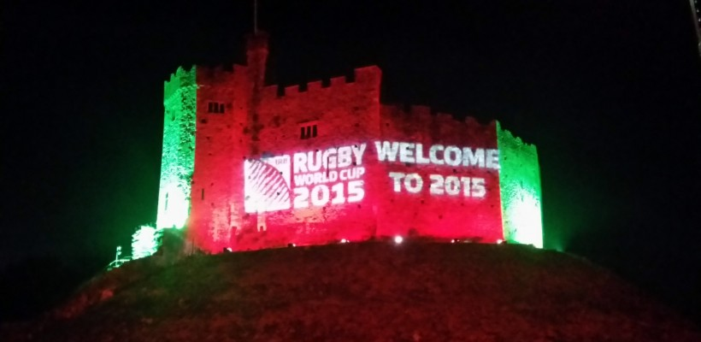
WALES TOURISM 2015
Major Tourism Boost in first 6 months
16.8m Visitors, 7% increase on 2014
£575m Tourism Spend, 41% increase on 2014
Overnight Stays £132m, increase of 19% on 2014
Rugby World Cup 2015 Cardiff – Fanzone and Ball in the Wall
Notes:
Good weather early summer again boosted tourism numbers along with the Rugby World Cup bringing in mass international tourism to Cardiff in the autumn. This had a major impact and the famous ball in the wall in Cardiff Castle was the most photographed scene on social media giving major attention to the capital city. Unfortunately poor transport logistics at the event created negative publicity for the event but this was overcome by the atmosphere in the city and it’s fan zone becoming the most popular and most successful of all the event’s fanzones.

Slide 8
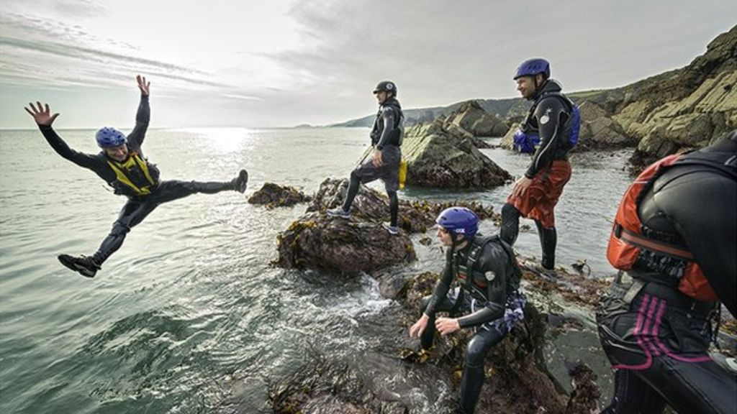
WALES TOURISM 2016
YEAR OF ADVENTURE
40% Increase in Day Visitor Spend
15% increase in International Tourism
England and Scotland recorded increases of only 2.5%
61% of International Visitors stated Historical Sites as Key reason for visiting
Attractions recorded major increased spend and visits
Staycation
Wales’ success in Euro 2016 Football created a team of heroes and legends
BUT LESS THAN 2% OF UK TOURISM SPEND IS IN WALES………..
Notes:
Visit Wales launched the Year of Adventure to publicise holidays to Wales – The campaign was a great success with major increases in visitors to attractions and destinations and accompanied byhigh trip advisor ratings. This led to 2017 being launched as year of myths and legends. The title links well to the culture. Heritage, traditions,images and languages of Wales also known for poetry and song. It was also reinforced by the massive success of the Wales football team getting through to the semi finals in their first tournament in over 60 years – this has become a legend and brought international attention to Wales including media coverage and a new film about the story.

Slide 9
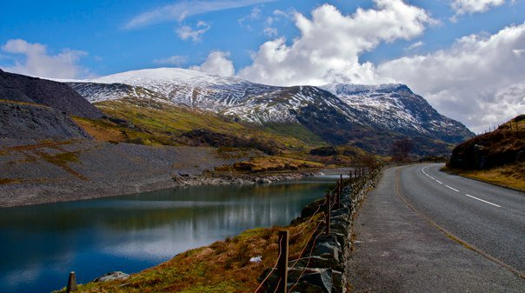
VISIT BRITAIN
Aim to attract 9m extra overseas visitors
Ensure Staycation becomes a reality
Assist Visit Wales in showcasing Wales
Historic Castles
Vibrant Cities
Spectacular Countryside
Stunning Coasts
BUT competition from England, Scotland, Ireland and Europe……..
Notes:
Visit Britain supported Visit Wales campaign however it shows the massive competition provided by England, Ireland and Scotland – their brand identities are so much stronger despite all Wales offers – Myths and Legends is therefore vital to develop a brand identity for Wales.

Slide 10
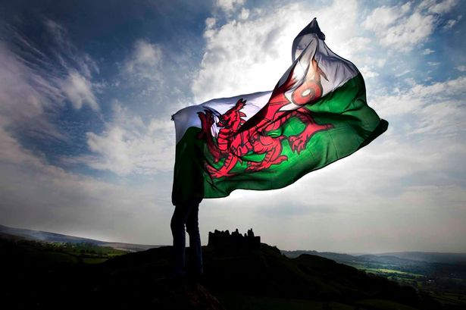
WALES TOURISM DEVELOPMENT
Develop Tourism Activity
Develop Specialist Market
Major Events
High Profile Venues
Extend Season
Promote Destination through High Quality Tourism
Funding for Infrastructure and Product Development
Training and Management Investment
Notes:
These are the targets of the Growrth Strategy but it is interesting to note that the targets do not include marketing which is perhaps at the core of the branding issues. World Travel Market was reintroduced to the Wales strategy in 2011 after much political campaigning but the event needs to be further developed to fully market Wales internationally.

Slide 11
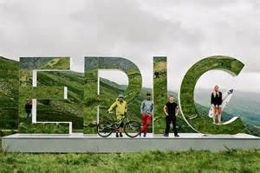
WALES TOURISM STRATEGY 2013-2020
ICONIC
HIGH QUALITY REPUTATION
CHANGING PRODUCTS AND EVENTS
MORE LUXURY BRANDED HOTELS
MORE HERITAGE HOTELS – HISTORIC & DISTINCTIVE BUILDINGS
WELL BEING FACILITIES – SPA’S
MORE YEAR ROUND ATTRACTIONS, ACTIVITIES AND CULTURAL EXPERIENCES
MORE INNOVATIVE, UNUSUAL AND DISTINCTIVE PRODUCTS
EVENTS
CRUISE TOURISM
Notes:
These are the core objectves of the Growth Strategy to create Iconic Tourism and relate to Epic Wales, and the brand image of Myths and Legends in terms of Destination Management

Slide 12

STRATEGIC AIMS
WARMEST WELCOME
OUTSTANDING QUALITY
EXCELLENT VALUE FOR MONEY
MEMORABLE, AUTHENTIC EXPERIENCE FOR EVERY VISITOR
Notes:
These are the long term aims and link to the Year of Myths and Legends and developing Brand Wales Destination

Slide 13
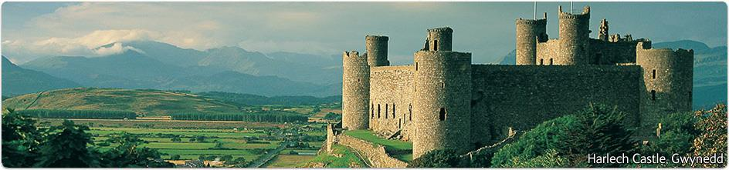
TOURISM GOALS
SUSTAINABLE TOURISM GROWTH
INCREASE TOURISMS ECONOMIC, SOCIAL AND ENVIRONMENTAL CONTRIBUTIONS
IMPACT UPON THE WELL BEING OF WALES
Notes:
This highlights the goals of the strategy and links to Myths and Legend Strategy

Slide 14
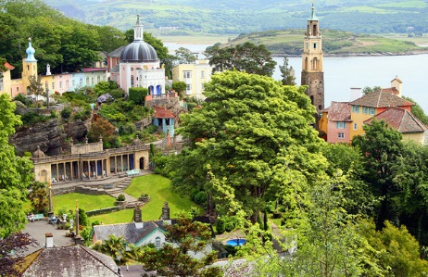
TOURISM OBJECTIVES
PROMOTE THE BRAND
DISTINCTIVE PRODUCT
SELL EXCELLENCE
PRODUCT LED – To create compelling reasons to visit Wales
TARGET EXISTING AND NEW MARKETS
COAST, RURAL, CULTURE, ACTIVITIES, EVENTS AND DISTINCTIVE DESTINATION TOURISM
Notes:
These objectives show the development of the Wales Tourism brand and this years Myths and Legends and the hoped for legacies.

Slide 15
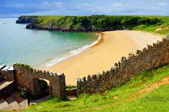
WALES TOURISM VISION
PROMOTE THE BRAND
PRODUCT DEVELOPMENT
PLACE BUILDING
PEOPLE DEVELOPMENT – Training for Customer Satisfaction
PROFITABLE PERFORMANCE – Yield Management
PARTNERSHIP FOR GROWTH
Notes:
The vision shows the development for the Growth Strategy, and the aims, objectives and legacy planning of Myths and Legends

Slide 16
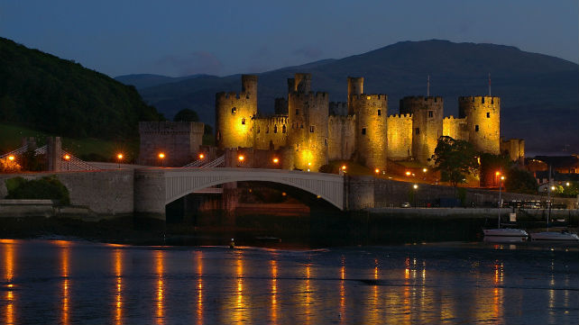
BRANDING
BRAND POSITIONING
BRAND NARRATIVE
PRODUCT LED STRATEGY
BRAND INNOVATION
PRODUCT QUALITY AND RANGE
Notes:
Branding is at the heart of Myths and Legends and the key legacy of Epic Wales Campaign,

Slide 17

YEAR OF MYTHS AND LEGENDS 2017
EPIC WALES
BRINGING THE PAST ALIVE LIKE NEVER BEFORE
HISTORY
WELSH LANGUAGE
CASTLES
MERLIN
SPORT – RUGBY AND FOOTBALL
THE LAND OF SONG
POETRY AND LITERATURE
CELEBRATE FUTURE OF WALES
INCREASE TOURISM SPEND TO £320M
INCREASE WELSH TRAVEL TRADE BY £7M
Notes:
2017 has been designated by Visit Wales as the Year of Myths and Legends . This is not just about historical myths and legends but also moderns legends in Sport and developing a legacy for a new Wales.

Slide 18
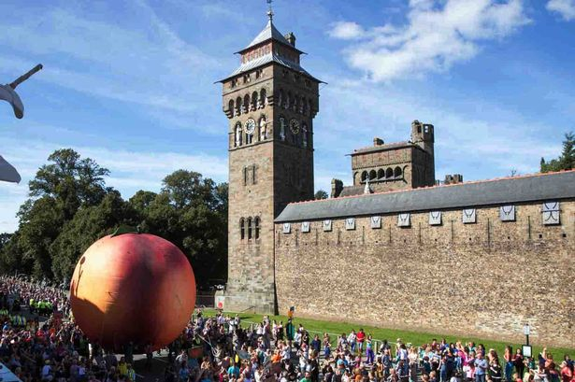
PEOPLE, PRODUCTS AND PLACES
AUTHENTIC, CREATIVE AND ALIVE
BOOST THE PROFILE OF WALES AS A TOURISM DESTINATION
RICH DISTINCT HERITAGE AND CULTURE
INSPIRE VISITORS – Yield Management
GROW WALES’ MARKET SHARE
UNCOVER AND CREATE ICONIC WELSH LEGENDS
CREATE PRIDE AND IDENTITY
DELIVER MEANINGFUL EXPERIENCES
SUSTAINABLE – Respect and Protect
Notes:
The tourism strategy relies on People, Product and Places and creating a clear destination image and brand that relies on traditions, culture and heritage as well as moderns stories and developing sustaibility for the future rather than a short term solution.

Slide 19
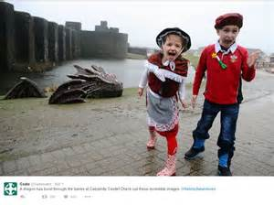
AIMS OF THE YEAR OF MYTHS LEGENDS
A PLATFORM FOR US TO TELL OUR STORY AND PROMOTE HERITAGEAND CULTURE TO THE WORLD
FOR TOURISM AND THE ARTS TO FIND A NEW AND INNOVATIVE WAY OF TELLING STORIES
BRINGING THE PAST TO LIFE LIKE NEVER BEFORE
CUTTING EDGE INNOVATIONS
CREATING AND CELEBRATING NEW WELSH LEGENDS
MODERNS DAY PERSONALITIES, PRODUCTS AND EVENTS MADE IN WALES
LONG TERM VISION
STENGTHEN AND ENHANCE CULTURE
Notes:
The aims are based on story telling and the power of inspiration, interaction and interpretation all powerful tourism marketing tools focusing on tourism development for a sustainable future.

Slide 20
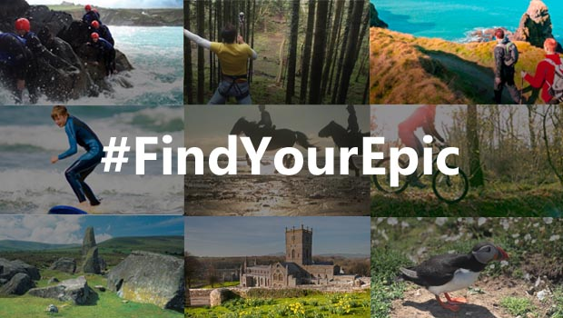
FLAG SHIP PROJECT – LAND OF EPIC
CASTLES ALIVE
FESTIVALS OF FESTIVALS
NATION OF STORY TELLING
EPIC ADVENTURE
EPIC SUMMER OF SPORTDSCAPES
LEGENDARY LANDSCAPES
LOCAL FOOD LEGENDS
POP UP EVENTS
NETWORK OF WALKING, RIDING AND DRIVING ROUTES
Notes:
Land of Epic demonstrates the flashship approach to the strategy and it’s links to Year of Adventure and Destination Management

Slide 21
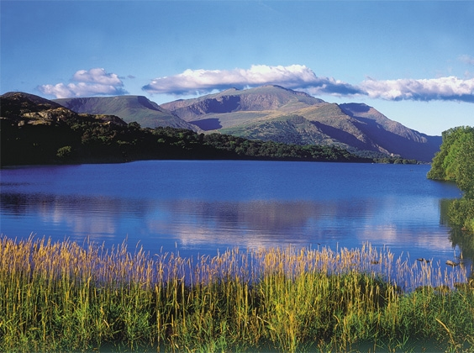
PROMOTION
HISTORIC SITES
HISTORIC MYTHS
CULTURE
LITERATURE
HISTORIC LEGENDS UEFA CHAMPIONS LEAGUE – Single biggest Sporting Event in the World in 2017
SPORTING LEGENDS – RUGBY & FOOTBALL
Notes:
Epic is promoted through history and modern culture, myths, places and legends as well as modern events that will interest all ages and nationalities

Slide 22
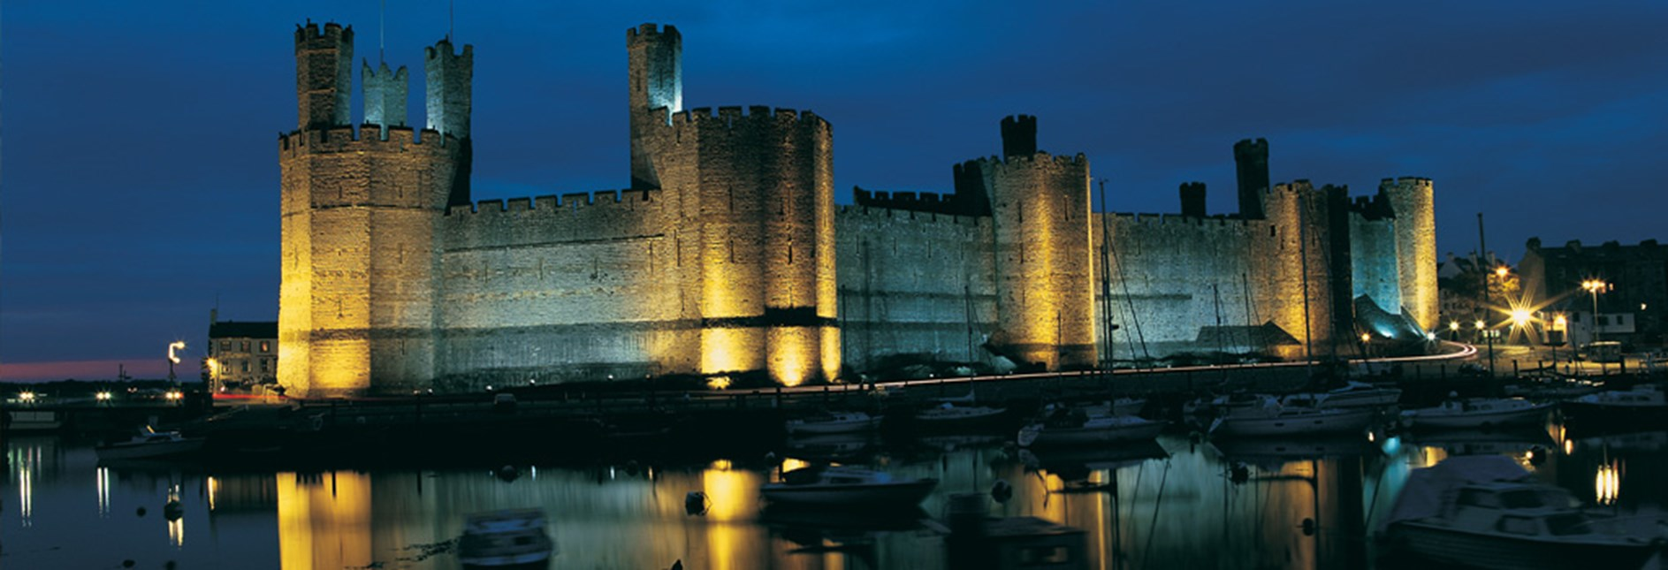
MARKETING
DISTINCTIVENESS
DISCOVERY
VALUE
AUTHENTICITY
ATTACHMENT
MEMORY
Notes:
These are the experiential marketing principles used to underpin the tourism strategy and develop a creative, inspirational, interactive and positive image which relies on history of Wales as well as modern legends

Slide 23
TARGET MARKET
CULTURAL EXPLORERS
SCENIC EXPLORERS
FAMILY EXPLORERS
ACTIVE EXPLORERS
INTERNATIONAL VISITORS
PEOPLE OF WALES
Notes:
The target market is varied as this shows and includes the generally older and richer clientele, or family market who will engage with the product and spend during their stay rather than lower socio economic grouping. The aim is to create brand loyalty and meet the guests needs.

Slide 24
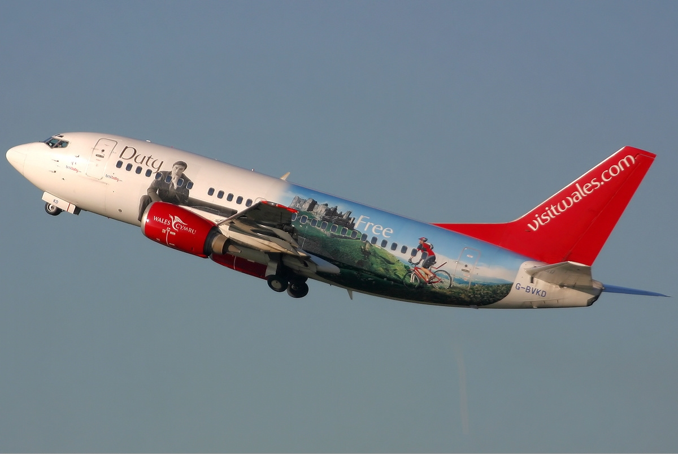
STRATEGIC MARKETING
WIDGET
BRANDED BANNERS FOR WEBSITES
SOCIAL MEDIA BANNERS
PROMOTIONAL WORDING
IMAGES
TV ADVERT LAUNCHED ON ST DAVID’S DAY (PATRON SAINT)
Notes:
Myths and legends will be utilised by attractions and destinations through out Wales to become part of an ongoing digital marketing and social media campaign – This will also use events and target guests attention with the use of pre prepared literature, wording and pictures to create a country wide brand identity. Visit Wales is responsible for educating the tourism organisations to promoted the campaign through direct sales, buyer to buyer and buyer to consumer.

Slide 25
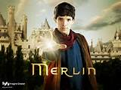
HISTORICAL LEGENDS
KING ARTHUR
MERLIN
OWAIN GLYNDWR
King Henry V11
PIRATES – Black Bart and Blackbeard
TWM SION CATI
ST DAVID (PATRON SAINT)
KING HENRY V11
Notes:
Wales has a wealth of historical legends whose stories will be told through the year of myths and legend and tourism at attractions through out the principality. These are just a few examples – King Arthur was a chieftan who fought against the Saxons in the 5th century including famously pulling a sword from a stone near Swansea – there are a range of exciting stories and myths about his famous round table for his knights and his magician Merlin. Both have bee frequently included in films and television series around the world.
King Henry v111 was the first Tudor King who was smuggled as a child from Wales to safety in France before returning to Wales and fighting a battle to win the crown of England as well as Wales. Owain Glydwyr is famously known as the last true Welsh Prince of Wales and a national hero.
With the wonderful coastline many stories focus on pirates such a Black Bart a Welsh Pirate and Blackbeard the notorious Welsh Pirate who ruled the seas of the Caribbean, whilst Wales also has its own Robin Hoos (Twm Sion Cati) who robbed from the rich to give to the poor.
Wales has it’s own patron Saint St David whose shrine is in St David’s Cathedral and through out the country celebrations are hosted on 1st March when all children dress in welsh costumes, sing songs in Welsh and eat Cawl a Welsh soup wearing leeks of daffodils the national symbols.

Slide 26
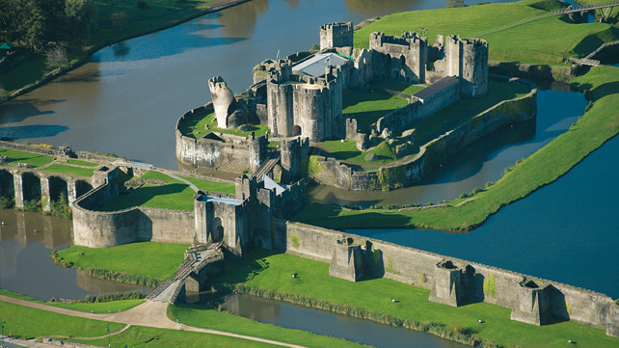
LAND OF LEGENDS – PLACES TO SEE
MAE HEN WLAD FAN NHADAU – MEANING LAND OF MY FATHERS
ISLANDS, MOUTAINS AND BEACHES
ST DAVIDS (World’s smallest city)
CASTLES
Notes:
The legends of Wales are not just about people and history but about places. The national anthem Mae Hen Wlad fan nhadau translates to Land of My Fathers and refers to the battles for the nation, pride, land of song and the telyn which is a welsh musical similar to a harp. As well as referring to history and choirs and culture it also refers to a nation of castles and fortresses. The castles are all individual and all have their own magical stories to tell. Many include wonderful tales of princes and princesses, wars and battles to defend welsh culture and heritage.
The language is often central to these stories and whilst not all Wales speaks Welsh, even little England where Welsh isn’t spoken the locals are fiercely proud of their Welsh identity, castles and fortresses. One of the prettiest Castles is of course Castell Coch like a fairy story castle rising out of the forest, differing greatly from the modern Cardiff Castle, Pembroke Castle in the West, Harlech in the North and the Roman ruins of Caerleon in the East.
The nation also boasts beautiful Islands including Anglesey, Bardsey said to be the resting place of 20,000 saints and Caldey with it’s monastery. Wales has some of the most beautiful beaches including world renowned Rhossilli, the Mountains of Snowdonia and Brecon Beacons, the Pressellis where the Blue Stones for Stonehenge originated and the islands of Skomer and Ramsey covered with puffins, birds and sealife.
Meanwhile St David’s is renowned as one of Wales’ most iconic religious sites with two or three medieval pilgrimages to the cathedral equivilant to a trip to Rome or Jerusalem.The city is also renowned as the smallest city in the world with less than two thousand residents.

Slide 27
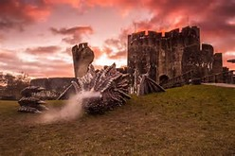
LEGEND OF THE DRAGON
HISTORICAL STORY TELLING
WELSH FLAG
INTERACTIVE
TRAVELLING DRAGON
Notes:
Fire breathing red dragons are the staple folk lore the world over, but in Wales we throw in Knights, Princesses and Castles. The story of the welsh dragon is another myth based on the story of Merlin who was to be sacrificed when he advised the Celtic King that his fortress was to be built above an underground lake where two dragons lay sleeping. Sure enough they dug down and awoke the sleeping dragons, one white and one red who fought a fierce battle with the red dragon representing Wales triumphing. Even today the red dragon sits proudly on the welsh flag, and is central to welsh rugby matches.

Slide 28
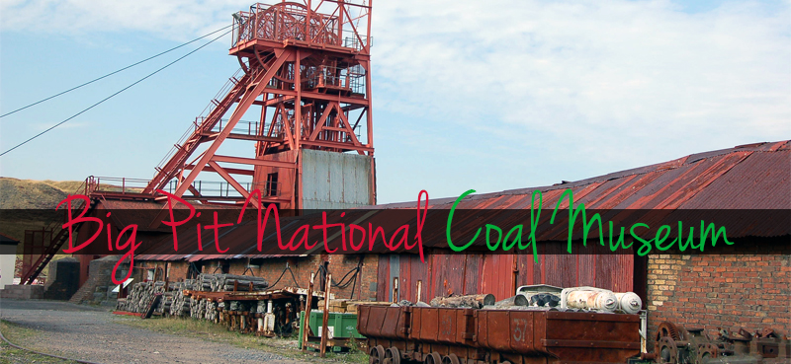
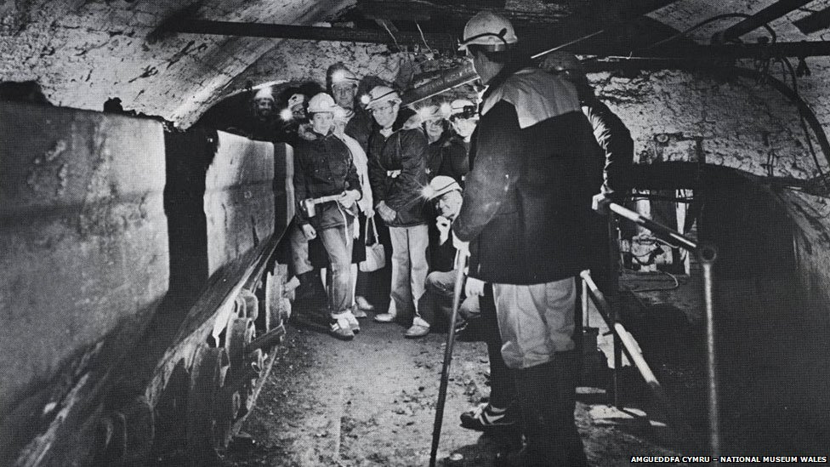
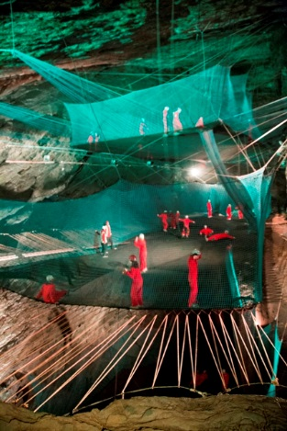
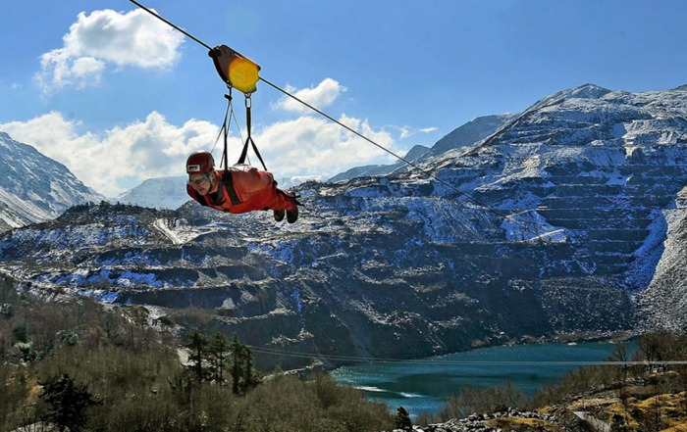
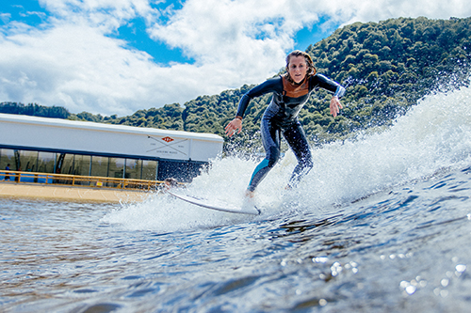
HISTORY IN THE MAKING
ATTRACTIONS
BRINGING THE PAST ALIVE THROUGH EXPERIENCES
St Fagans
Big Pit
STORYTELLING AND INTERPRETATION
Castles
Heritage Centres
NEW ADVENTURE ATTRACTIONS
Zip World
Surf Snowdonia
Bounce Below
Notes:
Atitractions in wales bring alive the tourism experience. At St Fagan you can experience the homes and lives through history, whilst at Big Pit Mining Museum retired coal miners are your guides when you are taken underground to mine coal. This story telling is brought alive in Castles through re-enactments whilst modern attractions include the 100mph Zip World experience travelling through an old slate mine, surf Snowdonia relives Welsh passion for surfing by creating a dream wave on a manmade lagoon in the middle of the countryside and Bounce Below lets you unleash your trampolining skills insidea cathedral like slate cavern.

Slide 29
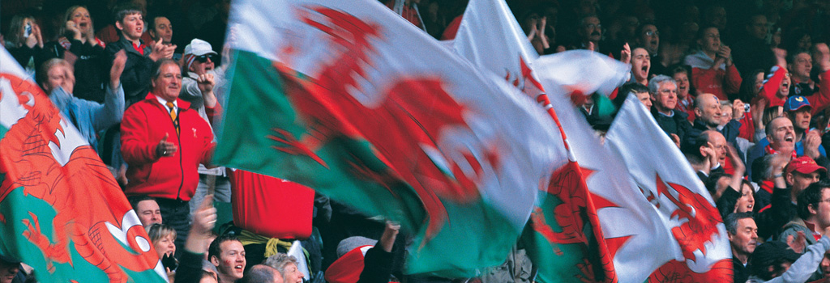
EVENTS
EISTEDDFODS – Music, Language and Literature Festivals
HAY LITERARY FESTIVAL
FOOD FESTIVALS – Welsh food and drink
RUGBY EVENTS
IRON MAN WALES
ST DAVID’S DAY DEWI SANT – 1ST MARCH
ROMANCE – ST DWYNWEN’S DAY -25TH JANUARY
Notes:
Wales boasts a long history of tourism events including world renowned Eisteddfods focusing on music, poetry and literature. Internationally recognised Hay Literary festival involve debate, story telling and entertainment focusing on literature. Whilst Wales celebrates romance with it’s own version of Valentine’s Day, St Dwynyn’s Day for lovers, and Wales on St David’s Day on 1st March
Welsh food and drink are celebrated at numerous food festivals including local produce, cheeses, meats, recipes, welsh whiskey, gin and vodka.
Whilst Sport especially rugby is a major celebrated event at Millennium Stadium supported by a nation dressed in red to support their team. New sporting events include Iron Man Wales and in 2017 Cardiff hosts the Champions league final.
The legends theme was used to promote the highly successful Roald Dahl Festival in 2016 to celebrate the Welsh born authors 100 birthday. Giant Peaches, Chocolate Factories and other ilusions took place as crowds gathered through out Cardiff City to celebrate the event.

Slide 30
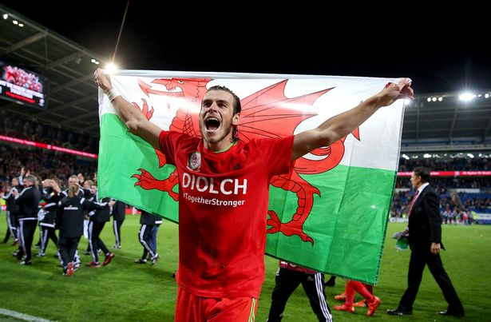
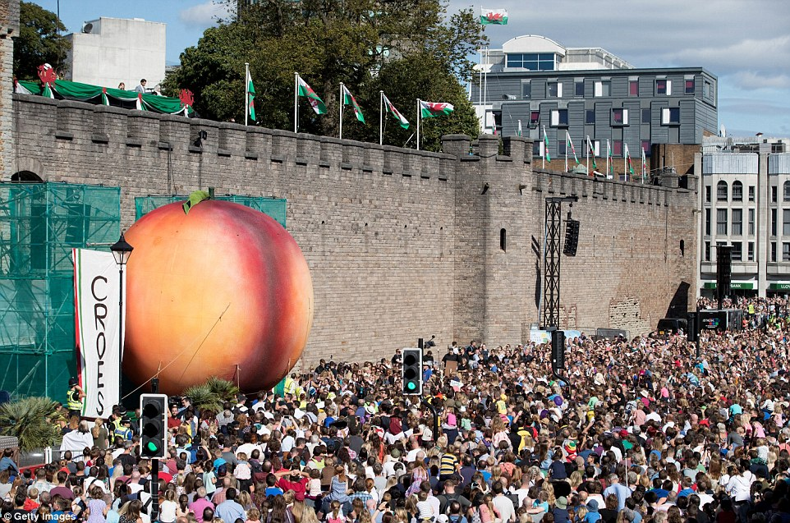
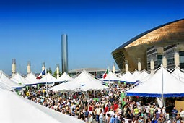
MODERN LEGENDS
CELEBRATE FUTURE WELSH TALENT
DR WHO
SPORTING LEGENDS - GARETH BALE
ACTORS – MICHAEL SHEEN
LAND OF SONG - CERYS MATHEWS
FILMS – HARRY POTTER (Shell Cottage), Robin Hood
Notes:
Wales Tourism is not just about history but about celebrating the future too. Dr Who was re created in Wales and there is an interactive DrWho attraction at Cardiff Bay whilst sporting legends are honoured and visitors can take a tour around the famous Millennium Stadium.
The year of legends also celebraties Welsh Hollywood links including actor Michael Sheen , music stars including Catatonia’s Cerys Mathews and films made in Wales including Harry Potters Shell Cottage and Robin Hood.
Wales will truelly take you on a tourism journey through history celebrating the past the present and the future of Wales, by creating new legends. Welcome to our Epic Land.

