Slide 1


W E L C O M E
B
U
S
I
N
E
S
S
PLAN
PRESENTATION about
THE
TINY
DRAGONS
About
FLM
LOGO
Made by
Resume
6 steps
FACEBOOK
ABOUT
DAY CARE

Slide 2

MISSION
INTRODUCTION
AIMS &…
SMART
SECURE
WHAT
Part made by Mihaela Titriga
LEADER

Slide 3
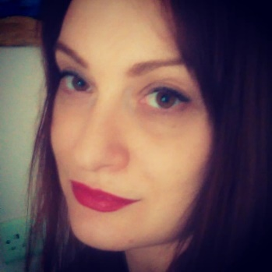
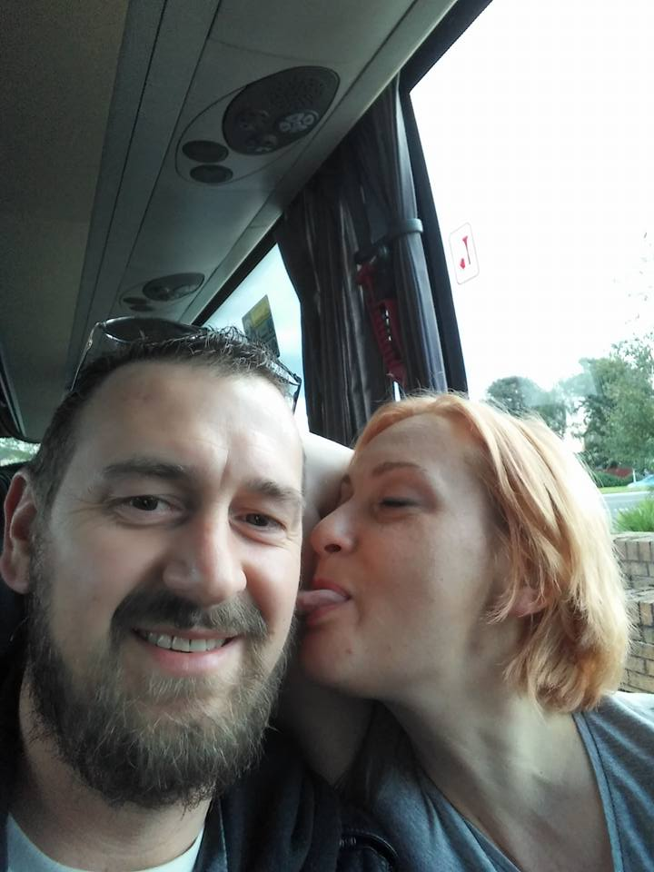
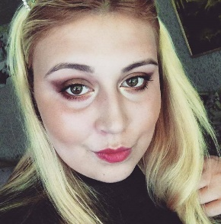
TABLE CONTEST
PHYSICAL RESOURCES
INTRODUCTION
MISSION STATEMENT
FINANCIAL RESOURCES
AIM &
OBJECTIVIES
MISSION
INTRODUCTION
AIMS &…
SMART
SECURE
STRENGHTS
AND
WEAKNESSES
WHAT
MARKETING
HR
SMART

Slide 4



Tiny Dragons is a business that provides care services for young children
We are committed to work together as a team and share a common commitment to success
It is structured as a Limited Company
It has 4 partners who share responsibility for the company equally
MISSION
INTRODUCTION
AIMS &…
SMART
SECURE
WHAT

Slide 5

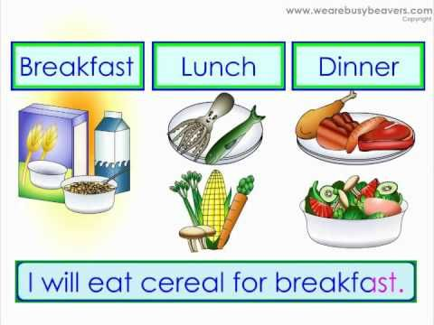

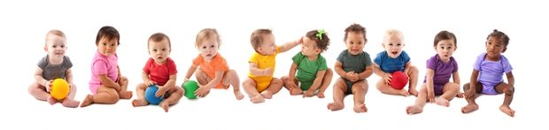
WHAT WE PROVIDE?
MISSION
INTRODUCTION
AIMS &…
SECURE
SMART
WHAT
CAPASITY OF TEN CHILDREN
FULL TIME DAY CARE
Physical, entertainment and learning activities

Slide 6

MISSSION STATMENT?
MISSION
AIMS &…
INTRODUCTION
SECURE
SMART
WHAT
To change the life of children and families in the community, through creating a Day Care that is fun and feels like home

Slide 7




AIMS AND OBJECTIVES?
To engage actively in the life of children and young families by providing a safe and fun place for children to spend their day
To work together with families to improve children’s experiences
MISSION
INTRODUCTION
AIMS &…
SECURE
SMART
WHAT
To provide a high quality service at an accessible price
To be open to parent’s views and contributions to improve the service

Slide 8
SMART
S
M
A
R
T
- to become selected by the young working families as the Best Day Care in Moriston Area
-to develop a loyal customer base
-turn in profits by 6 months
MISSION
INTRODUCTION
AIMS &…
SMART
SECURE
-offer services to young working families
WHAT
-within 12 months the company will have a loyal customer base
-Profit of 30% in 12 months
- 12 months

Slide 9
Made by
COST OF
PHYSICAL…
MONTHLY COST
Basics
FINANCIAL RESOURCES
Selection
EQUITMENT
Part made by Martin
PHYSICAL RESOURCES AND FINANCIAL RESOURCES

Slide 10
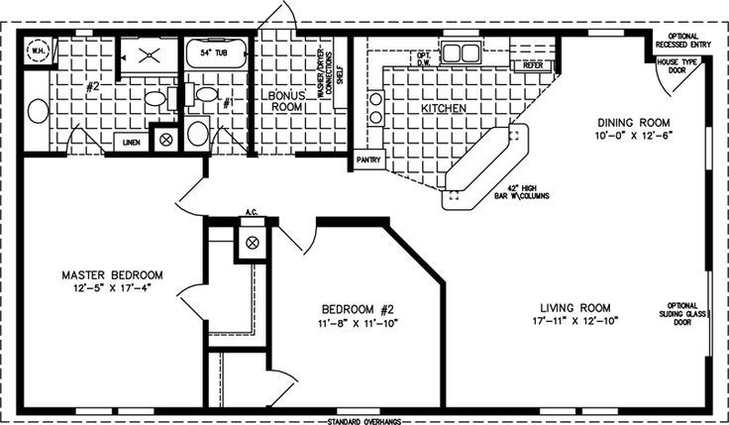
PHYSICAL RESURCES
Bricks based Company Bungalow Fenced outside play area Lounge and dining room Sensory room
Made by
COST OF
PHYSICAL…
MONTHLY COST
Basics
FINANCIAL RESOURCES
Selection
EQUITMENT

Slide 11
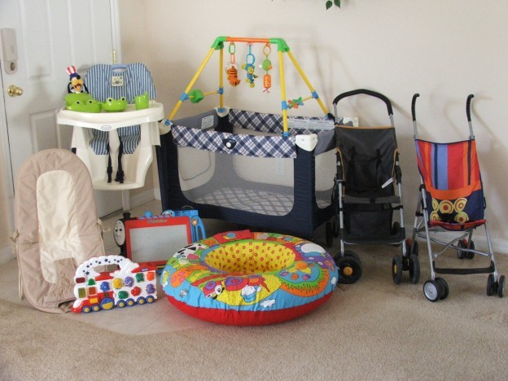
EQUITMENT NEEDED
-cribs
-changing table
-clothes hamper
-dresser
-high chair
Made by
COST OF
PHYSICAL…
MONTHLY COST
Basics
EQUITMENT
FINANCIAL RESOURCES
Selection

Slide 12
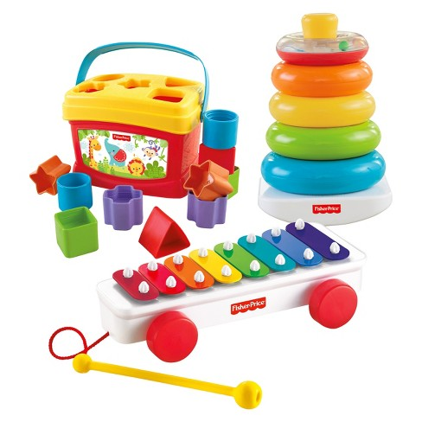

EQUITMENT NEEDED
Made by
COST OF
PHYSICAL…
MONTHLY COST
Basics
EQUITMENT
FINANCIAL RESOURCES
Selection
ACTIVITY
LEARNING

Slide 13
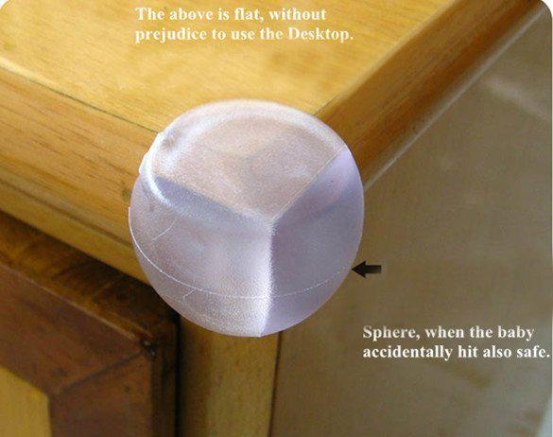
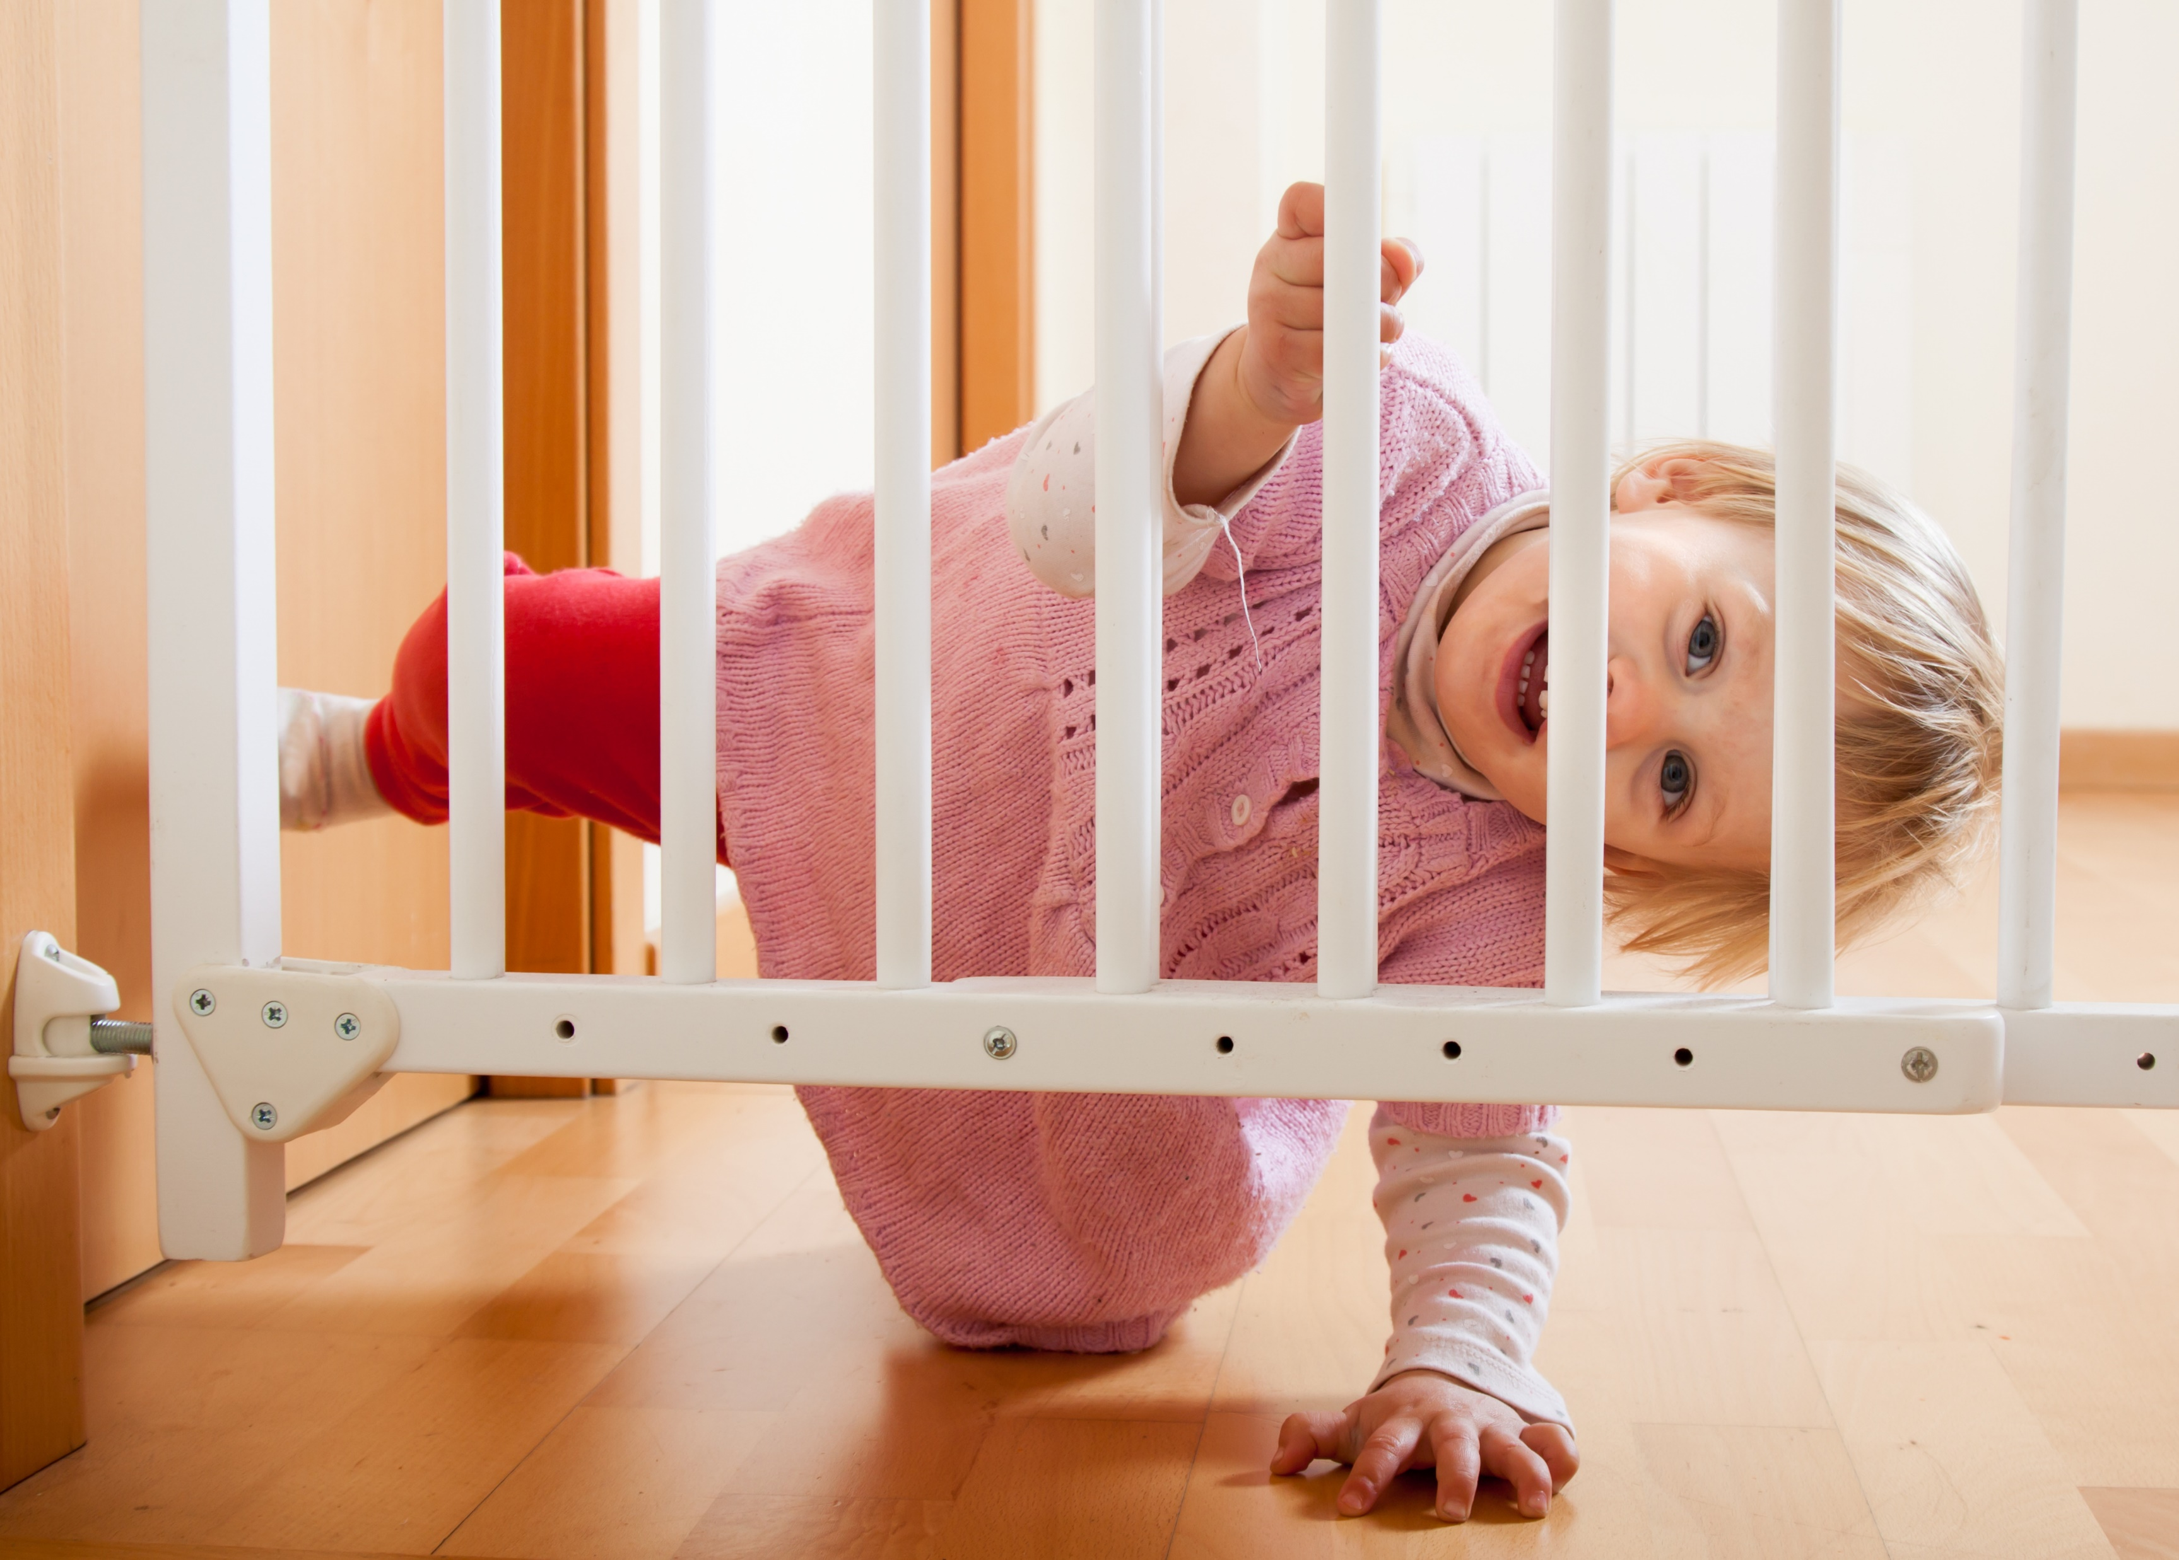
HEALTH AND SAFETY EQUITMENT
Made by
COST OF
PHYSICAL…
MONTHLY COST
Basics
EQUITMENT
FINANCIAL RESOURCES
Selection

Slide 14
FINANCIAL RESURCES
Each partner provides £20.000 from personal savings
Additional financial support from Business Wales of £50.000
The loan will be payed back equally by the 4 partners
Made by
COST OF
PHYSICAL…
MONTHLY COST
FINANCIAL RESOURCES
Basics
EQUITMENT
Selection
Martin M. | £20.000 | £12.5002
Mihaela T. | £20.000 | £12.500
George B. | £20.000 | £12.500
Natalia M. | £20.000 | £12.500

Slide 15
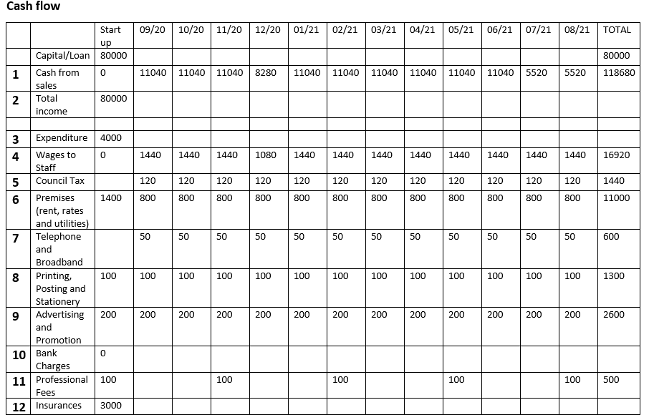
FINANCIAL RESURCES
Made by
COST OF
PHYSICAL…
MONTHLY COST
FINANCIAL RESOURCES
Basics
EQUITMENT
Selection

Slide 16
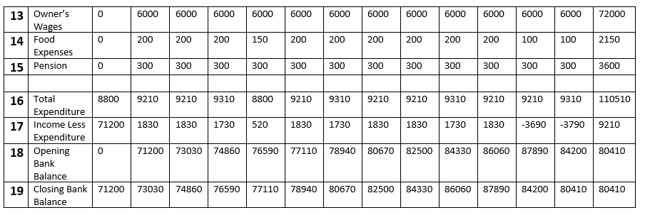
FINANCIAL RESURCES
Made by
COST OF
PHYSICAL…
MONTHLY COST
FINANCIAL RESOURCES
Basics
EQUITMENT
Selection

Slide 17

COST OF STARTING A BUSINESS
Business licences and permits
Business registration fees
Starting inventory (food and drinks)
Rent & Bond
Payments on equipment
Utility fees
Made by
COST OF
PHYSICAL…
MONTHLY COST
FINANCIAL RESOURCES
Basics
EQUITMENT
Selection

Slide 18

ALLOCATION OF MONEY ON MONTHLY BASIS
RENT
UTILITIES
SALARIES
SUPPLIES
INSURANCE
TAXES
LOAN
Made by
COST OF
PHYSICAL…
MONTHLY COST
FINANCIAL RESOURCES
Basics
EQUITMENT
Selection

Slide 19
Made by
STRUCTURE
DAILY ROUTINE
TRAINING
DUTIES AND…
RECRUTING
Part made by GEORGE BARZECU
HUMAN RESOURCES

Slide 20

ORGANISATIONAL STRUCTURE
George B -HR Manager
Mihaela T Manager
Martin M Finance accounting manager
Natalia Marketing
Made by
STRUCTURE
DAILY ROUTINE
TRAINING
DUTIES AND…
RECRUTING

Slide 21

ORGANISATIONAL STRUCTURE
What we recruit ?
Job Description
To implement daily routine
To contribute to a high standard of care for children
To ensure child is collected by someone known to the nursery
Read, teach and entertain children
Record incidents
Keep individual records
Be prepared to help with domestic jobs
Attend out of working hours activities
-2 full time Childcare Assistants
-2 Nursery Practitioner Apprentices
Made by
STRUCTURE
DAILY ROUTINE
TRAINING
RECRUTING
DUTIES AND…

Slide 22
DAILY ROUTINE
Dinner/Play
Made by
STRUCTURE
DAILY ROUTINE
TRAINING
Play Time
RECRUTING
DUTIES AND…
Nap Time
Lunch/Play
Bfast/
Play

Slide 23
DUTIES AND REQUITMENTS OF EMOLOYESS
To help, maintain, supervise and organise a child friendly environment
Keep records
Adhere to the Policies and Procedures of the Company
Contribute to good standards
Ensure High Standards
Have legal right to work in UK
Minimum lev 2 Childcare Qualification
DBS
Made by
STRUCTURE
DAILY ROUTINE
TRAINING
DUTIES AND…
RECRUTING

Slide 24
TRAINING REQUIRED AND INDUCTION
-Know the Facilities
-Have knowledge of the specific needs of the children
-Have knowledge of the routines and transitions
-Policies regarding communication with parents
-Meal patterns and food handling policies
-Health and Safety procedures
Made by
STRUCTURE
DAILY ROUTINE
TRAINING
DUTIES AND…
RECRUTING

Slide 25

LOGO
Made by
FACEBOOK
About
Designed by Natalia Weronika Michalak
MARKETING ACTIVITIES VOL 1

Slide 26




S L I D E S P L A N S
PLAN
PLAN
PLAN
PLAN
1
2
3
4
POSTERS
FLYERS
Made by
COUNSIL
RADIO
WEBSITE
LOGO
OPEN DAY
PAPER
FACEBOOK
About
ADVERTISING
MARKETING
VOL1
MARKETING
VOL2
STRENGTHS AND WEAKNESSES
SMART

Slide 27
LOGO
LOGO
Made by
ADVERTISING
About
ADVERTISING

Slide 28
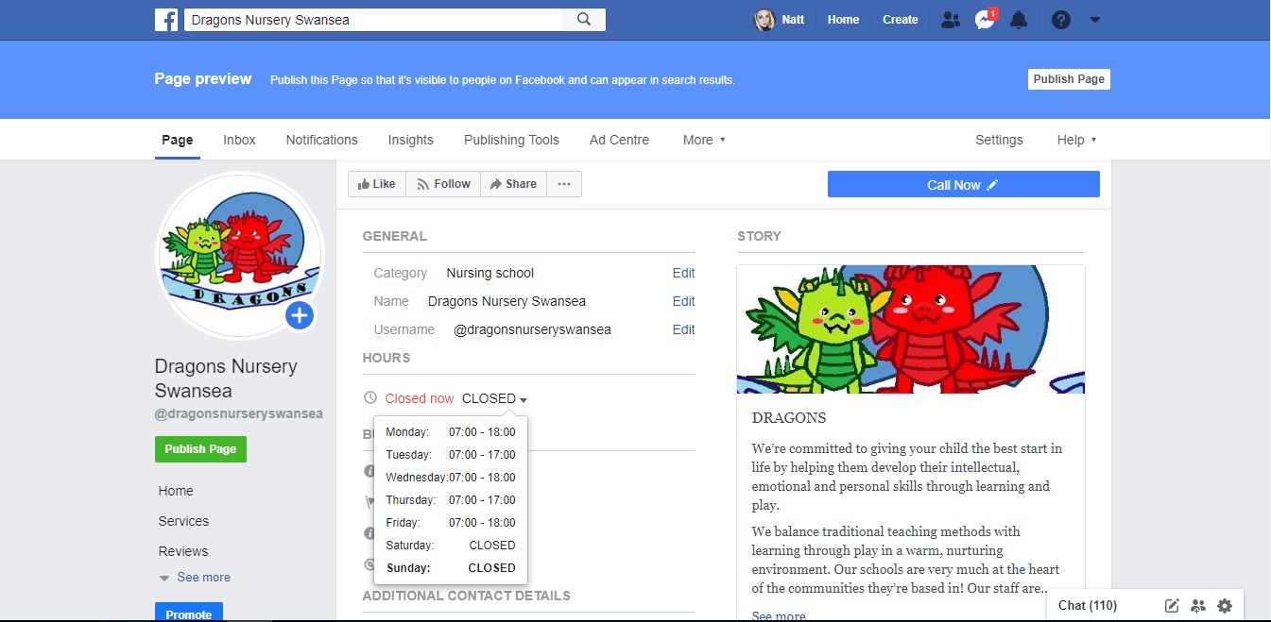
DRAGONS NURSERY SWANSEA
Checking references, drawing up a contract and offering the job
R.process
Made by
FACEBOOK
About
https://www.facebook.com/dragonsnurseryswansea/ ←FACEBOOK FANPAGE

Slide 29
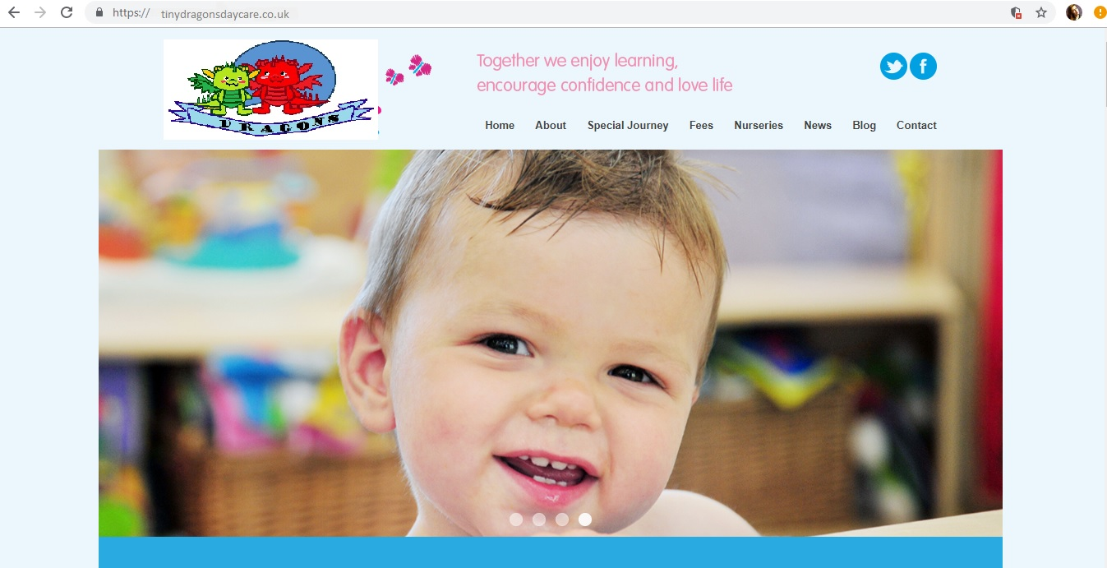
tinydragonsdaycare.co.uk
8 steps
Job analysis
WEBSITE
Made by
Resume
6steps
FLM
About
EXAMPLE
!!!

Slide 30
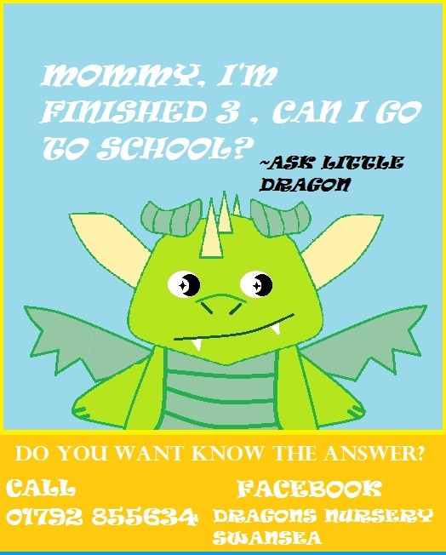
CAN YOU SEE?
POSTERS
Made by
About

Slide 31


100, 200…1000?
POSTERS
FLYERS
LOGO
Made by
FACEBOOK
About

Slide 32

HALO?
RADIO
Job analysis
Made by
Resume
FACEBOOK
FLM
About

Slide 33
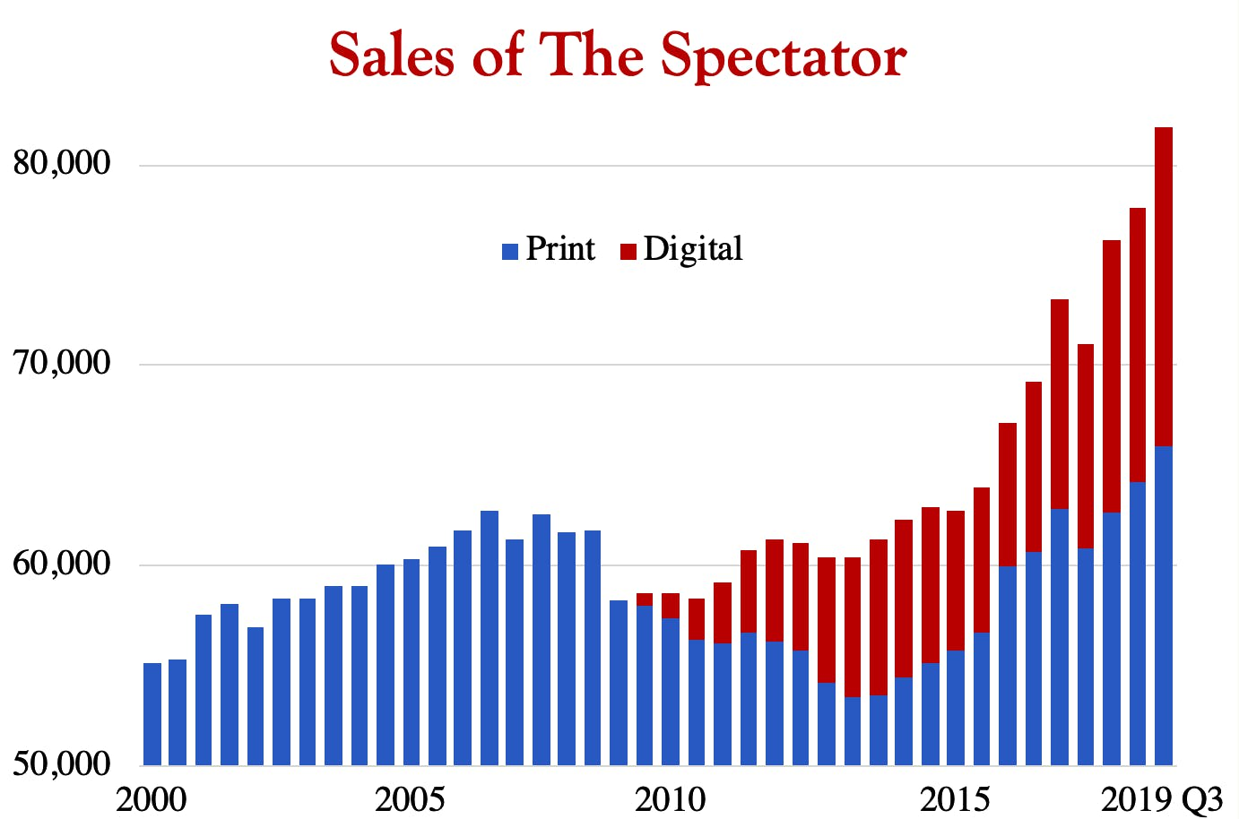
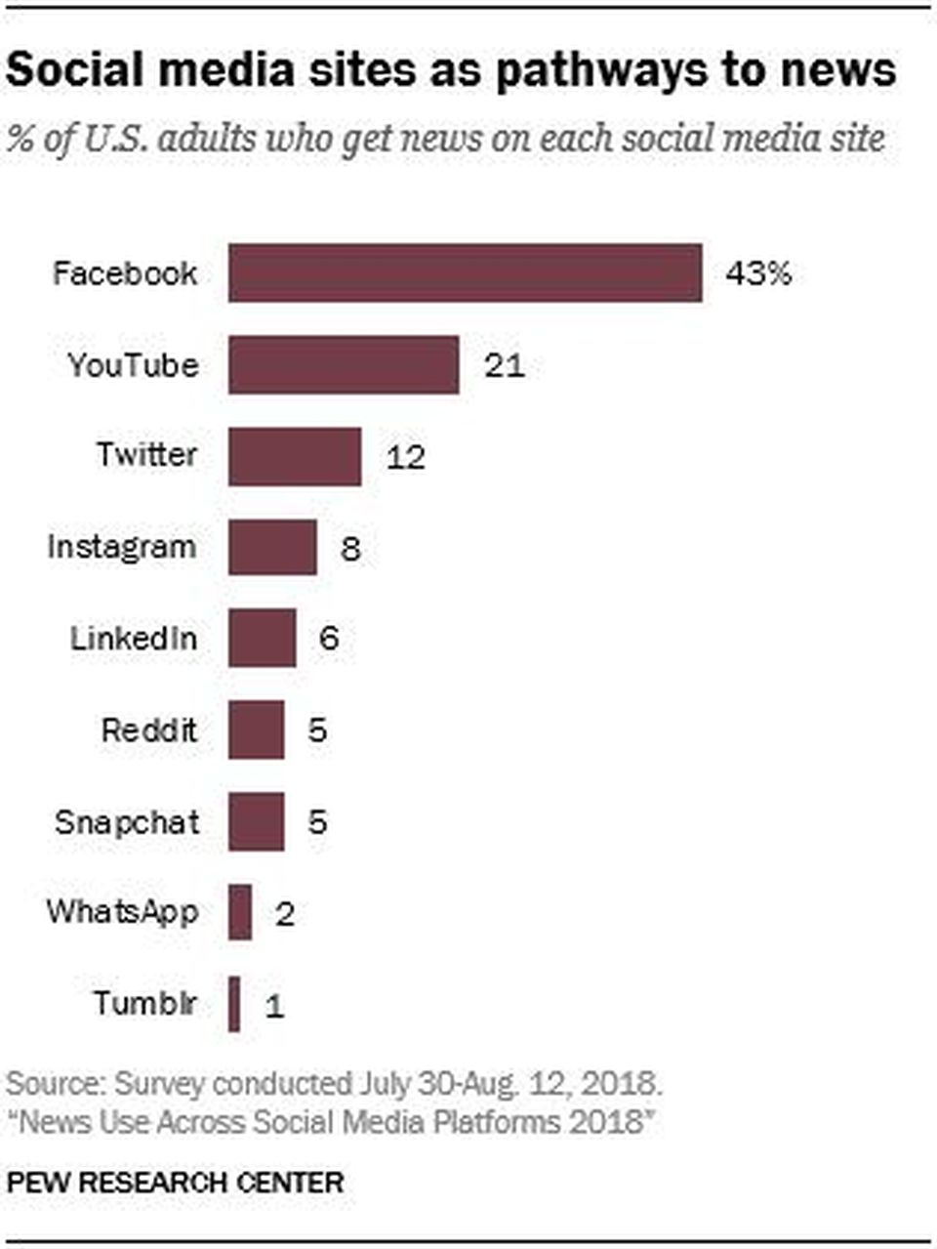
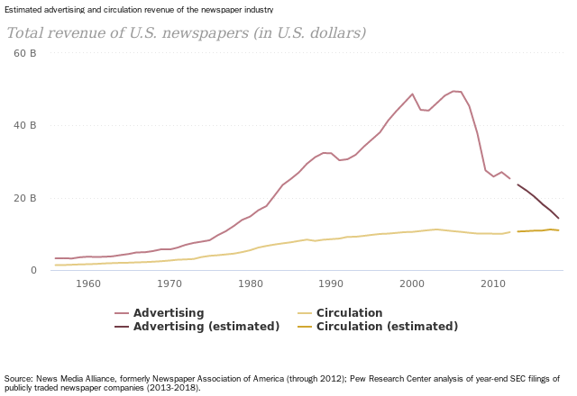
IS IT STILL WORTH IT?
Resume
PAPER
Made by
About

Slide 34
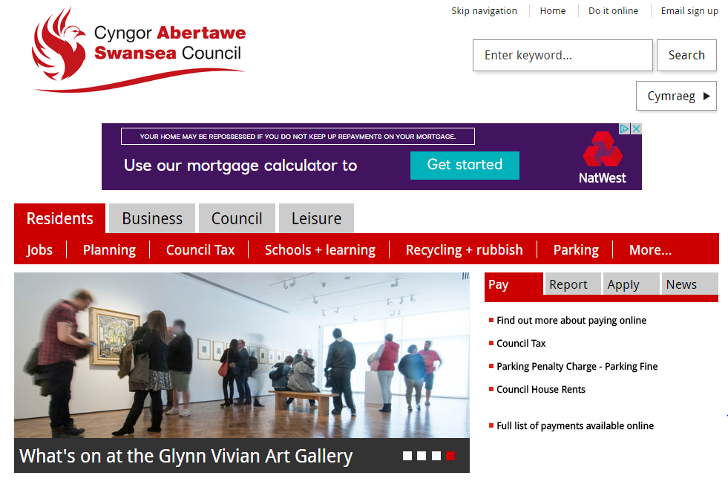
MORE HELP?
8 steps
Job analysis
7steps
R.process
6steps
Made by
COUNSIL
FLM
S.process
About

Slide 35
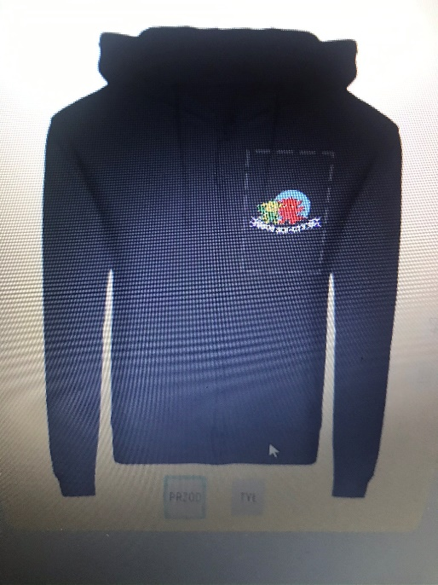
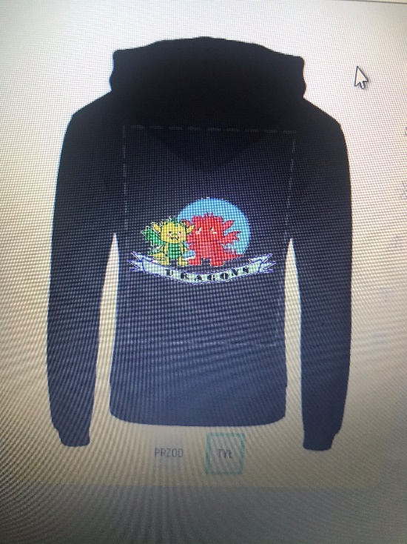
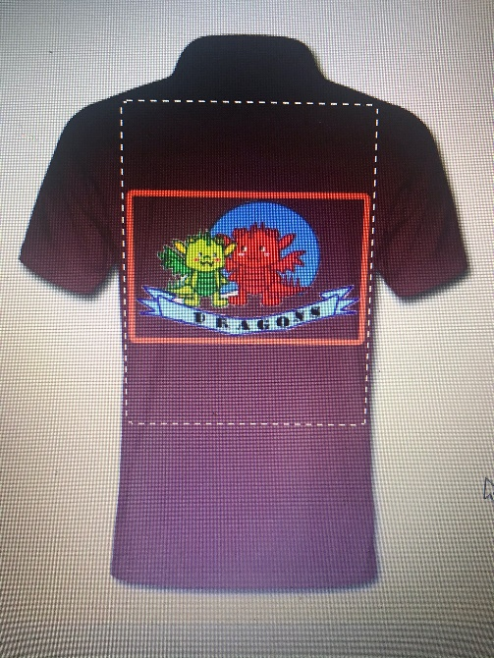
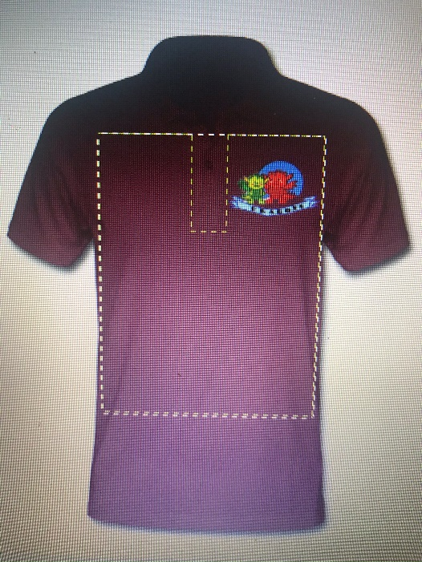
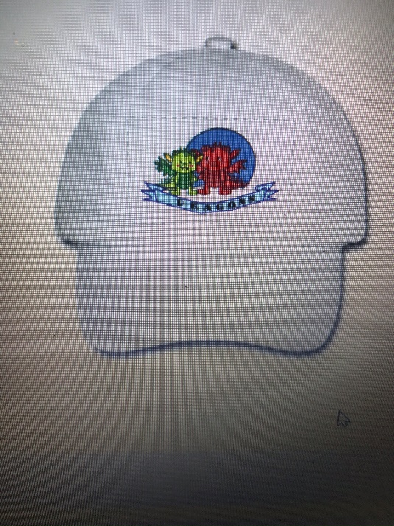
WHAT CAN WE WEAR?
RESUME?
8 steps
Job analysis
7steps
R.process
6steps
Made by
COUNSIL
FLM
S.process
About
CLOTHES

Slide 36
HOW MUCH FOR ALL?
RESUME?
1633,97£
FOR ONE MONTH
FACEBOOK- 0£
WEBSITE- 95£-ANNUALLY
A3 POSTERS- 138,92£/50 QUANTITY
FLYERS- 12£/ 250 QUANTITY
RADIO- DEPENDS FROM 20£ TO 200£ EACH/MONTHLY BUDGET 1000£
CLOTHES- TSHIRTS 108£, CAPS 54£, HOODIES 144£/18 QUANTITY EACH/306£ TOTAL
COUNSIL-350£/MONTH
4901,92£
PER 3 MONTHS!!!
8 steps
Job analysis
7steps
R.process
6steps
Made by
COUNSIL
FLM
S.process
About
ADVERTISING
ADVERTISING

Slide 37
Made by
MAP
START
COMPETITORS
Part made by Natalia Michalak
MARKETING VOL 2

Slide 38
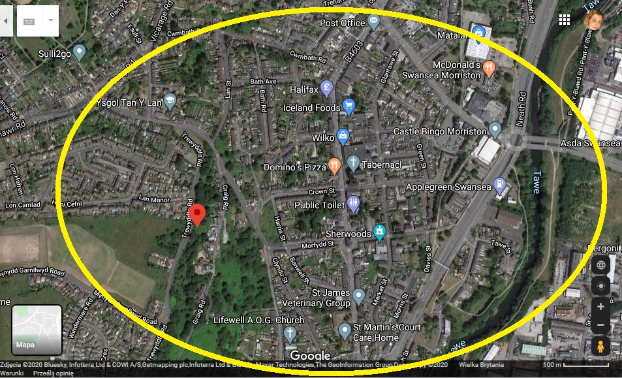
WHERE?
MAP
START
Made by
COMPETITORS

Slide 39
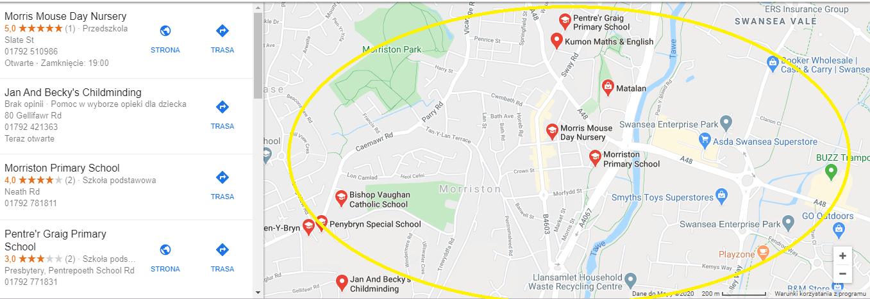
CONCURRENCY?
MAP
START
Made by
COMPETIRTORS

Slide 40
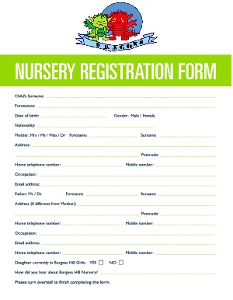
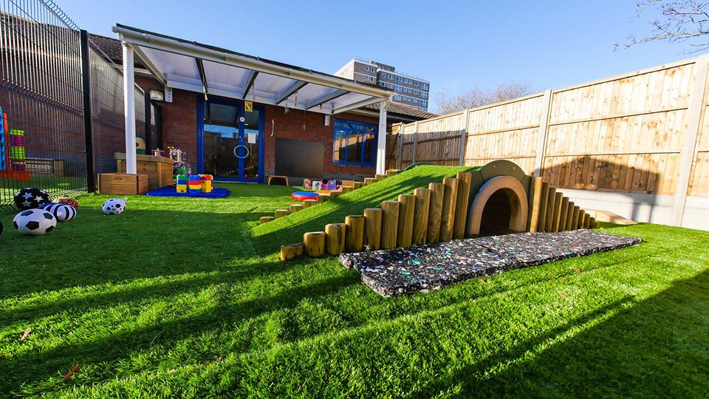

WHEN WE CAN START?
Made by
START
START
SEPTEMBER 2020
REGISTRATION
BY 10TH MAY 2020

Slide 41
STRENGTHS
WEAKNESSES
Part made by Natalia Michalak
STRENGTHS AND WEAKNESSES

Slide 42
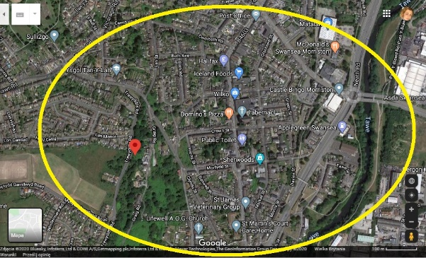



BE STRONG
DEMOGRAPHIC OF AREA
About
Indeed
MORRISTON AREA
PARKING SPACE
STHRENGTHS
Resume
WEAKNESSES
SUPPORT YOUNG FAMILIES
ENGAGEMENT WITH WELLBEING OF COMMUNITY

Slide 43

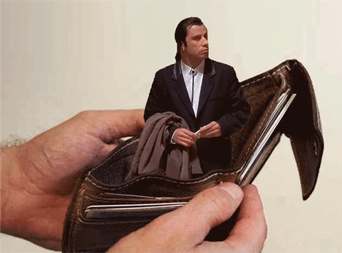
ONE THING?
FINANCIAL BANKING AT THE BEGGINIG
About
Indeed
Resume
WAKNESSES

Slide 44
SMART
2 YEARS
END
Part made by Natalia Michalak
SMART

Slide 45
SMART
-To develop a loyal customer base
-business to be open in September and to start making profit after 6 months
-business to be sustainable
-1 year to expand the capacity ( 10 children)
-2 years to open another Day Care in a different area (Sketty)
SMART
SMART IN 2 YEARS
END

Slide 46
SMART
S
M
A
R
T
- to become selected by the young working families as the Best Day Care in Sketty Area
- find loyal base customers in new area
-turn in profits by 6 months
-offer services to young working families
-within 12 months the company will have a loyal customer base or develop Morrison area base
-Profit of 50% in 12 months
- 24 months

Slide 47
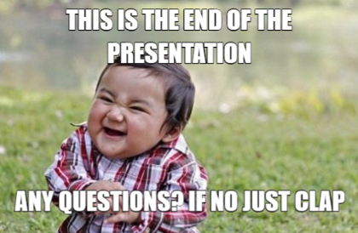
Q&A?
https://www.mememaker.net/meme/presentation-questions-967

