Slide 1
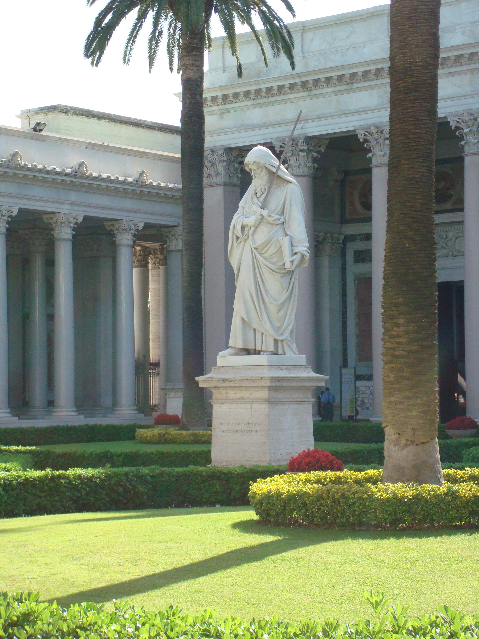

Slide 2
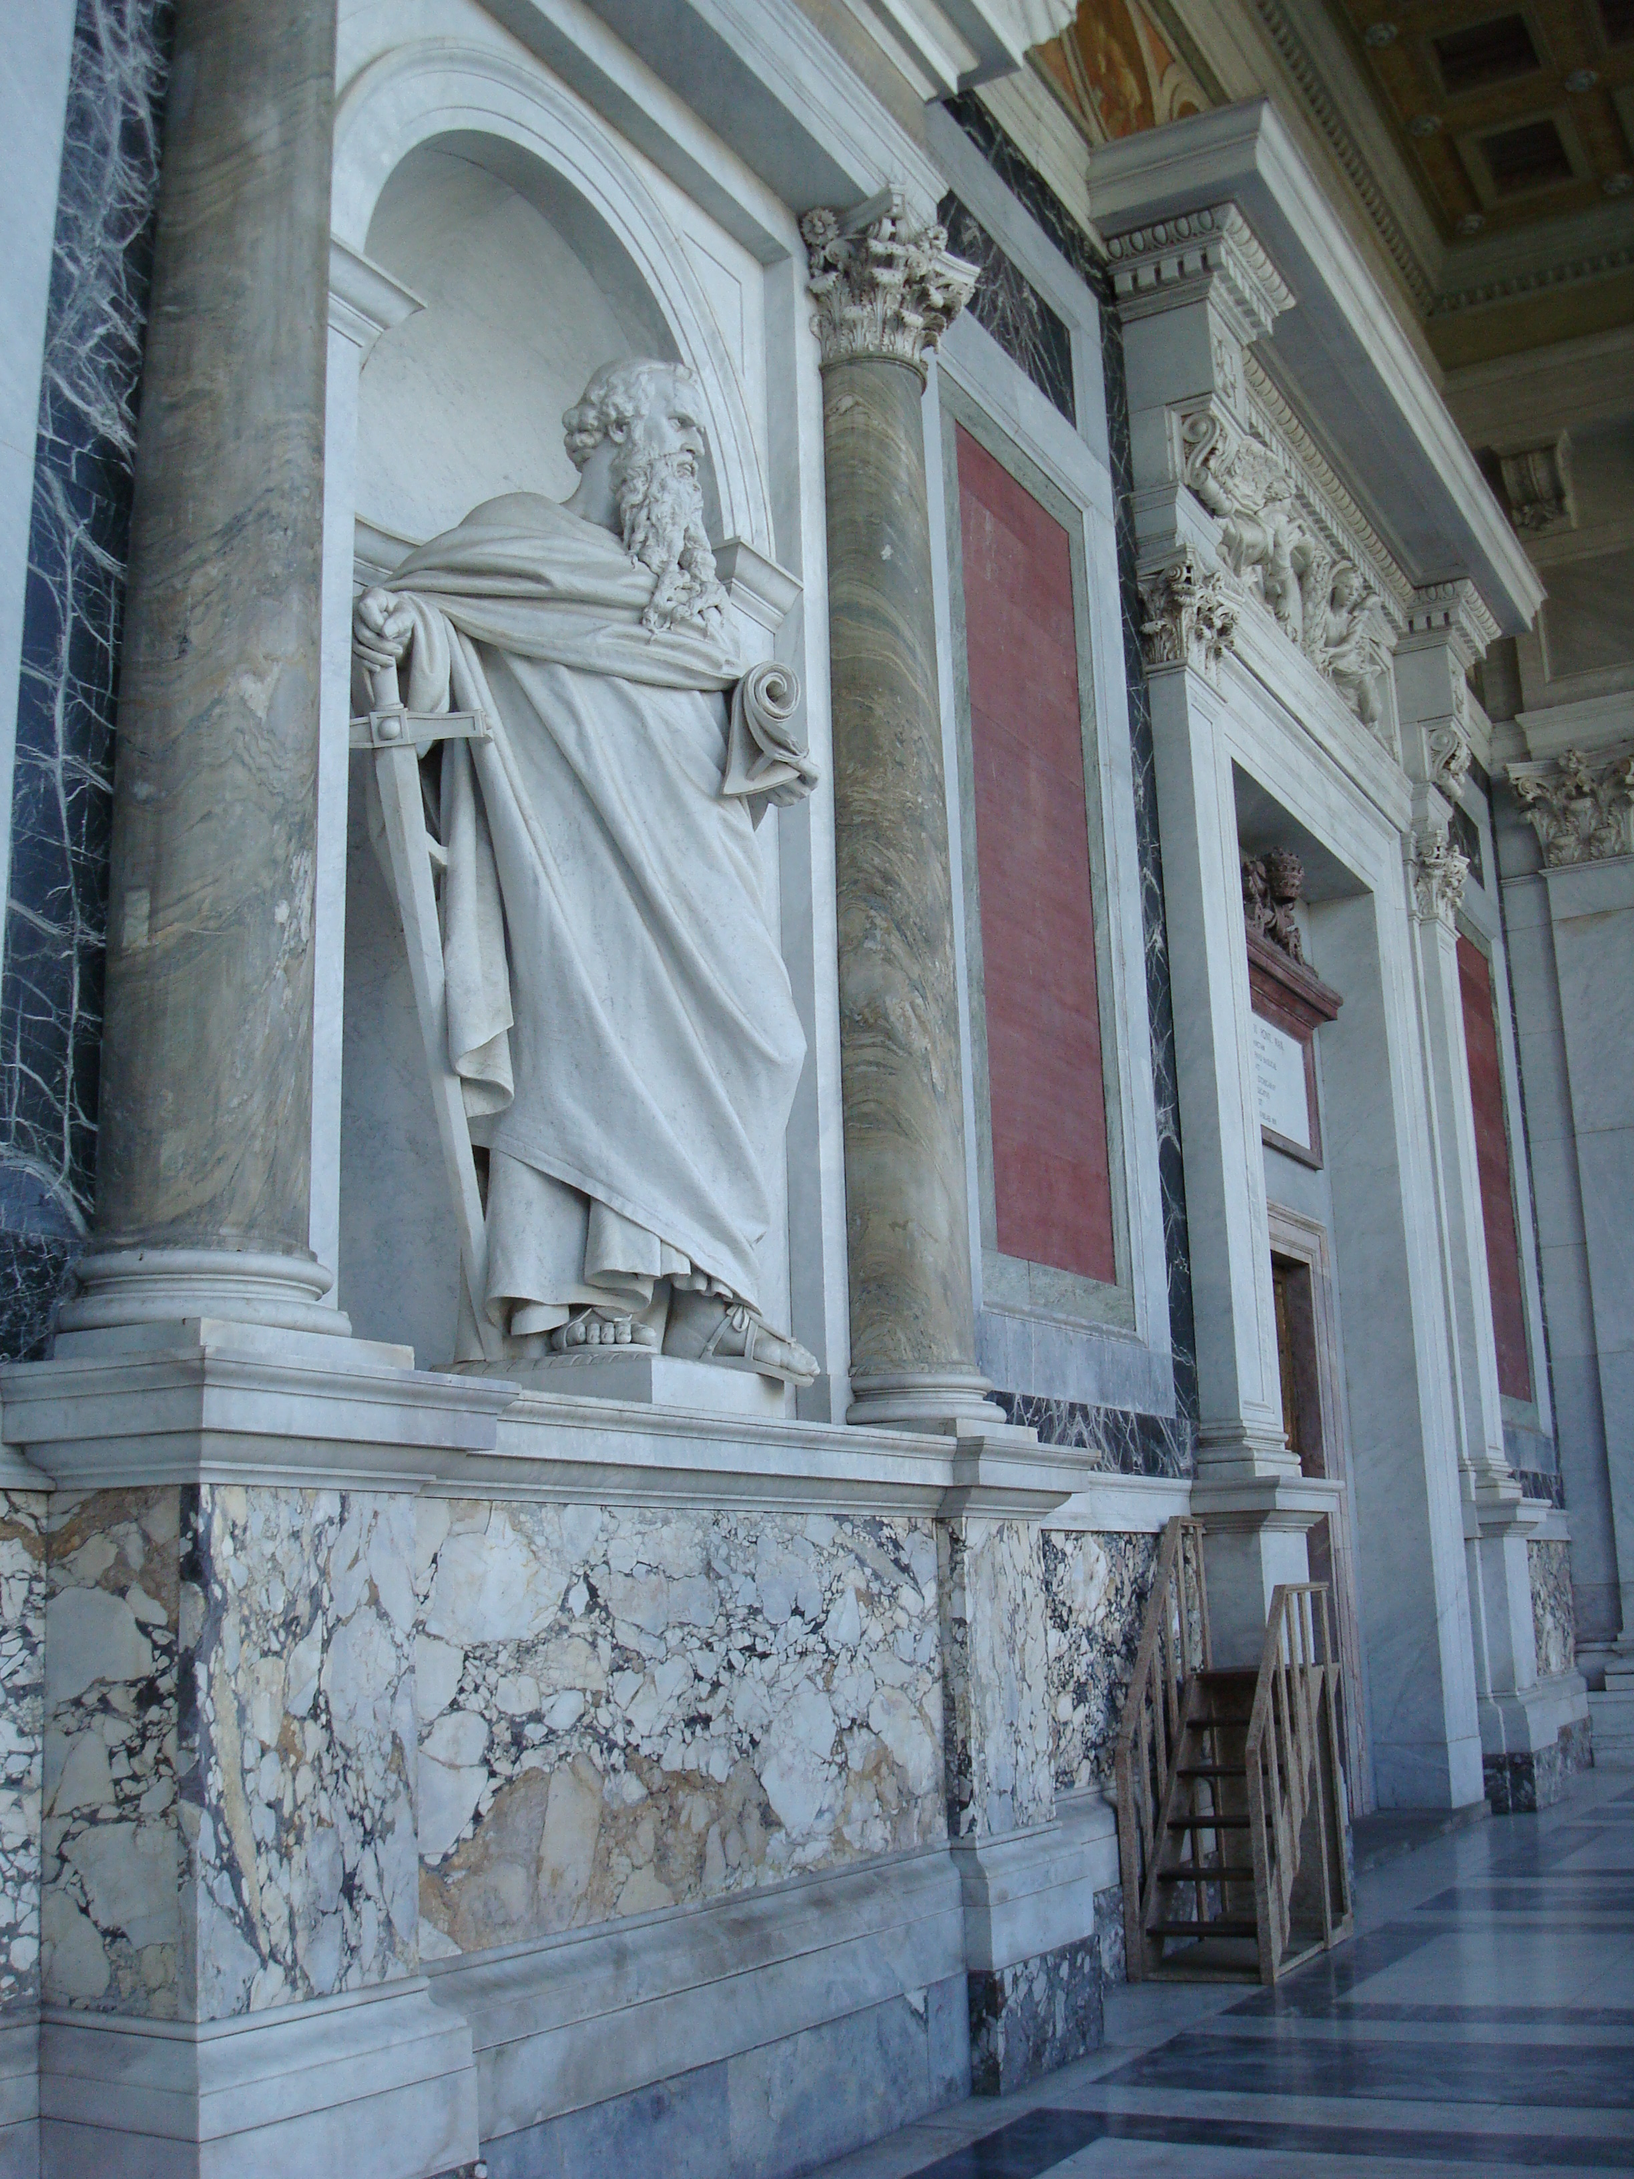

Slide 3
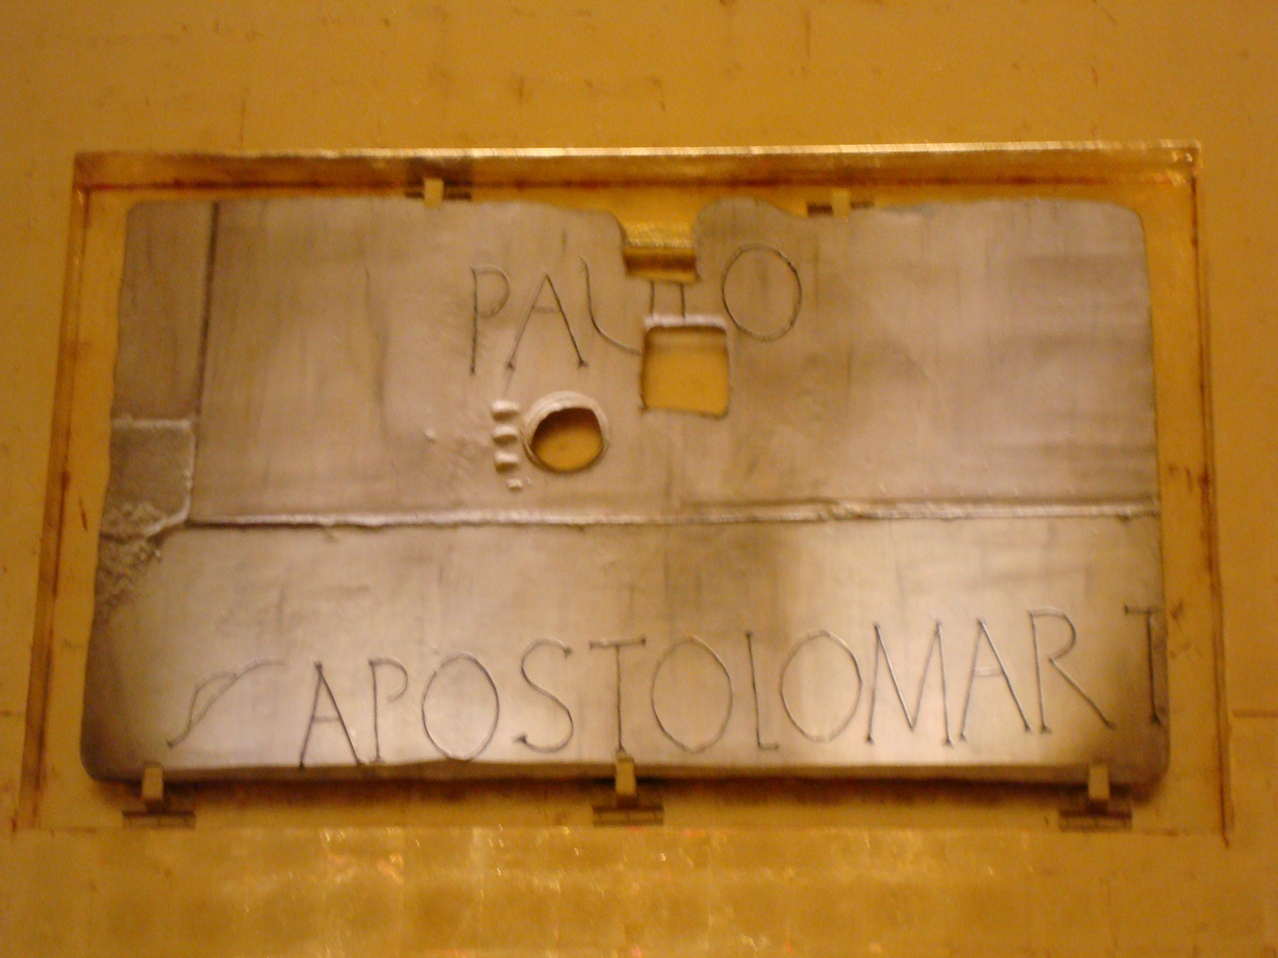

Slide 4
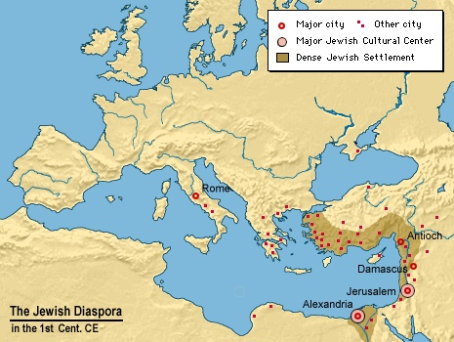
PAUL – Context
Jewish Diaspora 1st Century

Slide 5
PAUL - the first personal witness
Oldest Texts of Christian Tradition
One of the few Jewish writings
of the 1st century CE
Only writings from a Pharisee
Witness of intercultural communication and interaction of the 1st century CE

Slide 6
Paul, the Apostle
Letter Writing – Communication at a Distance
Fragments of Communication
Other ways of communicating :
  Personal visits
  Messengers
  Networks of communication

Slide 7
The Sources
Letters
The Book of Acts
Indirect information – archaeology, Graeco-Roman and Jewish literature etc

Slide 8
Paul‘s Self-Perception
Persecutor of the ekklesia (Gal 1.13)
Called Apostle (to the non-Jews) (Gal 1.15-16)
Educated Jew (Gal 1.14)
Pharisee (Phil 3.5)
Hebrew of Hebrews (Phil 3.5)
Slave of Christ (Rom 1.1)
Manual laborer (1 Cor 4.12; 9.4-18; 2 Cor 12.13)
Witness of Christ (1 Cor 15.8)

Slide 9
Tentative Chronology
10 BCE – 10 CE Paul born
Ca 30 Jesus crucified
Ca 34/35 Paul receives revelation of Christ
Ca 37/38 Meeting with Peter and other leaders
Ca 51/52 Corinth
55/56 Paul writes Romans
64-68 Death of Paul ?

Slide 10
The Letters
Undisputed Letters:
Romans
1 Corinthians
2 Corinthians
Galatians
Philippians
1 Thessalonians
Philemon
Disputed Letters
Ephesians
Colossians
2 Thessalonians
1 Timothy
2 Timothy
Titus

Slide 11
Paul and the Other Apostles
For I am the least of the apostles (1 Cor 15.9)
…an apostle not from men nor through man but through Jesus Christ and God the Father….(Gal 1.1)
Emphasis not on independence but on recognition
Interdependence and mutual recognition of apostles (Gal 2.6-10)

Slide 12
Paul and Networking
Other apostles recognized (Peter,James, Timothy, Silvanus)
Apostles/called prior to Paul (Peter, James, the pillars, Barnabas, Junia and Andronicus…)

Slide 13
Paul and Networking
Co-Workers (sunergoi):
Titus, Timothy (1.Thess.3.2), Apollos (1. Cor 3.9), Prisca and Aquila (Rom 16.3), Mark, Aristachus, Demas, Luke (Phlm 24), Urbanus (Rom 16.9) ,Tryphanea, Tryphosa, Persis (Rom 16.12), Euodia and Syntyche, Clement (Phil 4.2-3)

Slide 14
Paul and Networking
Diakonos – Phoebe (Rom 16.1)
Paul and Apollos (1 Cor 3.15)
Brothers (and sisters) – adelphoi/e
Used for all members of a community
Or for a particular ‘brother’ like Quartus in Rom 16.23

Slide 15
Paul and Women
Paul the Father of Misogynism ?
Statements concerning women explicitly
1 Cor 11.2-16 head covering
1 Cor 14.34-35
1 Cor 7.1-16
Phlm 2
Rom 16.1-16

Slide 16


