Slide 1

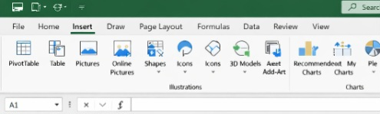
How to insert a chart in Excel
The first thing you will need to do is open the Excel app on your laptop/computer, then once you have entered the app on the laptop it should show you a tab that says Insert. Click on it and on the line under it, among the row press on Recommended Charts. You can then choose from the many charts that are available to you.
There are charts ranging from column to combo charts, all of these are at your disposal to use as you may see fit for your work. They come in very handy when you want to calculate salaries or evaluate the progress of a business using the graphs.

