Slide 1
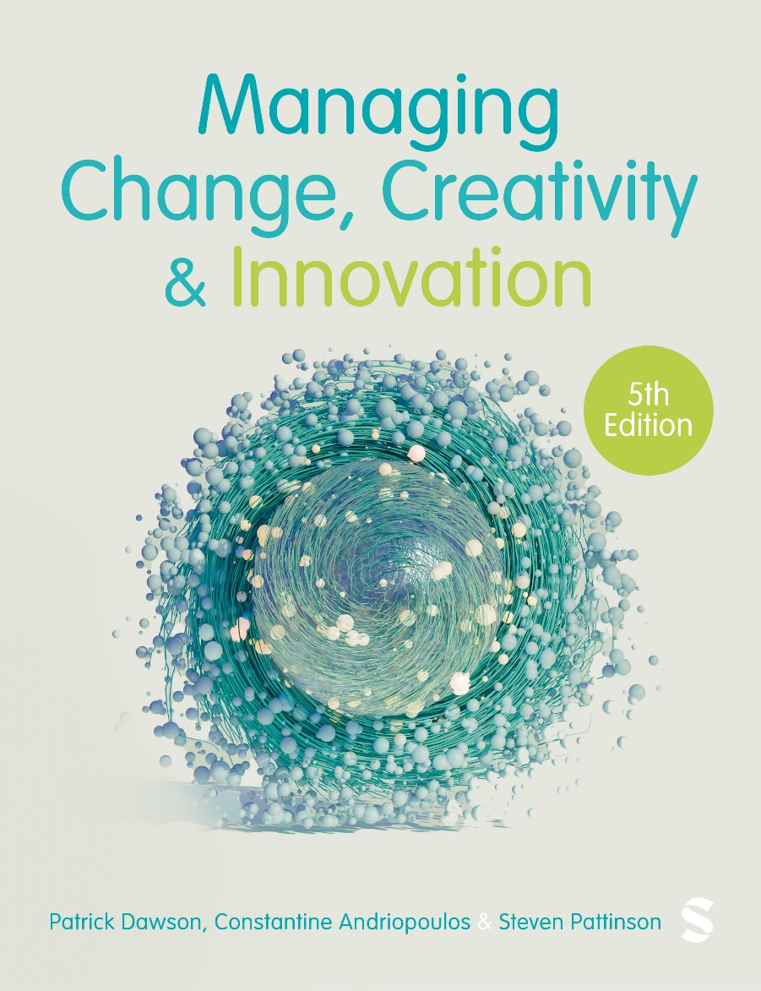
Managing Change, Creativity and Innovation, 5e
© Patrick Dawson, Constantine Andriopoulos, Steven Pattinson

Slide 2
Chapter 8
Conventional frameworks: Planning, diagnostics and sequence

Slide 3
Learning outcomes
After reading this chapter, you will be able to:
  Understand the three-step model of unfreezing, moving and refreezing, and the influence of Kurt Lewin on change management theories.
  Summarize the organizational development perspective for managing planned change.
  Evaluate the contribution of contingency theory through the discussion of a situational model for leading change.
  Describe Kotter’s eight-step model for successful change and his principles of a dual system for making change happen in an accelerating world.

Slide 4
Planning approaches and stage models
Advocate sequence of stages from initial state through transition to desired state.
Focus on the importance of people involvement to gain commitment.
Poor communication and lack of buy-in seen as prime reason for resistance (or slow reluctant compliance).

Slide 5
Organizational Development (OD)
Cummings and Worley (2015: 2) draw attention to a range of OD definitions putting forward a composite definition:
  ‘Organizational development is a system-wide application and transfer of behavioral science knowledge to the planned development, improvement, and reinforcement of the strategies, structures, and processes that lead to organization effectiveness’.

Slide 6
Values underpinning OD
Treat people with respect and dignity.
Develop a climate of trust, openness and support.
Hierarchical control mechanisms are not effective.
Problems and conflicts should be confronted and reconciled.
People affected by change should be involved in its implementation.

Slide 7
Major steps in OD programme
Identifying a need for change.
Select an intervention technique (often use a change agent external to company).
Gain top management support.
Plan the change process.
Engage people and resolve any conflicts or resistance.
Monitor and evaluate the change process.

Slide 8
Lewin’s three phases of planned change
Unfreezing
  create a need for change.
  minimize resistance (reduce resisting forces).
Changing (or moving)
  implementation of new systems of operation.
  employees learn new attitudes and behaviours.
Refreezing
  positive reinforcement of desired outcomes to promote internalization of new behaviours.
  evaluation to ensure new ways habitualized.

Slide 9
Unfreezing for change: Field theory
Analysis of current situation – forces that shape behaviours.
Strategies of engagement and involvement.
Use disconfirming information to reduce constraining forces in creating felt need.

Slide 10
The force field concept
Work practices represent a Quasi-Stationary Equilibrium (QSE) resultant of driving and restraining forces.
Attempts to increase driving forces will increase tension and higher levels of aggressiveness and emotionality.

Slide 11
Moving forward: Action research
Collect data to plan action.
Take action on plan.
Evaluate.
Collect further data (feedback).
Develop plan.
Data feeds into action, evaluation, further research.
A collaborative iterative process that encourages participation and involvement.

Slide 12
Refreezing: Group dynamics
Positive reinforcement of desired outcomes.
Internalization of new attitudes and behaviours.
Appraisal of effectiveness to gauge whether new ways of doing things have become habitualized.
Successful change a group activity.
Unless group norms and routines change individual behavioural change will not be sustained.

Slide 13
Criticisms of Lewin’s model
Planned approach is seen as too simplistic and mechanistic (Dawson, 1994; Garvin, 1993; Kanter et al., 1992; Nonaka, 1988; Pettigrew, 1990a, 1990b; Pettigrew et al., 1989; Stacey, 1993; Wilson, 1992),
Lewin’s work is only relevant to incremental and isolated change projects (Dawson, 1994; Dunphy and Stace, 1992, 1993; Harris, 1985; Miller and Friesen, 1984; Pettigrew, 1990a, 1990b),
Lewin’s stands accused of ignoring the role of power and politics (Dawson, 1994; Hatch, 1997; Pettigrew, 1980; Pfeffer, 1992; Wilson, 1992),
Lewin is seen as advocating a top-down, management-driven approach to change (Dawson, 1994; Kanter et al., 1992; Wilson, 1992).

Slide 14
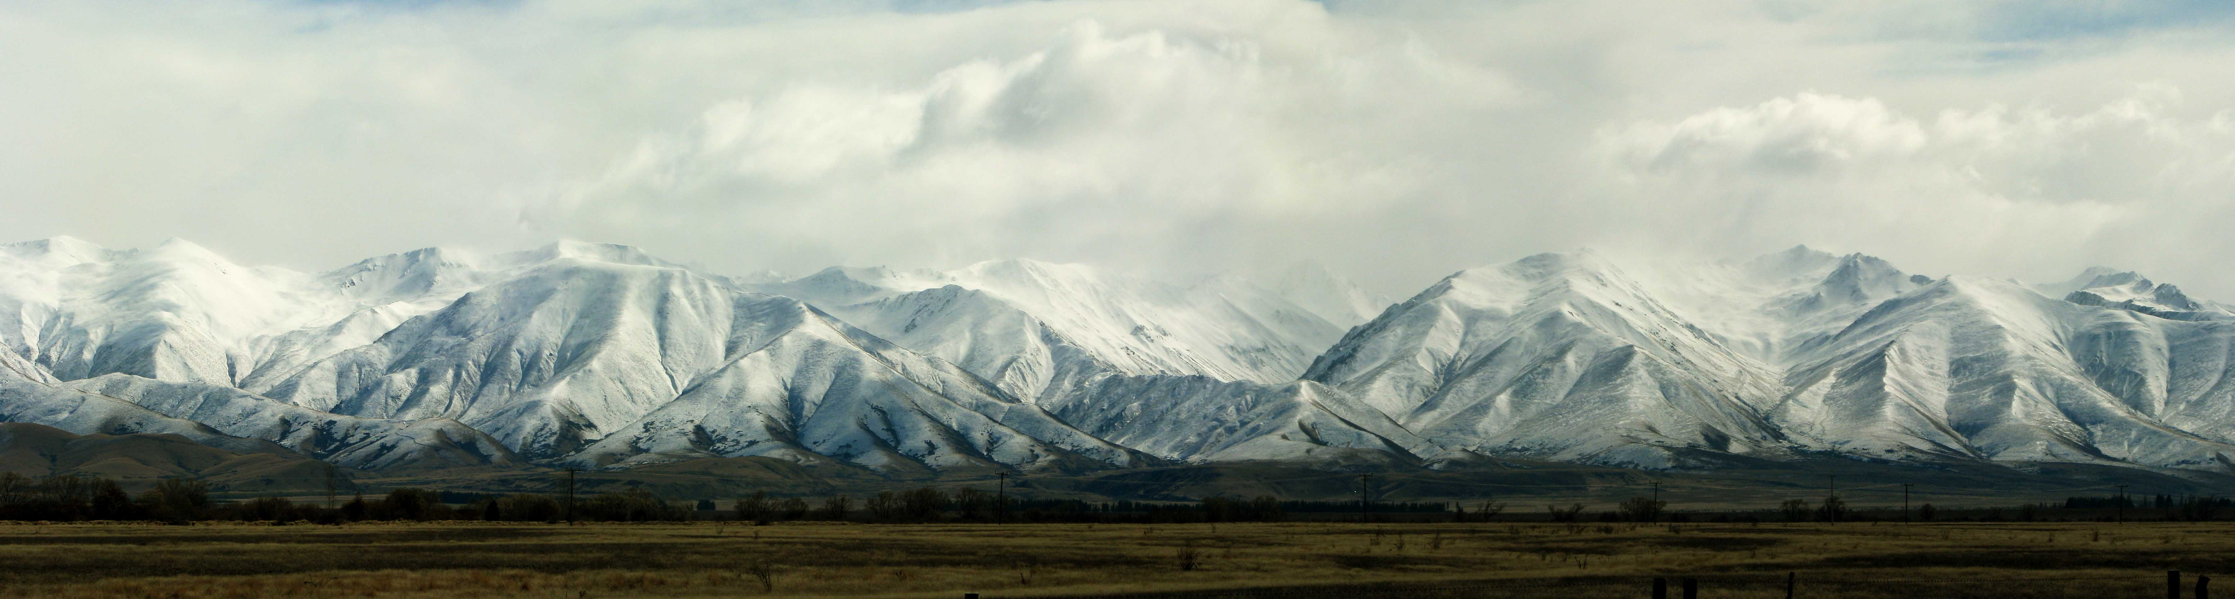
Problem with the refreezing image
May develop cultures and structures not conducive to continuous change.
Creates image of the need to design in stability (refreezing).
  ‘Organizations are never frozen, much less refrozen, but are fluid entities’. (Kanter et al., 1992: 10)

Slide 15
Dunphy and Stace situational model of change
Scale of change
  Fine tuning
  Incremental adjustment
  Modular transformation
  Corporate transformation
Style of leadership
  Coercive
  Directive
  Consultative
  Collaborative

Slide 16
Four types of change strategies
Participative Evolution: refers to incremental change through collaboration
Forced Evolution: refers to directive incremental change
Charismatic Transformation: used to describe large-scale collaborative change
Dictatorial Transformation: describes large-scale coercive change programmes

Slide 17
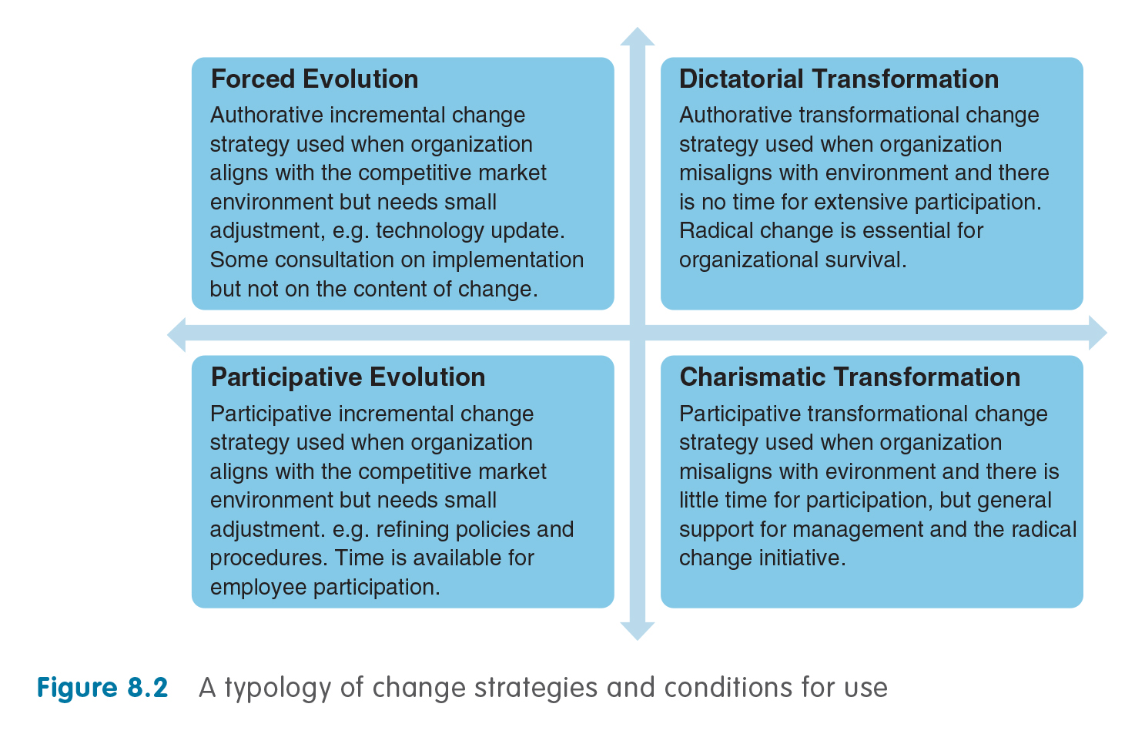
Source: Dunphy, D. and Stace, D. (1990: 90) Under New Management. NSW: McGraw-Hill

Slide 18
Weaknesses of situational model
Suggest that there is a single strategy appropriate for regaining internal fit with the external environment.
Snapshot that ignores timeframe of change.
No account of political dimension (trade unions, negotiation) and power plays.
Contingency approach tends to impose unidirectional rational models on what is a complex and dynamic process is.

Slide 19
Transforming your organization
1. Establish a sense of urgency
  Examine the market and competitive realities.
  Identify and discuss crises, potential crises or major opportunities.
2. Form a powerful guiding coalition
  Assemble a group with enough power to lead the change effort.
  Encourage the group to work together as a team.

Slide 20
Vision and communication
Create a vision
  Create a vision to help direct the change effort.
  Develop strategies for achieving the vision.
Communicate the vision
  Use every vehicle possible to communicate the new vision and strategies.
  Teach new behaviours by the example of the guiding coalition.

Slide 21
Empowerment and short-term wins
Empower others to act on the vision
  Get rid of obstacles to change.
  Change systems or structures that seriously undermine the vision.
  Encourage risk-taking and non-traditional ideas, activities and actions.
Create short-term wins
  Plan for visible performance improvements.
  Recognize and reward employees involved in improvements.

Slide 22
Consolidate and institutionalize
Consolidate improvements and change
  Use increased credibility to change systems, structures and policies that do not fit the vision.
  Hire, promote and develop employees who can implement the vision.
  Reinvigorate the process with new projects.
Institutionalize new approaches
  Articulate the connections between the new behaviours and corporate success.
  Develop means to ensure leadership development and succession.

Slide 23
Three criticisms of the model
Kotter’s model implies that change is a sequence of events that if managed correctly guarantees success.
Very top-down and difficult to change direction once started (flexibility issue).
In practice, stages often overlap and re-order.

Slide 24
Kotter’s Dual operating system
Mounting complexity and rapid change create strategic challenges that even a souped-up hierarchy can’t handle. That’s why the dual operating system – a management-driven hierarchy working in concert with a strategy network – works so remarkably well.
(Kotter, 2012: 48)

Slide 25
Two systems in concert
The Strategy system
  Networks.
  Flexibility and agility.
  Seeks strategic opportunities.
  Dynamic innovative creative force.
  Searching, doing, learning, modifying.
The Operating system
  Hierarchies.
  Structure and regulation.
  Maintains daily operations.
  Performance and efficiency driven.
  Predictability, control effectiveness.

Slide 26
Five principles
Many change agents, not just the usual few appointees (volunteers).
A ‘want-to’ and a ‘get-to’ not just a ‘have-to’ mindset (desire to engage).
Head and heart, not just head (give meaning to work, appeal to emotions).
Much more leadership, not just more management.
Two systems, one organization (strategy network and hierarchy inseparable).

Slide 27
Kotter’s (2012) Eight accelerators for change (1 of 2)
Create a sense of urgency around a single big opportunity: ongoing, abiding urgency.
Build and maintain a Guiding Coalition (GC): volunteers from all areas, all equal.
Formulate a strategic vision and develop change initiatives designed to capitalize on the big opportunity.
Communicate the vision and the strategy to create buy-in and attract a growing volunteer army.

Slide 28
Kotter’s (2012) Eight accelerators for change (2 of 2)
Accelerate movement towards the vision and the opportunity by ensuring that the network removes barriers.
Celebrate visible, significant short-term wins.
Never let up. Keep learning from experience. Don’t declare victory too soon.
Institutionalize strategic changes in the culture as evidence in day-to-day activities.

Slide 29
The process that enables the strategy network to function

Slide 30
Volunteer army on the move
The volunteer army are regular employees – not consultants or new hires – that are committed and enthusiastic.
It is essential that the guiding coalition and the executive committee maintain close communication.
  People won’t want to do a day job in the hierarchy and a night job in the network – which is essentially how a dual operating system works – if you appeal only to logic … you must appeal to their emotions. (2012: 49)

Slide 31
Summary of areas covered
Lewin’s unfreezing, changing, refreezing stages are a founding OD example.
Contingency approaches advocate aligning change strategies with prevailing circumstances.
Kotter’s dual strategy and operating system start to engage with process.

