Slide 2


The DCF and AFL
UWTSD
5008 Presents

Slide 3

The
DCF and
AFL?

Slide 4

By the end of the Lecture, you will have...
Discussed what the DCF and AFL are
Learned about how to use digital platforms in your teaching
Experimented with digital platforms
Started to plan an activity that includes a new digital platform that you have been introduced to in this lecture

Slide 5

Assessment of, Assessment for
What are the major differences between the concepts of assessment of learning and assessment for learning?

Slide 6
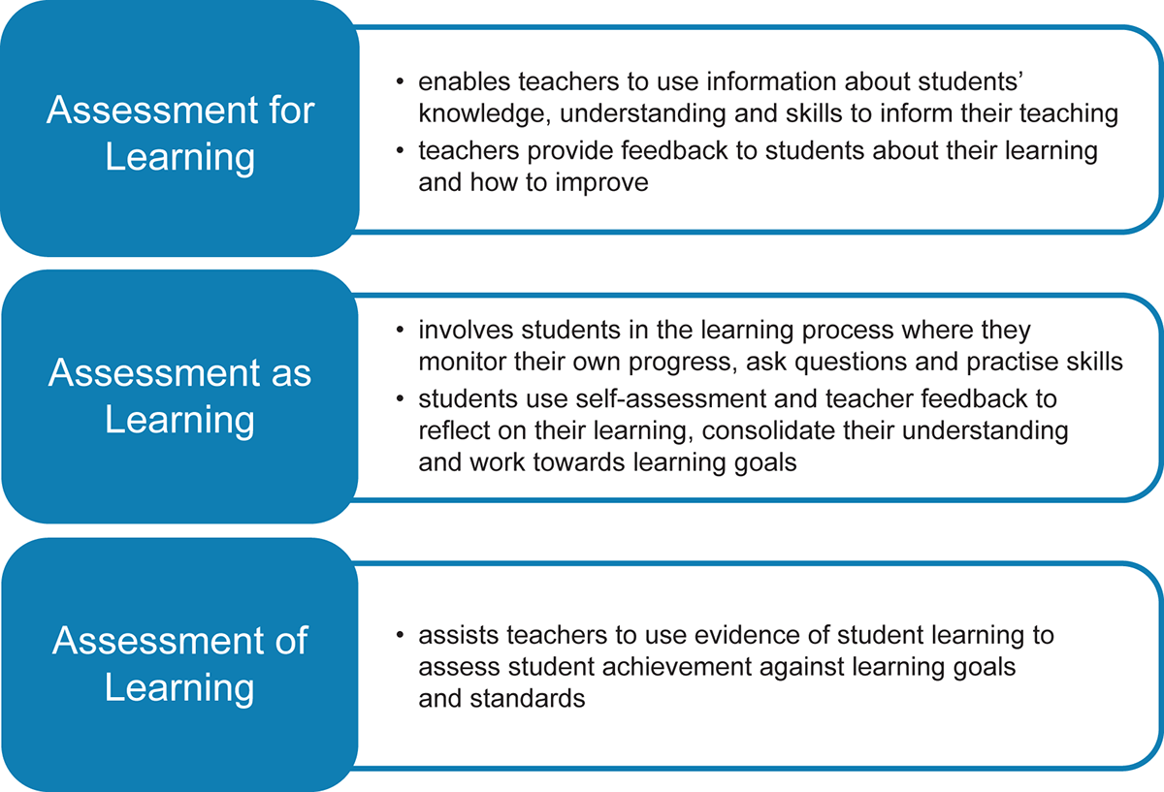

Slide 7
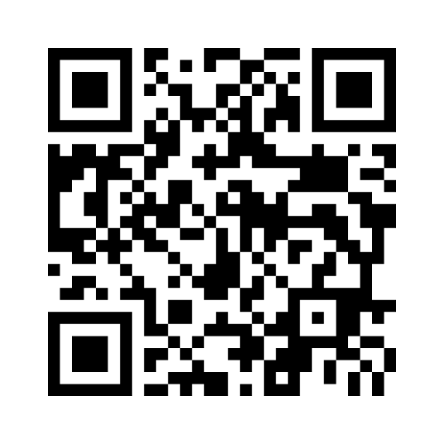
What comes to mind when you think of the DCF?
7968 0287

Slide 8
WHAT THE DCF IS, AND WHAT IT ISN'T
Digital competence is the set of skills, knowledge and attitudes that enable the confident, creative and critical use of technologies and systems.
Not using tech for techs sake

Slide 9
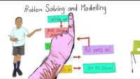

Slide 10

The Strands and elements
Citizenship | Interacting and collaborating | Producing | Data and computational thinking
Identity, image and reputation Health and well-being Digital rights licensing and ownership Online behaviour and cyberbullying | Communication Collaboration Storing and sharing | Planning, sourcing and searching Creating Evaluating and improving | Problem solving and modelling Data and information literacy

Slide 11
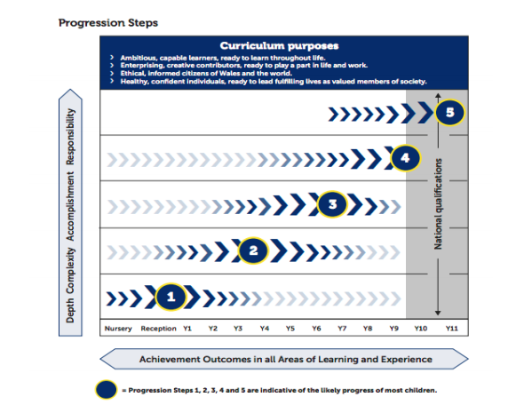
Key stage 2 (ISH)
Loose links to progression steps and years
Anywhere from the lower end of Progression Step 2 and top of progression step 3

Slide 12
Links to AFL - Quick Task
Citizenship | Interacting and collaborating | Producing | Data and computational thinking
Identity, image and reputation Health and well-being Digital rights licensing and ownership Online behaviour and cyberbullying | Communication Collaboration Storing and sharing | Planning, sourcing and searching Creating Evaluating and improving | Problem solving and modelling Data and information literacy
Notes:
You have 10 mins work as Nosy Neighbours
Consider these strands of the DCF and think could they lend themselves or link to assessment for Learning in my teaching practice ?
Use the 4 strands above as branches to a mind map of ideas. Include as many different ideas as you think of.

Slide 13
Links
Clear links : where evidence can be generated using DCF Skills
Extra links: where work can be generated to meet DCF requirements

Slide 14
William’s (2005) 5 key strategies for AfL
Clarifying and understanding
clarifying and understanding learning intentions and criteria for success
Engineering
engineering effective classroom discussions, questions and tasks that elicit evidence of learning
Providing
providing feedback that moves learners forward
Activating
activating students as instructional resources for each other, and
Activating
activating students as owners of their own learning
Notes:
.

Slide 15
clarifying and understanding learning intentions and criteria for success
engineering effective classroom discussions, questions and tasks that elicit evidence of learning
providing feedback that moves learners forward
activating students as instructional resources for each other, and
activating students as owners of their own learning
Using
Aspects of the DCF
Interacting and collaborating
Producing
Notes:
Class room discussion does not have to happen exclusively verbally

Slide 16
Interacting and collaborating | Through these elements learners will look at methods of electronic communication and know which are the most effective. Learners will also store data and use collaboration techniques effectively.
Element | Progression step 2 | Progression step 3
Communication | I can exchange simple online communication using one or more types of technology, e.g. e-mail or video call. | I can exchange online communications, making use of a growing range of available features, e.g. add attachments or hyperlinks, change formatting.
 | I can explain the advantages of communicating electronically, e.g. time saving, cost effectiveness, ability to have multiple users communicating simultaneously. | I can show an understanding of the advantages and disadvantages of different forms of communication and when it is appropriate to use each, e.g. explain when video conferencing may be more appropriate than e-mail, and vice versa; explain the pros and cons of using instant messaging in social contexts; talk about purpose and audience.
Collaboration | I can use online collaborative platforms to create and edit a file, e.g. word processing, presentation tools and spreadsheets. | I can work with others to create an online collaborative project for a specific purpose, sharing and appropriately setting permissions for other group members, e.g. editing, commenting, viewing.

Slide 17
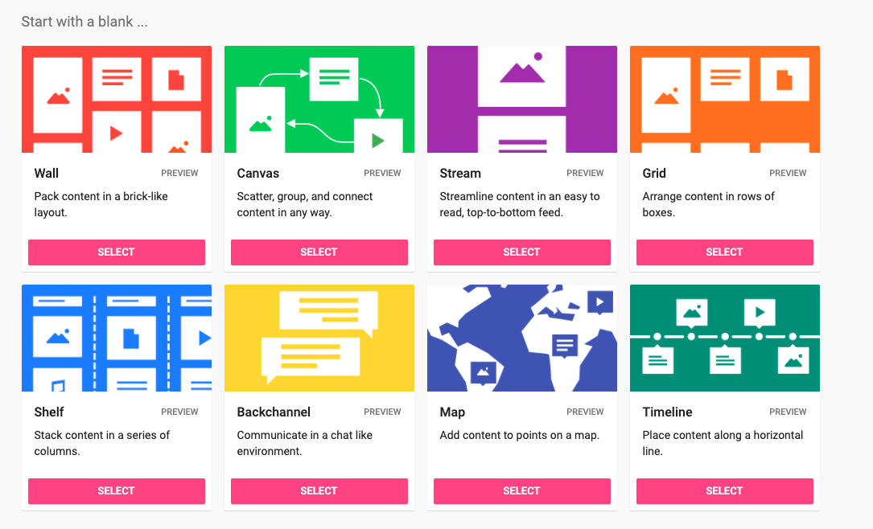
Padlet
Good for creating debates
Using ideas to generate feedback, discussion and opinions.
You can use it to reward pupils for good ideas and it allows people to attempt to answer without feeling shy or worried about people's reaction

Slide 18
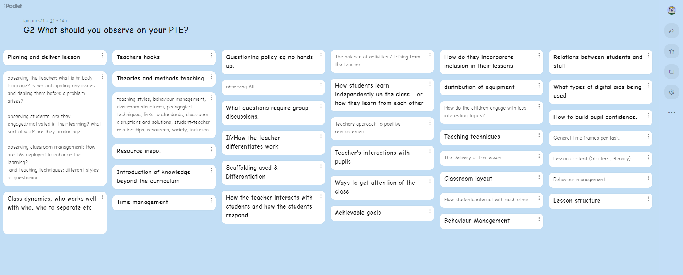

Slide 19
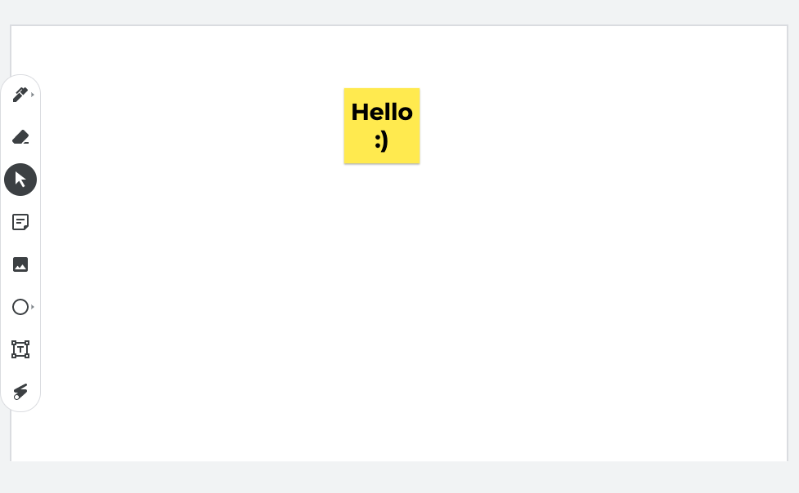
Google Jamboard
Really great for combining ideas and collaborating on projects
Can be a mix of images, text/ post its etc.
Go to the board and select a sticky note add a note with your favorite film in it

Slide 20


Slide 21
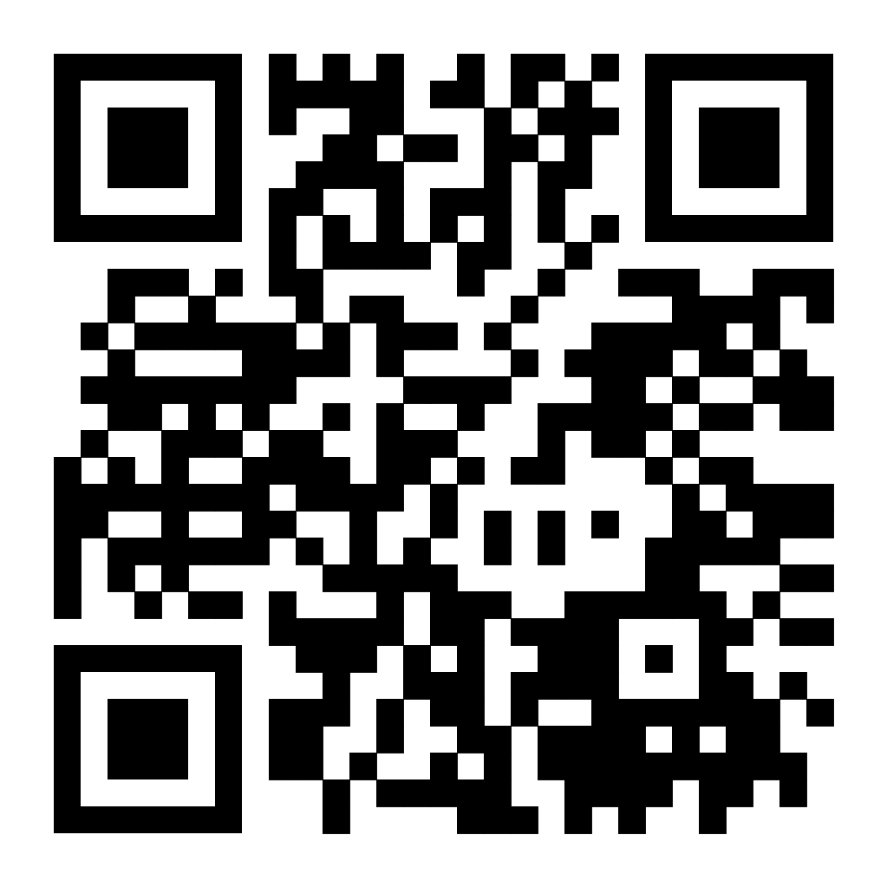
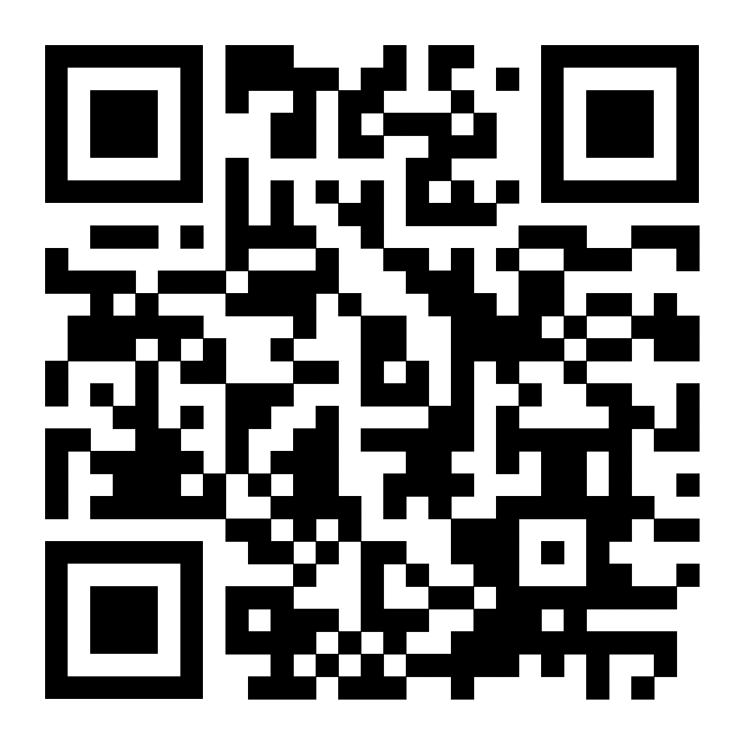

Slide 22

Office 365
A huge benefit of the MS suite is we can use it to collaborate and share but it is also free to schools and educators.
You can download for free on up to 5 different devices
How many of these elements do you use?

Slide 23


Slide 24


Slide 25

JOIN CODE c3867634
Flipgrid
As mentioned previously, flipgrid can be used to help:
  Establish a sense of community with learners
  Engage learners in open discussion
Possible Activities
  Topic discussion
  Goal Setting/Reflection
  Digital/Oral Reading Responses
  Teacher/Student Introduction
  Exit Ticket
  Collaboration
  Video for Future Students
  Peer Reviews and/or Feedback on Science Projects (or any subject/project)

Slide 26
Platforms | Link | How it is used
Jamboard | https://jamboard.google.com/ | A shared collaboration space similar to a whiteboard
Padlet | https://en-gb.padlet.com/ | Allows submission of text and media to a shared noticeboard
O365/Sharepoint | Various | Office 365 allows you to collaborate and contribute to the same documents.
Google docs | https://docs.google.com/ | Works in a similar way to the office suite but using Google Docs
Trello | https://trello.com/en | Similar to Padlet though more rigidly structured. Also useful for project planning
Minecraft Education edition | https://education.minecraft.net/ | Allows collaboration and creativity in a 3-D environment. Free with your UWTSD email
Mentimeter | https://www.mentimeter.com/ | Allows some submission from students
Mural | https://app.mural.co/ | allows teams to collaborate on ideas
SeeSaw | https://web.seesaw.me/seesaw-for-schools-demo | Students can record and allows teachers to create and share activities
Wakelet | https://learn.wakelet.com/ | Allows the creation of a collaborative “collection” – these can be anything from projects to reading lists or plans
Flipgrid |  | Can create and share topics and collaborate in groups with feedback ☺

Slide 27
Planning to include DCF
You don’t!
You plan to teach based on your sound pedagogy
You look for opportunities for DCF

Slide 28

TASK
Consider all the different things we have spoken about today and start to plan 40 -60 min activity with a year group from Y3-6.
1
You must choose a strand of the DCF as clear focus to the activity and include one of the new technologies we have spoken about today in your lesson.
2
Plan the activity, with timings, location, environment, how the task will be completed and if it’s a individual, pair or group task.
3

Slide 29
At the end of the Lecture, do you feel confident that you have...
Discussed and understood what the DCF and AFL are?
Learned about how to use digital platforms in your teaching?
Experimented with digital platforms ?
Started to plan an activity that includes a new digital platform that you have been introduced to in this lecture

