Slide 1

ECDE7013 FT
OCTOBER- DECEMBER 2023:
PLANNING YOUR WORK

Slide 2

Today’s session
2 October 2023
10.00-4.00

Slide 3
2 October
Welcome and overall plan for today
AM
-Review Saturday’s session, research tools and design and your two draft chapters
-Why a research dairy?
- How you planning your overall structure? See example of contents page
PM
-Why research tools and value of a pilot?
-Why your chosen form of data analysis?

Slide 4
Reflecting on Saturday 30-9 ?
Bruner and a ‘spiral’
June-July
August-
September
October-December
Bruner argued:
‘A curriculum as it develops should revisit … basic ideas repeatedly, building upon them until the student has grasped the full formal apparatus that goes with them’ (1960,p.13).
Jerome Bruner (1960) The Process of Education
https://infed.org/mobi/jerome-bruner-and-the-process-of-education/

Slide 5
Reflecting on Saturday 30-9 ?
Bruner and a ‘spiral’
Initial plan
Draft/s:
Reflect & refine
Pilot & amend
Keeping a research diary
See example (link on moodle)
Ways of reflecting on and refining your work

Slide 6

What is the difference between method and methodology?

Slide 7
How does the theoretical frame shape the reserch design & analysis of data?
The development of the theoretical framework helps to clarify your implicit theory in a manner that is more clearly defined.
It helps you to consider possible frameworks for analysis

Slide 8
What is the difference between method and methodology?
Methodology
Methods or research tools
refers to the overarching strategy and rationale of your research project. It involves studying the methods used in your field and the theories or principles behind them in order to develop an approach that matches your objectives.
“Methodology is the philosophical framework within which the research is conducted or the foundation upon which the research is based” (Brown, 2006).
are the specific tools and procedures you use to collect and analyse data (e.g. questionnaires, interviews).

Slide 9
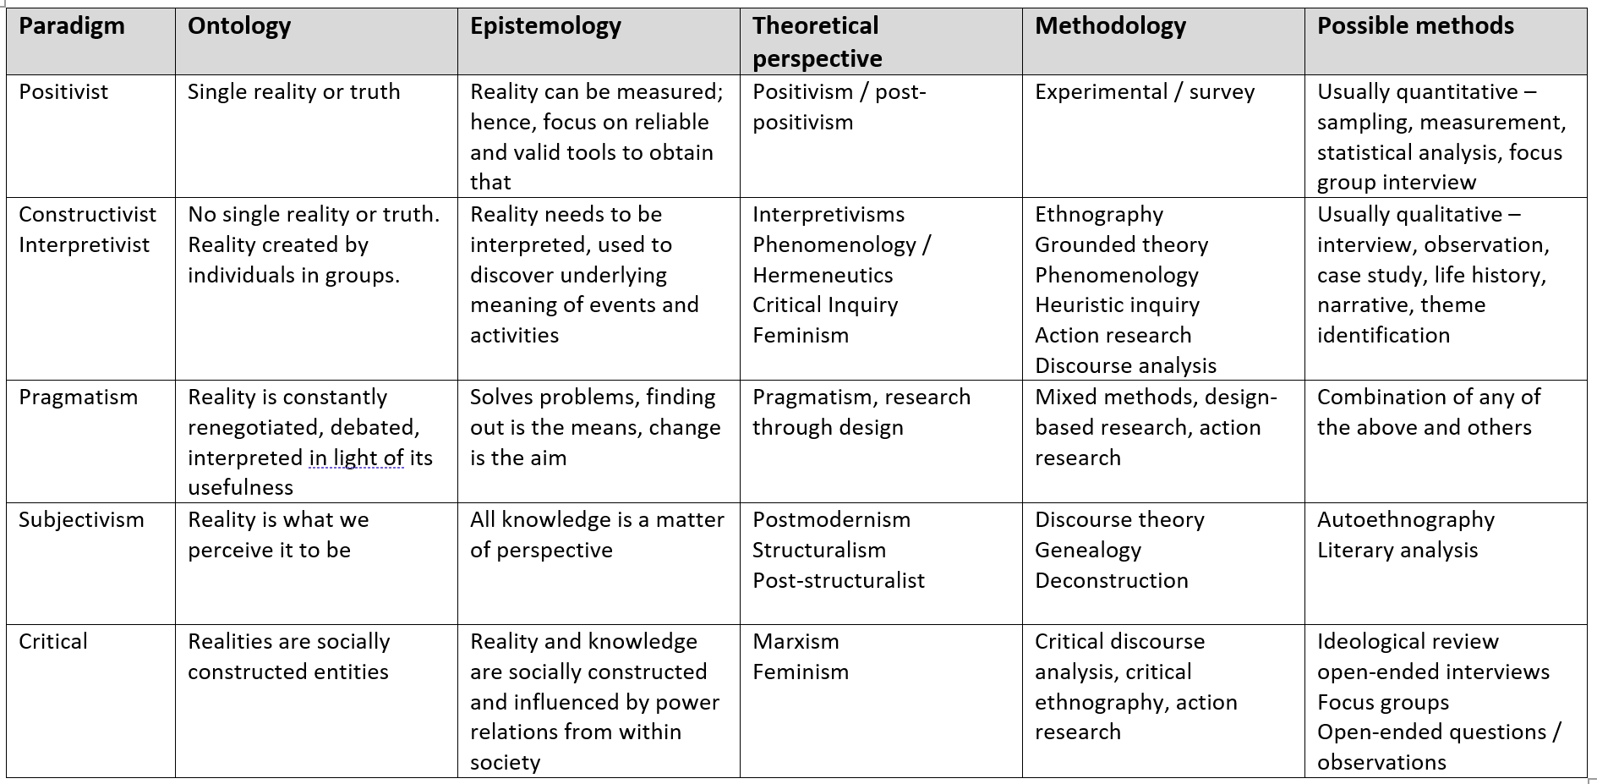

Slide 10
Further reading – after today : 2 October
Research methodologies. Re-read McGregor (2018)
See ‘Resources FT students’
Read one page table that summarises research paradigms and chapter by McGregor (2018, p.1-7).
Ask yourself : How does table, and the key ideas in p1-7 of chapter, relate to the research methodology you have chosen?
Please review your draft ‘Methodology and methods’ chapter – and check for clarity

Slide 11
Review your methodological approach? Combine
Your “what” ?
With your “why” ?
What research problem or question are you investigating?
Are you
  Aiming to describe the characteristics of something?
  Explore an under-researched topic?
  Establish a causal relationship?
What type of data do you need to achieve this aim?
Quantitative data, qualitative data, or a mixture of both?
Start with a discussion of the rationale and assumptions underpinning your methodology. In other words, why did you choose these methods for your study?
Why is this the best way to answer your research question?
Is this a standard methodology in your field or does it require justification?
Were there any ethical considerations involved in your choices?
What are the criteria for validity and reliability in this type of research? Or why trustworthy?

Slide 12
What is the difference between research methods and research design?

Slide 13
What is the difference – but relationship-between research design and methods/tools?
Research design
Research methods/tools
is the overall structure of the research
focuses on the type of study that is planned and the results that might be expected
is based on the research question
are the tools and procedures that will be used to collect, gather and analyse data
focus on the most suitable ways in which data can be collected- gathered or constructed
will depend on the research design

Slide 14
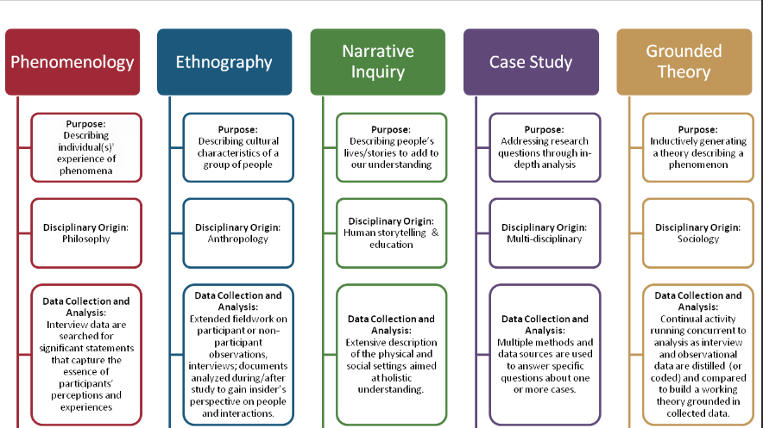

Slide 15
Task: 15 mins. Your research design and tools
Design a diagram/slide outlining your research design, your tools and sequence
This might take the form of a flow diagram, a timeline or a table: September – December
Include the research activities of the project and steps in your design (for example, how the outcomes of a survey will inform the question design for your interview).

Slide 16

Reporting your research tools

Slide 17
Questionnaires
Describe where, when and how the questionnaire was conducted.
How did you design the questionnaire?
What form did your questions take (e.g. multiple choice, Likert scale)?
Were your surveys conducted in-person or virtually?
What sampling method did you use to select participants?
What was your sample size and response rate?
Interviews
Describe where, when and how the interviews were conducted.
How did you find and select participants?
How many participants took part?
What form did the interviews take (structured, semi-structured, or unstructured)?
How long were the interviews?
How were they recorded?
Use of pre-existing data
Explain how you gathered and selected the material (such as datasets or archival data) that you used in your analysis.
Where did you source the material?
How was the data originally produced?
What criteria did you use to select material (e.g. date range, related to a particular group)?
Observation
Describe where, when, and how you conducted the observation.
What group or community did you observe? How long did you spend there?
How did you gain access to this group? What role did you play in the community?
How long did you spend conducting the research? Where was it located?
How did you record your data (e.g., audiovisual recordings, note-taking)?

Slide 18
Building on Saturday’s event?
Review
Research tools | Key authors | How are you planning to use the tools-in your context | Why these tools- given your aims, objectives and research questions
Messages from students who completed 7013 – and now in first year of their thesis?
Write
Re-write
Keep writing

Slide 19
Piloting research tools – why bother?
Interviews & questionnaires
Piloting is crucial:
ensure that researcher has included questions necessary to measure the concept being studied (Dikko, 2016)
help identify if there are flaws, or limitations within the interview design that allow necessary modifications to the major study (Kvale, 2007)
To ensure validity- reliability- and trustworthiness
Paired work- and piloting tools with group

Slide 20
What do I include in a methodology and methods chapter? Review your draft ☺
This chapter of your research study should
Combine brief description/ intro – with an analysis of your theoretical framework, research design, research methods/tools, approaches and methods of data analysis.
Justify why the methods/ tools applicable / ‘fit for purpose’
Justifies your choices by describing advantages- how piloted and developed- but recognising limitations of methods/tools, approach and design
Drafting and refining final version? Need for critical reading and notemaking using core textbooks and specific journal articles

Slide 21
Review and revise overall structure ? 12,000 words
See moodle page and ‘Resources’
https://moodle.uwtsd.ac.uk/course/view.php?id=6837&section=9
Questions about your draft structure and content page?
Revise overall structure- if needed- and make notes on what you plan to do next

Slide 22

Analysing what we see?

Slide 23
Describe your data collection methods
Be sure to discuss the criteria you used to select your data, the context in which your research was conducted and the role you played in collecting your data (e.g. were you an active participant or a passive observer?)
Once you have introduced your reader to your methodological approach, you should share full details about your data collection methods.
Discuss your sampling method as well as any tools you used to gather your data.

Slide 24
Questions to consider?
What might have an impact on the way in which we interpret data?
Does / might the way in which we look at data depend on our own interests? How? Why?
What might we analyse?
Might we undertake the analysis differently depending on what we are looking for?
Your questions about data analysis?
Discuss in group
Follow up with notes in your research diary

Slide 25
Describe your analysis method
Next, you should discuss the way in which you processed and analysed your data.
NB - you should not start introducing or discussing any of your results at this point.
Quantitative methods
In quantitative research, your analysis will be based on numbers. In your methods section, you can include:
How you prepared the data before analysing it (e.g. checking for missing data, removing outliers)
Which software you used (e.g. SPSS)
Which statistical tests you used (chi square, t-test) https://stats.oarc.ucla.edu/spss/modules/an-overview-of-statistical-tests-in-spss/
Qualitative methods
In qualitative research, your analysis will be based on language, images and observations (often involving some form of textual analysis). Specific methods might include:
Content analysis: Categorizing and discussing the meaning of words, phrases and sentences
Thematic analysis: Coding and closely examining the data to identify broad themes and patterns
Discourse analysis: Studying communication and meaning in relation to their social context
Include information about software if you used any, e.g. Nvivo (or mention that you did it manually)

Slide 26
Evaluate and justify the methodological choices you made
Your ‘methodology’ section should make the case for why you chose the methods you did.
Show how this approach contributes new knowledge or understanding.
You could also discuss why other methods were not suitable for your objectives (but take care with word counts).
It should be clear to your reader that you set yourself up for success in terms of your methodology’s design.
Show how your methods should lead to results that are valid and reliable (while leaving the analysis of the meaning, importance and relevance of your results for your discussion section)

Slide 27
Reliable v. Valid???
 | Reliability | Validity
What does it tell you? | The extent to which the results can be reproduced when the research is repeated under the same conditions. | The extent to which the results really measure what they are supposed to measure.
How is it assessed? | By checking the consistency of results across time, across different observers, and across parts of the test itself. | By checking how well the results correspond to established theories and other measures of the same concept.
How do they relate? | A reliable measurement is not always valid: the results might be reproducible, but they’re not necessarily correct. | A valid measurement is generally reliable: if a test produces accurate results, they should be reproducible.

Slide 28
Reliable v. Valid???
A symptom questionnaire is used to diagnose a patient with a long-term medical condition.
Reliability =
The extent to which the results can be reproduced when the research is repeated under the same conditions.
Several different doctors use the same questionnaire with the same patient at the same time with the same diagnoses.
This indicates that the questionnaire…..
Several different doctors use the same questionnaire with the same patient at the same time but give different diagnoses.
This indicates that the questionnaire…
has high reliability
has low reliability

Slide 29
Reliable v. Valid???
A symptom questionnaire is used to diagnose a patient with a long-term medical condition.
Reliability =
The extent to which the results can be reproduced when the research is repeated under the same conditions.
Validity =
The extent to which the results really measure what they are supposed to measure.
Several different doctors use the same questionnaire with the same patient at different times. The diagnoses are the same.
This indicates that the questionnaire…..
has high reliability and high validity

Slide 30
What elements can effect validity?
Element | Meaning
Sampling bias | The sample is not representative of the population.
History | An unrelated event influences the outcomes (e.g. results of a test makes participants have a negative view).
Experimenter effect | The characteristics or behaviours of the experimenter unintentionally influence the outcomes.
Hawthorne effect | The tendency for participants to change their behaviours simply because they know they are being studied.
Situation effect | Factors like the setting, time of day, location, researchers’ characteristics etc. limit generalisability of the findings.
How can we counter these threats?

Slide 31
Ensuring…
Validity: The extent to which the results really measure what they are supposed to measure.
Can participants answer the questions? We must ensure that we should ask the questions that they are capable of providing answers.
In a questionnaire, are the response codes provided sufficient? Missing response codes can lead to answers being forced to fit into the codes provided, or to large numbers of ‘other’ answers.
Do the response codes provide the sufficient discrimination? If most respondents give the same answer, then the pre-codes provided may need to be reviewed to see how the discrimination can be improved and, if that cannot be achieved, queries should be raised regarding the value of including the question.
Do questions and responses allow us to answer the research question(s)? We need to ensure that the answers which respondents give to those questions are the responses to the questions that we think we are asking.

Slide 32
Reliability
The extent to which the results can be reproduced when the research is repeated under the same
In an interview situation, do the questions sound right? It is surprising how often a question looks acceptable when written on piece of a paper but sounds false, stilted or simply silly when read out loud. Might the question need to be paraphrased so that it sounds more natural?
Do the participants understand the questions? It is easy for technical vocabulary and jargon to creep into questions, so we need to ensure that it is eliminated.
Have we included any ambiguous questions, double barrelled questions, loaded or leading questions?
Does the interview retain the attention and interest of participants throughout? If attention is lost, then the quality of the data may be in doubt. Changes may be required in order to retain the respondent’s interest.
Does the interview flow properly?
In a questionnaire, can the respondent understand the routing instructions? Particularly with paper questionnaires, we should check that the routing instructions can be understood.
Does the questionnaire unfolds in a logical sequence, with a minimum of jumps between different ideas?

Slide 33
Trustworthiness- not reliable or valid
Lincoln and Guba (1985) refined the concept of trust-worthiness by introducing the criteria of credibility, transferability, dependability, and confirmability to parallel the conventional quantitative assessment criteria of validity and reliability
See these criteria of trustworthiness
Credibility eg to include a ‘fit’ between respondents’ views and the
researcher’s representation of them.
Transferability – not directly from one to another- but ‘thick descriptions’
Dependability - including clearly documented
Confirmability- and rigour eg the researcher can show how the conclusions have been reached

Slide 34

Exploring Theses

Slide 35
Exploring Theses
https://ethos.bl.uk
Or google: EThOS

Slide 36
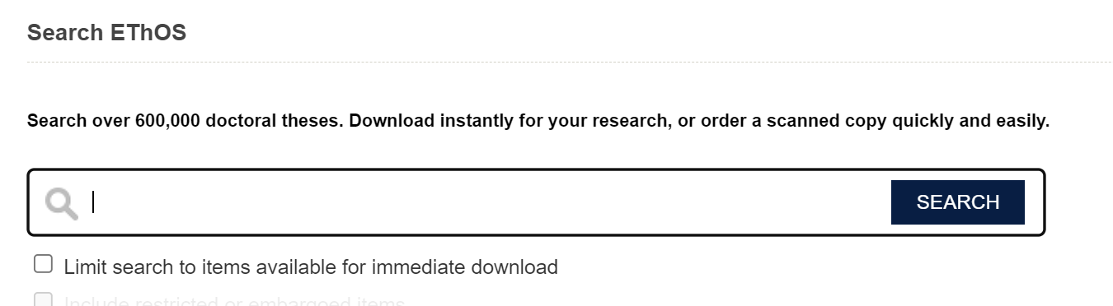
Exploring Theses

Slide 37
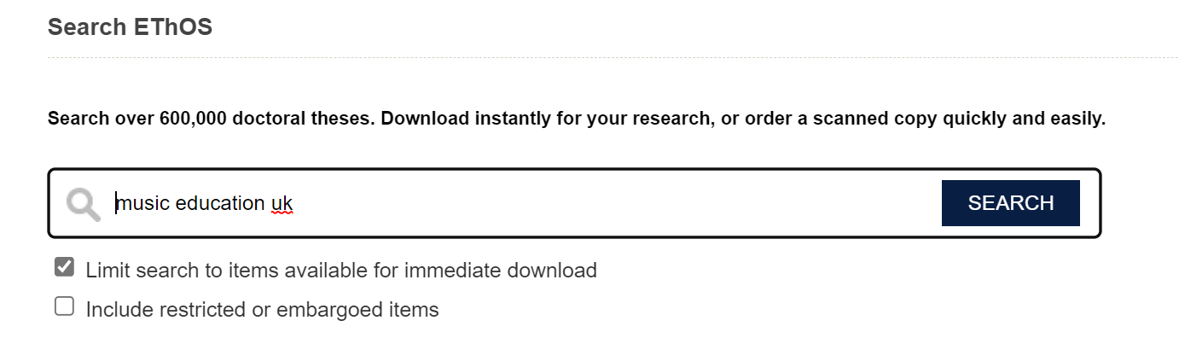
Exploring Theses
Write in keywords here.
Tick this box.

Slide 38
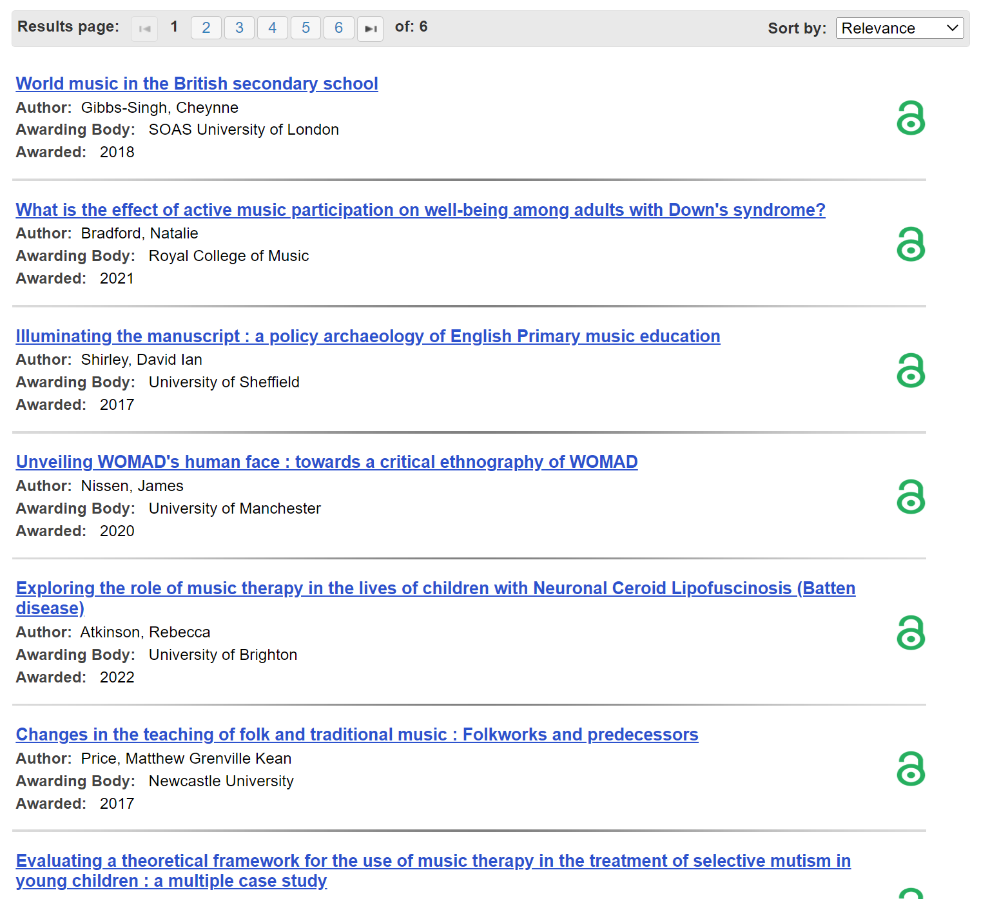
Exploring Theses

Slide 39
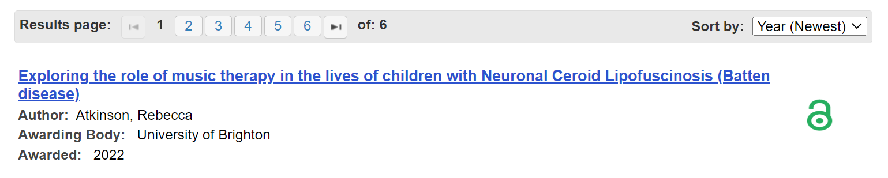
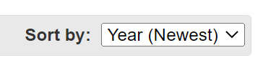
Exploring Theses

Slide 40
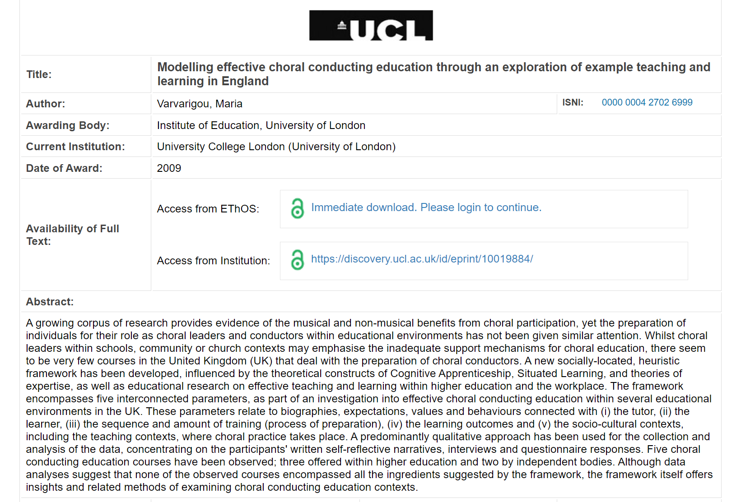
Exploring Theses

Slide 41
Exploring Theses
#1 – read the abstract
01
03
04
05
02

Slide 42
Exploring Theses
#1 – read the abstract
01
#3 – identify the methodology
03
#4 – identify the research tools
04
#5 – identify the analytical framework
05
#2 – identify the theoretical framework
02
Can you…?

