Slide 1

Notes:
Welcome to the Presentation

Slide 2

BMIH4003 Hospitality and Guest Services
Assignment Tittle: The role and importance of quality service, hospitality,
and guest services within the hotel industry
Notes:
Topic: The role and importance of quality service, hospitality, and guest services within the hotel industry

Slide 3
Table of Contents
Introduction
An Overview of Marriott International Hotel’s Brand
Potential Customers of JW Marriot in Different Countries
  Services Available for Business Guests
  Services Available for Family Guests
  Services Available for Tourist
Significance of Hospitality and Guest Service in the Tourism Industry
Skilled Required for Fulfilling Customer's Expectation
Strategies to Fulfill Customer's Expectations
Conclusion
Reference
Notes:
Contents

Slide 4

Introduction
The tourism industry is the combination of several industries such as hospitality, travel company, transportation and tourist destination.
The tourism industry is intended to facilitate business activities by providing quality services and goods to give pleasure and created a home environment for leisure activities and relaxation (Kasemsap, 2015).
A good customer service strategy is successfully interacting with the customers, understanding their needs, listening to their opinion and providing a favourable environment to meet their needs.
Notes:
The tourism industry is the combination of several industries such as hospitality, travel company, transportation and tourist destination. The tourism industry is intended to facilitate business activities by providing quality services and goods to give pleasure and created a home environment for leisure activities and relaxation (Kasemsap, 2015). Customer service is creating opportunities for potential customers to offer the company product or service for use. The service or product ensures the best utilization and enjoyable experience for the customers. A good customer service strategy is successfully interacting with the customers, understanding their needs, listening to their opinion and providing a favourable environment to meet their needs.

Slide 5
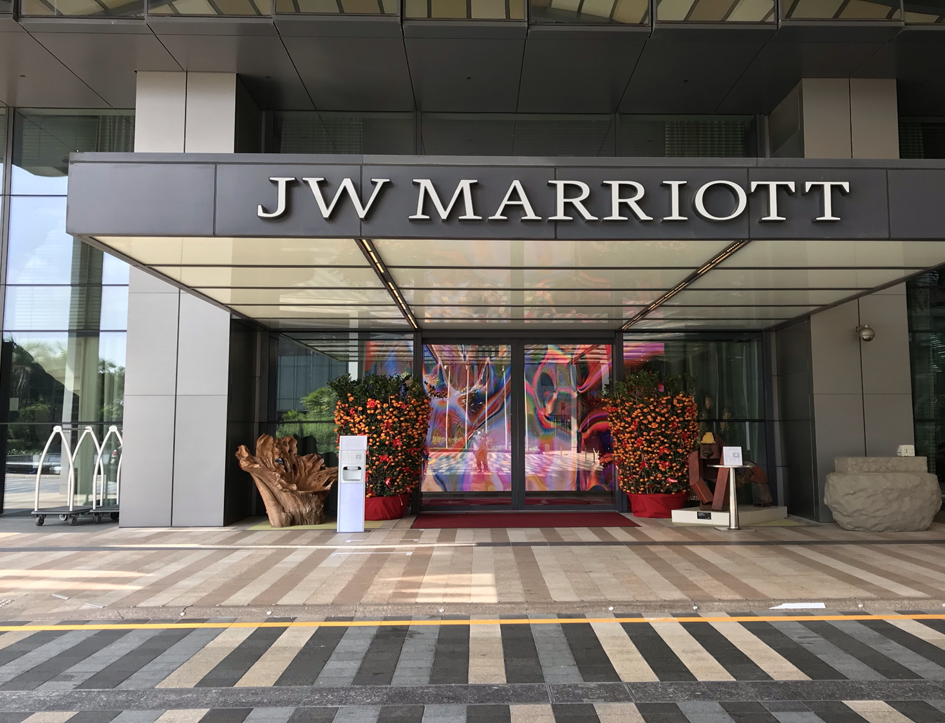
An Overview of Marriott International Hotel’s Brand
Marriot International is one of the most innovative luxurious and clients oriented hotels in the world. It has almost 7000 properties in 131 different countries to provide customer service to people (Granito, 2014)
JW Marriot has over 100 properties in 35 countries which is offering a favourable environment that specially designs to give the best experience to the customers of relaxation and spending leisure. This hotel brand is motivated by the principles of relaxation and mindfulness that gives customers a remarkable experience
Notes:
Marriott International is one of the most innovative, luxurious and clients oriented hotels in the world. This American multinational hotel company has a powerful portfolio in the field of customer service. It has almost 7000 properties in 131 different countries to provide customer service to people (Granito, 2014). JW Marriot is one of the luxurious hotel brands of Marriott International that provide hotel services on five continents.
JW Marriot has over 100 properties in 35 countries which is offering a favourable environment that specially designs to give the best experience to the customers of relaxation and spending leisure. This hotel brand is motivated by the principles of relaxation and mindfulness that gives customers a remarkable experience.

Slide 6

Potential Customers of JW Marriot in Different Countries
Potential customers are attracted by the quality of products and services that fulfil their needs. In the tourism industry, most of the consumers are:
Tourists
Family Guests
Business Organizations (Sharma, 2019).
Notes:
Potential customer refers to a person who has an interest to experience the service or buy the product of a company which he didn't buy or experienced before. Potential customers are attracted by the quality of products and services that fulfil their needs. In the tourism industry, most of the consumers are tourists, families and business organizations (Sharma, 2019). This hotel gives the best experience of spending leisure, hangout with families and restaurant services. The higher class people of society are also facilitated by the luxurious service of the hotel. Tourists are getting lodging services in the hotel as well as business organizations have organized conferences and hotel meetings in the hotel to get a better experience.

Slide 7

Significant Guests Services Provided by JW Marriot (cont’d)
Services Available for Business Guests
Providing several services such as selecting rooms, cancelling their bookings, online reservations and catering service to customers (Kamin, 2016).
Arrange business conferences and corporate meeting in the hotel.
Gives emergency services like booking flights and helps to reach the airport with hotel transportation
Notes:
Hotel customer service represents the assistance provided by the hotel before, during or after the stay of the customers. For business guests, JW Marriot is providing several services such as selecting rooms, cancelling their bookings, online reservations and catering service to customers (Kamin, 2016). The business guests also arrange their business conferences and corporate meeting in the hotel. JW Marriot provides the best environment for a business conference with huge participant capability as well as excellent guest services. It also gives emergency services like booking flights and helps to reach the airport with hotel transportation.

Slide 8

Significant Guests Services Provided by JW Marriot (cont’d)
Services Available for Family Guests
Family guests are coming to the hotel for relaxation and to spend quality time with their family members. Hotel services are:
Provides good catering service, swimming pool facilities, bike rental and theatre facilities (Mensah, 2016)
Offer kid-centric services baby cribs, play yards and video games
Introducing several service packages that attract families to experience the hotel services.
Notes:
Family guests are coming to the hotel for relaxation and to spend quality time with their family members. They hangout with a family member at the hotel and arrange their special program in the hotels. The hotel provides good catering service, swimming pool facilities, bike rental and theatre facilities (Mensah, 2016). They also offer kid-centric services baby cribs, play yards and video games. And introducing several service packages that attract families to experience the hotel services.

Slide 9

Significant Guests Services Provided by JW Marriot
Services Available for Tourist
The JW Marriot is intended to provide the best service to the tourists such as :
Reception Service
Room service for the stay
Food services in restaurant environments
Ensure high security
Notes:
A tourist is travelling from one country to another for pleasure and experience purposes, especially on holiday. Though he has no specific place to stay or eat, he intended to select hotel services. The JW Marriot is intended to provide the best service to the customers such as reception guests, and room service for the stay (Sharma, 2019). It also provides food services in restaurant environments. The hotel authority ensures high security for the tourist as well as provides higher internet facilities

Slide 10

Significance of Hospitality and Guest Service in the Tourism Industry
To determine the higher level of hospitality and customer-oriented service that attract new guest to the hotel
To build the trust of the customer which makes them loyal to the hotel (Kasemsap, 2015).
By engaging more guests, hotels can drive their operating activities and generate more profit.
To evaluate the feedback of the customers and improve their services to meet their expectations.
Notes:
Guest service determines the higher level of hospitality and customer-oriented service that attract new guest to the hotel. The quality service of the hotel helps to build the trust of the customer which makes them loyal to the hotel (Kasemsap, 2015). By engaging more guests, hotels can drive their operating activities and generate more profit. The hotels evaluate the feedback of the customers and improve their services to meet their expectations.

Slide 11

Skilled Required for Fulfilling Customer's Expectation
The hotel management has to be concerned about their duties to the customer for building customer loyalty
The hotel staff are trained to provide professional and supreme service to the customer to meet their expectations (Granito, 2014).
The management should maintain efficient communication with employees to ensure continuous services.
Notes:
The hotel management has to be concerned about their duties to the customer for building customer loyalty. The hotel staff are trained to provide professional and supreme service to the customer to meet their expectations (Granito, 2014). The management should maintain efficient communication with employees to ensure continuous services. And the hotel environment has to be neat and clean and reliable for the guests.

Slide 12

Strategies to Fulfill Customer's Expectations
Set catering menu according to the needs and preferences of the customers.
Implement a safety policy and train their employees to be more efficient and punctual in their services (Mensah, 2016).
Optimize their website to ensure easy access to booking and hotel services
Use customer reviews for building a good reputation.
Notes:
The JW Marriot should set its catering menu according to the needs and preferences of the customers. The hotel should implement a safety policy and train their employees to be more efficient and punctual in their services (Mensah, 2016). They should optimize their website to ensure easy access to booking and hotel services. For getting a competitive advantage the hotel management should use customer reviews for building a good reputation.

Slide 13

Conclusion
In the hotel industry, customer satisfaction mostly relies on the services of the hotel. If the hotel has trained and experienced employees quality service will satisfy the customers. Satisfied and loyal customers have a great contribution to promoting and building a reputation for the hotels (Kamin, 2016).
The hotel should recognize the loyal customers and give them extra benefits to encourage them. The customers will choose JW Marriot for the excellent service in a peaceful environment as well as the experience and well-trained employees chain
Notes:
In the hotel industry, customer satisfaction mostly relies on the services of the hotel. If the hotel has trained and experienced employees quality service will satisfy the customers. Satisfied and loyal customers have a great contribution to promoting and building a reputation for the hotels (Kamin, 2016). The hotel should recognize the loyal customers and give them extra benefits to encourage them. The customers will choose JW Marriot for the excellent service in a peaceful environment as well as the experience and well-trained employees chain.

Slide 14
Reference
Granito, V.J. (2014) “American Psychological Association san Diego Marriot Hotel - August 12, 2010 division 47--Exercise and Sport Psychology Executive Committee meeting minutes,” PsycEXTRA Dataset [Preprint]. Available at: https://doi.org/10.1037/e521362012-004.
Kamin, M. (2016) “Customer service and the bottom line,” Customer Service Training, pp. 89–93. Available at: https://doi.org/10.4324/9780080455815-11.
Kasemsap, K. (2015) “The role of marketing strategies in the Tourism Industry,” Emerging Innovative Marketing Strategies in the Tourism Industry, pp. 174–194. Available at: https://doi.org/10.4018/978-1-4666-8699-1.ch010.
Mensah, I. (2016) “Hotel Energy Efficiency Towards Sustainable Tourism,” Journal of Hotel & Business Management, 03(01). Available at: https://doi.org/10.4172/2169-0286.1000e108.
Sharma, A. (2019) “Conference report – 7th International Conference on hydrogen and fuel cells during 9th – 11th December 2018 at Hotel Marriot Jodhpur, India,” International Journal of Hydrogen Energy, 44(12), pp. 6366–6368. Available at: https://doi.org/10.1016/j.ijhydene.2019.01.007.
Notes:
References

