Slide 1

Managing enterprise
PRESENTATION
Domiciliary Care
Bauket and Sons care Ltd
Presented by
PATRICIA CHANDA

Slide 2

AI Acknowledgement:
I have not submitted work generated by artificial intelligence as my own.
I confirm that I have copies of drafts, notes and other materials used that may be required asevidence.
Module Name: Managing Enterprise
Module Code: BMSW4011
Assignment Name: Business Plan Presentation
Student Name: Patricia Chanda
Student number 1350365
Lecture: Melanie Squire.
Deadline: 31/08/2026

Slide 3

contents
1. Introduction
2. IA Acknowledgement
3. Definition
4. Types of services
5. Operational services
6. Types of payments
7. Types of Sergmentations
8. Target Market Segmentations
9. Conclusion
10. References

Slide 4
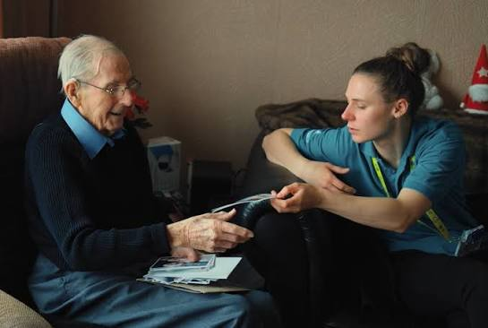
Definition
Domiciliary care is the provision of personal, practical and social health care services to individual in their homes .
The aim is to encourage individuals such as elderly, people with disabilities and people recovering from illness to stay in their homes.
Department of Health 2024

Slide 5


Type of Service provision
Personal Daily Assistance:
Hands-on assistance with basic daily activities, such as grooming, bathing, dressing, toileting, and physical mobility.
Household Management Support:
Help with routine domestic chores, including cooking, light cleaning, laundering, and grocery running.
Social and Emotional Companionship:
Non-clinical visitation aimed at mitigating social isolation, accompanying individuals to appointments, and engaging them in recreational activities.
Residential 24/7 Care: Continuous,
Full-time assistance provided by a live-in care practitioner who resides on-site to offer ongoing aid.
Carer Respite Services:
Short-term, interim coverage intended to provide primary informal carers with temporary relief from daily caregiving duties.

Slide 6

Operation Service Management
Responsible Individual (RI)Directs strategic alignment, corporate compliance, and official communications with CIW.
Registered Manager: Manages daily operations, regulatory standards, staff supervision, and safeguarding protocols (Welsh Government 2019).
Field Care Supervisors: Team leader) Executes initial needs assessments, field observations, care plan adjustments, and operational mentoring
Domiciliary Care Workers: Frontline care delivery personnel registered with Social Care Wales (Welsh Government 2020).
Quality Control & Safeguarding Mechanisms
Quality Assurance Monitoring: Unannounced field supervisory audits, regular care plan evaluations conducted with clients and families, and electronic medication management systems (eMAR) Accredilink Care 2024).

Slide 7

Types of payments
Direct Payment Beneficiaries:
Service users allocated direct funding from their local authority to arrange personalised care, allowing them to make informed choices about the service provision.
Private Self-funded clients:
These are Self-funded clients who uses their personal funds to pay for the service provision. sometime Self-funded individuals seeking bespoke, premium, or extended care hours that exceed local authority assistance thresholds.
(Welsh Government 2019) 2019)

Slide 8
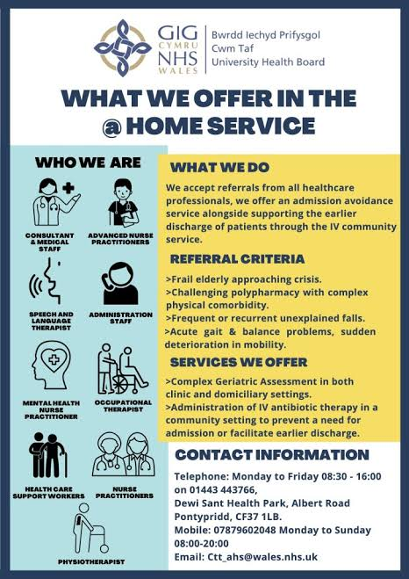
Types of
Segmentations
Sergementation by care( Service user) individual needs should be identified such as bathing, dressing ,medication adminstration and meal preparation
Segmentation by care buyer ( the decision makers ) as the organisation should focus on marketing and negociating prices
Behaviour and psysogeogrphic Segmentation
Brand Awareness
Digital channels such as search engines and social media platform are vital in this digital era. It enables and encorage client to make informed choice when choosing service and providers( Pasaribu et al., 2022)

Slide 9
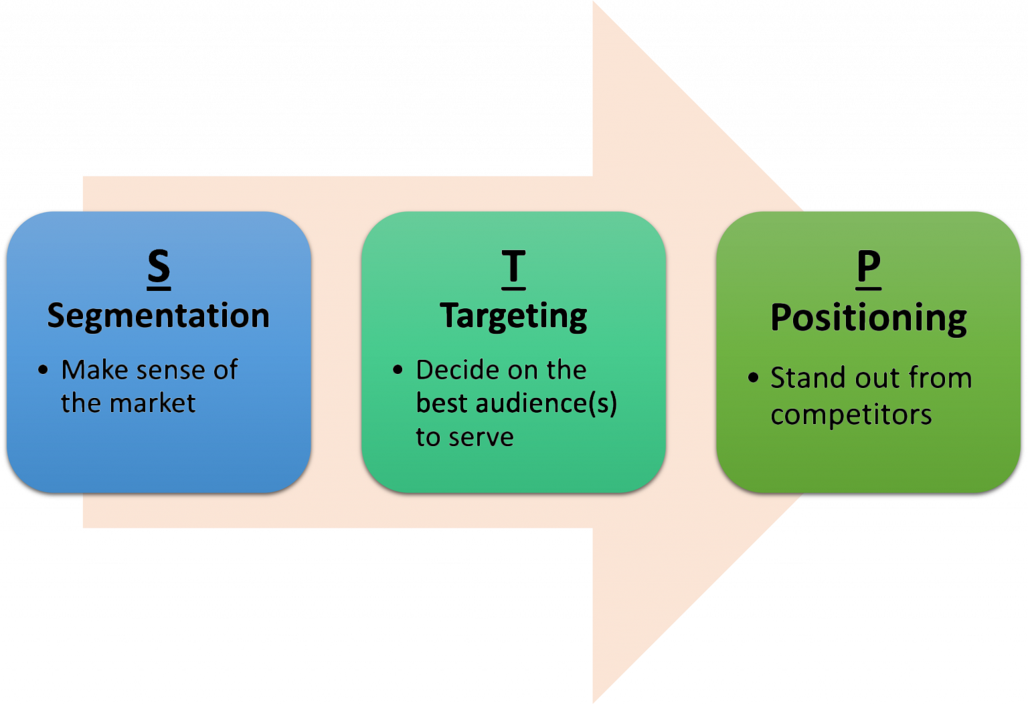
Target Market Segmentation
Local Government Contracted Services:
The local authority provides Framework agreements alongside block and spot-purchase contracts. Eligible clients can also use their Attendance Allowance awards (up to £108.55 per week in 2024/25) to pay for supplemental support services. •
Direct Payment Beneficiaries: •
Service users are given direct funding from their local authority to arrange personalised care, giving them autonomy when contracting independently. Pendent care organisations (Welsh Government, 2019).
Private self-funded clients: •
Individuals who are self-funded and require bespoke, premium, or extended care hours that exceed the local authority assistance thresholds, or extended care hours that exceed local authority assistance thresholds.

Slide 10
Conclusion
To be able to search the web effectively to find relevant and vital information
To analyse and organise information by using tools such as s preadsheet , and database exiles etc
To design clear documents
To learn and adjust quickly to new software and technology emerges

Slide 11
Reference
Accredilink Care, 2024. Compliance, Regulation and Care Funding in Wales. Available at: https://accredilinkcare.co.uk/compliance [Accessed August 2026].
Care Inspectorate Wales (CIW), 2020. Code of Practice for Inspection of Regulated Services under the Regulation and Inspection of Social Care (Wales) Act 2016. Merthyr Tydfil: Care Inspectorate Wales.
National Assembly for Wales, 2016. Regulation and Inspection of Social Care (Wales) Act 2016. Cardiff: Welsh Government.
Pasaribu, S.B.; Novitasari, D.; Goestjahjanti, F.S.; and Hendratono, T. (2022). The Impact and Challenges of Digital Marketing in the Healthcare Industry During the COVID-19 Pandemic, Frontiers in Public Health, 10. DOI is 10.3389/fpubh.2022.969523
Social Care Wales, 2024. Social Care Workforce Report 2024. Cardiff: Social Care Wales.
Welsh Government, 2014. Social Services and Well-being (Wales) Act 2014. Cardiff: Welsh Government.
Welsh Government, 2017. The Regulated Services (Service Providers and Responsible Individuals) (Wales) Regulations 2017. Cardiff: Welsh Government.
Welsh Government, 2019. The Regulated Services (Service Providers and Responsible Individuals) (Wales) Amendment Regulations 2019. Cardiff: Welsh Government.
Welsh Government, 2020. Registration and Inspection of Social Care (Wales) Act 2016: Regulatory Impact Assessment and Service Provider Guidance. Cardiff: Welsh Government

Slide 12
Thank you

