Slide 1
Jodie Dickinson
LCHS4010
Neale Haddon
Psychology in Health and Social Care
Bowlby’s Theory for Issac

Slide 2
Isaac is a 4-year-old child who:
Becomes distressed when separated from his mother
Is quiet and withdrawn during play
Has delayed language development
Struggles with group activities
Has disrupted childcare experiences
Lives with a mother experiencing post-natal depression
Aim
To analyse Isaac's development using Bowlby's Attachment Theory and propose suitable support strategies.

Slide 3
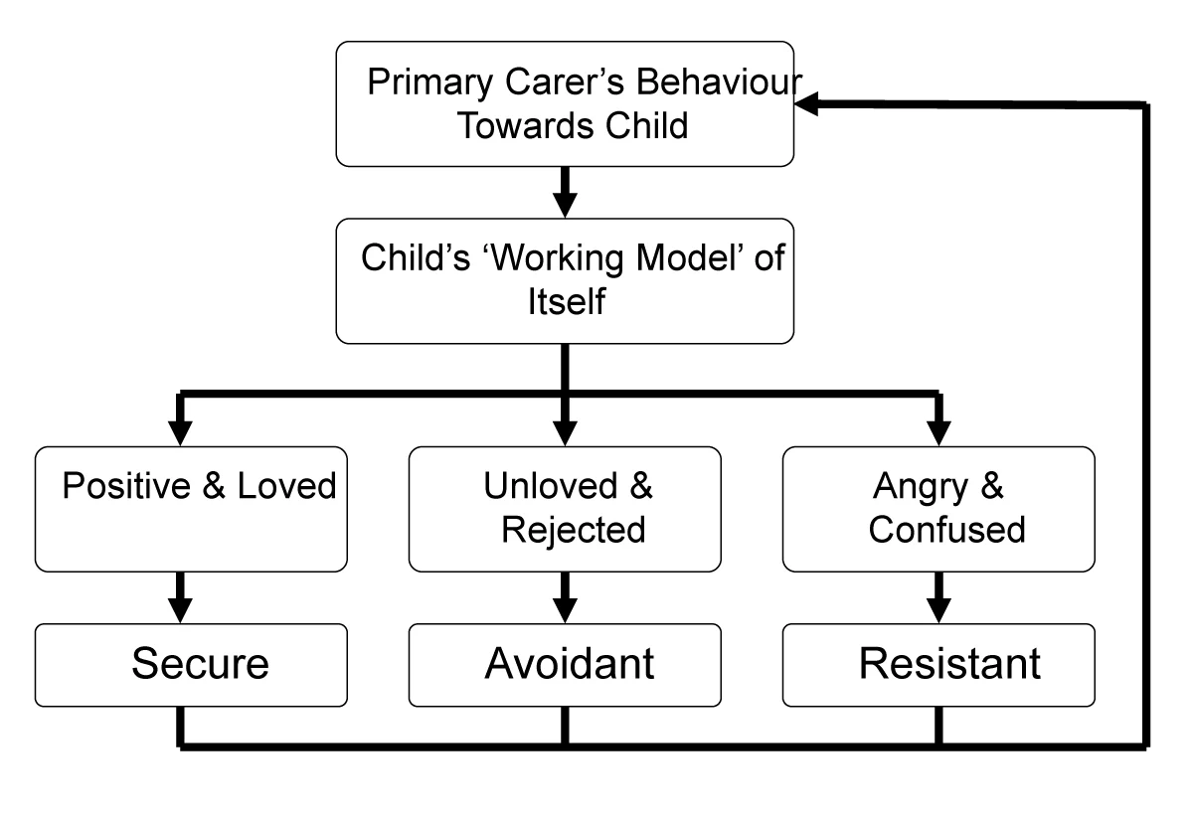
Developed by John Bowlby (1969).
Attachment is:
"A lasting psychological connection between a child and caregiver.“
Key ideas:
Attachment is biologically driven
Infants seek proximity to caregivers
Early relationships influence future development
Secure attachment promotes healthy emotional development
Core Concepts:
Monotropy
Internal Working Model
Secure Attachment
Separation Anxiety
Critical Period
Bowlby (1969)
McLeod, S. (2025) John Bowlby's Attachment Theory. Available at: https://www.simplypsychology.org/bowlby.html (Accessed: 13 June 2026).

Slide 4
Developmental Assumptions Bowlby Believed:
Children need:
Consistent caregiving
Emotional warmth
Reliable responses to distress
When attachment needs are met:
Emotional security develops
Confidence increases
Social relationships improve
When attachment is disrupted:
Anxiety may increase
Behavioral difficulties may occur
Social and emotional development can be affected
Relevance to Early Childhood:
Ages 0–5 are critical for attachment formation and emotional development.
Bowlby (1969)

Slide 5

Applying Bowlby to Isaac
Disrupted Childcare Arrangements
Isaac has experienced:
Frequent changes in childcare
Family relocation
Reduced stability
According to Bowlby:
Repeated separations can create insecurity
Children may struggle to trust unfamiliar adults
Anxiety during transitions may increase
Evidence from Isaac:
Distress during separation
Reluctance to join activities
Dependence on his mother
Bowlby (1969)

Slide 6
Maternal Mental Health and Attachment
Isaac's mother experiences:
Post-natal depression
Low confidence
Limited support networks
Research suggests maternal depression can affect:
Emotional availability
Sensitive caregiving
Child attachment security
Impact on Isaac:
Possible outcomes:
Clinginess
Emotional insecurity
Difficulty regulating emotions
Bowlby (1969); Murray & Cooper (1997)

Slide 7
Language and Social Development
Attachment and Communication:
Secure attachment supports:
Exploration
Communication
Social interaction
Isaac shows:
Language delay
Withdrawal from peers
Difficulty joining groups
Bowlby would argue emotional insecurity may reduce confidence to explore and interact.
Possible Consequences:
Delayed language acquisition
Reduced social competence
Lower self-confidence
Bowlby (1969)

Slide 8
Nature and Nurture (Biological Influences)
Temperament
Genetic factors
Brain development
Some children are naturally more cautious or sensitive
Nurture (Environmental Influences)
Quality of caregiving
Maternal mental health
Social experiences
Childcare stability
Isaac's Development:
His development is likely influenced by an interaction between biological predispositions and environmental experiences.
Bowlby (1969); Bronfenbrenner (1979)

Slide 9

Support Plan
Attachment-Based Strategies
Key Person Approach:
Consistent trusted adult
Predictable routines
Emotional reassurance
Gradual Separation Support:
Short separations
Visual timetables
Comfort objects
Parent Support:
Parenting programmes
Mental health support referrals
Positive interaction coaching
Theory Link:
These strategies strengthen secure attachment relationships.
Bowlby (1969)

Slide 10

Further Interventions
Storytelling
Singing
Small group conversations
Play-Based Learning:
Child-led play
Role-play opportunities
Social interaction activities
Multi-Agency Working:
Collaboration between
Children's Centre staff
Speech and Language Therapy
Health Visitor
Family Support Services
Emotional Regulation:
Feelings charts
Emotion coaching
Calm spaces
Department for Education (2024); Bowlby (1969)

Slide 11
Critical Evaluation Strengths:
✔ Highlights importance of early relationships
✔ Widely used in early years practice
✔ Supported by attachment research
✔ Helps explain Isaac's behaviour
Limitations:
✘ Overemphasises the mother-child relationship
✘ Underestimates role of fathers and wider family
✘ May not reflect all cultures
✘ Some children form multiple secure attachments
Relevance to London's Diverse Communities:
Practitioners must recognise:
Different family structures
Cultural variations in caregiving
Extended family support systems
Rutter (1995); Van IJzendoorn & Sagi-Schwartz (2008)

Slide 12
Conclusion
Bowlby's Attachment Theory helps explain:
Isaac's separation anxiety
Emotional insecurity
Social withdrawal
Language difficulties
Early intervention should focus on:
Building secure relationships
Supporting his mother
Encouraging communication
Multi-agency collaboration
Through attachment-informed practice, Isaac's emotional wellbeing and developmental outcomes can be improved.

Slide 13
Reference List:
Bowlby, J. (1969) Attachment and Loss: Volume 1. Attachment. London: Hogarth Press.
Bronfenbrenner, U. (1979) The Ecology of Human Development. Cambridge, MA: Harvard University Press.
Department for Education (2024) Early Years Foundation Stage Framework. London: DfE.
Murray, L. and Cooper, P.J. (1997) Postpartum Depression and Child Development. New York: Guilford Press.
Rutter, M. (1995) 'Clinical implications of attachment concepts', Journal of Child Psychology and Psychiatry, 36(4), pp. 549–571.
Van IJzendoorn, M.H. and Sagi-Schwartz, A. (2008) 'Cross-cultural patterns of attachment', in Cassidy, J. and Shaver, P.R. (eds.) Handbook of Attachment. 2nd edn. New York: Guilford Press.
McLeod, S. (2025) John Bowlby's Attachment Theory. Available at: https://www.simplypsychology.org/bowlby.html (Accessed: 13 June 2026).

