Slide 1

Student Example

Slide 2
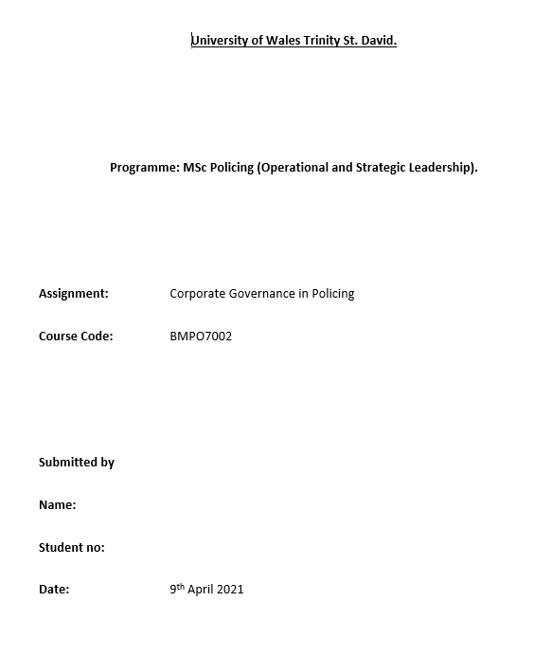
Cover Page
Cover Page included key information for the paper
Could have used an MS Word standard cover page

Slide 3
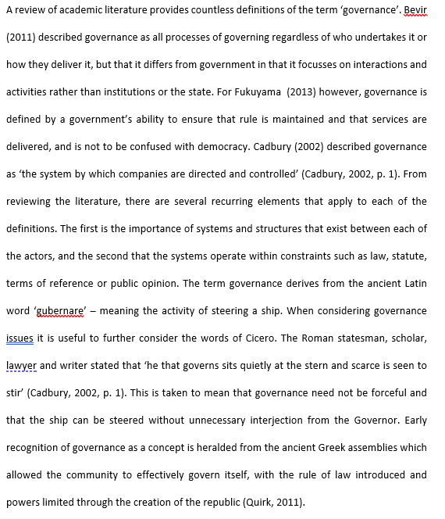
Opening
Straight into ‘governance’ without any delay
Immediate citations to sources
Students compares and contrasts different definitions and brings out common threads

Slide 4
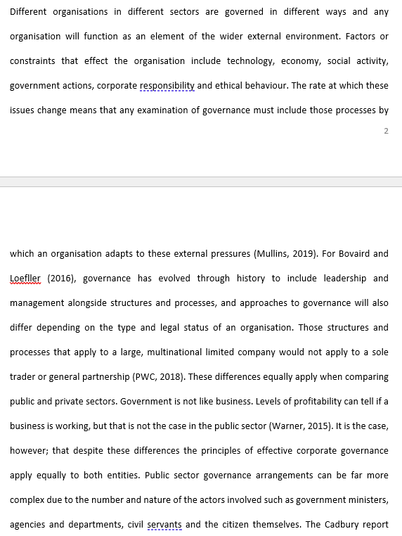
Different approaches
Challenges and constraints
Environmental pressure
Links to leadership and management
Difference between government and business

Slide 5
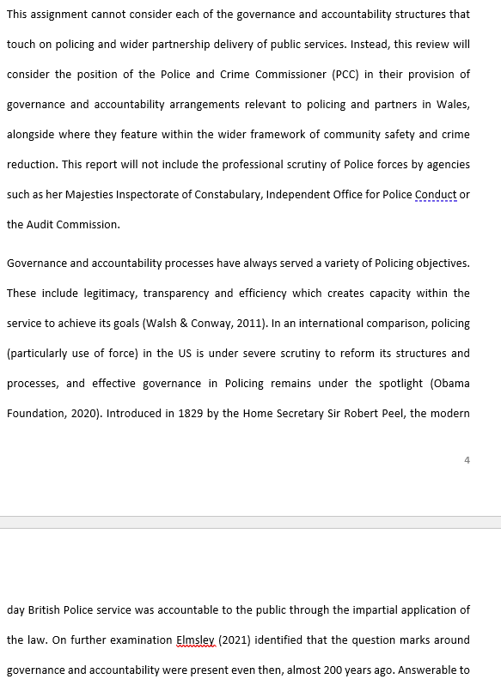
Turns towards Policing
Narrowing of focus to PCC role
Focus on key aspects of policing

Slide 6
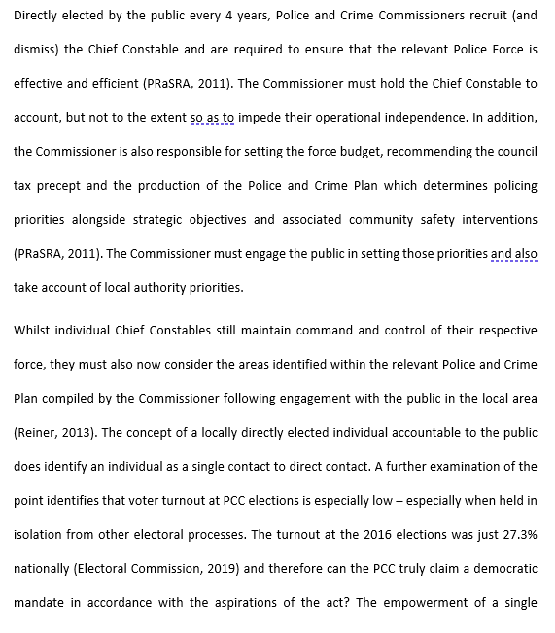
More in depth
PCC – CC
Operational independence
Election turnout
Democratic mandate?

Slide 7
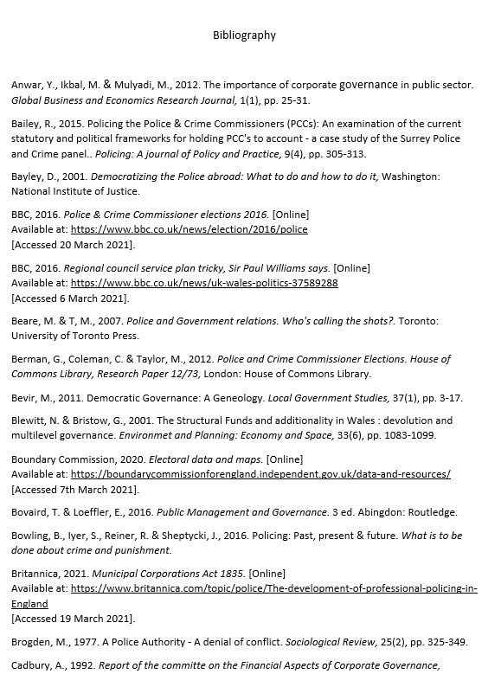
Reference List
Student used MS Word automatic features for citations and bibliography
Saved a huge amount of time

