Slide 1
Introduction to Logistics
Humanitarian logistics

Slide 2
Quote
‘‘Since disaster relief is about 80 % logistics it would follow then that the only way to achieve this is through slick, efficient and effective logistics operations and more precisely, supply chain management.’’
Van Wassenhove (2006)
‘‘Logistics is the part [of any disaster relief] that can mean the difference between a successful or failed operation.’’
Van Wassenhove (2006)

Slide 3
The 2004 earthquake and resulting tsunami in South Asia claimed approximately 230,000 lives and displaced 1.7 million people.
Over 40 countries and 700 nongovernmental organizations (NGOs) provided humanitarian assistance.
The response in the private sector was unprecedented: for example, US companies alone mobilized more than US$565 million (cash and in kind), and the role of logistics companies (e.g., UPS, FedEx, and DHL)—together with their existing aid agency partners—was also crucial in providing free or subsidized transportation and logistics.
The world responded by donating more than $13 billion and initiating the largest relief effort in history (Thomas and Fritz 2006).
Humanitarian Logistics and Supply Chain Management - Springer
www.springer.com/cda/content/document/cda.../9783642301858-c2.pdf

Slide 4
As a result of the Indian Ocean tsunami in 2004, logistics applied to disasters has received increasing interest from both researchers and practitioners.
In fact, the tsunami provided evidence that the effectiveness of the emergency aid response hinges on logistic speed and efficiency thereby increasing the awareness of the crucial role of logistics in humanitarian relief operations.
Specifically, the activities of ‘‘planning, implementing and controlling the efficient, cost-effective flow of and storage of goods and materials as well as related information, from point of origin to point of consumption for the purpose of alleviating the suffering of vulnerable people’’ are known as ‘‘humanitarian logistics’’.
Briefly, ‘‘for humanitarians, logistics is the processes and systems involved in mobilising people, resources, skills and knowledge to help vulnerable people affected by disaster’’
Van Wassenhove (2006)

Slide 5
In a disaster context, it is of course important to ensure efficient and effective delivery, such that the appropriate commodities and people reach the victims of the emergency (logistic point of view).
However, optimising the logistic performance requires that all the relationships among the actors involved are managed through an integrated approach to efficiently and effectively coordinate inter-organizational performance, eliminate redundancy, and maximize efficiency along the entire emergency supply chain (supply chain management point of view).
In fact, though logistics is more focused on moving something or someone from a point of origin to a destination, supply chain management mainly focuses on relationships among the actors that make such movement possible. Logistics and supply chain management are both crucial to properly set the response to a disaster.
Usually, the term ‘‘disaster’’ refers to a ‘‘disruption that physically affects a system as a whole and threatens its priorities and goals’’
Van Wassenhove (2006)

Slide 6
With respect to cause, it is possible to distinguish between a natural and a man-made disaster; with respect to predictability and speed of occurrence, it is possible to distinguish between a sudden-onset and a slow-onset disaster.
Taking into account also the different impact in terms of required logistic effort (from higher to lower), it is possible to identify four types of disaster

Slide 7
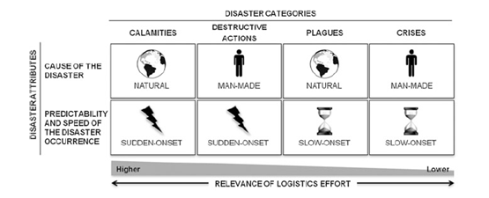

Slide 8
Calamities, characterised by natural causes and sudden-onset occurrences (e.g., earthquakes, hurricanes, tornadoes);
• Destructive actions, characterized by man-made causes and sudden-onset occurrences (e.g., terrorist attacks, coups d’état, industrial accidents);
• Plagues, characterized by natural causes and slow-onset occurrence (e.g., famines, droughts, poverty);
• Crises, characterized by man-made causes and slow-onsets occurrence (e.g. political and refugee crises).
Calamities and destructive actions are disasters that demand a higher logistic effort in terms of knowledge and cost because sudden-onset occurrences require a very fast response in devastated areas.
The four categories may be interlinked: a calamity (such as an earthquake) may cause plagues (such as an epidemic disease) and crises (such as an economic crisis). Thus, it is sometimes more appropriate to talk about disasters instead of a single disaster.

Slide 9
Different types of disasters need to be managed in different ways.
The aid provided to assist in a region’s development is distinct from that given to deal with famine and drought; running refugee camps is very different to providing the kind of aid that is needed after a sudden-onset natural disaster or a nuclear accident.
Humanitarian efforts are organised along two broad lines:
• Disaster relief;
• Continuous aid work.
Ordinarily, disaster relief deals with calamities, destructive actions, and plagues (Long 1997).
Continuous aid work is mainly required in the case of plagues and crises.

Slide 10
Logistics is the most important element in any disaster relief effort, and it is the one that makes the difference between a successful and a failed operation. (Van Wassenhove 2006)
But it is also the most expensive part of any disaster relief: it has been estimated that logistics accounts for about 80 % of the total costs in disaster relief. (Van Wassenhove 2006)
And given that the overall annual expenditure of aid agencies is of the order of $20 billion, the resultant logistic spending is around $15 billion (Christopher and Tatham 2011).

Slide 11
Thus, proper investment in logistics in disaster relief provides the main opportunity to develop and implement effective and efficient use of resources in humanitarian operations. (Cozzolino et al. 2012).
In addition, a more strategic use of resources allows humanitarian organizations to raise donor trust and long-term commitment by increasingly sceptical benefactors. (Scholten et al. 2010).
Humanitarian organizations are therefore under greater scrutiny to monitor the impact of aid and the arrangement of their entire operations; they have to prove to donors, who are pledging millions in aid and goods, that they are really reaching the ones in need. (Van Wassenhove 2006).
As a consequence, it would be useful identify each of the different phases that constitute the overall logistics process to provide a better guide for potential improvements. In the next section, therefore, the typical stages of an emergency supply chain are described.

Slide 12
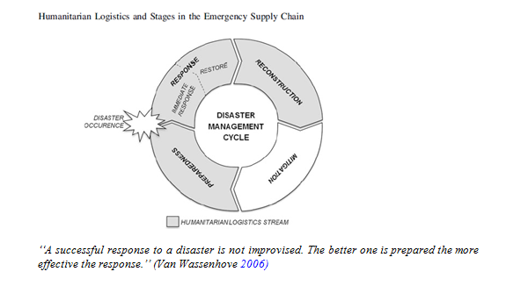

Slide 13
Since disaster relief efforts are characterized by considerable uncertainty and complexity, they need to be properly managed in order to address and implement better responses.
Thus, disaster management is a key factor that drives successful execution of relief efforts, and it begins with strategic process design. (Tomasini and Van Wassenhove 2009).
Disaster management is often described as a process composed of several stages, even though there is disagreement among authors as to the structure and nomenclature of the stages (Kovács and Spens 2007, 2009; Altay and Green 2006; Pettit and Beresford 2005; Van Wassenhove 2006; Lee and Zbinden 2003; Thomas 2003; Cottrill 2002; Nisha de Silva 2001; Long 1997).
However, for the most part, the literature concurs on the existence of the following phases:
• Mitigation;
• Preparation;
• Response;
• Reconstruction.

Slide 14
These four phases constitute the disaster management cycle. With the focus on logistics and supply chain management, the process that involves logisticians mainly concerns the preparation, response and reconstruction; together these constitute humanitarian logistics stream.
The mitigation phase refers to laws and mechanisms that reduce social vulnerability.
These are issues that relate to the responsibilities of governments and do not involve the direct participation of logisticians.
The preparation phase refers to various operations that occur during the period before a disaster strikes. This phase incorporates the strategies put into place that allow the implementation of a successful operational response. This phase is crucial because it is the one in which the physical network design, information and communications technology systems, and the bases for collaboration are developed.
The aim of this stage is to avoid the gravest possible consequences of a disaster.

Slide 15
This phase also incorporates the efforts that are made between disasters in learning and adapting from past experiences so as to meet new challenges.
The response phase refers to the various operations that are instantly implemented after a disaster occurs. This phase has two main objectives; they are consecutive and constitute two sub-phases (Cozzolino et al. 2012):
• The first objective is to immediately respond by activating the ‘‘silent network’’ or ‘‘temporary networks,’’ as defined by Jahre et al. (2009); this is the immediate-response.
• The second objective is to restore in the shortest time possible the basic services
and delivery of goods to the highest possible number of beneficiaries; this is the
Restore phase.
In the response stage, coordination and collaboration among all the actors involved in the humanitarian emergency deserve particular attention. Connections to feasible donors, suppliers, NGOs, and other partners are made in the first phase, but they are not activated until the catastrophic event takes place.
Then, all the actors involved operate as quickly as possible: at the start, speed—at any cost—is of the essence, and the first 72 h are crucial . (Van Wassenhove 2006).

Slide 16
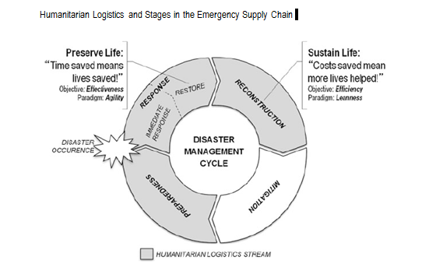

Slide 17
The reconstruction phase refers to different operations in the aftermath of a disaster. It involves rehabilitation, and this phase aims to address the problem from a long-term perspective. The effects of a disaster can continue for a long period of time, and they have severe consequences on the affected population.
In addition, disasters can also have long-term effects on the management of companies.
For example, immediately after a disaster, transportation companies may undergo a modal shift from road to rail that prevails long after the occurrence of the disaster. (Kovács and Spens 2007).

Slide 18
With regard to humanitarian logistics stream, it is interesting that the transition between the stages involves the shift in focus from speed to cost reduction in terms of operational performance (Tomasini and Van Wassenhove 2009b).
Each stage of the process has a specific objective that can be achieved through the application of two supply chain principles: agility and leanness (Cozzolino et al. 2012).
Agility is usually defined as the ability to respond to unexpected changes (Sheffi 2005) when an unpredictable demand is combined with short lead times (Christopher 2005). Leanness usually refers to doing more and better with less when demand is relatively stable and predictable (Childerhouse and Towill 2000).
Briefly, while agility focuses on effectiveness and speed, leanness focuses on efficiency and cost saving (Charles et al. 2010; Scholten et al. 2010; Kovács and Spens 2009; Pettit and Beresford 2009; Taylor and Pettit 2009; Oloruntoba and Grey 2006; Narasimhan et al. 2006; Christopher 2005; Sheffi 2005; Aitken et al. 2002; Towill and Christopher 2002; Christopher and Towill 2001; Childerhouse and Towill 2000; Mason-Jones et al. 2000; Naylor et al. 1999).
In consideration of their specific objectives, agility and leanness may be applied to the stages of humanitarian logistics.

Slide 19
In humanitarian supply chains, effectiveness ensures that we save time, and time saved means more lives saved; efficiency ensures that we save costs, and costs saved means more lives helped.
The objective of the restoring sub-stage (as part of the response phase) is saving as much time as possible, and it can be achieved through agility.
The objective of the reconstruction phase is saving as many costs as
possible, and it can be achieved through leanness. It is through preparedness and the immediate response that agility and leanness can be used to design and develop processes and procedures to be performed in the following steps, restore and reconstruction

Slide 20
Governments—host governments, neighbouring country governments, and other country governments within the international community—are the activators of humanitarian logistics stream after a disaster strikes since they have the power to authorize operations and mobilize resources.
In fact, without the host government authorization, no other player—with the exception of national aid agencies and the military—can operate in the disaster theatre.
Host government authorization is fundamental for the involvement of other countries (neighbours or not). The engagement of other countries is a delicate matter since it can be facilitated or blocked as a consequence of the relationship quality between the host government and the international community (in many cases host countries do not enjoy good relations with their neighbours).

Slide 21
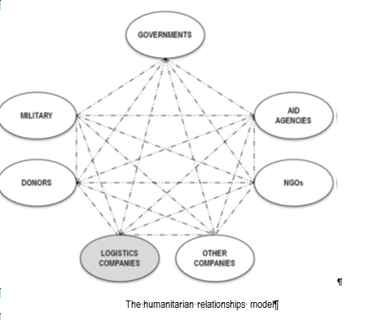

Slide 22
Another important role in the aid process can be played by international agreements to which the host government subscribes with other countries (e.g., the European Union, North American Free Trade Agreement, Asia–Pacific Economic Cooperation, Arab League, African Union).
Moreover, host governments have the responsibility to put into place protocols and take action to reduce the probability of disasters (mitigation).
On many occasions, the military has been a very important actor since soldiers are called upon to provide primary assistance (i.e., hospital and camp installation, telecommunications, and route repair) thanks to their high planning and logistic capabilities.

Slide 23
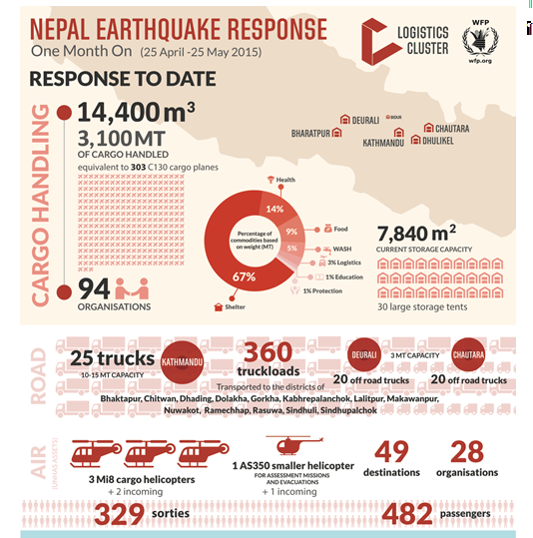

Slide 24
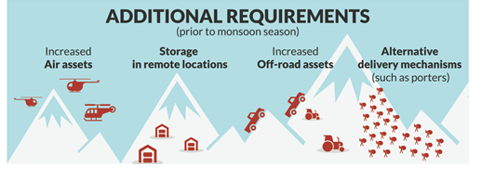

Slide 25
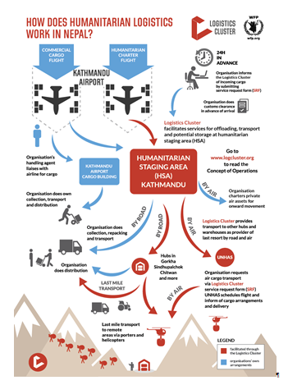

Slide 26
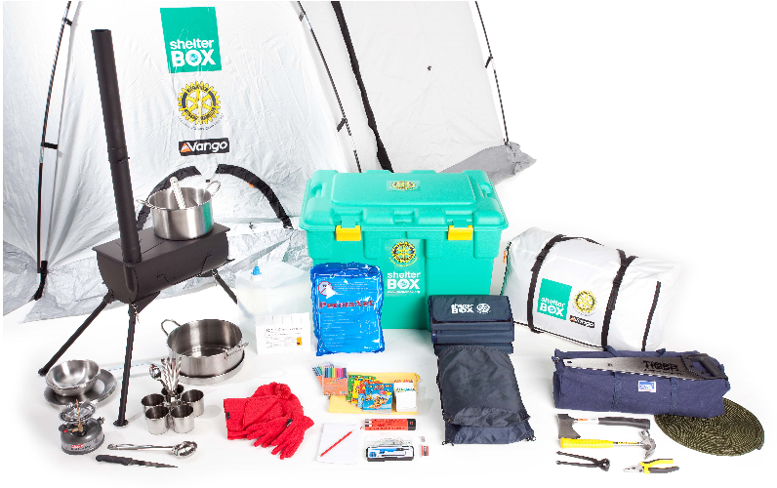

Slide 27
ShelterBox is an international disaster relief charity that provides temporary shelter and life saving supplies to displaced families.
Each ShelterBox typically contains a tent designed to withstand extreme weather conditions, water purification kit, blankets, tools, and other necessities to help a family survive after a disaster.[
The contents of a ShelterBox are tailored to the nature and location of the disaster.
ShelterBox Response Teams distribute boxes on the ground, working closely with local organisations, international aid agencies and Rotary clubs worldwide.
https://www.shelterbox.org/
https://en.wikipedia.org/wiki/ShelterBox

Slide 28
ShelterBox was founded in 2000 in the town of Helston, Cornwall, UK. That same year the Rotary club of Helston-Lizard adopted it as its millennium project.
The first consignment of 143 boxes was sent to earthquake victims of the 2001 Gujarat earthquake. Over the next three years the project matured and by the end of 2004 nearly 2,600 boxes had been dispatched, following 16 major disasters.
The company significantly expanded its work in response to the 2004 Indian Ocean earthquake and tsunami In 2002, ShelterBox's American affiliate was adopted as a project of the Rotary Club of Lakewood Ranch in Sarasota, Fla. In 2004, ShelterBox USA was officially established as a 501(c)3 non-profit organization.
One of ShelterBox's largest responses was the 7.0 magnitude earthquake in Haiti in 2010. ShelterBox provided shelter for 28,000 families or approximately 25% of all tents delivered in areas surrounding Port au Prince.
In 2010, the Australian and Canadian branches of ShelterBox split from the main organization and formed new organizations called Disaster Aid Australia and Disaster Aid Canada, respectively. However, new teams in Australia and Canada were immediately put in place and the charity's work was unaffected by the breakaway groups.
After the 2011 Tōhoku earthquake and tsunami in Japan, ShelterBox provided assistance to about 1,600 families in the disaster region.

Slide 29
In August 2012, the Board of Directors of ShelterBox removed founder Tom Henderson as CEO, stating it was a unanimous decision.
In February 2013, Alison Wallace was appointed CEO of ShelterBox after her position as director of international fundraising at Amnesty International.[
In August 2014 ShelterBox founder and former CEO Tom Henderson was charged with conspiracy to commit fraud. In the subsequent Old Bailey court case it was alleged that he gave supply contracts to his son.
He was cleared of conspiracy to commit fraud: not guilty verdicts were accepted and the Crown Prosecution Service said it would not request a retrial following a 44-day trial, which ended with the jury failing to reach a verdict after more than 30 hours of deliberation.

Slide 30
Responding to disasters
ShelterBox has tracking systems to monitor weather systems around the globe and anticipate the likely scale of hurricanes and cyclones.
In addition, an earthquake alert system gives immediate notice of any seismic activity that could result in a humanitarian disaster.
ShelterBox works with international aid agencies and Rotary clubs worldwide who also relay information when they become aware of an urgent need for shelter.
ShelterBox aims to get the first shipment of boxes dispatched to a disaster area within 2–3 days where a ShelterBox Response Team (SRT) meets it.
ShelterBox tries to get to the disaster as quickly as possible and aims to be one of the first organizations on the ground.

Slide 31
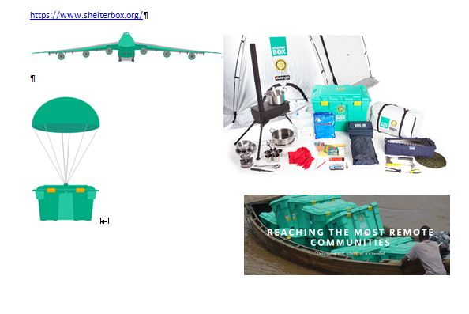

Slide 32
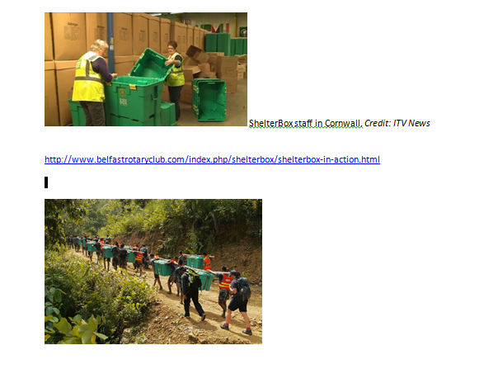

Slide 33
ShelterBox in Action
ShelterBox are immensely grateful for the generous donations of its supporters which allow it to respond to humanitarian disasters around the world.
2015 arrived like a deluge with record flooding in many parts of the world with hundreds of thousands of people fleeing monsoons, rainstorms and rising rivers.
ShelterBox had an extremely busy year supporting families with tailored responses but particularly notable has been the introduction of the different types of shelter being deployed as well as the standard boxes – UN spec tents, Shelter Kits, Tarpaulins, a new Flex tent with stove & chimney and school kits

Slide 34
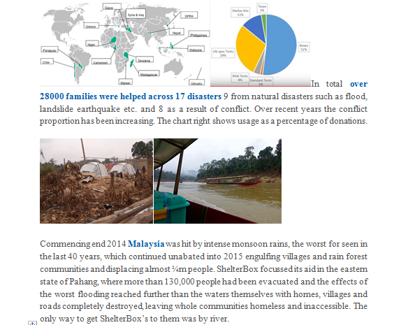

Slide 35
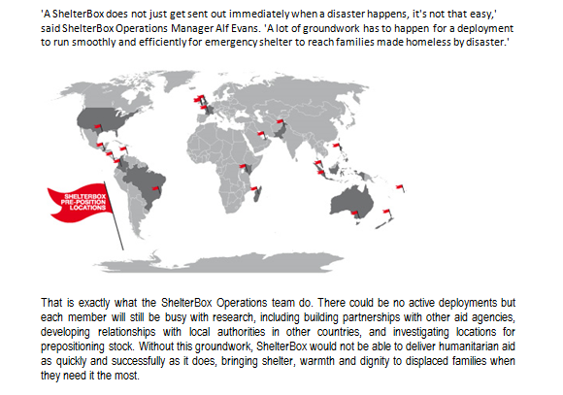

Slide 36
'There are currently 9,061 ShelterBoxes prepositioned across 18 different countries, enabling to respond immediately to a disaster.
t is much quicker to have boxes in the country where the disaster has happened or the country next door as opposed to sending them from headquarters in UK.'

Slide 37
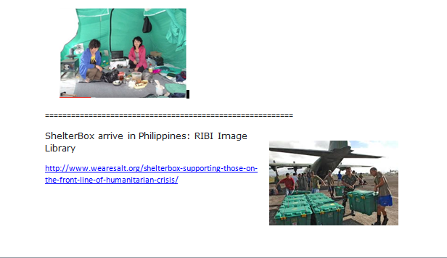

Slide 38
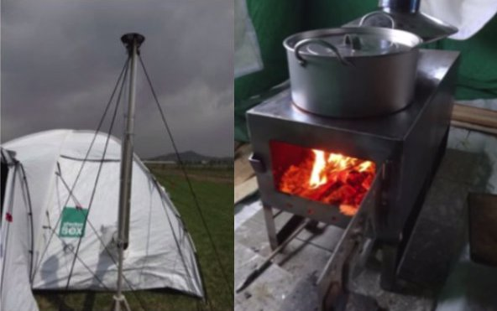

Slide 39
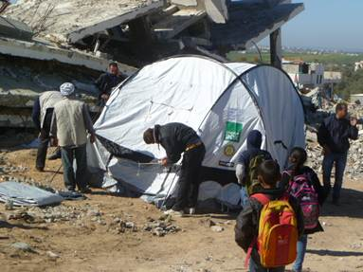

Slide 40
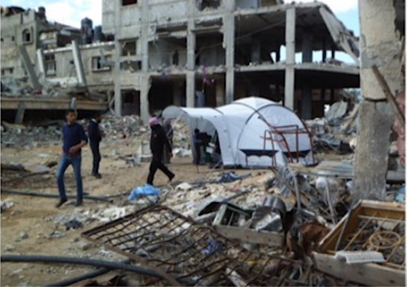

Slide 41
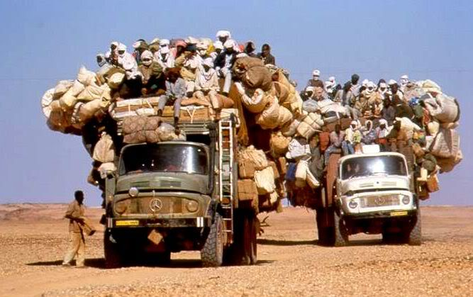
QUESTIONS

