Slide 1
Student name: | GRAWAL YASH DEEPAKKUMAR | Student ID number: | 2511041
Programme: | MSc Computing portfolio
Module: | Research Methods and Professional Development
Module code: | ACFA7004 | Contribution to Overall Module Assessment (%): | 30%
Lecturer: | Dr.Suresh Shanmugasundaram | Internal Verifier: | Dr Nitheesh Kaliyamurthy
Assignment Title: | Presentation | Word count (or equivalent): | 10 mins
Submission deadline: | Week commencing: 20th April 2026 (Week 11) in-class presentation | Return date of provisional marks & written feedback: | 15th May 2026
Submission method: | All written assessments, where practical and possible, must be submitted via Turnitin unless otherwise instructed by the Lecturer. (Please DO NOT put this assessment specification into Turnitin or it will match many similarities with other students’ submissions.) Alternative submission method (if applicable): Late submission of the assessment will result in a late penalty mark:. Work which is submitted up to 1 week late will be capped at 50% for the first attempt and will be awarded a mark of 0% for re-assessment. Late submission penalties may be lifted only if there is an approved extenuating circumstances claim. Work submitted more than 1 week late will be considered as a non-submission and will not be marked. The work may be considered as a submission for reassessment if offered by an Examining Board or if there is an approved extenuating circumstances claim.
Academic honesty / referencing: | Academic honesty is required. In the main body of your submission you must give credit to authors on whose research and ideas your work is based. Append to your submission a reference list that indicates the books, articles, etc. that you have used, cited or quoted in order to complete this assessment.

Slide 2
ASSESSING MACHINE LEARNING-BASED CYBERSECURITY RISKS MODEL OF IOT DEVICES

Slide 3
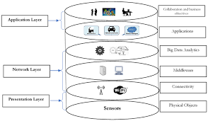
Research Context and Background
Rapid growth of the Internet of Things (IoT)
Billions of connected devices worldwide
IoT used in:
  Smart homes
  Healthcare
  Industrial automation
  Smart cities
Increasing cybersecurity vulnerabilities
Machine learning is used for automated threat detection
Notes:
The Internet of Things is now one of the most significant technological advances that has digitised daily items. IoT devices are smart home, wearable, healthcare sensors, and industrial monitoring systems (Simanjuntak, 2024). The International Data Corporation reports that by 2030, the number of connected IoT devices will go beyond 40 billion. On the one hand, this fast development provides the possibility to innovate the digital sector; on the other hand, it enhances the risk of cybersecurity since many IoT devices are not effectively protected. Consequently, machine learning methodologies are being more and more automated to observe abnormal network behaviour and possible cyber threats.

Slide 4
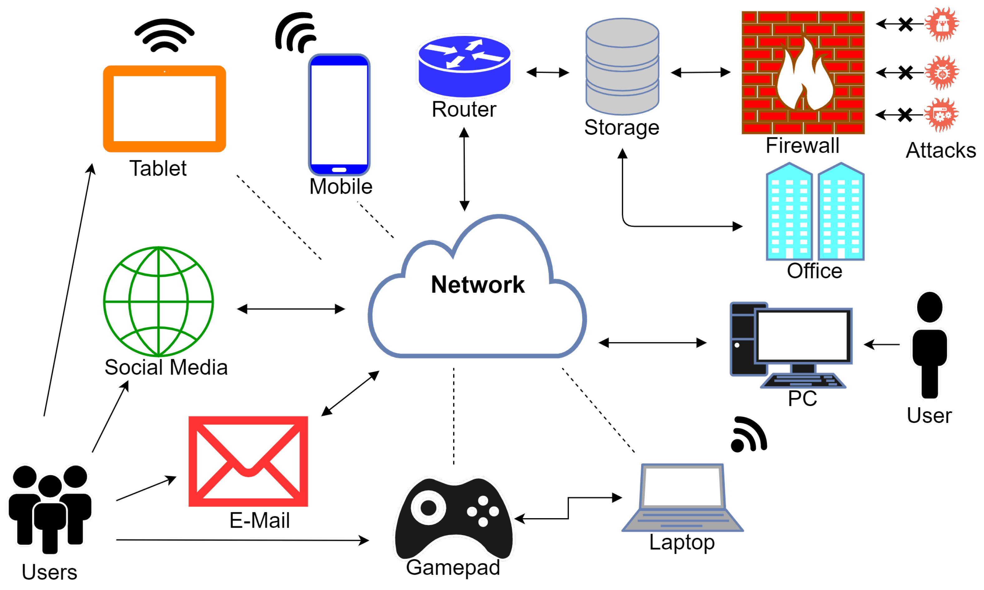
Current Developments in IoT Cybersecurity
Increasing use of AI and Machine Learning in cybersecurity
ML helps detect:
  Network anomalies
  Malware attacks
  Unauthorized access
Example: IoT botnet attacks
Need for intelligent threat detection systems
Notes:
The latest developments in the sphere of artificial intelligence have contributed to the significant enhancement of cybersecurity. Machine learning algorithms have the ability to analyse vast data about networks to detect suspicious patterns and identify cyber threats (Alomiri, Mishra and AlShehri, 2024). The famous case example is Mirai Botnet, which infected thousands of IoT devices and utilised them to perpetrate high volumes of distributed denial-of-service attacks. This event showed how susceptible the IoT ecosystems are to this form of protection, having weak security measures. Thus, to safeguard the IoT environments, threat detection systems with a machine learning basis are increasingly being designed.

Slide 5
Research Problem
IoT devices have limited computing resources
Lack of built-in security features
Machine learning models can be targeted by attackers
Security challenges:
  Data poisoning
  Adversarial attacks
  Model manipulation
Need for a risk assessment framework
Notes:
Even though machine learning enhances cybersecurity identification, it also presents new adversaries. Some IoT devices are characterised by low memory and computation capacity, and thus, it is not easy to install sophisticated security mechanisms. The machine learning models themselves also can fall victim to cyberattacks (Abbas et al. 2025). As an illustration, the attackers can alter the training data or misuse the weaknesses in the algorithm to bypass the detectors. Research by the National Institute of Standards and Technology found that it is essential to assess the reliability and security of AI-based systems to guarantee reliable cybersecurity systems.

Slide 6
Research Aim
Aim
To assess cybersecurity risks in IoT environments using machine learning models.
Notes:
The primary purpose of the research is to analyse the way in which the methods of machine learning may be applied to determine the cyber threat posed by the use of IoT devices (Jamshidi et al. 2025). The research is aimed at determining the vulnerabilities, examining the security threats, and coming up with a model to identify any attack that could be encountered in IoT networks.

Slide 7
Research Objectives
To analyse cybersecurity threats affecting IoT devices
To evaluate machine learning techniques used in IoT security
To design a risk assessment model using ML algorithms
To test the effectiveness of the proposed model using cybersecurity datasets
To analyse limitations and improvements of ML-based security frameworks
Notes:
The research objectives embrace the general design of the study. To start with, the study will examine typical cybersecurity risks within the IoT systems. Second, it will examine machine learning algorithms that have been utilised to detect cyber threats. Third, the research will build a risk assessment model using machine learning techniques. Fourth, the proposed model will be experimented on the available cybersecurity data points. Lastly, the study will assess the strengths and weaknesses of the model that has been developed.

Slide 8
Research Methodology
Research Approach:
Quantitative research approach
Methods Used:
Machine learning algorithms
Data analysis
Cybersecurity dataset evaluation
ML Algorithms:
Random Forest
Support Vector Machine
Logistic Regression
Notes:
This research follows a quantitative research methodology because it involves analysing numerical data from cybersecurity datasets (Alshammari, 2023). Machine learning algorithms such as Random Forest, Support Vector Machine, and Logistic Regression will be used to classify network traffic and detect cyber threats. These algorithms are widely used in cybersecurity research due to their ability to process large datasets and identify patterns in network behaviour.

Slide 9
Data Collection and Evaluation
Data Sources:
Public cybersecurity datasets
IoT network traffic datasets
Data Processing Steps:
Data collection
Data preprocessing
Feature selection
Model training
Model evaluation
Evaluation Metrics:
Accuracy
Precision
Recall
F1 Score
Notes:
The given research is based on the methodology of quantitative research since it deals with the analysis of numerical data provided in cybersecurity data sets (Alattas and Mardani, 2022). Random Forest, Support Vector machine and Logistic Regression are machine learning algorithms that will be employed to classify network traffic and identify cyber threats. Because they are capable of processing large files of data and determining patterns within network behaviour, these algorithms are popular in cybersecurity studies.

Slide 10
Project Planning and Resource Management
Project Timeline:
Literature review
Dataset collection
Model development
Model testing
Report writing
Resources Required:
Python programming
Machine learning libraries
Computing resources
Research papers and datasets
Notes:
The paper will utilise the publicly available cybersecurity datasets that provide the network traffic data of the IoT devices. The data will be initially cleaned and preprocessed in such a manner that irrelevant information can be removed (Al-Quayed, Ahmad and Humayun, 2024). Following preprocessing, feature selection will be done to incorporate significant variables by the training machine learning models. Standard metrics that will be used to measure the performance of the models against the standard metrics will include accuracy, precision, recall, and F1 score, which will be used to show the effectiveness of the model in identifying cyber threats.

Slide 11
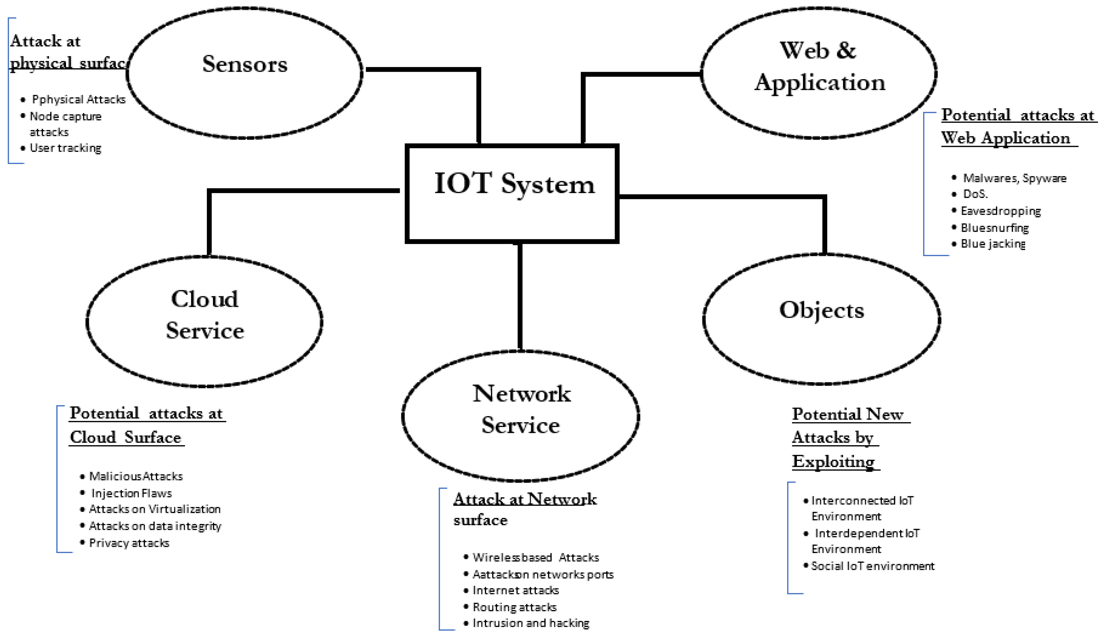
Potential Impact of the Research
Improved IoT cybersecurity frameworks
Better threat detection systems
Support for secure smart environments
Contribution to AI-driven cybersecurity research
Notes:
The timeline in which the project will be undertaken will include a literature review and examination of the current studies in the surrounding field of research on IoT cybersecurity. The next step will be gathering and processing datasets (Alfahaid et al. 2025). Then, machine learning algorithms will be constructed and tested with the help of corresponding algorithms. The last phase of the work will be the results analysis and the preparation of the research report. Such resources as Python programming tools, machine learning libraries like Scikit-learn, and access to cybersecurity datasets are key resources.

Slide 12
Limitations
Limited availability of real IoT attack datasets
ML models may require high computational power
Security threats are constantly evolving
Risk of bias in training data
Notes:
These studies have a number of possible implications. It can help to enhance the cybersecurity frameworks of IoT devices by creating more useful risk detection models. The findings would serve organisations to determine weaknesses in their IoT, which they could use to enhance their security measures (Khan et al. 2023). Moreover, the research project can facilitate the creation of a smart cybersecurity architecture where machine learning is being implemented to help intercept and avert cyberattacks on the fly.

Slide 13
Conclusion
IoT devices are highly vulnerable to cyber threats
Machine learning provides intelligent threat detection
Risk assessment models can improve IoT security
Continuous research is needed to address evolving cyber threats
Notes:
However, it has limited the study in a few ways. Of the key constraints, the availability of real-life attacks on IoT data is limited, and this can impact the accuracy of machine learning models (Inuwa and Das, 2024). Also, machine learning algorithms need access to computational resources, which are not necessarily on hand in real-time IoT systems. The cybersecurity threats also keep changing at a high rate, implying that models should be upgraded regularly to be effective.

Slide 14
Reference
Simanjuntak, T., 2024. Emerging Cybersecurity Threats in the Era of AI and IoT: A Risk Assessment Framework Using Machine Learning for Proactive Threat Mitigation. International Journal of Information System and Innovative Technology, 3(1), pp.15-23.
Alomiri, A., Mishra, S. and AlShehri, M., 2024. Machine learning-based security mechanism to detect and prevent cyber-attack in IoT networks. International Journal of Computing and Digital Systems, 16(1), pp.645-659.
Abbas, G., Ali, M., Ahmed, M. and Khan, A., 2025. Cira-cyber intelligent risk assessment methodology for industrial internet of things based on machine learning. IEEE Access.
Jamshidi, S., Nafi, K.W., Nikanjam, A. and Khomh, F., 2025. Evaluating machine learning-driven intrusion detection systems in IoT: Performance and energy consumption. Computers & Industrial Engineering, 204, p.111103.
Alshammari, F.H., 2023. Design of capability maturity model integration with cybersecurity risk severity complex prediction using bayesian-based machine learning models. Service Oriented Computing and Applications, 17(1), pp.59-72.
Alattas, K.A. and Mardani, A., 2022. A novel extended Internet of things (IoT) Cybersecurity protection based on adaptive deep learning prediction for industrial manufacturing applications. Environment, Development and Sustainability, 24(7), pp.9464-9480.
Al-Quayed, F., Ahmad, Z. and Humayun, M., 2024. A situation based predictive approach for cybersecurity intrusion detection and prevention using machine learning and deep learning algorithms in wireless sensor networks of industry 4.0. Ieee Access, 12, pp.34800-34819.
Alfahaid, A., Alalwany, E., Almars, A.M., Alharbi, F., Atlam, E. and Mahgoub, I., 2025. Machine learning-based security solutions for iot networks: A comprehensive survey. Sensors, 25(11), p.3341.
Khan, Z.F., Alshahrani, S.M., Alghamdi, A.A., Alangari, S., Altamami, N.I., Alissa, K.A., Alazwari, S., Al Duhayyim, M. and Al-Wesabi, F.N., 2023. Machine Learning Based Cybersecurity Threat Detection for Secure IoT Assisted Cloud Environment. Comput. Syst. Sci. Eng., 47(1), pp.855-871.
Inuwa, M.M. and Das, R., 2024. A comparative analysis of various machine learning methods for anomaly detection in cyber attacks on IoT networks. Internet of Things, 26, p.101162.

Slide 15


