Slide 1
ECPS4022 Skills for Success in Psychology
Week 2: The Psychology Student Toolkit
"Good psychologists do not simply consume information and communicate it effectively—they must also use technology responsibly, evaluate evidence critically, and understand how psychological knowledge is produced. Technology can support learning, but it cannot replace critical thinking. "

Slide 2
Session 1 (2 Hours): Making Every Hour Count: Time Management
Session Aim
To help students identify their own time management abilities and to examine ways to maximise efficiency.

Slide 3
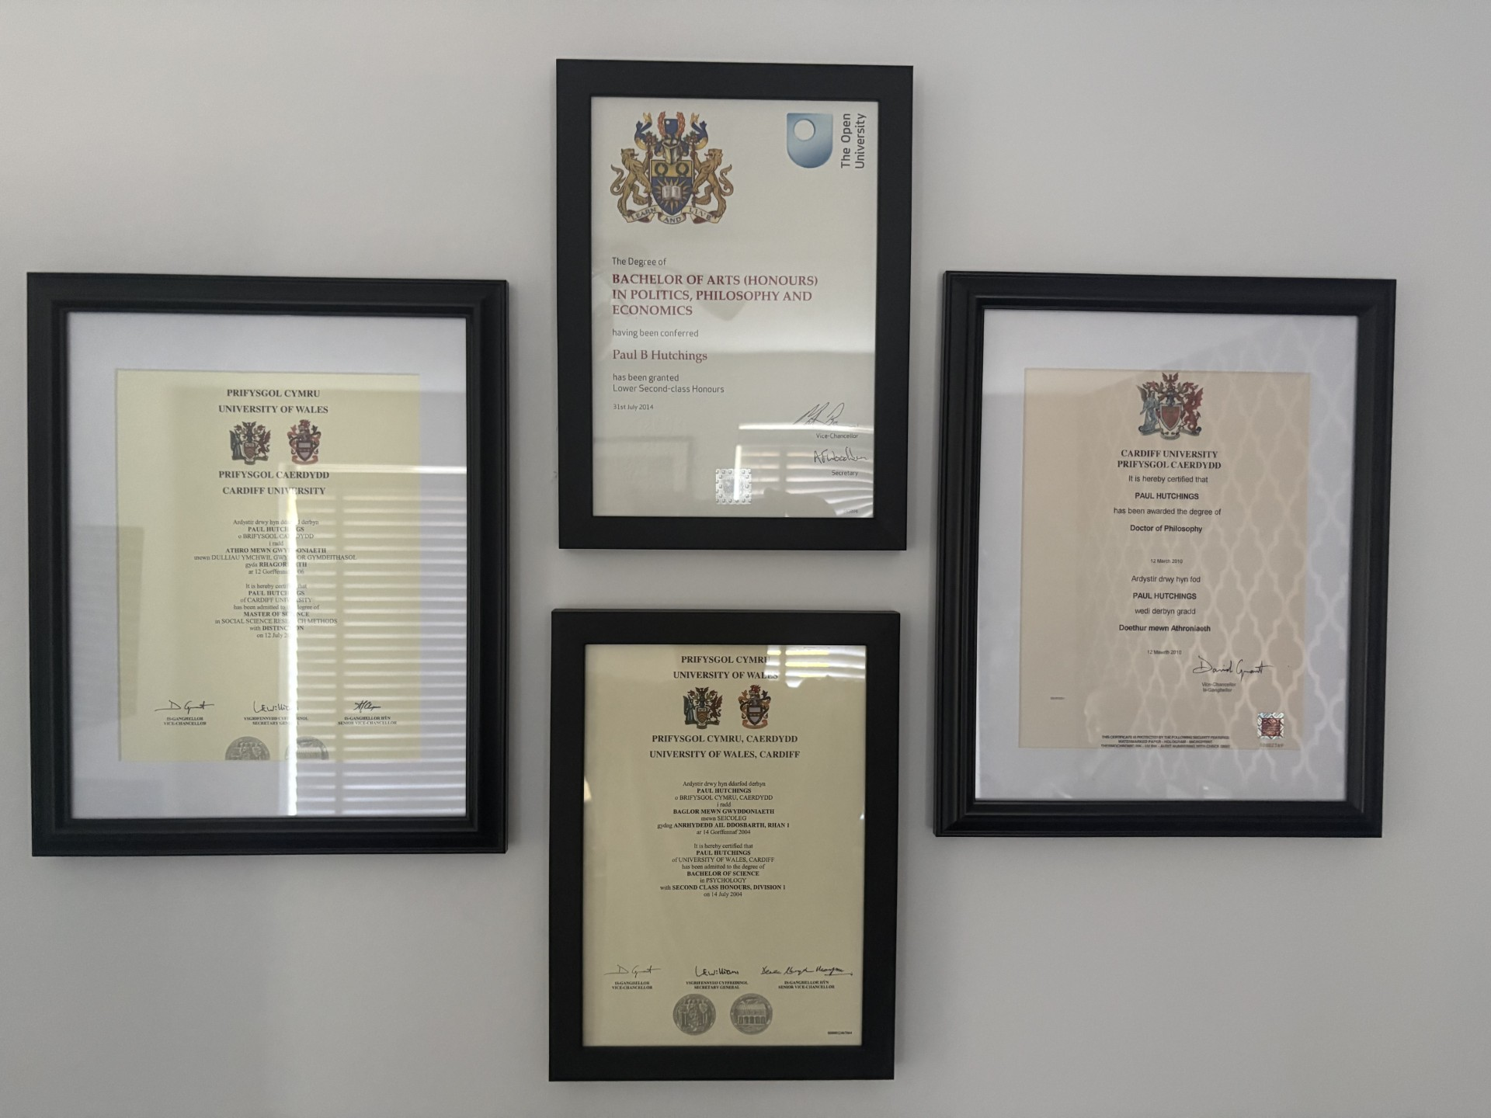

Slide 5


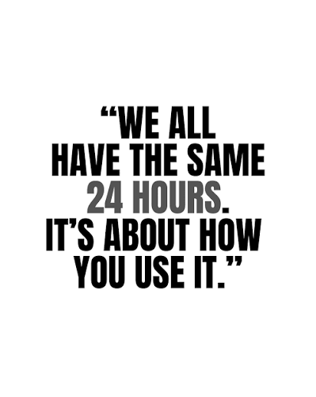

Slide 6
HEPI survey of student academic experience:
University Expectation = 35-40 hours per week combined study
UK average = 26-31 hours per week
Year of Study | Ave Contact Hours | Ave Independent Hours
Year 1/Level 4 | 10-13 | 15-20
Year 2/Level 5 | 8-10 | 20-25
Year 3/Level 6 | 4-8 | 25-35

Slide 7
Activity 1 (MLA5): Time and Space Audit (30 mins)
Using the Time Audit document, identify times across the days and weeks where you can, and can’t, study.
  Are there resources that you need to use that time? E.g., a quiet space
  Are those resources available to you?
Two important things to remember here:
Don’t panic! This is an exercise to identify issues so that we can consider ways to resolve them
Adaptability is key – sometimes this is physical, sometimes it is psychological

Slide 8
Maximising Your Available Time
There is no universal ‘right way’ to study
  There is research on effectiveness of specific ways to learn
  Finding the right ways for you and your environment is key
E.g., Pomodoro technique

Slide 9
Pomodoro Core Steps
Choose a task: Pick a specific task or assignment you need to finish. Have a rough idea of how long it will take… <25 minutes have an additional small task to hand; >25 minutes consider how many pomodoros it will take
Set a timer: Set your countdown timer for exactly 25 minutes.
Work with exclusive focus: Dedicate yourself entirely to the task – do not check emails, social media, or phones until the buzzer sounds.
Record your progress: Mark one completed "Pomodoro" interval.
Take a short break: Rest, stretch, or grab a drink for 5 minutes. Do not do any work.
Take a long break: Repeat this cycle four times. After the fourth session, enjoy a longer, more restorative 15-to-30-minute break.
1hr 40 mins intensive work in a 2-hour cycle

Slide 10
Activity 2: Pomodoro Reading (1 hour)
We will do two pomodoros on the papers available on Moodle (2x25mins)
Prepare yourself – you will be doing this on your own, with no phones or distractions
Break after 25 minutes – when the break comes you must stop
Read deeply, take notes, think about what you are reading

Slide 11
Session 2 (2 Hours): Digital Literacy for Psychology Students
Session Aim
To develop students' understanding of how digital technologies can support academic success whilst encouraging critical and responsible technology use.

Slide 12
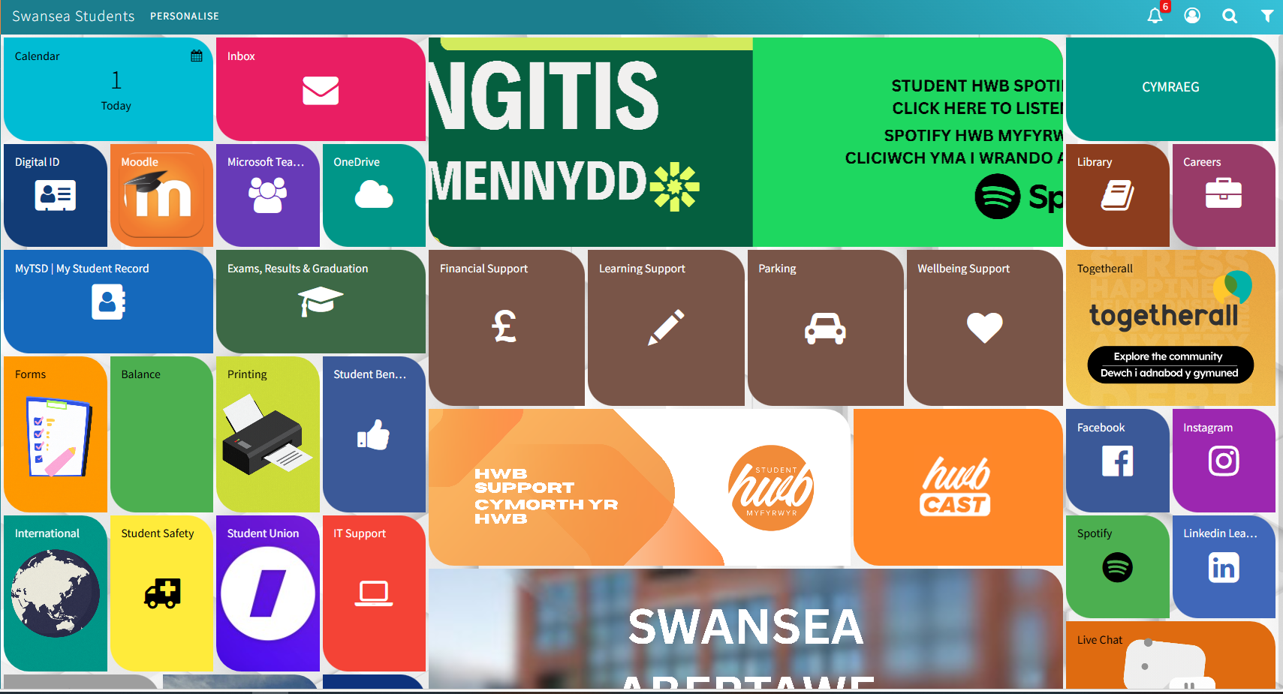
Technology Resources in the University

Slide 13

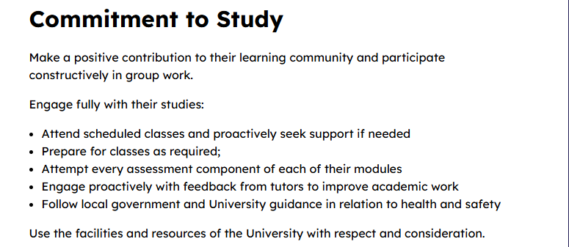
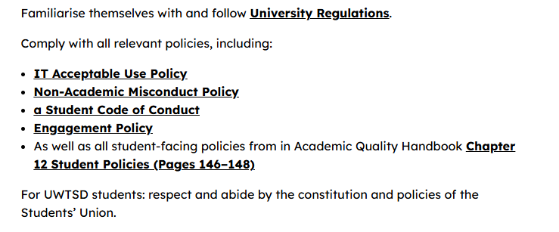

Slide 15
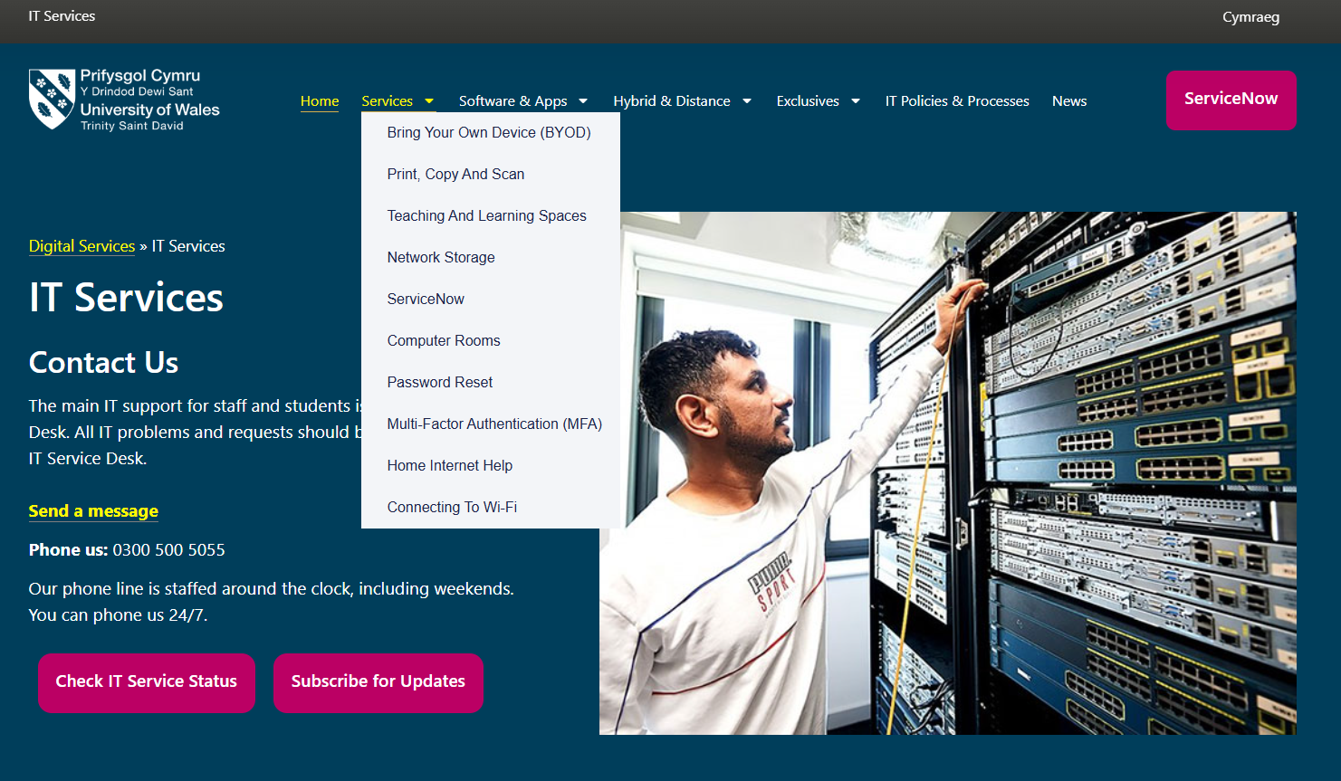

Slide 17
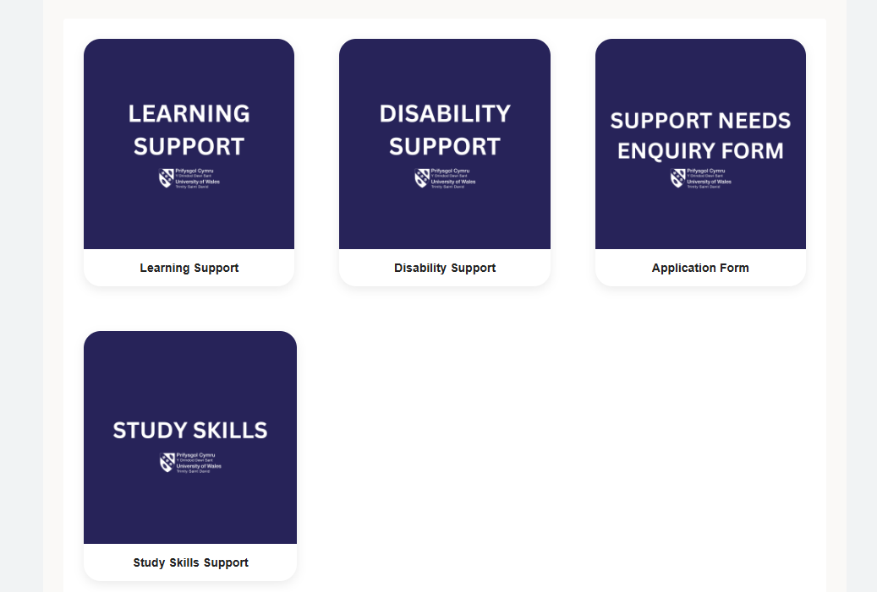
Learning Support

Slide 19
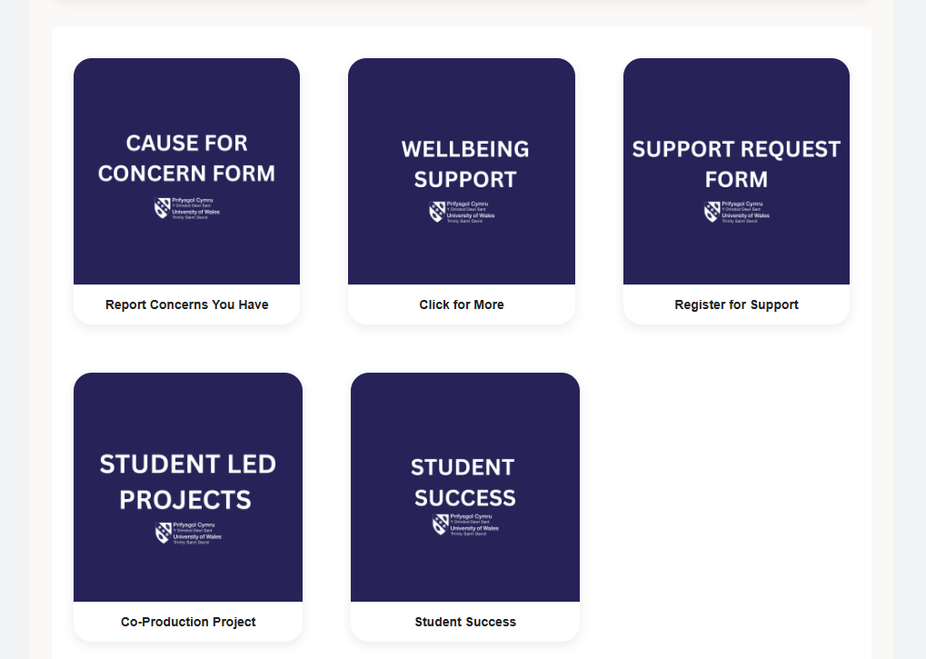

Slide 21

Library and Learning Resources

Slide 23
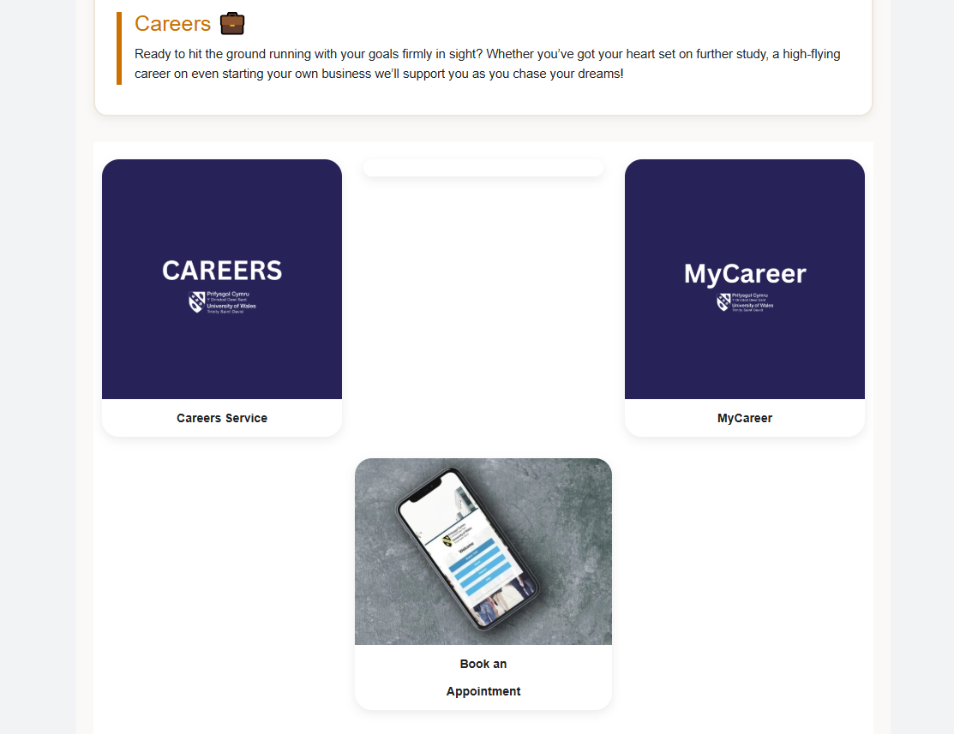

Slide 25
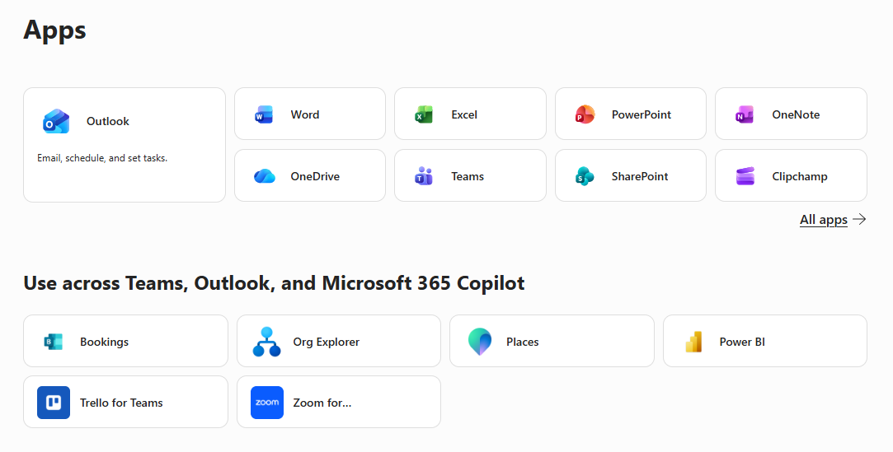

Slide 26
Activity 3: Discovering Resources (45 mins)
As individuals or small groups, explore the resources available to you
  If you want to visit the library building at the same time feel free to do so – the physical and virtual systems are integrated
Know what is available to you and where to find it
  Even if you don’t need it right now, knowing where to find it in the future if you do need it is important

Slide 27
What Does Digital Literacy Mean?
Finding information effectively
Organising academic materials
Evaluating digital content
Using productivity tools
Managing digital workloads
Communicating professionally

Slide 28
Technology Throughout a Psychology Degree
Literature searching
Data collection
Data analysis
Presentations
Group collaboration
Reflective learning
Portfolio development

Slide 29
Activity 4 (MLA6): Digital Habits (20 mins)
Critically evaluate the following about yourself:
Screen time
Multitasking habits
Procrastination behaviours
Technology-related distractions
Ultimately you are being asked to reflect upon the following:
  "Does my technology use support learning or undermine it? If the latter, what can I do to change this?"

Slide 30
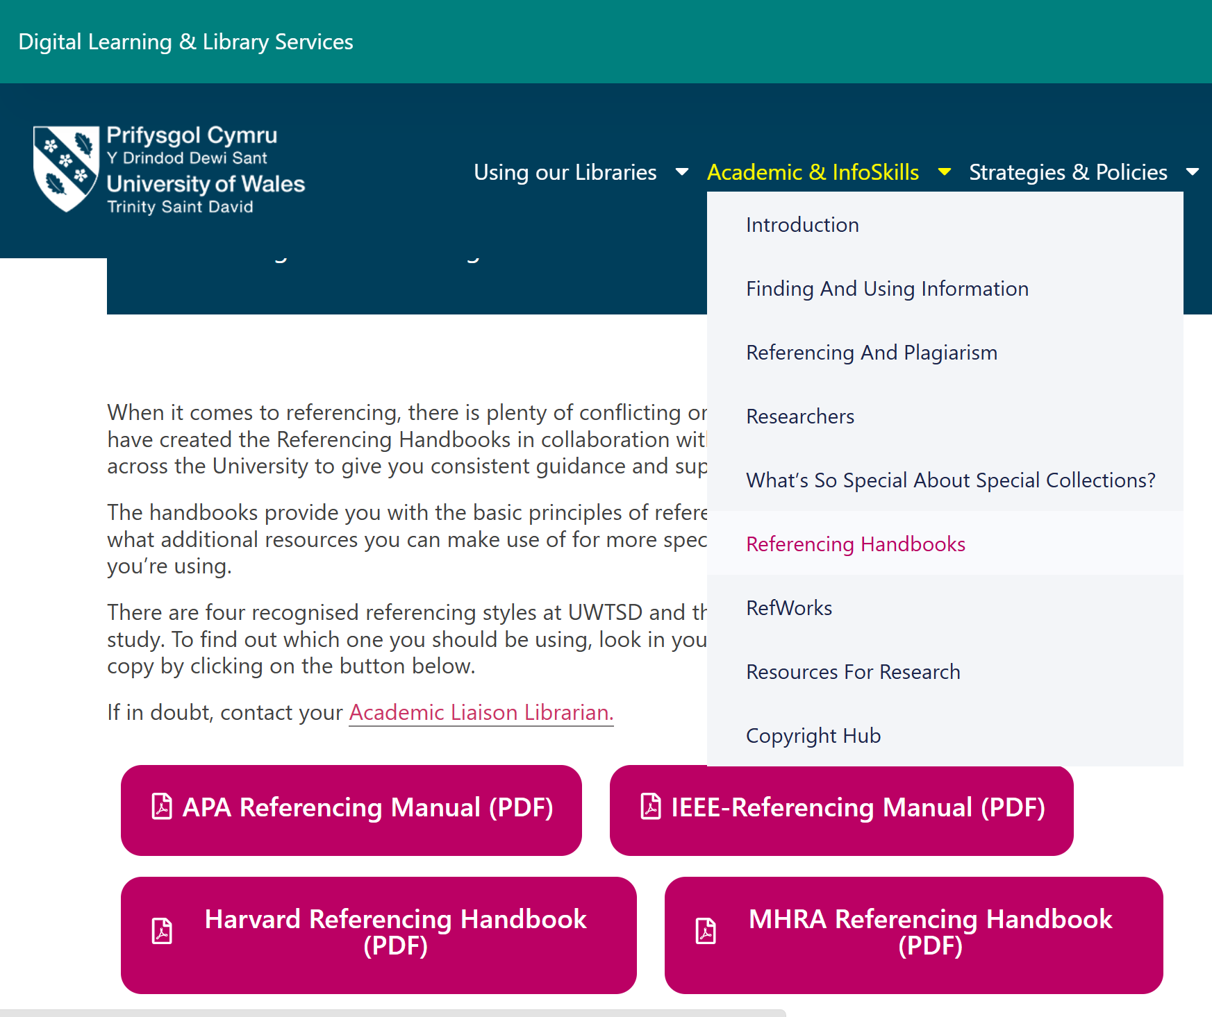
Session 3 (2 Hours): Referencing for Psychology Students

Slide 31


Referencing: Publication Manual of the APA 7th Edition

Slide 32
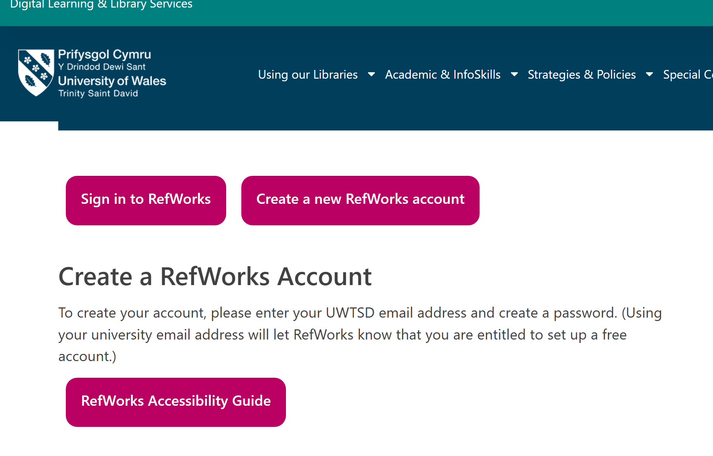
Activity 5 (MLA7): Create your RefWorks Account (30 mins)

Slide 33
Activity 6 (MLA8): The Jumbled Reference List (1 hour)
Put the reference list on Moodle into an APA style reference list
  Just because you can put it into AI doesn’t mean you should!

Slide 34
Week 2 Portfolio Evidence
Possible portfolio artefacts:
Time audit (Activity 1).
Digital Habits audit (Activity 4).
RefWorks account (Activity 5).
Jumbled Reference List solution (Activity 6).

Slide 35
The overarching Week 2 question that can continue throughout the entire module is:
"How do I use the tools that are available to me to maximise my learning and achievement, on this course and in other areas of my life, now and into the future?"

Slide 36
"Good psychologists do not simply consume information and communicate it effectively—they must also use technology responsibly, evaluate evidence critically, and understand how psychological knowledge is produced. Technology can support learning, but it cannot replace critical thinking. "

