Slide 1




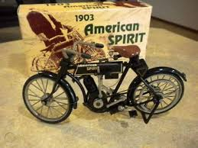
DATA PRIVACY AWARENESS AMONG SOCIAL MEDIA USERS
Module title: Research Methods and Professional Development
Module code: ACFA7004
Name: Vishal Bapodara
Student ID: 2514482
Submission Date: 11 November 2025

Slide 2

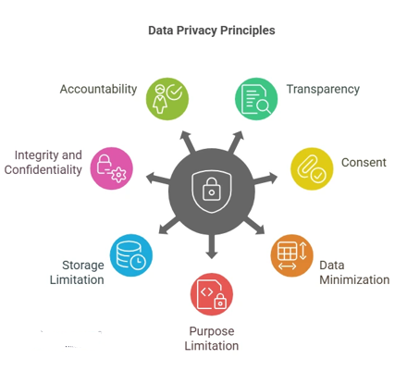
Introduction
• Examines data privacy awareness among social media users.
• Highlights critical research topic for digital era understanding.
• Focuses on app permissions and data collection policies.
• Aims to empower users, inform future policy development.
• Significance of user comprehension grows with platform use.

Slide 3






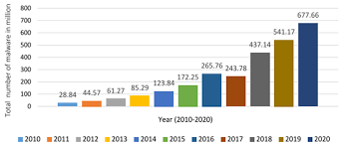
Research Context and Background
• Digital age features extensive social media data collection.
• Users engage with apps, unknowingly sharing personal data [1].
• Disconnect exists between privacy concerns and online actions.
• Evolving landscape demands enhanced user data awareness.
• Urgent need to understand digital footprint and data rights [2].

Slide 4


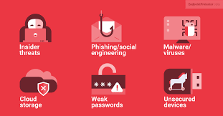

Research Problem and Literature Gap
• Users often misunderstand app data collection practices.
• Inadequate data privacy awareness is the core problem [3].
• Focuses on app permissions, collection policies specifically.
• Unknowing consent compromises user personal information [4].
• Creates power imbalance between platforms and users.

Slide 5

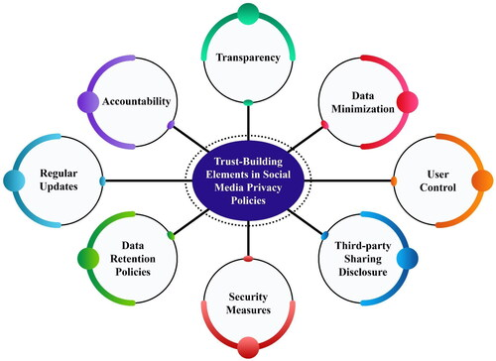
Research Aim and Objectives
  Research Aim: To make a change, this study will measure the level of awareness among social media users about the problem of app permissions and data-collection policies.
  Research Objectives
  • Measure ignorance and misperceptions through validated survey and scenario-based knowledge tests [5].
  • Examples: Policy snippet and consent form discussion (survey and secondary qualitative studies).
  • Evidence-based recommendation to deploy improved permission flows and user education [6].

Slide 6

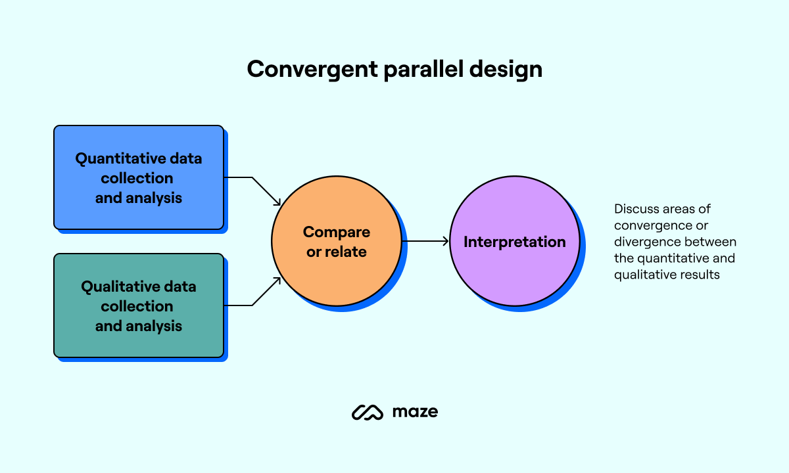
Research Methodology - Design
• Mixed-methods approach: quantitative and qualitative designs.
• Cross-sectional survey for broad awareness assessment [7].
• Provides statistical generalizability across diverse users.
• Secondary qualitative research methodology will be used for deep understanding [8].
• Triangulation offers comprehensive insights, strengthening findings.

Slide 7


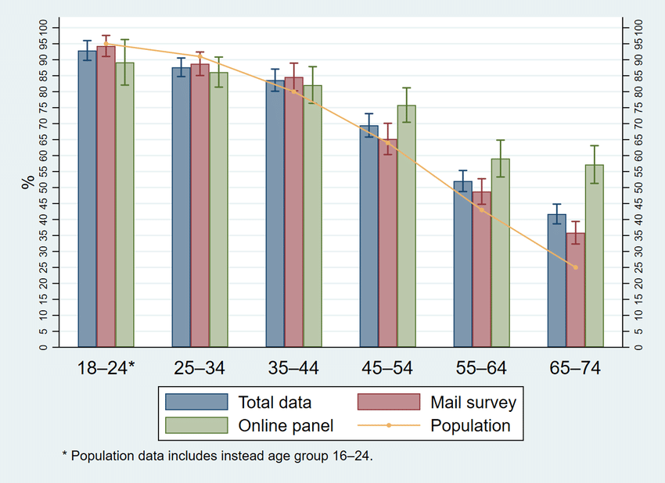
Research Methodology - Data Collection & Evaluation
• Online survey distributed to diverse social media users [9].
• Recruitment via social media, university networks ensures representation.
• Multiple-choice questions assess app permission knowledge [10].
• Likert-scale questions gauge self-assessed privacy understanding.
• Ethical approval and informed consent are paramount [11].

Slide 8
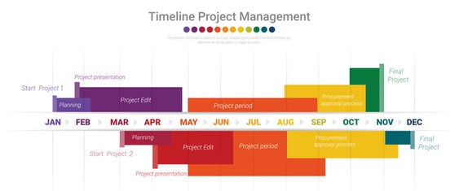
Project Planning and Resources
• Project timeline: approximately twelve months duration.
• Months 1-3: ethics, survey, interview protocol development [12].
• Months 4-6: quantitative data collection (online surveys) [13].
• Months 7-9: qualitative data collection (survey and secondary qualitative research).
• Months 10-12: data analysis, report writing, dissemination.

Slide 9
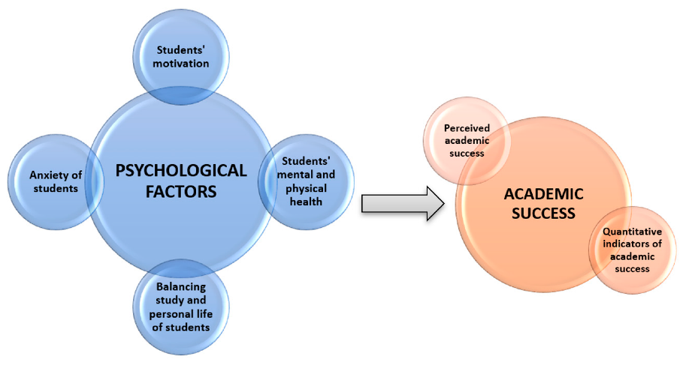
Project Impact and Limitations
• Research provides significant academic, professional, societal impact.
• Contributes novel empirical data on privacy policy comprehension [14].
• Enriches literature on digital literacy and informed consent.
• Guides social media platforms for clearer privacy interfaces.
• Empowers users, fosters responsible online behavior [15].

Slide 10
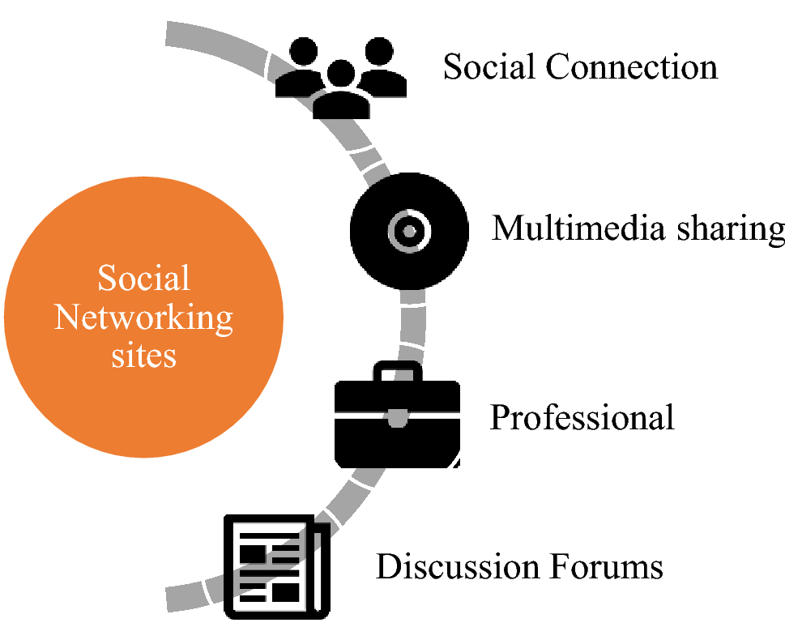
Conclusion and Q&A
• Comprehensive study proposed on social media data privacy awareness.
• Focuses on app permissions and data collection policies.
• Robust mixed-methods approach aims for actionable insights.
• Advances academic understanding of digital citizenship.
• Provides practical recommendations for improved user awareness.

Slide 11
References
[1] T. S. Raghupathi and S. K. Raghupathi, "Data privacy in the age of big data: A review of recent literature," Computers in Human Behavior, vol. 116, pp. 106649, Mar. 2021.
[2] Acquisti, S. Egelman, and L. Cranor, "Measuring the effect of privacy notices on behavioral intent," ACM Transactions on Human-Computer Interaction (TOCHI), vol. 27, no. 1, pp. 1–34, Feb. 2020.
[3] F. Schaub, P. Leon, A. P. Camp, and L. F. Cranor, "Designing effective privacy notices and controls," Communications of the ACM, vol. 63, no. 10, pp. 74–84, Oct. 2020.
[4] E. G. Adjerid, B. P. Van der Sloot, and R. E. W. Wessels, "The privacy paradox revisited: Online privacy behavior in the age of personalized advertising," Information Systems Research, vol. 32, no. 2, pp. 450–470, Jun. 2021.
[5] K. C. Alwahaishi, "User awareness of data privacy in social media: An empirical study," International Journal of Electronic Commerce Studies, vol. 12, no. 1, pp. 1–20, Jan. 2021.
[6] S. G. Al-Saggaf and A. D. M. Al-Saggaf, "Investigating social media users' awareness of privacy settings and their willingness to share personal information," Telematics and Informatics, vol. 55, pp. 101452, Nov. 2020.
[7] D. G. Kamara and B. K. Singh, "Understanding privacy concerns in social media: A literature review," Journal of Systems and Information Technology, vol. 22, no. 3, pp. 321–346, Sep. 2020.
[8] M. H. Alharbi, "Examining user perceptions and privacy behaviors in social networking sites," Journal of Organizational and End User Computing (JOEUC), vol. 33, no. 1, pp. 1–20, Jan. 2021.
[9] Das and S. Mandal, "A study on privacy concerns and awareness among social media users in India," International Journal of Information Management Data Insights, vol. 2, no. 2, pp. 100096, Dec. 2022.
[10] S. A. Khan, F. G. Hussain, and S. Z. N. Syed, "User awareness and perceptions of privacy implications in mobile applications," Journal of Information and Knowledge Management, vol. 30, no. 4, pp. 2150009, Dec. 2021.
[11] M. H. Hasan, "Impact of demographic factors on privacy concerns and information sharing behavior on social media," Journal of Information Technology Management, vol. 32, no. 4, pp. 1–18, Oct. 2021.
[12] J. W. Creswell and J. D. Creswell, Research Design: Qualitative, Quantitative, and Mixed Methods Approaches, 5th ed. SAGE Publications, 2018.
[13] T. R. Carberry, S. Egelman, and J. R. Weng, "Measuring perceptions of privacy in digital interfaces," IEEE Security & Privacy, vol. 19, no. 1, pp. 60–64, Jan.-Feb. 2021.
[14] V. Clarke and V. Braun, "Thematic analysis: A practical guide," Qualitative Research in Psychology, vol. 18, no. 2, pp. 123–140, May 2021.
[15] C. Kamali and S. Mahajan, "Privacy preserving data mining and its applications: A survey," Journal of Data Mining and Knowledge Discovery, vol. 34, no. 1, pp. 1–28, Feb. 2020.

