Slide 1

Arsenal F.C

Slide 2
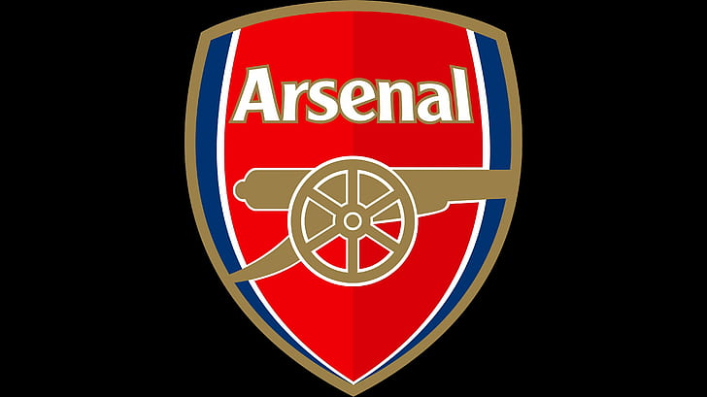
The Beginning
1893
Arsenal F.C first joined the Football league in 1893 after becoming the first London based club to turn professional, but it wasn’t until 1904 when they joined what was known as the English First Division.
Arsenal have only been relegated once in their entirety of their topflight career in 1913 and have continued to stay in the stop flight since.
Notes:
The origins of the club. How it all began in the rise to Arsenal F.C

