Slide 1
LCLM 5004
Managing Business Information
Week 8:
Emerging Technologies and Trends
Prepared by:
Oluwaseun (Olu) Adegbite, PhD.
BA (Hons) Leadership and Management Skills for the Workplace

Slide 2
Last Week (i.e., Week 7)
We examined ……………
Knowledge Management:
The role of knowledge in organizational success.
Theoretical Roots of Knowledge Management (KM).
Strategies for knowledge capture, storage, and dissemination.
Knowledge Management (KM) systems and tools.
Assessment 2 discussion.

Slide 3
This Week (i.e., Week 8)
We will examine ……………
Emerging Technologies and Trends:
Exploration of emerging technologies in information management.
The impact of Artificial Intelligence (AI) and Machine Learning (ML) on business information.
Future trends and their potential implications for business information management.
Assessment 2 discussion.

Slide 4
Session 1
Emerging Technologies and Trends:
Several technologies are advancing at an unimaginable rate, in this contemporary times.
It is therefore not possible to cover all of them during the course of this lecture, however, it is a good starting point!

Slide 5
Emerging Technologies and Trends
Emerging Technologies are vital to IT modernization.
They make processes more efficient.
Expand data and analytics capabilities.

Slide 6
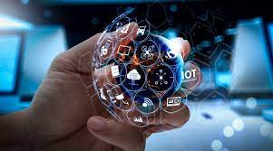
Emerging Technologies and Trends
Strengthen security, safety and reliability.
Highlight potential problems early and continuously.

Slide 7
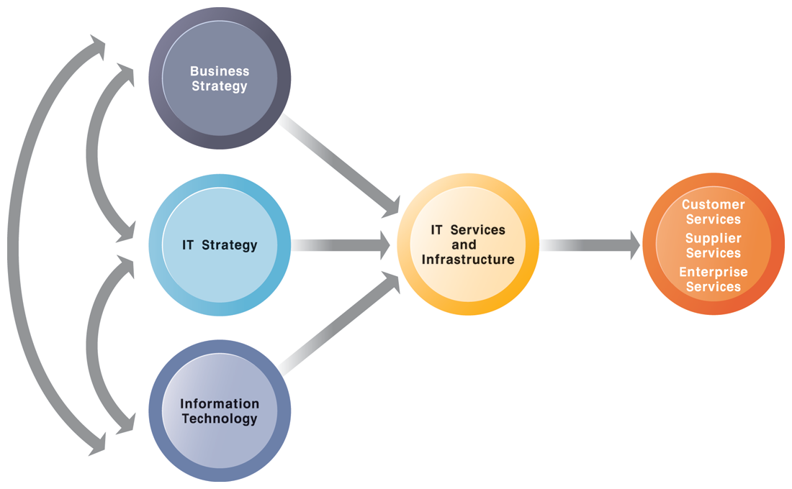
Emerging Technologies in Information Management.
The emerging technologies in IT showcases the connections among various elements (IT, strategies and relevant infrastructures) of the organization.
It aims to support business processes in the drive of offering/producing superior service/product to customers.
The services a firm is capable of providing to its customers, suppliers, and employees are a direct function of its IT infrastructure. Ideally, this infrastructure should support the firm’s business and information systems strategy. New information technologies have a powerful impact on business and IT strategies, as well as the services that can be provided to customers.

Slide 8
Emerging Technologies in Information Management
There are numerous emerging issues as it relates to information management in organisation.
Some of these are:
Contemporary Software Platforms
Management issues.
Cyber Security.
Competitive Forces Model For IT Infrastructure

Slide 9
Emerging Technologies in Information Management
Contemporary Software Platform Trends
Software outsourcing and cloud services
Three external sources for software:
Software packages and enterprise software
Software outsourcing
Contracting outside firms to develop software
Cloud-based software services
Software as a service (SaaS)
Accessed with Web browser over Internet
Service Level Agreements (SLAs): formal
agreement with service providers.

Slide 10
Emerging Technologies in Information Management
Contemporary Software Platform Trends
Software outsourcing and cloud services (cont.)
  Mashups
    Combinations of two or more online applications, such as combining mapping software (Google Maps) with local content
  Apps
    Small pieces of software that run on the Internet, on your computer, or on your cell phone
      iPhone, Android
    Generally delivered over the Internet.

Slide 11
Emerging Technologies in Information Management
Management Issues
Management and governance
  Who controls IT infrastructure?
  How should IT department be organized?
    Centralized
      Central IT department makes decisions
    Decentralized
      Business unit IT departments make own decisions
  How are costs allocated between divisions, departments?

Slide 12
Emerging Technologies in Information Management
Management Issues
Making wise infrastructure investments
Amount to spend on IT is complex question
Rent vs. buy, cloud computing
Outsourcing
Total cost of ownership (TCO) model
Analyzes direct and indirect costs
Hardware, software account for only about 20% of TCO
Other costs: Installation, training, support, maintenance, infrastructure, downtime, space, and energy
TCO can be reduced
Use of cloud services, greater centralization and standardization of hardware and software resources.

Slide 13
Emerging Technologies in Information Management
Management Issues
Competitive forces model for IT infrastructure investment
  Market demand for firm’s services
  Firm’s business strategy
  Firm’s IT strategy, infrastructure, and cost
  Information technology assessment
  Competitor firm services
  Competitor firm IT infrastructure investments.

Slide 14
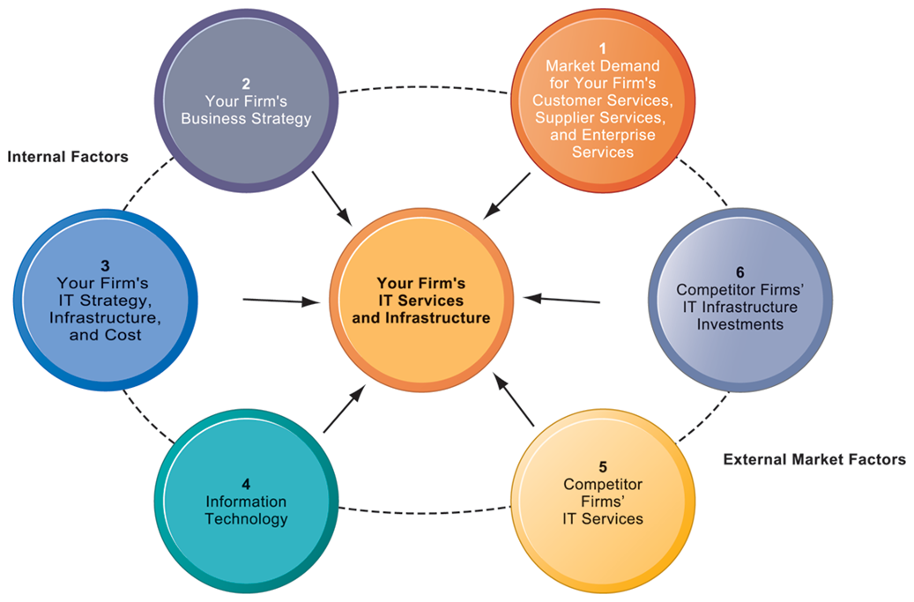
Emerging Technologies in Information Management
Competitive Forces Model For IT Infrastructure
There are six factors you can use to answer the question, “How much should our firm spend on IT infrastructure?”

Slide 15
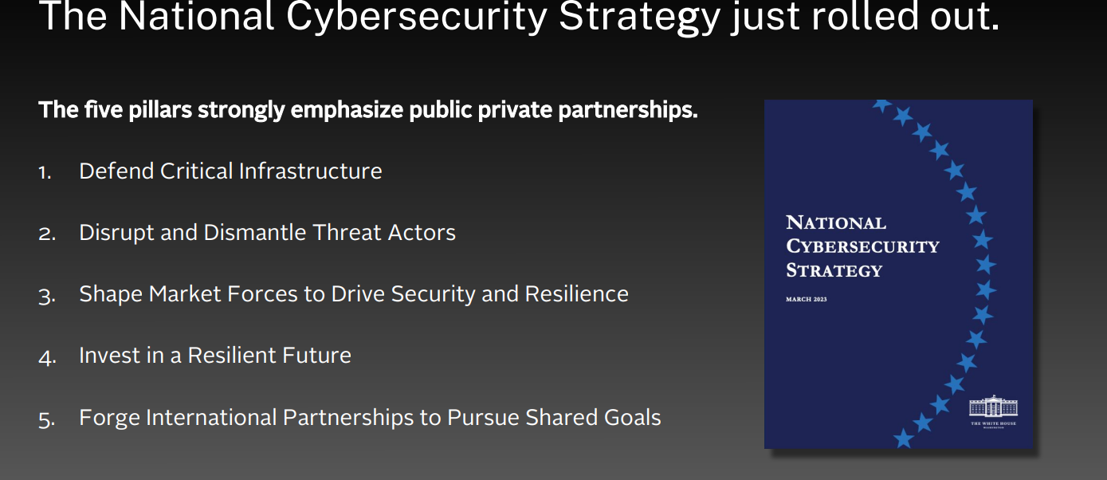
Emerging Technologies in Information Management
The issue of Cybersecurity is not only of concerns to organisations alone, but it is of great concern to many national securities. For example, in US…..

Slide 16

Next, …..
Break Time!

Slide 17

Next, …..
Welcome Back!

Slide 18
Session 2
Next, We Consider…..
The Impact of Artificial Intelligence (AI) and Machine Learning (ML) on Business Information.

Slide 19
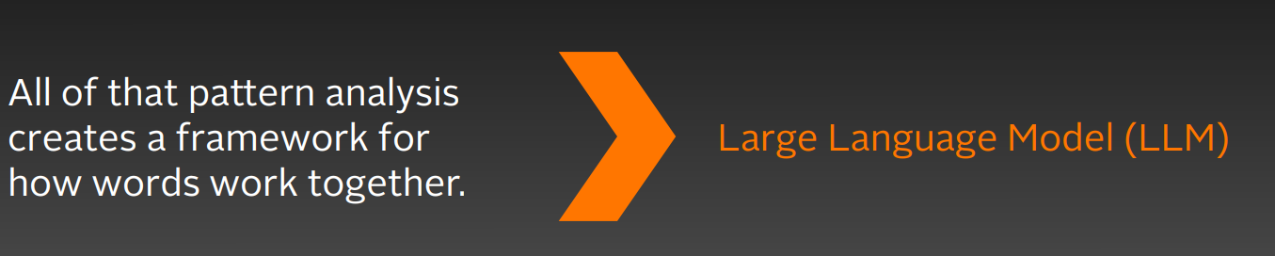
The Impact of Artificial Intelligence (AI) and Machine Learning (ML) on Business Information.
Artificial Intelligence (AI)
Is the science and engineering of making intelligent machines.
We deploy AI systems by feeding in data and letting them find patterns.

Slide 20
The Impact of Artificial Intelligence (AI) and Machine Learning (ML) on Business Information.
Artificial Intelligence (AI)
AI systems are algorithmic models that carry out cognitive or perceptual functions in the world that were previously reserved for thinking, judging, and reasoning human beings (Leslie et al. 2021: 8).

Slide 21
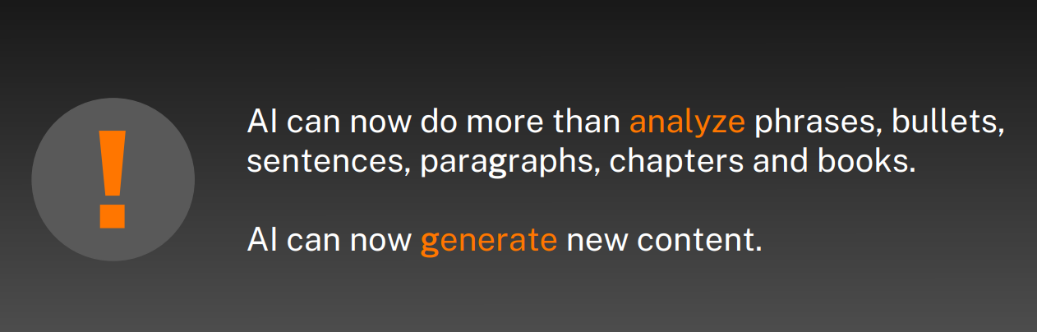
The Impact of Artificial Intelligence (AI) and Machine Learning (ML) on Business Information.
Artificial Intelligence (AI)

Slide 22
The Impact of Artificial Intelligence (AI) and Machine Learning (ML) on Business Information.
The Trend—and Why it Matters:
  With AI capabilities, such as machine learning (ML), computer vision, and natural-language processing (NLP), companies in all industries can use data and derive insights to automate processes, add or augment capabilities, and make better decisions. that value has been increasing.

Slide 23
The Impact of Artificial Intelligence (AI) and Machine Learning (ML) on Business Information.
The Trend—and Why it Matters:
  McKinsey research estimates the potential economic value at stake from applied AI to be $17 trillion to $26 trillion, and the share of companies pursuing that value has been increasing (McKinsey, 2023).

Slide 24
The Impact of Artificial Intelligence (AI) and Machine Learning (ML) on Business Information.
McKinsey’s (2023) future outlook report shows that the four industries likely to see the earliest economic impact from quantum computing are:
automotive,
chemicals,
financial services, and,
life sciences—stand to potentially gain up
to $1.3 trillion in value by 2035.

Slide 25
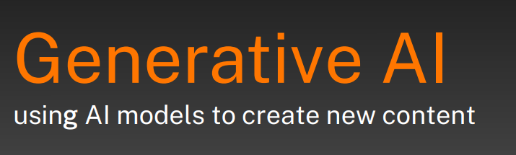
The Impact of Artificial Intelligence (AI) and Machine Learning (ML) on Business Information.
Generative AI
Generative AI goes beyond text to images and audio.

Slide 26
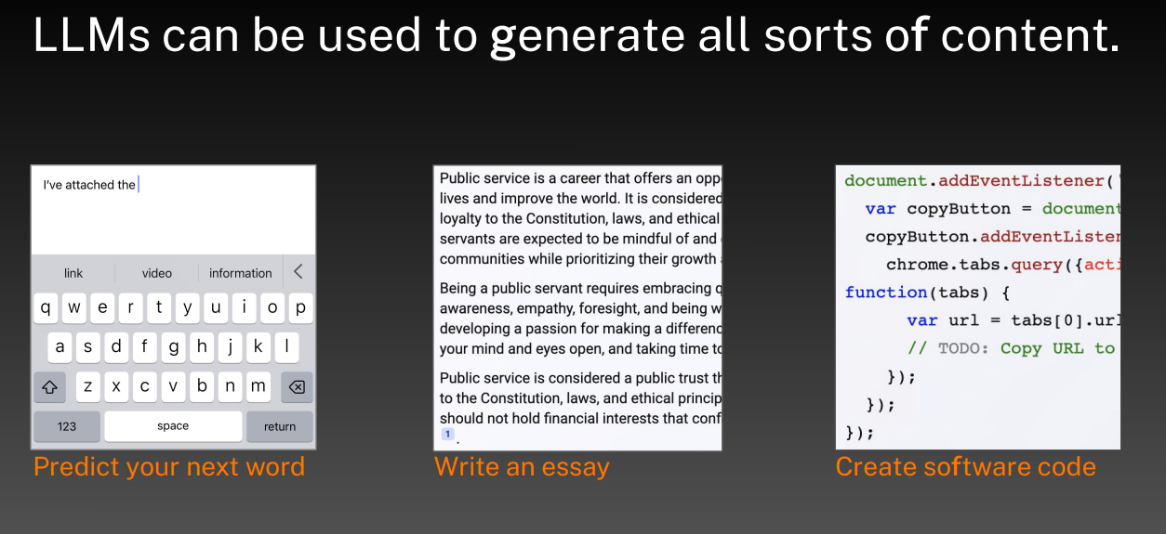
The Impact of Artificial Intelligence (AI) and Machine Learning (ML) on Business Information.
Generative AI

Slide 27
The Impact of Artificial Intelligence (AI) and Machine Learning (ML) on Business Information.
Generative AI
Generative AI marks a tipping point for AI. Unlike previous AI, it can enable the creation of new, unstructured content— such as text, audio, video, images, code, simulations, and even protein sequences or consumer journeys—based on information it learns from similar formats of unstructured data.

Slide 28
The Impact of Artificial Intelligence (AI) and Machine Learning (ML) on Business Information.
Generative AI
In a business context, generative AI could not only unlock novel use cases but also speed up, scale, or otherwise improve existing ones.

Slide 29
The Impact of Artificial Intelligence (AI) and Machine Learning (ML) on Business Information.
Generative AI
Generative AI has the potential to redefine businesses and value chains by enabling the development of new products and revenue streams, enhancing customer experience.
Its impact is expected to materialize most, however, in improving employee productivity and experience.

Slide 30
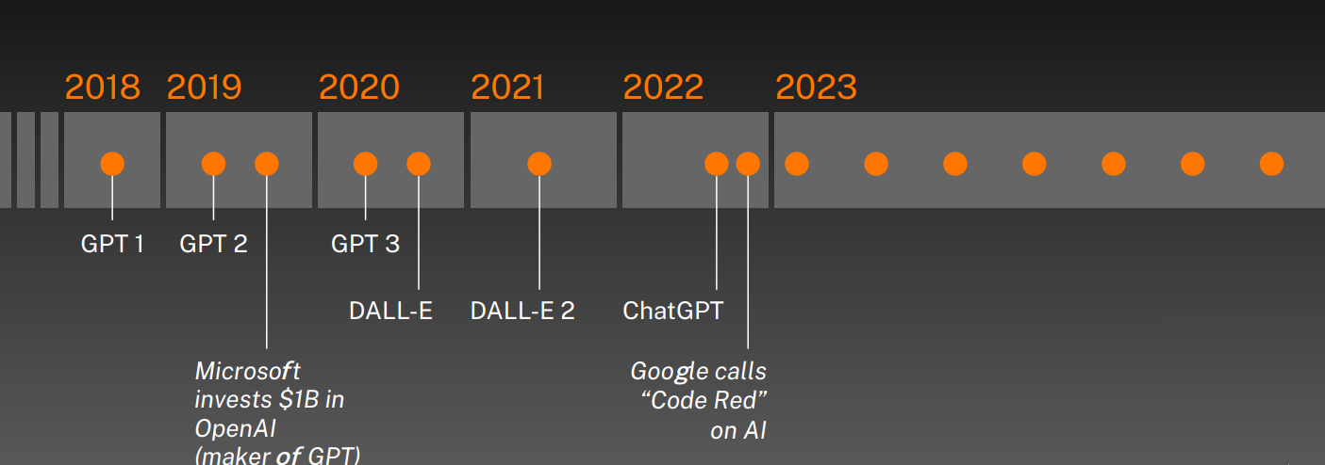
The Impact of Artificial Intelligence (AI) and Machine Learning (ML) on Business Information.
Generative AI
The pace of Generative AI advancements is going up.

Slide 31
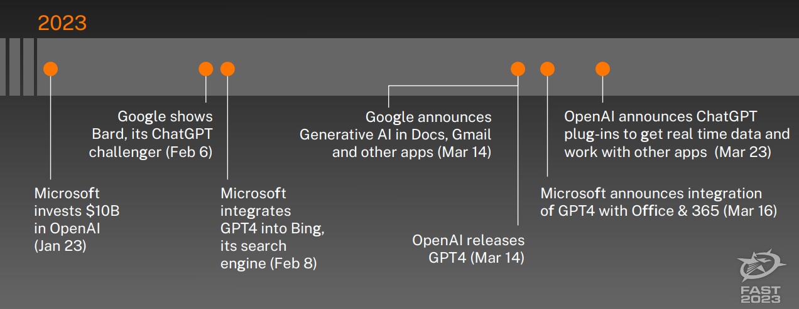
The Impact of Artificial Intelligence (AI) and Machine Learning (ML) on Business Information.
Generative AI
The pace of Generative AI advancements is going up.

Slide 32
Tipping Point.
Literally: the point at which a thing would begin to tip over.
The point at which a series of small changes or incidents becomes significant enough to cause a larger, more important change.
Some Examples:
Epidemiology: when an infectious disease reaches a point beyond any local ability to control it from spreading more widely. A tipping point is often considered to be a turning point.
“White Flight” (1950’s): Point at which a majority withdraws from a neighborhood when a minority moves in (10 – 15%)

Slide 33

Technology Tipping Points.
Source: http://www3.weforum.org/docs/WEF_GAC15_Technological_Tipping_Points_report_2015.pdf

Slide 34
Technology Tipping Points.
Early 2015, the World Economic Forum’s Global Agenda Council on the Future of Software and Society set out to help people prepare for changes enabled by software.
These potential changes will have far reaching impacts on human health, the environment, global commerce and international relations.
Source: http://www3.weforum.org/docs/WEF_GAC15_Technological_Tipping_Points_report_2015.pdf

Slide 35
Technology Tipping Point Survey
In March 2015, the Technological Tipping Points survey was launched.
Based on the council’s discussions over previous months, the survey asked respondents for their views on 21 “tipping points” – moments when specific technological shifts hit mainstream society.

Slide 36
Technology Tipping Point Survey
Survey of over 800 executives and experts from the information and communications technology sector.
The survey asked respondents for their perception of when these tipping points would occur, offering date ranges from “it has already happened” to “20+ years”. The option of “never” was also available.

Slide 37

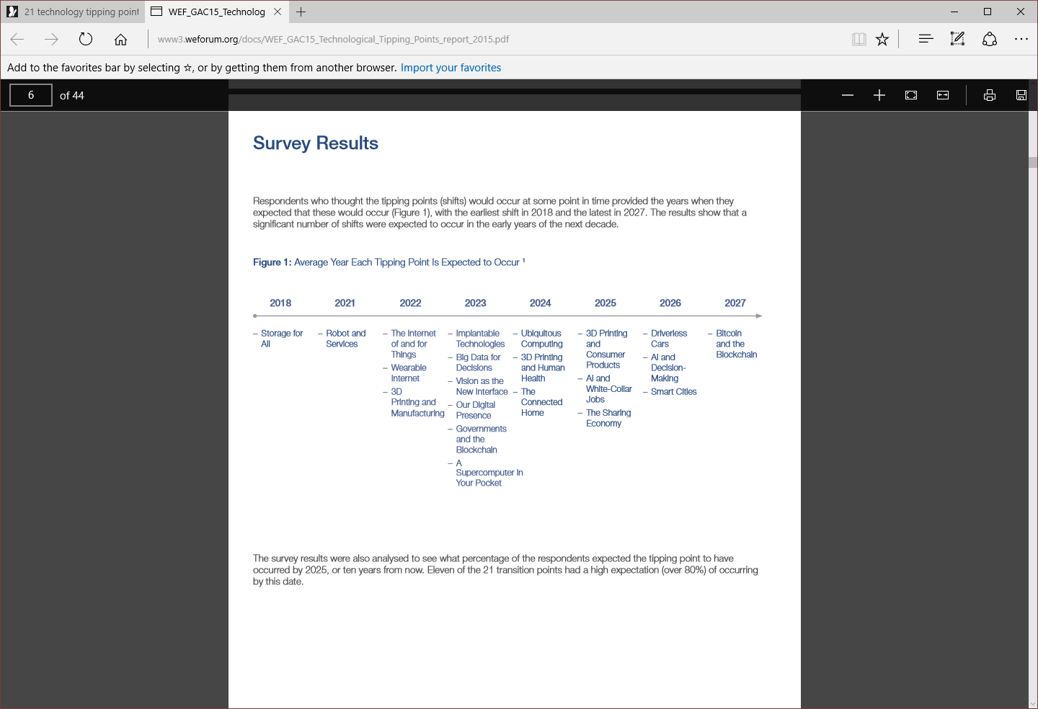
Technology Tipping Point Survey

Slide 38
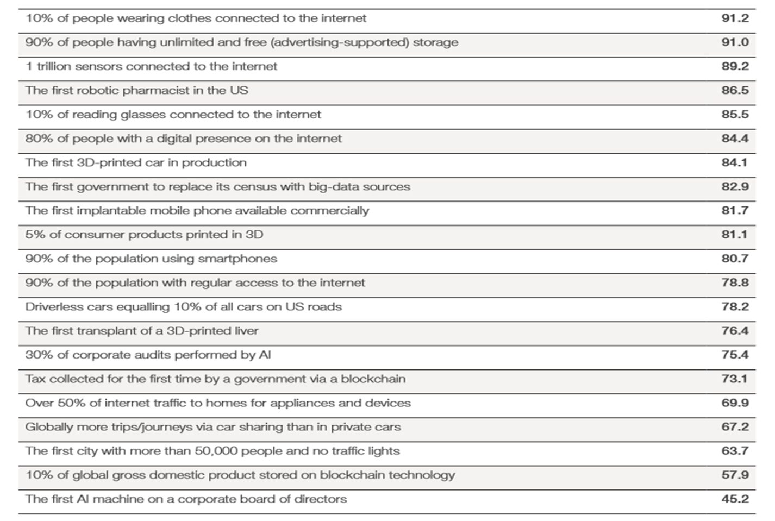
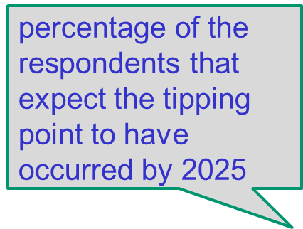
TPs Expected to Occur by 2025

Slide 39
Implantable Technologies
2023: The first implantable mobile phone available commercially.
People are becoming more and more connected to devices
Devices are increasingly becoming connected to our bodies
Devices are not just being worn, but also being implanted into bodies
Providing communications, location and behavior monitoring, and health functions.

Slide 40
Implantable Technologies
Pacemakers and cochlear implants were just the beginning.
New devices will be able to sense the parameters of diseases, enable individuals to take action, send data to monitoring centers, or potentially release healing medicines automatically.
Smart tattoos and other unique chips could help with identification and location. Implanted devices will likely also help to communicate thoughts normally expressed verbally through a “built-in” smartphone by reading brainwaves and other signals.

Slide 41
Vision as the New Interface
2023: 10% of reading glasses connected to the internet.
Glasses, headsets and eye-tracking devices can become “intelligent” with eyes and vision being connected to the internet and other devices.
Direct access to internet applications and data through vision, can enhance, mediate or completely augment an individual’s experiences to provide immersive reality.

Slide 42
Vision as the New Interface
With emerging eye-tracking technologies, devices can feed information through visual interfaces, and eyes can be the source for interacting with and responding to the information.
Enabling vision as an immediate, direct interface – by providing instruction, visualization and interaction – can change the way that learning, navigation, instruction and feedback for producing goods and services, experiencing entertainment and enabling the disabled are helping people to engage more fully with the world.

Slide 43
Wearable Internet
2022: 10% of people will be wearing clothes connected to the internet
Technology is becoming increasingly personal. Computers were first located in large rooms, then on desks and, following that, on people’s laps.

Slide 44
Wearable Internet
Released in 2015, Apple Watch is connected to the internet and contains many of the same functional capabilities as a smartphone.
Increasingly, clothing and other equipment worn by people will have embedded chips that connect the article and person wearing it to the internet.

Slide 45
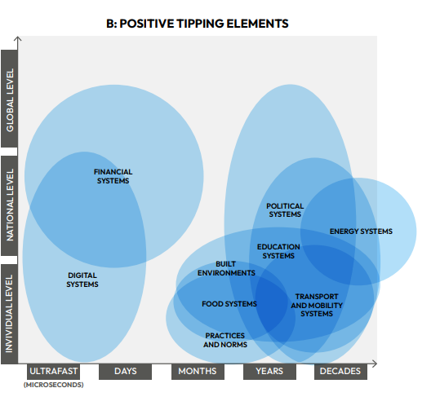
Positive Tipping Elements
Source: Section 4 Positive tipping points in technology, economy and society, UNIVERSITY OF EXETER Global Tipping Points Report, Downloads/GTP-Section-4-071223.pdf

Slide 46
Session 3
Assessment 2 Discussion!

Slide 47

Any Question?

Slide 48
Summary…Today we have looked at…
Emerging Technologies and Trends:
Exploration of emerging technologies in information management.
The impact of Artificial Intelligence (AI) and Machine Learning (ML) on business information.
Future trends and their potential implications for business information management.
Assessment 2 discussion.

Slide 49
References
Bourgeois, D., T., Smith, J., L., Wang, S., and Mortati, J., (2019). "Information Systems for Business and Beyond“, Open Textbooks. 1, available @: https://digitalcommons.biola.edu/open-textbooks/1 , (Accessed on 22/11/2023).
Coughlan, J., Lycett, M., and Macredie, R., D., (2005). Understanding the Business–IT Relationship, International Journal of Information Management, Vol. 25, pp.303–319.
Laudon, K.C. and Laudon, J. P. (2012). Management Information Systems, twelfth edition. Upper Saddle River, New Jersey: Prentice-Hall.
Leslie D. et al. (2021), Artificial intelligence, human rights, democracy, and the rule of law: a primer, Council of Europe, available at www.ssrn.com/abstract=3817999, accessed 25 June 2022.
McKinsey (2023). McKinsey Digital: Technology Trends Outlook 2023, available @:https://www.mckinsey.com/~/media/mckinsey/business%20functions/mckinsey%20digital/our%20insights/mckinsey%20technology%20trends%20outlook%202023/mckinsey-technology-trends-outlook-2023-v5.pdf

