Slide 1

Case study:
Lucy Letby Case
(Countess of Chester Hospital, UK)
Student Name: Sageeta Hussain
Student ID: 2129744
LCHS7006 - Quality Assurance and Service Improvements.

Slide 2
Background
Case Context:
Neonatal nurse Lucy Letby at Countess of Chester Hospital (2015–2016) (Lazaro, 2023).
Found guilty of murdering 7 infants and attempting to kill 6 others (Lawrence & Conn, 2025).
Systemic Issue: Failure in clinical governance, incident reporting, staffing, and leadership (Muir, 2025).
QA Relevance: A catastrophic breakdown of safety and quality assurance systems (Chakravorty, 2023).
Inquiry Aim:
Led by Lady Justice Thirlwall.
Give bereaved families answers.
Examine management failings.
Review how staff concerns were dismissed.

Slide 3
What Went Wrong
Timeline:
Rise in neonatal deaths between June 2015 – July 2016.
Doctors noticed Letby present during many collapses/deaths (Humphries, 2025).
Raised concerns → ignored for months (Shamim, 2025).
Letby suspended only after 2 more deaths in June 2016 (Lawrence & Conn, 2025)
Hospital Conditions:
Understaffed, low morale, inexperienced staff replacing senior nurses.
Failing infrastructure: sewage leaks, contaminated taps (Pseudomonas) (Muir, 2025; Alnaqi et al., 2017).
Overcapacity due to closures in nearby units & lack of transport to tertiary centres (Jazeera, 2025).
Investigations:
Internal reports highlighted poor care but did not find foul play.
RCPCH review confirmed shortages of senior staff and governance failings (Department of Health and Social Care, 2023).

Slide 4
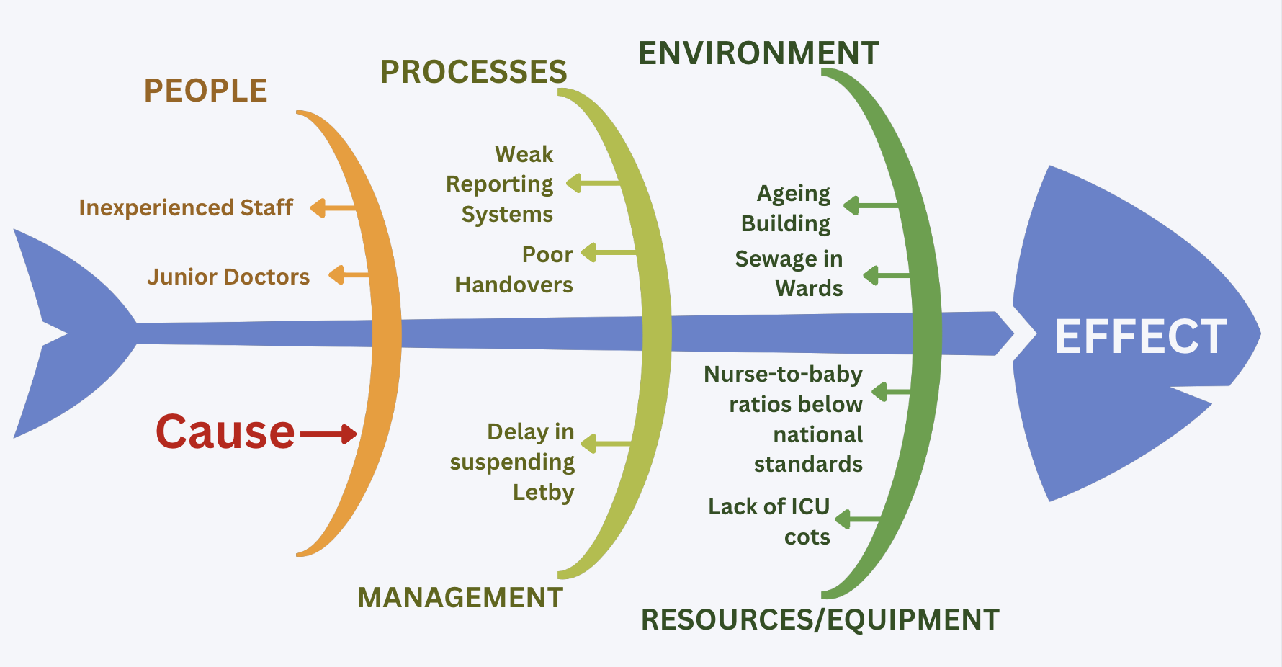
Root Cause Analysis - Fishbone Diagram
Source: Author

Slide 5
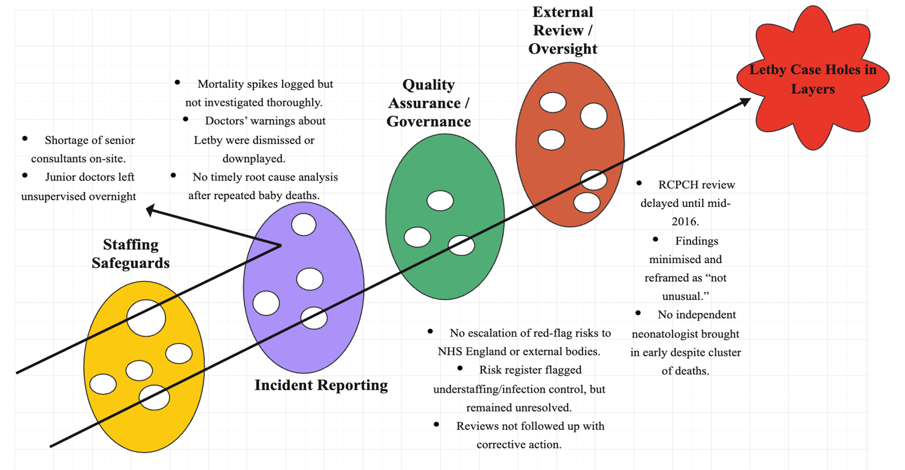
Swiss Cheese Model
Source: self-made

Slide 6
Swiss Cheese Model (Cont..)
Layer of Defence (Slice of Cheese) | Intended Function | Hole (Weakness)
Staffing Safeguards | Ensure adequate supervision and staffing levels to maintain patient safety. | - Shortage of senior consultants on-site. - Junior doctors left unsupervised overnight.
Incident Reporting | Detect and investigate unusual patterns or adverse events promptly. | - Mortality spikes logged but not investigated thoroughly. - Doctors’ warnings about Letby were dismissed or downplayed. - No timely root cause analysis after repeated baby deaths.
Quality Assurance / Governance | Escalate risks, maintain accountability, and ensure corrective action through governance mechanisms. | - No escalation of red-flag risks to NHS England or external bodies. - Risk register flagged understaffing/infection control but remained unresolved. - Reviews not followed up with corrective action.
External Review / Oversight | Provide independent review and external scrutiny to identify systemic issues. | - RCPCH review delayed until mid-2016. - Findings minimised and reframed as “not unusual.” - No independent neonatologist brought in early despite cluster of deaths.

Slide 7
Benchmark
Category | Details / Explanation
Policy Issues | Clinical Governance Failures: Lack of structured escalation of mortality spikes, weak reporting mechanisms, and failure to enforce accountability structures. Whistleblowing: No safe or effective mechanism for raising concerns; consultants who spoke up were sidelined (Chakravorty, 2023). Staffing Policy: Consultant shortages and inadequate supervision, with junior doctors left unsupervised overnight. Incident Reporting: Mortality spikes logged but not properly investigated; warnings by doctors dismissed or downplayed; no timely root cause analysis after repeated baby deaths (Smith and Hall, 2009).
Regulatory Oversight | CQC and RCPCH both produced reports identifying staffing and safety concerns (e.g., neonatal nurse staffing flagged in June 2016) (Lawrence & Conn, 2025; Muir, 2025). However, actions were delayed. The Trust failed to follow CQC neonatal standards, clinicians’ concerns were not escalated, and whistleblowing proved ineffective. Leadership failed to act on CQC standards. The CQC’s enforcement was slow, with no real-time monitoring (Lawrence & Conn, 2025; Muir, 2025).
Impact on Service Delivery | Patient Impact: Avoidable deaths and disabilities; families traumatised; public confidence eroded. Staff Impact: Burnout, tears, stress, and a collapse in morale due to ignored whistleblowing and a culture of fear (Alnaqi et al., 2017). Service Impact: Neonatal unit downgraded to Level 1, reducing capacity for high-risk babies; reputational harm to NHS. Financial Impact: Inquiry costs already exceeding £3 million, primarily due to legal fees (Lawrence & Conn, 2025).

Slide 8

Summary
Core Lesson: This was a systemic failure, not just individual wrongdoing.
Key Themes:
Ignored warnings.
Inadequate QA systems.
Poor staffing & leadership decisions.
Weak whistleblowing culture.
Implications:
Inquiry findings must inform NHS-wide reforms.
Patient safety must be prioritised over reputation management.

Slide 9

Component 2
Overview of the Report Structure:
Introduction: Introduction to the Lucy Letby case, setting the context for the report.
Root Cause Analysis:
Donabedian’s Model: Evaluating structure, process, and outcomes of care.
Swiss Cheese Model: Illustrating systemic failures in safety mechanisms.
Analysis of Failures:
Breakdown of communication, ignored warnings, weak whistleblowing mechanisms, and leadership complacency.
Policy Context:
NHS Reforms: Impact of the Thirlwall Inquiry on whistleblowing protections, incident reporting systems, and CQC oversight.
Conclusion:
Reflecting on the need for transparent, accountable, and learning-oriented quality assurance practices.

Slide 10
References
Alnaqi, H., McIntosh, B., & Lancaster, A. (2017). Cultures of fear: Perspectives on whistleblowing. British Journal of Mental Health Nursing, 6(3), pp. 134–137.
Chakravorty, I. (2023). Case of Nurse Letby: Systems failure in safeguarding patients. Sushruta Journal of Health Policy & Opinions, 15(3).
Department of Health and Social Care. (2023). Government agrees scope of inquiry into Lucy Letby’s crimes. GOV.UK. Available at: https://www.gov.uk/government/news/government-agrees-scope-of-inquiry-into-lucy-letbys-crimes
Humphries, J. (2025). Three ex-bosses of Lucy Letby arrested on suspicion of gross negligence manslaughter. Available at: https://www.bbc.com/news/articles/c62ddkde7y5o
Jazeera, A. (2025). Medical experts dispute evidence in Lucy Letby’s baby killing conviction. Al Jazeera. Available at: https://www.aljazeera.com/news/2025/2/4/medical-experts-dispute-evidence-in-lucy-letbys-baby-killing-conviction
Lawrence, F., & Conn, D. (2025). A superbug, doctor shortages and a neonatal unit ‘out of its depth’: failures at Lucy Letby hospital revealed. The Guardian. Available at: https://www.theguardian.com/uk-news/article/2024/sep/08/a-superbug-doctor-shortages-and-a-neonatal-unit-out-of-its-depth-failures-at-lucy-letby-hospital-revealed
Lazaro, B. D. O. J. M. L. H. &. R. (2023). Nurse Lucy Letby guilty of murdering seven babies on neonatal unit. Available at: https://www.bbc.com/news/uk-england-merseyside-65960514
Muir, L. (2025). Thirlwall Inquiry: Systemic failures at Countess of Chester Hospital exposed by nursing staff. Thirlwall Inquiry: Systemic failures at Countess of Chester Hospital exposed by nursing staff. Available at: https://www.switalskis.com/blog/thirlwall-inquiry-nurse-testimony
Smith, S. L., & Hall, M. A. (2009). Corrections. Archives of Disease in Childhood Fetal & Neonatal, 96(6), pp. 611.4-611.
Shamim, S. (2025). Baby murderer or scapegoat? Why is the Lucy Letby case so divisive? Al Jazeera. Available at: https://www.aljazeera.com/news/2024/10/6/baby-murderer-or-scapegoat-why-is-the-lucy-letby-case-so-divisivehttps://www.aljazeera.com/news/2024/10/6/baby-murderer-or-scapegoat-why-is-the-lucy-letby-case-so-divisive

