Slide 1



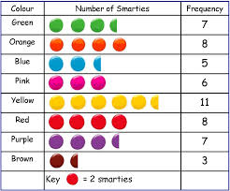
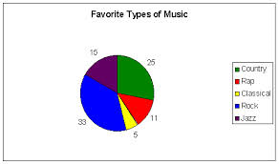
Data Handling and Developing Reasoning

Slide 2

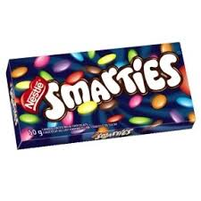
Present data about the Smarties
What data could you present?

Slide 3
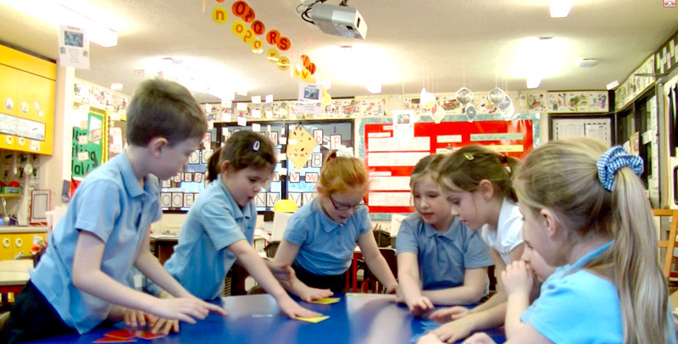
Progression in Sorting and Classifying
http://www.shodor.org/interactivate/activities/ShapeSorter
One criterion (reception)
Two or more criteria (usually discrete)(year 1)
Non-discrete criteria (often represented in Venn and Carroll diagrams – year 3 and 4)

Slide 4


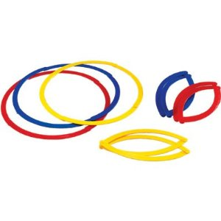
Sort the objects on your table.
Use one criterion
Use more than one criteria
Swap with another group.
Can they guess what your criteria for sorting are?
http://www.shodor.org/interactivate/activities/ShapeSorter/

Slide 5
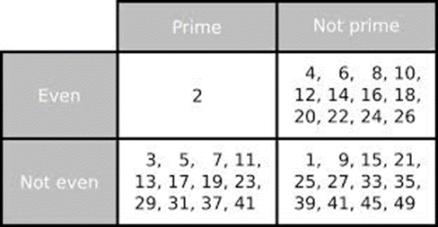
The Carroll Diagram
http://www.wldps.com/gordons/Carroll.swf
http://www.wldps.com/gordons/carroll__-_shape.swf
Now reorganise your circles into Carroll Diagrams

Slide 6
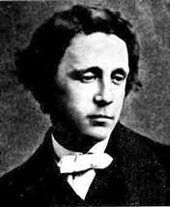
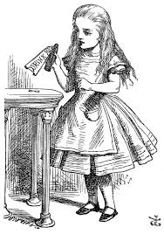
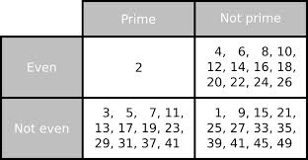
Lewis Carroll (aka Charles Dodgson),
1832-1898
The author of ‘Alice in Wonderland’ and ‘Through the Looking Glass’
A mathematician who specialised in logic and logic puzzles
The Carroll Diagram is named after him

Slide 7
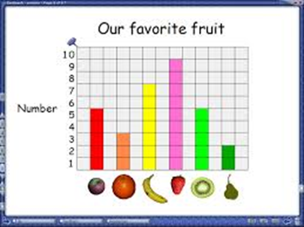
Stages in Data Handling
Asking a question
Deciding on the data which best answer the question
Gathering, recording and organising that data
Representing the data
Interpreting the data to answer the question
PROGRESSION IN DATA HANDLING WILL OCCUR THROUGH USING THESES STAGES AT DIFFERENT ‘LEVELS’ AND WITH DIFFERING EXPECTATIONS

Slide 8
Multiply 345 by 27
If you know that 345 × 27 is 9315, how could you quickly work out 345 × 54?
Consider the two questions above/
What is the same and what is different about them?

Slide 9
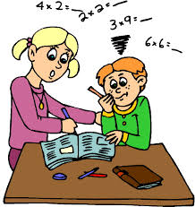
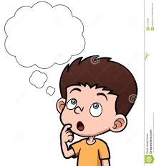


Procedural Questions/Tasks
Reasoning Questions/Tasks
Application of a process (knowing how)
Can rely on memory more than understanding
Requires learners to pause/stop and think
Requires a deeper of understanding than simply ‘being able to do something’
Offers a springboard for further thinking

Slide 10
Sort the cards on your table into two piles: procedural and reasoning.

Slide 11
Stem | Examples
If you know…what else do you know/how can you work out…? | If you know 8 + 11 , how could work out 8 + 41? If you know 3 + 7 = 10, what else do you know?
If … is the answer, what is the question? | If 54 is the answer, what is the question? If £1.50 is the answer, what is the question?
What is the same and what is different? | What is the same and what is different about these shapes?
How many different ways can you find to? | How many different ways can you find to calculate 24 + 49? How many different ways can you find to make 10p using coins?
Give me an example of… | Give me an example of a set of number whose mean is 5 Give me an example of a shape with an area of 16 square cm Give me an example of a hexagon
Change one thing… | Change one thing about the number sentence 12 ÷ 3 so that there is a remainder
Which is the odd one out… | 7, 11, 14 Which could be the odd one out? Why?

Slide 12

Numerical reasoning in the curriculum
Involves skills that should develop over time through selection of questions and tasks which allow for reasoning
Any mathematics teaching can have a numerical reasoning element within it, particularly if reasoning questions are used
A ‘rich task’ is a task which would require learners to use a range of numerical reasoning skills
nrich.maths.org has lots of rich tasks

Slide 13
Examples of cross-curricular data handling…
Look at the interactive literacy and numeracy framework at:
http://learning.gov.wales/resources/browse-all/nlnf/framework?lang=en
Choose ‘numeracy’ and a year group.
Filter by ‘strand’ – ‘data handling’
Select data handling skills – there will be examples of data handling being developed in other curriculum areas.

Slide 14
Resources
For data handling ideas: http://www.tes.co.uk/teaching-resource/Teachers-TV-Primary-Maths-Data-Handling-6045041/
www.nrich.maths.org.uk – a range of rich tasks for all ages and useful articles and resources
Reasoning in the classroom resource packs:
http://learning.wales.gov.uk/resources/learningpacks/reasoning-in-the-classroom/?skip=1&lang=en
The interactive framework on Learning Wales sites has ‘rich activities’ for some of the numeracy skills
Look at the ‘mathematical challenges’ on Moodle

Slide 15
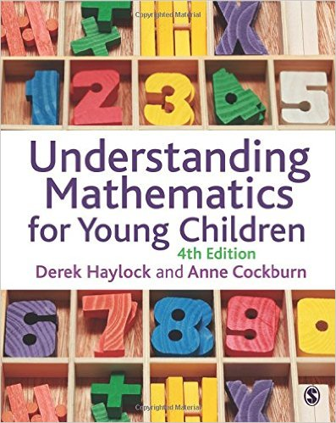
Further Reading
Chapter 10 and 11 of Understanding Mathematics for Young Children
(Data Handling and Reasoning)

