Slide 1
Consultancy Project
By Siobhan thomas

Slide 2
Aim, Objectives & Rationale
Rationale
  Environmental impacts of events is still lacking in research and should be considered more by organisers
Aim
  To help improve Ty Hafan's Rainbow Run impact on the environment
Objectives
  1. Evaluate the Rainbow Run's current environmental strategy
  2. Identify problem areas where improvement can be made
  3. Recommend ideas to help combat problem areas
Notes:
My aim for this consultation is to help improve the environmental impact of the Rainbow Run event which is hosted by Ty Hafan.
My three objectives for this project is to find out the current environmental strategy of the event and evaluate it, identify any problem areas where there is room for improvement and finally to give recommendations to combat the problem areas.
My rationale for this project is that I feel there is still a lot of room for research into the environmental impacts of events and it should be taken into consideration by organisers when planning an event.

Slide 3
Who are Ty Hafan & Who arr the event’s staleholders
Ty Hafan
  Ty Hafan is a charity based in Sully, Vale of Glamorgan who provide care and support to life-limited children, young people and their families.
Stakeholders
  - Local members of the community
  - Participants
  - Event organisers
Notes:
Ty Hafan are based in the Vale of Glamorgan where they have a hospice in order to provide care and support to life-limited children, young people and their families.
The stakeholders that could benefit from this consultation would be not only Ty Hafan but local members of the community and people living in the surrounding areas, participants of the event and the event organisers.

Slide 4
Rainbow Run
In order for Ty Hafan to offer support to those in need, they need to raise £4 million each year.
The Rainbow Run is a 5k fun run held by Ty Hafan in order to raise money for their cause.
Each participant pays £13 to enter the race which goes towards hosting the event and are encouraged to raise as much money as they can to help fund the charity.
Runners are splashed with colour throughout the race which makes it a fun event for people of all ages
Notes:
Ty Hafan aim to raise £4million each year to provide nurses and therapists, specialist teams and advisers to the patients and their families.
The Rainbow Run is just one of the many events that Ty Hafan host in several locations each year in order to raise money for their cause.
Participants pay a fee which goes towards the event but they are more importantly asked to do as much fundraising as possible to help Ty Hafan reach their goal.
The event is for people of all ages and is made fun by splashing the runners with colour throughout the track.

Slide 5


Slide 6
Research
The research I will carry out will be to look at the local transport infrastructure to see how it could be utilised more for participants, families coming to watch and for everybody else involved.
I will mainly use primary research and ask local members of the public how they are affected by the event. I will also look at Ty Hafan's current environmental strategy surrounding the Rainbow Run and give suggestions on how it could be improved regarding things such as waste.
Notes:
I feel that by encouraging people to use the local transport infrastructure could help to reduce the carbon footprint left behind by the event. This means gathering local bus and train routes and making them known to not only the participants, but any friends and family coming to support the runners on the day.
I also feel that primary research would help me to gather the information that I need as it would allow me to speak to local members of the public and see how they are affected by the event.
I also think it is important to look at the event’s current environmental strategy and see if any changes could be made with regards to issues such as waste and recycling.

Slide 7
Benefits
1. To give the organisation a measurable plan of how they could improve their environmental impact
2. To give the organisation ideas on how they could better use the local travel infrastructure to decrease their carbon footprint
3. To give the company suggestions on how they could minimise their waste
Notes:
The benefits of this project are the opportunity to give Ty Hafan a measurable plan on how they could improve their environmental impact, to give them ideas on how they could utilise the transport infrastructure to reduce their carbon footprint and to suggest how they could minimise their waste.

Slide 8
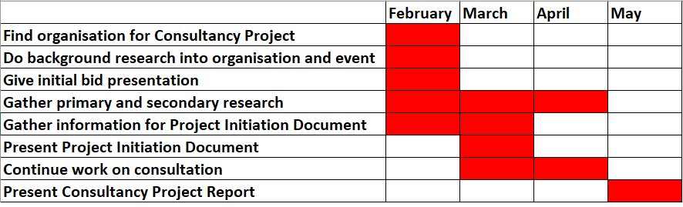
Project Reporting
Notes:
This is a basic plan of how I will manage my project with attention on deadlines for my Project Initiation Document and Consultancy Project whilst continuing to gather information throughout the following months.

Slide 9
Why me?
- Events Management student
- Passionate about environmental issues
- Currently working for an Urban Regeneration company who host events
- Participated in Ty Hafan's Rainbow Run
- Volunteered and participated in other outdoor running events
Notes:
So, why me?
I am currently in my third year as an Events Management student with the hope of continuing my studies into a master’s qualification.
I am passionate about environmental issues and strongly believe that every event held should have a minimum carbon footprint in order to create a more sustainable future within events.
I currently work for an Urban Regeneration company who host local events, which I have worked with to minimise their waste, boost their recycling and draw attention to the small changes that could make a big environmental difference.
I have also participated in the Rainbow Run and other outdoor running events so I have seen first hand what changes could be made and think this will help me when it comes to giving suggestions on making environmentally friendly changes.

