Slide 1

Social Media Use
By Clare Thomas 2514560
Notes:
Today I will be discussing social media use and its implications for mental health.
I will focus specifically on adolescents aged approximately 13–18 in the UK.
I will first outline the current UK situation, then discuss mental health impacts, and finally present three strategies to improve outcomes.

Slide 2
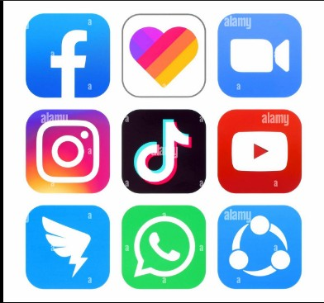
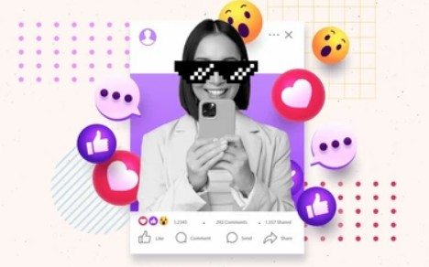
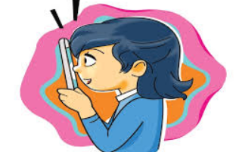
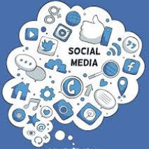
Notes:
Social media refers to online platforms that allow users to create, share and interact with content.
Examples include Instagram, TikTok, Snapchat and X.
Social media has become embedded in daily life, especially for young people.
Adolescents use social media for communication, entertainment, identity formation and social comparison.
While social media offers benefits such as connection and support, there are growing concerns about its impact on mental health.

Slide 3

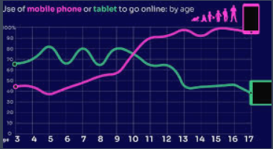
Current Situation in the UK (2025)
Most UK adolescents use social media daily
Many spend 3+ hours per day online
TikTok, Snapchat and Instagram most used
Smartphone access allows constant connection
Increased exposure to online comparison and interaction
Ofcom (2025a) Children and parents: media use and attitudes report 2025. London: Ofcom.
Ofcom (2025b) Online Nations Report 2025. London: Ofcom.
Notes:
Social media use among adolescents in the UK is extremely high.
Most teenagers report using at least one social media platform daily.
Many adolescents spend multiple hours per day online.
Smartphones allow constant access, increasing frequency of use.
Platforms such as TikTok, Snapchat and Instagram are the most popular among young people.
This high exposure increases both potential benefits and risks for mental wellbeing.

Slide 4
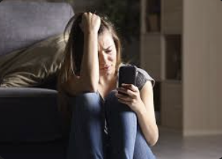
Why Focus on Adolescents?
Adolescence is a key stage for mental development
Increased sensitivity to peer approval
Identity formation occurs during this period
Greater exposure to social comparison online
Higher vulnerability to anxiety and low self-esteem
Sala et al. (2024); Shannon et al. (2022)
Notes:
Adolescence is an important stage of psychological and emotional development.
Young people are more sensitive to peer feedback and social approval.
Social media increases opportunities for comparison with others.
Adolescents are still forming their identity and self-esteem.
Exposure to idealised images and online interactions may negatively influence mental health.
Therefore, adolescents are considered a higher-risk group when examining social media use.

Slide 5
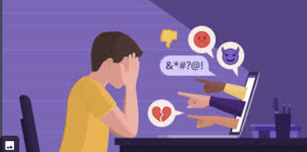
Mental Health Implications
Increased risk of anxiety and depression
Social comparison and low self-esteem
Exposure to unrealistic body standards
Cyberbullying and online harassment
Sleep disruption from excessive use
Keles, B., McCrae, N. and Grealish, A. (2020)
Notes:
High social media use linked with increased anxiety and depression
Adolescents compare themselves to peers and influencers
Social comparison can lower self-esteem and confidence
Idealised images create unrealistic body expectations
Cyberbullying more common on social media platforms
Negative online interactions impact emotional wellbeing
Excessive use, especially at night, disrupts sleep
Poor sleep linked to reduced mental wellbeing
Social media can also provide support and reduce isolation

Slide 6
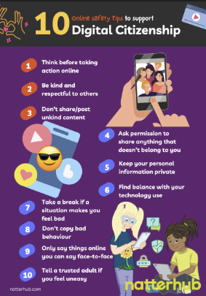
Strategy 1: Digital Literacy Education
Teach healthy social media use in schools
Develop critical thinking about online content
Reduce harmful social comparison
Promote positive online behaviour
Improve awareness of cyberbullying
(Sala et al., 2024; Shannon et al., 2022)
Notes:
Digital literacy education can help adolescents use social media safely
Schools can teach healthy and balanced social media use
Students can learn to question unrealistic online content
Helps reduce harmful social comparison
Education can address cyberbullying and online safety
Encourages positive online behaviour
Improves understanding of mental health impacts

Slide 7
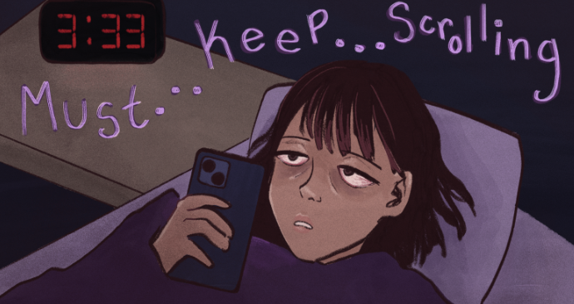
Strategy 2 — Screen Time and Sleep Boundaries
Encourage limits on daily social media use
Reduce phone use before bedtime
Promote healthy sleep routines
Support parental guidance and monitoring
Improve overall mental wellbeing
(Sala et al., 2024; Shannon et al., 2022)
Notes:
Setting screen time boundaries can reduce excessive use
Many adolescents use social media late at night
Night-time use disrupts sleep patterns
Poor sleep linked to anxiety and low mood
Limiting phone use before bed may improve sleep quality
Parents can help support healthy routines
Schools can promote balanced technology
use Improved sleep linked to better mental health

Slide 8

Strategy 3: Safer Platform Design
Improve safety features on social media platforms
Reduce exposure to harmful content
Stronger cyberbullying reporting tools
Screen time reminders and usage tracking
Age-appropriate content moderation
(Sala et al., 2024; Shannon et al., 2022)
Notes:
Social media platforms can help create safer environments for adolescents
Safety features can reduce exposure to harmful content
Reporting tools allow users to flag cyberbullying
Platforms can remove harmful or inappropriate material
Screen time reminders encourage healthier use
Usage tracking helps adolescents monitor time online
Age-appropriate content moderation protects younger users
These changes may reduce negative mental health impacts

Slide 9
Conclusion
Social media use is high among UK adolescents
Linked with both positive and negative mental health outcomes
Adolescents particularly vulnerable to impacts
Three strategies may improve mental wellbeing
Promote balanced and informed social media use
Notes:
Social media use among adolescents in the UK is very high
Excessive use linked with anxiety, low self-esteem and poor sleep Adolescents more vulnerable due to development and social comparison However, social media can also provide support and connection Digital literacy education may improve understanding Screen time boundaries may improve sleep and wellbeing Safer platform design may reduce harmful content Balanced social media use is important for mental health

Slide 10
REFERENCES
Keles, B., McCrae, N. and Grealish, A. (2020)
A systematic review: The influence of social media on depression, anxiety and psychological distress in adolescents. International Journal of Adolescence and Youth, 25(1), pp.79–93. https://doi.org/10.1080/02673843.2019.1590851
Odgers, C.L. and Jensen, M.R. (2020)
Annual research review: Adolescent mental health in the digital age: Facts, fears, and future directions. Journal of Child Psychology and Psychiatry, 61(3), pp.336–348. https://doi.org/10.1111/jcpp.13190
Ofcom (2025a)
Children and parents: media use and attitudes report 2025. London: Ofcom.
Ofcom (2025b)
Online Nation 2025 report. London: Ofcom.
Sala, A., Porcaro, L. and Gómez, E. (2024)
Social media use and adolescents’ mental health and well-being: An umbrella review. Computers in Human Behavior Reports, 14, 100404. https://doi.org/10.1016/j.chbr.2024.100404
Shannon, H., Bush, K., Villeneuve, P.J., Hellemans, K.G.C. and Guimond, S. (2022)
Problematic social media use in adolescents and young adults: Systematic review and meta-analysis. JMIR Mental Health, 9(4), e33450. https://doi.org/10.2196/33450

