Slide 1

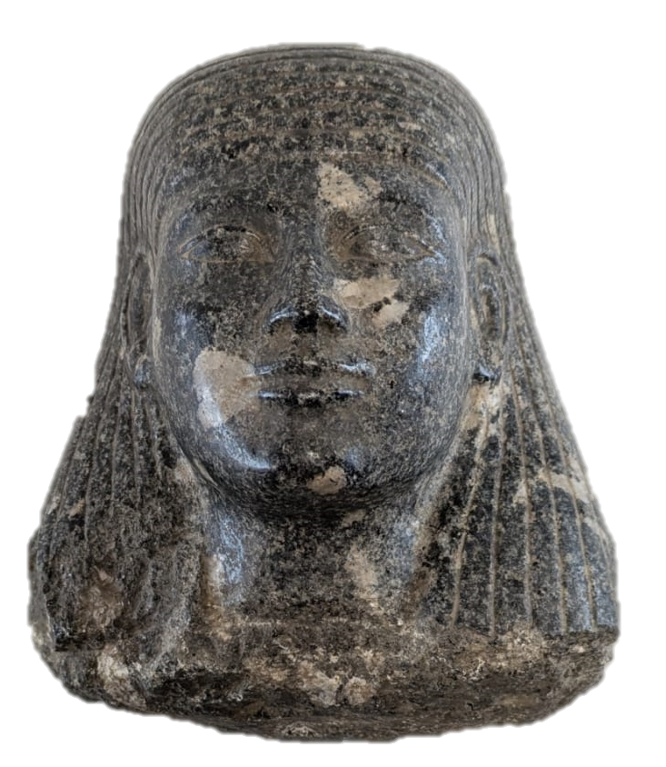
Information
Object number: 276.004
Dimensions: 19.1 cm x 17 cm x 14.5 cm
Black Statue Head
By Olivia Hunt
Introduction
The artefact is a broken head of an ancient Egyptian statue, with the rest of the body’s whereabouts unknown. Statues were used at varying places, such as tombs and temples. This statue is part of the Merthyr Tydfil’s Cyfarthfa Castle Museum, but before this was part of the collection acquired in the early twentieth century by Major Henry Hartley Waite Southey, known as Harry, who served in Merthyr Tydfil’s Volunteer and Territorial forces during the First World War. Throughout his lifetime, Major Southey had a keen interest in ancient Egypt and was associated with a curator of an Egyptian museum who helped him take “spoils from the tombs”.
Dating
It is possible to formulate an idea of what period this head came from though looking at the features – which do not come from one time but are part of Archaism, a movement that was inspired by previous styles and resulted in the mixing of features. Archaism happened throughout Pharaonic Egypt but was most prominent during the Late Period (664—332 B.C.) thus leading to the conclusion the statue head dates to the Late Period.
Types of Statues
Due to the missing body of the statue, it can only be assumed what type of statue this once was. Typically, there are three main types: block, seated and standing. The distinct flatness of the back of the statue suggests it may have been a seated statue.
Material
The primary material which the head is made of is granodiorite, an incredibly durable stone quarried in Aswan from the Old Kingdom up to Roman Egypt. The dark stone has lighter inclusions, as is common for granodiorite, that can be been so prominently on the cheek. Whilst some statues at the time were painted, however, the artefact noticeably lacks such decoration. This could either be because it was never painted – perhaps to cost save, fading over the years or cleaning once acquired. Granodiorite as a dark stone connects to ancient Egyptian beliefs that black – or Kem, translated to “black land” – represented death and rebirth.
Connection to Funerary Sphere
Statues in ancient Egypt played a prominent religious and funerary role. They played host to the Ka when it was receiving nourishment from offerings made by the living, either in a temple or tomb. The Ka was a spiritual component of the ancient Egypt beliefs on the soul that was with an individual during their life and their afterlife. For the Ka to function as needed, the Opening of the Mouth ritual was performed.

Slide 2
Bibliography
Ancient Egypt Online, The Ancient Egyptian Soul, 2017, https://ancientegyptonline.co.uk/soul/#:~:text=Ka%20(vital%20spark)&text=It%20was%20the%20double%20of,the%20image%20of%20a%20person.&text=The%20royal%20Ka%20had%20an,the%20image%20of%20his%20Ka. [accessed 22nd October 2025]
Global Egyptian Museum, Opening of the Mouth Ritual, https://www.globalegyptianmuseum.org/glossary.aspx?id=282 [accessed 22nd October 2025]
Harrel, James A., Ancient Egypt Hardstone Quarries, 2017, http://www.eeescience.utoledo.edu/faculty/harrell/egypt/quarries/Hardst_Quar.html [accessed 1st October 2025]
The Masonic Great War, Major Henry Hartley Waite Southey,(2020), https://www.masonicgreatwarproject.org.uk/legend.php?id=2892 [accessed 24th October 2025]
Kahl, Jochem, ‘Archaism’, UCLA Encyclopedia of Egyptology, (2012), https://escholarship.org/content/qt3tn7q1pf/qt3tn7q1pf.pdf [accessed 24th October 2025]
Latest Earthquakes, Egypt Earthquake Report, 2025, https://earthquakelist.org/egypt/#all-latest-earthquakes [accessed 22nd October 2025]
Nizar, Abu-Jaber, QuarryScapes: ancient stone quarry landscapes in the Eastern Mediterranean. Geological survey of Norway special publication. (Trondheim: Norges Geologiske Undersøkelse, 2009)
Robins, Gay, The Art of Ancient Egypt, (Cambridge, Massachusetts: Harvard University Press, 2000)
Tayloe, John H., Death and the Afterlife in Ancient Egypt, (London: British Museum Press, 2001)
World of Stones, Granodiorite Rock – All You Need to Know, 2023, https://worldofstonesusa.com/blogs/all/granodiorite-rock [accessed 13th October 2025]

