Slide 1



CRIME ANALYSIS IN CHICAGO (2022)
MODULE: DATA MINING & VISUALIZATION
Name: Divyesh Dudhat
Student ID: 2529493
Lecturer Name: Dr. Nouh Elmitwally

Slide 2



INTRODUCTION
Criminal analysis assists in enhancing the security of the people.
It discovers the crimes patterns and trends.
The insights based on data are better to make decisions.
The data of Chicago crimes (2022) is analyzed [7], [5].
Notes:
EDA is a step that is essential in comprehending data before subjecting it to an advanced approach. It assists in recognizing patterns, tendencies, and correlations in a set of data. Anomalies are also identified using EDA and it promotes superior quality data. It is used in crime analysis to determine high-risk and crime behavior. This paper examines Chicago crime data between the years 2022 to come up with informative data [1].

Slide 3

AIM
In order to come up with something to make decisions.
To examine and analyze EDA crime data.
To determine patterns and trends.
Notes:
The objective of the research is to discuss the Chicago crime data with the help of EDA. It is concerned with defining patterns, trends and relationships in the data. The knowledge can be used to make effective crime prevention decisions. EDA is a systematic method of investigating complex data. It assists in drawing valid information to analyze [7].

Slide 4








OBJECTIVES
Clean and preprocess data
Carry out univariate analysis.
Carry out multivariate analysis.
Determine trends and association.
Provide recommendations
Notes:
The tasks involved involve cleaning and preprocessing of the dataset in a way that makes it accurate. It also entails carrying out the univariate and multivariate analysis. The purpose of the study is to establish trends and correlation of crime data. The other goal is to come up with practical analysis insights. Data preparation will enhance the quality of results [5].

Slide 5

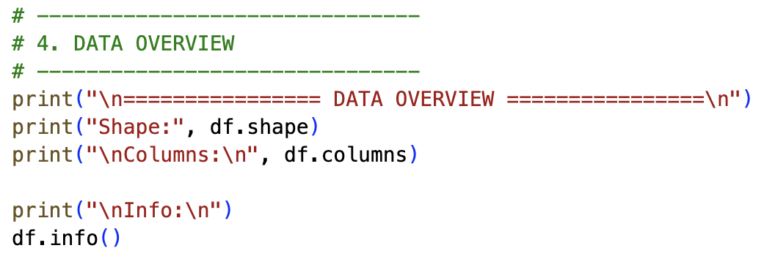
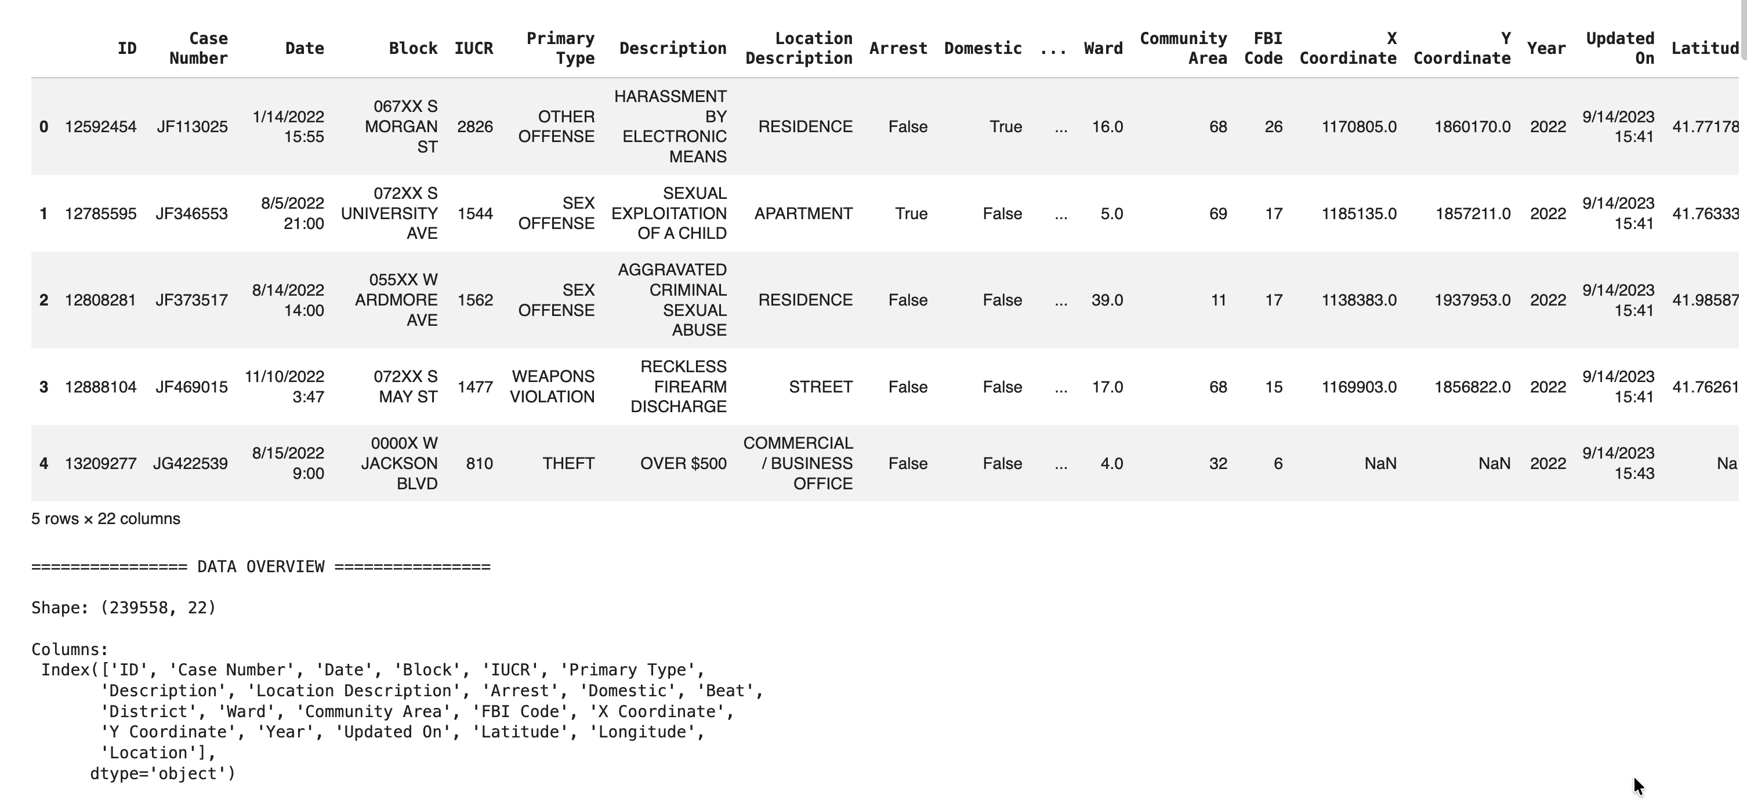
DATASET OVERVIEW
  AMO: Crime Prediction in Chicago (2022).
  Total records: 239,558
  Attributes: 22 columns
  Crime type, crime location, arrest status, etc .[6]
Notes:
The data of crime in Chicago of 2022 is available in the dataset. It consists of 239, 558 records with 22 attributes. Notable characteristics are type of crime, place of crime and arrest status. The raw data is comprehensive in examining the trends of crime. It also allows the examination of both space and time of crime. This assists in comprehending trends and justification of decisions based on facts [6].

Slide 6
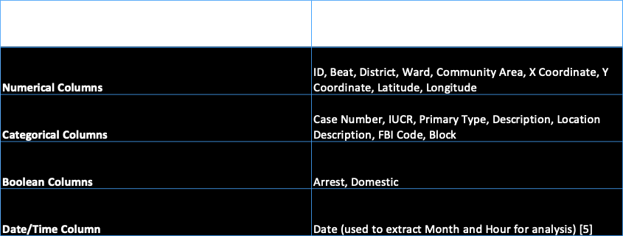
INGOUDE COMPANY
DATA
STRUCTURE
Notes:
The data format gives a glimpse of the important attributes of the data. It brings out the distribution of various types of crimes recorded in Chicago. The analysis reveals that the most prevalent crime is theft, then there is battery and criminal damage. Other major offenses are motor vehicle stealing and assaulting. The knowledge of the arrangement of the data assists in the determination of major crime categories. This helps in making a better analysis and decision-making in crime prevention [2].

Slide 7

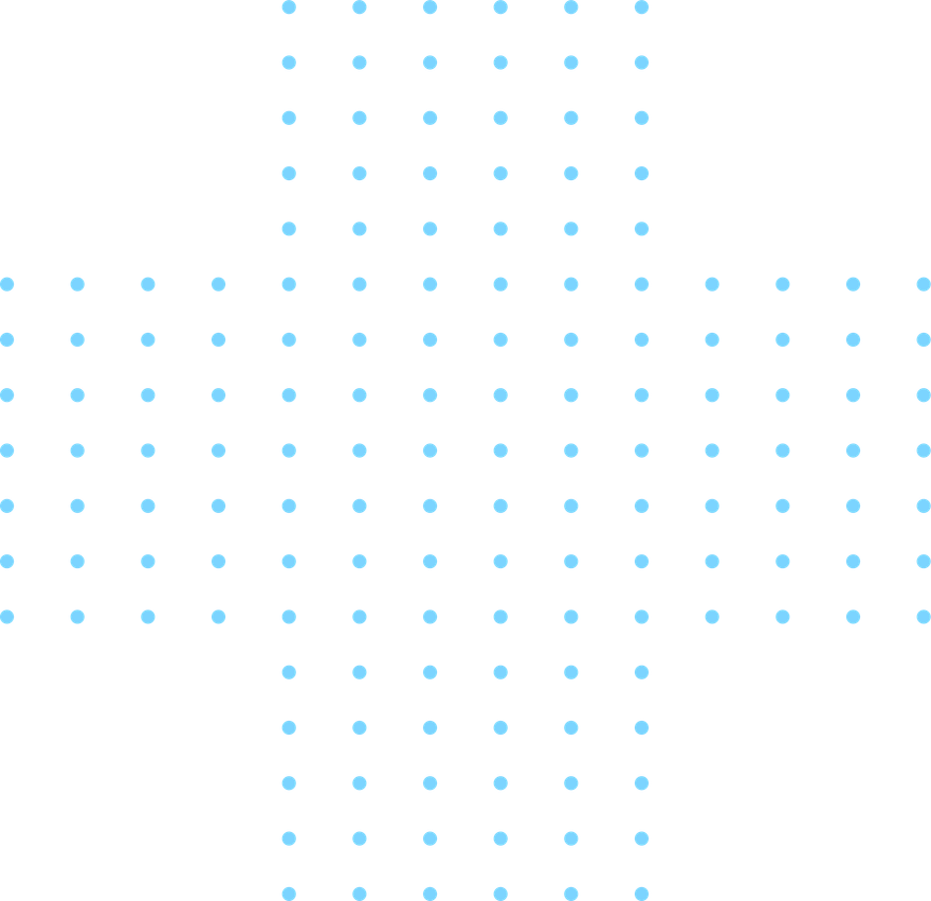
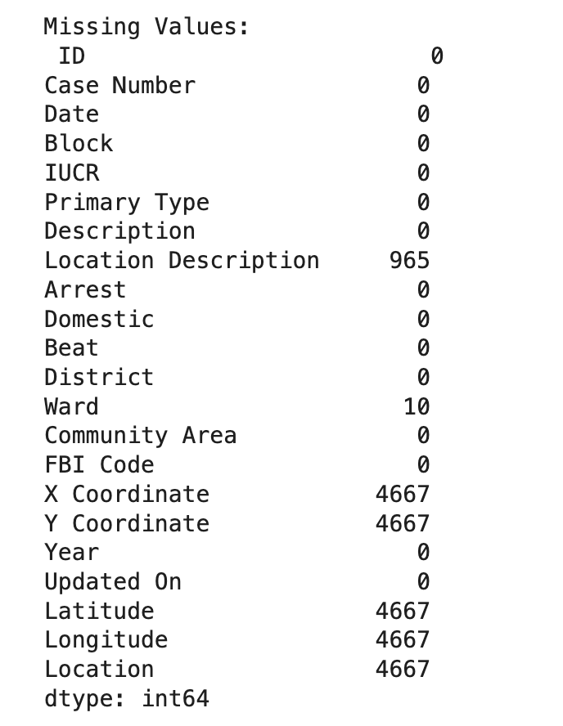
MISSING VALUES
Description of the location: 965 missing.
Ward: 10 missing
Latitude & Longitude: 4667 missing
Location: 4667 missing
Missing values that are removed[7].
Page 06
Notes:
There are missing values in a number of attributes in the dataset. These are location description, ward and geographical coordinates. Missing values have the potential to filter out the accuracy of analysis when they are not done in a proper way. Hence, proper methods like removal or cleaning were used. They are better handled resulting in high quality data [8].

Slide 8
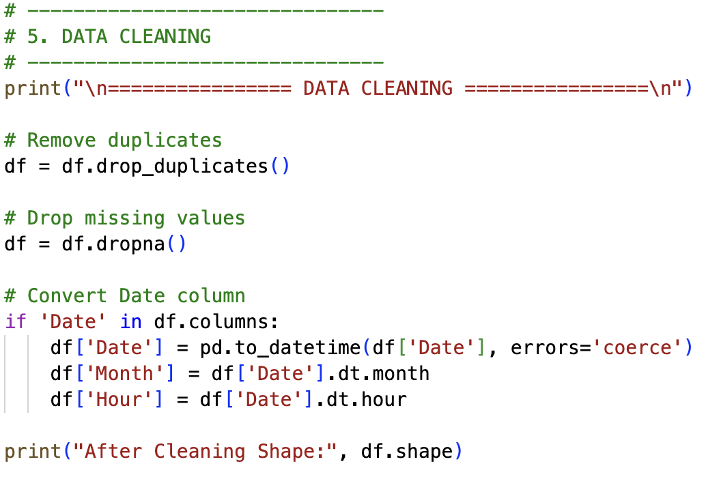
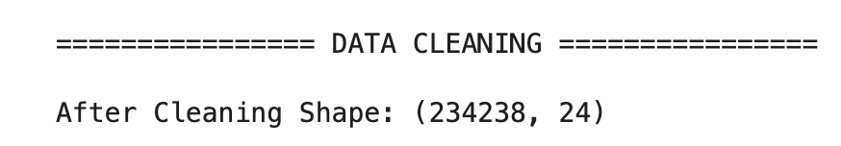
DATA CLEANING
1
Removed duplicate records
2
Removed missing values
3
Changed Converted Date todatetime [8].
Extracted Month and Hour
4
Notes:
Data cleaning was done to enhance data quality and consistency. Records that were duplicated were eliminated to prevent duplication. Cases where values were not available were done carefully to ensure accuracy. The date column was made into the format of datetime. Month and hour were the new features to be analyzed [5].

Slide 9

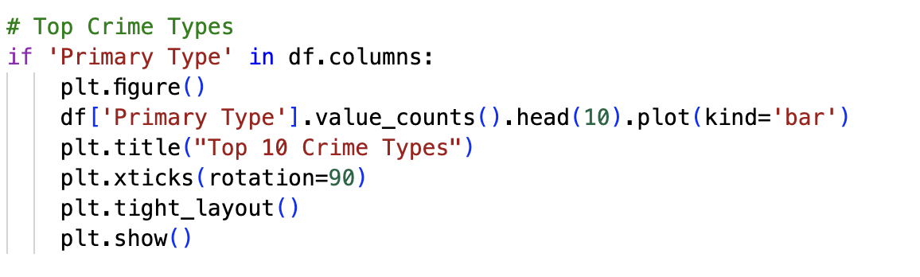
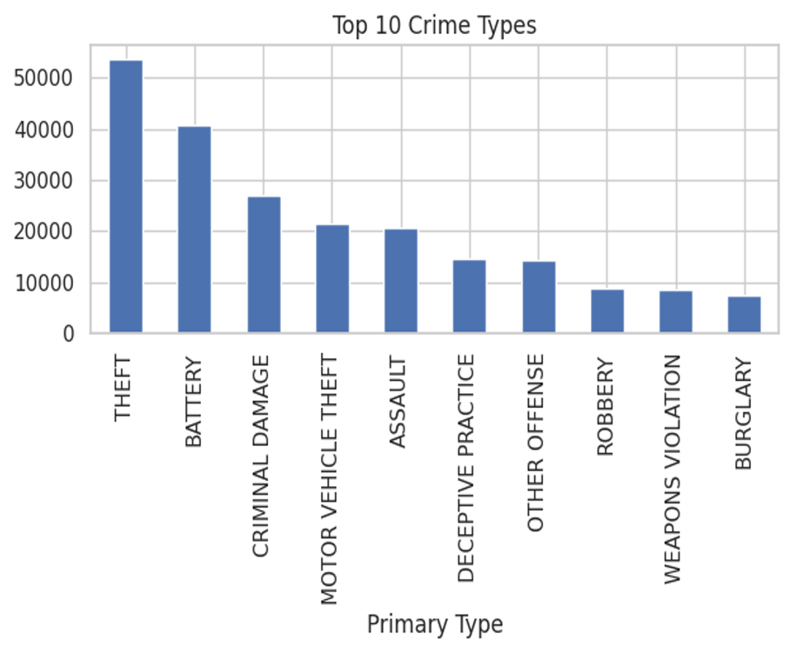
UNIVARIATE
ANALYSIS (CRIME TYPE)
The most prevalent crimes detected.
Top Crime: Theft (53,621 cases)
Followed by:
  Battery (40,800)
  Criminal Damage (27,028)
  Motor Vehicle Theft (21,386)
  Assault (20,737) [5]
Notes:
The univariate analysis was used to investigate the distribution of various types of crimes. The frequency of each category of crimes was visualised with the help of a bar chart. The findings indicate that the most prevalent crime has 53,621 cases, which is theft. This is succeeded by battery, criminal damage, theft of motor vehicle and assault. The comparison shows that crimes associated with property are more common. The knowledge on the distribution of crimes assists in establishing priority areas where the law enforcement is supposed to be implemented [2].

Slide 10
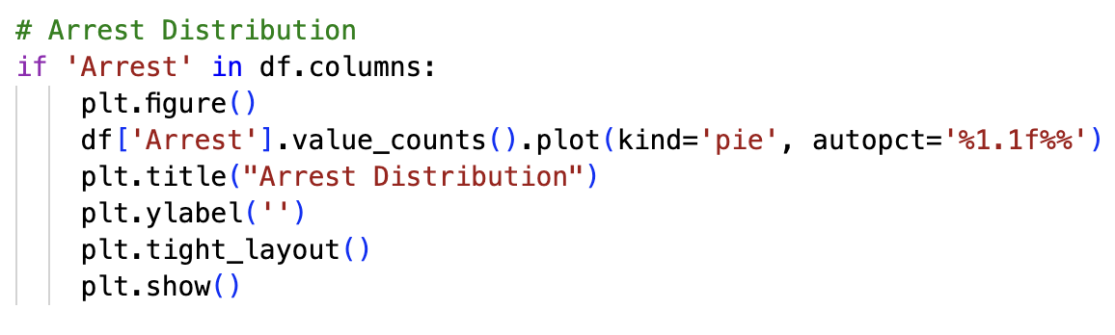
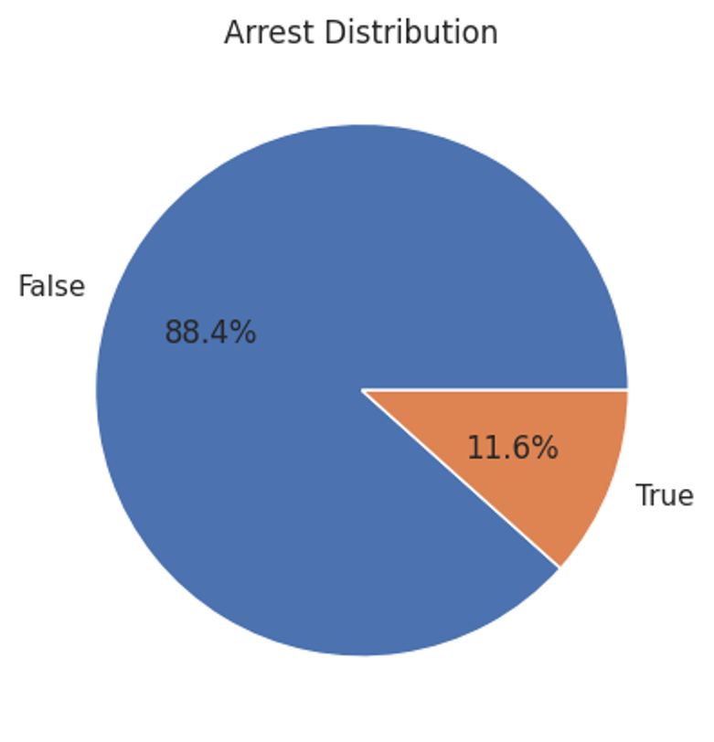
UNIVARIATE
ANALYSIS (ARREST)
  Cases of Arrest vs Non-Arrest analyzed.
  88.37% crimes have no arrest
  Only 11.62% result in arrest
  Indicates low arrest rate [3].
Notes:
Univariate analysis deals with one variable, including arrest status. The findings reveal that a majority of the crimes do not lead to arrests. A very small percentage of cases are the basis of arrests. This is an indication of low arrest rate in the data. It can point to the issues of law enforcement [3].

Slide 11
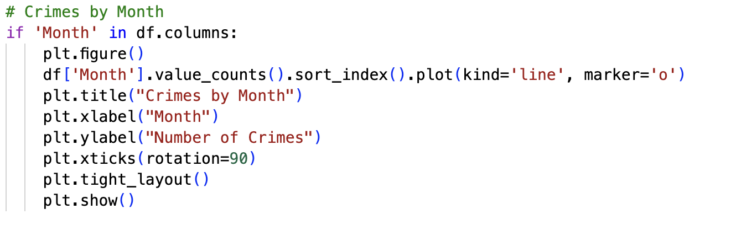
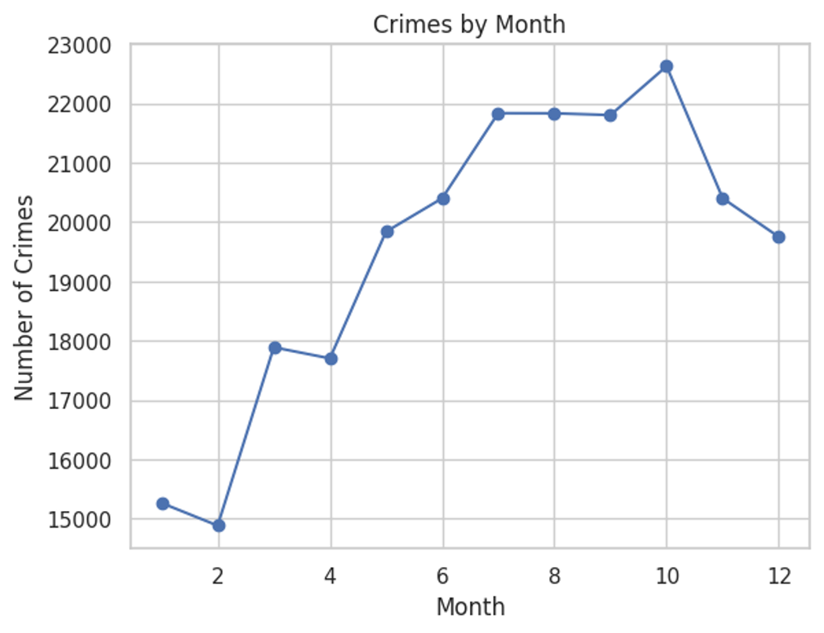
UNIVARIATE
ANALYSIS (TIME)
  Crimes analyzed by month
  The rate of crimes is not consistent throughout months.
  There are months with high frequencies of crime[4].
Notes:
Distribution of crime was examined in various months. The findings reveal that there is no uniformity in the crime rates all year round. There are months when the crime rates are higher than others. This implies that there exist seasonality patterns. These are insights that aid in the effective planning of resources [4].

Slide 12
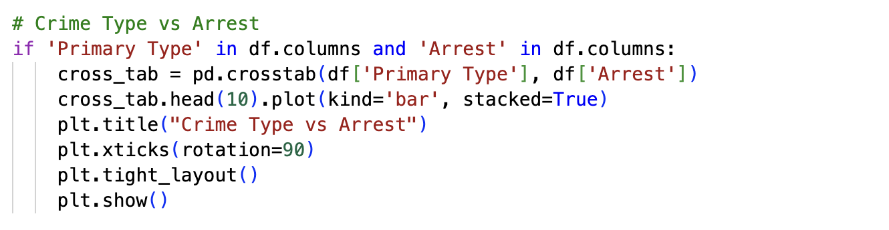
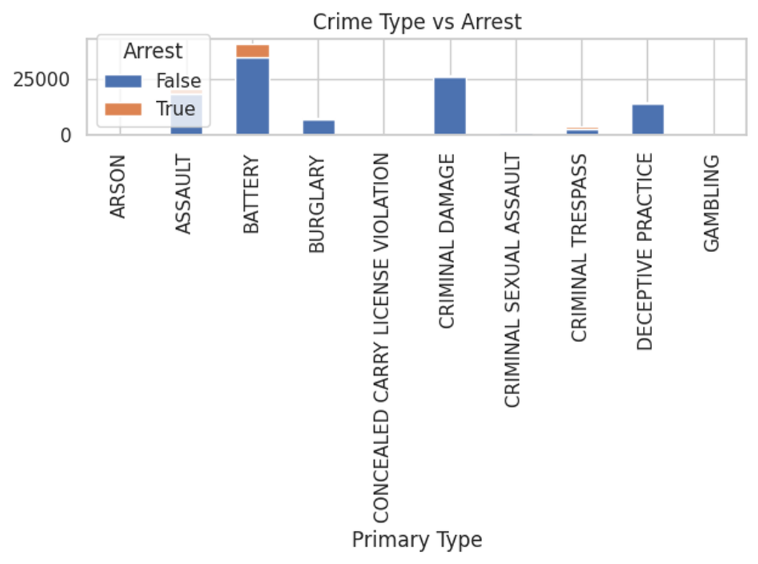
MULTIVARIATE
ANALYSIS (CRIME VS ARREST)
  Correlation between the type of crime and arrest.
  There are crimes whose arrest rates are very low[3].
  Helps name the high-risk categories of crimes.
Notes:
This discussion looks into the correlation between type of crime and arrest status. It demonstrates that there are reduced arrest rates on certain crimes. This could represent challenges in investigation or detection. The detection of these patterns can be used to work on high-risk crimes. It aids in the improved law enforcement [3].

Slide 13
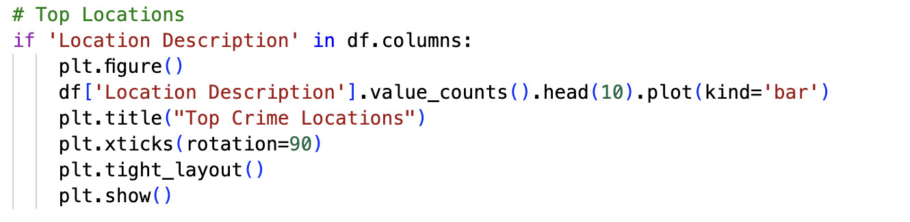
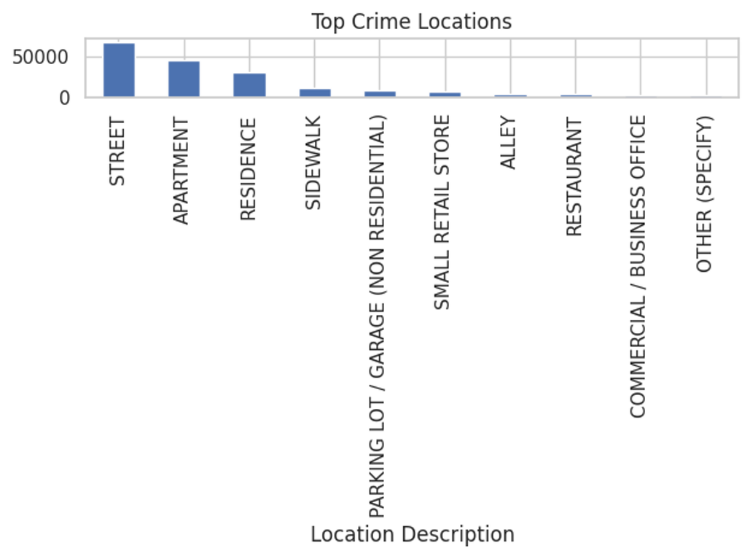
MULTIVARIATE
ANALYSIS (LOCATION)
Best crime places being identified:
  Street (67,239)
  Apartment (44,848)
  Residence (29,750)
  Sidewalk (11,895)
  Parking Lot (9,240)[6].
Notes:
The analysis reveals that most of the crimes are committed in particular areas. The crime rates are highest in the streets, apartments, and residences. This means that there is an influence on both the public and the private places. Such locations can also be identified so as to enhance security. It helps in improving resource allocation [8].

Slide 14
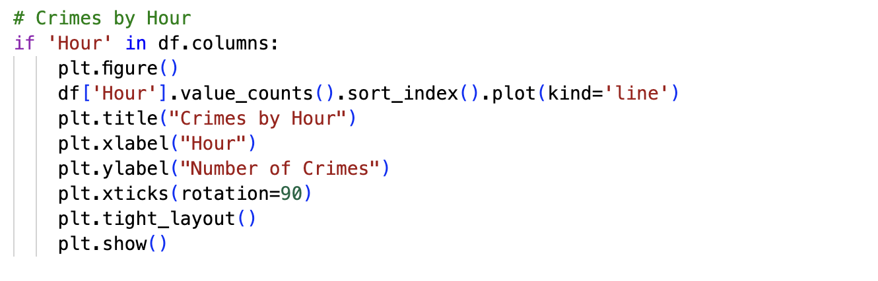
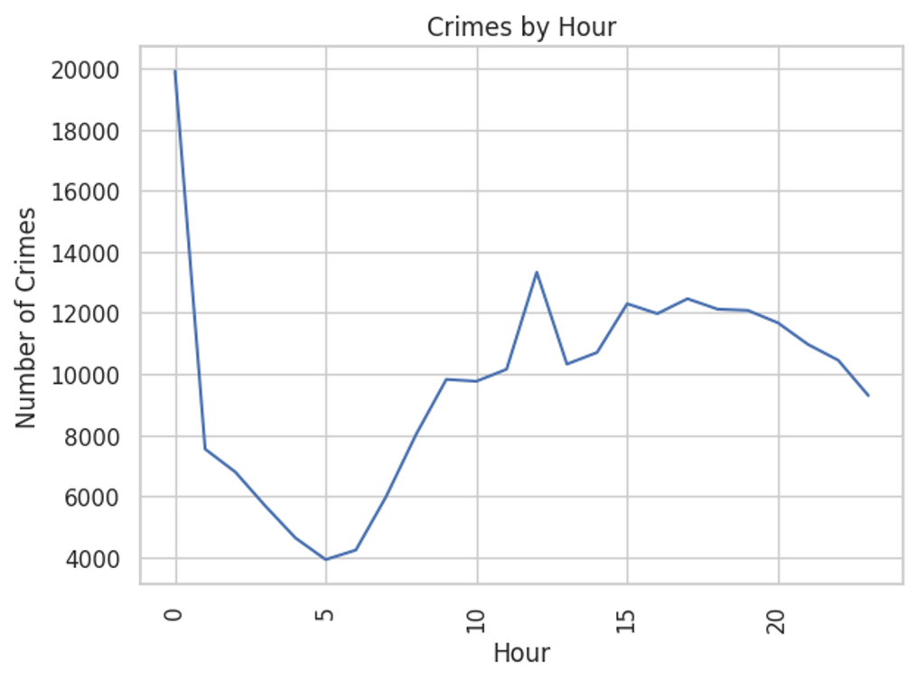
MULTIVARIATE
ANALYSIS (TIME)
  Crimes analyzed by hour
  Increased levels of crime at night.
  Good to use in the deployment of the police[7].
Notes:
The time based analysis indicates that there is variation in crime at various times of the day. At night time, crime is more prevalent. This could be because of reduced visibility and lack of activity of the people. These trends can be useful in designing the way patrol is planned. It assists in enhancing the aspect of public safety [4].

Slide 15
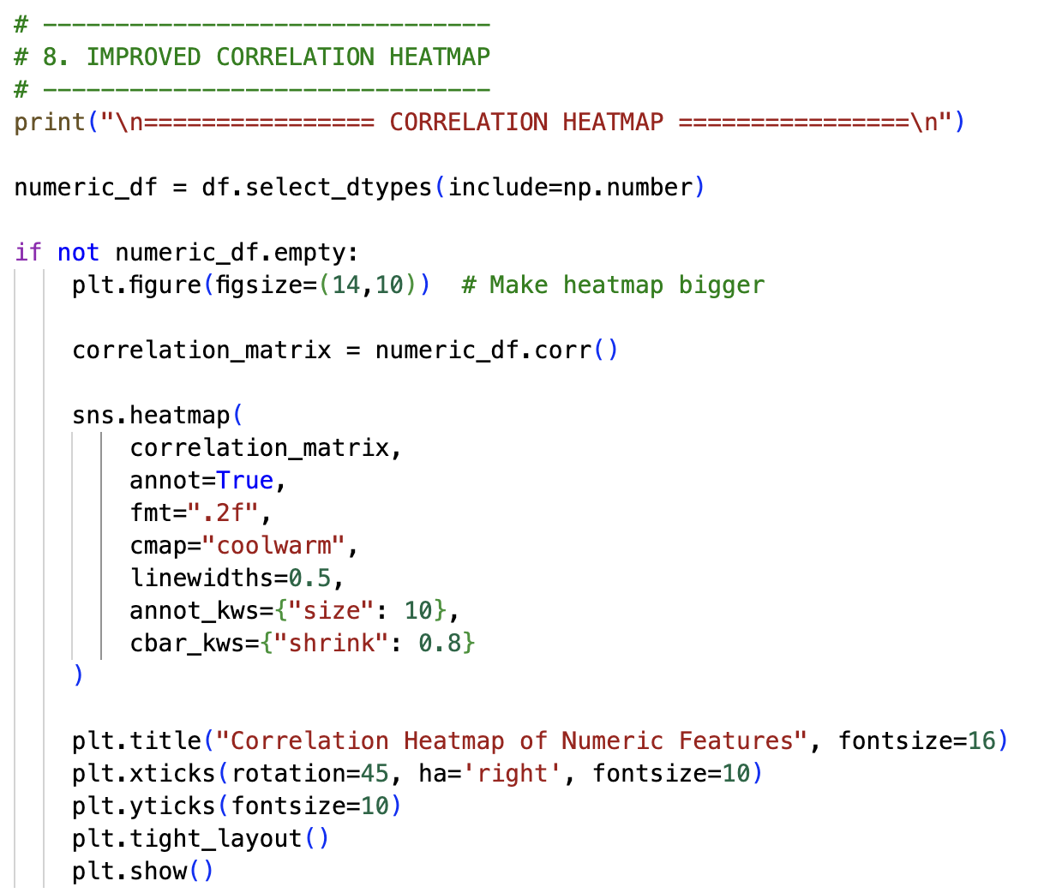
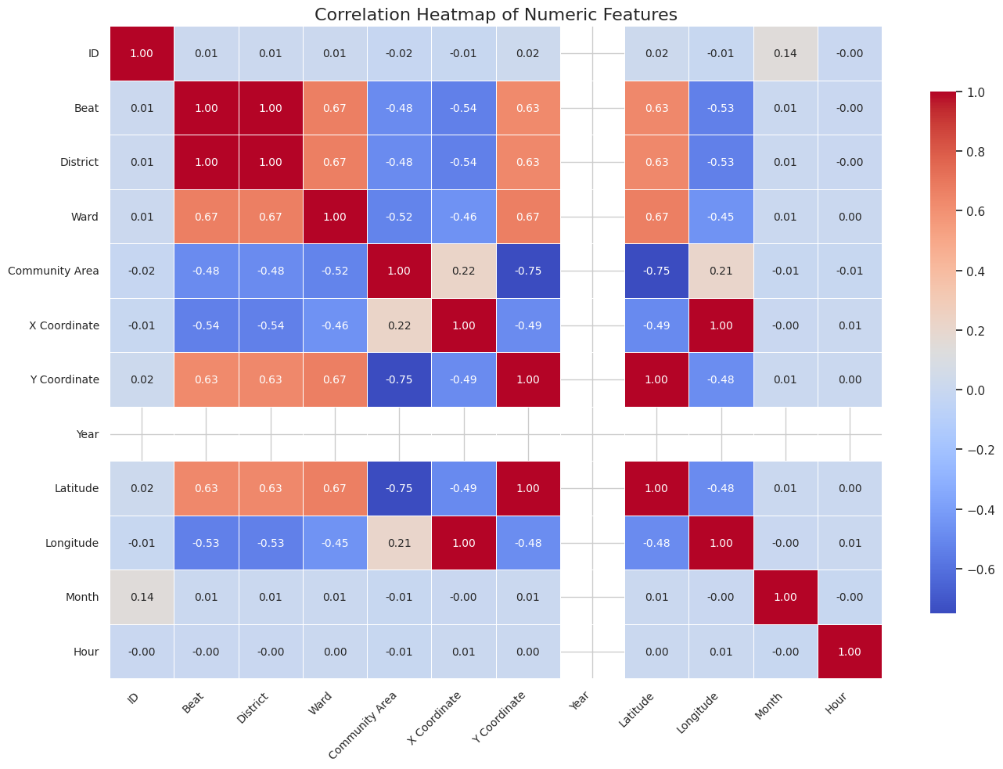
MULTIVARIATE
ANALYSIS (TIME - HEATMAP)
The heatmap shows crime frequency across different months and hours of the day.
Darker colors represent higher crime intensity, especially during evening and night hours.
Certain months display higher concentration of criminal activity.
The visualization helps identify temporal crime patterns for better resource planning [4].
Notes:
The heatmap visualizes crime intensity across different months and hours of the day. Darker color shades represent higher crime frequency, while lighter shades indicate lower activity. The results show that crime levels increase during evening and nighttime hours. Certain months also display higher concentration of criminal incidents. This pattern highlights temporal clustering of crimes within specific time periods. Heatmaps provide an effective way to analyze multivariate temporal patterns in crime data [4].

Slide 16
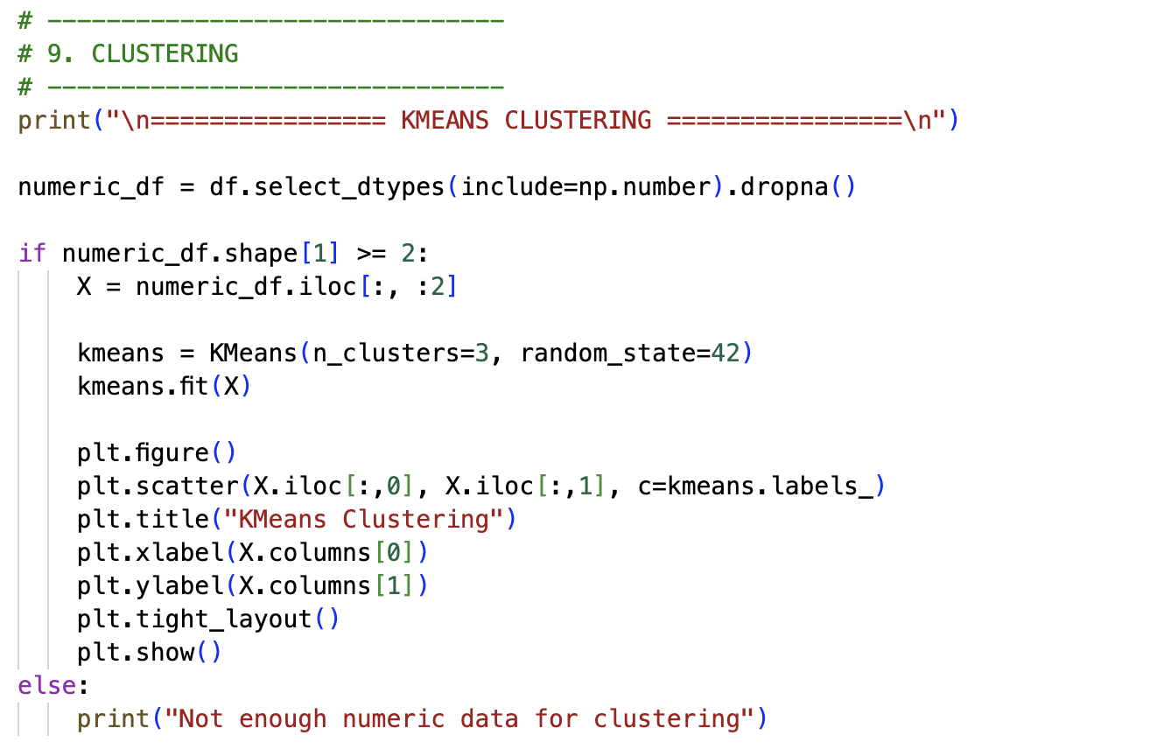
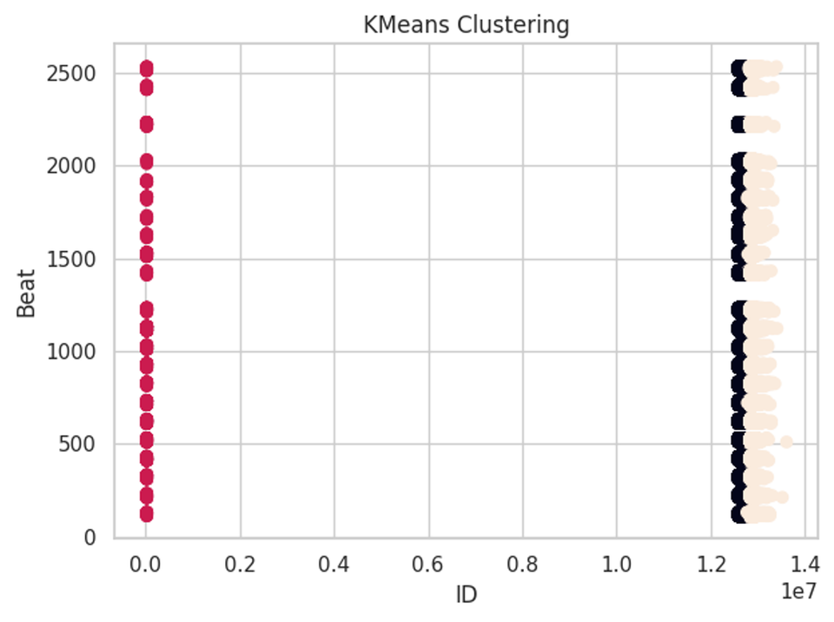
ADVANCED
ANALYSIS (CLUSTERING)
KMeans clustering applied
Data grouped into 3 clusters
Helps find the concealed patterns.
Enhances knowledge about the distribution of crimes [3].
Notes:
The clustering technique is employed to cluster similar data points. K-Means clustering was used in this research. The data was sub-divided into three clusters in terms of patterns. This assists in uncovering the concealed information in data. Clustering enhances knowledge on crime distributions [7].

Slide 17
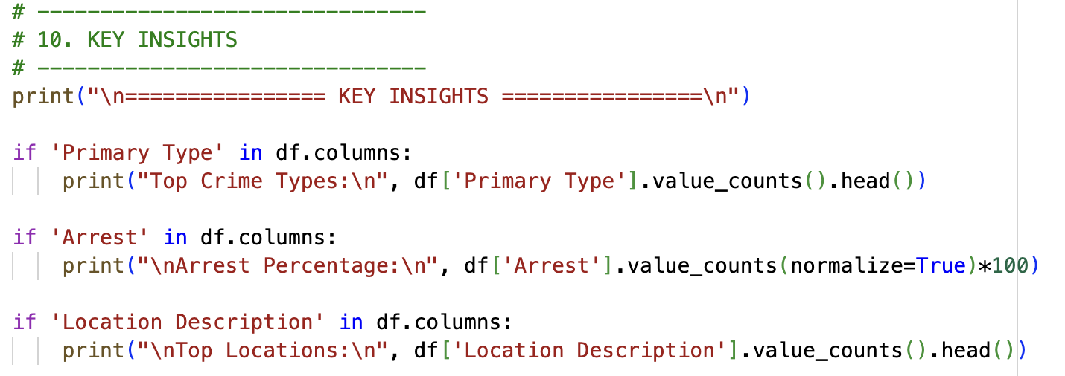
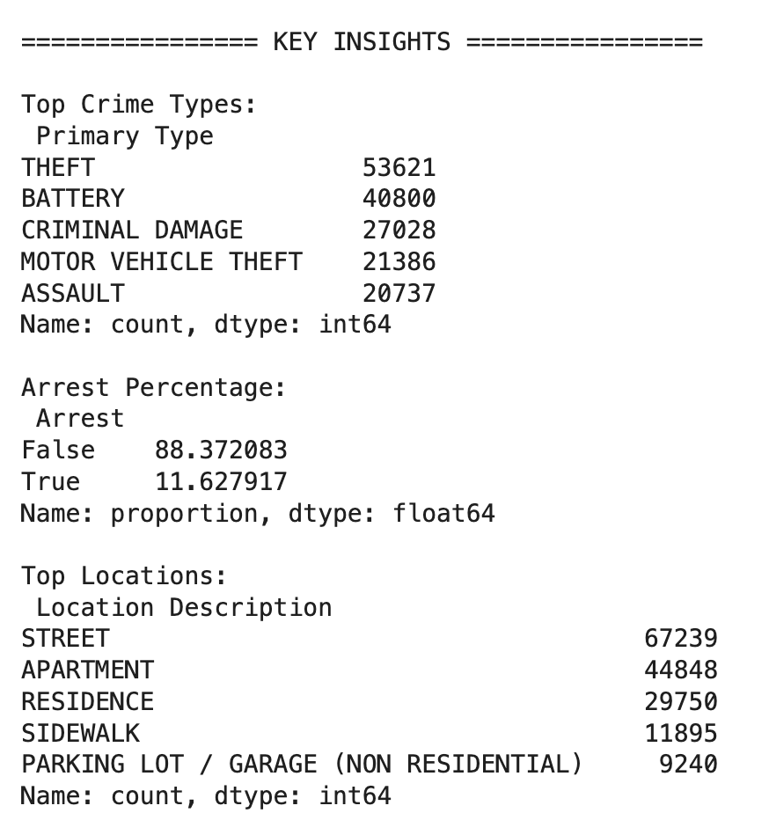
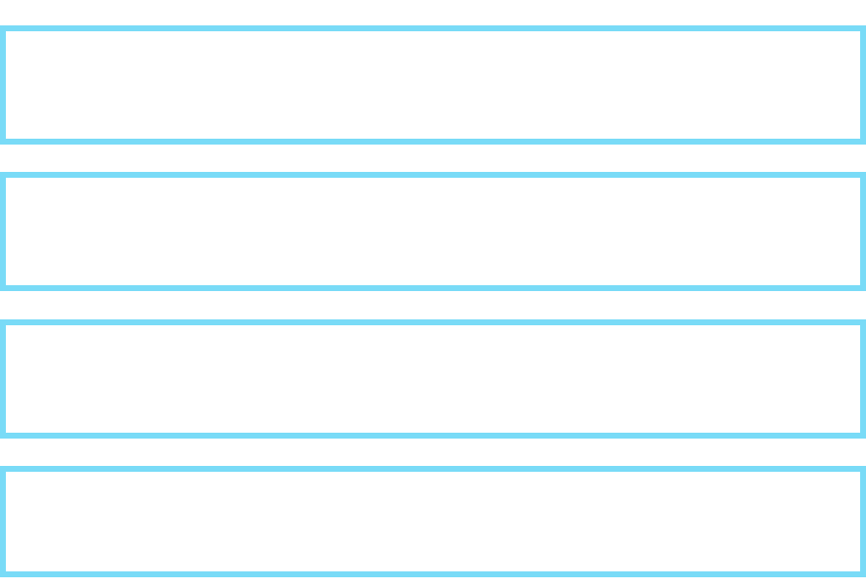

KEY
INSIGHTS
Notes:
There are some key findings that the analysis illustrates. The theft is the most prevalent in the data set. Majority of crimes do not lead to arrests. In the streets and residential places, the crime rate is higher. It is further seen that there are increased crime rates at night [1].

Slide 18
CONCLUSION & RECOMMENDATIONS
  Enhance police patrol in high crime zones.
  Concentrate on night watch operations.
  Enhance investigation in order to enhance arrest rate.
  Crime prevention with the help of data analytics[2].
  Future activity: Implement predictive models.
Notes:
The research gives practical information on crime patterns in Chicago. Increased patrols by the police ought to be done in the high-crime areas. The nighttime monitoring should be given special consideration. Premediation should be made towards greater arrest rates. The use of data-oriented methods can be used to improve crime prevention [2].

Slide 19
REFERENCE
[1] K. Clancy, J. Chudzik, A. J. Snowden, and S. Guha, “Reconciling data-driven crime analysis with human-centered algorithms,” Cities, vol. 124, p. 103604, 2022.
[2] D. Djon, J. Jhawar, K. Drumm, and V. Tran, “A comparative analysis of multiple methods for predicting a specific type of crime in the city of Chicago,” arXiv preprint arXiv:2304.13464, 2023.
[3] M. Elkhouly and T. Alhadidi, “Ride-sharing determinants: spatial and spatio-temporal Bayesian analysis for Chicago service in 2022,” IEEE Access, 2025.
[4] C. L. Gullion, B. P. Comer, and R. Randa, “Homicide hot spots in Chicago: examining spatiotemporal patterns longitudinally across police beats,” Crime & Delinquency, vol. 70, no. 3, pp. 643–671, 2024.
[5] U. Gupta and R. Sharma, “Analysis of criminal spatial events in India using exploratory data analysis and regression,” Computers and Electrical Engineering, vol. 109, p. 108761, 2023.
[6] H. Himanshi, “Analysing crime patterns using machine learning: a case study in Chicago,” MSc Research Project, National College of Ireland, 2022.

Slide 20
REFERENCE
[7] Kiran, P., Mounika, B., Naveen, P., Tejaswini, N. and Karthik, “Crime data anlysis using machine learning. South Asian J Eng Technol”, 12(3), pp.61-68, 2022.
[8] E. Kırpık, “Spatial patterns of crime and its relationship with the physical environment: Chicago case,” Kent Akademisi, vol. 16, no. 3, pp. 1597–1619, 2023.
[9] Y. Liang, “Mapping informality and violence: machine learning insights into crime patterns across South African police jurisdictions,” 2025.

Slide 21

THANK
YOU!

