Slide 1
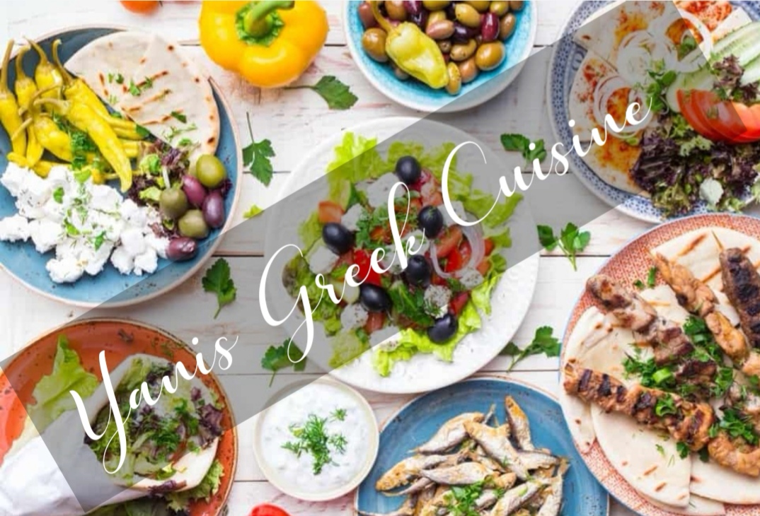
Yannis Greek Cuisine
Presentation

Slide 2

Marketing Environmental Audit
Title: Yannis Greek Cuisine
Name of the students: Ileana Grecu
Student ID: 1815471
Iuliana Anisoara Cata
Student ID: 1816309
Florin Constantin Nica
Student ID: 1815320
Ionut Dragoi
Student ID: 1816332
Lecturer Name: Olu Adegbite

Slide 3

We bring you the freshest ingredients, from our gardens and select vendors. Food preparation is paramount at Yannis, great Greek food takes time and expertise that is rarely found outside of traditional Greek homes.
© 2019 Yannis Greek Cuisine

Slide 4
About
Yannis Greek Cuisine
We service a variety of hearty, delicious Greek and Mediterranean
food, available for breakfast, lunch and dinner. We offer complete accommodation for sit down, takeout and catering, so you can enjoy our fine menu wherever you want! Just stop by Yannis Greek Cuisine, where our staff are friendly, the environment is comfortable, and where our Greek food can't be beat. Come on down today: we look forward to serving you!

Slide 5


Industry Analysis

Slide 6
Hospitality
& tourism
Industry
Restaurant Industry
Marketing segmentation is a big part of the marketing strategies of firms in the restaurant industry. For the most part, the restaurant market is segmented based on the speed of service and the amount of service offered to the customer.

Slide 7
SWOT Analysis
Strength
Weakness
Wide business
Famous name
Good brand image
Trusted buyers
Limited Greek menu
Lack of online promotional campaign
Opportunity
Threat
Opportunity to make a good quality food brand
Rising trends of eating out
Competitors offering cheaper prices
Competitors offering freebies and special offers.

Slide 8
PESTLE Analyses
Political Factors
Tax policy
Employment laws
Environmental regulations
Trade restrictions and tariffs
Political stability
Economic Factors
Economic growth
Interest rates
Exchange rates
Inflation rate
Social Factors
Health consciousness
Population growth rate
Technological Factors
R&D activity
Automation
Technology incentives
Rate of technological change
Legal:
Legislation can sometimes have a great impact on the restaurant business.
Environmental:
The environment around your restaurant can affect your business in a variety of ways. New freeways can improve or discourage traffic flow near your building. Watching your restaurant's environment can be crucial for marketing decisions.

Slide 9

Target Market

Slide 10
Target Market
We want the business man, happy couples, high-end singles, families, tourists with money, wealthy image seekers and compulsive spenders. We focus on these specific groups because these are the types of people who frequent other restaurants and bars in the area. They are the ones that are willing to spend their money on good dining and service at a value price. We generally know the characteristics of our clientele with the available demographics.

Slide 11
Segmentation Strategy

Slide 12
Yannis Greek Cuisine Segmentation Strategy
Yannis Greek Cuisine intends to provide to a wide group of people. We want everyone to feel welcome and relaxed in a cozy atmosphere with a wide and varied menu. It is our goal to have "something for everyone" everyday on our menu. In looking at our market analysis, we have defined the following groups as targeted segments.

Slide 13
Targeted segments
Tourists
Cultures
Business Men
The Family

Slide 14
Segment: Business Men
They work hard all day and often stay overnight in a strange city. They need a competent establishment that helps impress their clients and prospects. Afterward, they want to relax and use the money they are making. They are the people that spend the most on drinks, food and tips.

Slide 15
Segment: Family
The perfect place for a family dinner. Families will come for the accommodative menu and friendly service. The excellent value in their meals will keep Yannis Greek Cuisine in favor with the parents.

Slide 16
Segment: Tourists
WA is a city that attracts many vacationers during the summer months of May through September. Yannis Greek Cuisine will be a destination with its attractive atmosphere, international menu, and outdoor patio.

Slide 17
Segment: Cultures
Yannis Greek Cuisine want to attract its customers by providing a culture wide environment in their restaurant. They want to serve a menu that is equally delightful for all of the cultures in the areas of WA and surroundings.

Slide 18

Segmentation
& Communication Mix

Slide 19
Targeted Segment and Communication mix
We want the business man, happy couples, high-end singles, families, tourists with money, wealthy image seekers and compulsive spenders. We focus on these specific groups because these are the types of people who frequent other restaurants and bars in the area. They are the ones that are willing to spend their money on good dining and service at a value price. We generally know the characteristics of our clientele with the available demographics.
Our geographic include people from the local Long Branch area, restaurant patrons from neighboring cities, and tourists from other cities and states. The characteristics of our clientele will be people who are creative, entertaining and sophisticated diners.
In this regard, a communication mix strategy must be along. We need to invest for our business growth and customers’ satisfaction. The communication mix refers to specific methods used to promote the company or its products to targeted customers.

Slide 20
Communication Mix

Slide 21
Communication Objectives
Let’s say you’re a cultural wide and family restaurant; your objective, then, is to educate the public about these unique offerings and entice them to choose your spot for their next meal.
No matter whether your goal is to inform, persuade, or clarify, a best practice is to write your objectives from your audience’s point of view. If you are communicating a new organizational structure, for example, you’ll want to consider what information you’d like each group to know, what (if anything) you’d like them to do, and how they’re likely to feel after receiving your news.
Social media, blogging, digital advertising, media relations, e-mail, video, and staff meetings are all viable modes of communicating… but that doesn’t mean they’re right for you. Only invest in initiatives that are a good fit for your business, that you’re sure you’ll actually use, and that resonate with those on the receiving end of your message.

Slide 22
Communication Mix Strategy for Business Men (Segment)
To target the segment of Business Man, the restaurant don’t need to promote its business by providing special deals and freebies. But they need to show the class, style and rich food culture providing by the restaurant. So in case of our segment of Business Man, we need to use the strategies of online/digital shorts videos advertisements that show the class of the food and restaurant.

Slide 23
Communication Mix Strategy for Family (Segment)
What Makes Us Proud
~Family-Oriented
This is the message that Yanis Greek Cuisine is showing as their slogan on their websites and social media pages. To attract the segment of Family, the company need to use social media, and mass media promotional tactics. For example, a add that is highlighting a family dinner need on weekends and Friday nights on social media and magazines.

Slide 24
Communication Mix Strategy for Tourist and Cultures (Segment)
What Makes Us Proud
~ Greek and Mediterranean
We bring you the freshest ingredients, from our gardens and select vendors. Food preparation is paramount at Yannis, great Greek food takes time and expertise that is rarely found outside of traditional Greek homes.
We use imported Greek and local seasonal products in our dishes, our meats and chickens are antibiotic and hormone free, our oils are trans fat free. We hope you enjoy our hospitality and our tasteful Greek cuisine.

Slide 25
References
Mullet, G. M. (1993). Segmenting business markets. Marketing Research, 5(1), 54. Retrieved from http://search.ebscohost.com/login.aspx?direct=true&db=buh&AN=9602193052&site=ehost-live
Lord, K. R., & Putrevu, S. (1997). Be in tune with communications mix. Marketing News, 31(11), 10. Retrieved from http://search.ebscohost.com/login.aspx?direct=true&db=buh&AN=9706055171&site=ehost-live
White, H. (2011). Inventive Appetites. Central Penn Business Journal, 27(41), 21. Retrieved from http://search.ebscohost.com/login.aspx?direct=true&db=bwh&AN=66626650&site=ehost-live
Muirragui Davis, A. (2014). Family recipe. Indianapolis Business Journal, 35(24), 1. Retrieved from http://search.ebscohost.com/login.aspx?direct=true&db=bwh&AN=97499840&site=ehost-live

Slide 26
THANK YOU!
ANY QUESTIONS?
Team Dragoiionut

