Slide 1
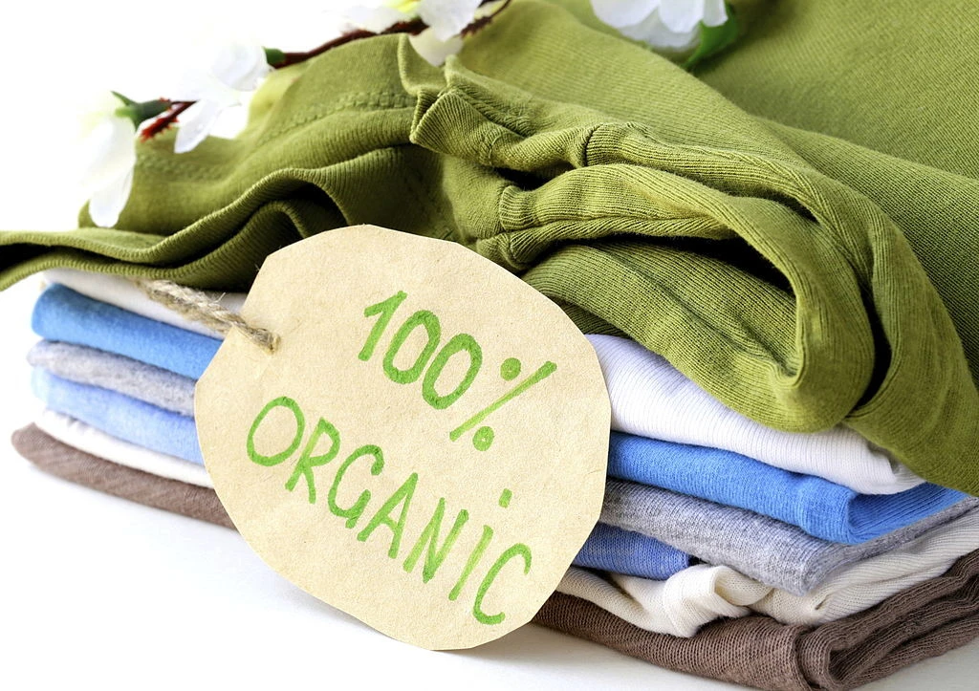
Business plan
D&S
Student Name: Diana Stoyanova
Student Number: 2007366
Module: Entrepreneurship
Module Code: LCBB5001
Lecturer: Vasilios Tavlaridis

Slide 2

Introduction, mission and vision
My name: Diana Stoyanova
D&S brand is a startup fashion company that aims to provide various fashions extracted from cotton and hemp
Individual and tailored brands
Specializations in vintage clothes
Mission “Quality from nature”
Desire to develop the business in a different direction.

Slide 3
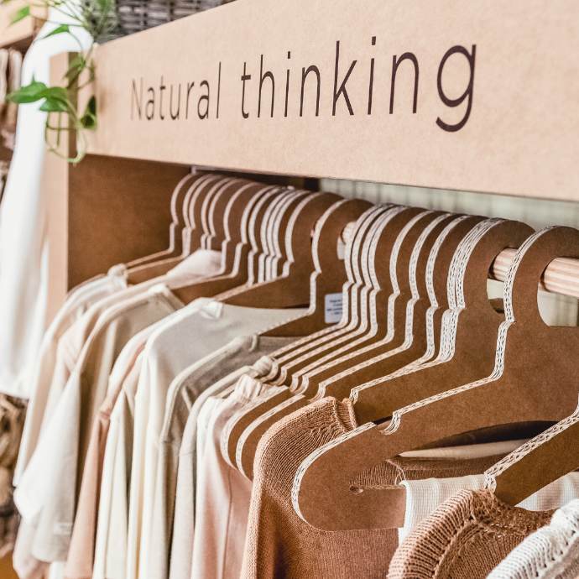
Company Overview
The venture will be located along High Street in Birmingham
Progressive outlets in different localities with the country
The company will be a limited liability company
Several members as the shareholders
Principal owner and 60% of the company

Slide 4

Strengths
High-quality guarantee by the cotton and hemp resources
Excellent location along the high street, which has an increased number of target customers
Increasing demand for vegan clothes and animal-free clothes across the country
Weakness
High-cost products due to the high quality of the fashions
Lack of adequate financial capacity to compete with the big and established fashion firms
Lack of high machinery to ensure increased production levels and high quality
Opportunities
Online access to the products through the company website will increase the consumer base
Establish a natural-made luxuries fashion line.
Establish dynamic artwork in the fashion designs
Threats
Increased imitation of D&S brand, which leads to the negative reputation of company’s products
High marketing cost
Increased taxation on natural-made products

Slide 5

Political Analysis – strict legalisation and country stability
Economic Analysis – economic condition, inflation, exchange rates
Social analysis – different occasions and areas, the artwork
Technological Analysis – the website, the reviews from customers
Environmental Analysis – natural fabric, non-biodegradable materials
Legal Analysis – registration and patent rights

Slide 6

TARGET MARKET
Our target market is all population in all age groups
The artwork in the styles will reach more people with social events
In 2020 – expenditure of 54 billion pounds in clothing industry
The locals within the city are targets for the products
Allows the consumers to state the modifications they will require
The company is targeting to venture on online consumers
By 2019, 93% of UK residents had internet access

Slide 7
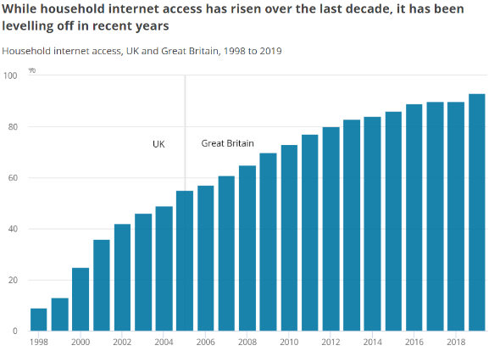

Slide 8
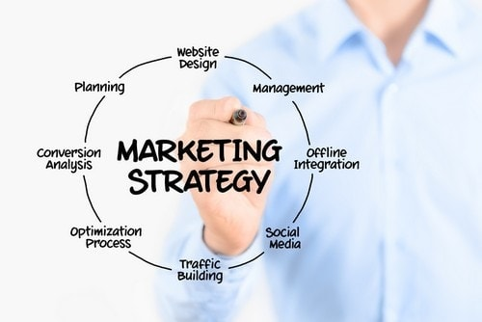
MARKETING PLAN
The company will have its marketing personnel
Dynamic changes in slogans
Combination of outstanding customer service and quality assurance
The customer's specifications will determine the products
The maintaining of the minimum standards for the company
Free development of new designs in the specific product lines
Utilizing the internet approach through the website

Slide 9
The new customers will be reached through social media advertising and referrals programs
Bringing new customers to our premises are provided with an award
Direct mailing campaigns will be conducted twice every month with 10% coupon
Clearance sales at the end of every year will be a critical approach
Next day Delivery
The website will have a review section

Slide 10

FINANCIAL PLAN
The company will require £10 000 to startup
The raw materials, rent, company registration and licensing, website development, branding, and social media promotion fees
60% from the owner and 40% from the stakeholders
The primary company source of income will be through the sale of the company products
The first financial year - revenue of
£111 000 from the sales

Slide 12
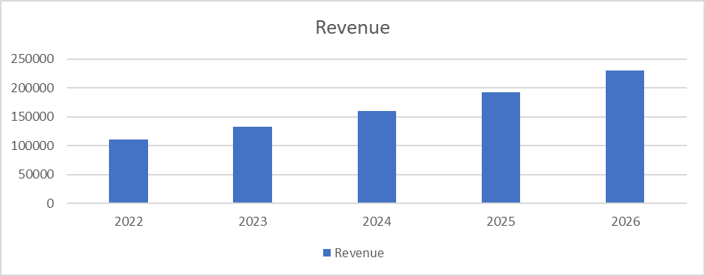
The April, August, and December periods are forecast to have high revenue due to the increased vacations
Online marketing will help increase sales by 20%
That means the year 2026; the company revenue is projected to be at £230,169

Slide 13
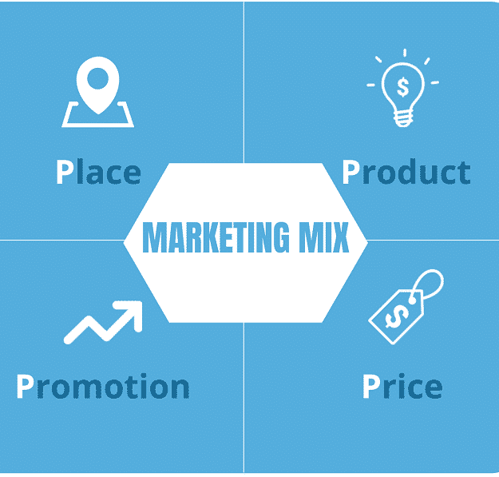
Marketing MIX
Product – Individual and tailored cotton and hemp clothes
Place – Birmingham City Centre and Internet
Promotion – 10% coupons twice every month and clearance sales every year.
Price - the price depends on the customer's desire, time and discount

Slide 14

D&S – “Quality from Nature”
Our clients will dress according to the trends and depending on what they like
Extremely personal attitude
Protection of nature and animals
Customers will be able to freely express their opinion
Reach our customers, not so much with the financing of innovations in the company, but with the knowledge and desire

Slide 15
References
Aakko, M., & Niinimäki, K. 2018. Fashion designers as entrepreneurs: Challenges and advantages of micro-size companies. Fashion Practice, 10(3), pp. 354-380.
Brough, G.H., 2005. Private limited companies: Formation and management. Sweet & Maxwell.
Chernev, A., 2020. The marketing plan handbook. Cerebellum Press.
Forbes, K., Kirkham, L., & Theodoridis, K. 2021. A Trendy Approach to UK Inflation Dynamics 1. The Manchester School, 89, pp. 23-75.
Grunert, K.G. and van Trijp, H.C., 2014. Consumer-oriented new product development. Encyclopedia of agriculture and food systems, 2, pp.375-386.
Hurley, R. 2018. Cannabis, cannabis everywhere: U\K to review medical cannabis policy as Canada plans imminent legalisation for all uses. BMJ: British Medical Journal (Online), p.361.
O2 The Blue. 2019. Internet access in the UK. [online] Available at: https://news.o2.co.uk/2019/08/13/internet-access-in-the-uk/
Pai, S., 2017. Small business marketing strategies for the first 5 years (Doctoral dissertation, Walden University).
Statista. 2018. Topic: Apparel market in the UK. Www.statista.com; Statista. https://www.statista.com/topics/3348/apparel-market-in-the-uk/

Slide 16




