Slide 1
BSc (Hons) Health and Social Care
BMHP6022: Community Care and Development
Student Name:
Student ID:

Slide 2
Introduction
Community Location
East London
Key Characteristics
High Population
Mix of urban and suburban areas.
Notable economic disparity
Demographic Changes
Increase international migrants and young professionals
Aging population

Slide 3
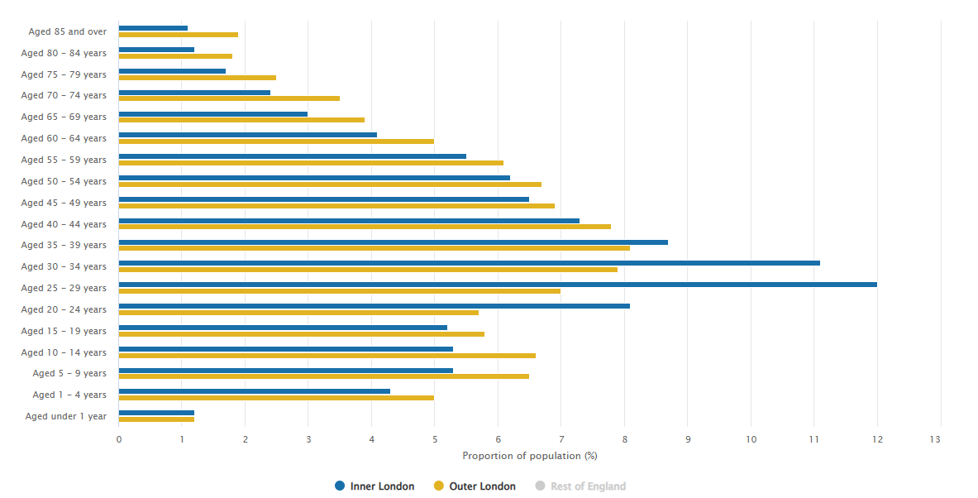
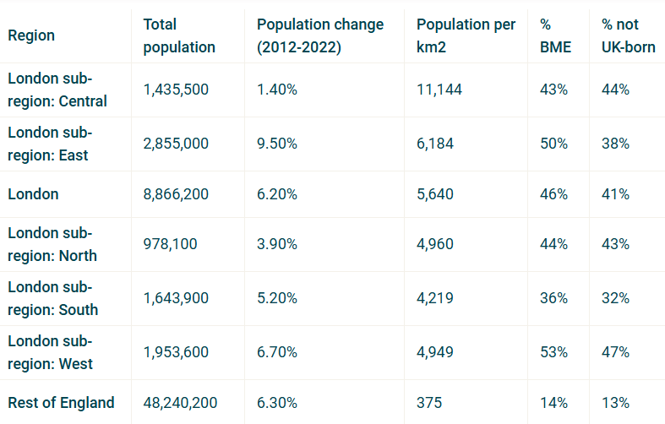
Demographic Analysis
Population: 2,855,000
Population Change: 9.50%
Age: Average 34 years
Population Composition
Source: Trust for London (2021)

Slide 4
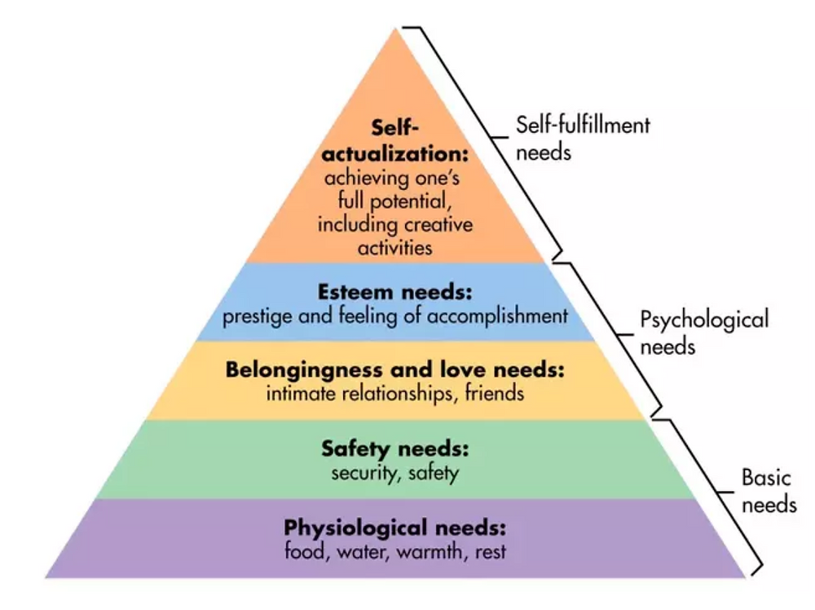
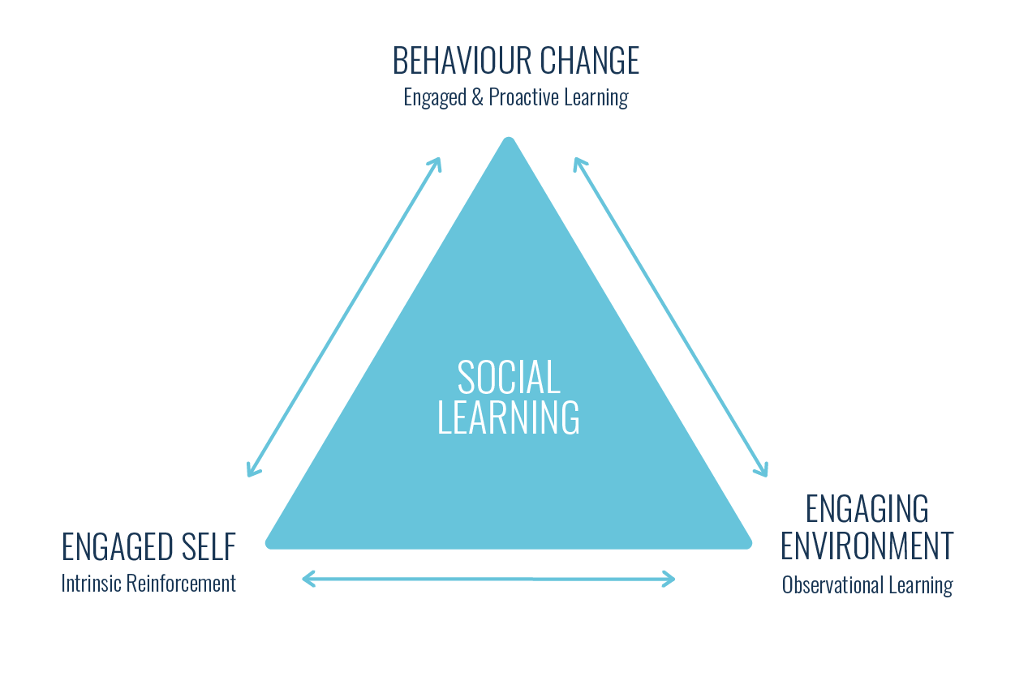
Integrated Theories
Maslow’s Need Hierarchy
Source: Peak Frameworks, 2015
Bandura’s Social Learning Theory
Source: Cloke, 2024

Slide 5
Health Risks and Contributing Factors
Socioeconomic Disparity
Cultural and Language Barriers
Environmental Risks

Slide 6
Health and Social Care Information Communication
Internal
MDTs
NHS Digital System
Community Forum
External
NHS England
NGOs
Public Health England

Slide 7
Digital Technologies
Channels
NHS App
Online Health Portal
Social Media Platforms
Telemedicine
Challenges
Lack of Digital Literacy among the older adults

Slide 8
Legislation and Policy Impact
Key Legislation
Health and Social Care Act 2012
Equality Act 2010
Local Policy
Integrated Care System (ICS)

Slide 9
Barriers and Obstacles to Community Development
Chromic Conditions
High rate of Hypertension and diabetes among older adults
Mental Health
Growing depression, anxiety, and obesity problem among young people.
Public Health Challenges
Low vaccination coverage among specific ethnic groups.
Rising obesity rates.

Slide 10
Recommendations and Conclusion
Recommendations
Expand digital literacy programmes
Culturally tailored health services
Collaboration between community groups and agencies
Summary
East London’s health shaped by chronic illness, diversity, and socioeconomic challenges.
Language barrier and communication gap

Slide 11
Reference
Cantor, J. H., McBain, R. K., Pera, M. F., Bravata, D. M., and Whaley, C. M. (2021). Who is (and is not) receiving telemedicine care during the COVID-19 pandemic. American journal of preventive medicine, 61(3), 434-438.
Davies, A. C. (2013). This time, it's for real: the Health and Social Care Act 2012.
Kirkman, M. S., Briscoe, V. J., Clark, N., Florez, H., Haas, L. B., Halter, J. B., ... and Swift, C. S. (2012). Diabetes in older adults. Diabetes care, 35(12), 2650.
Manthorpe, J., and Moriarty, J. (2014). Examining day centre provision for older people in the UK using the Equality Act 2010: findings of a scoping review. Health & Social Care in the Community, 22(4), 352-360.
Ng, E. S., Schweitzer, L., and Lyons, S. T. (2010). New generation, great expectations: A field study of the millennial generation. Journal of business and psychology, 25, 281-292.
NHS (2017). ChadwellHeathRushGreenRomfordRainhamUpminsterHornchurchHaroldWood. [online] Available at: https://democracy.cityoflondon.gov.uk/documents/s104423/ELHCP-better-care-and-wellbeing-in-east-London_Feb18.pdf [Accessed 23 Nov. 2024].
Okafor, E. J., and Akcay, E. (2024). Applying User-Centered Design Methods to Improve The Experience of the NHS APP. Qeios.
Tarantino, G., Cataldi, M., and Citro, V. (2022). Could alcohol abuse and dependence on junk foods inducing obesity and/or illicit drug use represent danger to liver in young people with altered psychological/relational spheres or emotional problems?. International Journal of Molecular Sciences, 23(18), 10406.
Taylor, S. (2023). East London Community - Simon Taylor. [online] Simon Taylor. Available at: https://www.propertywithsimon.com/pages/east-london-community [Accessed 23 Nov. 2024].
Trust for London (2021). Demography, London’s Population & Geography - Trust For London. [online] Trust for London. Available at: https://trustforlondon.org.uk/data/geography-population/.
Trust For London (2021). London’s Population Age, London Poverty. [online] Trust for London. Available at: https://trustforlondon.org.uk/data/population-age-groups/.
Vogel, C., and Cooper, C. (2022). Obesity across the lifecourse.

